Slide 1



Interactive Data Visualization for Rapid Understanding of Scientific Literature
Cody Dunne
Dept. of Computer Science and Human-Computer Interaction Lab, University of Maryland
cdunne@cs.umd.edu
STM Annual Spring Conference 2011
April 26-28, 2010 Washington, DC
Links from this talk:
http://bit.ly/stmase
Notes:
QR Codes from:
http://chart.apis.google.com/chart?chs=400x400&cht=qr&chl=http://bit.ly/stmase

Slide 2
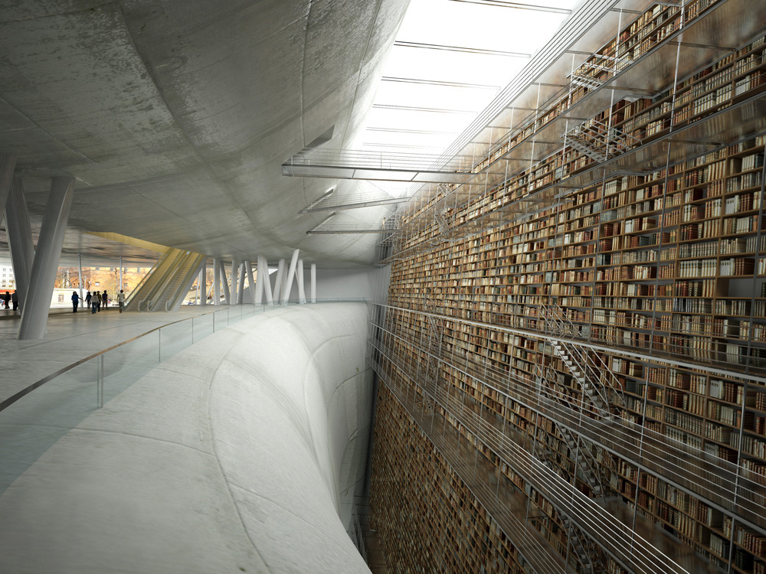
nochamo.com
Notes:
Image credit:
“Mind Shaft” by Olivier Charles, Armel Neouze, & Jacques Gelez
http://nochamo.com/stockholminter.jpg
http://features.cgsociety.org/story_custom.php?story_id=5097
This concept was made for an International Competition of Architecture, for the Stockholm Public Library
Alternatives:
http://www.amis.org/meetings/2007/images/beinecke1.jpg
http://www.wired.com/techbiz/people/magazine/16-10/ff_walker?currentPage=all

Slide 3
Roadmap
Network Analysis 101
Action Science Explorer (ASE)
Getting Started with Visualization

Slide 4
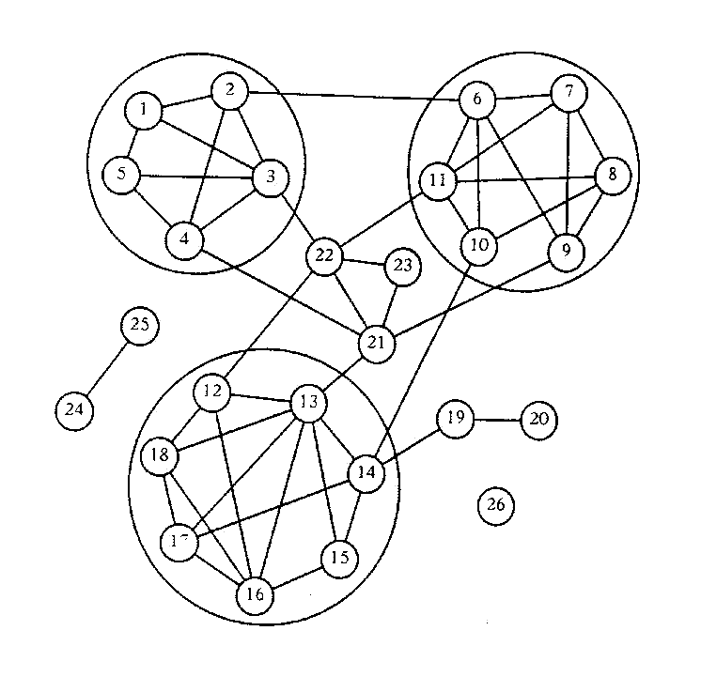
Network Theory
Central tenet
Social structure emerges from the aggregate of relationships (ties)
Phenomena of interest
Emergence of cliques and clusters
Centrality (core), periphery (isolates)
Source: Richards, W. (1986). The NEGOPY network analysis program. Burnaby, BC: Department of Communication, Simon Fraser University. pp.7-16

Slide 5
Terminology
A
Node
“actor” on which relationships act; 1-mode versus 2-mode networks
Edge
Relationship connecting nodes; can be directional
Cohesive Sub-Group
Well-connected group; clique; cluster; community
Key Metrics
Centrality (group or individual measure)
Number of direct connections that individuals have with others in the group (usually look at incoming connections only)
Measure at the individual node or group level
Cohesion (group measure)
Ease with which a network can connect
Aggregate measure of shortest path between each node pair at network level reflects average distance
Density (group measure)
Robustness of the network
Number of connections that exist in the group out of 100% possible
Betweenness (individual measure)
# shortest paths between each node pair that a node is on
Measure at the individual node level
Node roles
Peripheral – below average centrality
Central connector – above average centrality
Broker – above average betweenness
B
A
B
C
D
E?
C
D
E
F
G
C
H
D
I
E

Slide 6
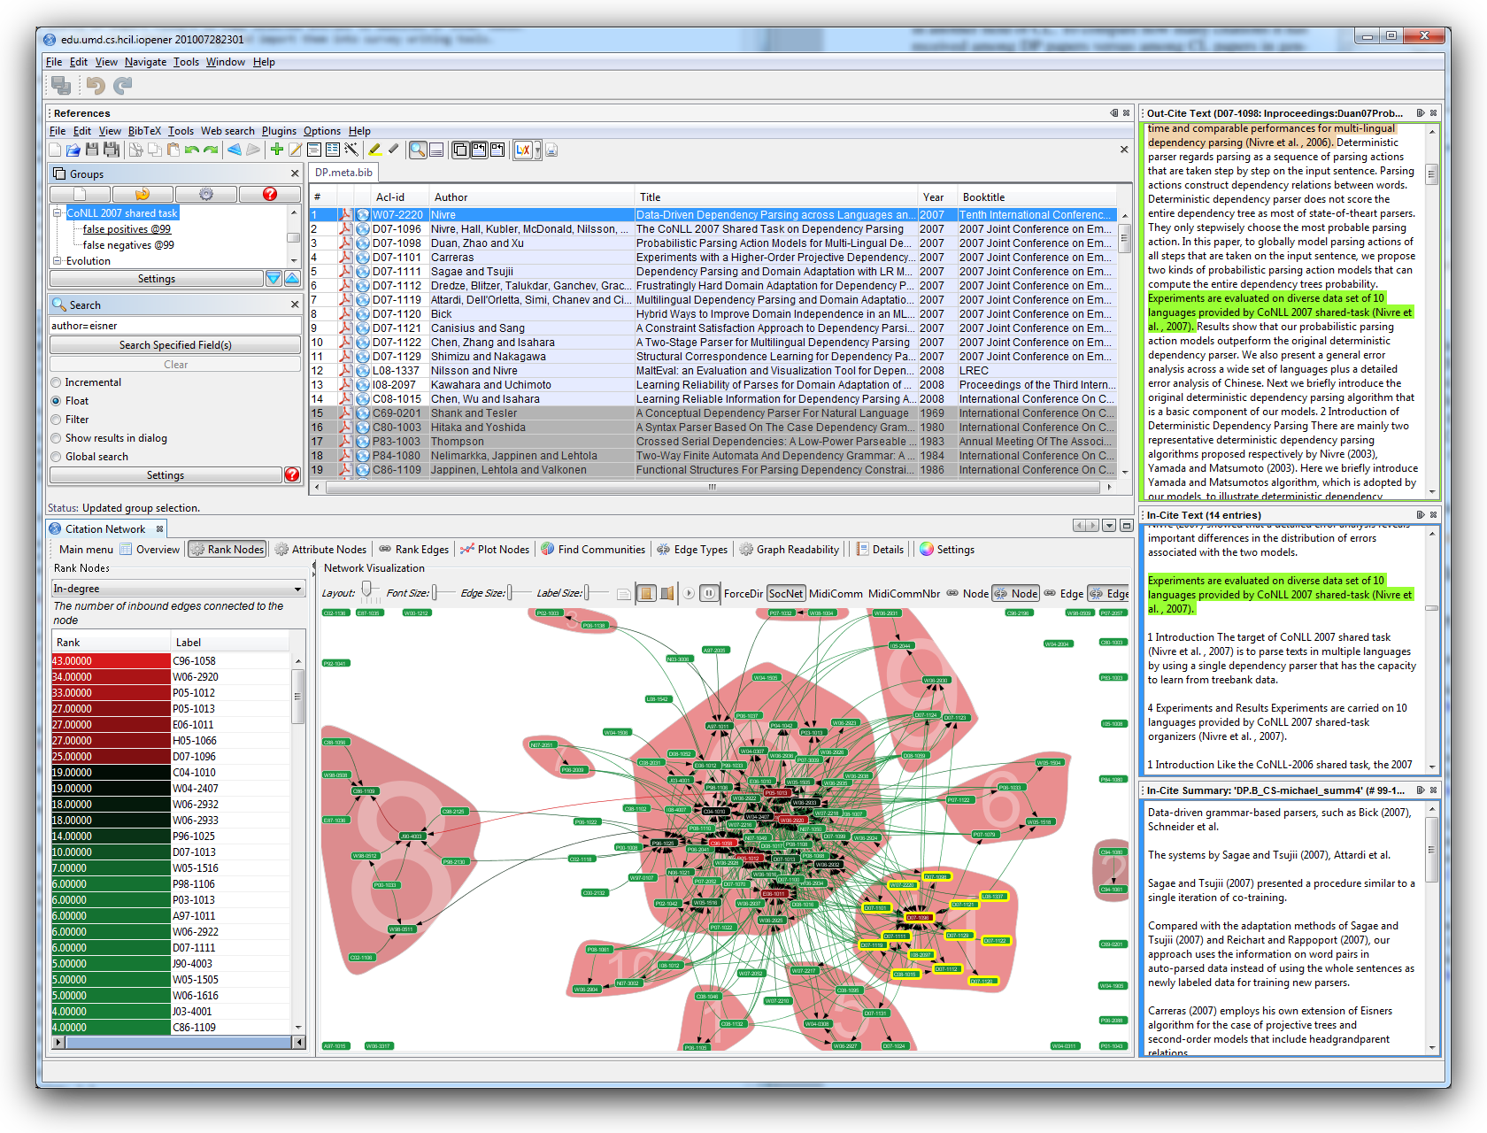
Action Science Explorer

Slide 7
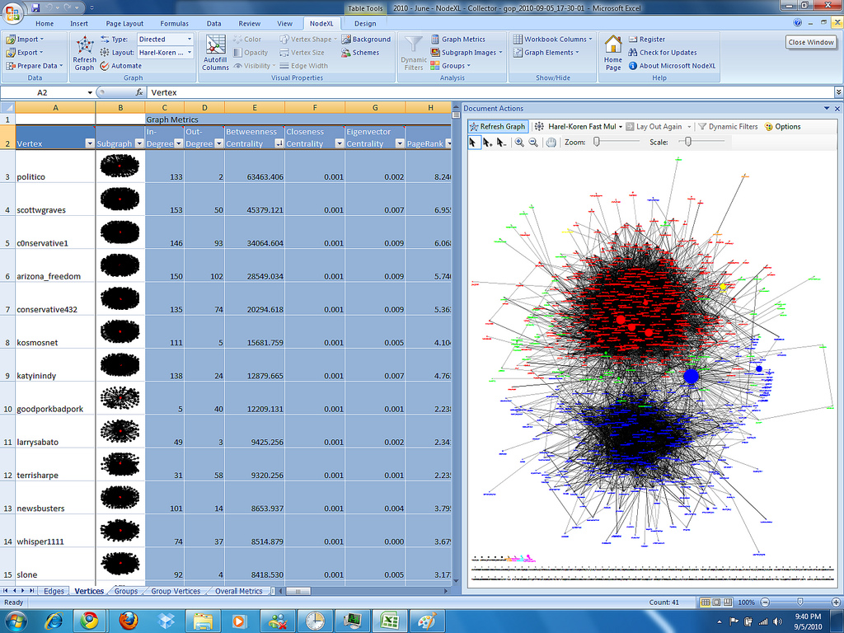
NodeXL FOSS Social Network Analysis add-in for Excel 2007/2010

Slide 8
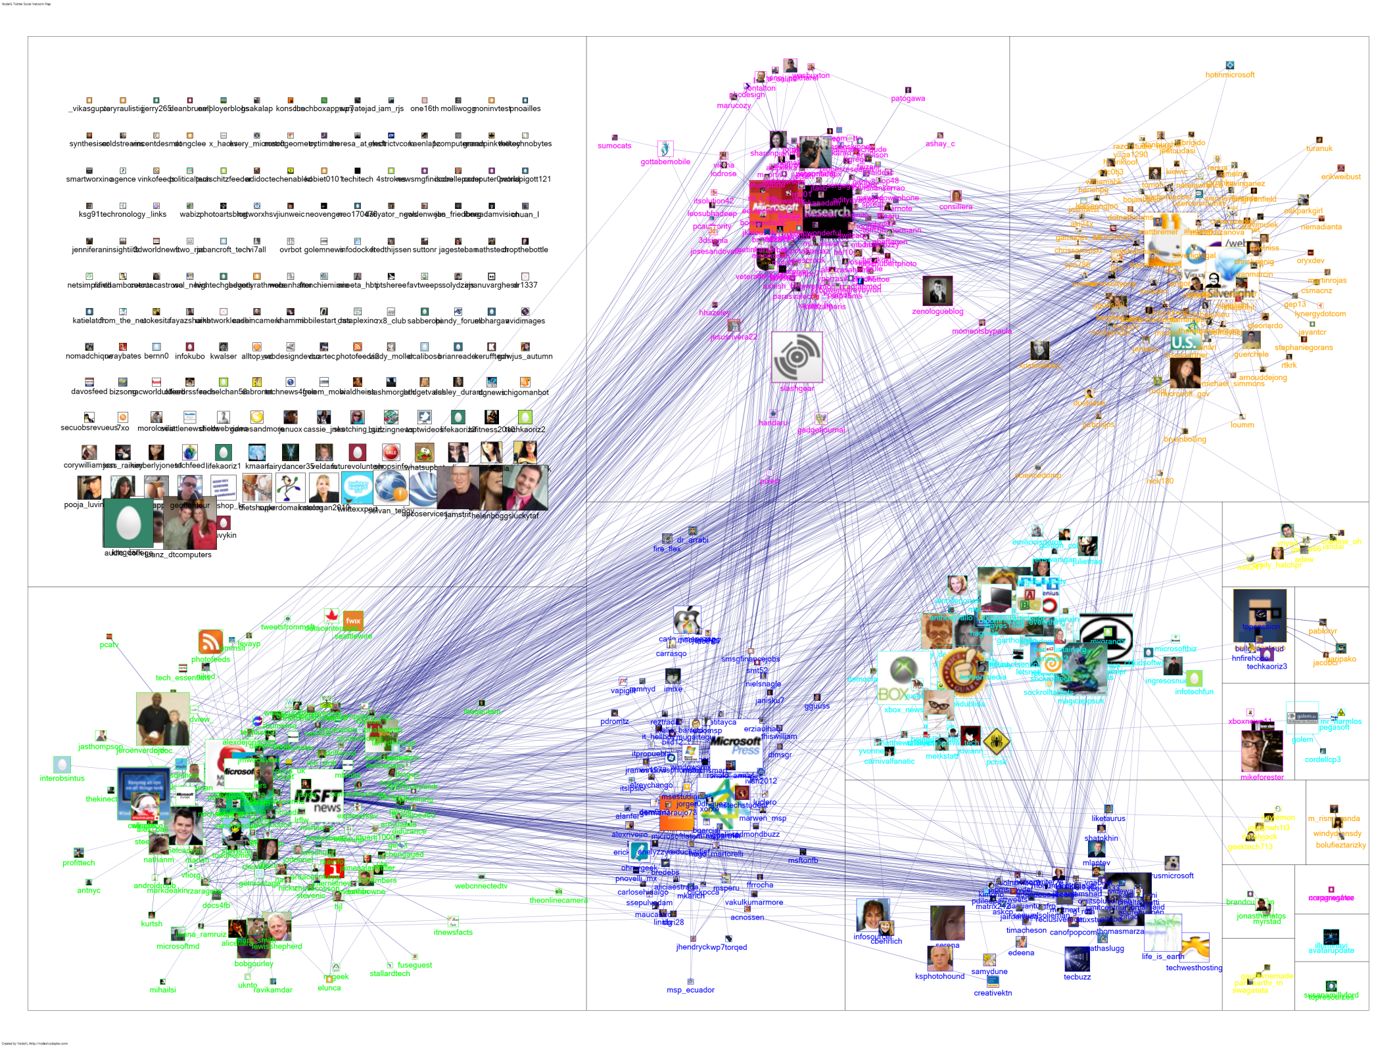
Notes:
http://www.flickr.com/photos/marc_smith/5535507384/
Connections among the Twitter users who recently mentioned msrtf11 OR techfest when queried on March 13, 2011, scaled by numbers of followers. Layout using the *new* Group Layout that places each cluster in its own treemaped region. Contrast this with a standard layout that places all nodes in the same full canvas frame: www.flickr.com/photos/marc_smith/5535814443.

Slide 9
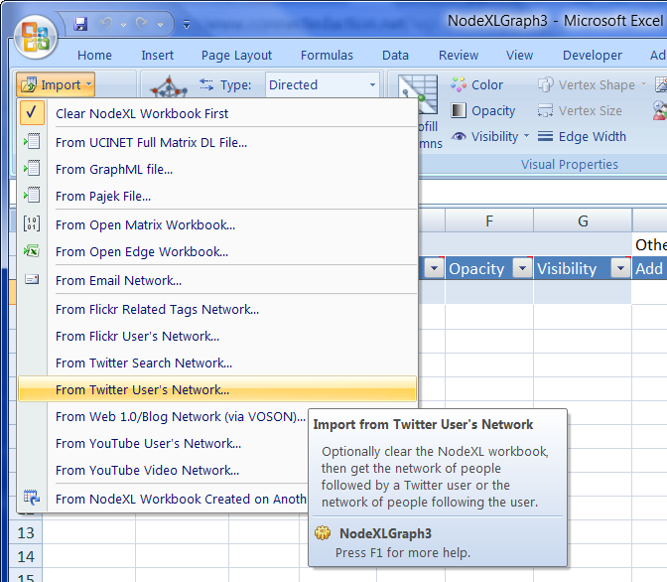




World Wide Web

Slide 10

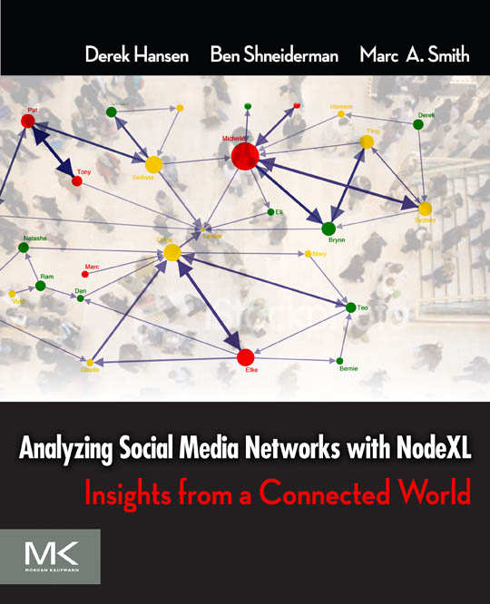



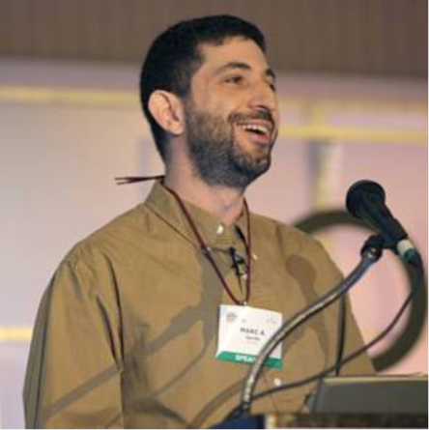
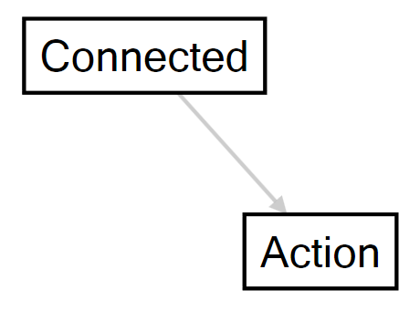
Now Available

Slide 11
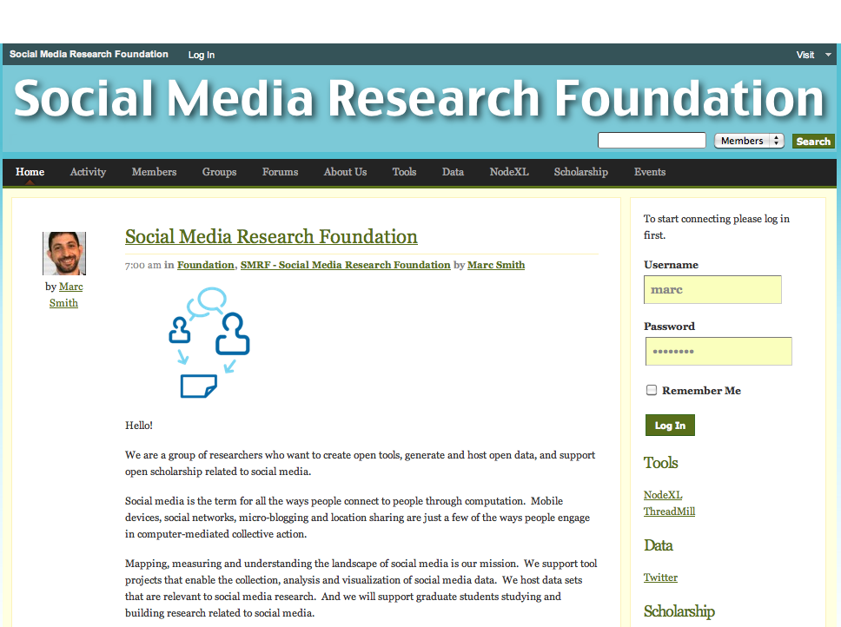
Open Tools, Open Data, Open Scholarship

Slide 12
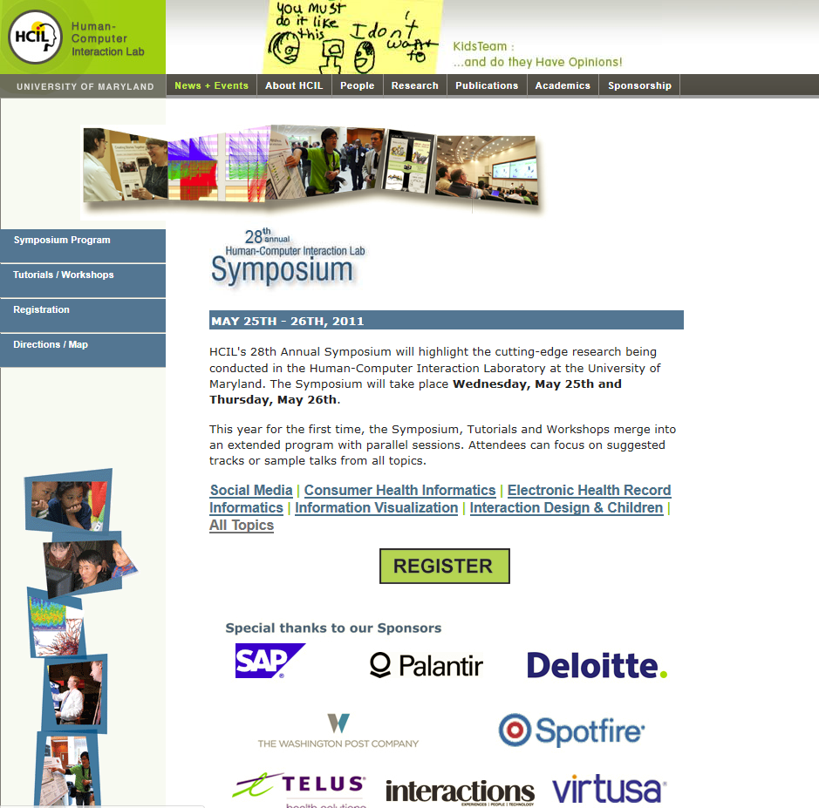

Slide 13
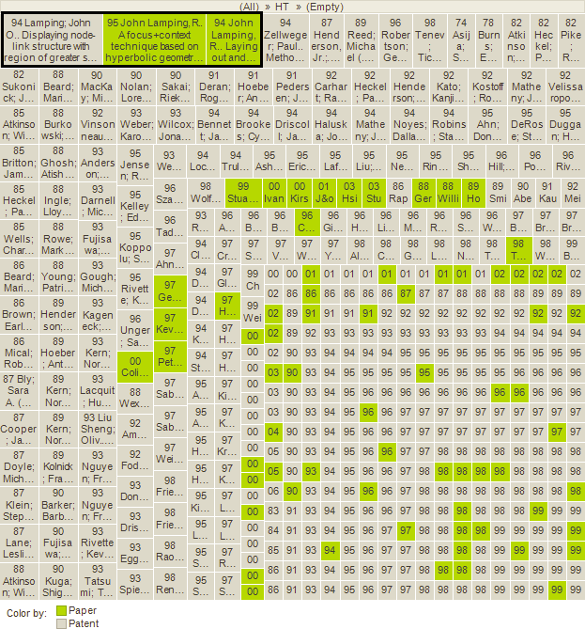
Treemaps can find papers & patents missed by searches

Slide 14
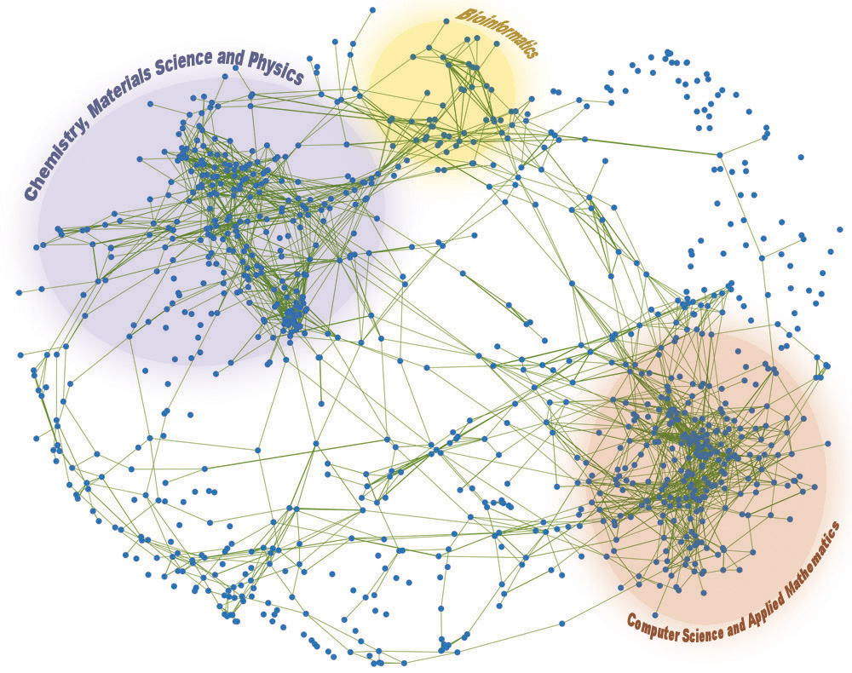
Rocha, L.M.; Simas, T.; Rechtsteiner, A.; Di Giacomo, M.; Luce, R.; , "MyLibrary at LANL: proximity and semi-metric networks for a collaborative and recommender Web service," Web Intelligence, 2005. Proceedings. The 2005 IEEE/WIC/ACM International Conference on , vol., no., pp. 565- 571, 19-22 Sept. 2005. doi: 10.1109/WI.2005.106
Notes:
Network of 1300 journal titles accessed by the users of the MyLibrary Web Service at the Los Alamos National Laboratory. The links shown denote a strong measure of co-occurrence (proximity) of two journals (the nodes) in user personalities. From this network, two main clusters were identified via Singular Value Decomposition: one pertaining to journals in chemistry, materials science, physics and the other to computer science and applied mathematics. A smaller cluster pertaining to journals in bioinformatics and computational biology is also highlighted. Figure better described in a recent paper describing our network approach to recommendation systems.
Rocha, L.M.; Simas, T.; Rechtsteiner, A.; Di Giacomo, M.; Luce, R.; , "MyLibrary at LANL: proximity and semi-metric networks for a collaborative and recommender Web service," Web Intelligence, 2005. Proceedings. The 2005 IEEE/WIC/ACM International Conference on , vol., no., pp. 565- 571, 19-22 Sept. 2005 doi: 10.1109/WI.2005.106

Slide 15
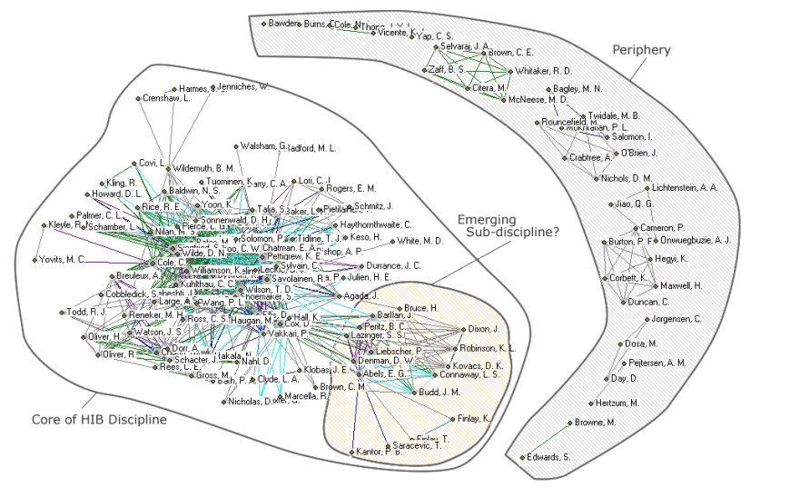
McKechnie, E.F., Goodall, G.R., Lajoie-Paquette, D. and Julien, H. (2005). "How human information behaviour researchers use each other's work: a basic citation analysis study." Information Research, 10(2) paper 220 [Available at http://InformationR.net/ir/10-2/paper220.html]
Notes:
Figure 1: Network representation of co-citation patterns among 155 human information behaviour papers

Slide 16
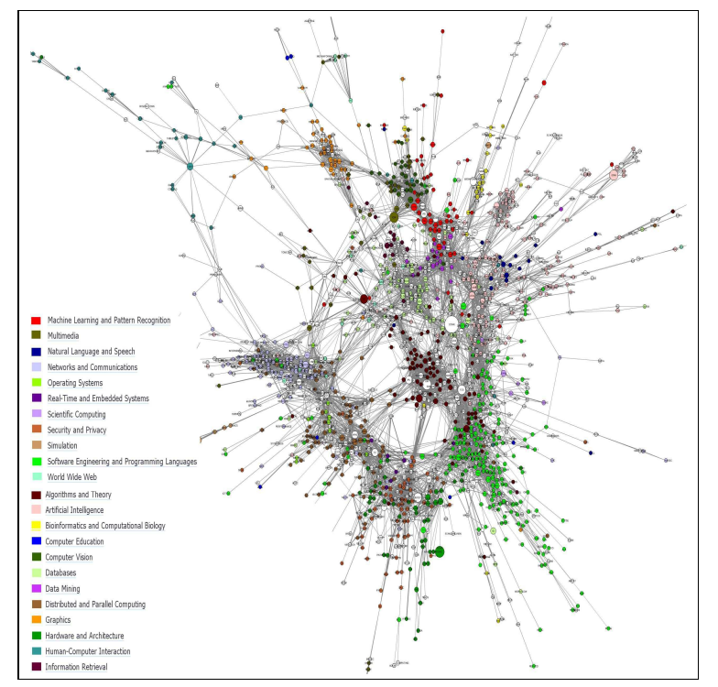
Notes:
arXiv:1103.1977v1

Slide 17
Overview
Network Analysis 101
Action Science Explorer (ASE)
Getting Started with Visualization

Slide 18
Interactive Data Visualization for Rapid Understanding of Scientific Literature
Cody Dunne
Dept. of Computer Science and Human-Computer Interaction Lab, University of Maryland
cdunne@cs.umd.edu
This work has been partially supported by NSF grant "iOPENER: A Flexible Framework to Support Rapid Learning in Unfamiliar Research Domains", jointly awarded to UMD and UMich as IIS 0705832.
Links from this talk:
http://bit.ly/stmase
Notes:
QR Codes from:
http://chart.apis.google.com/chart?chs=400x400&cht=qr&chl=http://bit.ly/stmase

