Slide 1

Visual Analytic Strategies for Organizing and Simplifying Complex Networks: Meta-layouts and Motif Simplification Ben Shneiderman ben@cs.umd.edu @benbendc Department of Computer Science & Human-Computer Interaction Lab, Institute for Advanced Computer Studies

Slide 2


Interdisciplinary research community
- Computer Science & Info Studies
- Psych, Socio, Poli Sci & MITH
(www.cs.umd.edu/hcil)

Slide 3
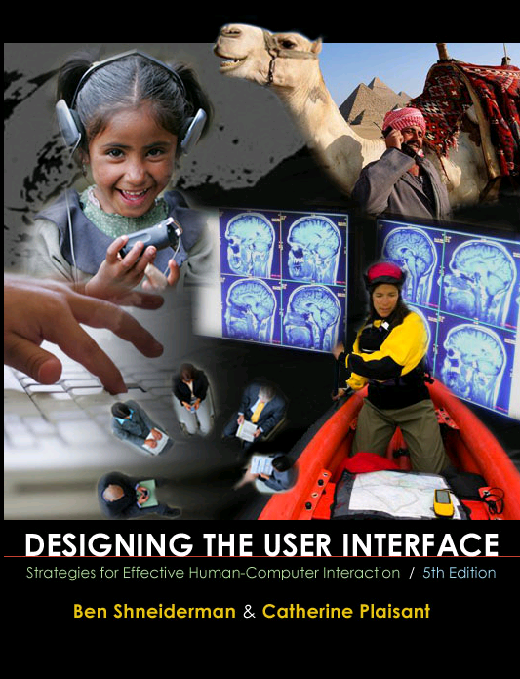
Design Issues
Input devices & strategies
Keyboards, pointing devices, voice
Direct manipulation
Menus, forms, commands
Output devices & formats
Screens, windows, color, sound
Text, tables, graphics
Instructions, messages, help
Collaboration & Social Media
Help, tutorials, training
Search
www.awl.com/DTUI
Fifth Edition: 2010
Visualization

Slide 4

Information Visualization & Visual Analytics
Visual bands
Human percle
Trend, clus..
Color, size,..
Three challe
Meaningful vi
Interaction: w
Process mo
1999

Slide 5

Information Visualization & Visual Analytics
Visual bandwidth is enormous
Human perceptual skills are remarkable
Trend, cluster, gap, outlier...
Color, size, shape, proximity...
Three challenges
Meaningful visual displays of massive da
Interaction: widgets & window coordinati
Process models for discovery
1999 2004

Slide 6
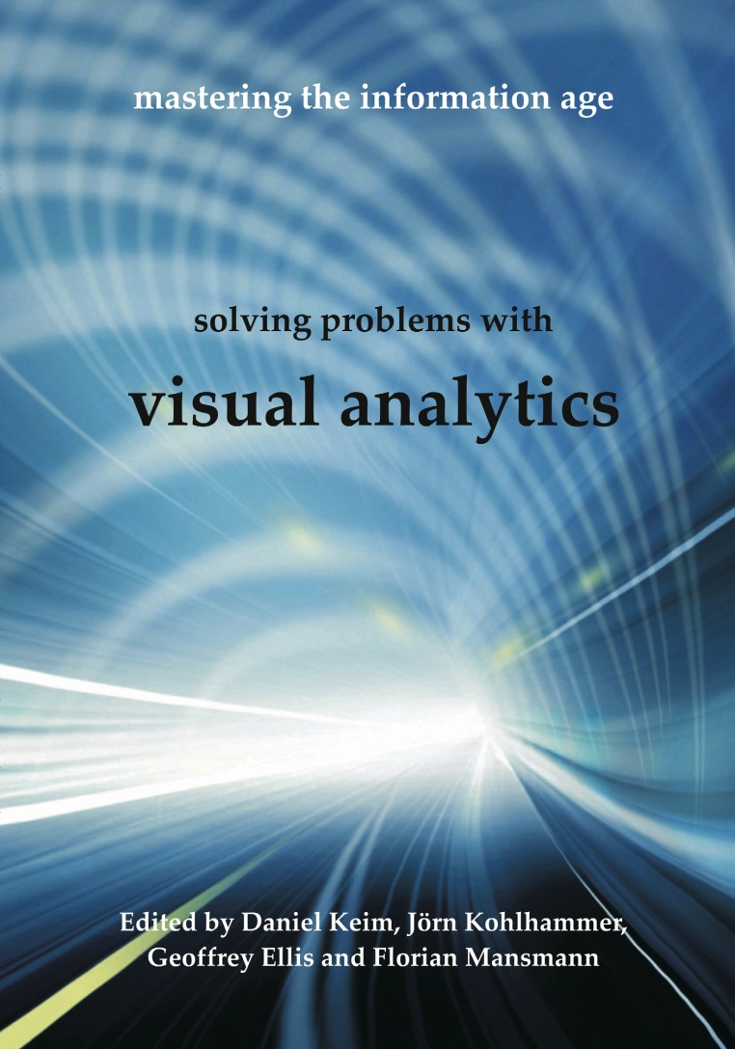
Information Visualization & Visual Analytics
Visual bandwidth is enormous
Human perceptual skills are remarkable
Trend, cluster, gap, outlier...
Color, size, shape, proximity...
Three challenges
Meaningful visual displays of massive data
Interaction: widgets & window coordination
Process models for discovery
1999 2004 2010

Slide 7

Obama Unveils “Big Data” Initiative (3/2012)
Big Data challenges:
Developing scalable algorithms for processing imperfect data in distributed data stores
Creating effective human-computer interaction tools for facilitating rapidly customizable visual reasoning for diverse missions.
http://www.whitehouse.gov/sites/default/files/microsites/ostp/big_data_press_release_final_2.pdf `

Slide 8
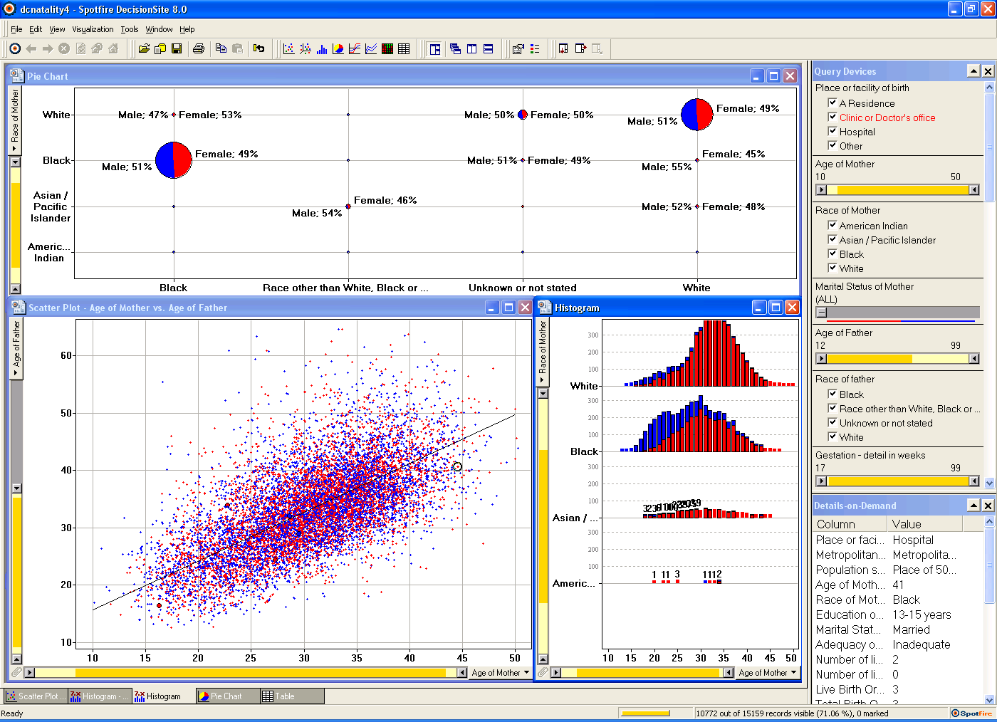
Spotfire: DC natality data

Slide 9

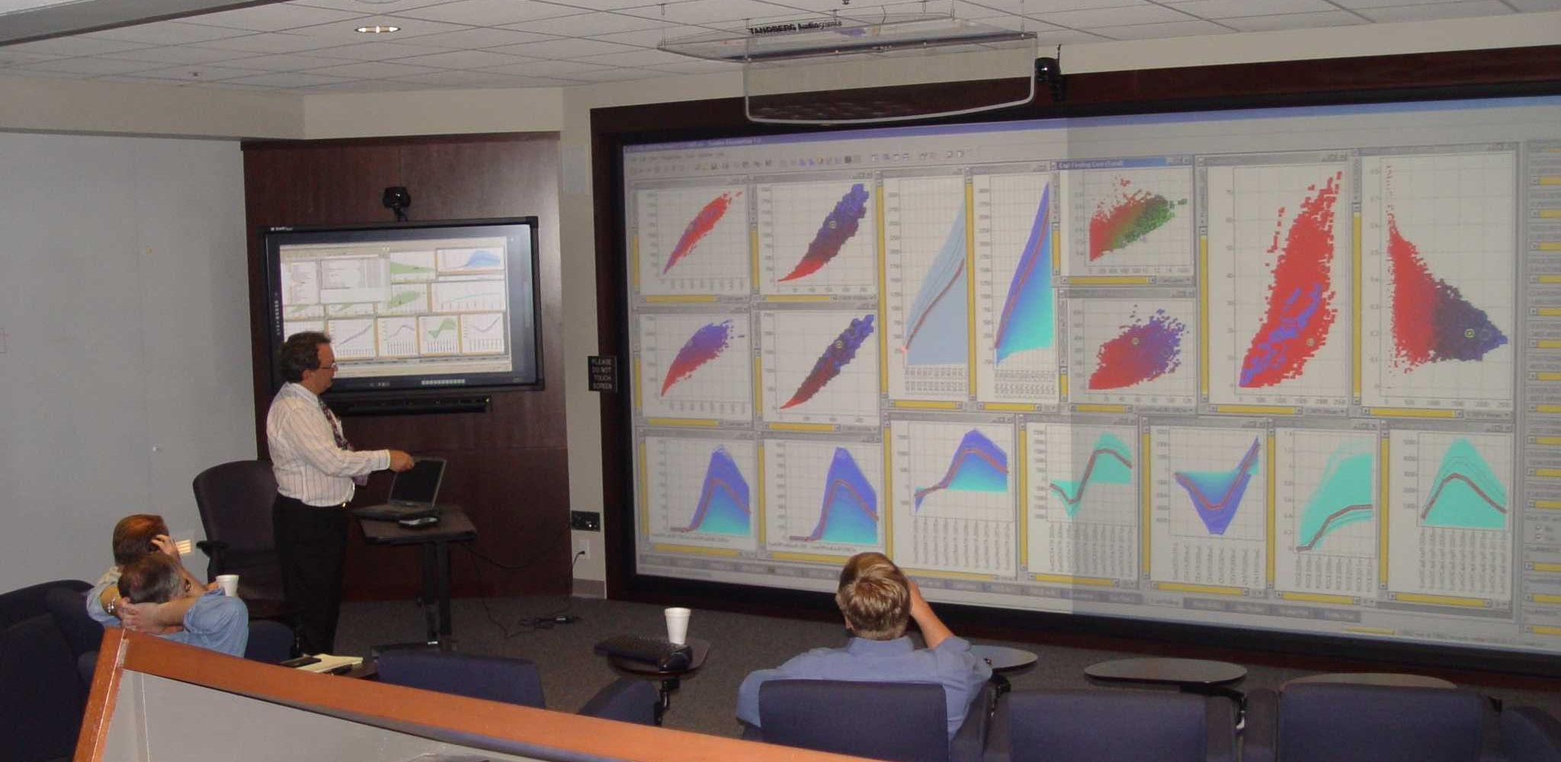

Slide 10
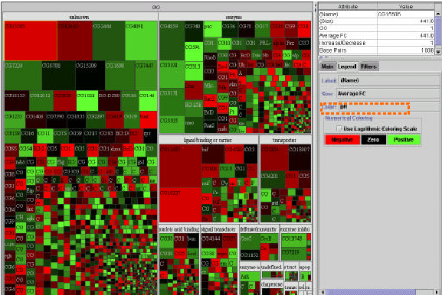
Treemap: Gene Ontology
(Shneiderman, ACM Trans. on Graphics, 1992 & 2003)
www.cs.umd.edu/hcil/treemap/

Slide 11
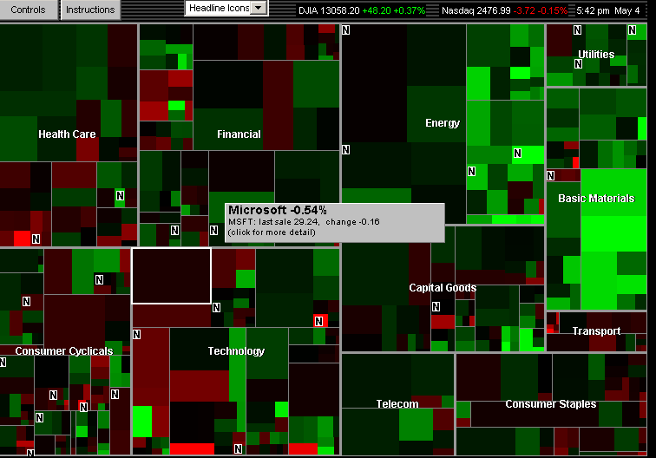
Treemap: Smartmoney MarketMap
www.smartmoney.com/marketmap

Slide 12
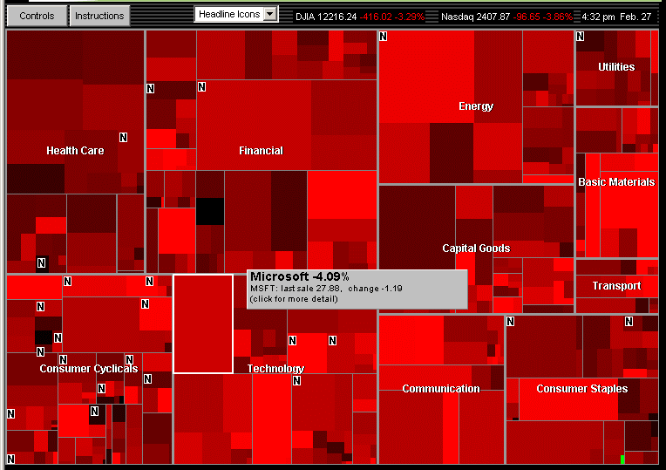
Market falls steeply Feb 27, 2007, with one exception
Notes:
12

Slide 13
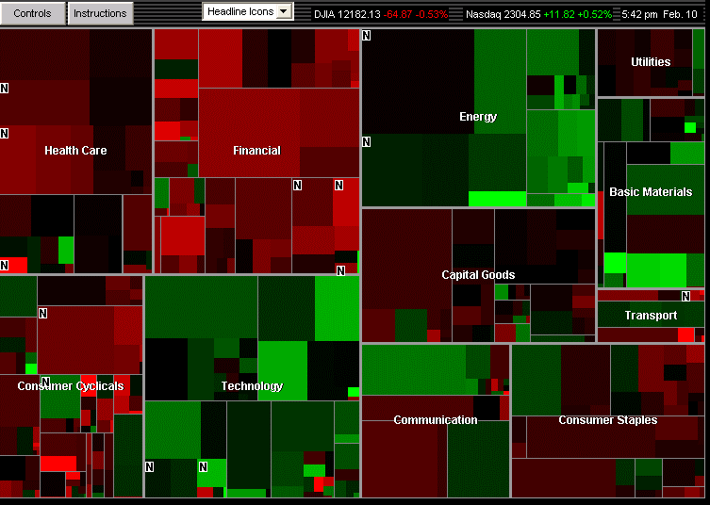
Market mixed, February 8, 2008 Energy & Technology up, Financial & Health Care down
Notes:
13

Slide 14
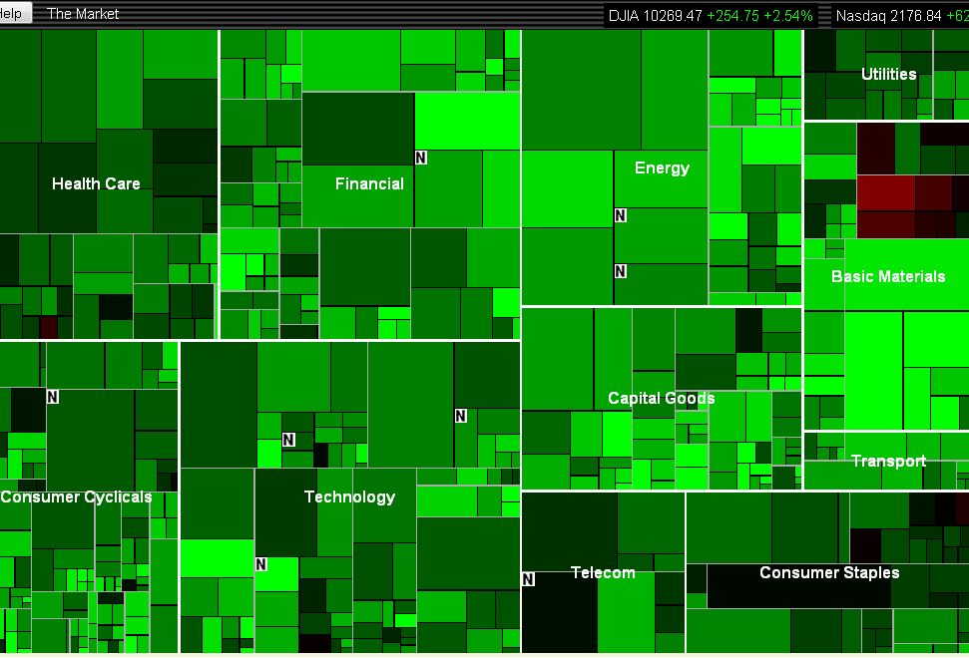
Market rises, September 1, 2010, Gold contrarians
Notes:
14

Slide 15
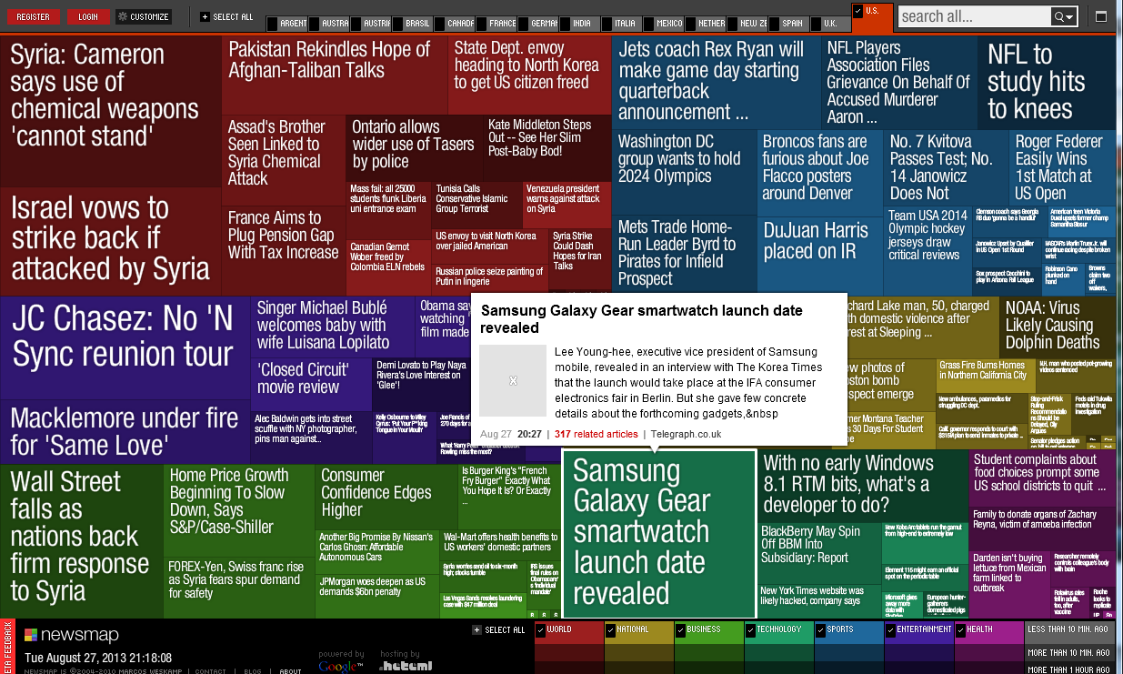
Treemap: Newsmap (Marcos Weskamp)
newsmap.jp

Slide 16
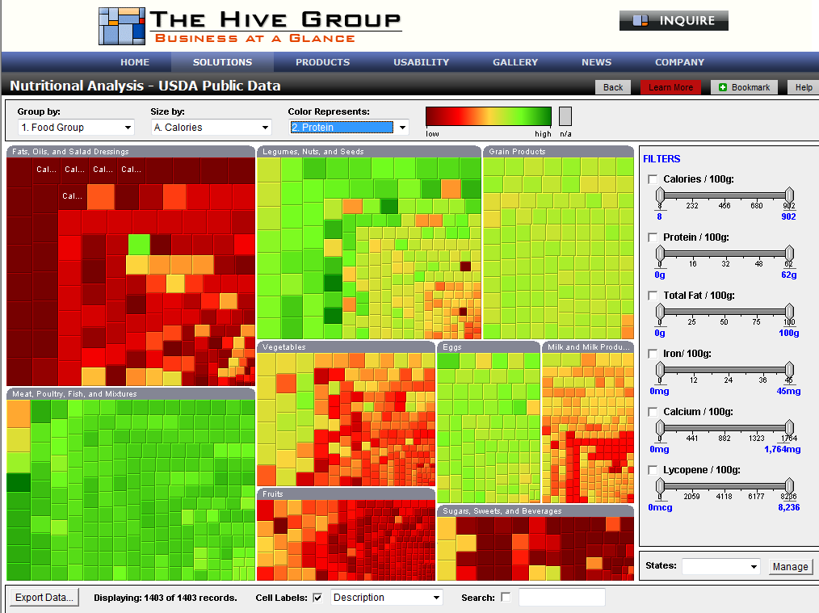
Treemap: Nutritional Analysis
www.hivegroup.com

Slide 17
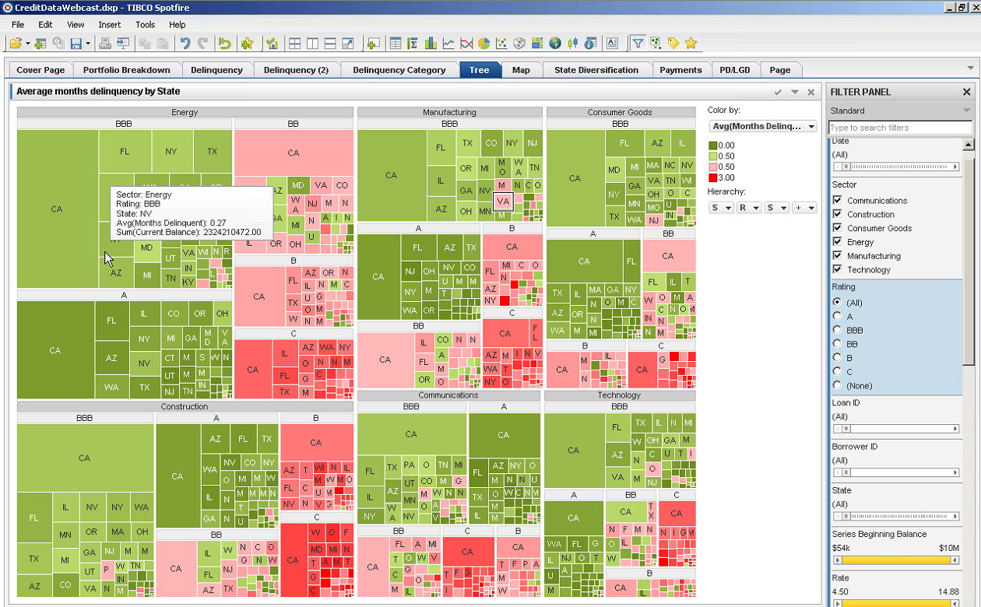
Treemap: Spotfire Bond Portfolio Analysis
www.spotfire.com

Slide 18
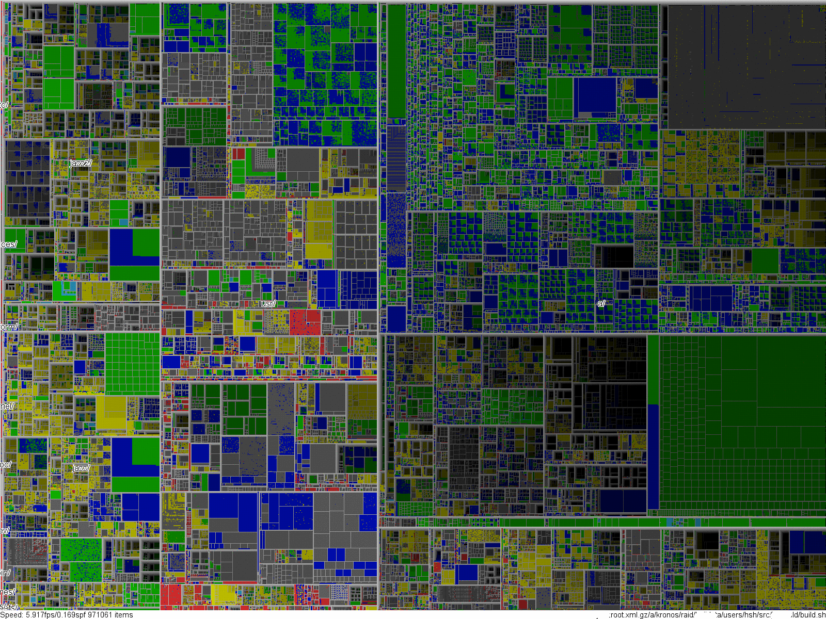
Notes:
Live Demonstration

Slide 19
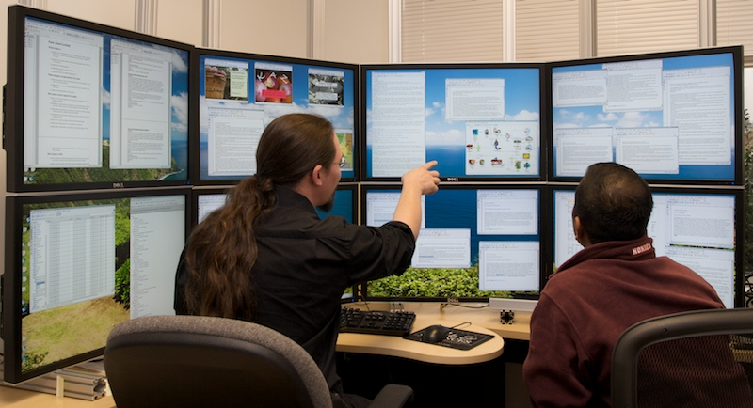
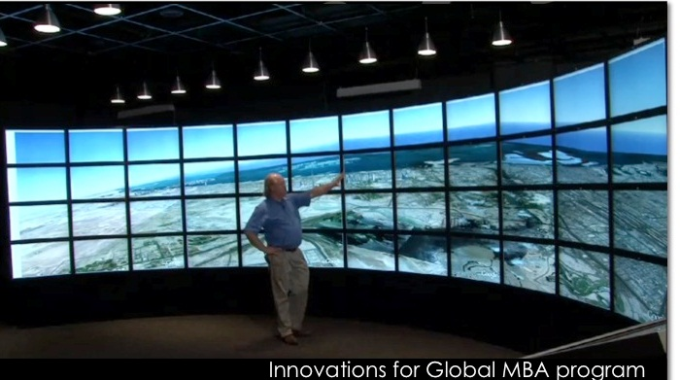
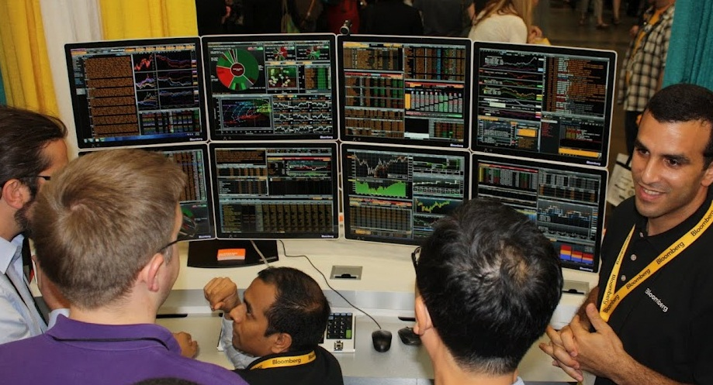
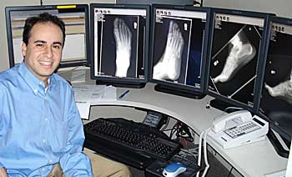
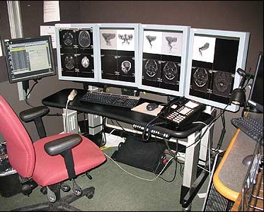
10M - 100M pixels: Large displays

Slide 20
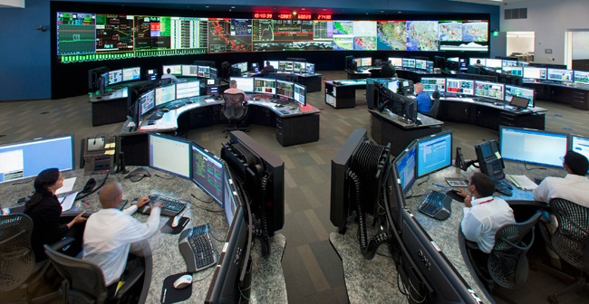
100M-pixels & more

Slide 21
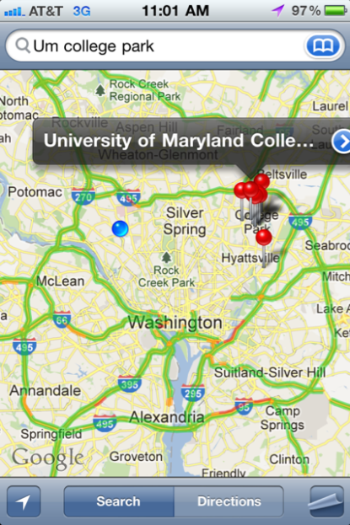


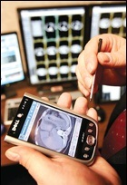
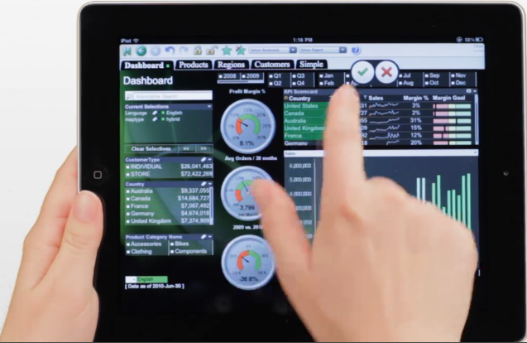

1M-pixels & less
Small mobile devices

Slide 22
Information Visualization: Mantra
Overview, zoom & filter, details-on-demand
Overview, zoom & filter, details-on-demand
Overview, zoom & filter, details-on-demand
Overview, zoom & filter, details-on-demand
Overview, zoom & filter, details-on-demand
Overview, zoom & filter, details-on-demand
Overview, zoom & filter, details-on-demand
Overview, zoom & filter, details-on-demand
Overview, zoom & filter, details-on-demand
Overview, zoom & filter, details-on-demand

Slide 23
Information Visualization: Data Types
InfoViz SciViz .
1-D Linear Document Lens, SeeSoft, Info Mural
2-D Map GIS, ArcView, PageMaker, Medical imagery
3-D World CAD, Medical, Molecules, Architecture
Multi-Var Spotfire, Tableau, Qliktech, Visual Insight
Temporal LifeLines, TimeSearcher, Palantir, DataMontage
Tree Cone/Cam/Hyperbolic, SpaceTree, Treemap
Network Pajek, UCINet, NodeXL, Gephi, Tom Sawyer
infosthetics.com visualcomplexity.com eagereyes.org
flowingdata.com perceptualedge.com datakind.org
visual.ly Visualizing.org infovis.org

Slide 24
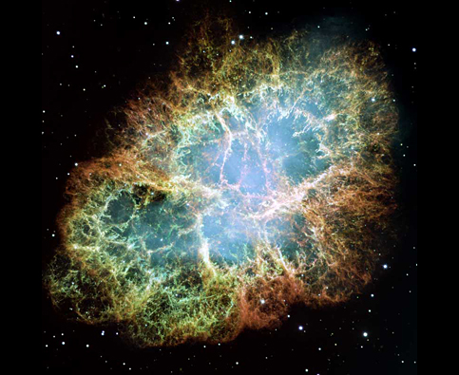

State-of-the-art Hubble images

Slide 25

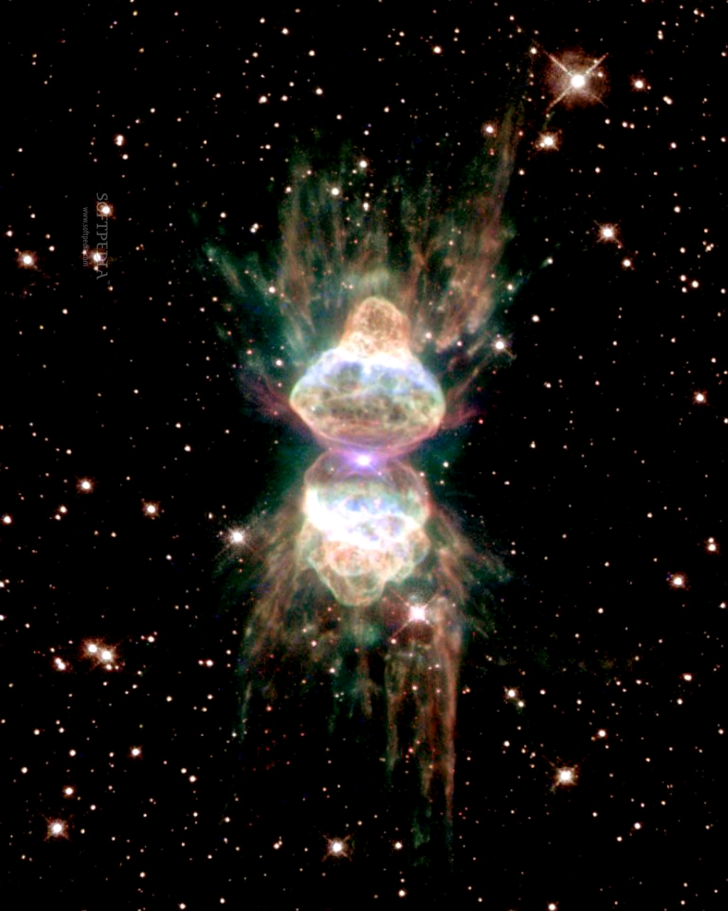
State-of-the-art Hubble images

Slide 26
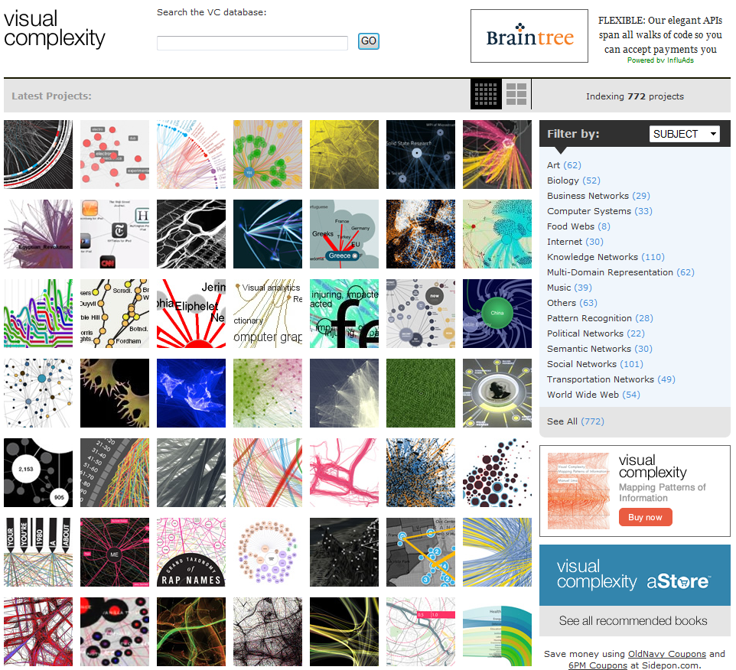
State-of-the-art network visualization

Slide 27
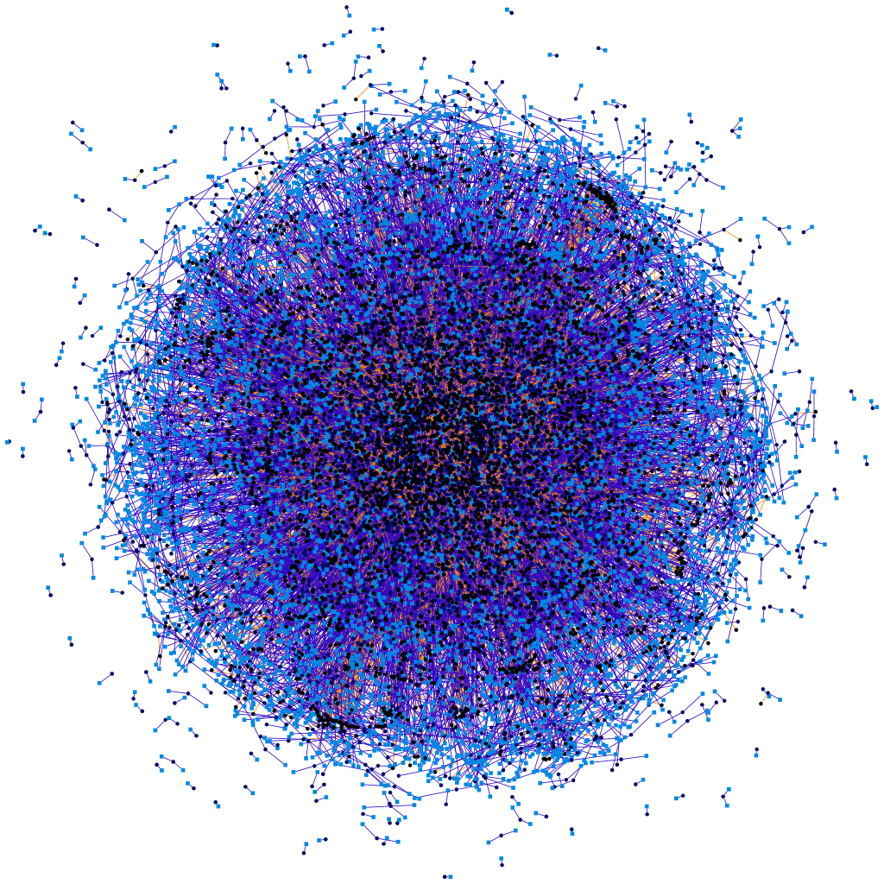
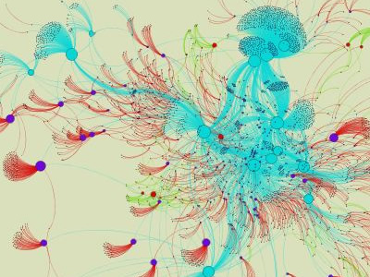
State-of-the-art network visualization

Slide 28
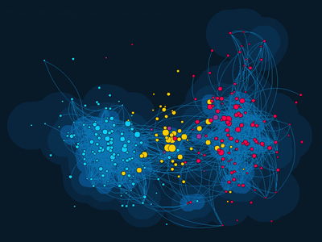
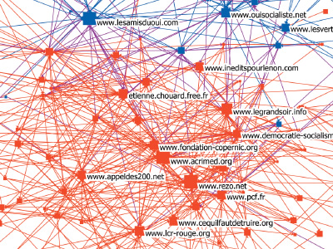
State-of-the-art network visualization

Slide 29

NetViz Nirvana
1) Every node is visible
2) For every node you can count its degree
3) For every link you can follow it from source to destination
4) Clusters and outliers are identifiable

Slide 30
Interactive Methods to Reveal Patterns
Filtering Node & link attribute values or statistics
Clustering Cluster algorithmically by link connectivity
Grouping Group based on node attributes
Motif Common, meaningful structures Simplification replaced with simplified glyphs

Slide 31
Interactive Methods to Reveal Patterns
Filtering Node & link attribute values or statistics
Clustering Cluster algorithmically by link connectivity
Grouping Group based on node attributes
Motif Common, meaningful structures Simplification replaced with simplified glyphs

Slide 32
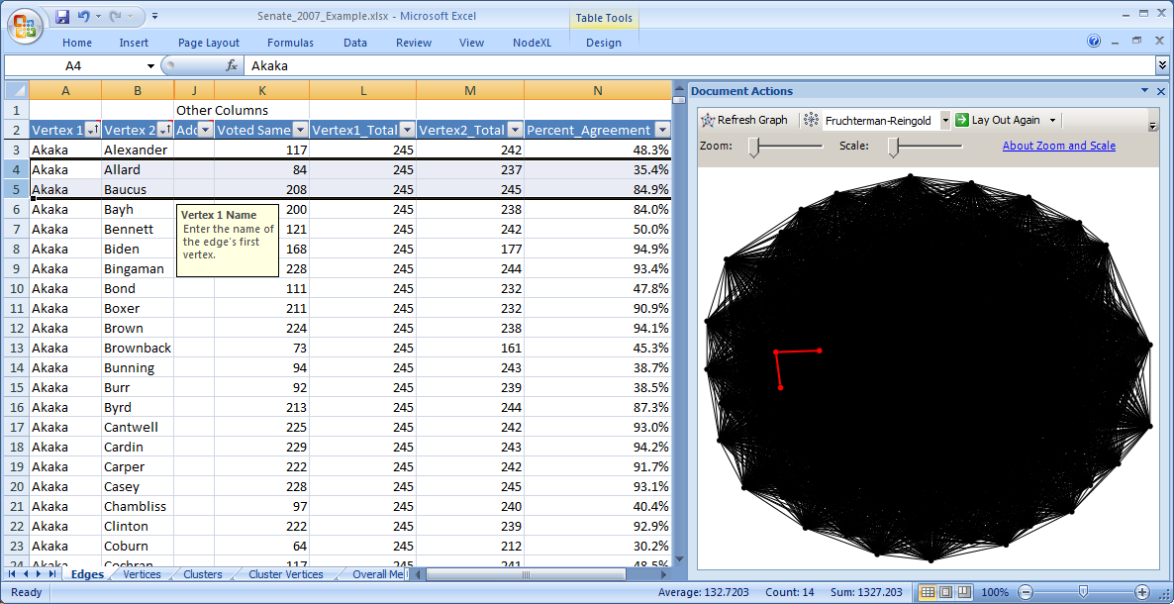
Fully Connected Graph: 100 Senators
www.codeplex.com/nodexl

Slide 33
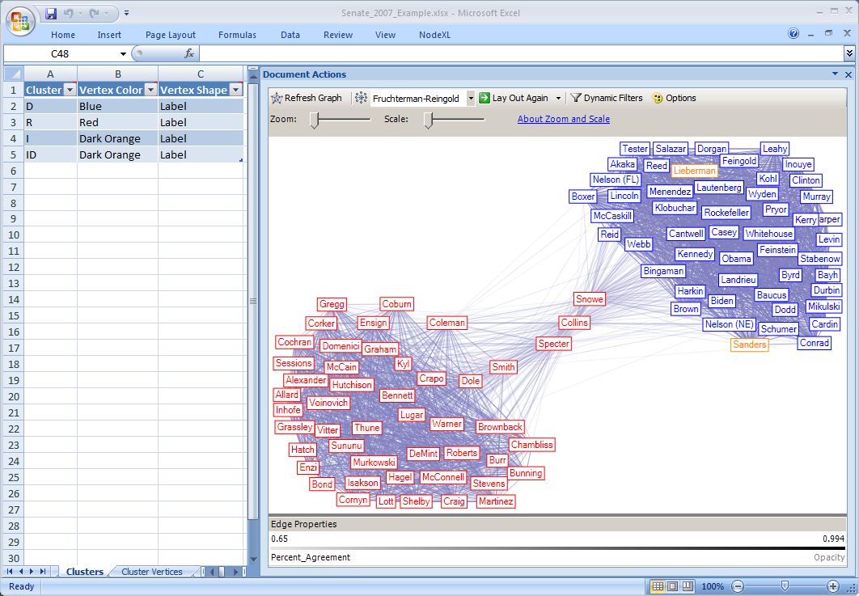
Filtering: 65% Co-Voting

Slide 34
Interactive Methods to Reveal Patterns
Filtering Node & link attribute values or statistics
Clustering Cluster algorithmically by link connectivity
Grouping Group based on node attributes
Motif Common, meaningful structures Simplification replaced with simplified glyphs

Slide 35
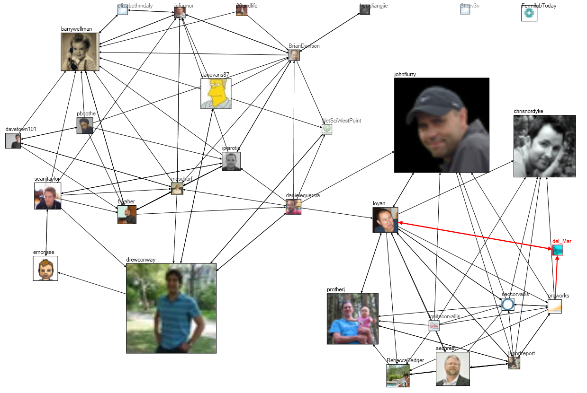
Tweets at #WIN09 Conference: 2 groups
Notes:
Chapter 3, Figure 1 (page 6). A NodeXL social media network diagram of relationships among Twitter users mentioning the hashtag “#WIN09” used by attendees of a conference on Network Science at NYU in September 2009. Each user’s node is sized proportional to the number of tweets they have ever made to that date.

Slide 36
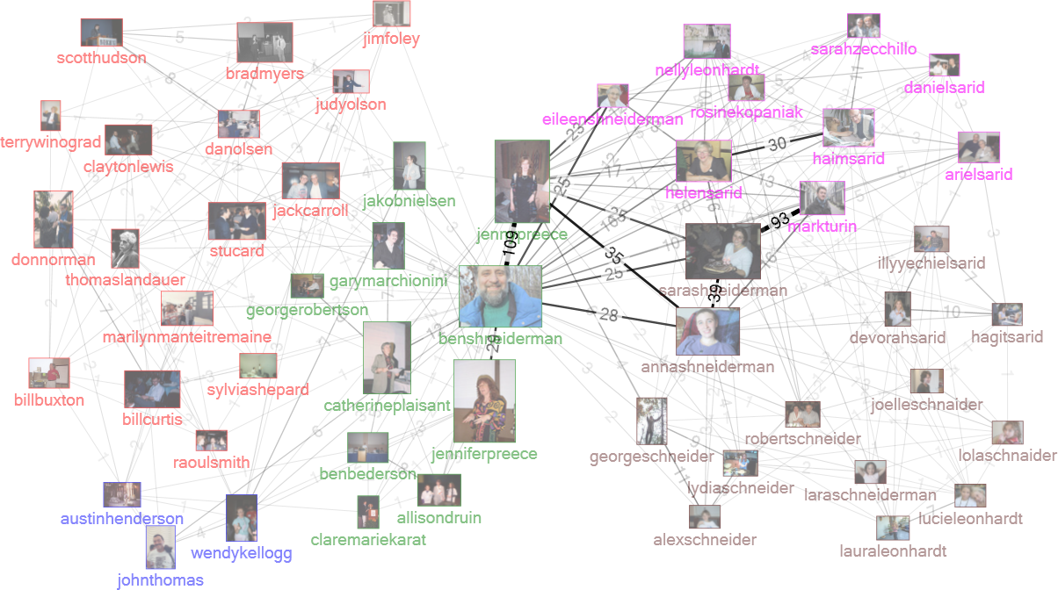
Flickr networks
Notes:
Chapter 3, Figure 1 (page 6). A NodeXL social media network diagram of relationships among Twitter users mentioning the hashtag “#WIN09” used by attendees of a conference on Network Science at NYU in September 2009. Each user’s node is sized proportional to the number of tweets they have ever made to that date.

Slide 37
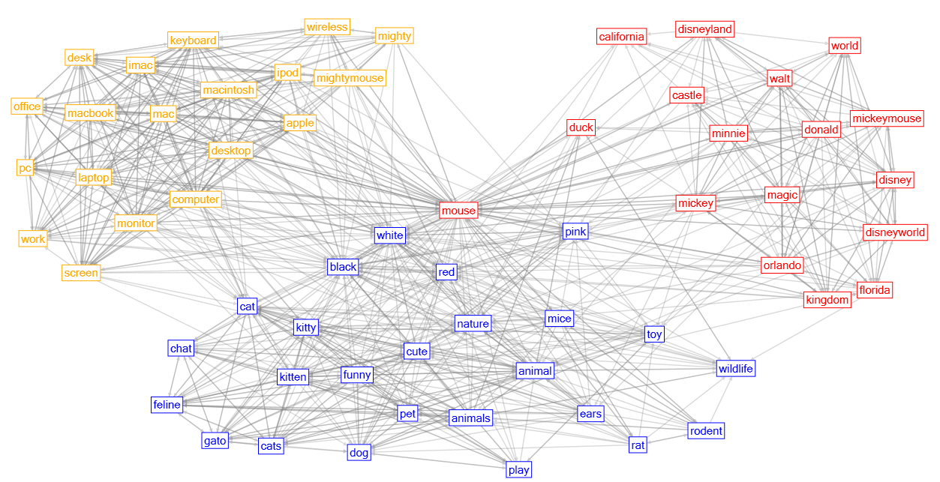
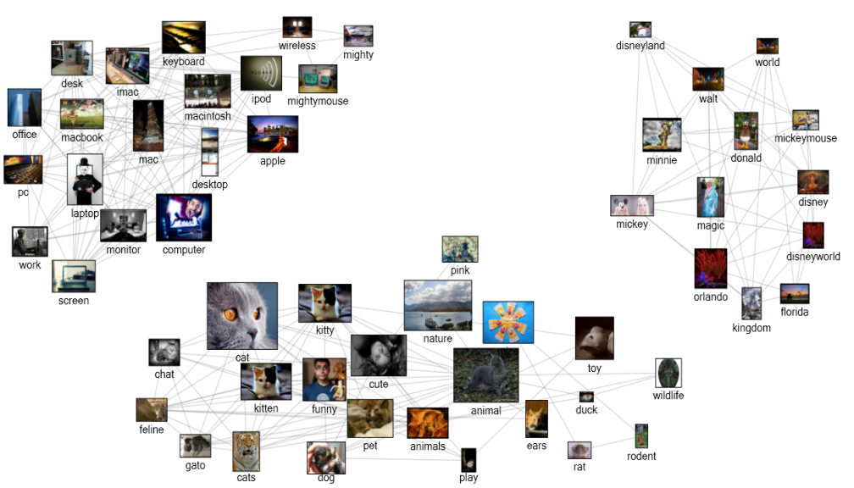
Flickr clusters for “mouse”
Computer Mickey
Animal
Notes:
Figure 13.20. NodeXL cluster visualization showing three Flickr tag clusters, each representing a different context for “mouse”.
Figure 13.21. NodeXL display of Isolated clusters for three different contexts for the “mouse” tag in Flickr: mouse animal, computer mouse, and Mickey Mouse Disney character.

Slide 38
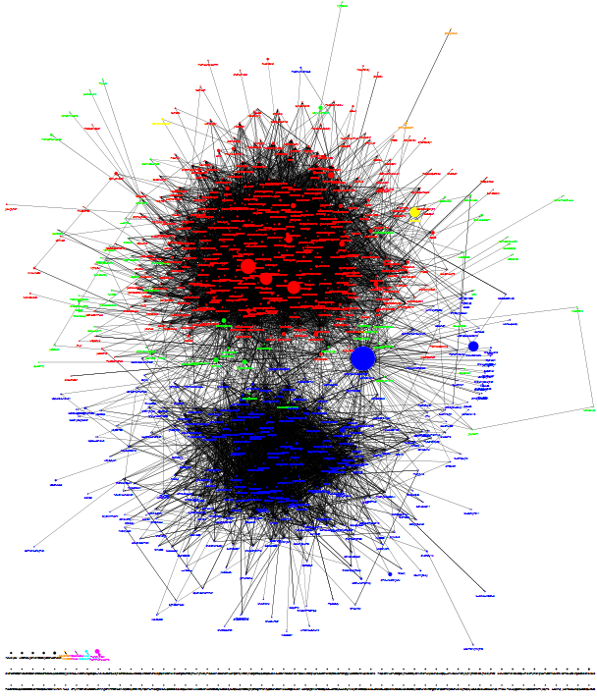
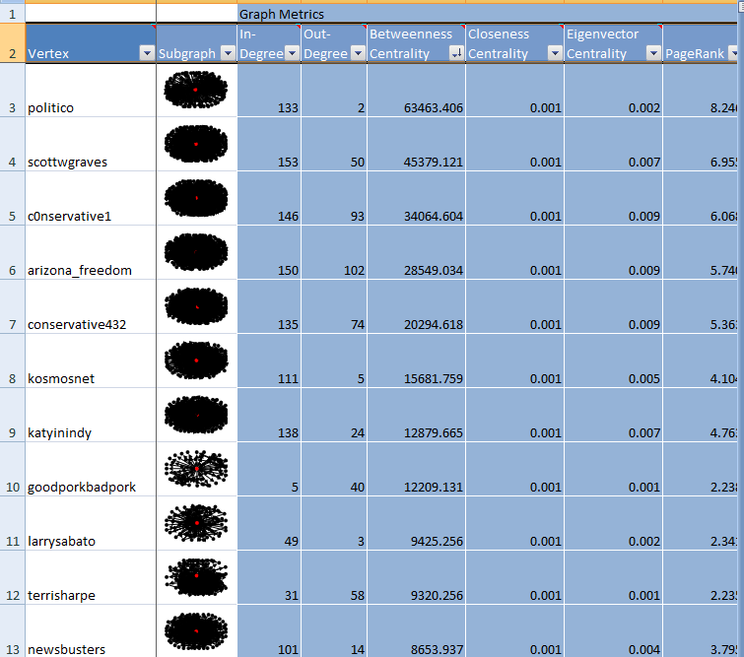
Twitter discussion of #GOP
Red: Republicans, anti-Obama,
mention Fox
Blue: Democrats, pro-Obama,
mention CNN
Green: non-affiliated
Node size is number of followers
Politico is major bridging group
Notes:
Figure 13.24. NodeXL network of Flickr users who comment on Marc_Smith’s photos (network depth 1.5; edge weight≥4).

Slide 39
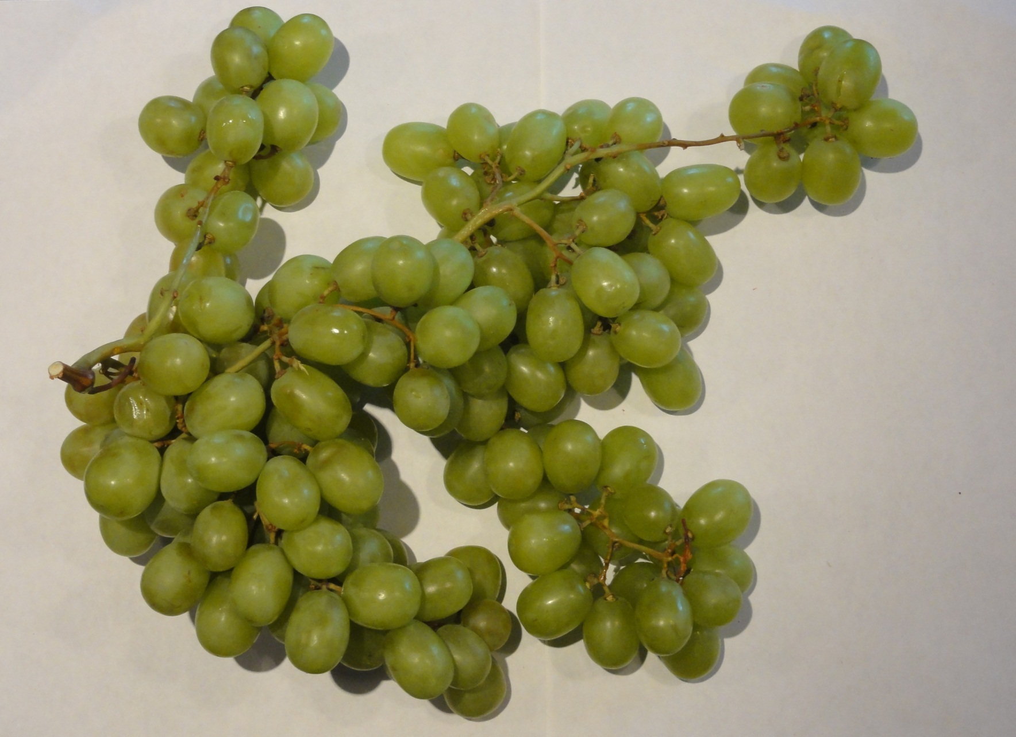
Analogy: Clusters Are Occluded Hard to count nodes, clusters

Slide 40
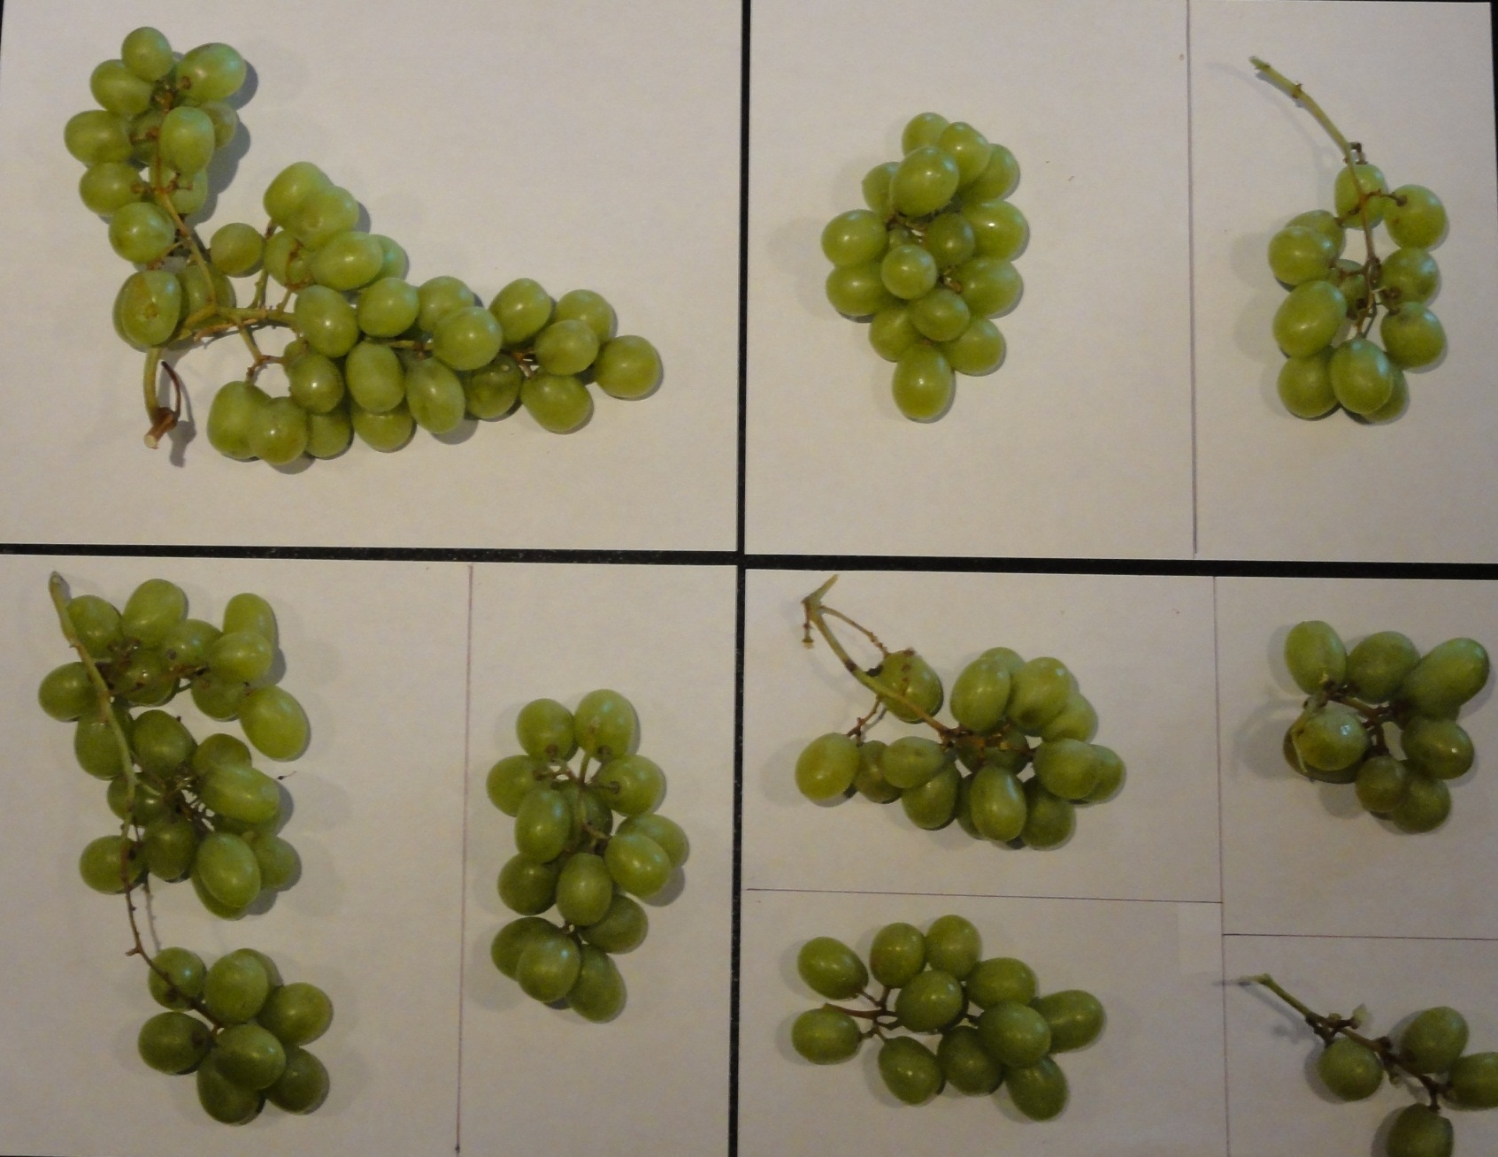
Separate Clusters Are More Comprehensible

Slide 41
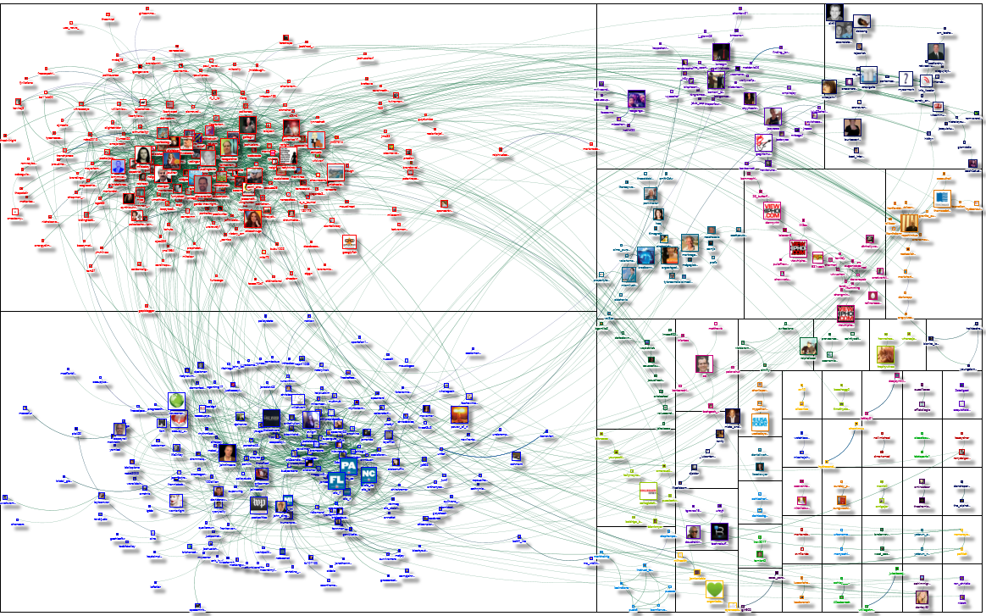
Twitter networks: #SOTU

Slide 42
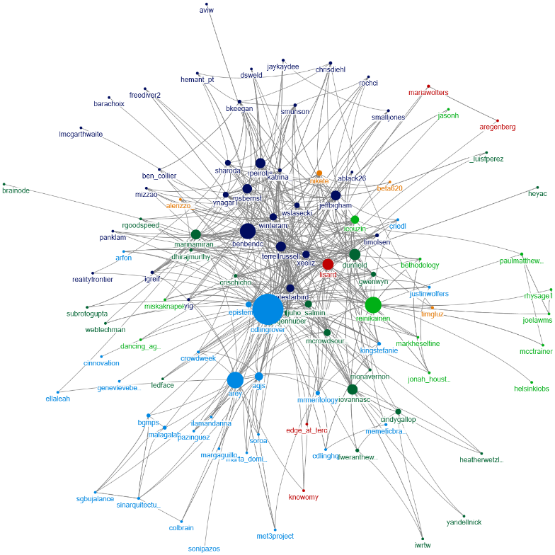
Twitter Network #CI2012

Slide 43
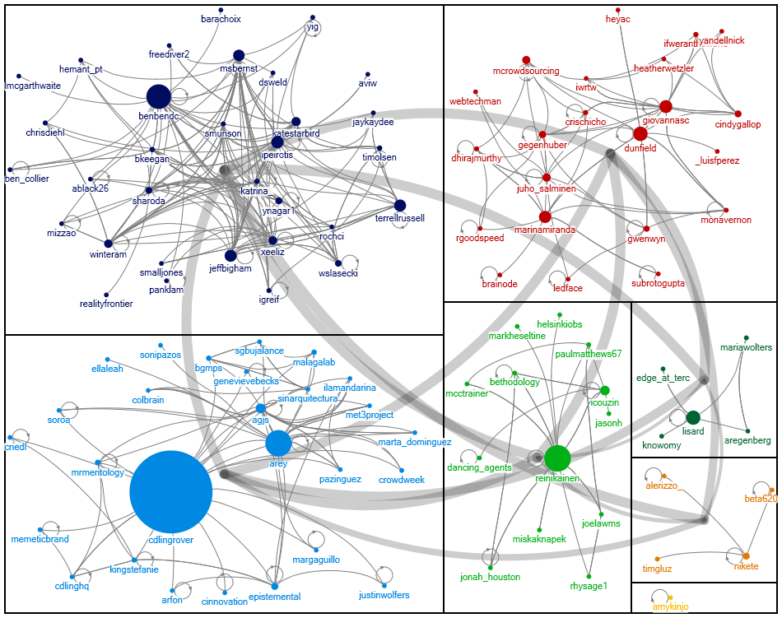
Twitter Network #CI2012: Group-In-A-Box

Slide 44
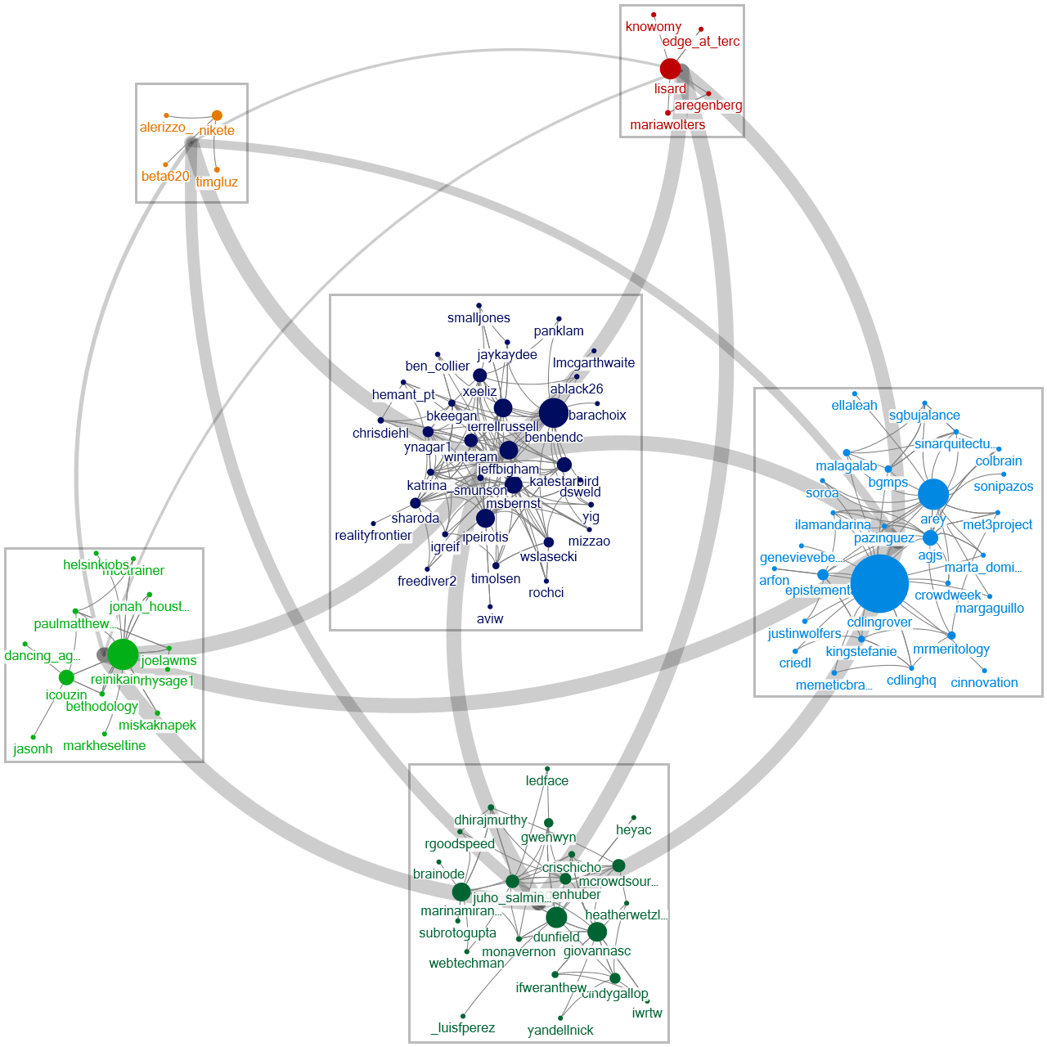
Twitter Network #CI2012: FD Group-in-a-Box

Slide 45
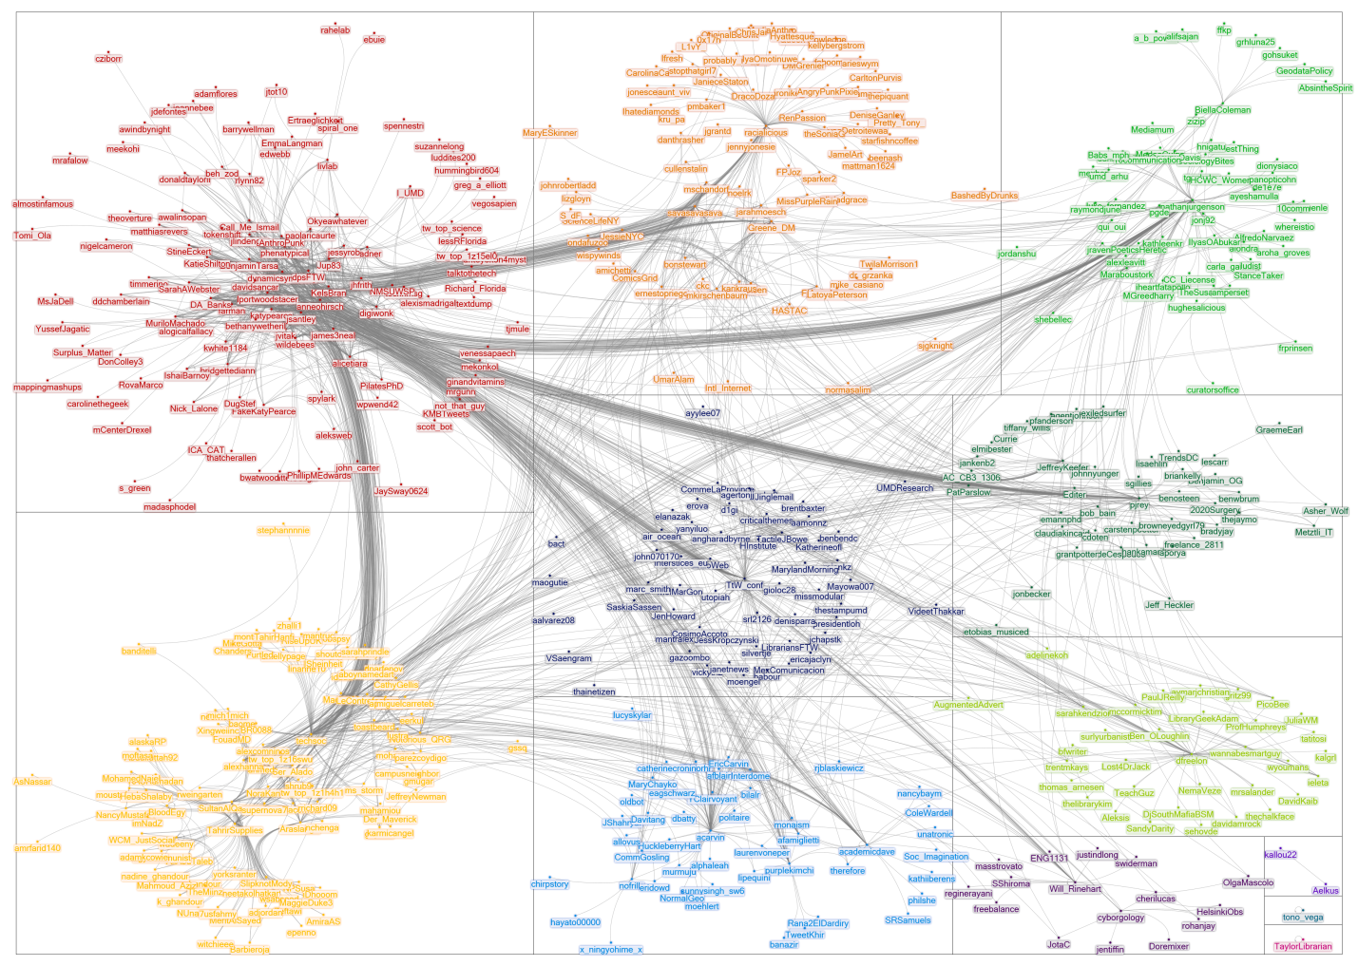
Group-In-A-Box: Twitter Network for “TTW”

Slide 46
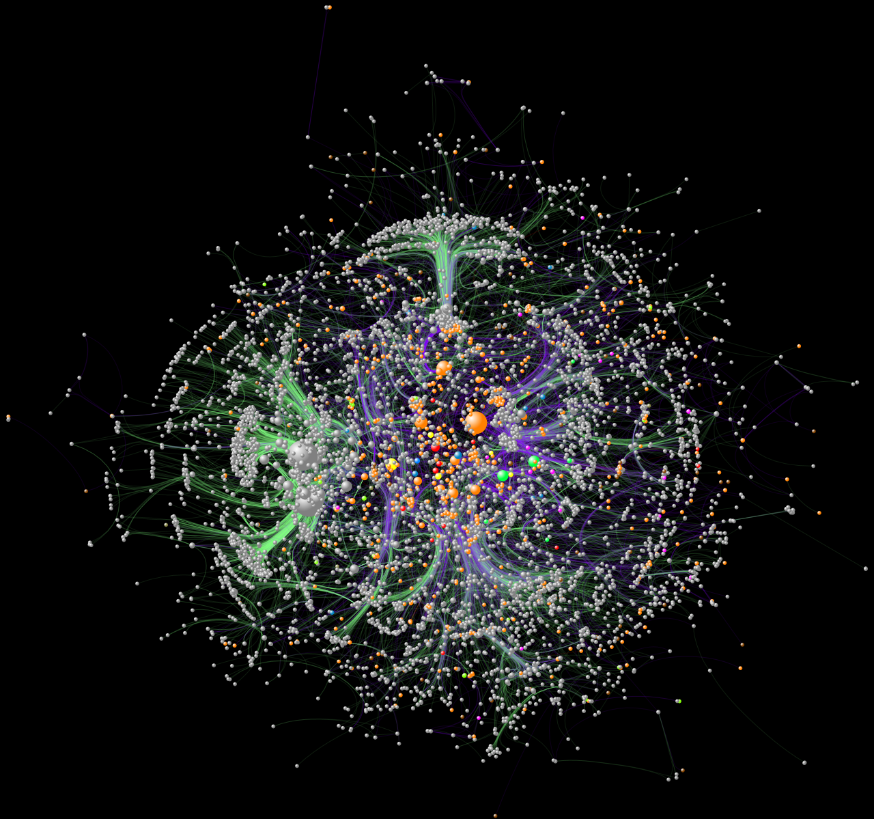
Pennsylvania Innovation Network

Slide 47
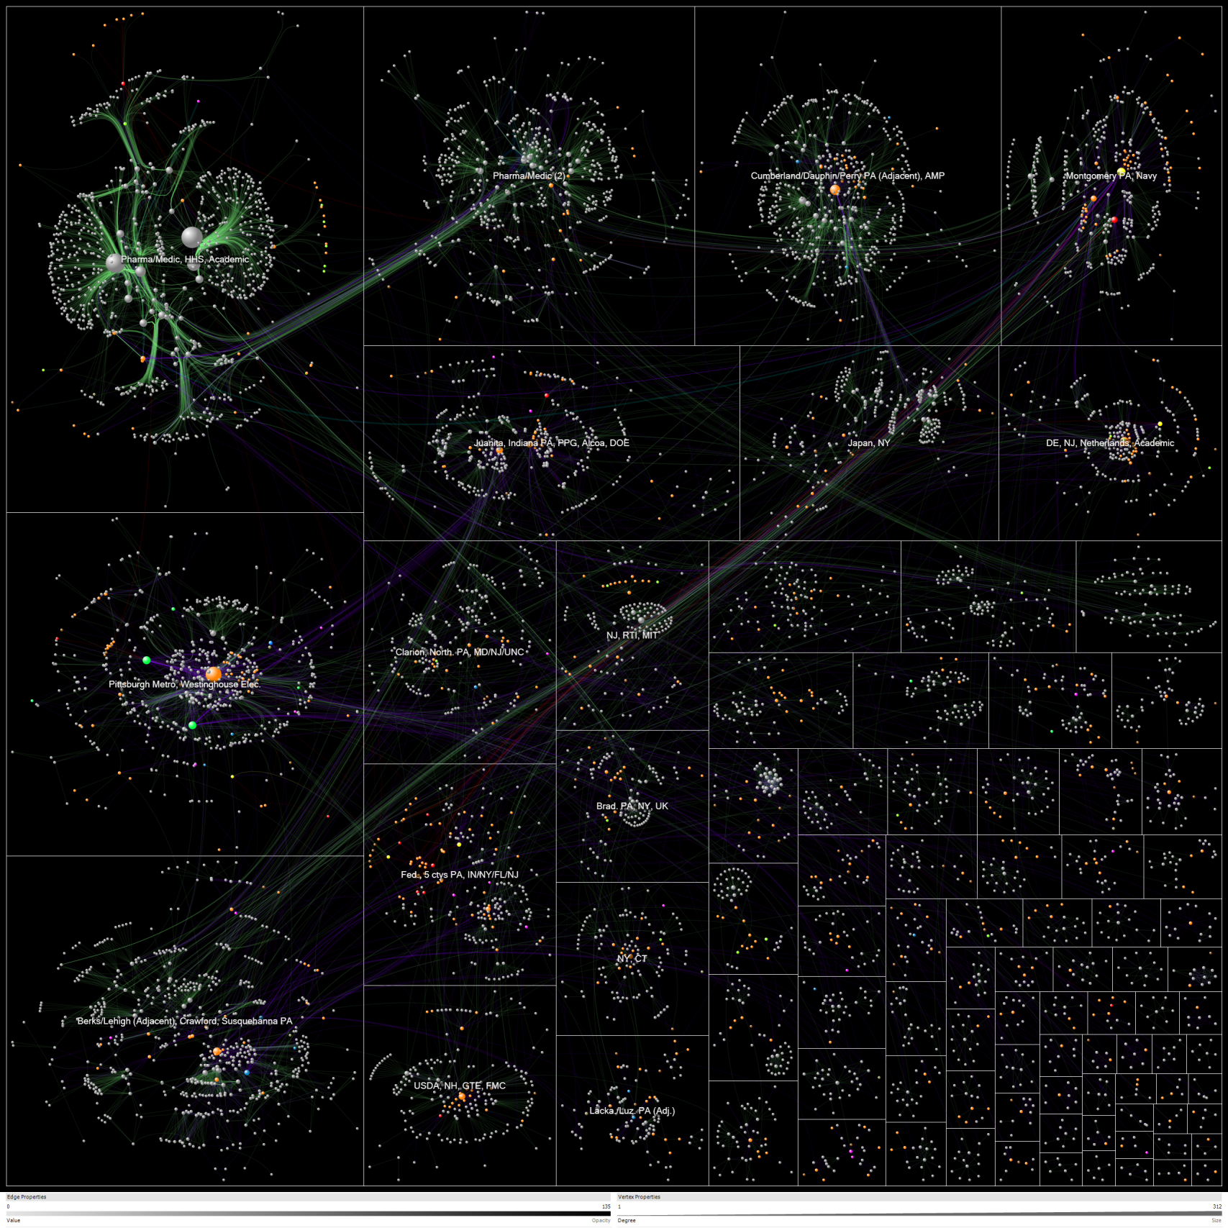
No Location
Philadelphia
Patent
Tech
Navy
SBIR (federal)
PA DCED (state)
Related patent
2: Federal agency
Pharmaceutical/Medical
3: Enterprise
Pittsburgh Metro
5: Inventors
9: Universities
10: PA DCED
11/12: Phil/Pitt metro cnty
13-15: Semi-rural/rural cnty
17: Foreign countries
Westinghouse Electric
19: Other states

Slide 48
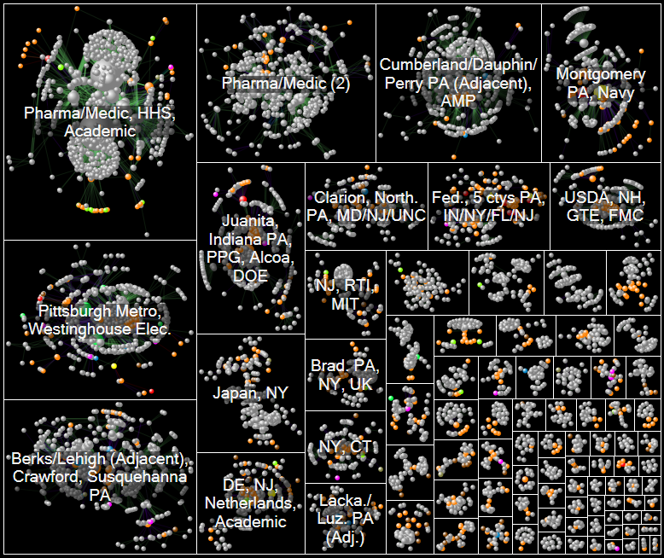
Innovation Patterns: 11,000 vertices, 26,000 edges

Slide 49
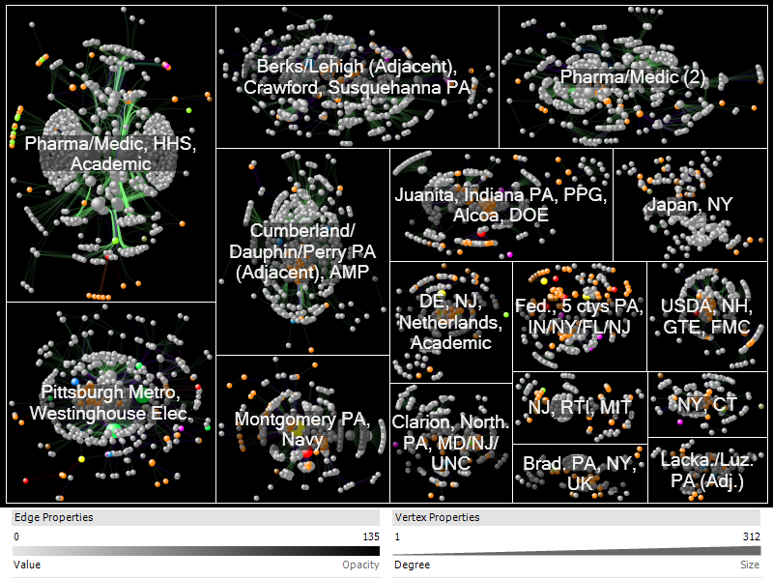
Innovation Clusters: People, Locations, Companies
No Location
Philadelphia
Patent
Tech
Navy
SBIR (federal)
PA DCED (state)
Related patent
2: Federal agency
Pharmaceutical/Medical
3: Enterprise
Pittsburgh Metro
5: Inventors
9: Universities
10: PA DCED
11/12: Phil/Pitt metro cnty
13-15: Semi-rural/rural cnty
17: Foreign countries
Westinghouse Electric
19: Other states

Slide 50
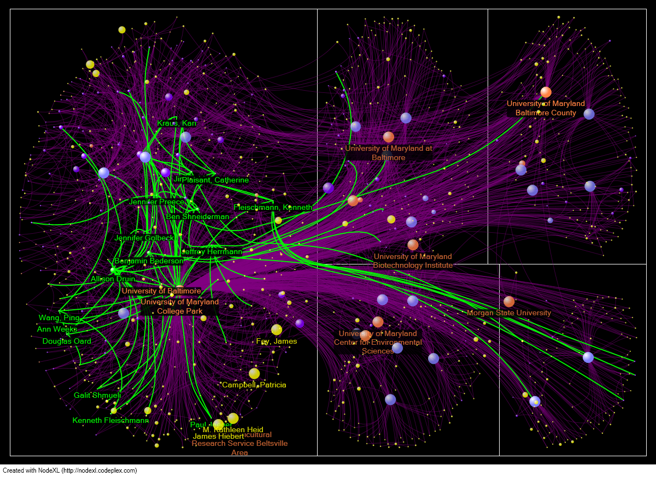

Slide 51
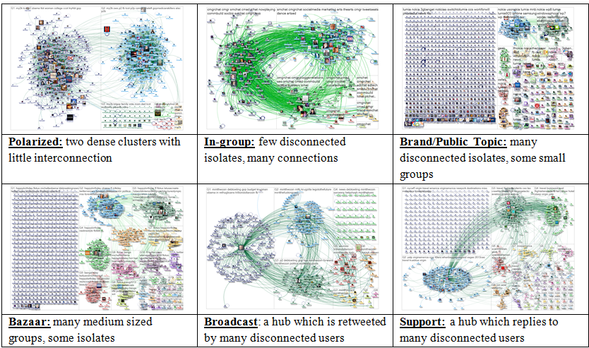
Six Structural Patterns in Twitter

Slide 52
Interactive Methods to Reveal Patterns
Filtering Node & link attribute values or statistics
Clustering Cluster algorithmically by link connectivity
Grouping Group based on node attributes
Motif Common, meaningful structures Simplification replaced with simplified glyphs

Slide 53
Senate Co-Voting

Slide 54

Group-In-A-Box by Region

Slide 55
Interactive Methods to Reveal Patterns
Filtering Node & link attribute values or statistics
Clustering Cluster algorithmically by link connectivity
Grouping Group based on node attributes
Motif Common, meaningful structures Simplification replaced with simplified glyphs

Slide 56

Motif Simplification
(a) Fan motifs & glyphs (b) Connector motifs & glyphs

Slide 57

Motif Simplification

Slide 58

Motif Simplification

Slide 59

Clique Motifs & Glyphs: 4, 5 & 6

Slide 60


Senate Co-Voting: 65% Agreement

Slide 61


Senate Co-Voting: 70% Agreement

Slide 62


Senate Co-Voting: 80% Agreement

Slide 63


Senate Co-Voting: 90% Agreement

Slide 64


Senate Co-Voting: 95% Agreement

Slide 65


Combined Motifs & Glyphs

Slide 66

Voson Web Crawl
Notes:
Published in NodeXL book
Think straightforward
Size unclear
Hidden relationships

Slide 67

Voson Web Crawl

Slide 68

Voson Web Crawl

Slide 69

Voson Web Crawl

Slide 70

Voson Web Crawl

Slide 71

Quantifying Effectiveness

Slide 72


Patients & Concepts Network Simplified
433 patients, 4071 concepts

Slide 73


Patients & Concepts Network Simplified

Slide 74
Discussion
Motif simplification effective for
Reducing complexity
Understanding relationships
However
Some motifs may not be addressed
Glyph design has tradeoffs
(Dunne & Shneiderman, CHI 2013)
Notes:
Four participants
Varying backgrounds
Little or no NodeXL experience, none with MS
45-60 min
Eager to change
o Makes more sense
o Reduce complexity
o Detect hidden patterns
o Could only look at two at a time

Slide 75

Nodexlgraphgallery.org

Slide 76

Analyzing Social Media Networks with NodeXL
I. Getting Started with Analyzing Social Media Networks 1. Introduction to Social Media and Social Networks 2. Social media: New Technologies of Collaboration 3. Social Network Analysis II. NodeXL Tutorial: Learning by Doing 4. Layout, Visual Design & Labeling 5. Calculating & Visualizing Network Metrics 6. Preparing Data & Filtering 7. Clustering &Grouping III Social Media Network Analysis Case Studies 8. Email 9. Threaded Networks 10. Twitter 11. Facebook 12. WWW 13. Flickr 14. YouTube 15. Wiki Networks
http://www.elsevier.com/wps/find/bookdescription.cws_home/723354/description

Slide 77

Social Media Research Foundation
Social Media Research Foundation
smrfoundation.org
We are a group of researchers who want to create open tools, generate and host open data, and support open scholarship related to social media.
smrfoundation.org

Slide 78

UN Millennium Development Goals
To be achieved by 2015
Eradicate extreme poverty and hunger
Achieve universal primary education
Promote gender equality and empower women
Reduce child mortality
Improve maternal health
Combat HIV/AIDS, malaria and other diseases
Ensure environmental sustainability
Develop a global partnership for development
Notes:
78

Slide 79

30th Anniversary
www.cs.umd.edu/hcil

Slide 80





Interactivity
Fan motif: 133 leaf vertices with head vertex “Theory”
Notes:
Lossless transformations
Direct manipulation
Visual & textual cues

Slide 81
Information Visualization & Visual Analytics
- Integration of statistics with visualization
- Turning Big Data into Big Insights
- Dynamic queries across multiple coordinated views
- Aggregation, clustering, and simplification strategies
- Insight extraction processes: systematic yet flexible

Slide 82

Force-Directed Group-in-a-Box

