Slide 1

Group-In-a-Box Layout for
Multi-faceted Analysis of Communities
Eduarda Rodrigues, Natasa Milic-Frayling, Marc A. Smith,
Ben Shneiderman & Derek Hansen
Contact: ben@cs.umd.edu, @benbendc

Slide 2
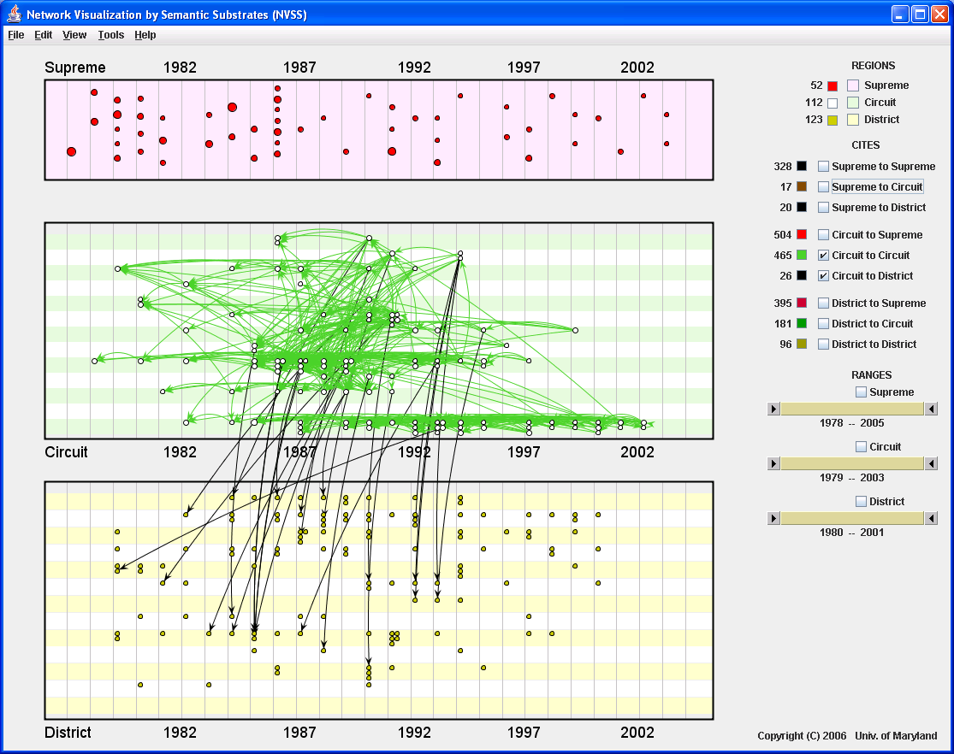
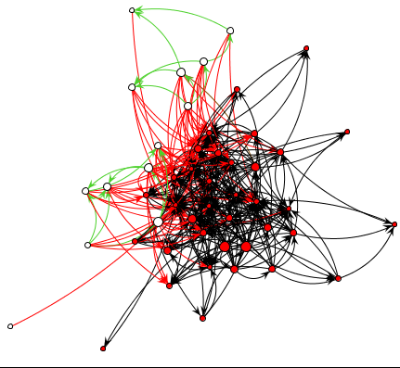
Force Directed
Network Layouts
Dominate, but...
Semantic Substrates
Can Produce
More Meaningful Layouts
www.cs.umd.edu/hcil/nvss

Slide 3
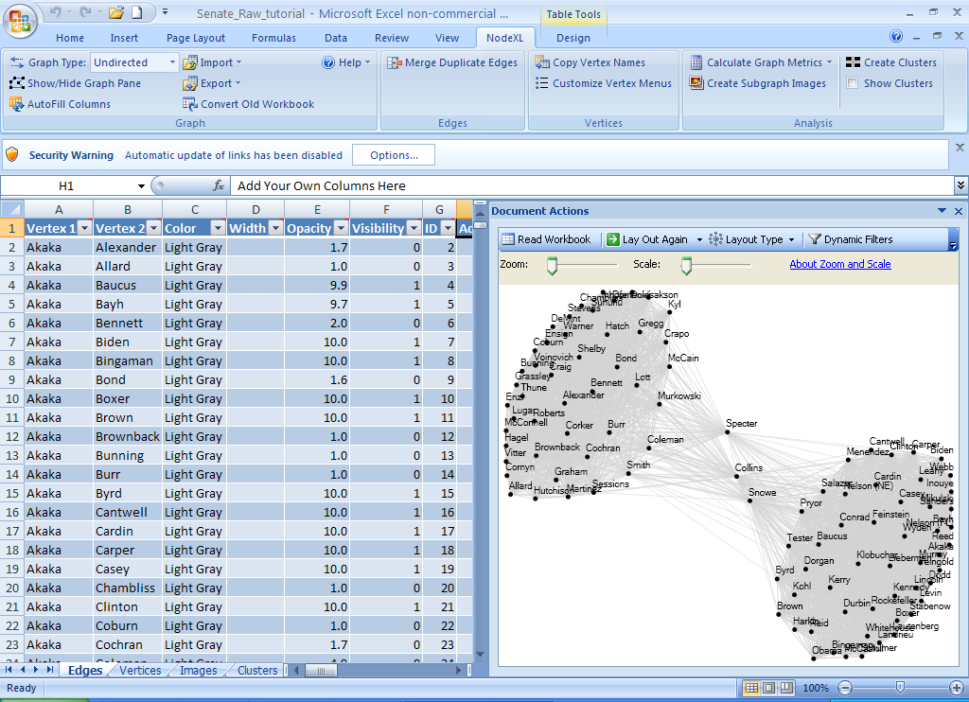
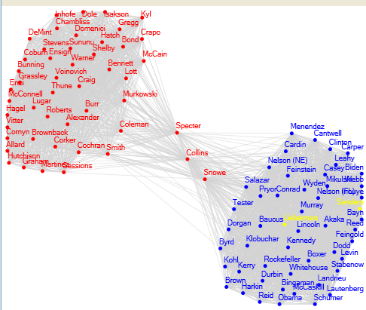
NodeXL:
Network Overview for Discovery & Exploration in Excel
www.codeplex.com/nodexl

Slide 4
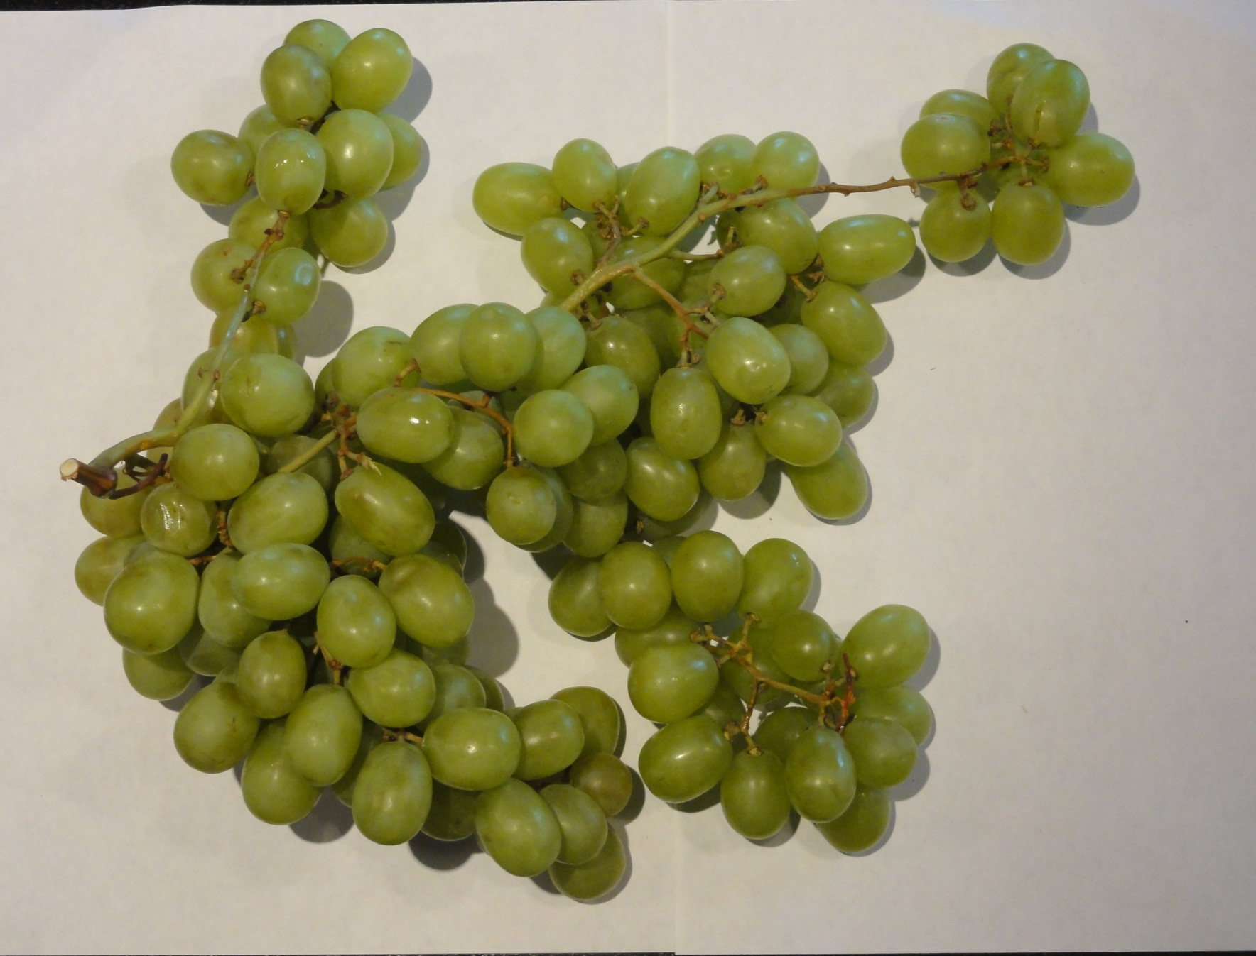
Analogy: Clusters Are Occluded
Hard to count nodes, clusters

Slide 5
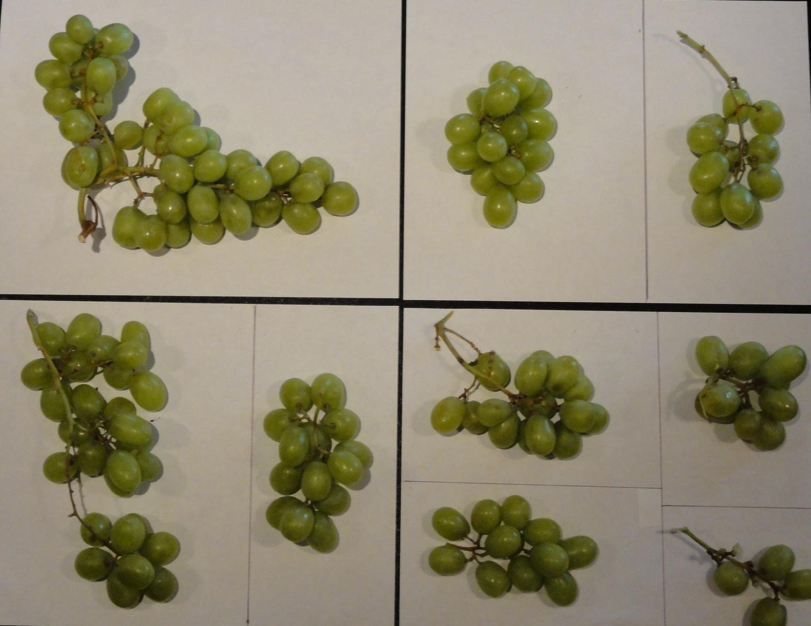
Separate Clusters Are More Comprehensible

Slide 6
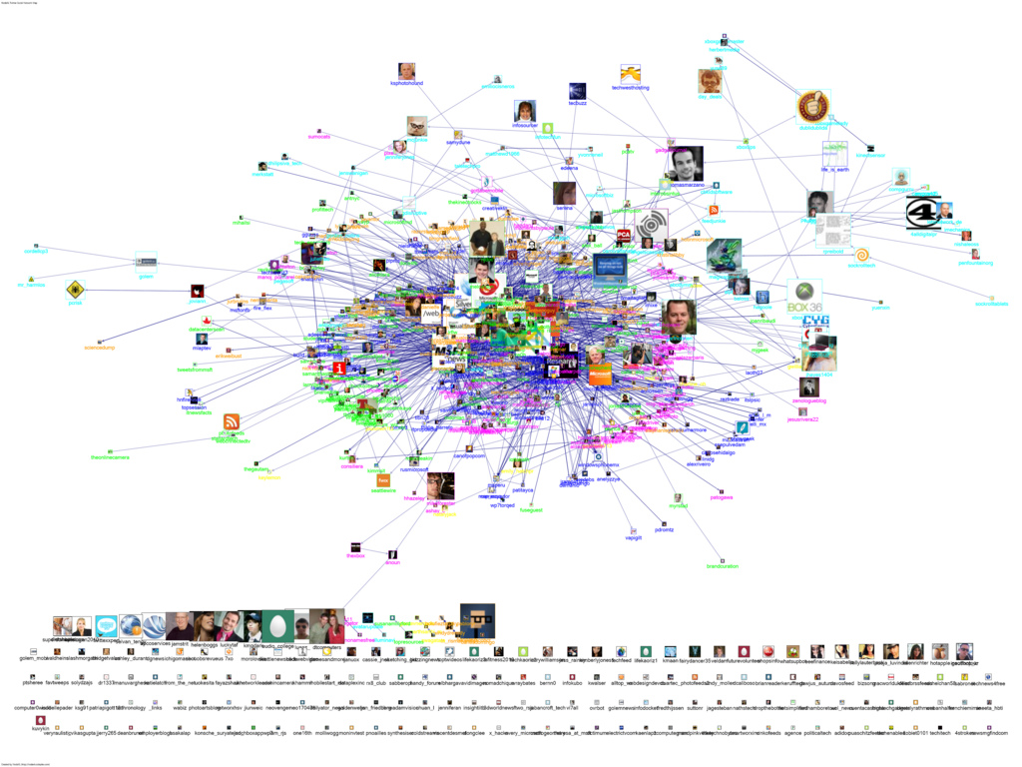
Twitter Network for “msrtf11 OR techfest ”
Notes:
Figure 1. (a) Harel-Koren (HK) fast multi-scale layout of a clustered network of Twitter users, using color to differentiate among the vertices in different clusters. The layout produces a visualization with overlapping cluster positions. . (b) Group-in-a-Box (GIB) layout of the same Twitter network: clusters are distributed in a treemap structure that partitions the drawing canvas based on the size of the clusters and the properties of the rendered layout. Inside each box, clusters are rendered with the HK layout.

Slide 7
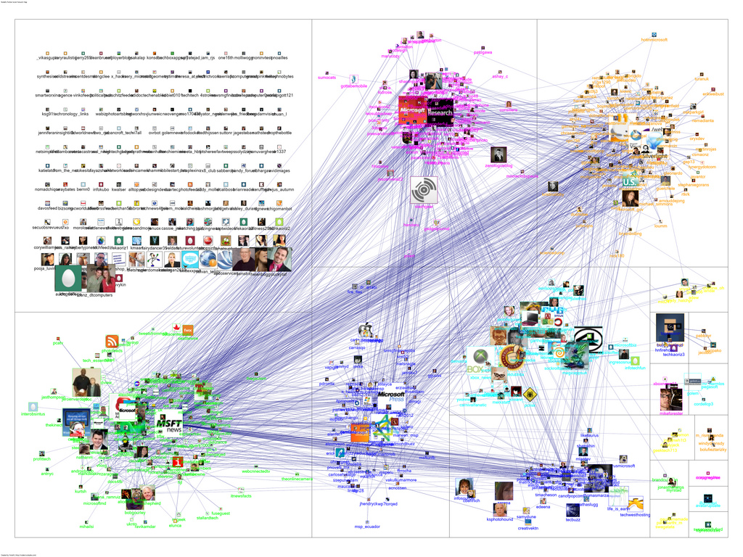
Twitter Network for “msrtf11 OR techfest ”

Slide 8
US Senate Co-Voting Network 2007
Notes:
Figure 2. The 2007 U.S. Senate co-voting network graph, obtained with the Fruchterman-Reingold (FR) layout. Vertices colors represent the senators’ party affiliations (blue: Democrats; red: Republicans; orange: Independent) and their size is proportional to betweenness centrality. Edges represent percentage of agreement between senators: (a) above 50%; (b) above 90%.

Slide 9
US Senate Co-Voting Network 2007, Clustered
South
Northeast
Mountain
Pacific
Midwest
Notes:
Figure 3. The 2007 U.S. Senate co-voting network graph, visualized with the GIB layout. The group in each box represents senators from a given U.S. region (1: South; 2: Midwest; 3: Northeast; 4: Mountain; 5: Pacific) and individual groups are displayed using the FR layout. Vertices colors represent the senators’ party affiliations (blue: Democrats; red: Republicans; orange: Independent) and their size is proportional to betweenness centrality. Edges represent percentage of agreement between senators: (a) above 50%; (b) above 90%..

Slide 10
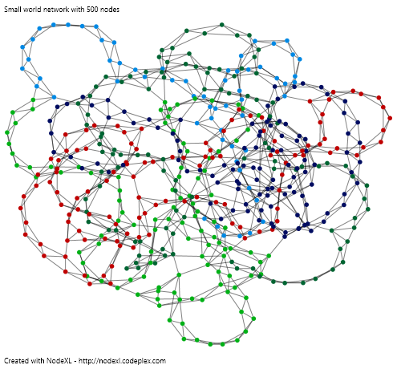
Small-World Graph with 5 Clusters
Notes:
Figure 4. Small-world network graph visualization obtained with the Harel-Koren layout, after clustering the graph with the Clauset-Newman-Moore community detection algorithm (5 clusters). (a) Full graph with 500 vertices colored according to the cluster membership. (b) GIB layout of the same 5 clusters showing inter-cluster edges. (c) GIB showing the structural properties of the individiual clusters.

Slide 11
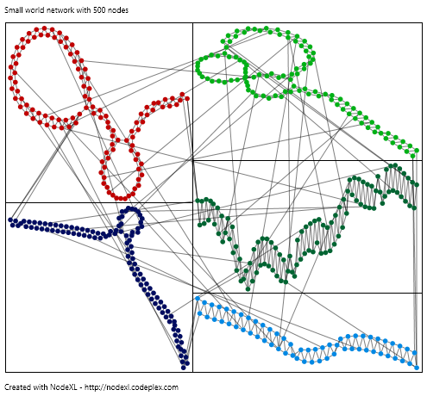
Small-World Graph with 5 Clusters

Slide 12
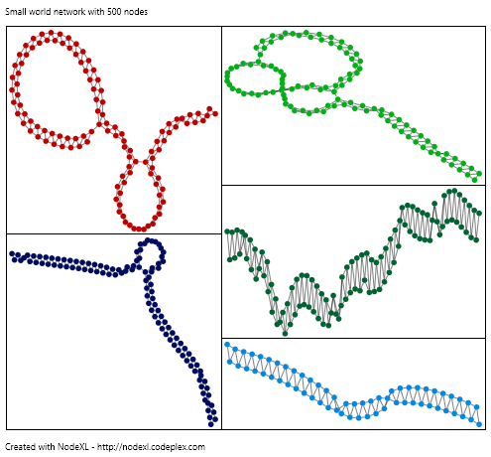
Small-World Graph with 5 Clusters

Slide 13
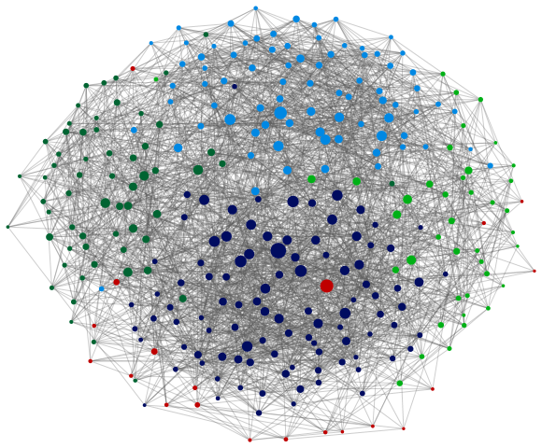
Pseudo-Random Graph with 5 Clusters
Notes:
Figure 5. Pseudo-random graphs with 5 clusters of different sizes (comprising 20, 40, 60, 80 and 100 vertices), with intra-cluster edge probability of 0.15: (a) inter-cluster edge probability of 0.05. The graphs are visualized using the Harel-Koren fast multi-scale layout algorithm and vertices are sized by betweenness centrality. The visualizations in (b) is the corresponding GIB layout.

Slide 14
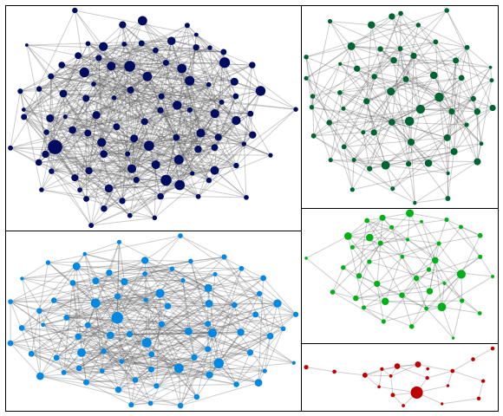
Pseudo-Random Graph with 5 Clusters

Slide 15
Scale-free Network with 10 Clusters
Notes:
Figure 6. Scale-free network with 10 clusters detected by the Clauset-Newman-Moore algorithm. Vertices are colored by cluster membership and sized by betweeness centrality. (a) Harel–Koren layout of the clustered graph. (b) Harel–Koren layout after removing inter-cluster edges. (c) Fruchterman-Reingold layout after removing inter-cluster edges. (d) GIB showing inter-cluster edges and (e) GIB showing intra-clsuter edges.

Slide 16
Scale-free Network with 10 Clusters

Slide 17
Scale-free Network with 10 Clusters

Slide 18
Scale-free Network with 10 Clusters

Slide 19
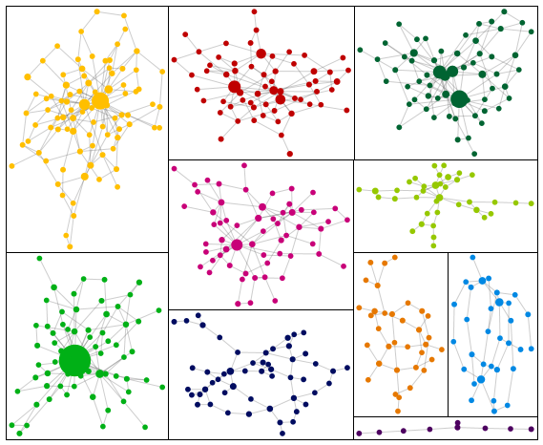
Scale-free Network with 10 Clusters

Slide 20
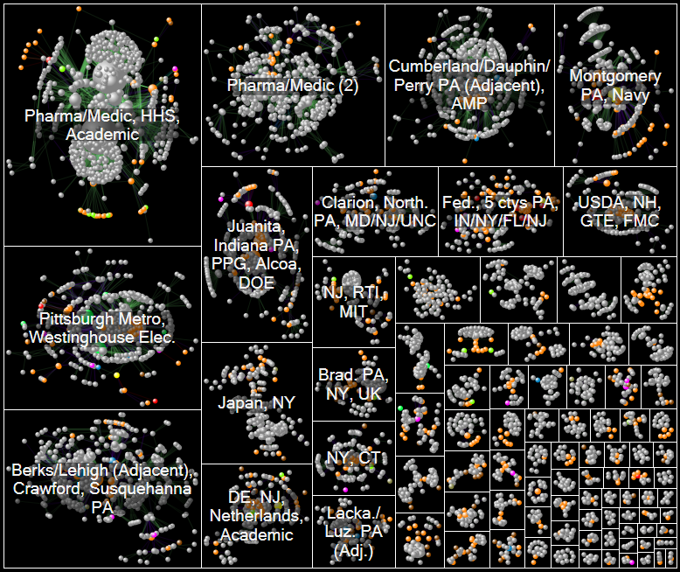
Innovation Patterns: 11,000 vertices, 26,000 edges

Slide 21
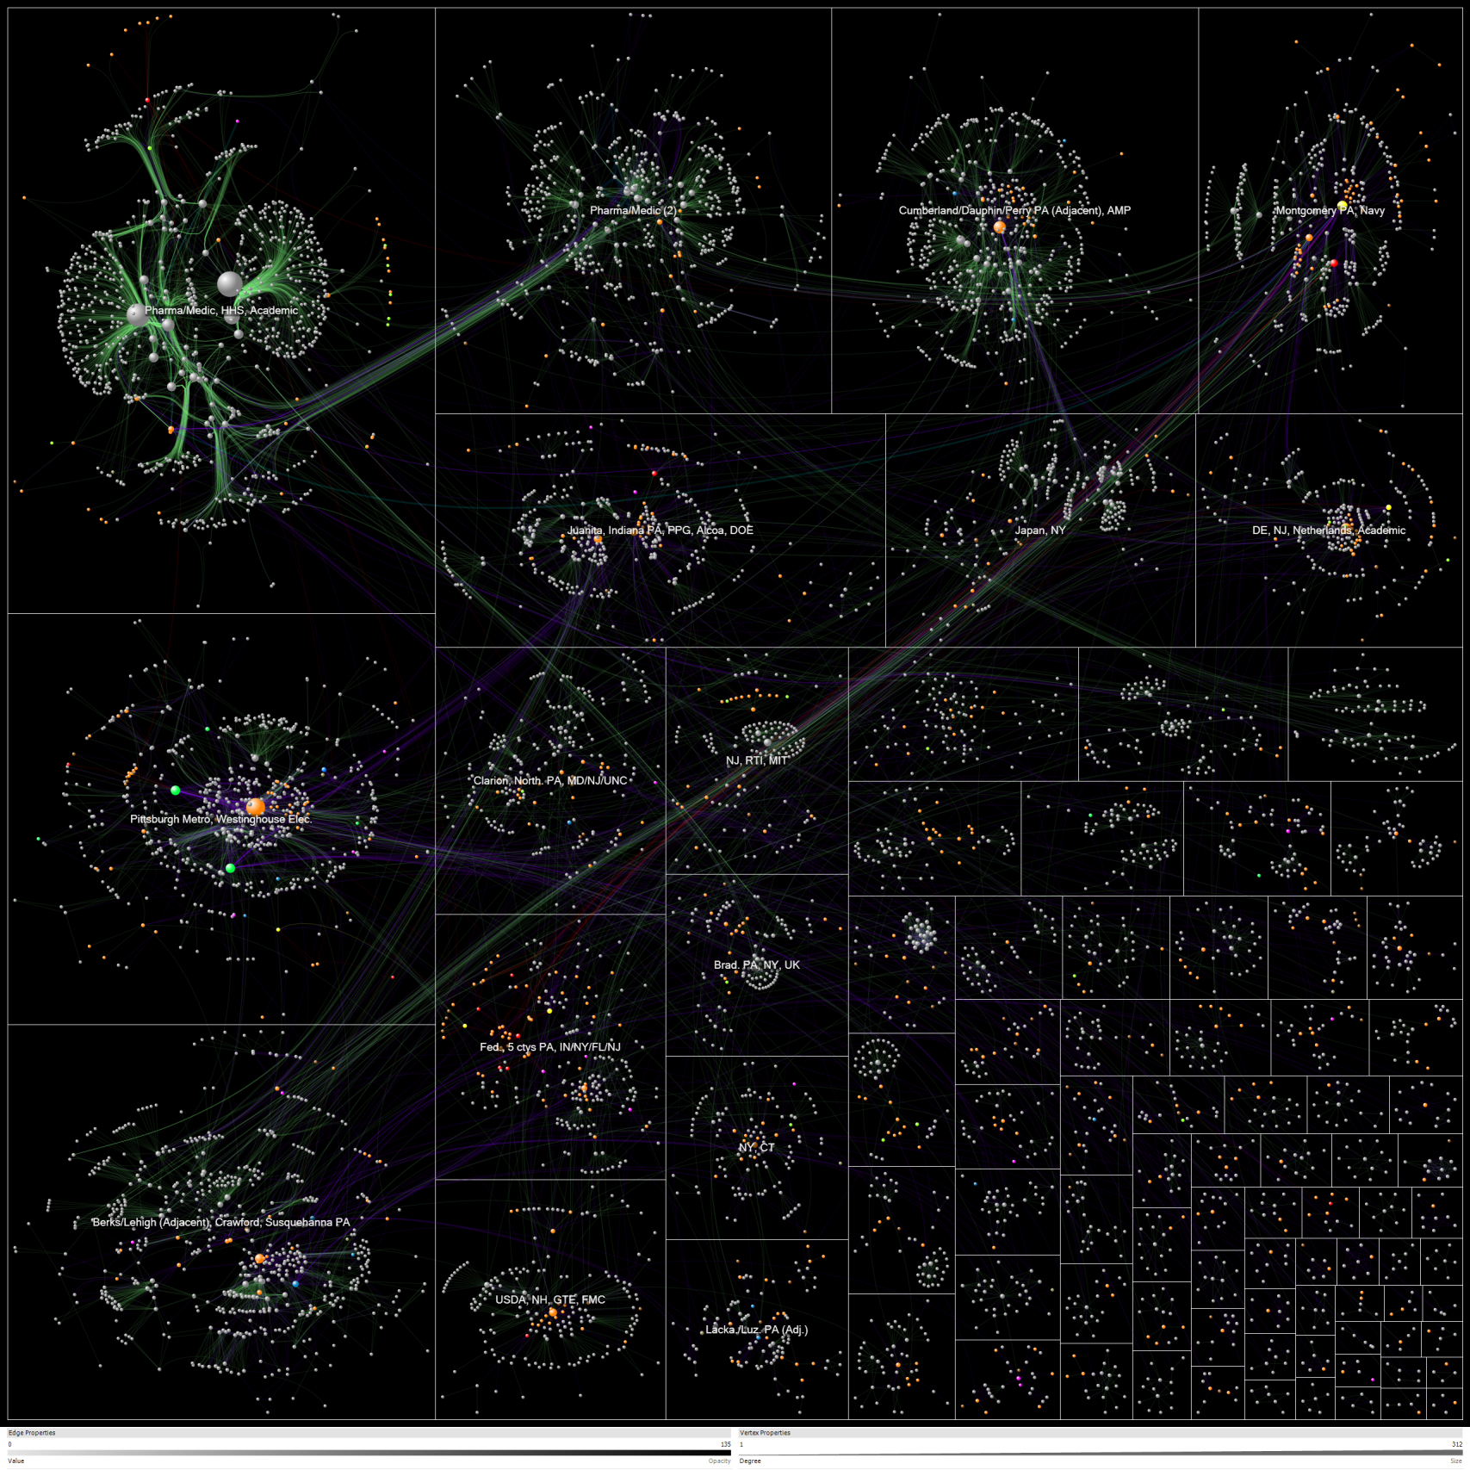
No Location
Philadelphia
Patent
Tech
Navy
SBIR (federal)
PA DCED (state)
Related patent
2: Federal agency
Pharmaceutical/Medical
3: Enterprise
Pittsburgh Metro
5: Inventors
9: Universities
10: PA DCED
11/12: Phil/Pitt metro cnty
13-15: Semi-rural/rural cnty
17: Foreign countries
Westinghouse Electric
19: Other states

Slide 22
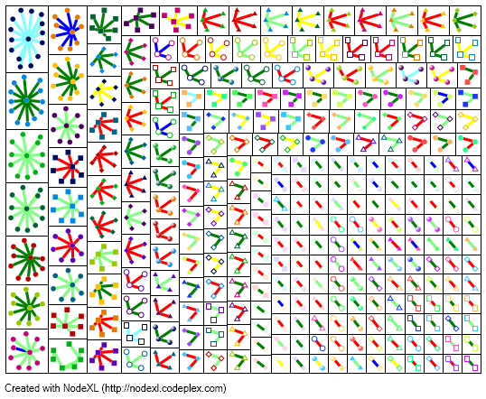
Discussion Group Postings, color by topic
www.cs.umd.edu/hcil/non
nationofneighbors.net

Slide 23

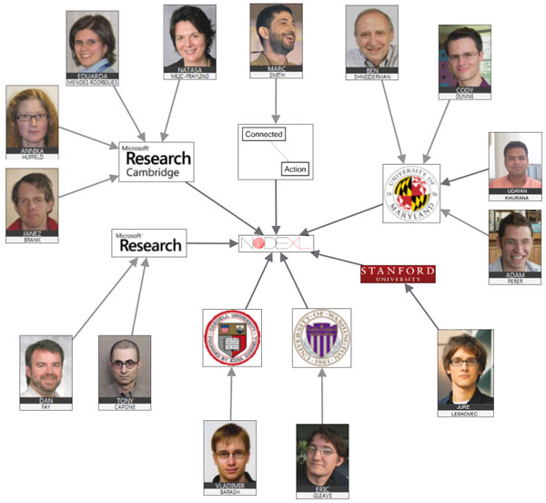
Social Media Research
Foundation
Researchers who want to
- create open tools
- generate & host open data
- support open scholarship
Map, measure & understand
social media
Support tool projects to
collection, analyze & visualize
social media data.
smrfoundation.org

Slide 24
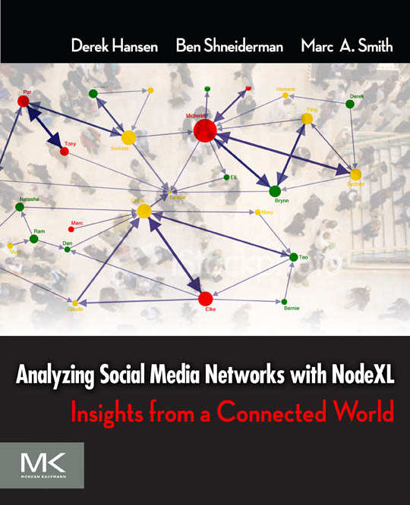
Analyzing Social Media Networks with NodeXL
I. Getting Started with Analyzing Social Media Networks
1. Introduction to Social Media and Social Networks
2. Social media: New Technologies of Collaboration
3. Social Network Analysis
II. NodeXL Tutorial: Learning by Doing
4. Layout, Visual Design & Labeling
5. Calculating & Visualizing Network Metrics
6. Preparing Data & Filtering
7. Clustering &Grouping
III Social Media Network Analysis Case Studies
8. Email
9. Threaded Networks
10. Twitter
11. Facebook
12. WWW
13. Flickr
14. YouTube
15. Wiki Networks
www.elsevier.com/wps/find/bookdescription.cws_home/723354/description

Slide 25
NodeXL:
Network Overview for Discovery & Exploration in Excel
www.codeplex.com/nodexl
Thanks to:
Microsoft External Research
U.S. National Science Foundation
Social Media Research Foundation

