Slide 1

Information Visualization for Knowledge Discovery Ben Shneiderman ben@cs.umd.edu Founding Director (1983-2000), Human-Computer Interaction Lab Professor, Department of Computer Science Member, Institute for Advanced Computer Studies University of Maryland College Park, MD 20742

Slide 2


Interdisciplinary research community
- Computer Science & Info Studies
- Psych, Socio, Poli Sci & MITH
(www.cs.umd.edu/hcil)

Slide 3
Scientific Approach (beyond user friendly)
Specify users and tasks
Predict and measure
time to learn
speed of performance
rate of human errors
human retention over time
Assess subjective satisfaction (Questionnaire for User Interface Satisfaction)
Accommodate individual differences
Consider social, organizational & cultural context

Slide 4
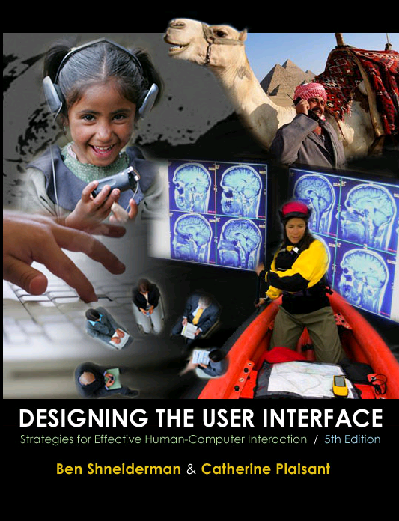
Design Issues
Input devices & strategies
Keyboards, pointing devices, voice
Direct manipulation
Menus, forms, commands
Output devices & formats
Screens, windows, color, sound
Text, tables, graphics
Instructions, messages, help
Collaboration & Social Media
Help, tutorials, training
Search
www.awl.com/DTUI
Fifth Edition: 2010
Visualization

Slide 5

U.S. Library of Congress
Scholars, Journalists, Citizens
Teachers, Students

Slide 6
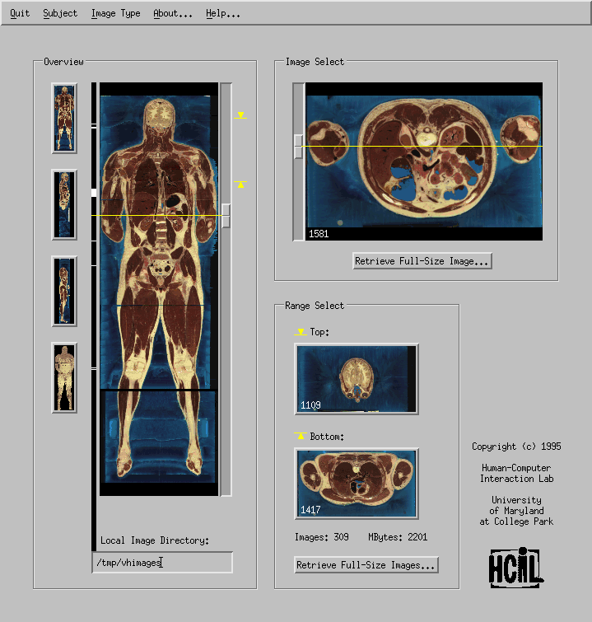

Visible Human Explorer (NLM)
Doctors
Surgeons
Researchers
Students

Slide 7
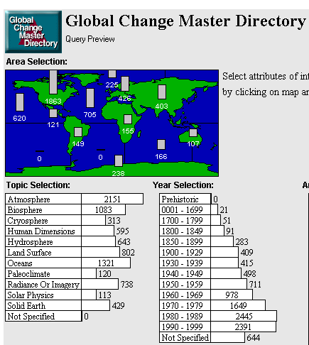
NASA Environmental Data
Scientists
Farmers
Land planners
Students

Slide 8

Bureau of the Census
Economists, Policy makers, Journalists
Teachers, Students

Slide 9

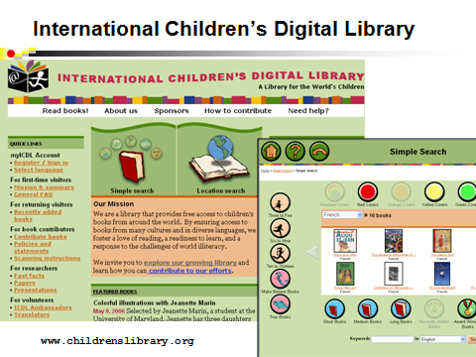


NSF Digital Government Initiative
Find what you need
Understand what you Find
Census,
NCHS,
BLS, EIA,
NASS, SSA
www.ils.unc.edu/govstat/

Slide 10
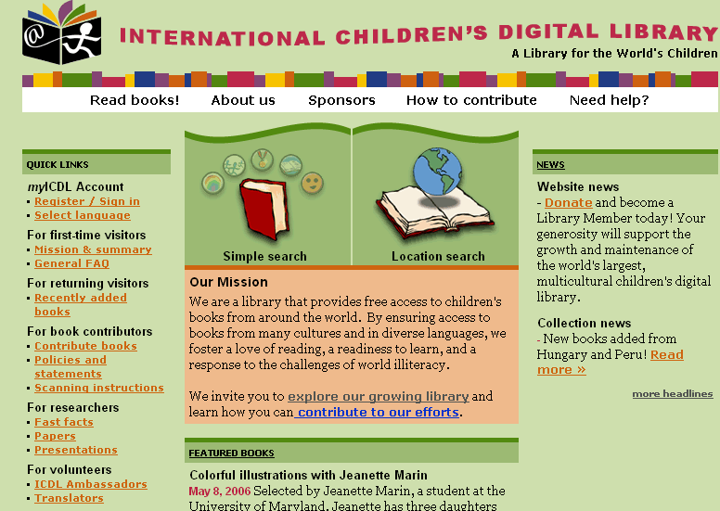
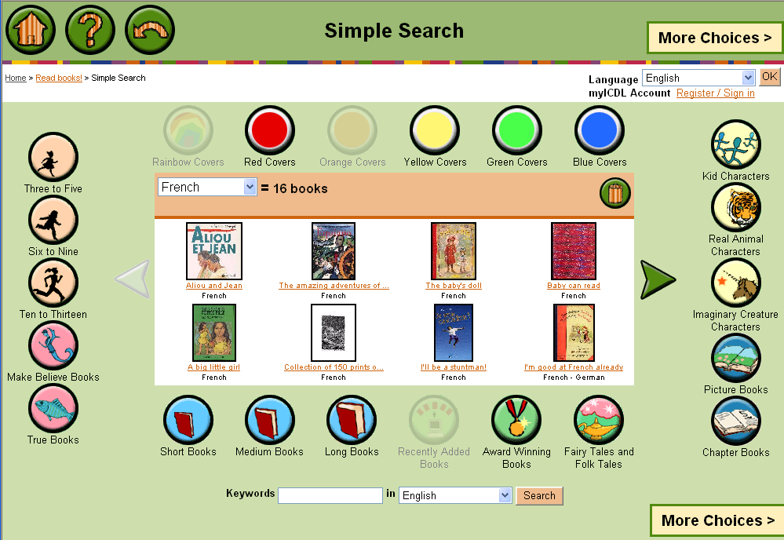
International Children’s Digital Library
www.childrenslibrary.org

Slide 11
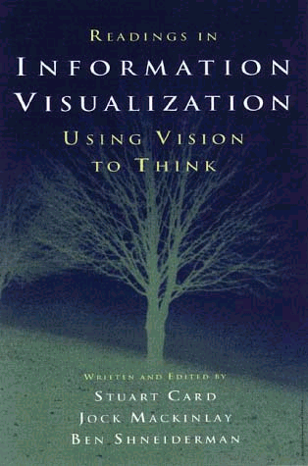
Information Visualization
Visual bandwidth is enormous
Human perceptual skills are remarkable
Trend, cluster, gap, outlier...
Color, size, shape, proximity...
Human image storage is fast and vast
Three challenges
Meaningful visual displays of massive data
Interaction: widgets & window coordination
Process models for discovery: Integrate statistics & visualization Support annotation & collaboration Preserve history, undo & macros

Slide 12
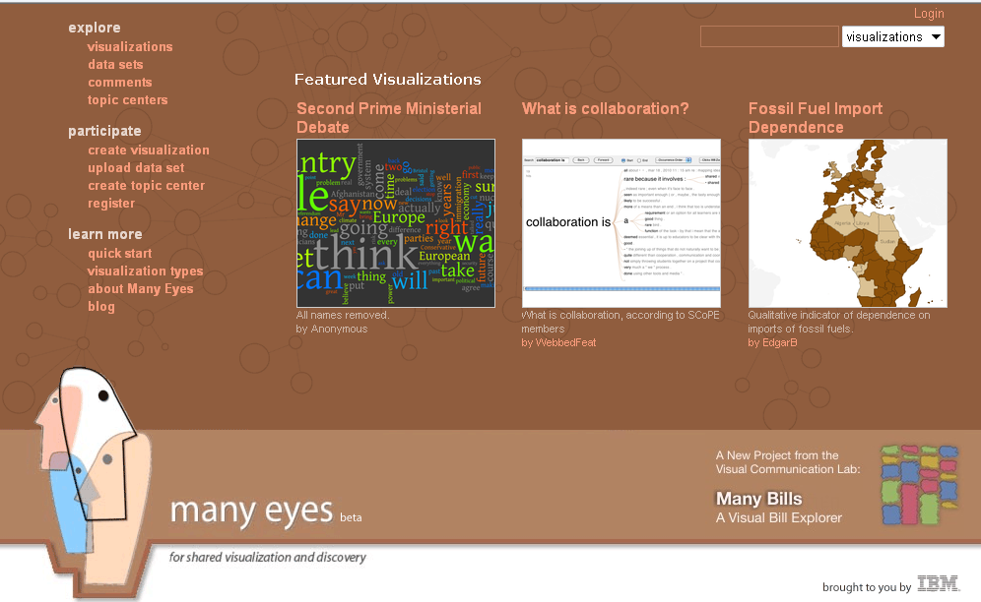
ManyEyes: A web sharing platform
http://manyeyes.alphaworks.ibm.com/manyeyes

Slide 13
Business takes action
General Dynamics buys MayaViz
Agilent buys GeneSpring
Google buys Gapminder
Oracle buys (Hyperion buys Xcelsius)
Microsoft buys Proclarity
InfoBuilders buys Advizor Solutions
SAP buys (Business Objects buys Infomersion & Inxight & Crystal Reports )
IBM buys (Cognos buys Celequest) & ILOG
TIBCO buys Spotfire

Slide 14
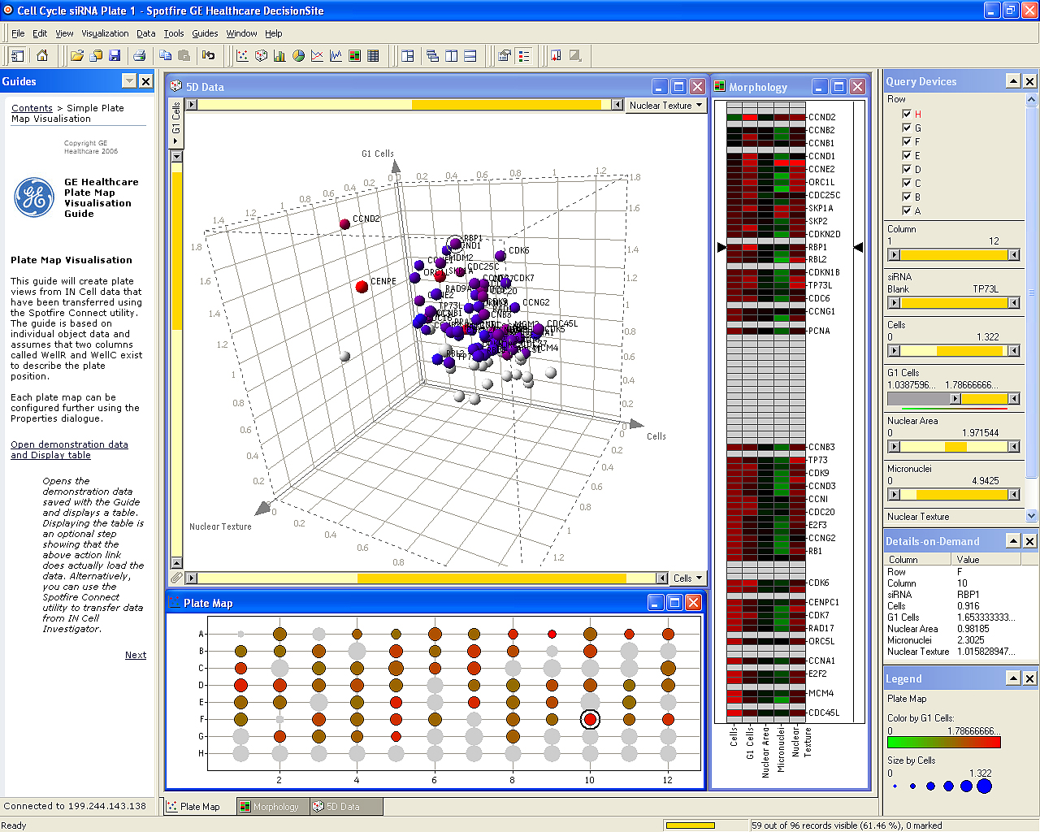
Spotfire: Retinol’s role in embryos & vision
Notes:
"The IN Cell Analyzer automated microscope was used to identify proteins influencing the division of human cells. After the images were analyzed, quantitative results were transferred to Spotfire DecisionSite. This screen revealed the previously unknown involvement of the retinol binding protein RBP1 in cell cycle control.(Stubbs S, & Thomas N. 2006 Methods in Enzymology; 414:1-21.) Retinol a form of Vitamin A plays a crucial role in vision and during embryonic development"

Slide 15

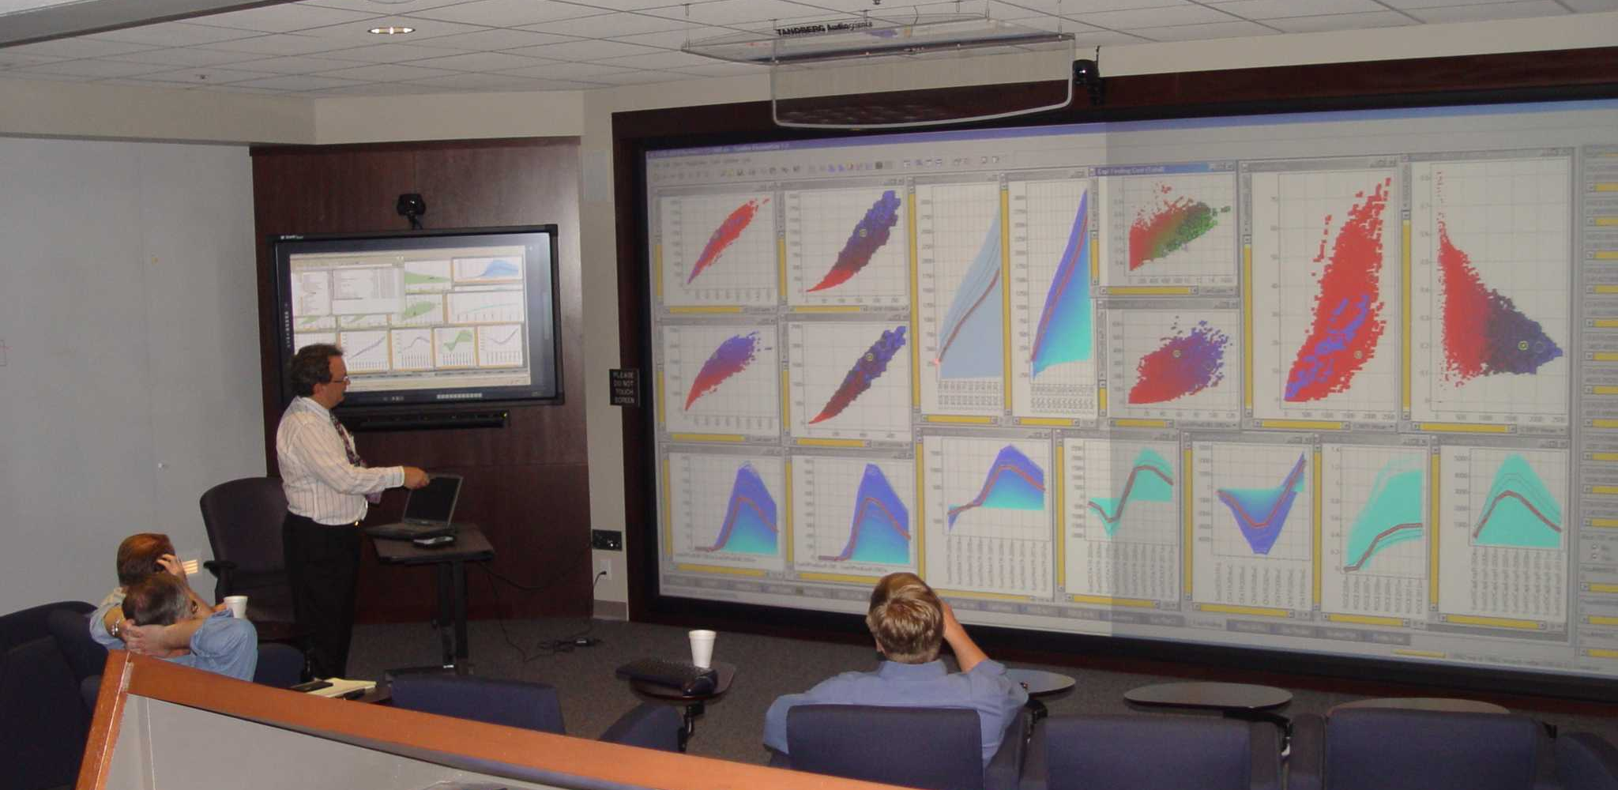

Slide 16
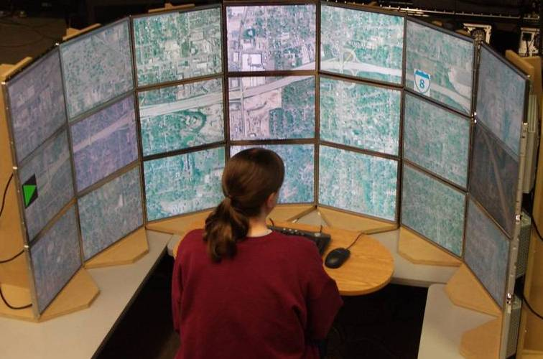
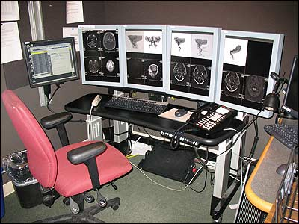
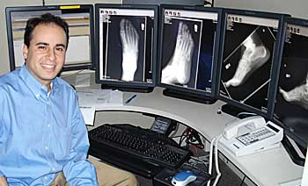
10M - 100M pixels
Large displays for single or multiple users

Slide 17
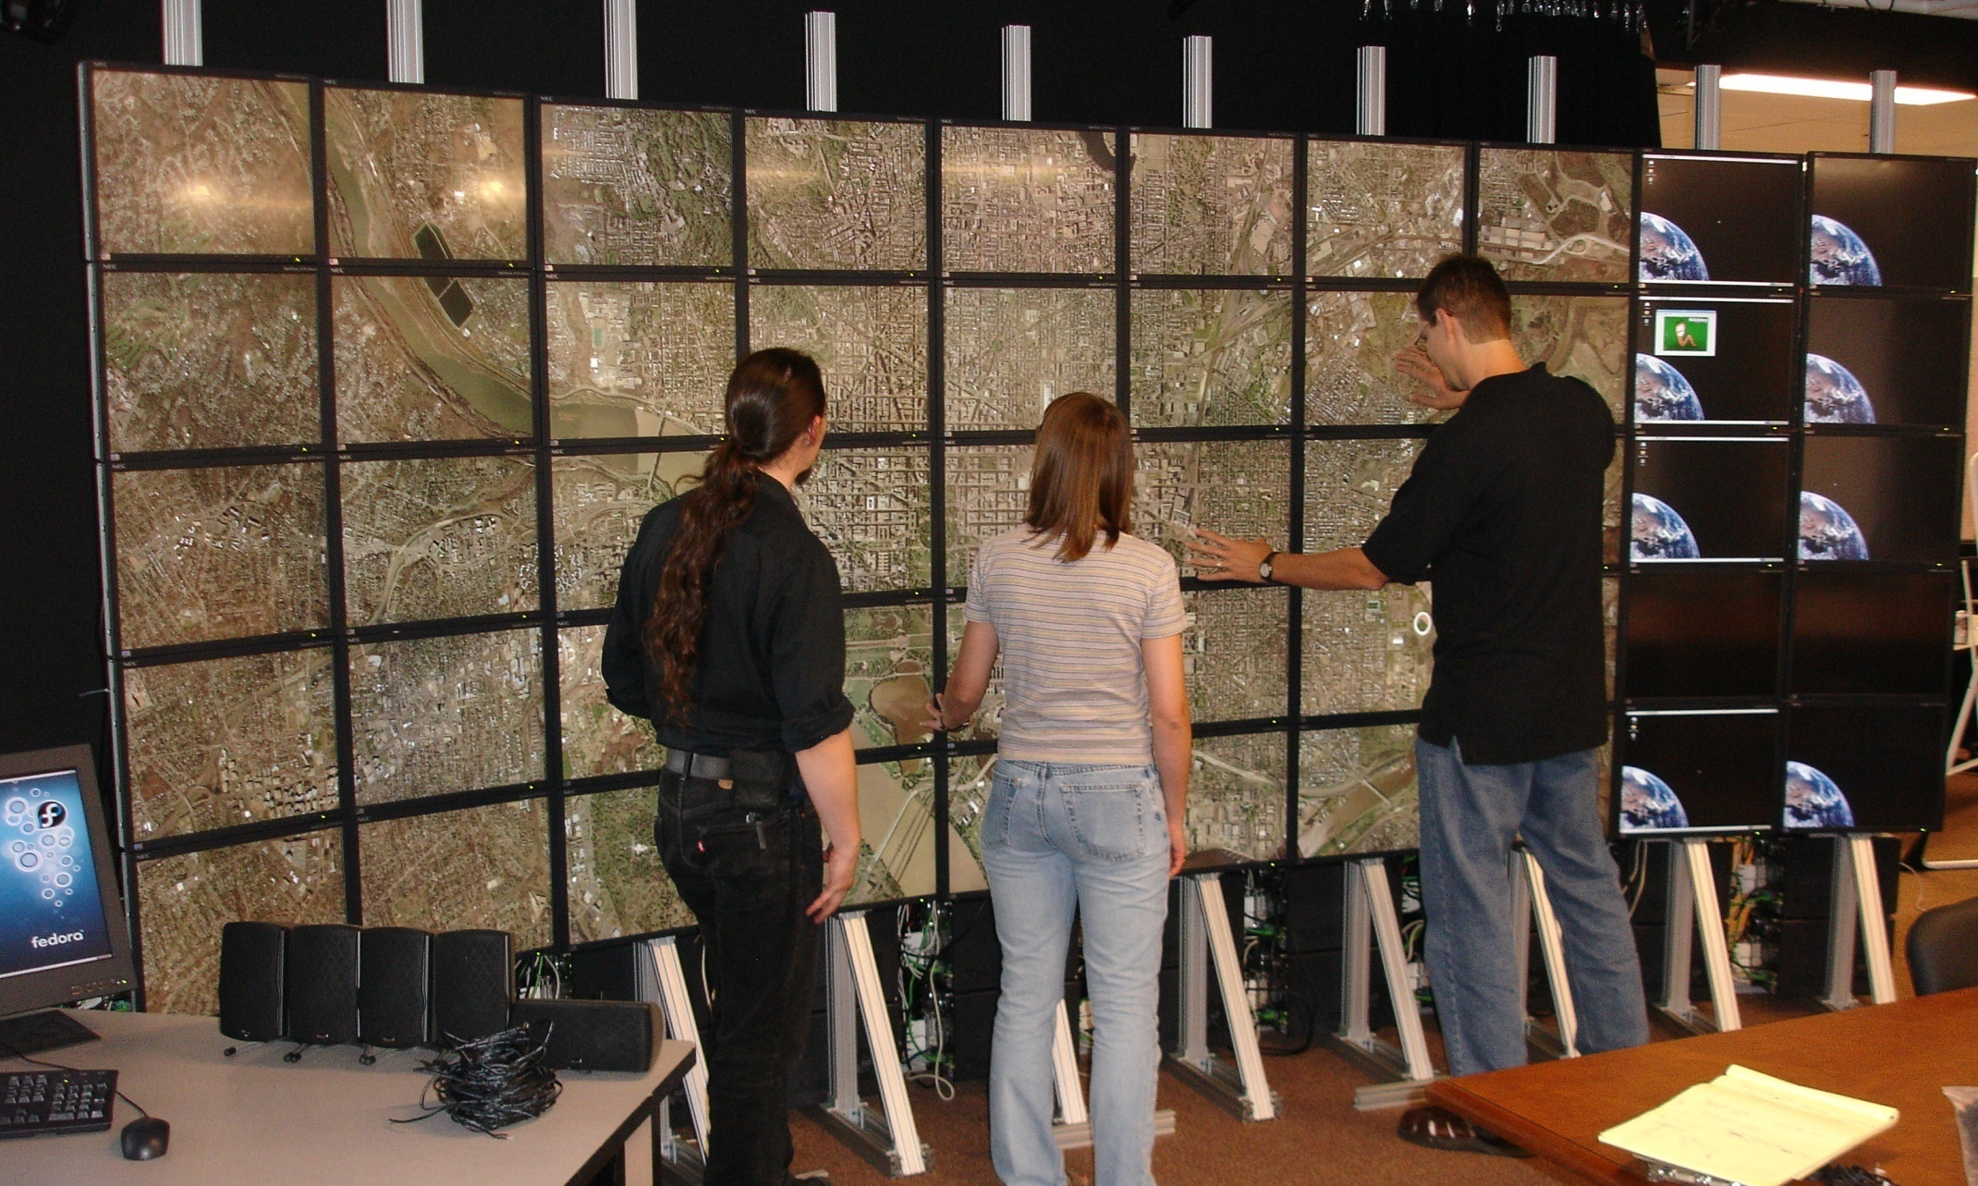
100M-pixels & more

Slide 18
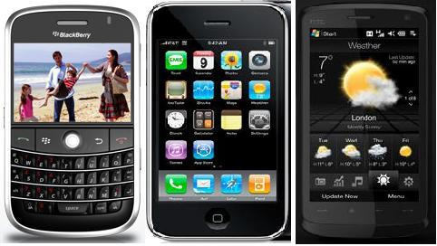
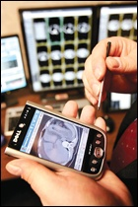
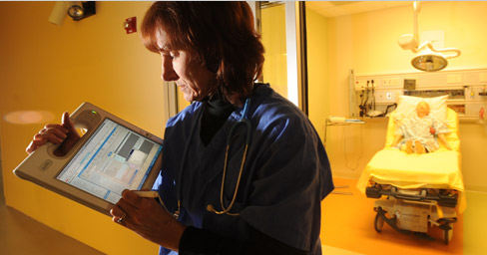
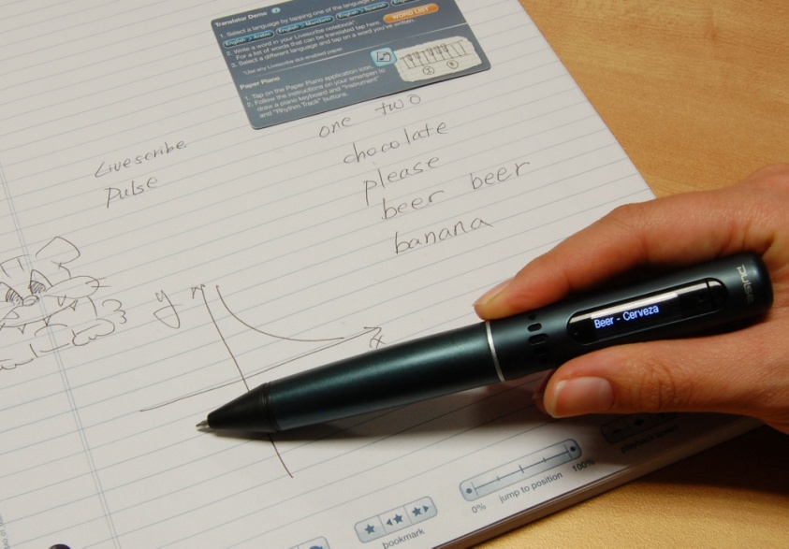
1M-pixels & less
Small mobile devices

Slide 19
Information Visualization: Mantra
Overview, zoom & filter, details-on-demand
Overview, zoom & filter, details-on-demand
Overview, zoom & filter, details-on-demand
Overview, zoom & filter, details-on-demand
Overview, zoom & filter, details-on-demand
Overview, zoom & filter, details-on-demand
Overview, zoom & filter, details-on-demand
Overview, zoom & filter, details-on-demand
Overview, zoom & filter, details-on-demand
Overview, zoom & filter, details-on-demand

Slide 20
Information Visualization: Data Types
InfoViz SciViz .
1-D Linear Document Lens, SeeSoft, Info Mural
2-D Map GIS, ArcView, PageMaker, Medical imagery
3-D World CAD, Medical, Molecules, Architecture
Multi-Var Spotfire, Tableau, GGobi, TableLens, ParCoords,
Temporal LifeLines, TimeSearcher, Palantir, DataMontage
Tree Cone/Cam/Hyperbolic, SpaceTree, Treemap
Network Pajek, JUNG, UCINet, SocialAction, NodeXL
infosthetics.com flowingdata.com infovis.org
www.infovis.net/index.php?lang=2

Slide 21
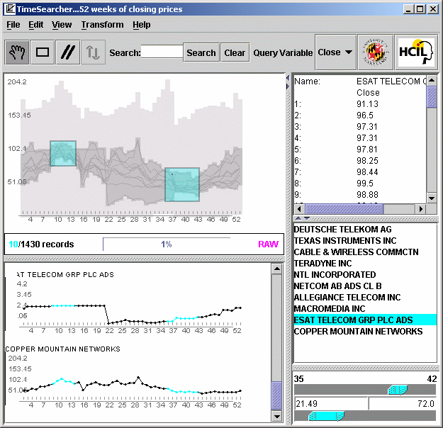
Temporal Data: TimeSearcher 1.3
Time series
Stocks
Weather
Genes
User-specified patterns
Rapid search

Slide 22
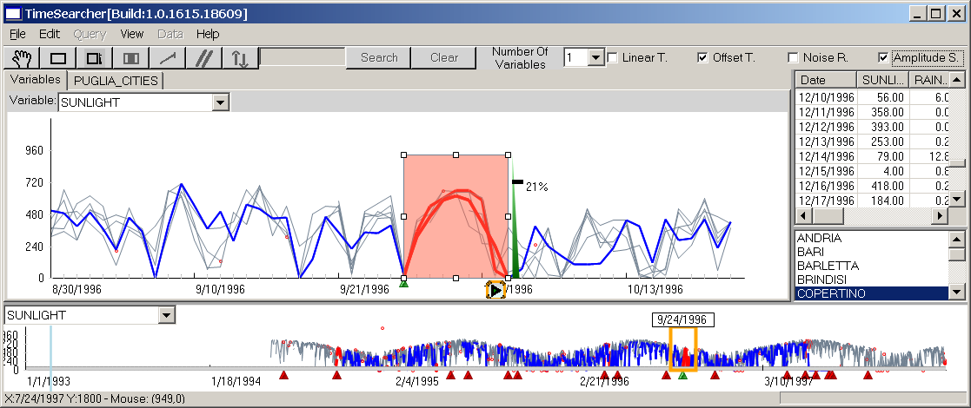
Temporal Data: TimeSearcher 2.0
Long Time series (>10,000 time points)
Multiple variables
Controlled precision in match (Linear, offset, noise, amplitude)

Slide 23
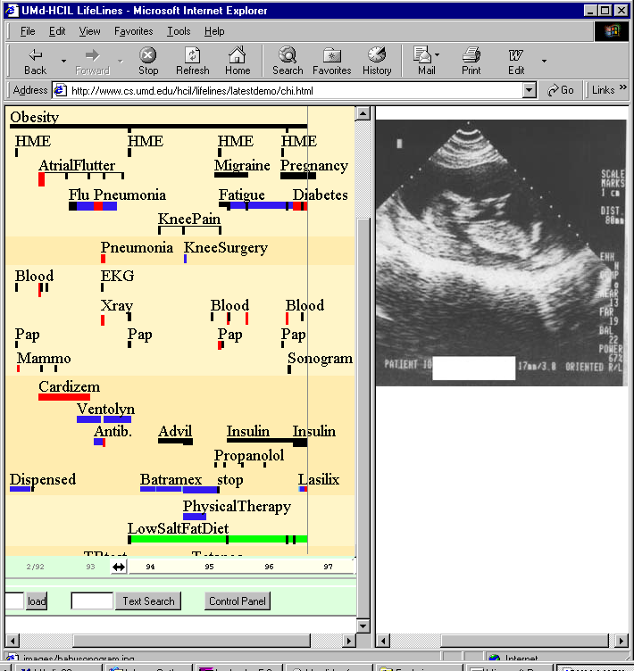
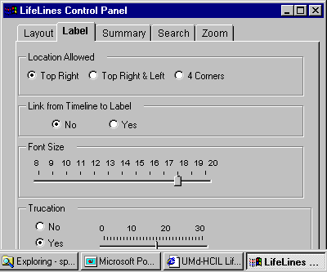
LifeLines: Patient Histories
www.cs.umd.edu/hcil/lifelines

Slide 24
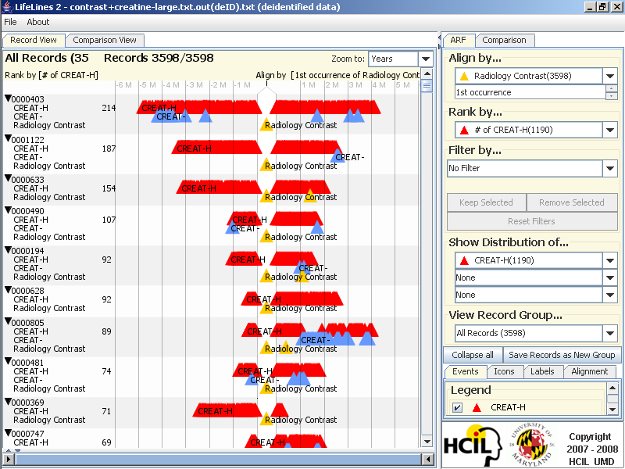
LifeLines2: Contrast+Creatine
Notes:
Contrast and Creatinine dataset
In some diagnostic radiology procedures, patients are injected contrast material. However, some patients develop adverse side
effects to the contrast material. One serious side effect is renal failure, which is detected by high creatinine levels in a patient's blood.
This adverse effect usually occur within two weeks after the radiology contrast. WHC is interested in finding the proportion
of patients who exhibit this condition in historical records.
Screenshots
1-aligned-ranked.png:
We align by the 1st occurrence of radiology contrast and rank by the number of creatinine high (CREAT-H) events to bring
the most severe patients to the top. We realize two things: (1) some patients have more than 1 "Radiology Contrast" events,
and (2), some patients have consistently high creatinine readings (chronic kidney failure).
2-aligned(all)-distribution-selected.png
We align by all occurrences of raiology contrast, and then show the temporal summary of CREAT-H events.
The patients are presented in 4 exclusive sets in the summary: those who have CREAT-H only before alignment, only after
alignment, both before and after, and neither. We then select from the "only after" summary the patients who have
at least one CREAT-H event within 2 weeks of any "Radiology Contrast" event. There are 421 patients.

Slide 25
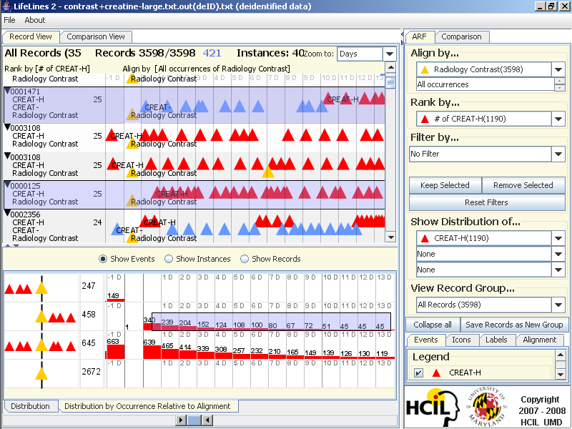
LifeLines2: Align-Rank-Filter & Summarize

Slide 26
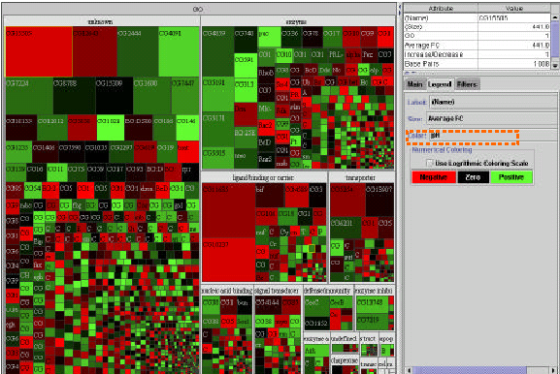
Treemap: Gene Ontology
Space filling
Space limited
Color coding
Size coding
- Requires learning
(Shneiderman, ACM Trans. on Graphics, 1992 & 2003)
www.cs.umd.edu/hcil/treemap/

Slide 27
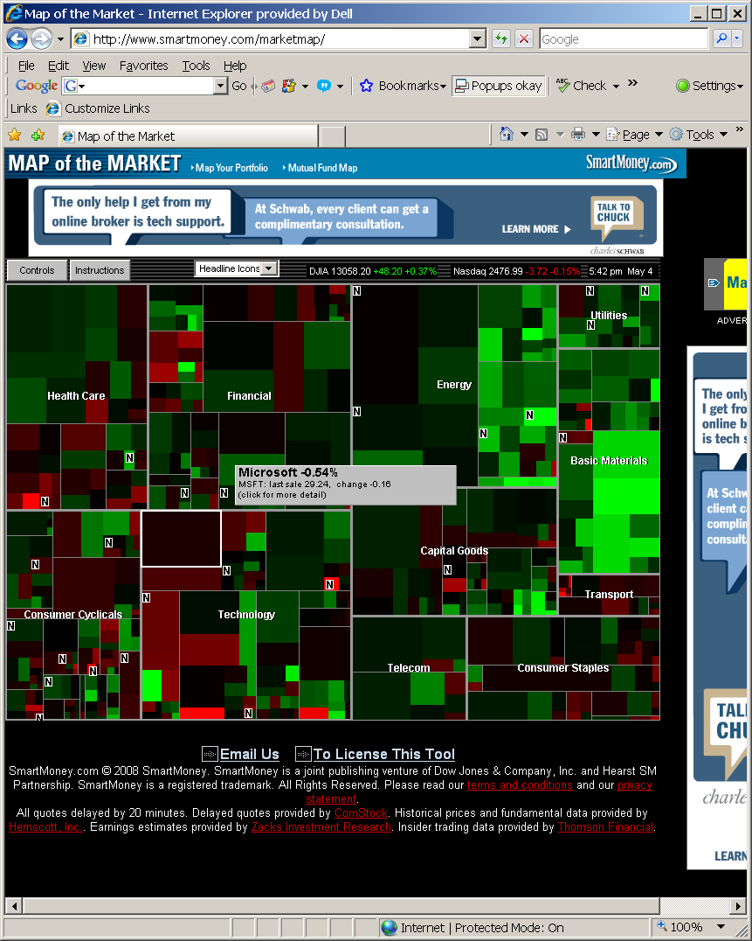
Treemap: Smartmoney MarketMap
www.smartmoney.com/marketmap

Slide 28
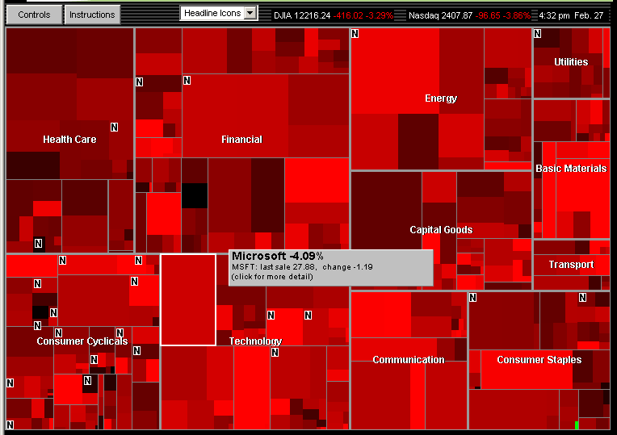
Market falls steeply Feb 27, 2007, with one exception
Notes:
28

Slide 29
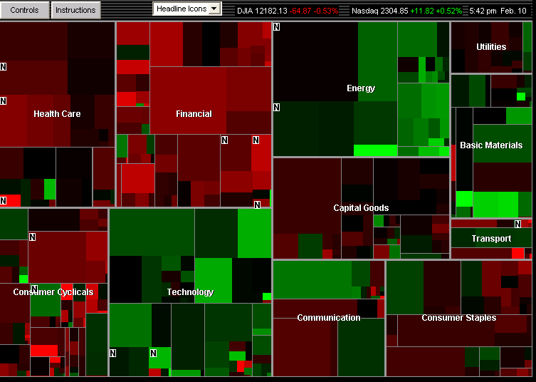
Market mixed, February 8, 2008 Energy & Technology up, Financial & Health Care down
Notes:
29

Slide 30
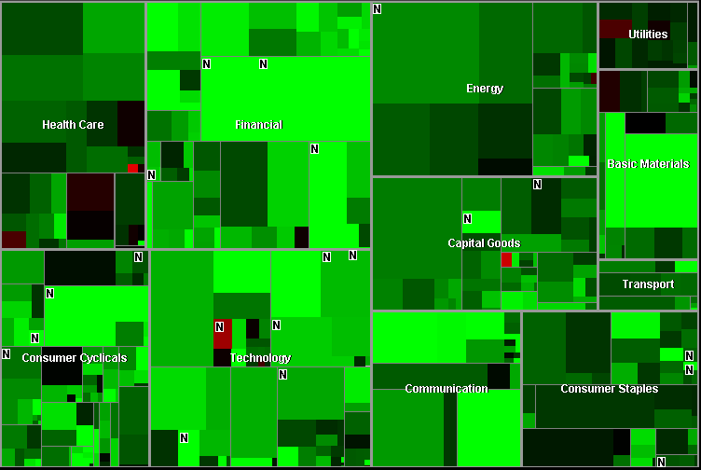
Market rises 319 points, November 13, 2007, with 5 exceptions
Notes:
30

Slide 31
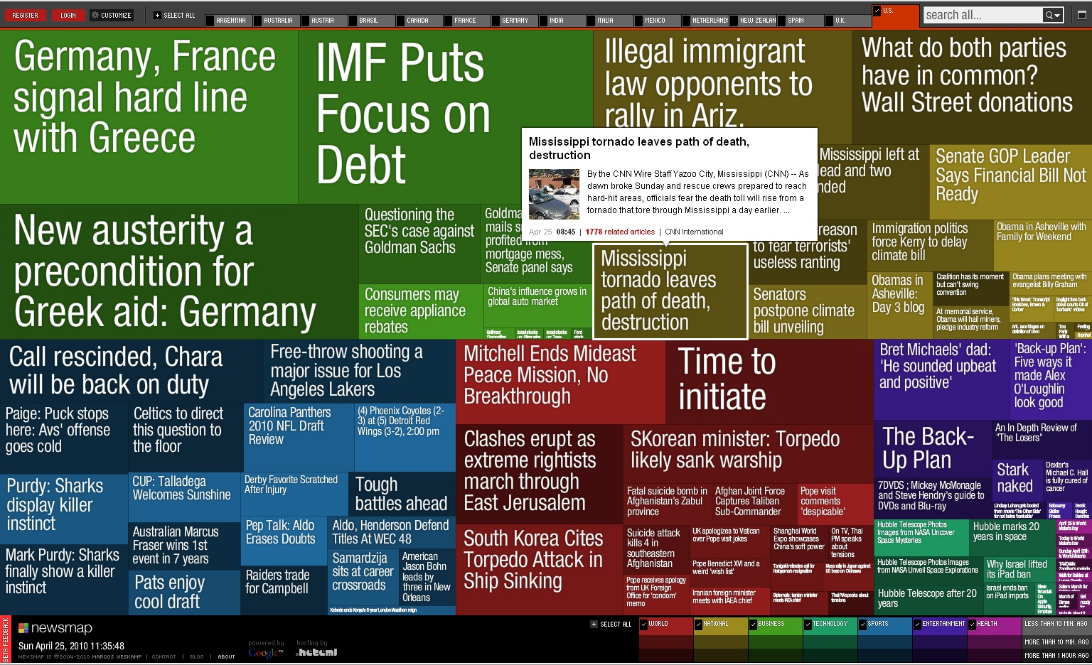
Treemap: Newsmap (Marcos Weskamp)
newsmap.jp

Slide 32
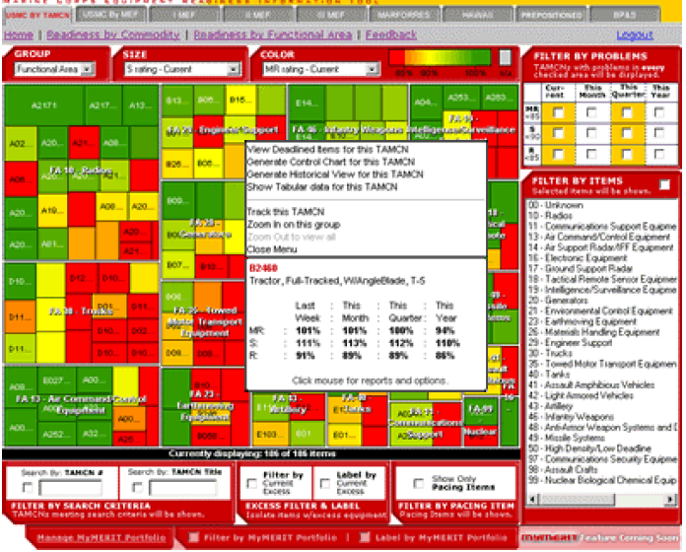
Treemap: Supply Chain
www.hivegroup.com

Slide 33
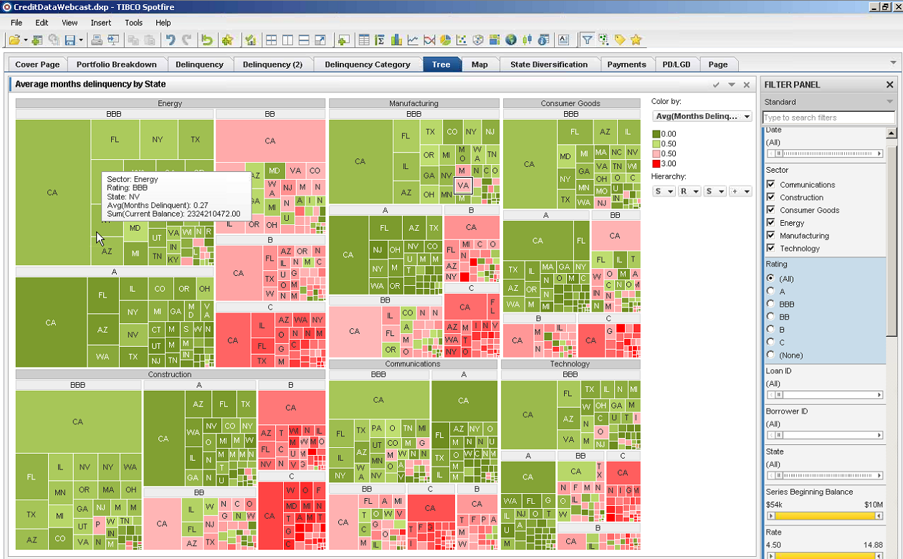
Treemap: Spotfire Bond Portfolio Analysis
www.spotfire.com

Slide 34
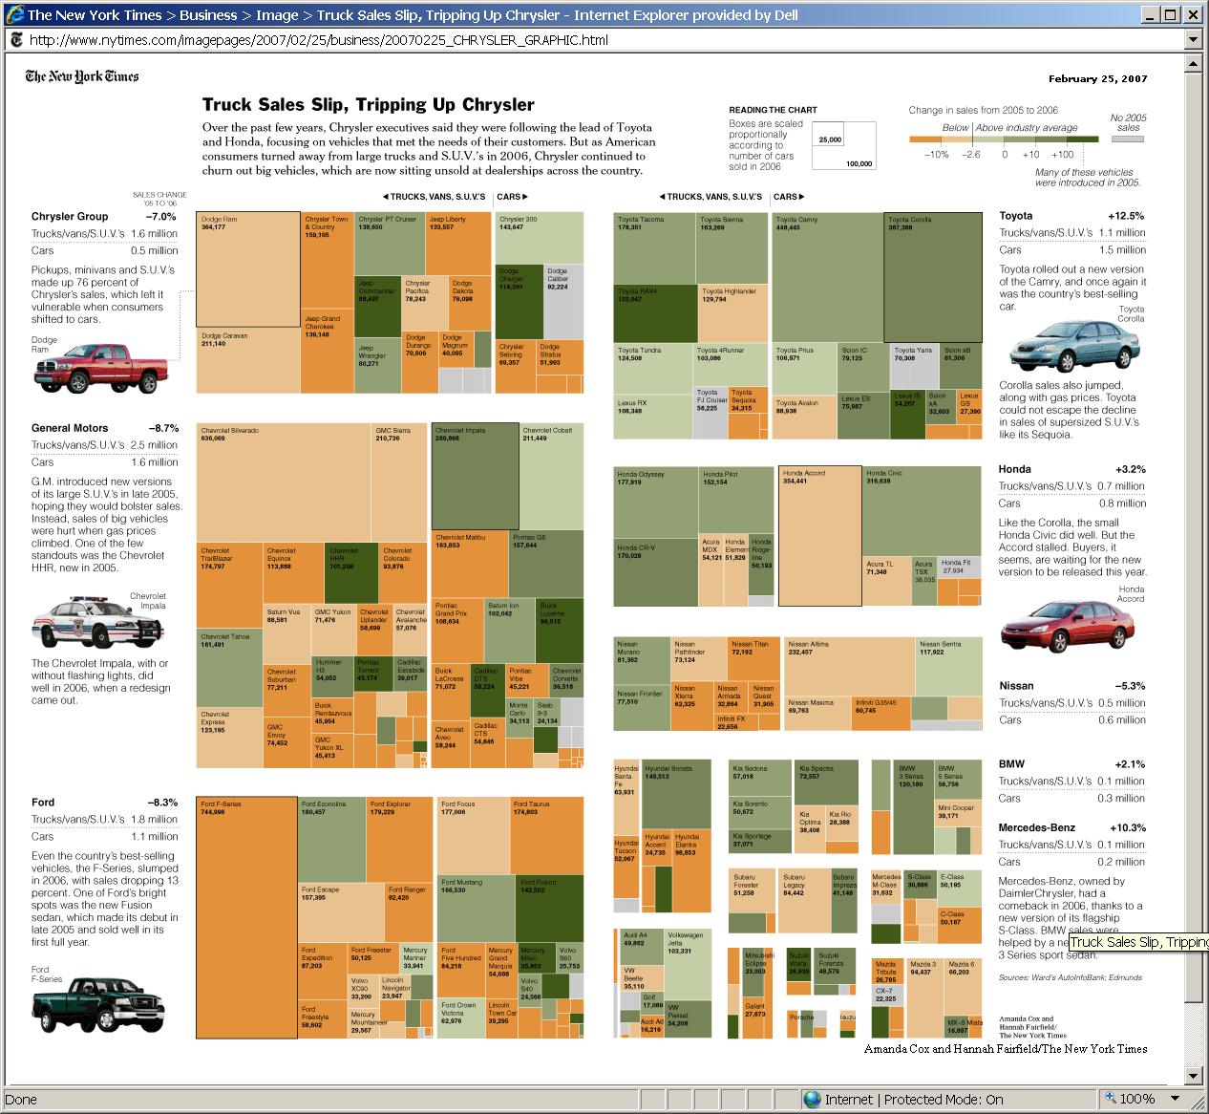
Treemap: NY Times – Car&Truck Sales
www.cs.umd.edu/hcil/treemap/

Slide 35
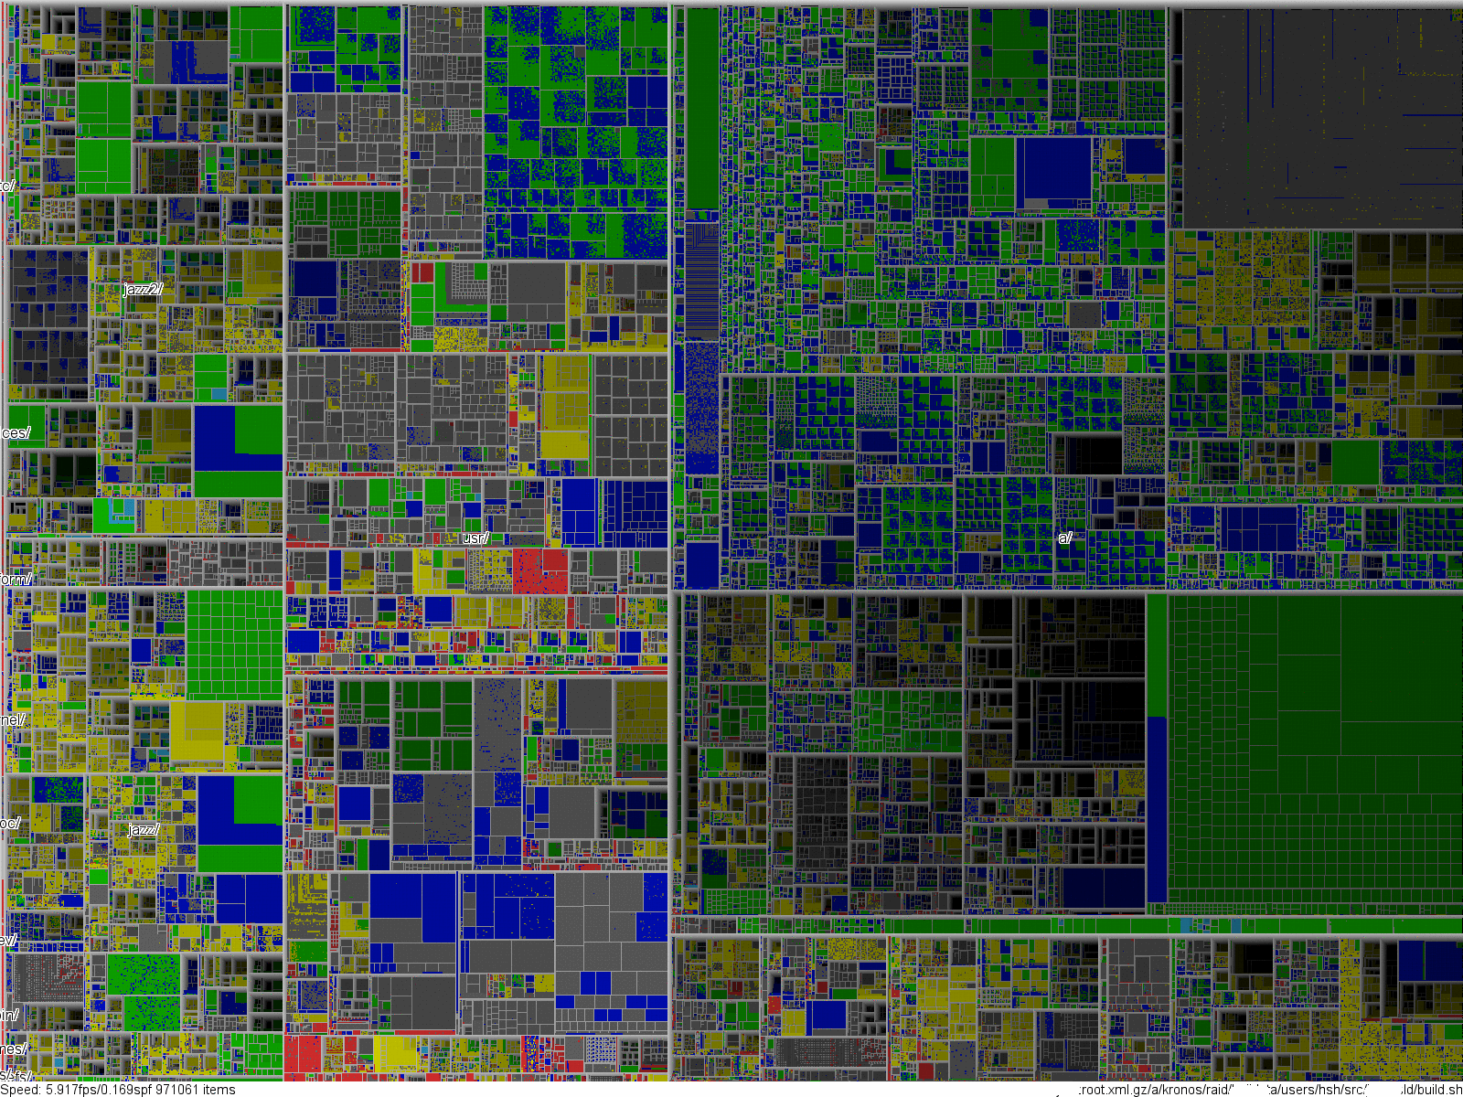
Notes:
Live Demonstration

Slide 36
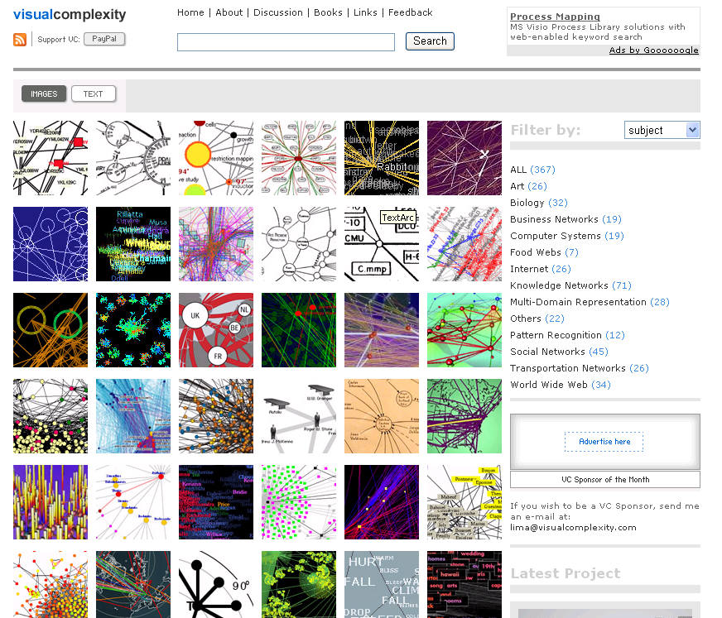
State-of-the-art network visualization

Slide 37
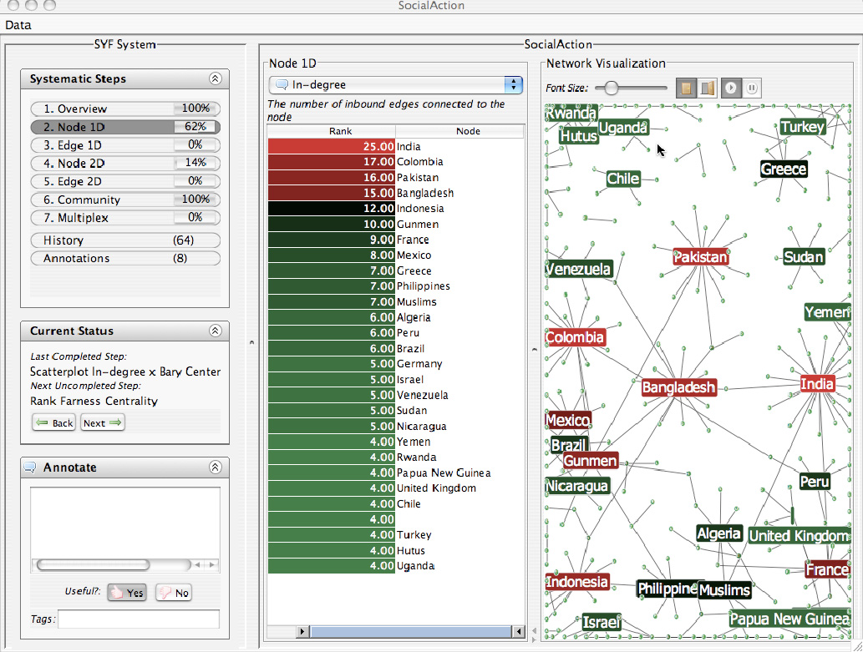
Discovery Process: Systematic Yet Flexible
Preparation
Own the problem & define the schedule
Data cleaning & conditioning
Handle missing & uncertain data
Extract subsets & link to related information

Slide 38
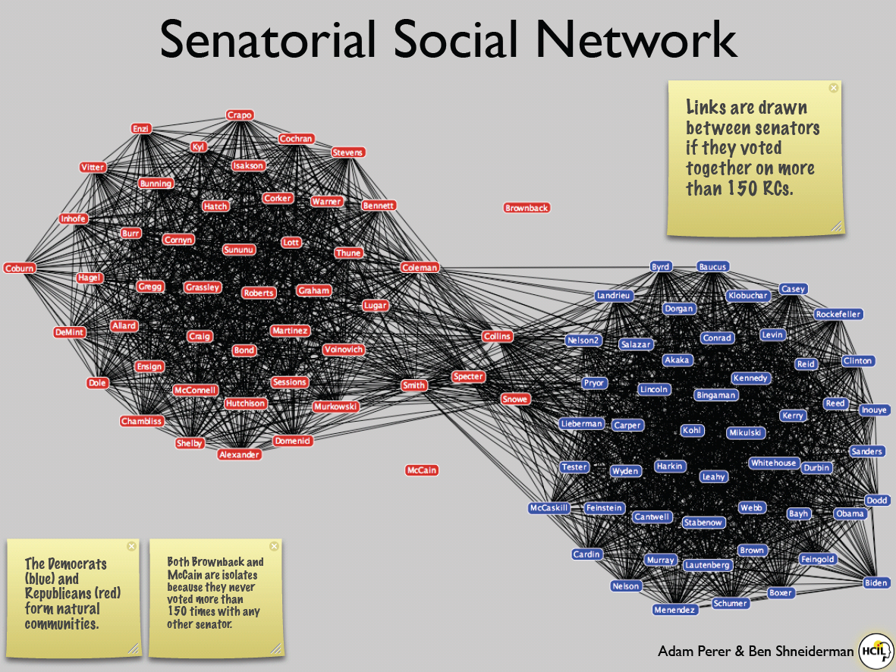
SocialAction
Integrates statistics & visualization
4 case studies, 4-8 weeks (journalist, bibliometrician, terrorist analyst, organizational analyst)
Identified desired features, gave strong positive feedback about benefits of integration
www.cs.umd.edu/hcil/socialaction
Perer & Shneiderman, CHI2008, IEEE CG&A 2009

Slide 39
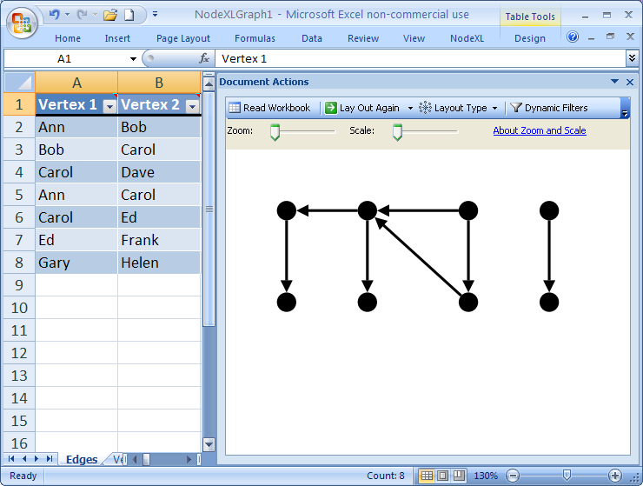
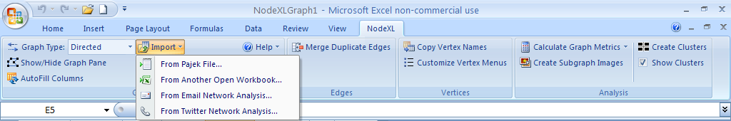
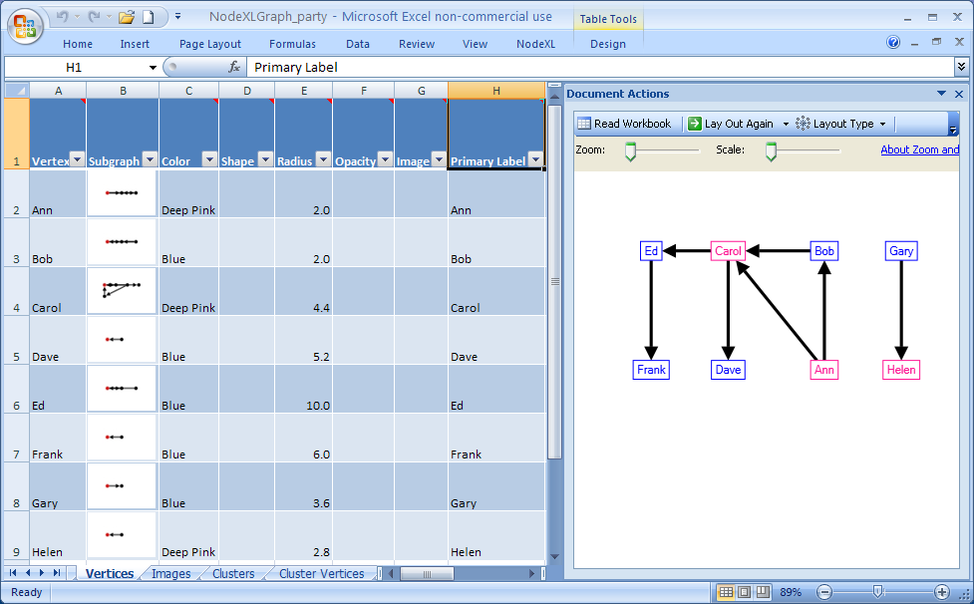
NodeXL: Network Overview for Discovery & Exploration in Excel
www.codeplex.com/nodexl

Slide 40
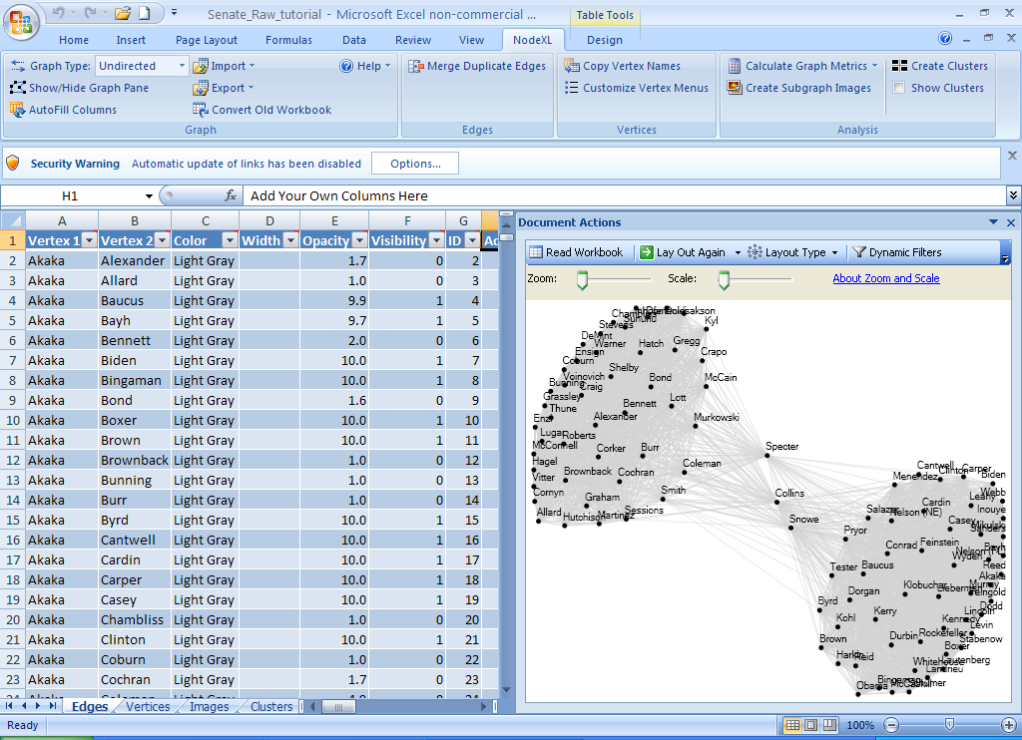
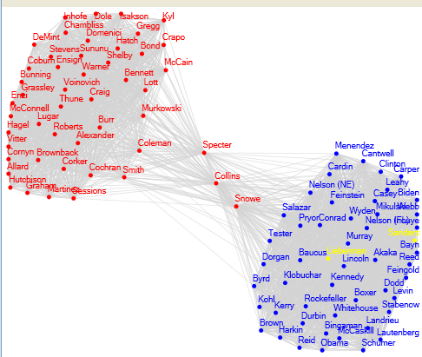
NodeXL: Network Overview for Discovery & Exploration in Excel
www.codeplex.com/nodexl

Slide 41
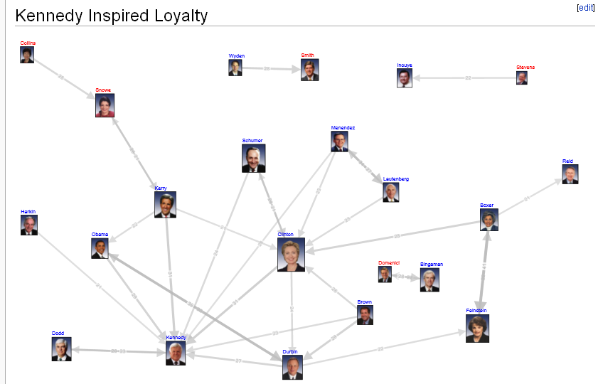
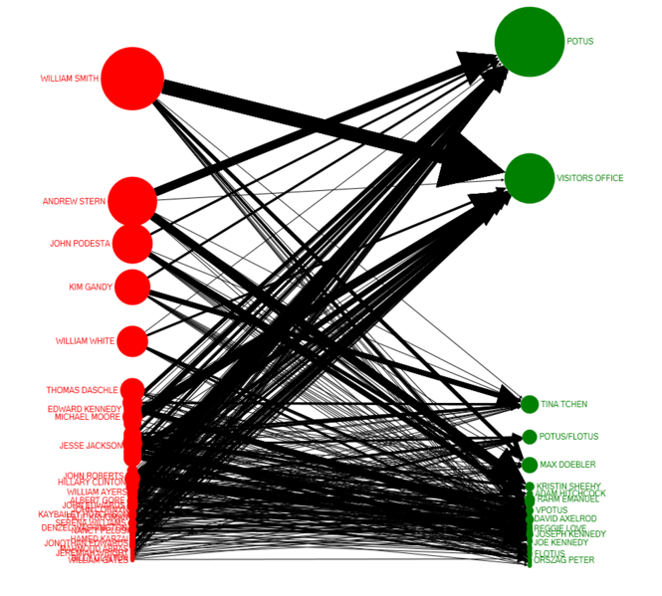
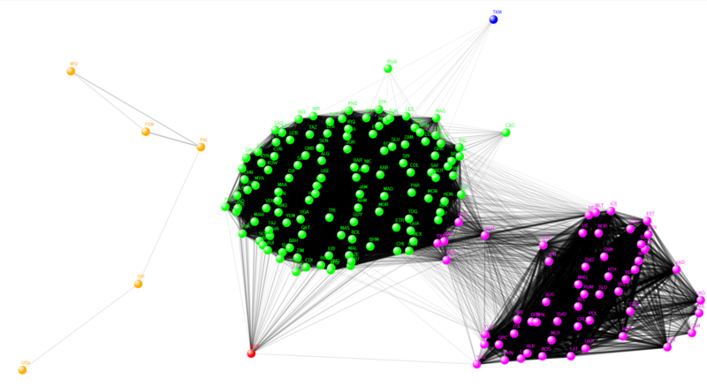
NodeXL: Network Overview for Discovery & Exploration in Excel
https://wiki.cs.umd.edu/cmsc734_09/index.php?title=Homework_Number_3

Slide 42
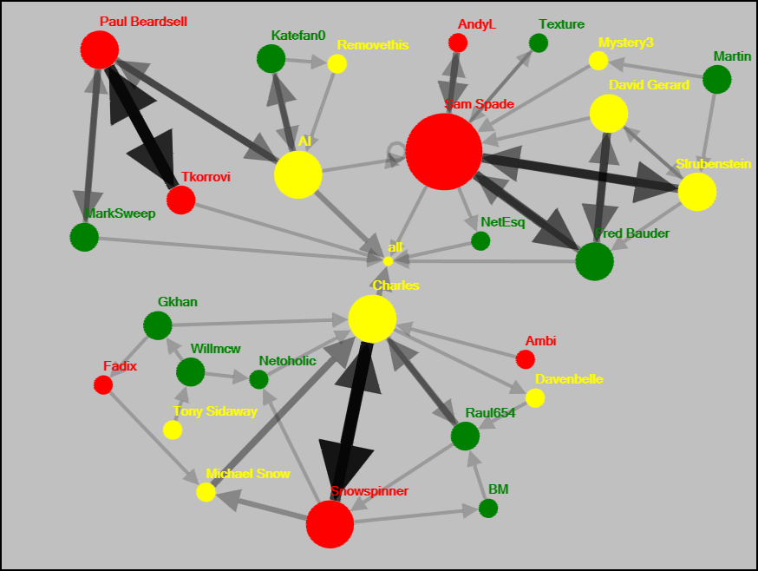
Wikipedia Discussion
Red nodes (most confrontational) are involved in the strongest dyadic ties, and they tend to have the highest out-degree
Notes:
Figure 15.12 This NodeXL network graph depicts user to user talk page connections from a Wikipedia policy article. The graph illustrates one way that styles of contribution are tied to structural attributes. Note that the red nodes (most confrontational) are involved in the strongest dyadic ties, and they tend to have the highest out-degree. In contrast, the most deliberative contributors tend to have fewer partners, and do not necessarily involve themselves in intense dyadic interactions. Observations like these can provide direction for further research that statistically tests the strength of these observer relations. Ultimately, if those measures are robust predictors they could be used in automated systems for identifying more or less collaborative contributors, assessing community health, and deciding where interventions or support might be most helpful
.

Slide 43
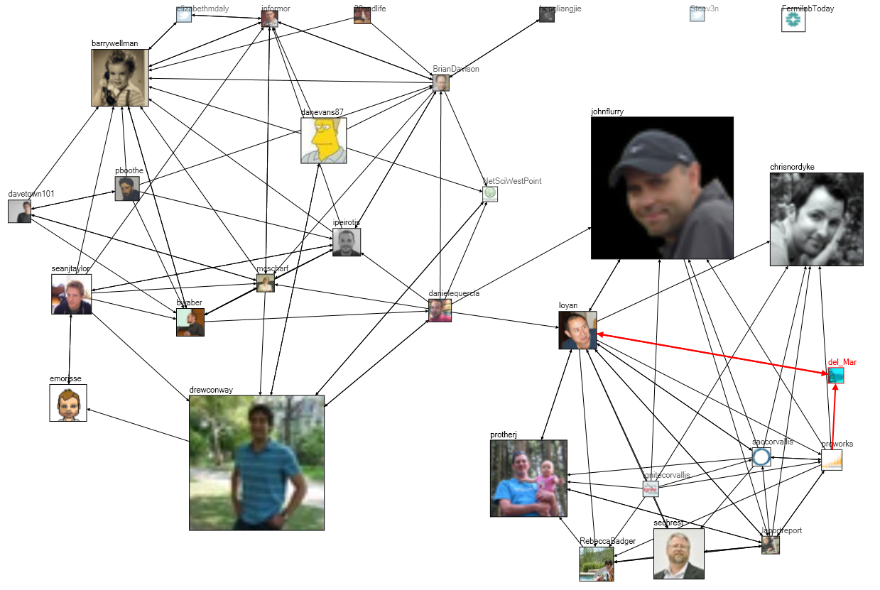
Tweets at #WIN09 Conference: 2 groups
Notes:
Chapter 3, Figure 1 (page 6). A NodeXL social media network diagram of relationships among Twitter users mentioning the hashtag “#WIN09” used by attendees of a conference on Network Science at NYU in September 2009. Each user’s node is sized proportional to the number of tweets they have ever made to that date.

Slide 44
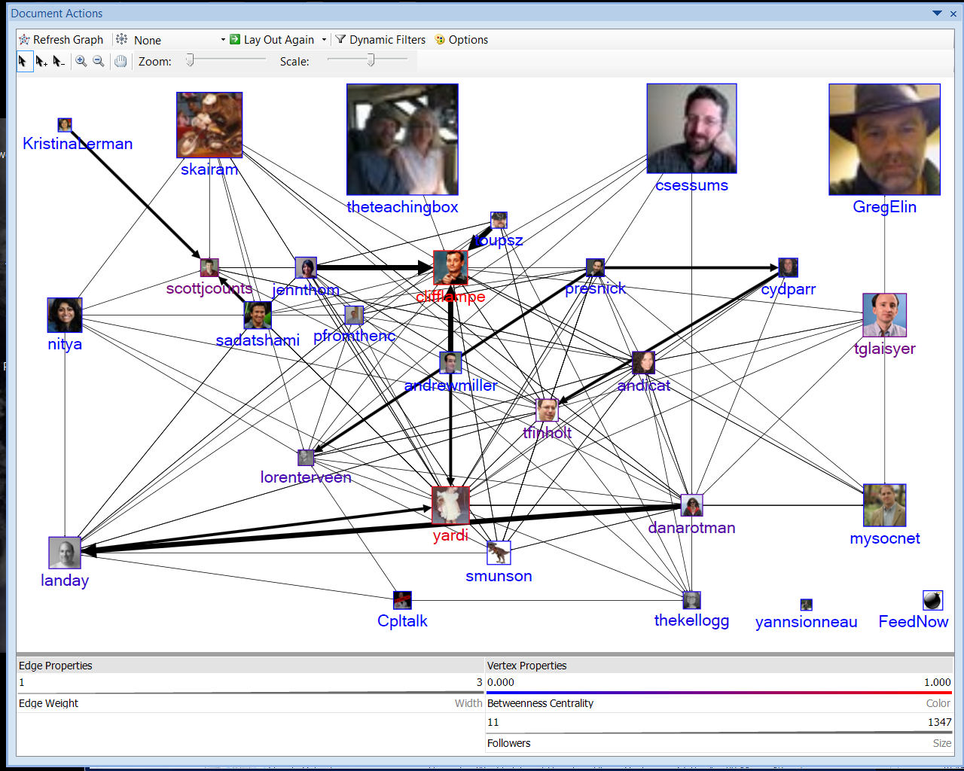
Tweets at #TMSP Workshop
Notes:
Chapter 3, Figure 1 (page 6). A NodeXL social media network diagram of relationships among Twitter users mentioning the hashtag “#WIN09” used by attendees of a conference on Network Science at NYU in September 2009. Each user’s node is sized proportional to the number of tweets they have ever made to that date.

Slide 45
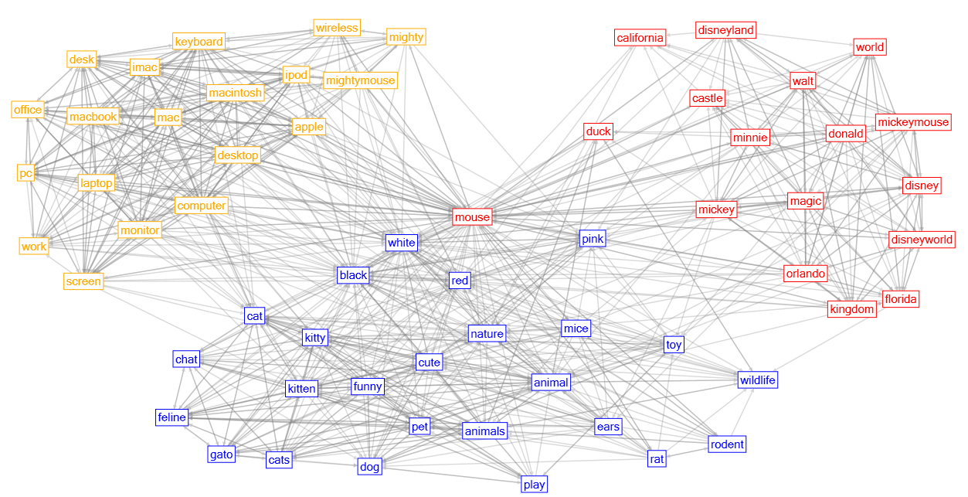
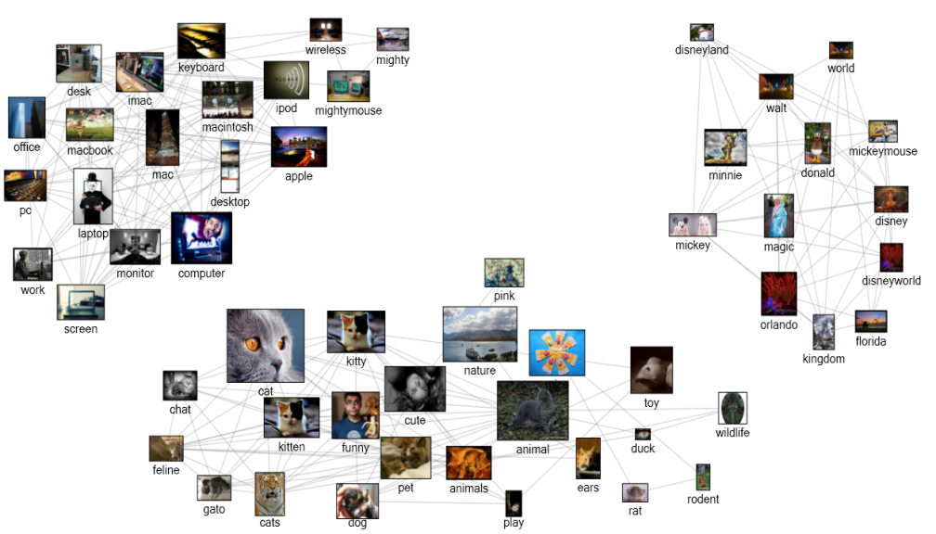
Flickr clusters for “mouse”
Computer Mickey
Animal
Notes:
Figure 13.20. NodeXL cluster visualization showing three Flickr tag clusters, each representing a different context for “mouse”.
Figure 13.21. NodeXL display of Isolated clusters for three different contexts for the “mouse” tag in Flickr: mouse animal, computer mouse, and Mickey Mouse Disney character.

Slide 46

Flickr commenters on Marc Smith’s pix
Notes:
Figure 13.24. NodeXL network of Flickr users who comment on Marc_Smith’s photos (network depth 1.5; edge weight≥4).

Slide 47

NodeXL: Book & Social Media Research Fnd
Social Media Research Foundation
smrfoundation.org
We are a group of researchers who want to create open tools, generate and host open data, and support open scholarship related to social media.
Mapping, measuring and understanding the landscape of social media is our mission. We support tool projects that enable the collection, analysis and visualization of social media data.

Slide 48
Take Away Messages
Visualization supports Discovery
Multi-Var
Temporal
Tree
Network
… and Communication

Slide 49
Three Challenges
Meaningful visual displays of massive data
Interaction: widgets & window coordination
Process models for discovery: Integrate statistics & visualization Support annotation & collaboration Preserve history, undo & macros

Slide 50

UN Millennium Development Goals
To be achieved by 2015
Eradicate extreme poverty and hunger
Achieve universal primary education
Promote gender equality and empower women
Reduce child mortality
Improve maternal health
Combat HIV/AIDS, malaria and other diseases
Ensure environmental sustainability
Develop a global partnership for development

Slide 51

27th Annual Symposium
May 27-28, 2010
www.cs.umd.edu/hcil

Slide 52
For More Information
Visit the HCIL website for 400 papers & info on videos www.cs.umd.edu/hcil
Conferences & resources: www.infovis.org
See Chapter 14 on Info Visualization Shneiderman, B. and Plaisant, C., Designing the User Interface: Strategies for Effective Human-Computer Interaction: Fifth Edition (March 2009) www.awl.com/DTUI
Edited Collections: Card, S., Mackinlay, J., and Shneiderman, B. (1999) Readings in Information Visualization: Using Vision to Think Bederson, B. and Shneiderman, B. (2003) The Craft of Information Visualization: Readings and Reflections

Slide 53
For More Information
Treemaps
HiveGroup: www.hivegroup.com
Smartmoney: www.smartmoney.com/marketmap
HCIL Treemap 4.0: www.cs.umd.edu/hcil/treemap
Spotfire: www.spotfire.com
TimeSearcher: www.cs.umd.edu/hcil/timesearcher
NodeXL: nodexl.codeplex.com
Hierarchical Clustering Explorer: www.cs.umd.edu/hcil/hce
LifeLines2: www.cs.umd.edu/hcil/lifelines2
Similan: www.cs.umd.edu/hcil/similan

Slide 54

Twitter Network
Notes:
Figure 10.5.11: Twitter mentions network for “Black Friday.” @ShopNPartyGirl and her friend/follow relationships are highlighted in red. Greener vertices have more tweets, larger vertices have more followers. @ShopNPartyGirl is represented in the canvas by her Twitter profile image

Slide 55

Discussion Network
Notes:
Fig 9.10: Bi-modal network connecting 3 Ravelry groups (i.e., forums) represented as blue text boxes to contributors represented as circles. Edge width is based on number of posts (with logarithmic mapping). Vertex size is based on number of completed Ravelry projects. Maroon vertices have a blog and solid circles are either Community Moderators or Volunteer Editors.

