Slide 1

Building Safe, Thriving Communities with Credible Content: Design Principles for Web Sites and Social Structures Ben Shneiderman ben@cs.umd.edu @benbendc Founding Director (1983-2000), Human-Computer Interaction Lab Professor, Department of Computer Science Member, Institute for Advanced Computer Studies

Slide 2


Interdisciplinary research community
- Computer Science & Info Studies
- Socio, Psych, Poli Sci & MITH
(www.cs.umd.edu/hcil)

Slide 3
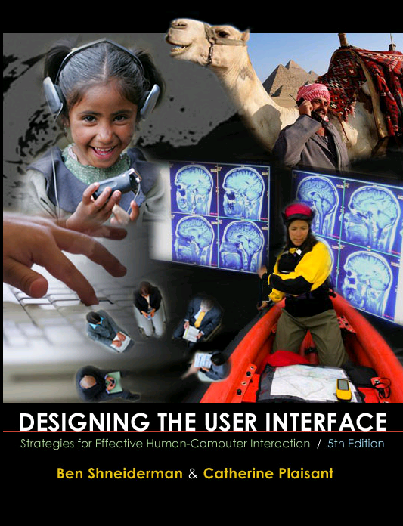
Design Issues
Input devices & strategies
Keyboards, pointing devices, voice
Direct manipulation
Menus, forms, commands
Output devices & formats
Screens, windows, color, sound
Text, tables, graphics
Instructions, messages, help
Collaboration & Social Media
Help, tutorials, training
Search
www.awl.com/DTUI
Fifth Edition: 2010
Visualization

Slide 4
Goal: Next 50 years
Apply social media to transform society
Reduce medical errors, obesity & smoking
Promote resource & biodiversity conservation
Prevent disasters & terrorism
Increase community safety
Improve education
Facilitate good government
Resolve conflicts

Slide 5
Challenges
Malicious attacks
Privacy violations
Not trusted
Fails to be universal
Unreliable when needed
Misuse by
Terrrorists & criminals
Promoters of racial hatred
Political oppressers

Slide 6
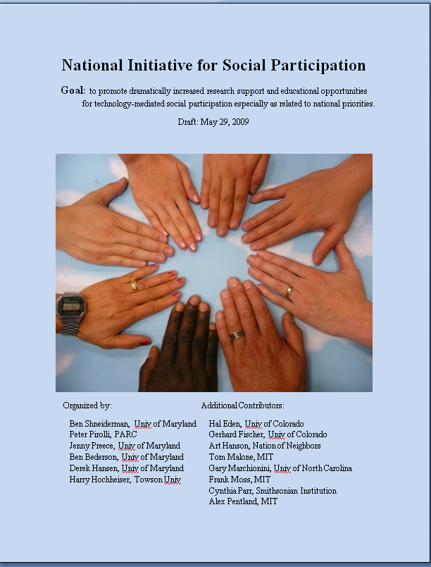
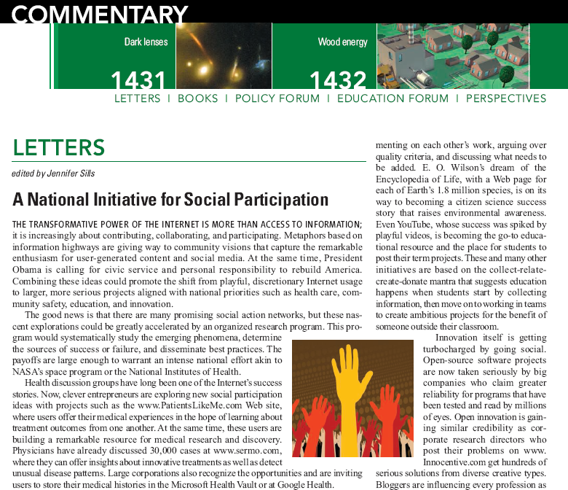
Early Steps
Informal Gathering College Park, MD, April 2009
Article: Science March 2009
BEN SHNEIDERMAN
http://iparticipate.wikispaces.com
Notes:
Todd Beamer – United 93

Slide 7
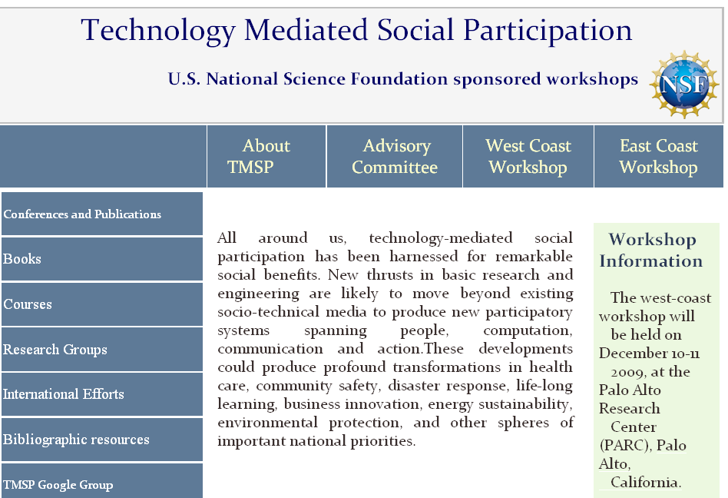
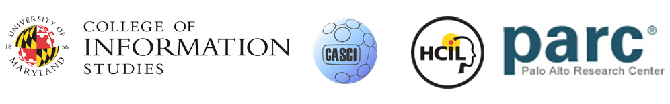
NSF Workshops: Academics, Industry, Gov’t
Jenny Preece (PI), Peter Pirolli & Ben Shneiderman (Co-PIs)
www.tmsp.umd.edu

Slide 8
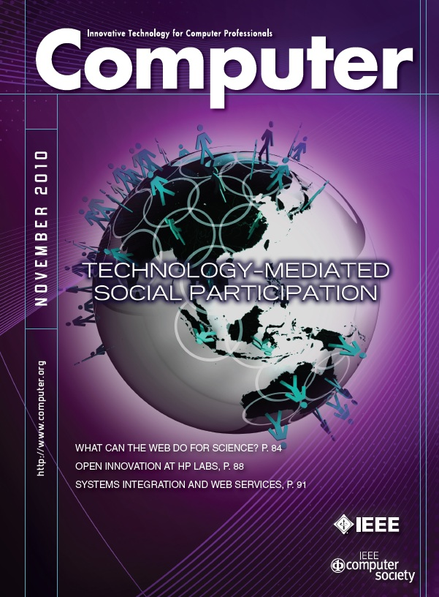
Cyberinfrastructure for Social Action on National Priorities
- Scientific Foundations
- Advancing Design of
Social Participation Systems
- Visions of What is Possible With Sharable Socio-­technical Infrastructure
- Participating in Health 2.0
- Educational Priorities for Technology Mediated Social Participation
- Engaging the Public in Open Government: Social Media Technology and Policy for Government Transparency

Slide 9

President’s Council of Advisors on Science & Technology: Dec 2010
Investment in the “science” of social networking, crowdsourcing, and other emerging paradigms that exploit extreme-scale usage, scalable systems, and clouds & data centers.
Creating a science of social computing: Scientists and technologists don’t yet know how to take the lessons of one success or failure and apply it to another problem. So far, in other words, we have ad hoc solutions without any underlying theory or engineering principles …how to organize the human contributions, how to incentivize them, and so on. …the same underlying technology can be used to solicit data and deliver messaging to many millions of participants about broad health concerns such as diabetes, but could also serve communities of thousands with an interest in much rarer conditions such as ALS (cf. PatientsLikeMe).
http://www.whitehouse.gov/sites/default/files/microsites/ostp/pcast-nitrd-report-2010.pdf
Notes:
9

Slide 10
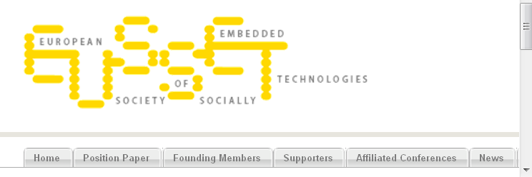
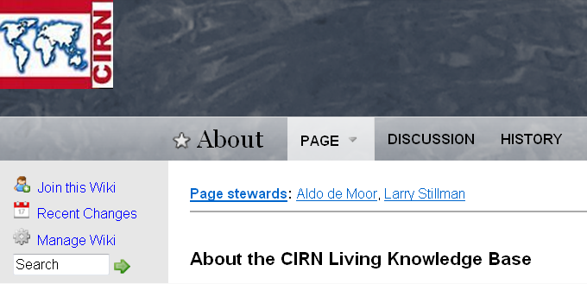
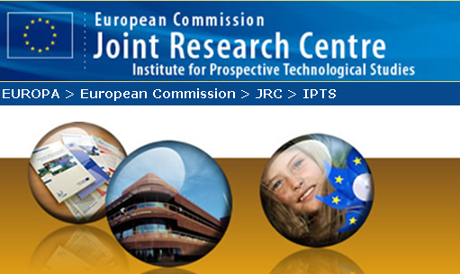
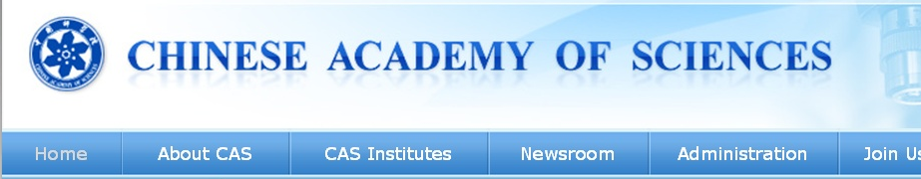
International Efforts
Community Informatics
Research Network
intlsocialparticipation.net

Slide 11
KredibleNet: Terminology
Credible information
Review, comment, post, video
Trusted actors
Source, reviewer, respondent, provider
Reliable, secure resources
Software, device, network
Responsible, accountable organizations
Notes:
Authority, liable, trustworthy, dependable, authoritative

Slide 12
KredibleNet: Terminology
Credible information
Review, comment, post, video
Trusted actors
Source, reviewer, respondent, provider
Reliable, secure resources
Software, device, server, network
Responsible, accountable organizations
Professional society, corporation, government agency
Notes:
Authority, liable, trustworthy, dependable, authoritative

Slide 13
KredibleNet: Terminology
Trusted contributors
Sources, reviewers, respondents, providers
Credible content
Reviews, comments, posts, videos
Reliable resources
Software, devices, servers, networks
Responsible organizations
Professional societies, corporations, government agencies
Notes:
Authority, liable, trustworthy, dependable, authoritative

Slide 14
KredibleNet: Dangers
Incorrect, misleading, mistaken information
Hostile phrasing, partial truths, incomplete information
Deceptive, malicious, destructive actors
Criminals, terrorists, hate-mongers, propagandists
Spammers, hackers, promoters, political oppressors
Inaccessible, malfunctioning, vulnerable resources
Software, device, network failures
Not universally usable
Sham organizations
Illegitimate groups, political operatives, commercial shells

Slide 15
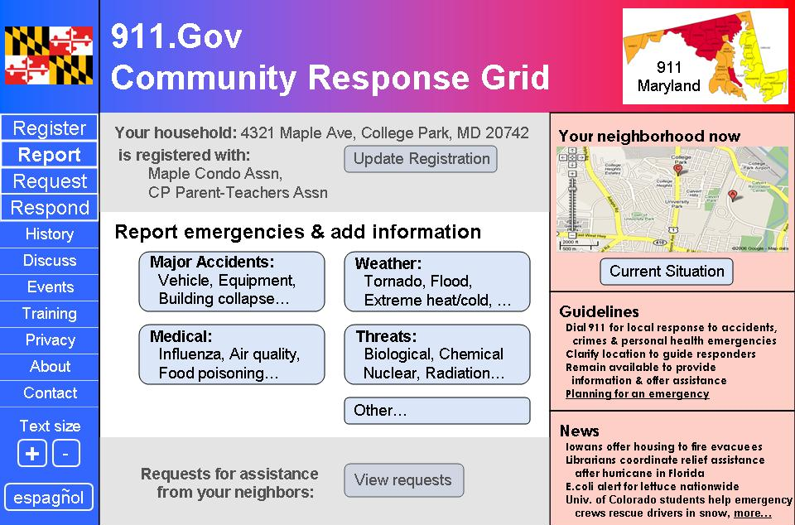
911.gov: Internet & mobile devices
Residents report information
Professionals disseminate instructions
Resident-to-Resident assistance
Professionals in control while working with empowered residents
Shneiderman & Preece, Science (Feb. 16, 2007)
www.cs.umd.edu/hcil/911gov

Slide 16
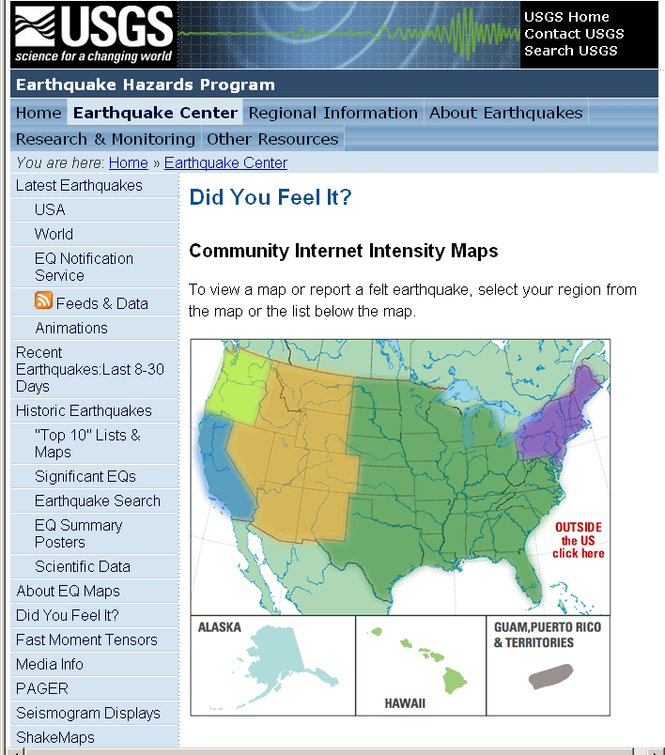
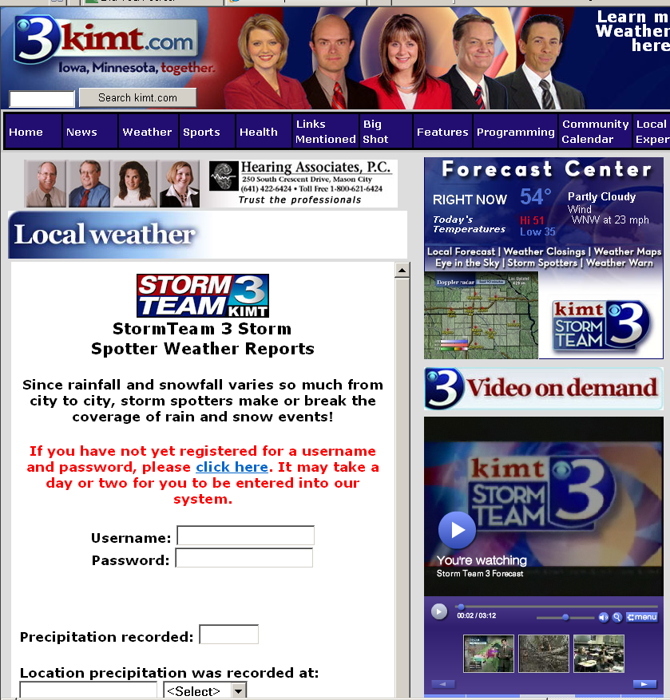
Reporting: Earthquakes & Storms
earthquake.usgs.gov/eqcenter/dyfi
weather.kimt.com

Slide 17
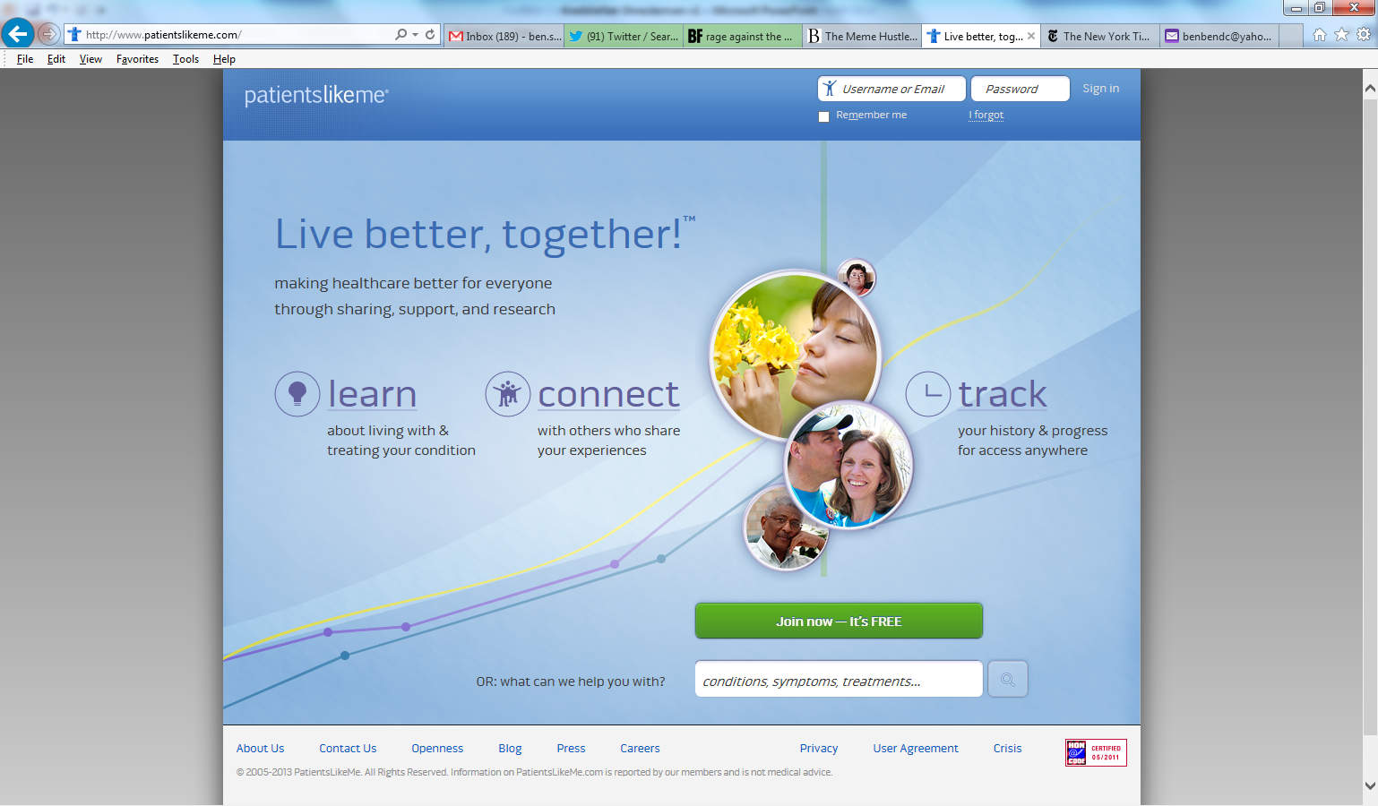
Healthcare & Wellness

Slide 18
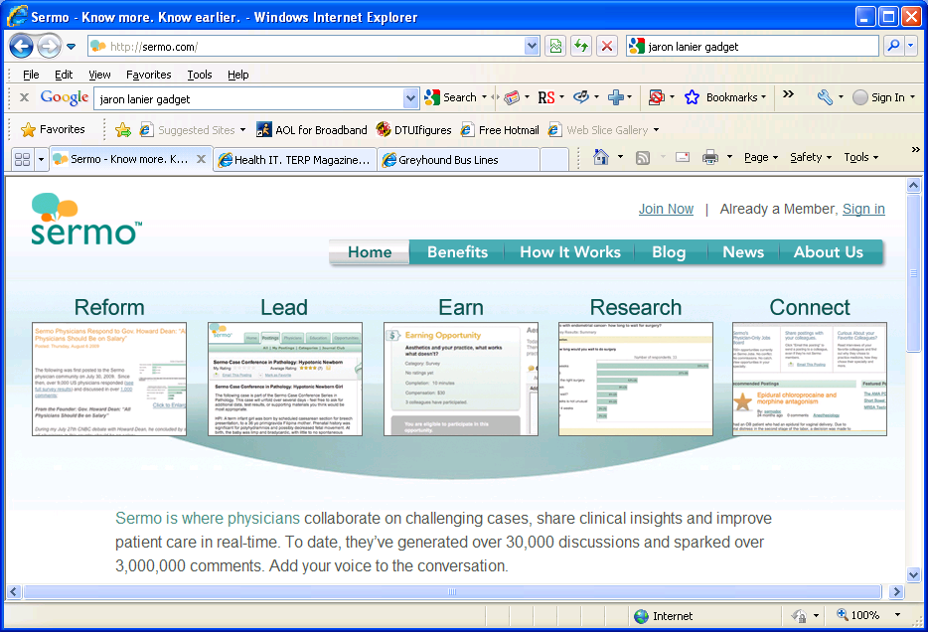
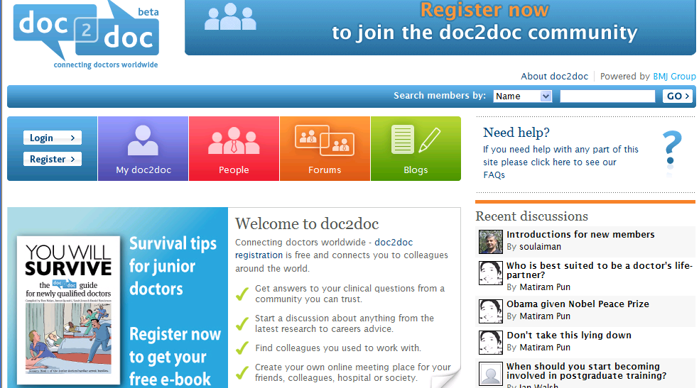
Doctor-to-Doctor Networks

Slide 19
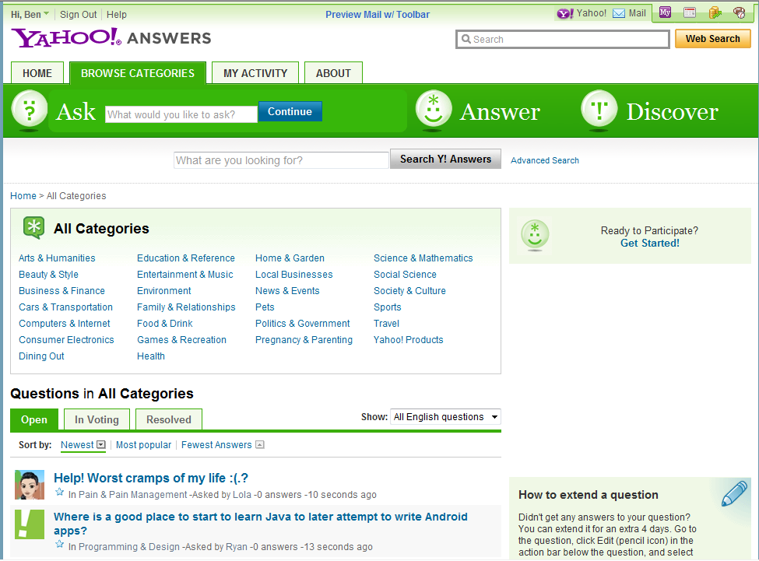
YAHOO! Answers

Slide 20
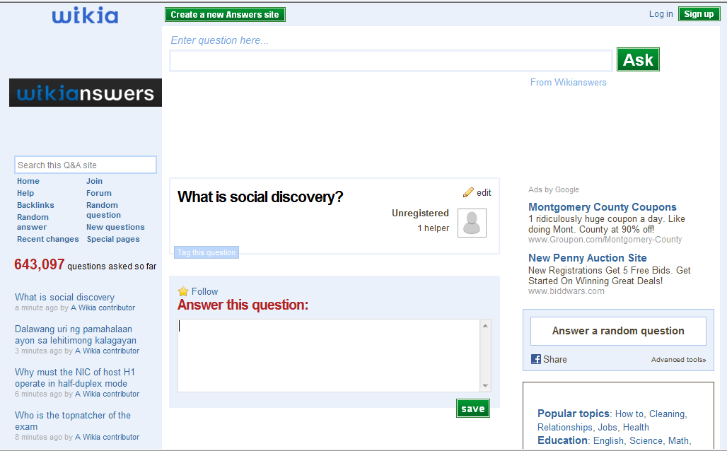
Wikia Answers

Slide 21
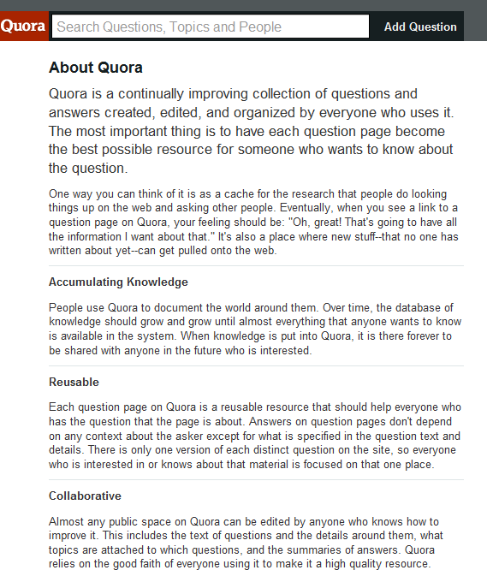
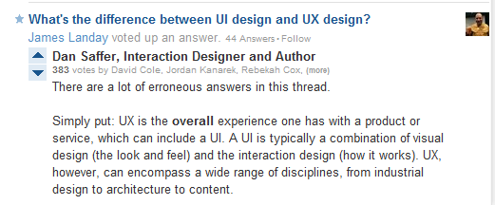
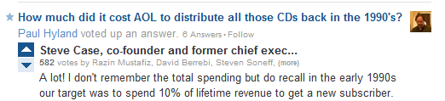
Quora
Search question topics
Read questions
Read answers from named sources
Rate & contribute

Slide 22
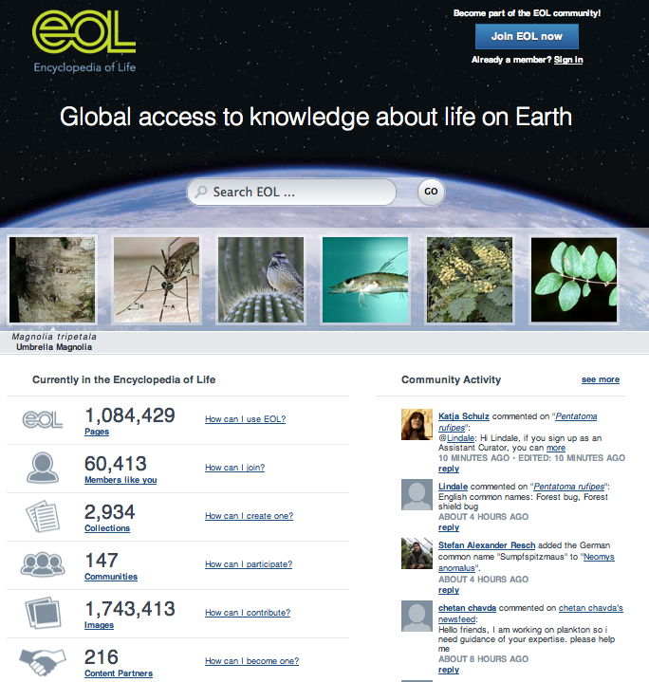
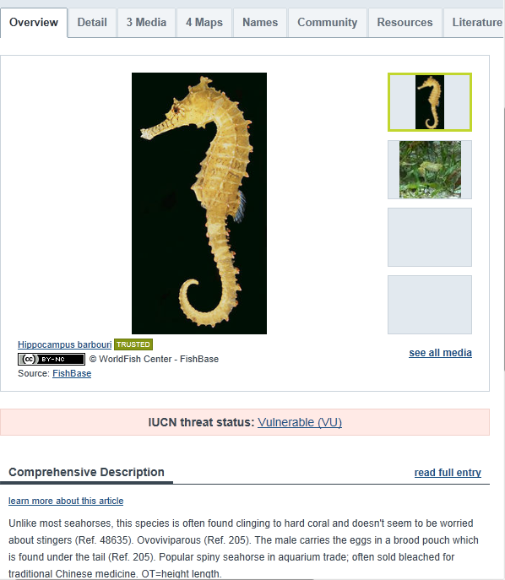
eol.org

Slide 23
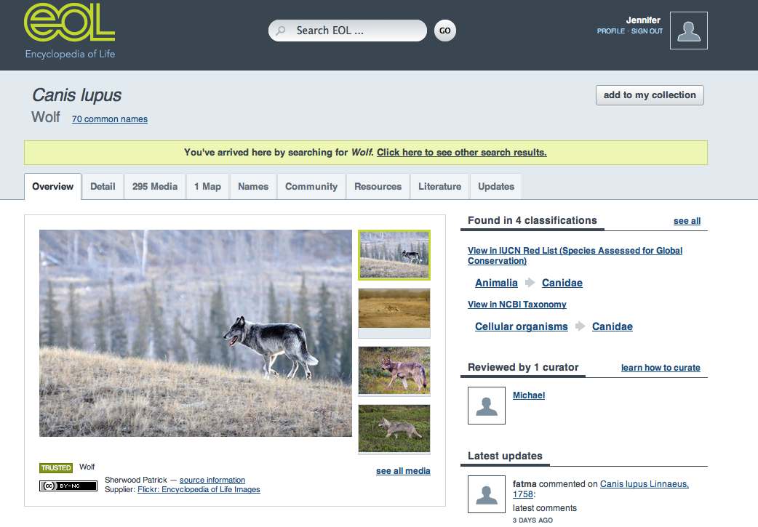

Slide 24
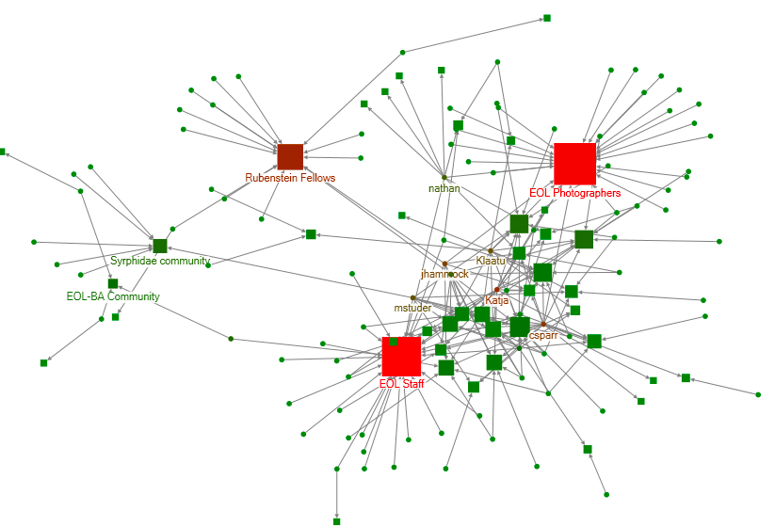

Soc network analysis EOL participation
Notes:
Community-user network. Squares are communities and circles are users. The size corresponds to degree and the color corresponds to betweenness centrality (red means higher centrality).. We can find some important communities here (bigger squares?) and the users. Some of them overlap with the next one, such as Cyndy, Jen, Katja, nathan, etc.

Slide 25
Network Theories: Evolution models
Random, preferential attachment,…
Monotonic, bursty,…
Power law for degree (hubs & indexes)
Small-world property
Forest fire, spreading activation,…
Matures, decays, fragments, …
Watts & Strogatz, Nature 1998; Barabasi, Science 1999, 2009;
Newman, Phys. Rev. Letters 2002
Kumar, Novak & Tomkins, KDD2006
Leskovec, Faloutsos & Kleinberg, TKDD2007

Slide 26
Network Theories: Social science
Relationships & roles
Strong & weak ties
Motivations: egoism, altruism, collectivism, principlism
Collective intelligence
Collective action & governance
Social information foraging
Moreno, 1938; Granovetter, 1971; Burt, 1987; Ostrom, 1992;
Wellman, 1993; Batson, Ahmad & Tseng, 2002;
Malone, Laubaucher & Dellarocas, 2009; Pirolli, 2009

Slide 27
Network Theories: Stages of participation
Wikipedia, Discussion & Reporting
Reader
First-time Contributor (Legitimate Peripheral Participation)
Returning Contributor
Frequent Contributor
Preece, Nonnecke & Andrews, CHB2004
Forte & Bruckman, SIGGROUP2005; Hanson, 2008
Porter: Designing for the Social Web, 2008
Vassileva, 2002, 2005; Ling et al., JCMC 2005; Rashid et al., CHI2006
Notes:
five stages of emotional response: (1) denial, (2) bargaining, (3) anger, (4) despair, (5) acceptance. ...

Slide 28
From Reader to Leader: Motivating Technology-Mediated Social Participation
All
Users
Reader
Contributor
Collaborator
Leader
`
Preece & Shneiderman, AIS Trans. Human-Computer Interaction1 (1), 2009
aisel.aisnet.org/thci/vol1/iss1/5/

Slide 29
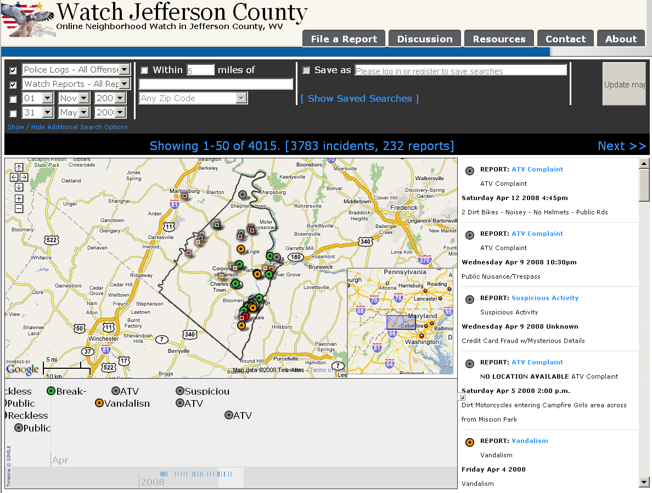
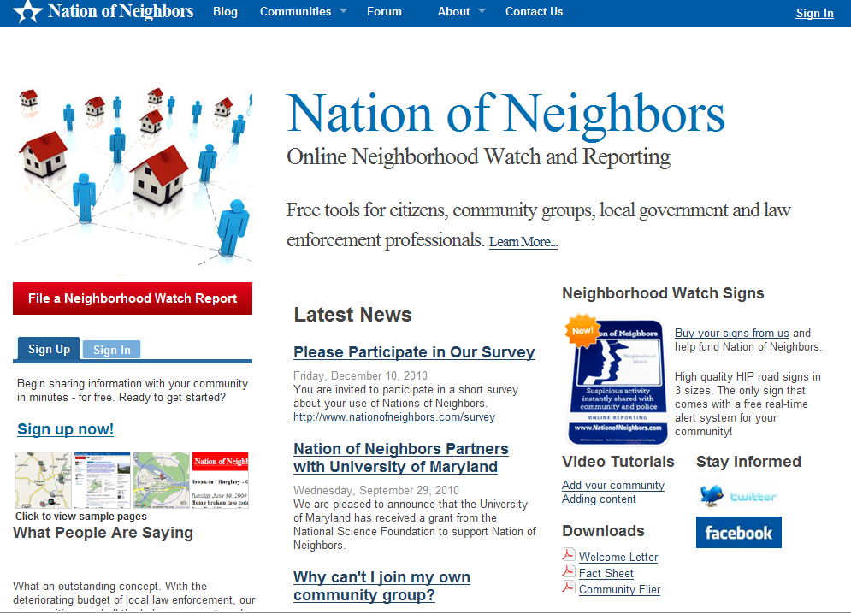
Reporting: Local incidents
watchjeffersoncounty.net → nationofneighbors.net

Slide 30
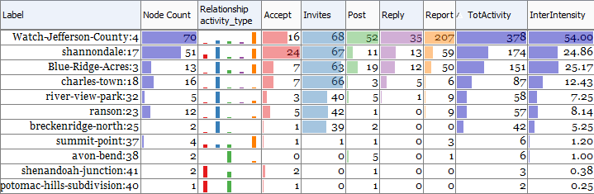
Leaders Determine Success in Nation of Neighbors
No of Leaders | Member growth per month
0 | 0.6
1 | 2.7
2 | 5.5
PJ Rey & Awalin Sopan, 2012, NSF SoCS Project
www.cs.umd.edu/hcil/manynets

Slide 31
Motivating Readers
Usability | Sociability
Interesting & relevant content presented in attractive, well-organized layouts | Encouragement by friends, family, respected authorities, advertising
Frequently updated content with highlighting to encourage return visits | Repeated visibility in online, print, television, other media
Support for newcomers: tutorials, animated demos, FAQs, help, mentors, contacts | Understandable norms & policies
Clear navigation paths → sense of mastery and control | Sense of belonging: recognition of familiar people & activities
Universal usability: novice/expert, small/large display, slow/fast network, multilingual, support for users with disabilities | Charismatic leaders with visionary goals
Interface design features to support reading, browsing, searching, sharing | Safety & privacy

Slide 32
Motivating Contributors
Usability | Sociability
Low threshold interfaces to encourage small contributions (no login) | Support for legitimate peripheral participation
High ceiling interfaces that allow large frequent contributions | Chance to build reputation over time while performing satisfying tasks
Visibility for users’ contributions & impact - aggregated over time | Recognition for the highest quality & quantity of contributions
Visibility of ratings & comments | Recognition of a person’s specific expertise
Tools to undo vandalism, limit malicious users, control pornography & libel | Policies & norms for contributions

Slide 33
Motivating Collaborators
Usability | Sociability
Ways to locate relevant & competent individuals to form collaborations | Atmosphere of empathy & trust that promotes belonging to the community & willingness to work within groups to produce something larger
Tools to collaborate: communicate within groups, schedule projects, assign tasks, share work products, request assistance | Altruism: a desire to support the community, desire to give back, willingness to reciprocate
Visible recognition collaborators, e.g. authorship, citations, links, acknowledgements | Ways to develop a reputation for themselves & their collaborators; develop & maintain status within group
Ways to resolve differences (e.g. voting), mediate disputes & deal with unhelpful collaborators | Respect for status within the community

Slide 34
Motivating Leaders
Usability | Sociability
Leaders are given higher visibility & their efforts are highlighted, sometimes with historical narratives, special tributes, or rewards | Leadership is valued and given an honored position & expected to meet expectations
Leaders are given special powers, e.g. to promote agendas, expend resources, or limit malicious users | Respect is offered for helping others & dealing with problems
Mentorship efforts are visibly celebrated, e.g. with comments from mentees | Mentors are cultivated & encouraged

Slide 35
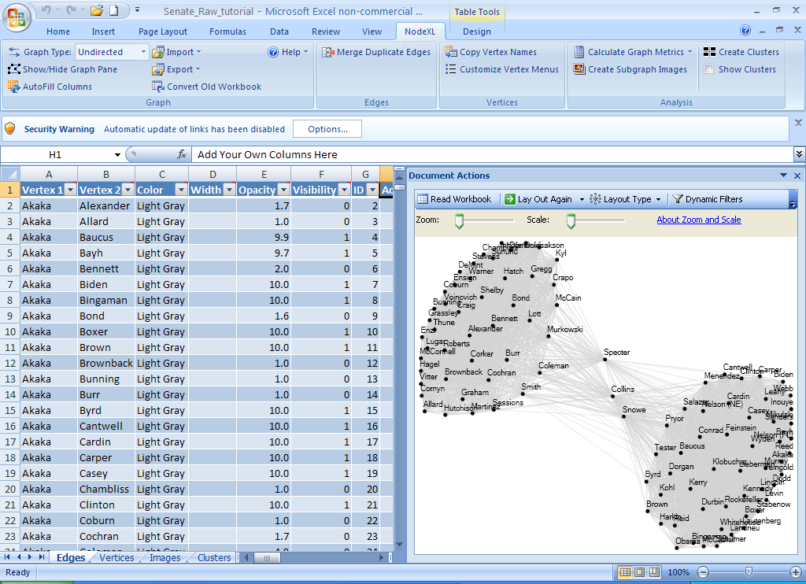
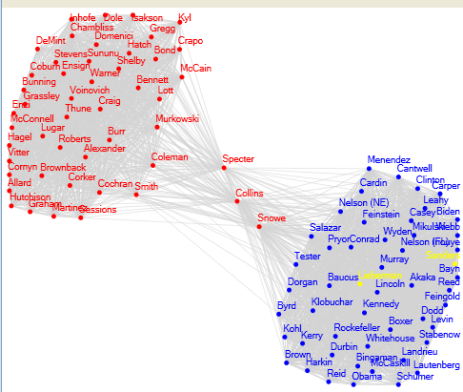
NodeXL: Network Overview for Discovery & Exploration in Excel
www.codeplex.com/nodexl

Slide 36
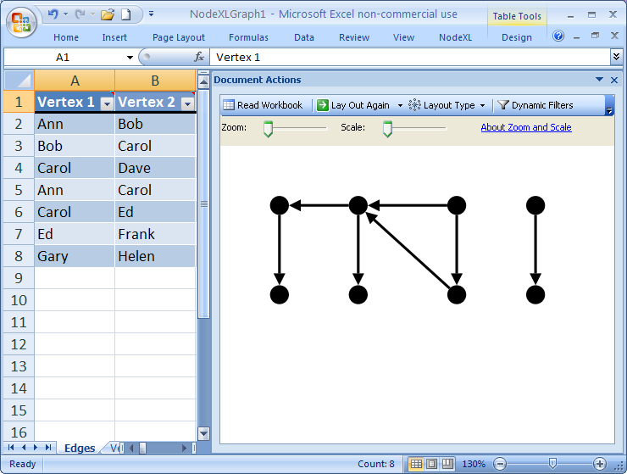
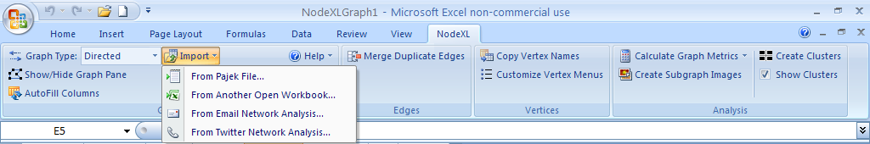
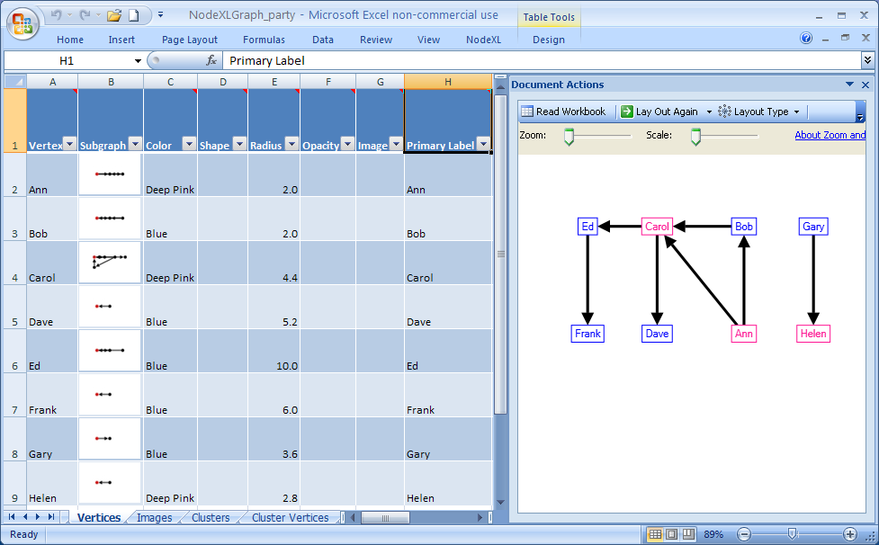
NodeXL: Network Overview for Discovery & Exploration in Excel
www.codeplex.com/nodexl

Slide 37
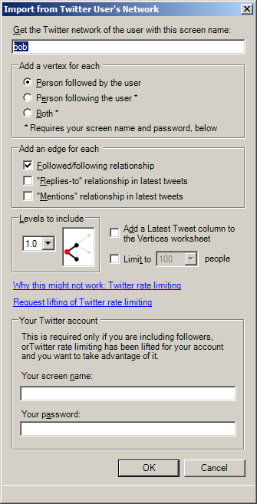
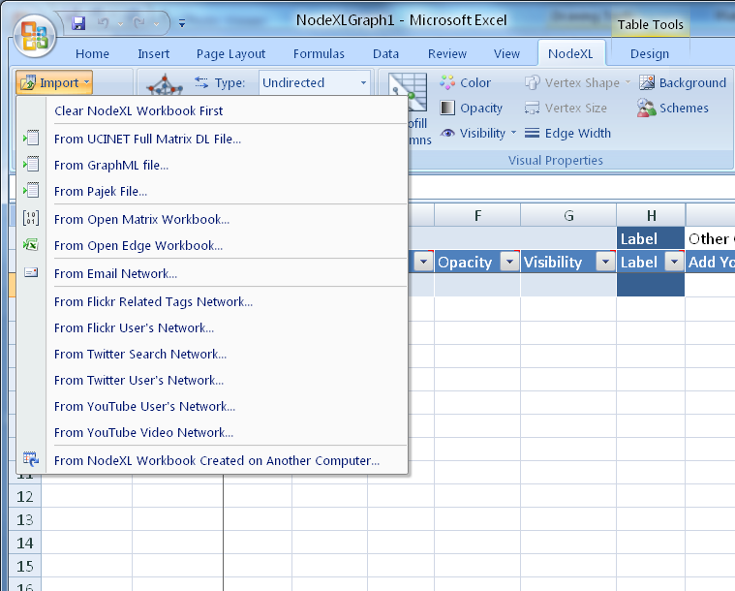
NodeXL: Import Dialogs
www.codeplex.com/nodexl

Slide 38
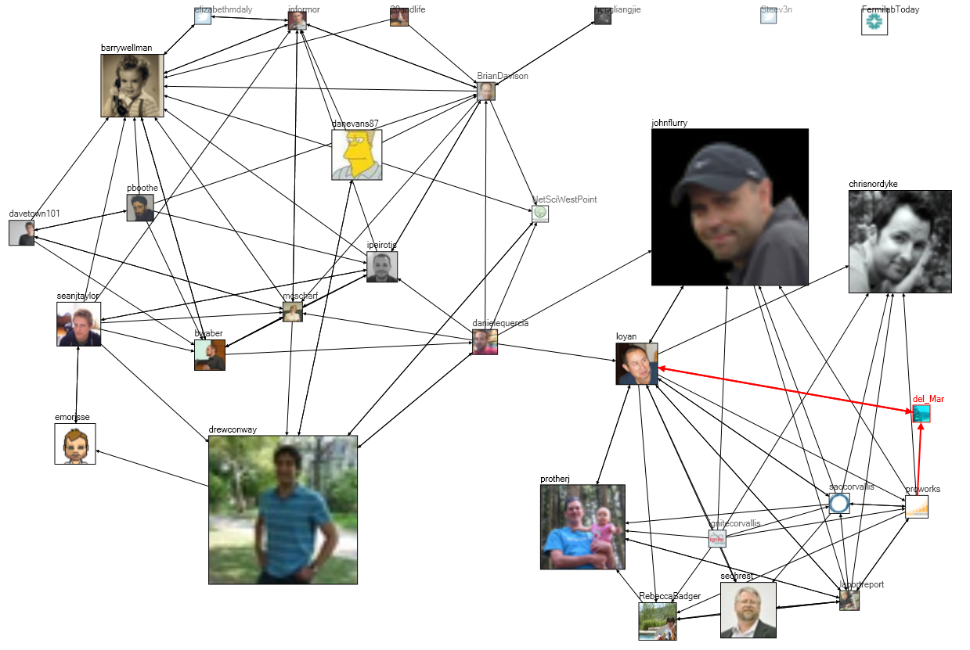
Tweets at #WIN09 Conference: 2 groups
Notes:
Chapter 3, Figure 1 (page 6). A NodeXL social media network diagram of relationships among Twitter users mentioning the hashtag “#WIN09” used by attendees of a conference on Network Science at NYU in September 2009. Each user’s node is sized proportional to the number of tweets they have ever made to that date.

Slide 39
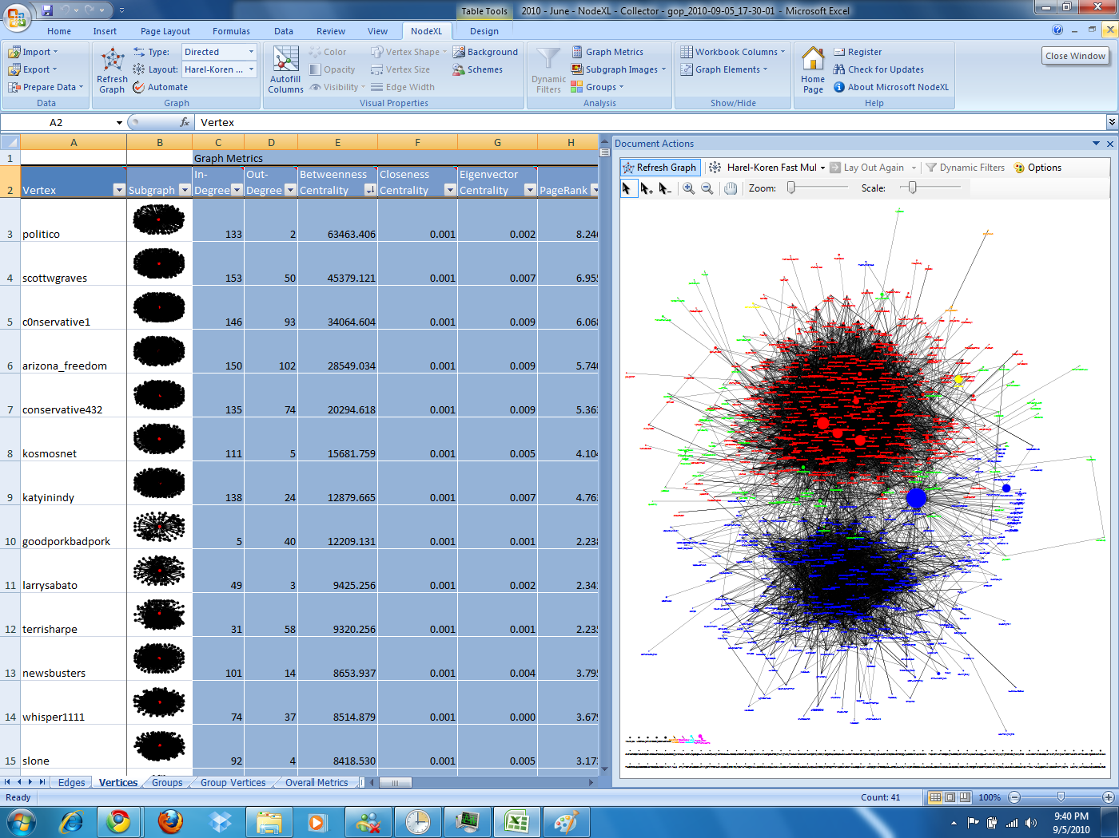
‘GOP’ tweets, clustered (red-Republicans)

Slide 40
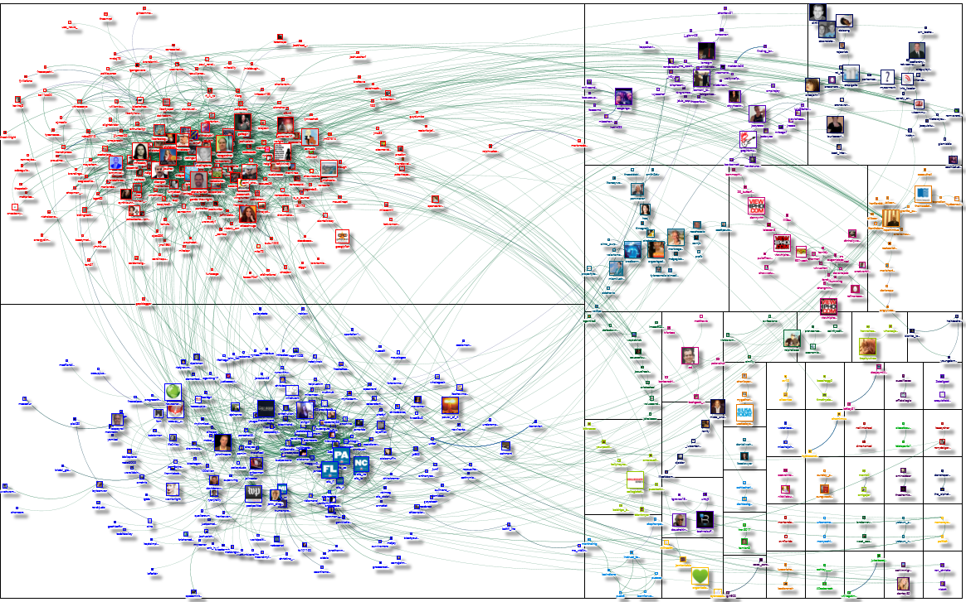
Twitter networks: #SOTU

Slide 41
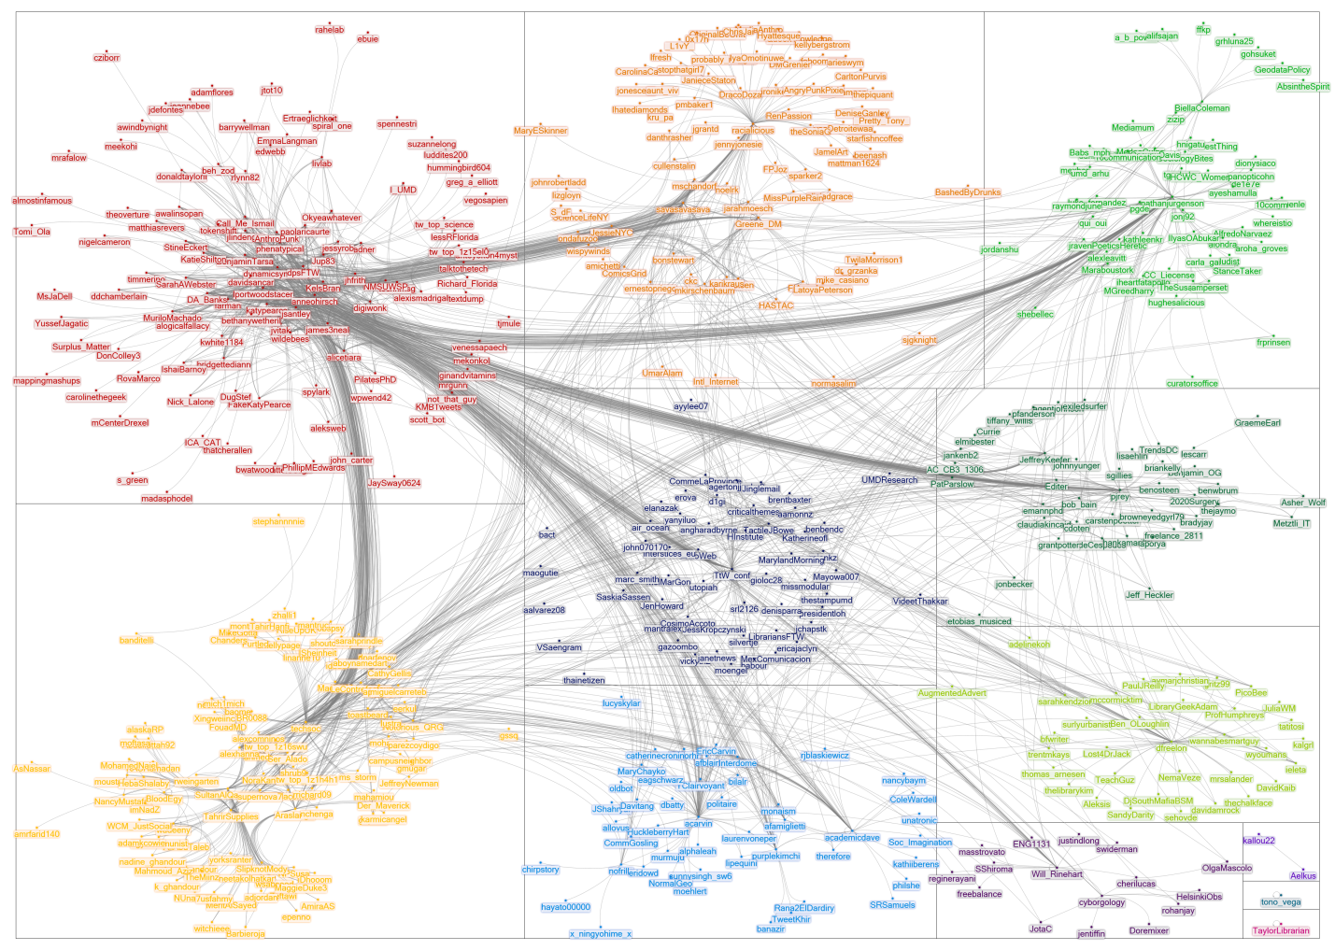
Group-In-A-Box: Twitter Network for “TTW”

Slide 42
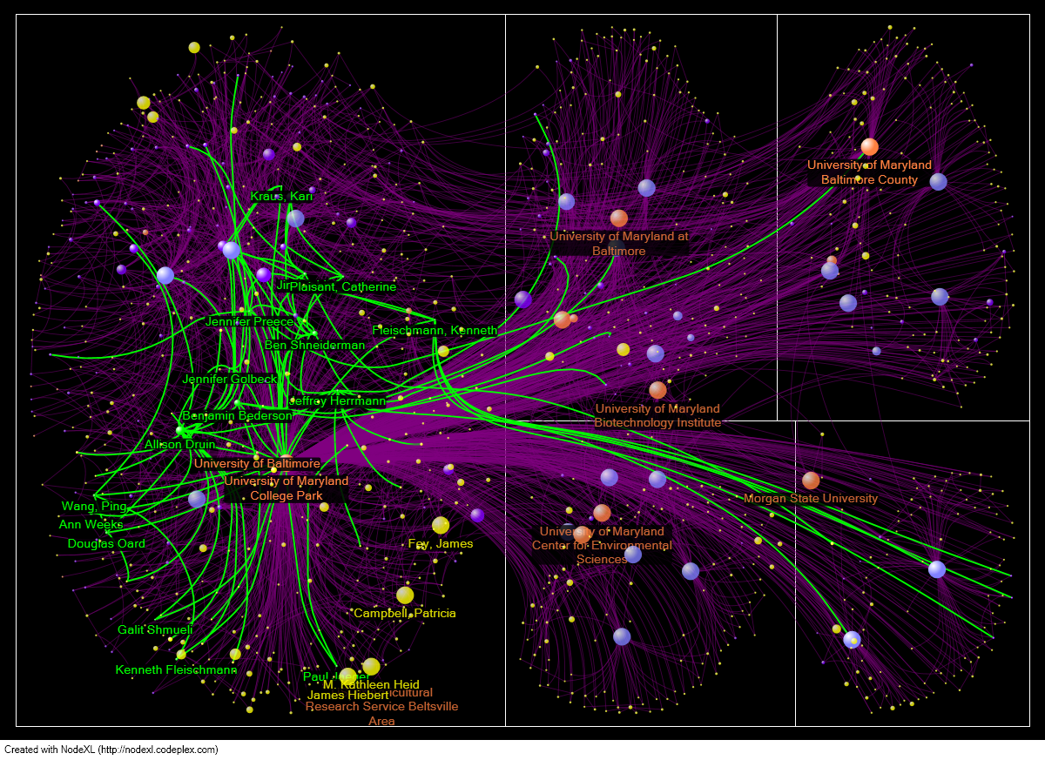
Figure 7.11. : Lobbying Coalition Network connecting organizations (vertices) that have jointly filed comments on US Federal Communications Commission policies (edges). Vertex Size represents number of filings and color represents Eigenvector Centrality (pink = higher). Darker edges connect organizations with many joint filings. Vertices were originally positioned using Fruchterman-Rheingold and hand-positioned to respect clusters identified by NodeXL’s Find Clusters algorithm.

Slide 43
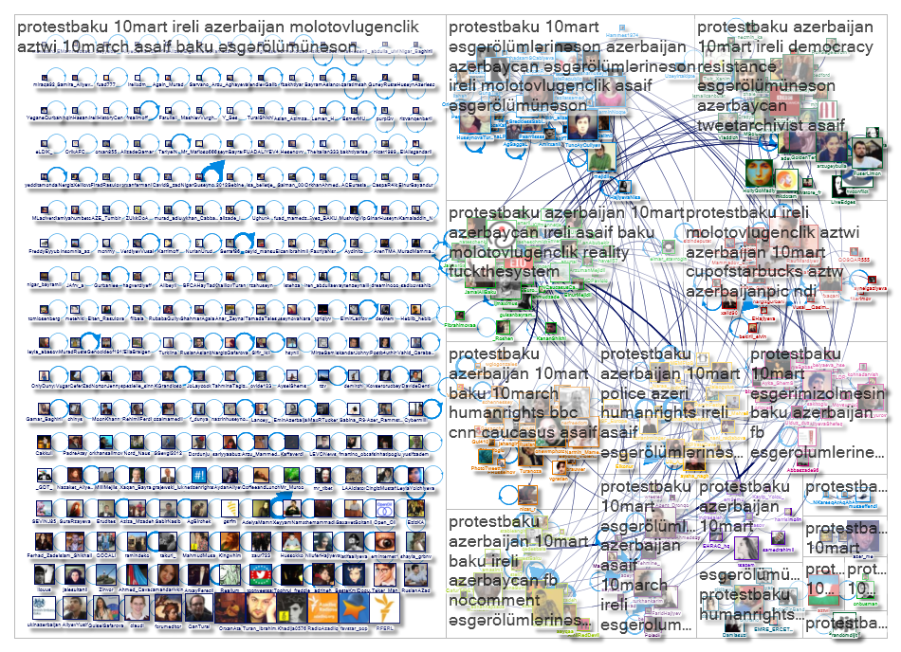

Slide 44
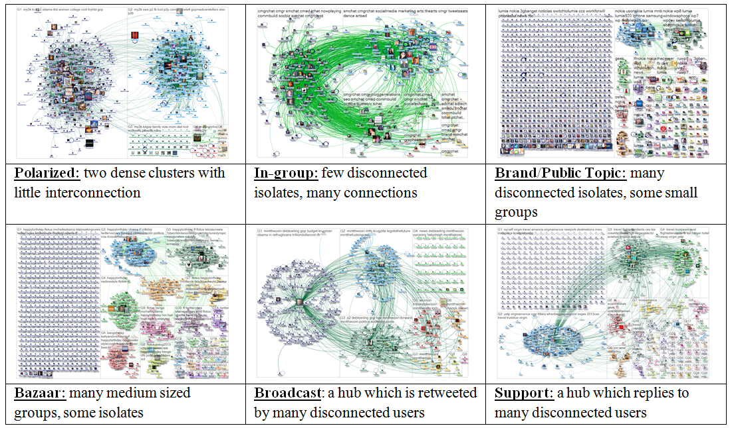
Structural Patterns in Twitter Discussions

Slide 45
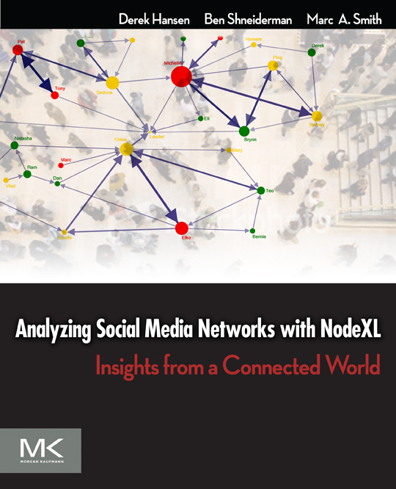
Analyzing Social Media Networks with NodeXL
I. Getting Started with Analyzing Social Media Networks 1. Introduction to Social Media and Social Networks 2. Social media: New Technologies of Collaboration 3. Social Network Analysis II. NodeXL Tutorial: Learning by Doing 4. Layout, Visual Design & Labeling 5. Calculating & Visualizing Network Metrics 6. Preparing Data & Filtering 7. Clustering &Grouping III Social Media Network Analysis Case Studies 8. Email 9. Threaded Networks 10. Twitter 11. Facebook 12. WWW 13. Flickr 14. YouTube 15. Wiki Networks
http://www.elsevier.com/wps/find/bookdescription.cws_home/723354/description

Slide 46
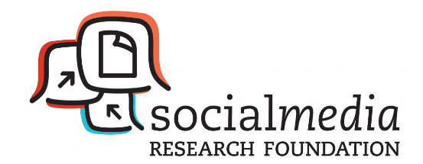
Social Media Research Foundation
Social Media Research Foundation
smrfoundation.org
We are a group of researchers who want to create open tools, generate and host open data, and support open scholarship related to social media.
smrfoundation.org

Slide 47
KredibleNet: Analytic methods
Text Analytics: Words, phrases, content, tone, links
Temporal flow: Frequency, recency, topics
Relationships: Others, organizations, topics
Verification: check source, second opinion, trusted review

Slide 48
KredibleNet: Analytic methods
Text Analytics: Words, phrases, content, tone, links
Temporal flow: Frequency, recency, topics
Relationships: Others, organizations, topics
Verification: check source, second opinion, trusted review
Reputation Management
Internal: Edit history, karma points, badges, reviews
External: Known source, contacts, references
Certifications: eTrust, TRUSTe, BBB, VeriSign, McAfee
Retrospective review: Previous performance, critical events

Slide 49
KredibleNet: Design methods
Restricted login, CAPTCHA, verified identity
Review of proposed postings
Critiques of postings: likes, value, offensive, spam
Transparency: Visible organization, responsible parties

Slide 50
KredibleNet: Design methods
Restricted login, CAPTCHA, verified identity
Review of proposed postings
Critiques of postings: likes, value, offensive, spam
Transparency: Visible organization, responsible parties
Processes
Social: Contact to complaint, dispute resolution method
Management: Metrics for continuous improvement
Industry: Comparison across products

Slide 51
KredibleNet: Research Roadmap
Text analysis & verifications
Raising the barriers to entry
Community verification by votes, likes, references
Network analyses to reveal suspicious members
Leadership strategies to promote trust & resilience
Independent validation by trusted external organizations

Slide 52
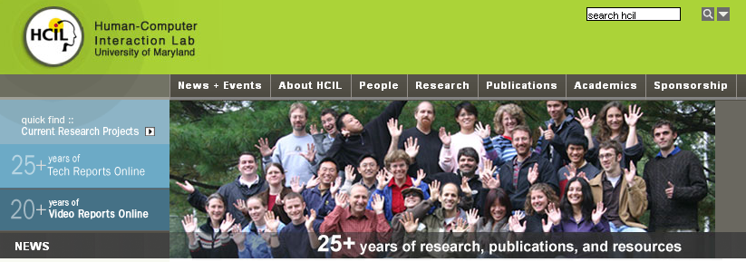
30th Anniversary Symposium
May 22-23, 2013
www.cs.umd.edu/hcil

