Slide 1

Evidence-based Usability Guidelines for Promoting Safety and Efficacy Ben Shneiderman ben@cs.umd.edu Founding Director (1983-2000), Human-Computer Interaction Lab Professor, Department of Computer Science Member, Institute for Advanced Computer Studies Member, National Academy of Engineering
NIST: A Community-Building Workshop: Measuring, Evaluating and Improving the Usability of Electronic Health Records

Slide 2
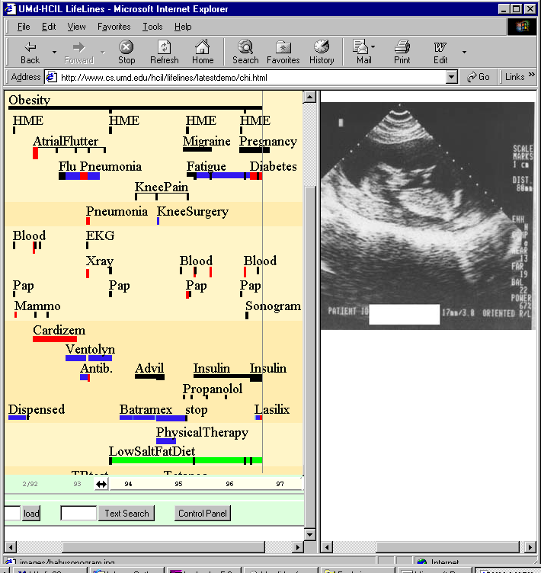
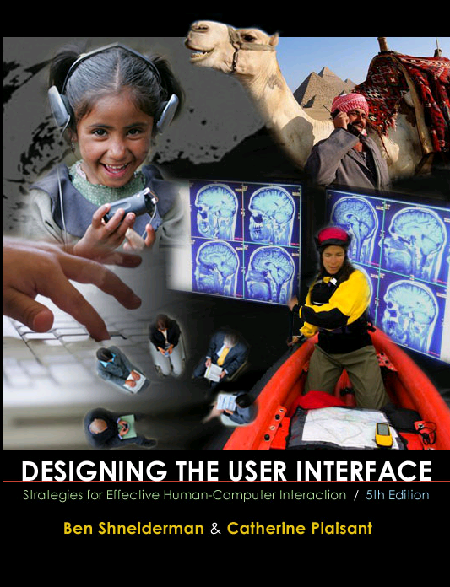
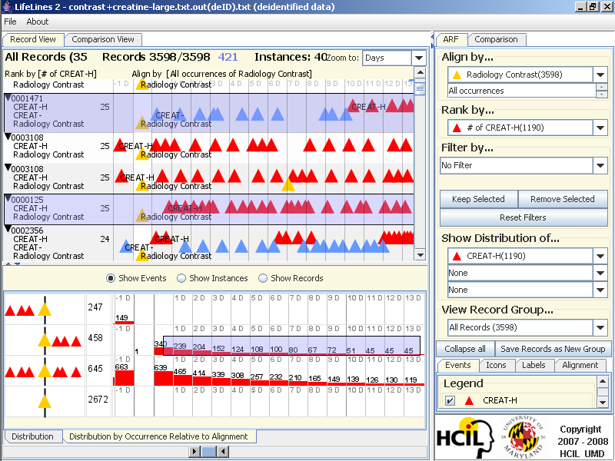
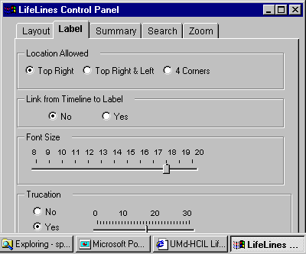
UMd HCIL’s work for NIH & ONC
Strategic Health IT Advanced Research Projects
- Security of Health Information Technology
- Patient-Centered Cognitive Support
- Healthcare & Network Platform Architectures
- Secondary Use of EHR Data
Sharpc.org
www.cs.umd.edu/hcil/sharp

Slide 3
Usability Guidelines are Powerful
Apple, Microsoft, Android, ...
NASA, FAA, DoD, ...
HFES, WWW-Consortium, ...
RAISE QUALITY
Promote Consistency → User Performance
Speed Development → Programmer Productivity
Reduce Errors → Organization Reputation

Slide 4
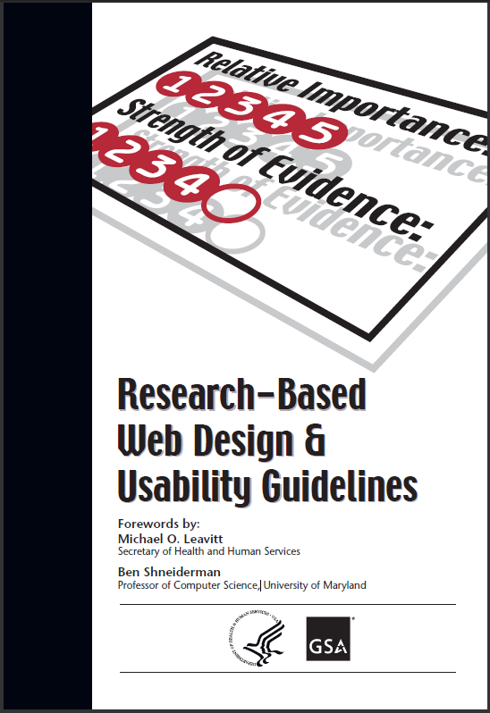
Usability Guidelines are Powerful
Education
Enforcement
Exemption
Enhancement
- 209 Guidelines
400+ References
Usability.gov

Slide 5
Improving Usability of EHRs
Publish EHR guidelines documents
Permit examination & discussion of products
Report on usability study results

Slide 6
Improving Usability of EHRs
Publish EHR guidelines documents
Permit examination & discussion of products
Report on usability study results
Promote consistency with industry-led common user interface guidelines
Report failures periodically with common metrics
Work with Government agencies to coordinate specific industry practices

Slide 7
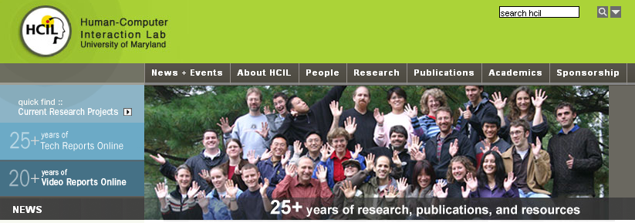
www.cs.umd.edu/hcil

