Slide 1

Introduction to NodeXL
Like MSPaint™ for graphs.
— the Community

Slide 2
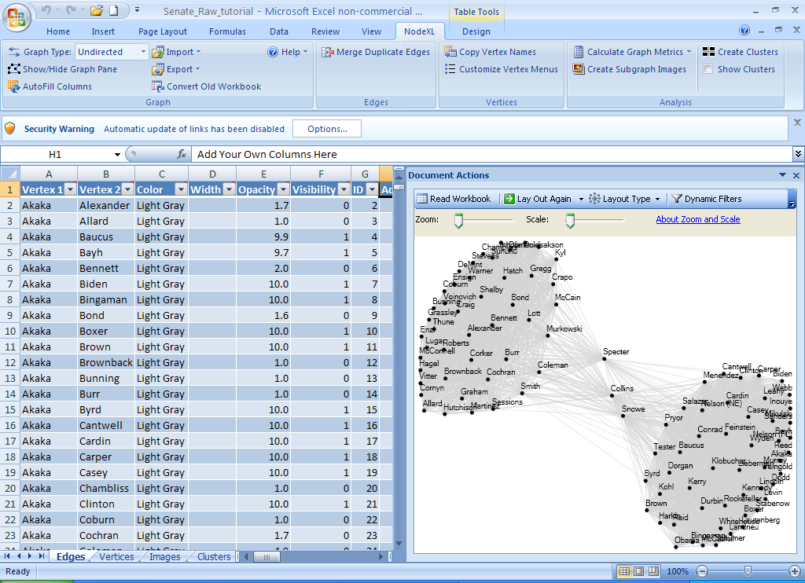
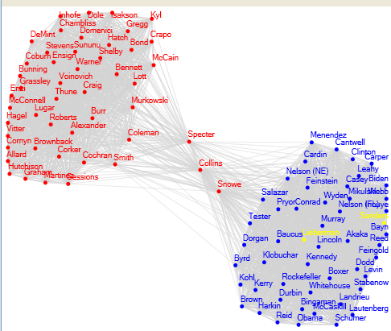
NodeXL
Free/Open Network Analysis add-in for Excel 2007/2010
http://nodexl.codeplex.com

Slide 3
Who Uses Network Analysis
Politics
Urban Planning
Scientometrics
Biology
Archaeology
Sociology
WWW
Notes:
Sociology (Newman & Girvan, 2004)
Scientometrics (Henry et al., 2007)
Politics (Adamic & Glance, 2005)
Urban Planning (Scott Dempwolf)
Biology (Kelley et al., 2003)
Archaeology (Tom Brughmans)
WWW (Cheswick et al. 2000)

Slide 4


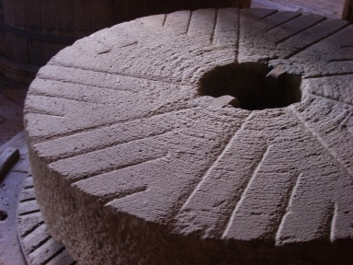


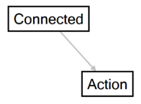

Network Analysis Data Flow
Providers
Container
Analysis
Visualization
Publication

Slide 5
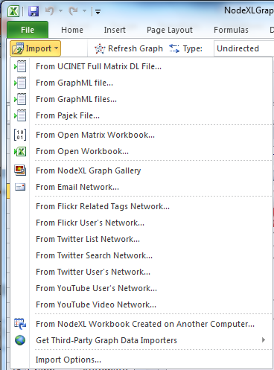
Providers
Social media
Email, Blogs, YouTube…
Facebook, Twitter, LinkedIn…
Publications
Scientific & Legal citations
Science
Predator-prey networks
Biological pathways
Epidemic contagion
Business
Corporate boards
Sales networks
International trade

Slide 6

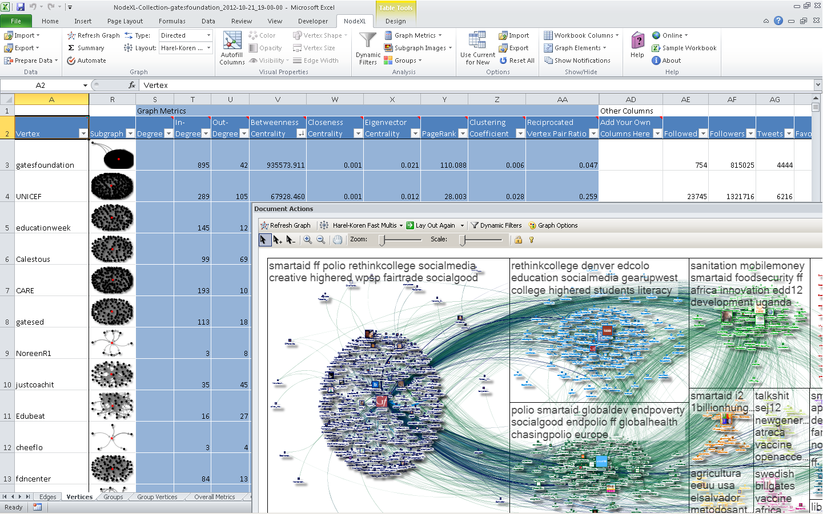
Container

Slide 7
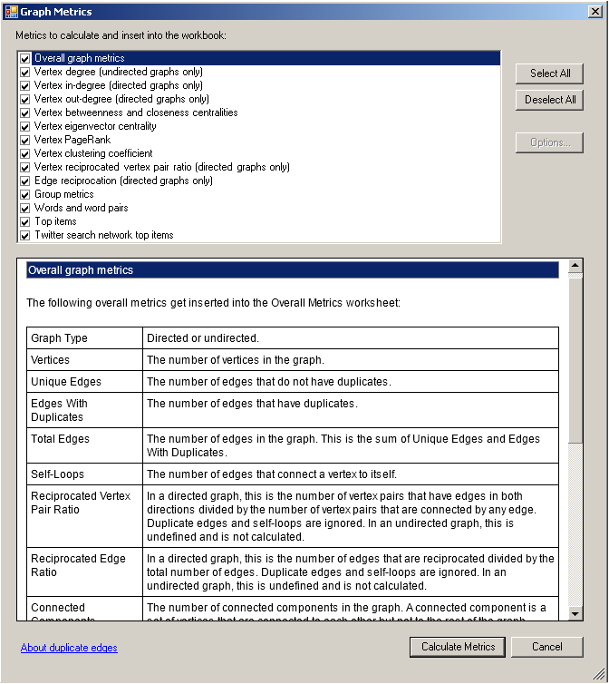

Analysis

Slide 8
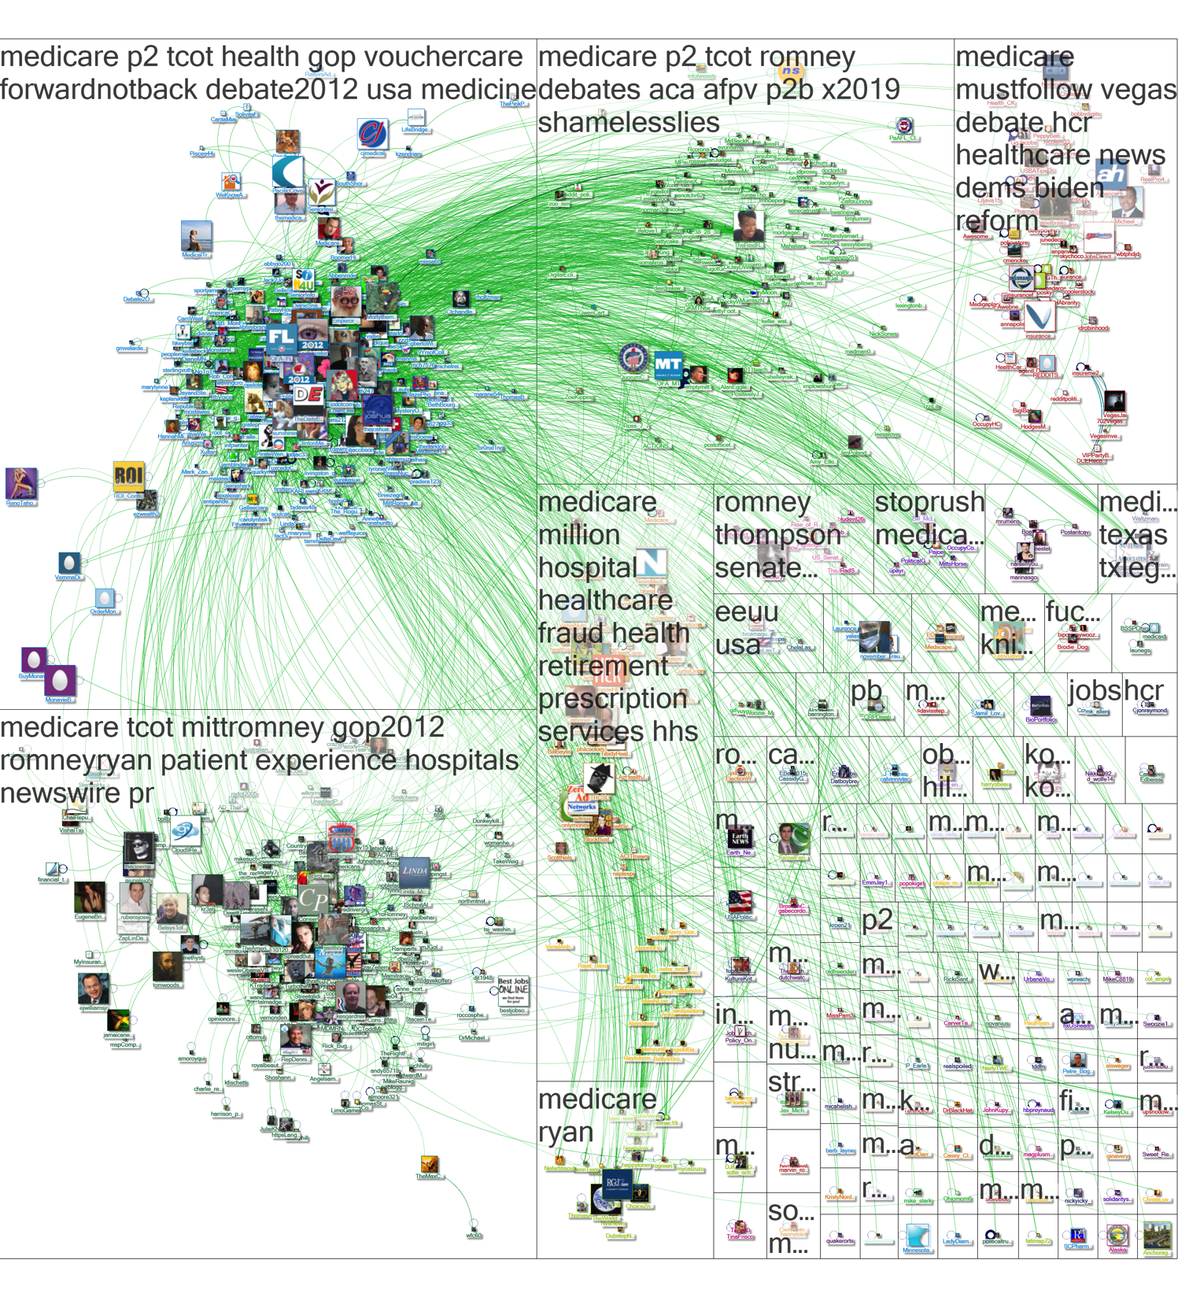

Visualization

Slide 9

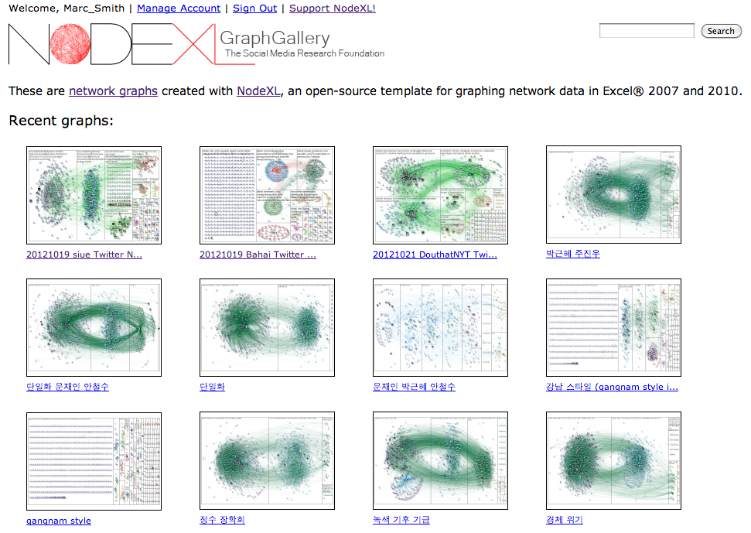
Publication

Slide 10
Network Definitions & Visualization
A
B
C
Vertex (Node)
Labels & Attribute values
Edge (Link, Tie)
Directed/Undirected
Labels & Attribute values
Cohesive Sub-Groups
Components
Clique
Cluster
D
E
F
G
H
I
J
K
L
M

Slide 11
Network Definitions & Visualization
A
B
C
Vertex (Node)
Labels & Attribute values
Edge (Link, Tie)
Directed/Undirected
Labels & Attribute values
Cohesive Sub-Groups
Components
Clique
Cluster
D
E
G
F
H
I
J
K
L
M

Slide 12
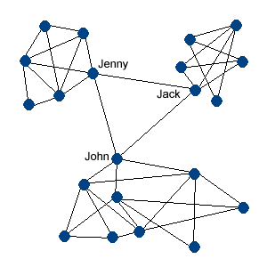
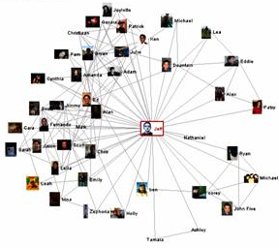
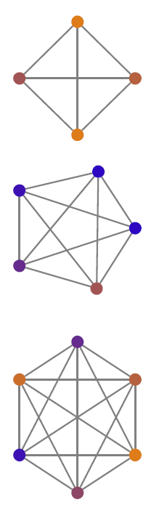
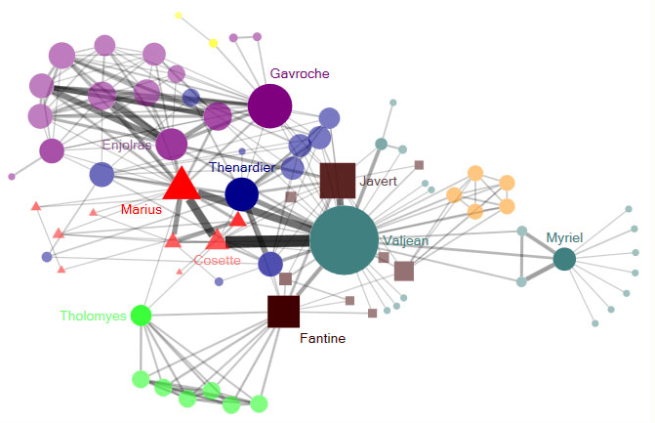
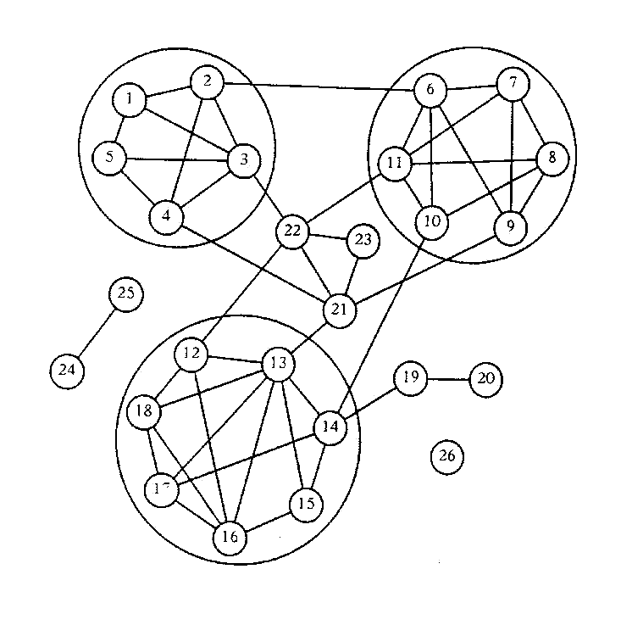
Many Structures Are Possible
Notes:
Ego-centric networks: study participants (egos) identify their network members (alters), and the relationships between them
Whole networks: members are known or identified a priori; all are surveyed to obtain information on their connections with other members

Slide 13
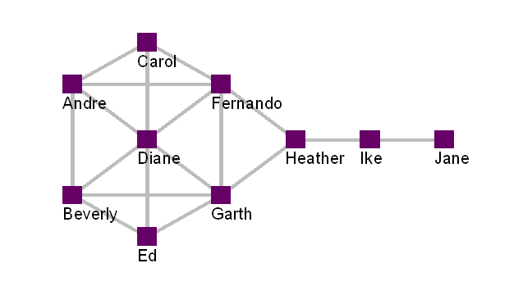
Descriptive Network Measures
Individual
Centrality
Degree (In, Out, Total)
Betweenness
Closeness
Eigenvector
Network characteristics
Density
Hierarchy
Diameter
Notes:
Critical point – make sure that you unit of analysis makes sense (given your question) and is consistent with your data.
Also: Many of the measures are highly correlated – so while the measures may be conceptually differentiable, sometimes they aren’t emperically differentiable (and if you’re not careful they may actually be mathematically equivalent).

Slide 14
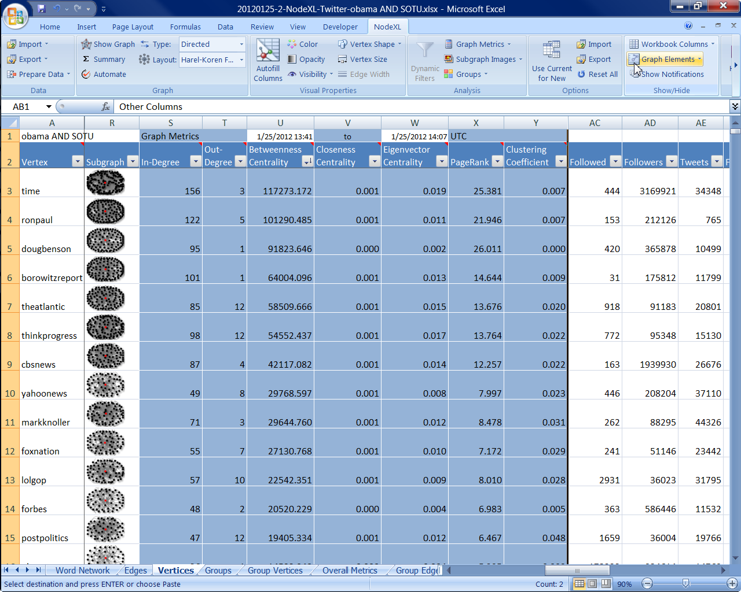
NodeXL displays subgraph images along with network metadata
NodeXL creates a list of “vertices” from imported social media edges

Slide 15
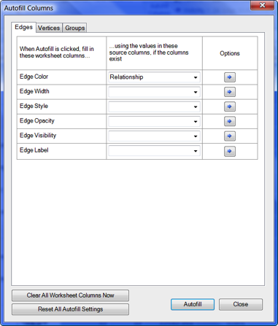
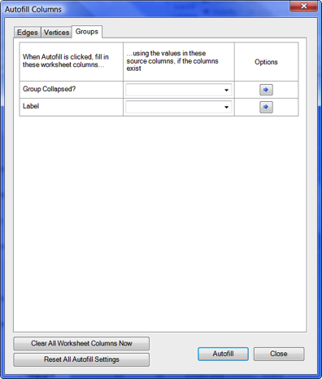
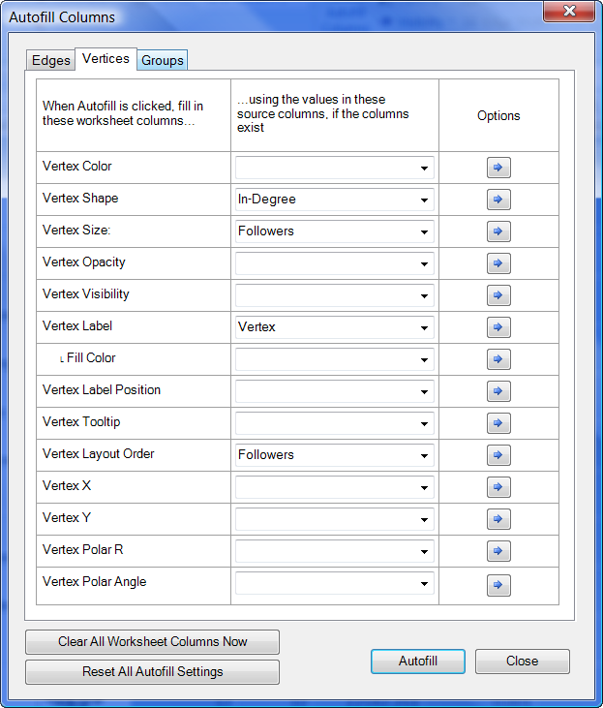
NodeXL “Autofill columns” simplifies mapping data attributes to display attributes

Slide 16
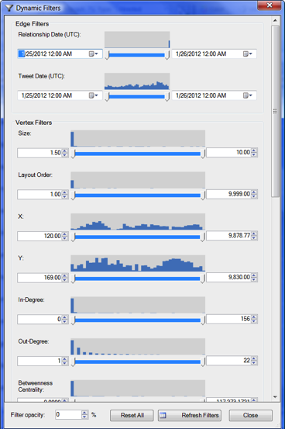
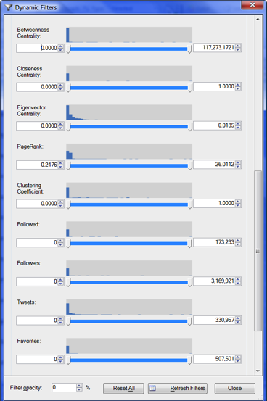
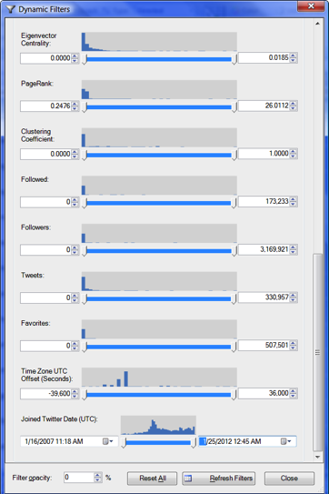
NodeXL enables filtering of networks

Slide 17
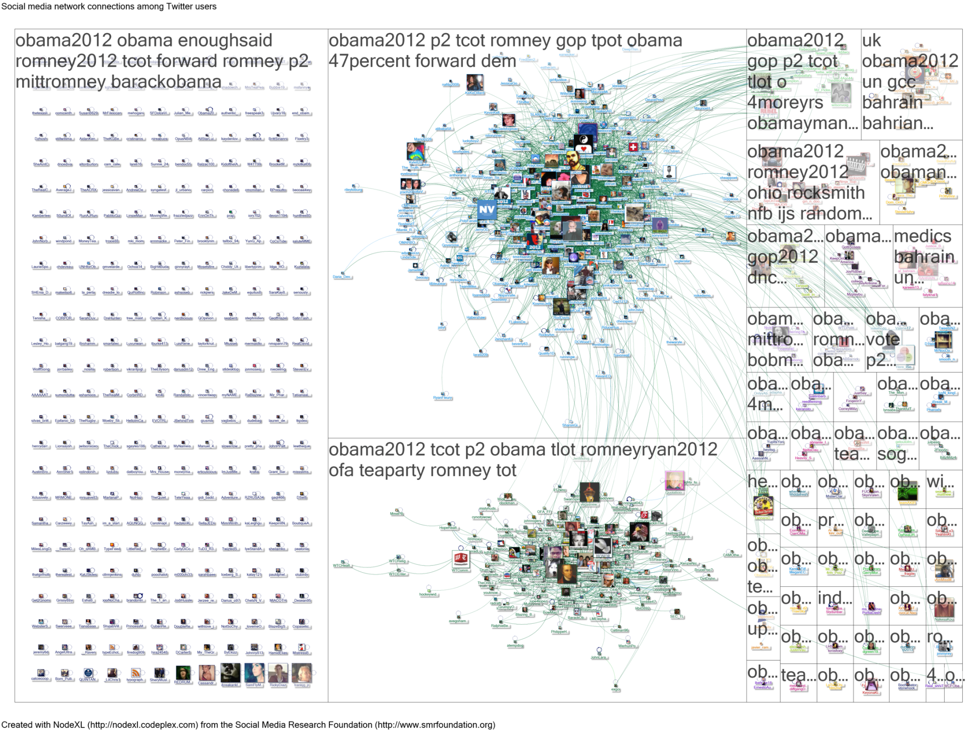

Slide 18
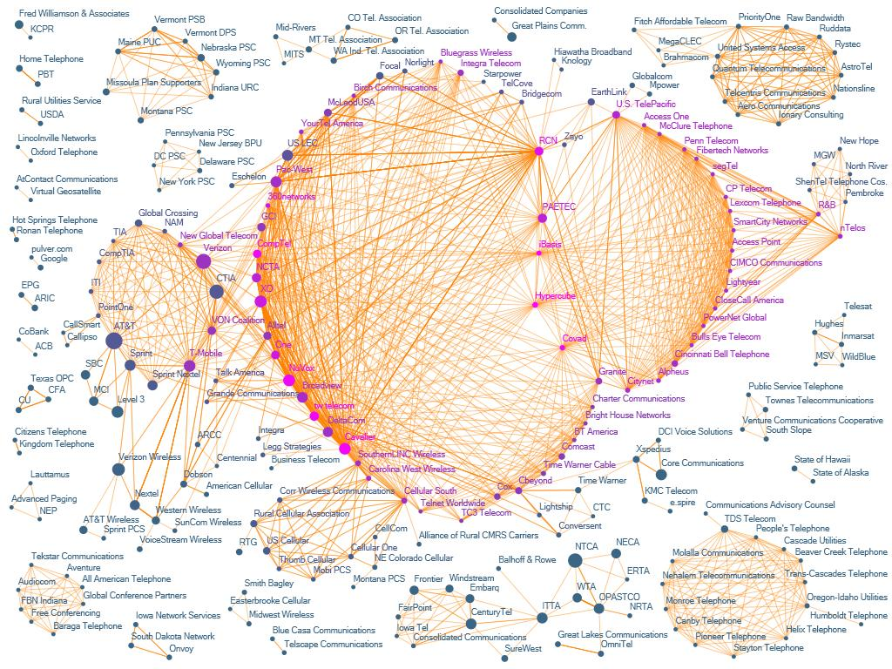
FIGURE 7.11
Chapter 7
Lobbying Coalition network connecting organizations (vertices) that have jointly filed comments on U.S. Federal Communications Commission policies (edges). Vertex size represents number of filings and color represents eigenvector centrality (pink higher). Darker edges connect organizations with many joint filings. Vertices were originally positioned using Fruchterman-Reingold and handpositioned to respect clusters identified by NodeXL’s Find Clusters algorithm.

Slide 19
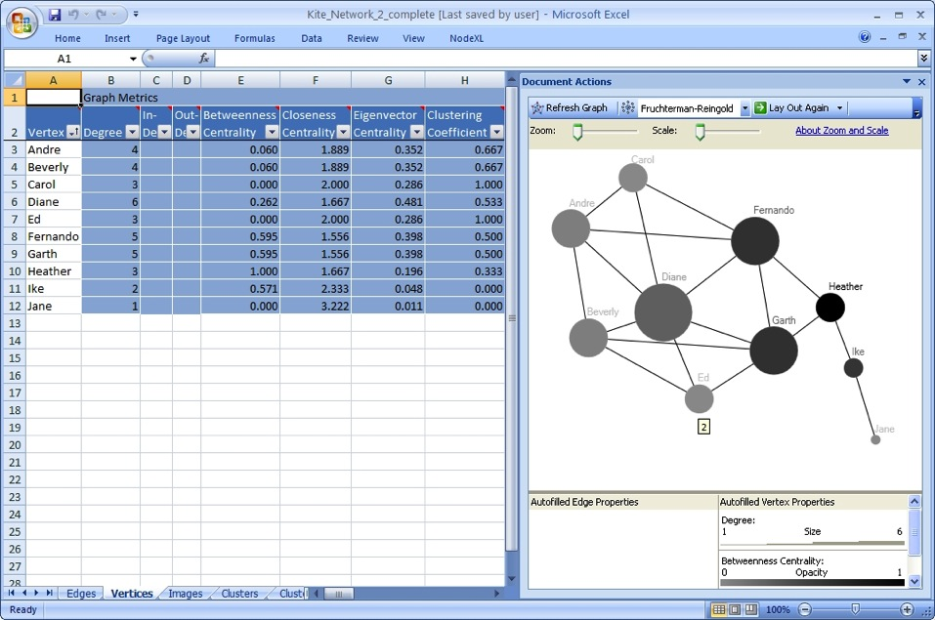
Example
Heather has high betweenness
A minimal network can illustrate the ways different locations have different values for centrality and degree
Diane has high degree
Notes:
A tutorial on analyzing social media networks is available from: casci.umd.edu/NodeXL_Teaching
Different positions within a network can be measured using network metrics.

Slide 20

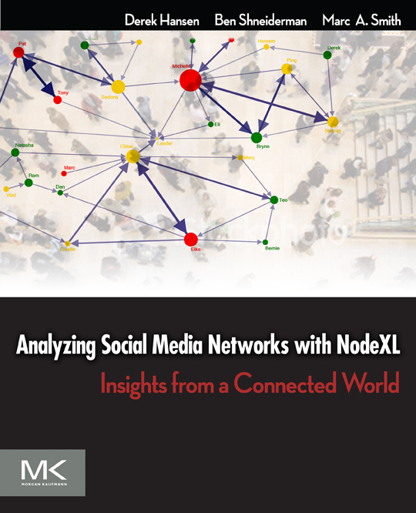




http://nodexl.codeplex.com
Notes:
The book introduces social media and social network analysis and then uses NodeXL to demonstrate how to analyze and visualize various social media networks
such as email, forums, Twitter, Facebook, website hyperlinks, Flickr, YouTube, and Wikis.

Slide 21
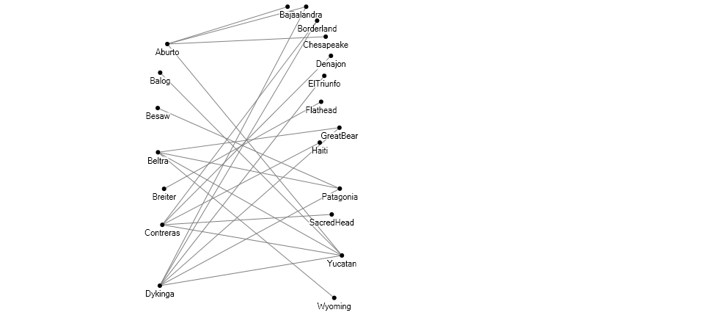
Elizabeth Schwarz, UCRiverside, eschw001@ucr.edu

Slide 22
