Slide 1





  Project 4: Cognitive Information Design and Visualization
Presented by
Dr. Ben Shneiderman
Catherine Plaisant
Surreya Tarkan
Tiffany Chao
Jorge Herskovic
Elmer Bernstram
Elis Markovitz
Chitra Shriram
Todd Johnson

Slide 2
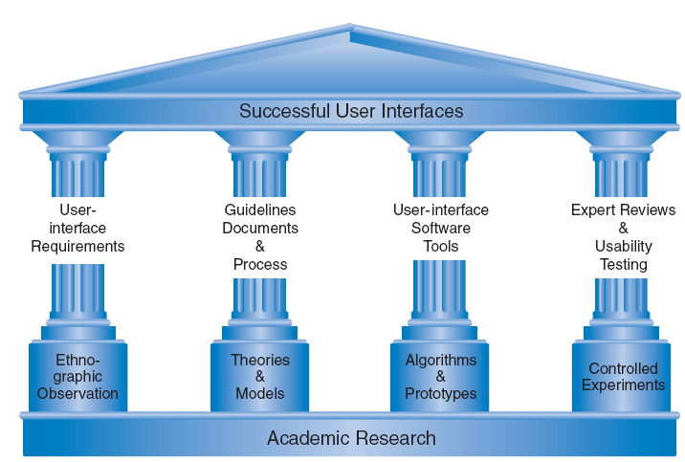
Human-Computer Interaction has Strong Structures

Slide 3
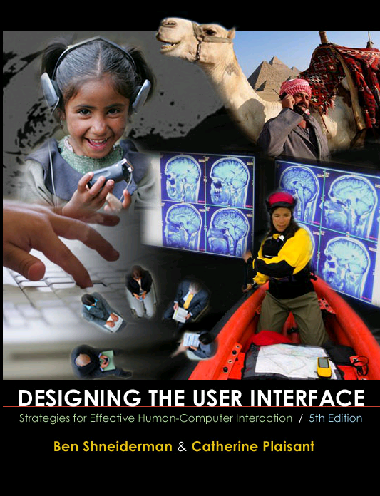
Human-Computer Interaction has Strong Structures

Slide 4
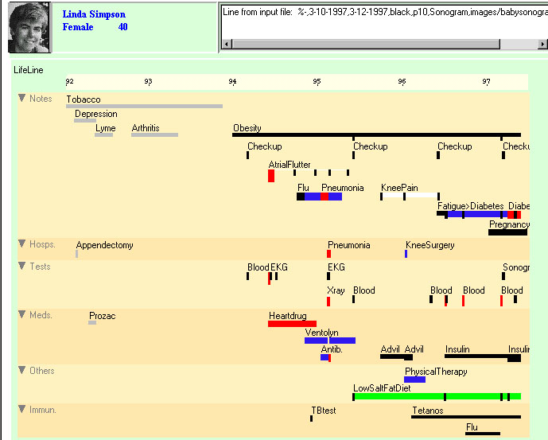
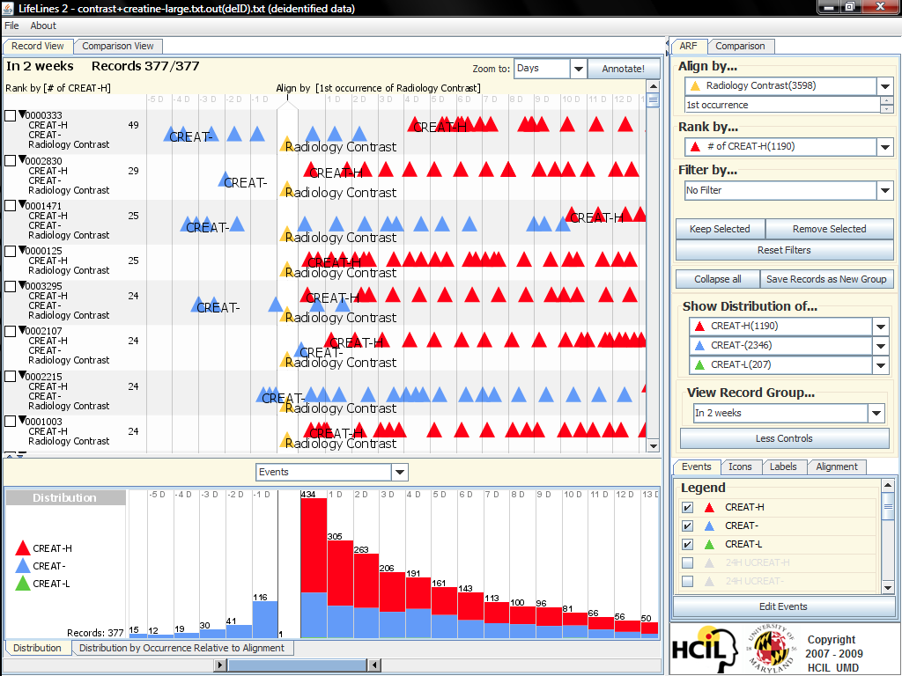
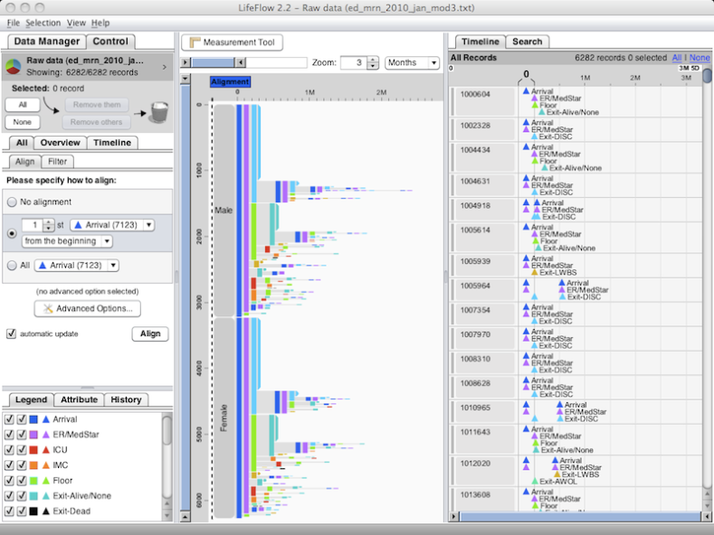
History of EHR Interfaces &Tech Transfer
Lifelines (AMIA 1998) www.cs.umd.edu/hcil/lifelines
Lifelines2 (CHI 2009 - IHI 2010) www.cs.umd.edu/hcil/lifefines2
Now Integrated with i2b2 & BTRIS
LifeFlow (CHI 2011, IHI 2011 with Mayo) www.cs.umd.edu/hcil/lifeflow

Slide 5
Overall Goals of Project 4
Create framework & guidelines for designing
interactive information visualizations that provide
patient-centered cognitive support by enhancing accessibility & understanding of patient data.
Short Term Goals:
  Focus on clinician-centered visualization tools that
  address national priorities.
  Lab & study tracking to ensure completion
  Medication Reconciliation

Slide 6

Initial efforts
Survey EHR visualizations
Build relationships
Workshops with partners & vendors
Create national interest in EHR usability
ACM, UPA, HIMSS, InfoVis
article by Steve Lohr
See: www.cs.umd.edu/hcil/sharp

Slide 7
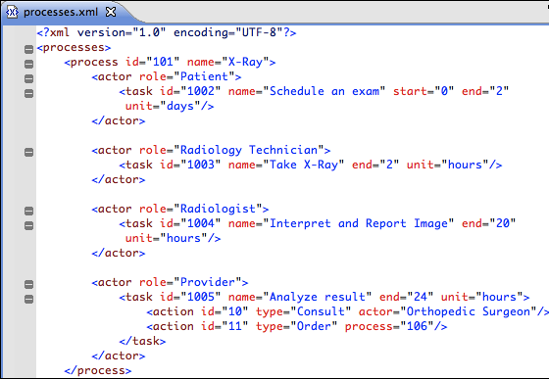
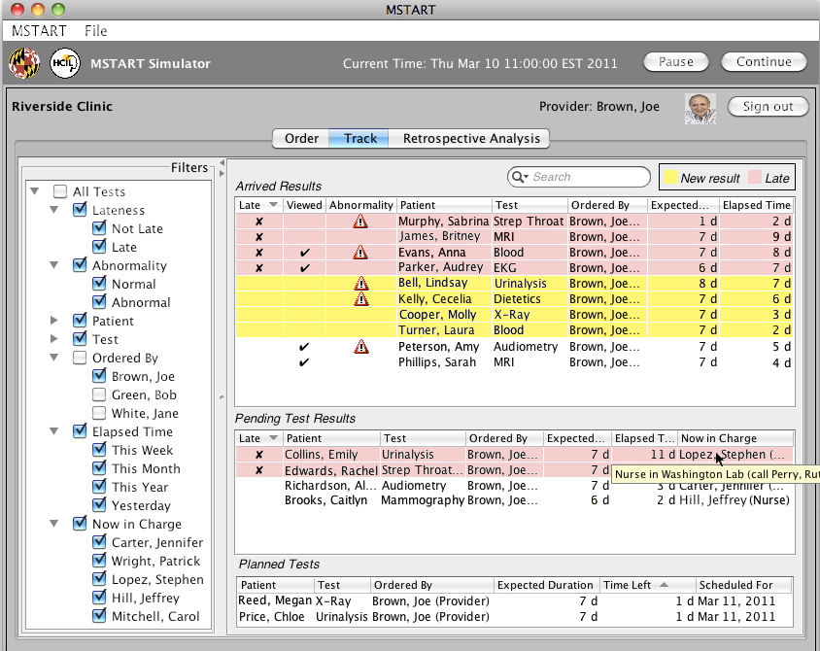
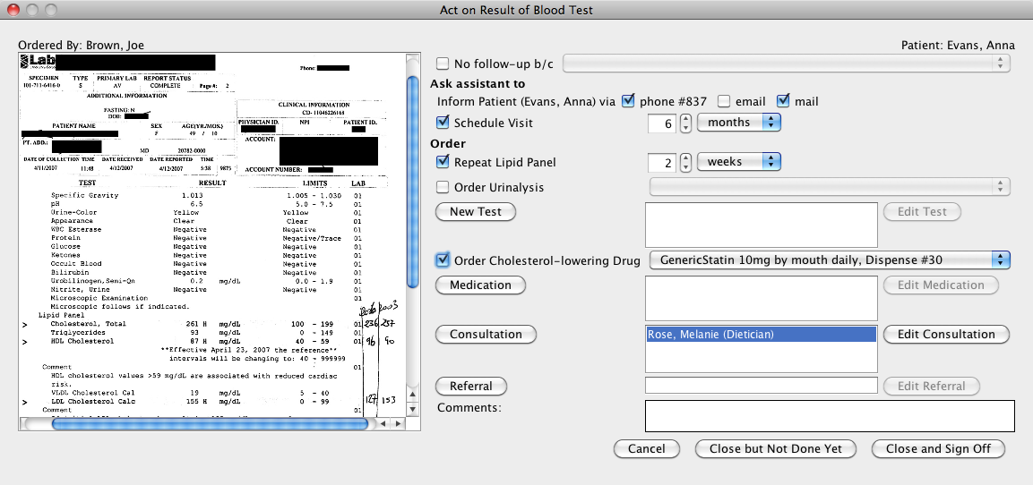
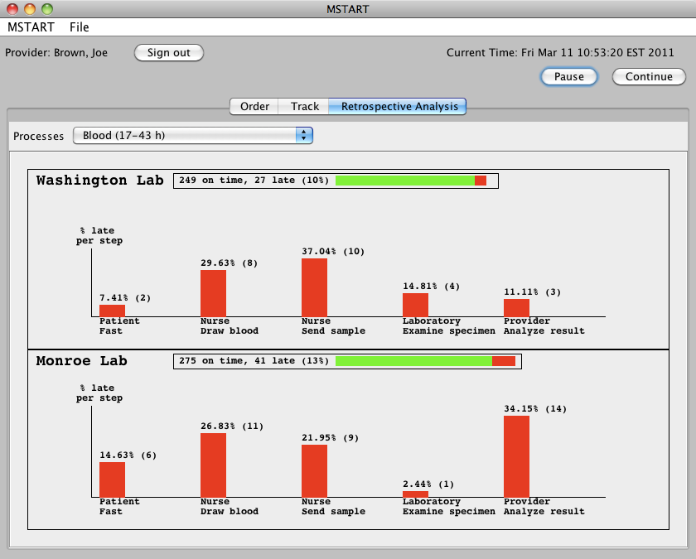
Lab & study tracking to ensure completion
Sureyya Tarkan
Define tracking processes
Assign temporal responsibility
Define possible actions
Predict expected duration
Generate User Interface from processes
Enhance situation awareness
Integrate follow-up actions with results
Simplify rapid operations
Provide retrospective analysis

Slide 8




Medication Reconciliation
A complex process:
  Develop a list of current medications;
  Develop a list of medications to be prescribed;
  Compare the medications on the two lists
  Make clinical decisions based on the comparison
  Communicate the new list to appropriate caregivers and to the patient.
http://www.ihs.gov/cio/ehr/index.cfm?module=medication_reconciliation

Slide 9
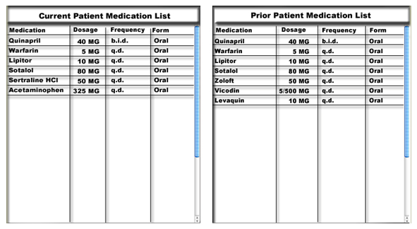
Example of Medication Lists
What is unique? What is identical? What is equivalent?

Slide 10
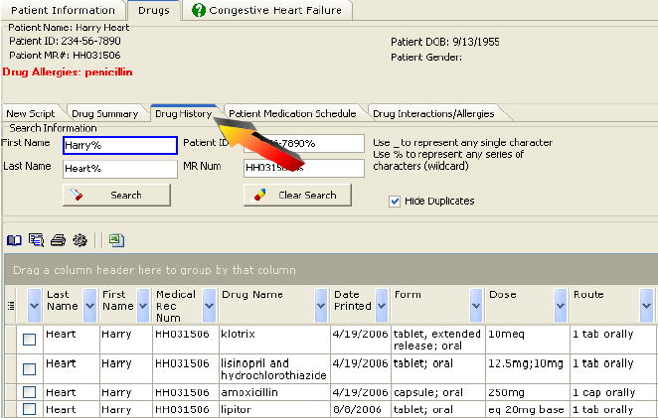
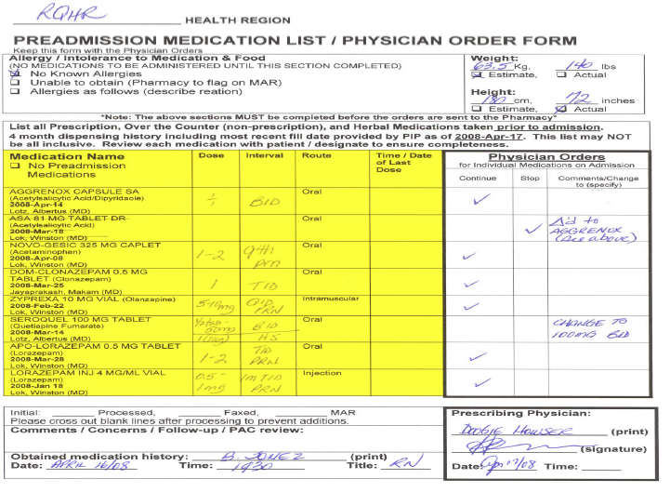
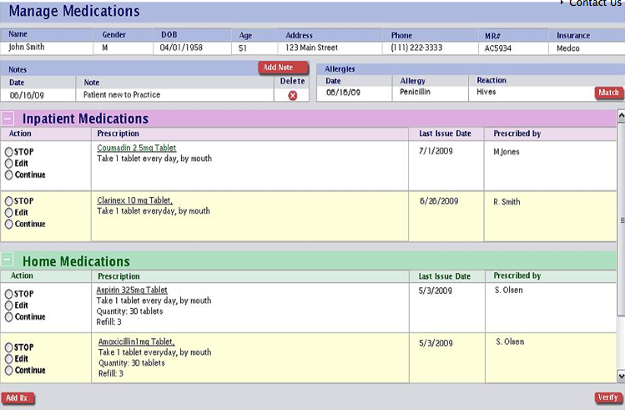
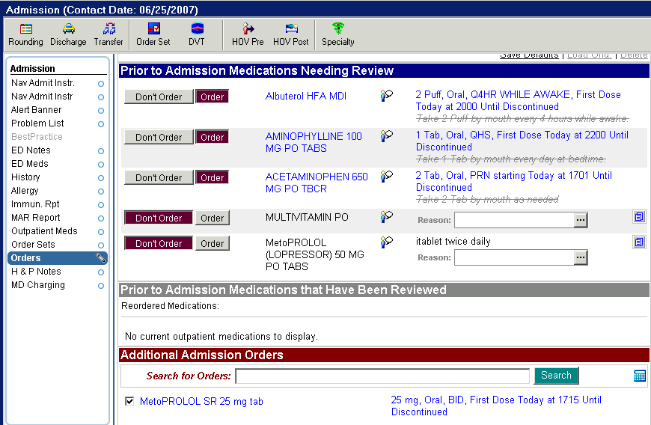
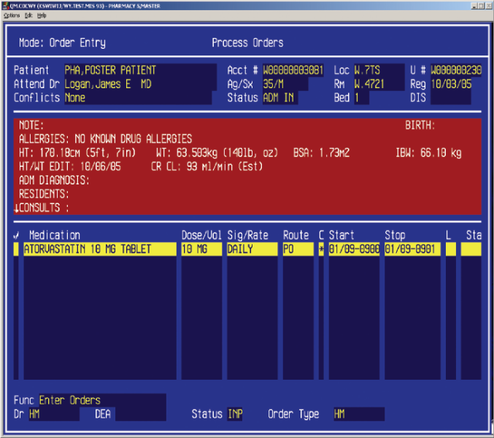
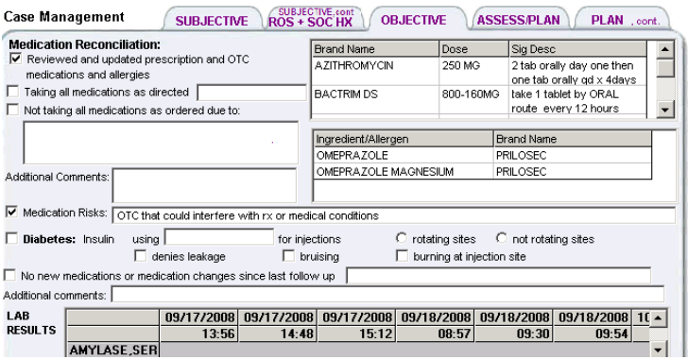
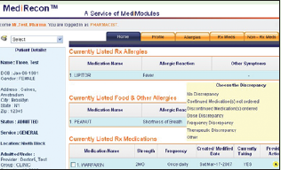
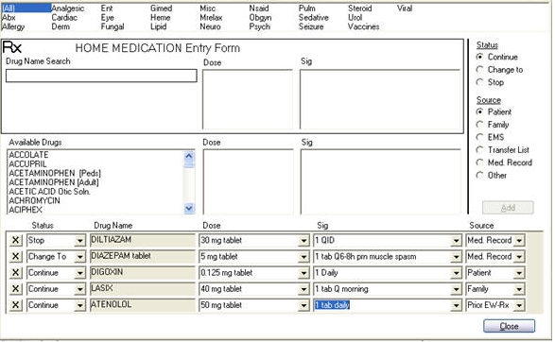
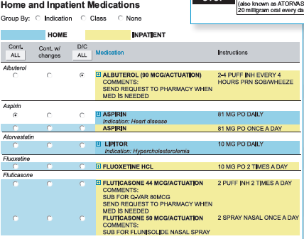
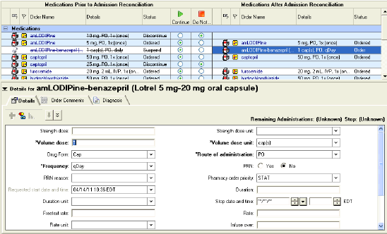
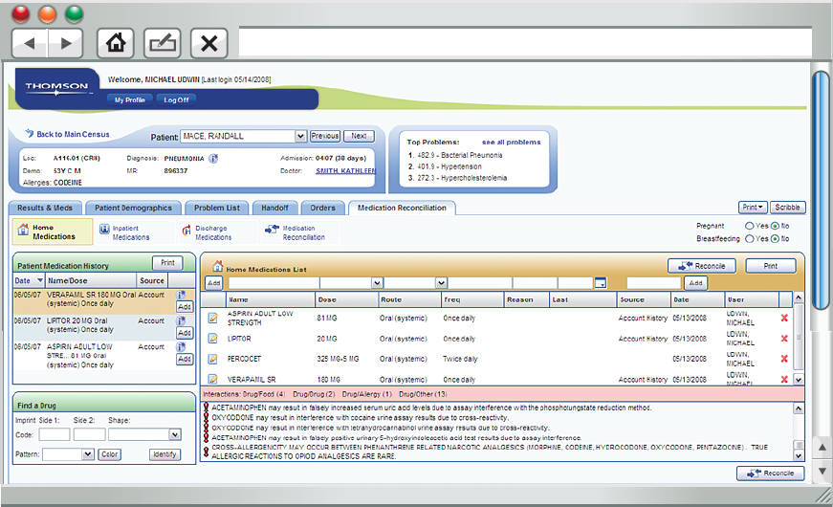
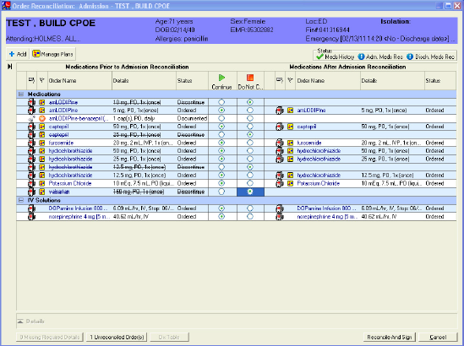
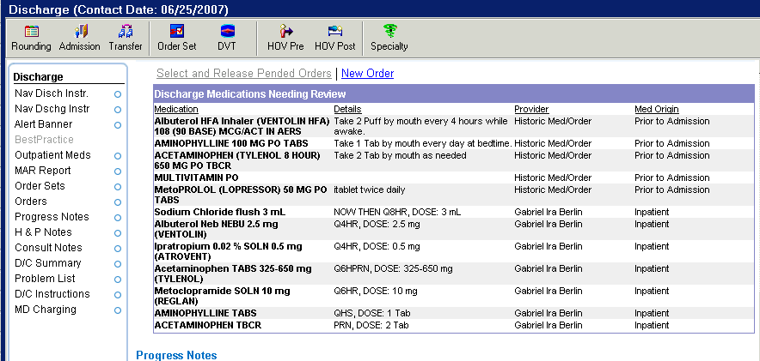
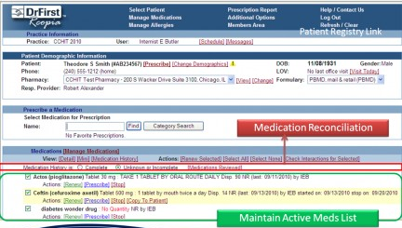
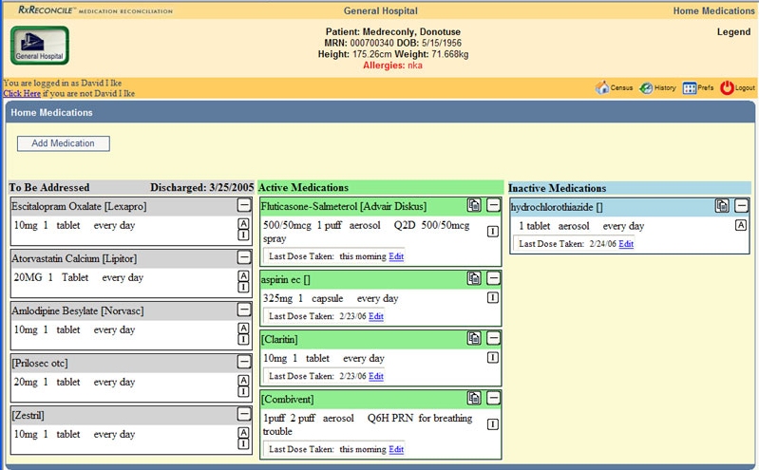
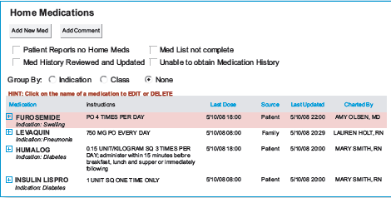
Existing tools
    Limitations: 1. No or limited assistance
    2. Increases workload for the clinician.
            3. Usability problems

Slide 11
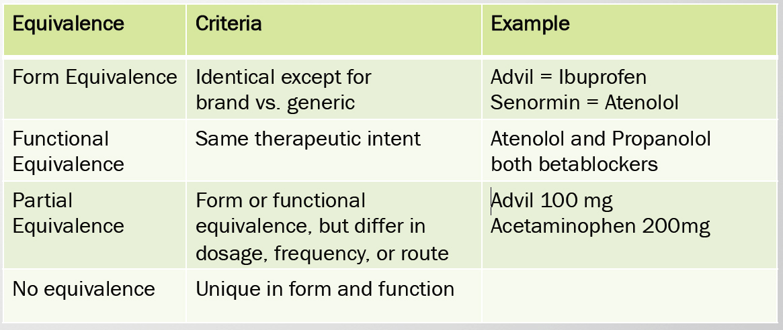
Levels of Equivalence

Slide 12
Levels of Equivalence
Bozzo Silva, P., Bernstam, E., Markowitz, E., Johnson, T.,Zhang, J., Herskovic, J. | Automated medication reconciliation and complexity of care transitions | S87 Wednesday, Oct. 26 8:50 – 9:10 AM | Lincoln West

Slide 13
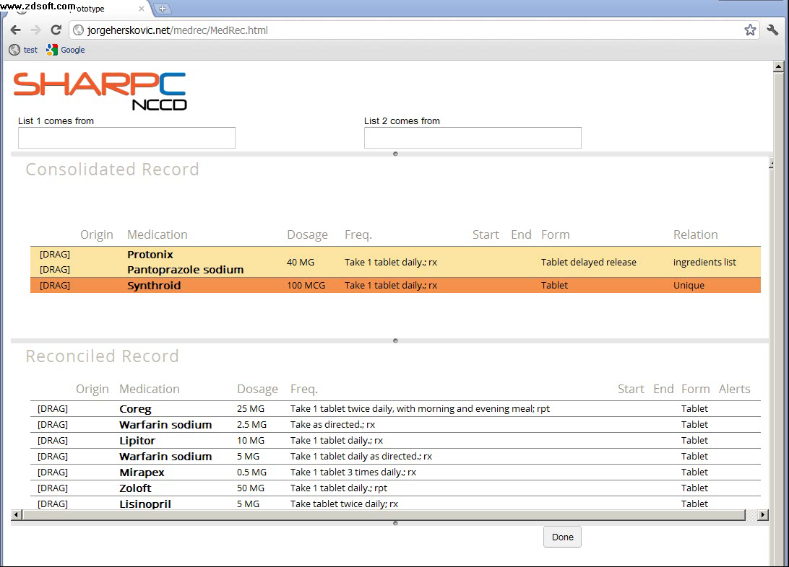
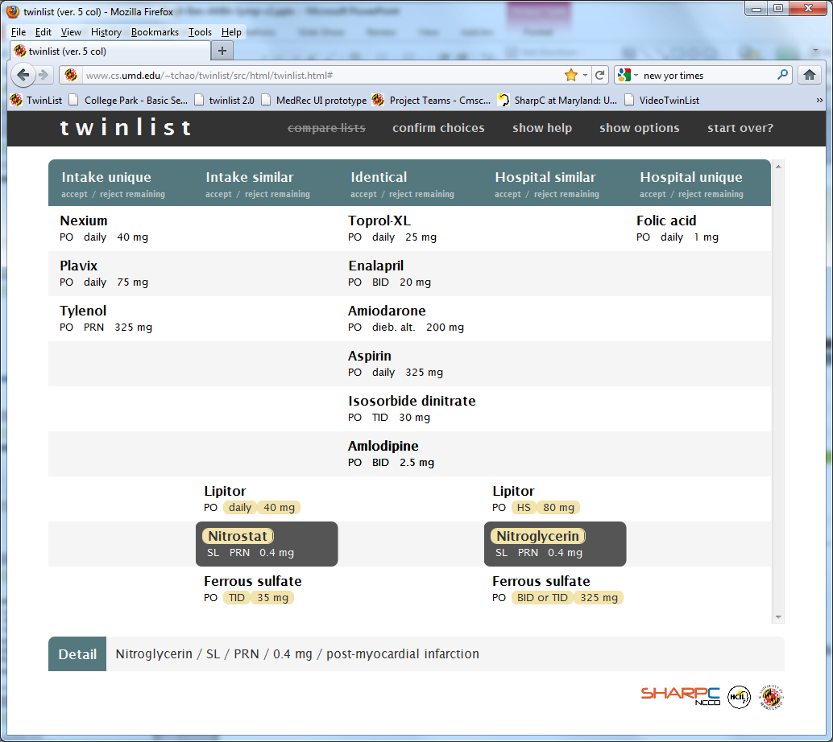
Two Designs - Demos
Tabular layout Spatial Layout
Grouped rows = similarity Closeness = similarity
MedRecon TwinList

Slide 14
MedRecon: semi automatic reconciliation
Eliz Markowitz, Elmer V. Bernstam, Jorge Herskovic, Jiajie Zhang, Todd R. Johnson
Video demo
Un-reconciled medications
require clinician’s selection or rejection
Identical medications automatically reconciled

Slide 15

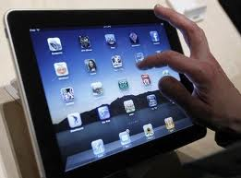
MedRecon:
Compatibility with hand held devices ?

Slide 16
MedRecon: semi automatic reconciliation
Eliz Markowitz, Elmer V. Bernstam, Jorge Herskovic, Jiajie Zhang, Todd R. Johnson
Video demo
Un-reconciled medications
require clinician’s selection or rejection
Identical medications automatically reconciled
Markowitz, E., Bernstam, E., Herskovic, J., Zhang, J., Shneiderman, B, Plaisant, C., Johnson, T. | Medication Reconciliation: Work Domain Ontology, Prototype Development, and a Predictive Model | S87 Wednesday, Oct. 26 8:30 – 8:50 AM | Lincoln West | Paper

Slide 17
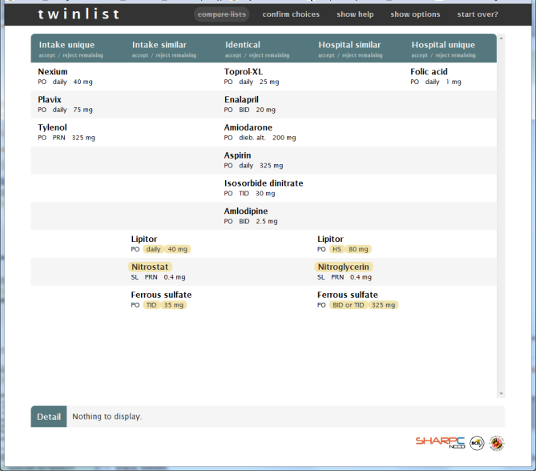
Twinlist
Tiffany Chao, Catherine Plaisant, Ben Shneideman
Based on class project of : Leo Claudino, Sameh Khamis, Ran Liu, Ben London, Jay Pujara
Students of CMSC734 Information Visualization class
Presentations:
HCIL symposium (200+ attendees)
AMIA WISH tomorrow
”Best reconciliation app I have ever seen”
Dr. Shawn Murphy, PartnersHealthcare & Harvard Medical

Slide 18
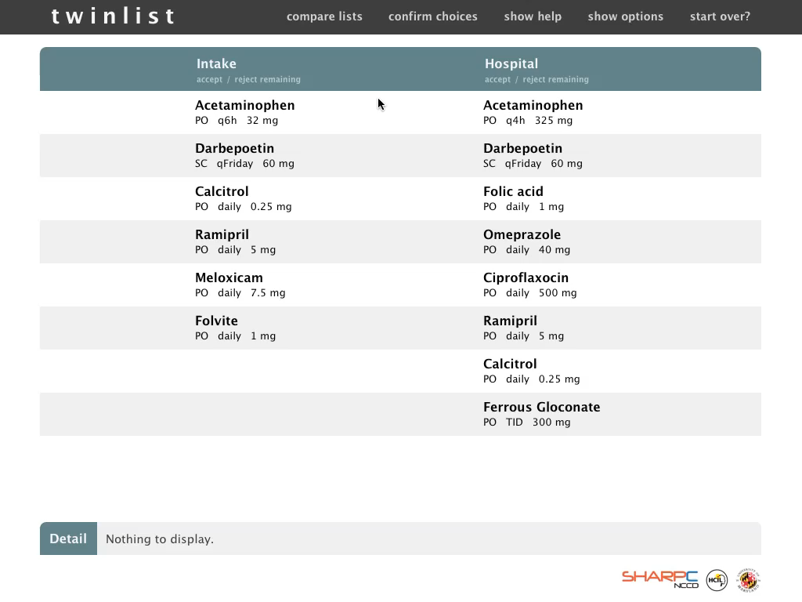

Slide 19
Twinlist
Tiffany Chao, Catherine Plaisant, Ben Shneiderman
Based on class project of : Leo Claudino, Sameh Khamis, Ran Liu, Ben London, Jay Pujara
UMD CMSC734 Information Visualization
Presentations:
HCIL symposium (200+ attendees)
AMIA WISH tomorrow
”Best reconciliation app I have ever seen”
Dr. Shawn Murphy, PartnersHealthcare & Harvard Medical

Slide 20
Systematic Yet Flexible HIT
Eliz Markowitz
Need balance between
  Systematicity to ensure consistency, efficiency & safety
  Flexibility to accommodate variability
Hypothesis:
Matching task & interface systematicity &
flexibility improves efficiency & usability
Goal: design guidelines
Eliz Markowitz, MS, Jiajie Zhang, PhD, Elmer V. Bernstam, MD, PhD, and Todd R. Johnson, PhD

Slide 21
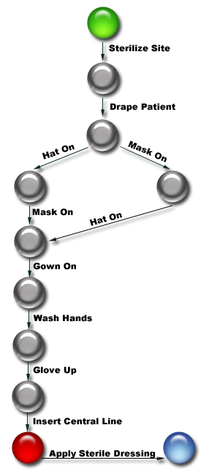
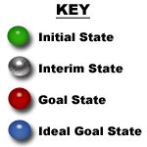
Systematic Yet Flexible HIT
Eliz Markowitz PhD Thesis
Example: SYF & Catheter Insertion
384 total states
  286 goal states
13,004 paths to any state in which the central line is inserted
  1,680 paths to the ideal goal state
  Only 2 paths contain the appropriate sequence of 9 actions

Slide 22
Reducing Wrong Patient Errors
Meirav Taieb, Jyothi Vinjumur, Catherine Plaisant, Ben Shneiderman
With long lists, users may choose wrong item→
Poor visual design
Inadequate feedback
Lack of error prevention
Wrong patients, medications, lab tests
Test: 100 subjects with 4 treatments
Photos (Y/N) & Animation (Y/N)

Slide 23

University Health Service
Provider: Smead, John
Register
Your patient list: Sex Age MedRec Birth Date Admission Date Attending Dr
Report
Culbertson, George M 77 9845722 EMM 3/4/1934 6/11/2011 Connors, Greg
Request
Census
Culbertson, Susan F 24 9887333 JDC 5/22/1987 6/11/2011 Schneider, Ben
History
Donder, Bill M 21 9823244 EMM 6/4/1990 6/102011 Tabibi, Mary
Discuss
Harris, Emily F 24 9828970 DRD 5/22/1987 6/12/2011 Tabibi, Mary
Feedback
Isaacson, Thomas M 53 9845722 EMM 7/11/1958 6/11/2011 Connors, Greg
Training
Privacy
Burchard, Susan F 24 9887333 JDC 5/22/1987 6/12/2011 Schneider, Ben
About
Culbertson, George M 77 9823244 EMM 3/4/1934 6/11/2011 Connors, Greg
Contact
Culbertson, Susan F 24 9828970 DRD 5/22/1987 6/12/2011 Franks, George
Text size
Albertson, George M 77 9845722 EMM 3/4/1934 6/11/2011 Schneider, Ben
+
-
Burchard, Susan F 24 9887333 JDC 5/22/1987 6/12/2011 Schneider, Ben
~
espagnol
Albertson, George M 77 9823244 EMM 3/4/1934 6/11/2011 Tabibi, Mary
Burchard, Susan F 24 9828970 DRD 5/22/1987 6/12/2011 Schneider, Ben

Slide 24
University Health Service
Patient: Culbertson, George
Register
Report
Rounds Report
PT#: 0897709870987
Sex: M MR#: 9845722
Birth date: 3/4/1934 Admit: 6/11/2011
Rm/Bed: EMM Attending: Connors, Greg
Request
Census
History
Discuss
Feedback
Training
Privacy
Blood Test
Electrocardiogram
MRI
CT Scan
About
Contact
Text size
+
-
~
espagnol

Slide 25
University Health Service
Patient: Culbertson, George
Register
Report
Rounds Report
PT#: 0897709870987
Sex: M MR#: 9845722
Birth date: 3/4/1934 Admit: 6/11/2011
Rm/Bed: EMM Attending: Connors, Greg
Request
Census
History
Discuss
Feedback
Training
Privacy
Blood Test
Electrocardiogram
MRI
CT Scan
About
Contact
Text size
+
-
Blood Test Confirmed: Due back in 6 hours
~
espagnol

Slide 26
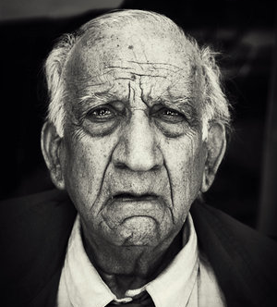
University Health Service
Patient: Culbertson, George
Register
Report
Rounds Report
PT#: 0897709870987
Sex: M MR#: 9845722
Birth date: 3/4/1934 Admit: 6/11/2011
Rm/Bed: EMM Attending: Connors, Greg
Request
Census
History
Discuss
Feedback
Training
Privacy
Blood Test
Electrocardiogram
MRI
CT Scan
About
Blood Test
Electrocardiogram
MRI
CT Scan
Contact
Text size
+
-
~
espagnol

Slide 27
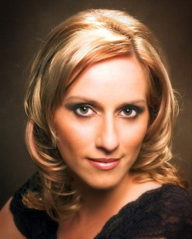
University Health Service
Patient: Culbertson, Susan
Register
Report
Rounds Report
PT#: 0897709870987
Sex: F MR#: 9845758
Birth date: Admit: 6/11/2011
Rm/Bed: EMM Attending: Connors, Greg
Request
Census
History
Discuss
Feedback
Training
Privacy
Blood Test
Electrocardiogram
MRI
CT Scan
About
Contact
Text size
+
-
~
espagnol

Slide 28
University Health Service
Provider: Smead, John
Register
Your patient list: Sex Age MedRec Birth Date Admission Date Attending Dr
Report
Culbertson, George M 77 9845722 EMM 3/4/1934 6/11/2011 Connors, Greg
Request
Census
Culbertson, Susan F 24 9887333 JDC 5/22/1987 6/11/2011 Schneider, Ben
History
Donder, Bill M 21 9823244 EMM 6/4/1990 6/102011 Tabibi, Mary
Discuss
Harris, Emily F 24 9828970 DRD 5/22/1987 6/12/2011 Tabibi, Mary
Feedback
Isaacson, Thomas M 53 9845722 EMM 7/11/1958 6/11/2011 Connors, Greg
Training
Privacy
Burchard, Susan F 24 9887333 JDC 5/22/1987 6/12/2011 Schneider, Ben
About
Culbertson, George M 77 9823244 EMM 3/4/1934 6/11/2011 Connors, Greg
Contact
Culbertson, Susan F 24 9828970 DRD 5/22/1987 6/12/2011 Franks, George
Text size
Albertson, George M 77 9845722 EMM 3/4/1934 6/11/2011 Schneider, Ben
+
-
Burchard, Susan F 24 9887333 JDC 5/22/1987 6/12/2011 Schneider, Ben
~
espagnol
Albertson, George M 77 9823244 EMM 3/4/1934 6/11/2011 Tabibi, Mary
Burchard, Susan F 24 9828970 DRD 5/22/1987 6/12/2011 Schneider, Ben

Slide 29
University Health Service
Provider: Smead, John
Register
Your patient list: Sex Age MedRec Birth Date Admission Date Attending Dr
Report
Request
Census
History
Discuss
Feedback
Training
Privacy
About
Culbertson, George M 77 9823244 EMM 3/4/1934 6/11/2011 Connors, Greg
Contact
Text size
+
-
~
espagnol

Slide 30
Culbertson, George
Register
Report
Request
Census
History
Discuss
Feedback
Training
Privacy
About
Contact
Text size
+
-
~
espagnol

Slide 31
University Health Service
Patient: Culbertson, George
Register
Report
Rounds Report
PT#: 0897709870987
Sex: M MR#: 9845722
Birth date: 3/4/1934 Admit: 6/11/2011
Rm/Bed: EMM Attending: Connors, Greg
Request
Census
History
Discuss
Feedback
Training
Privacy
Blood Test
Electrocardiogram
MRI
CT Scan
About
Contact
Text size
+
-
~
espagnol

Slide 32
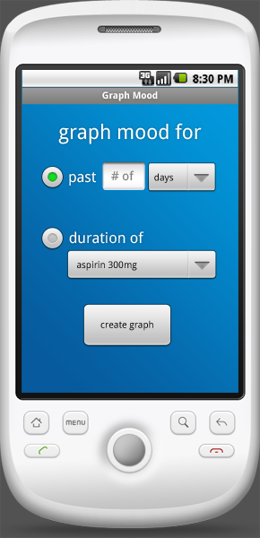
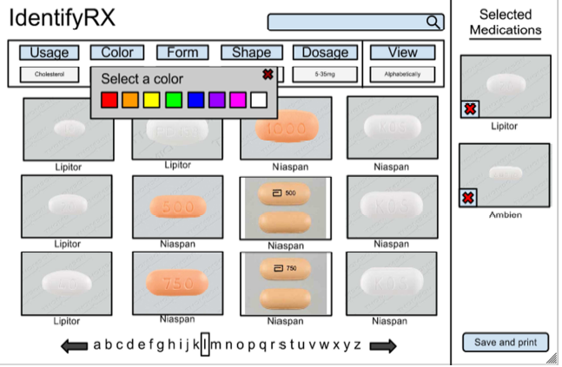
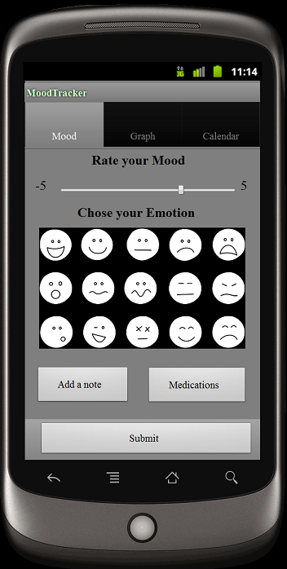
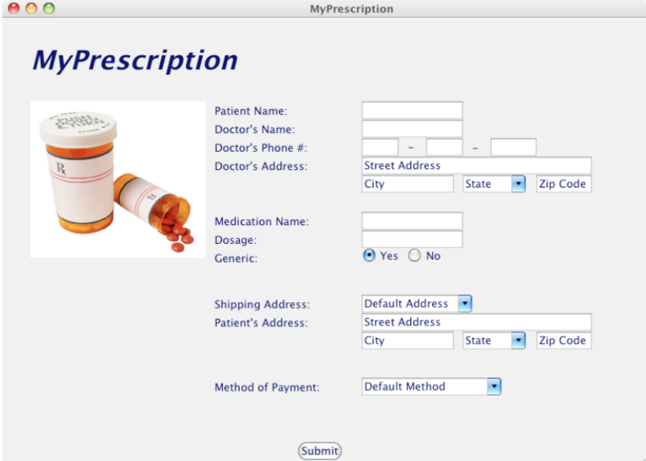
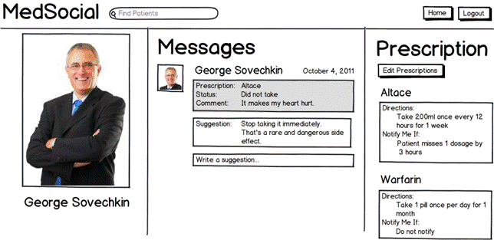
Student spinoff projects
MoodTracker

Slide 33
Next?
Two PhD theses emerging
  - Lab tracking & Systematic Yet Flexible Framework
Nov/Dec special section of ACM Interactions
  - Includes paper by Siemens/Allscripts
Presentations to corporate designers
Users studies & clinician reviews
Comparative analyses & guidelines

Slide 34
  Project 4: Cognitive Information Design and Visualization
Thanks for support (#10510592) from:
Office of the National Coordinator
Strategic Health IT Advanced Research Projects
Pre-doctoral training fellowship:
Agency for Healthcare Research and Quality

