Slide 1

Information Visualization in Medical Informatics Ben Shneiderman ben@cs.umd.edu @benbendc Founding Director (1983-2000), Human-Computer Interaction Lab Professor, Department of Computer Science Member, Institute for Advanced Computer Studies University of Maryland College Park, MD 20742

Slide 2


Interdisciplinary research community
- Computer Science & Info Studies
- Psych, Socio, Poli Sci & MITH
(www.cs.umd.edu/hcil)

Slide 3
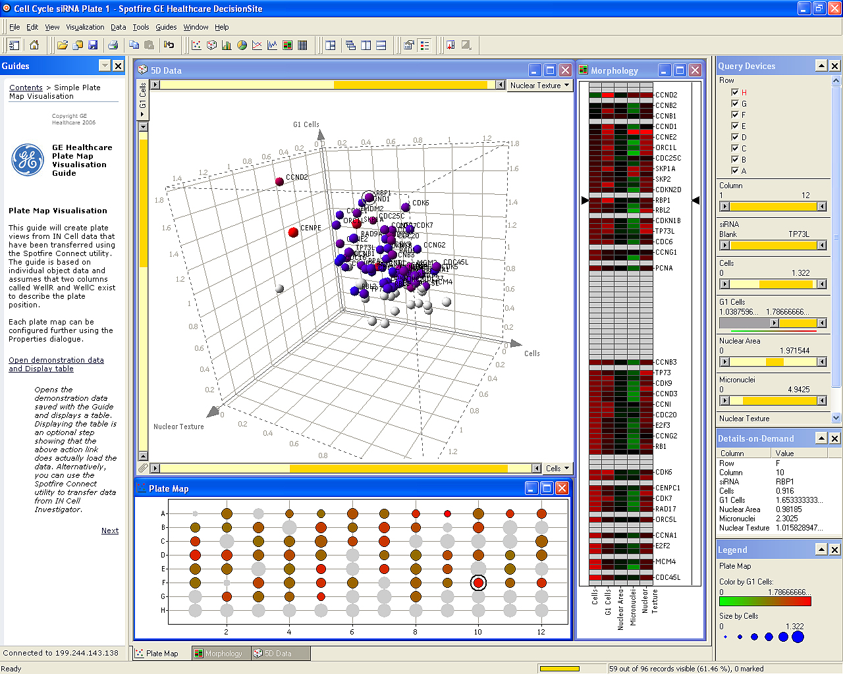
Spotfire: Retinol’s role in embryos & vision
Notes:
"The IN Cell Analyzer automated microscope was used to identify proteins influencing the division of human cells. After the images were analyzed, quantitative results were transferred to Spotfire DecisionSite. This screen revealed the previously unknown involvement of the retinol binding protein RBP1 in cell cycle control.(Stubbs S, & Thomas N. 2006 Methods in Enzymology; 414:1-21.) Retinol a form of Vitamin A plays a crucial role in vision and during embryonic development"

Slide 4
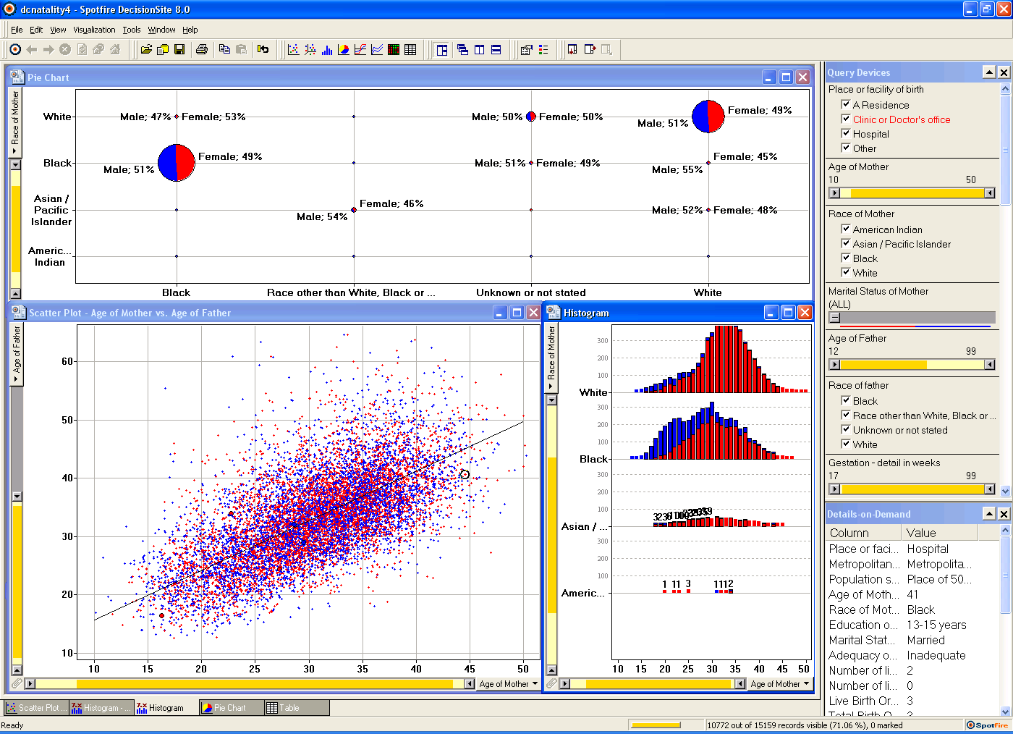
Spotfire: DC natality data

Slide 5

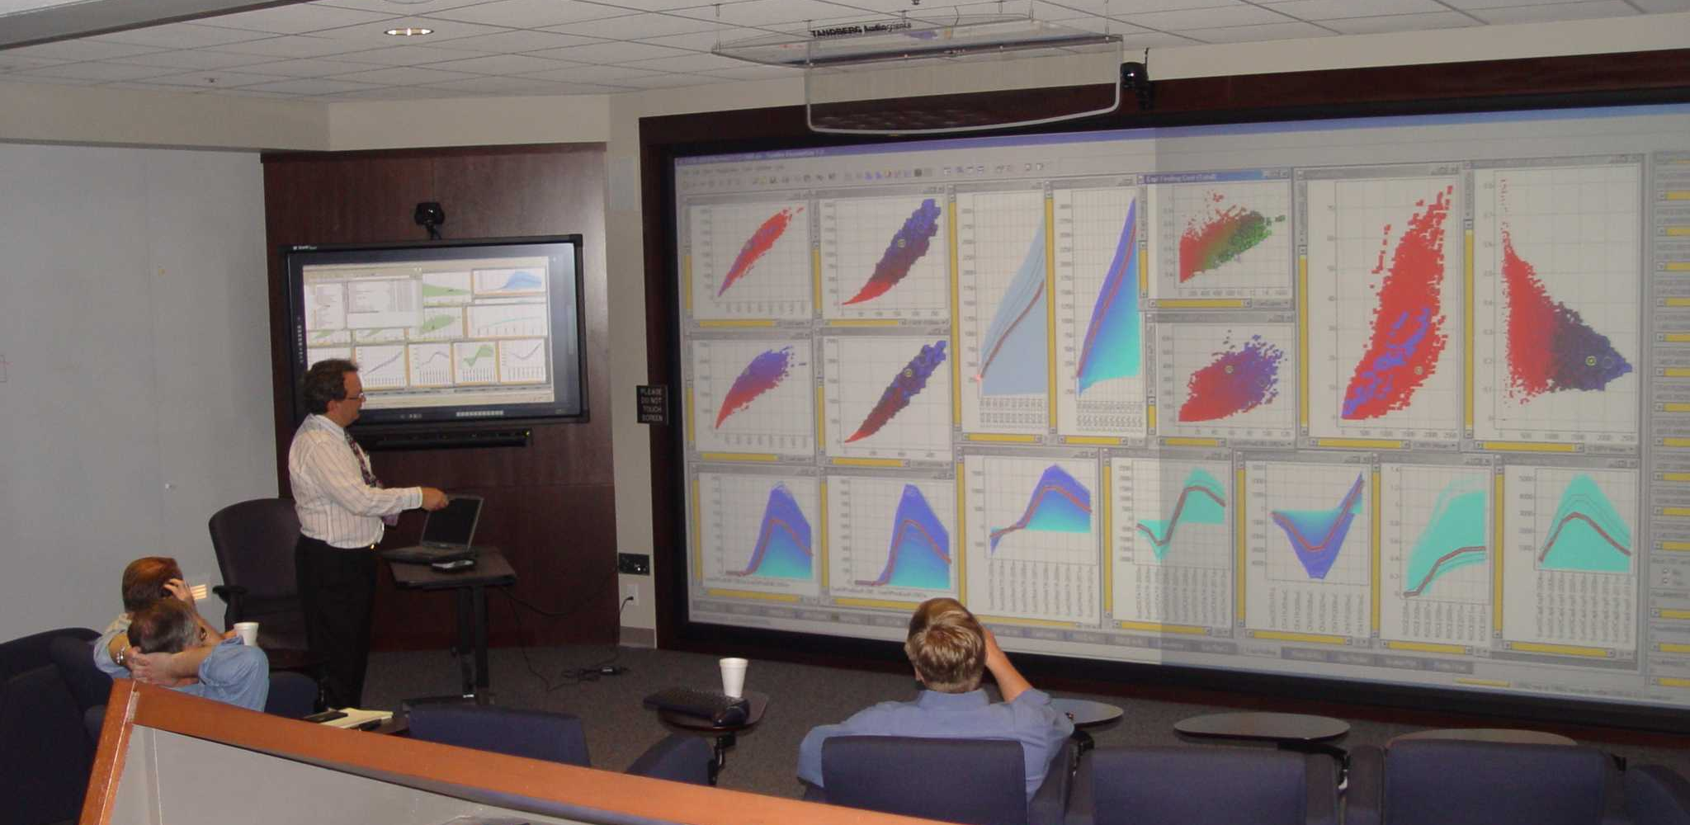

Slide 6
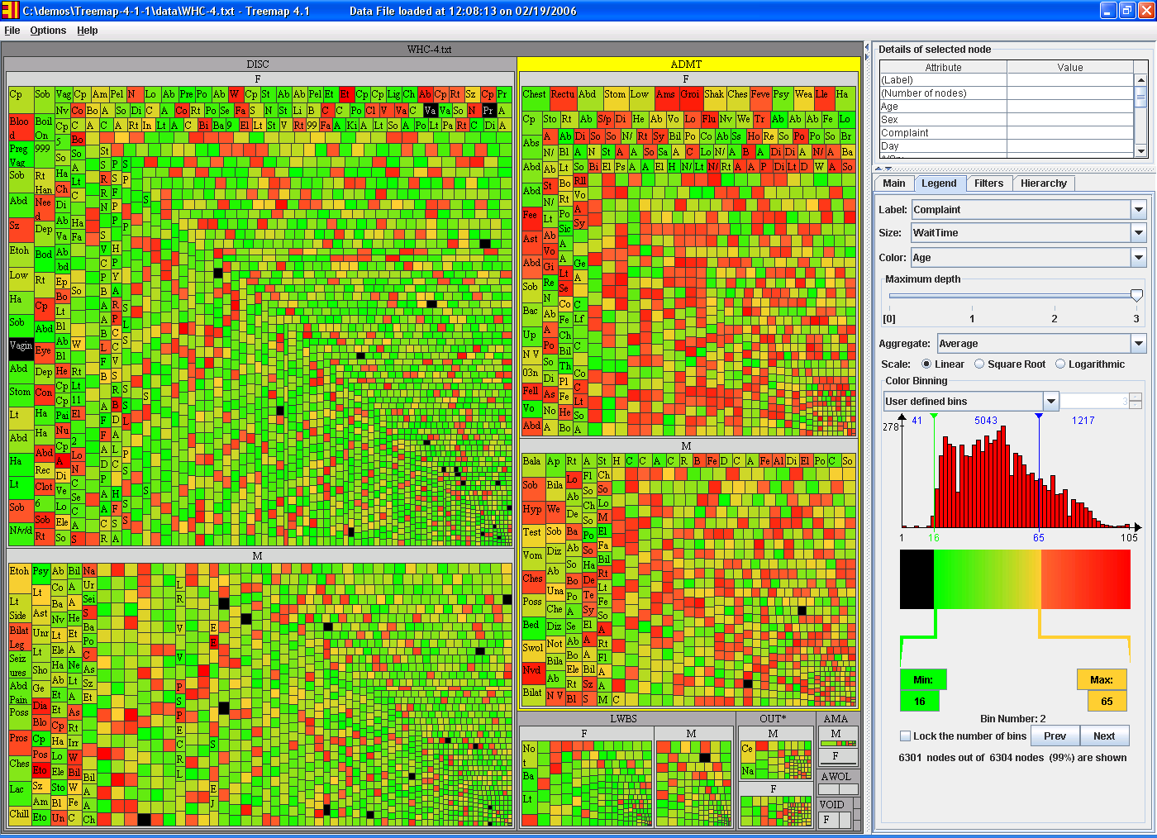
Treemap: WHC Emergency Room (6304 patients in Jan2006)
Group by Admissions/MF, size by service time, color by age

Slide 7
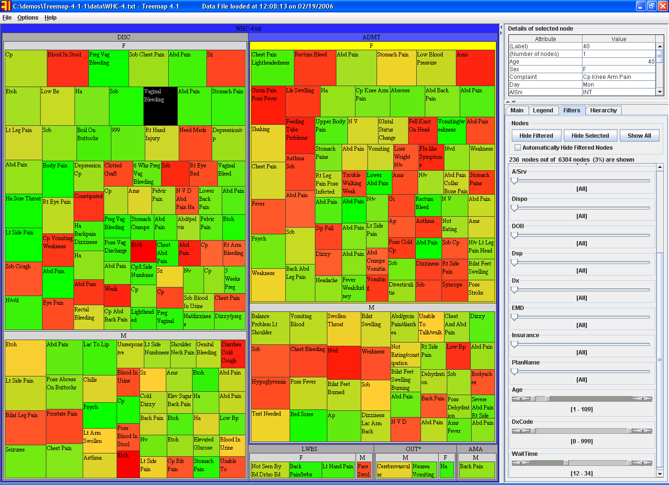
Treemap: WHC Emergency Room (6304 patients in Jan2006) (only those service time >12 hours)
Group by Admissions/MF, size by service time, color by age

Slide 8
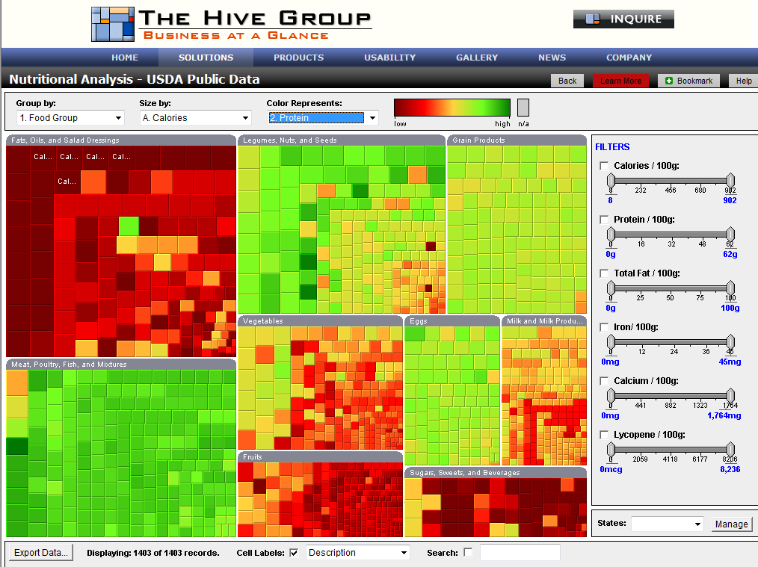
Treemap: Nutritional Analysis
www.hivegroup.com

Slide 9
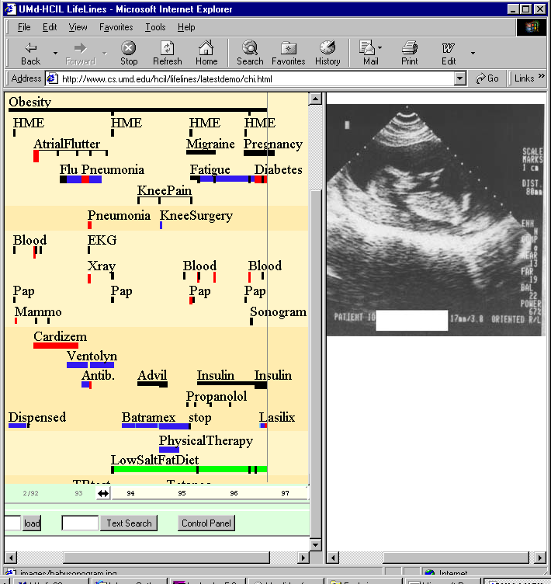
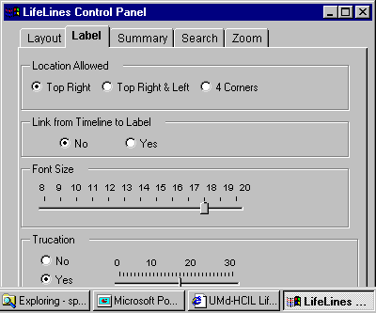
LifeLines: Patient Histories
www.cs.umd.edu/hcil/lifelines

Slide 10
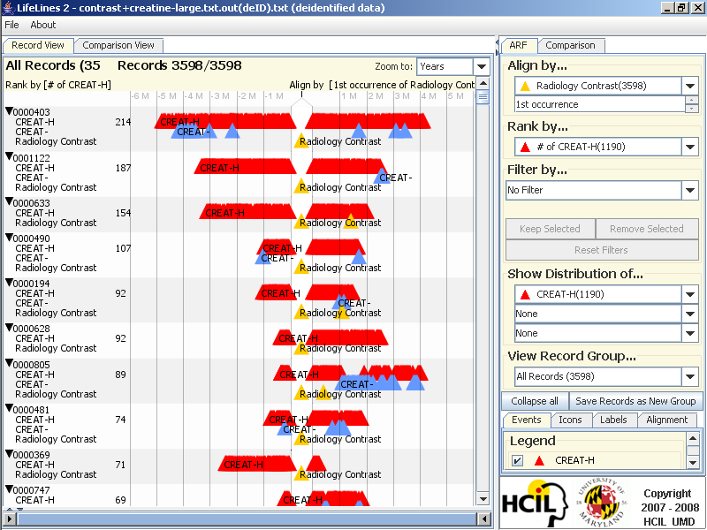
LifeLines2: Contrast+Creatine
Notes:
Contrast and Creatinine dataset
In some diagnostic radiology procedures, patients are injected contrast material. However, some patients develop adverse side
effects to the contrast material. One serious side effect is renal failure, which is detected by high creatinine levels in a patient's blood.
This adverse effect usually occur within two weeks after the radiology contrast. WHC is interested in finding the proportion
of patients who exhibit this condition in historical records.
Screenshots
1-aligned-ranked.png:
We align by the 1st occurrence of radiology contrast and rank by the number of creatinine high (CREAT-H) events to bring
the most severe patients to the top. We realize two things: (1) some patients have more than 1 "Radiology Contrast" events,
and (2), some patients have consistently high creatinine readings (chronic kidney failure).
2-aligned(all)-distribution-selected.png
We align by all occurrences of raiology contrast, and then show the temporal summary of CREAT-H events.
The patients are presented in 4 exclusive sets in the summary: those who have CREAT-H only before alignment, only after
alignment, both before and after, and neither. We then select from the "only after" summary the patients who have
at least one CREAT-H event within 2 weeks of any "Radiology Contrast" event. There are 421 patients.

Slide 11
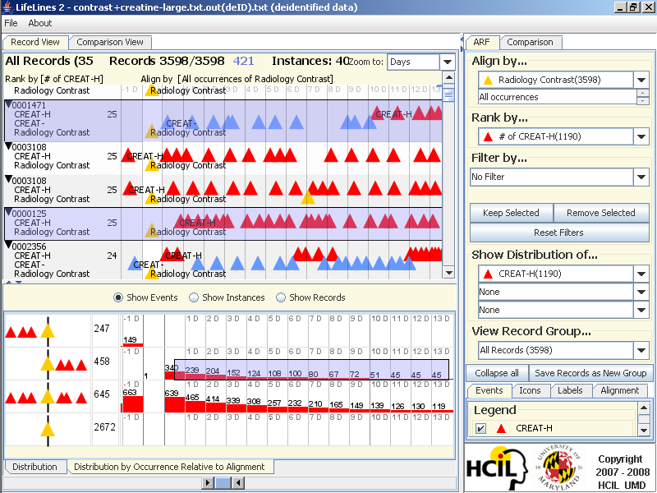
LifeLines2: Align-Rank-Filter & Summarize

Slide 12
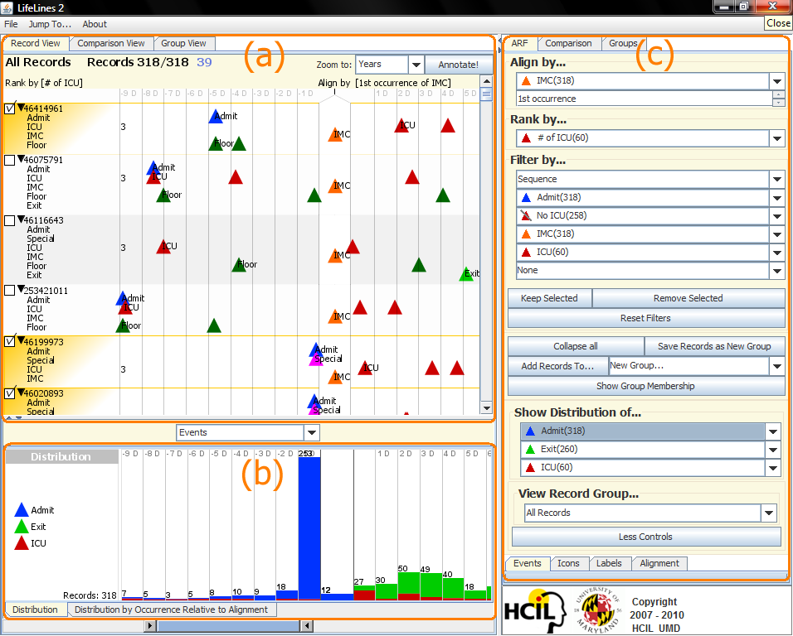
LifeLines2: Align-Rank-Filter & Summarize
Notes:
(a) shows the main visualization of multiple EHRs. (b) is a temporal summary, showing the distribution of the three event types Admit, Exit, and ICU over time. (c) is the control panel for Lifelines2. Each of the 318 patients is aligned by their 1st occurrence of IMC, ranked by the number of ICU events, and filtered by the sequence of events.

Slide 13
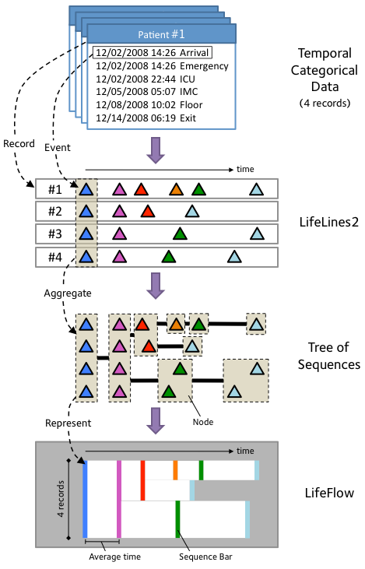
LifeFlow: Aggregation Strategy
Temporal
Categorical Data
(4 records)
LifeLines2 format
Tree of Event Sequences
LifeFlow Aggregation
www.cs.umd.edu/hcil/lifeflow

Slide 14
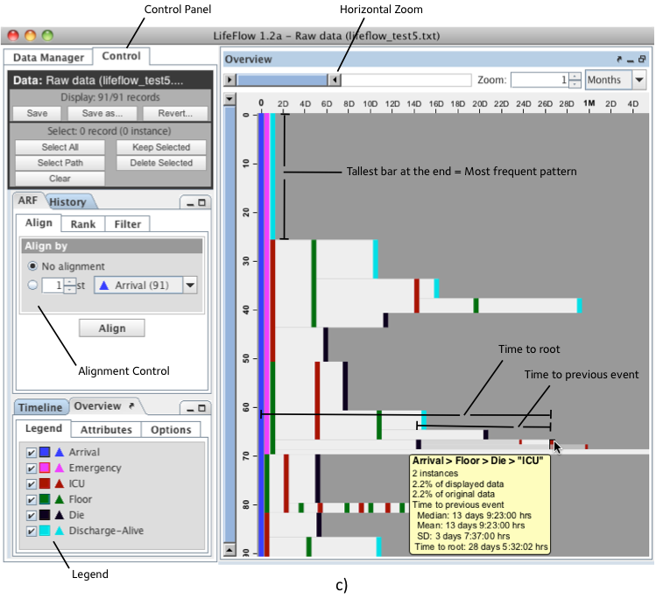
LifeFlow: Interface with User Controls

Slide 15
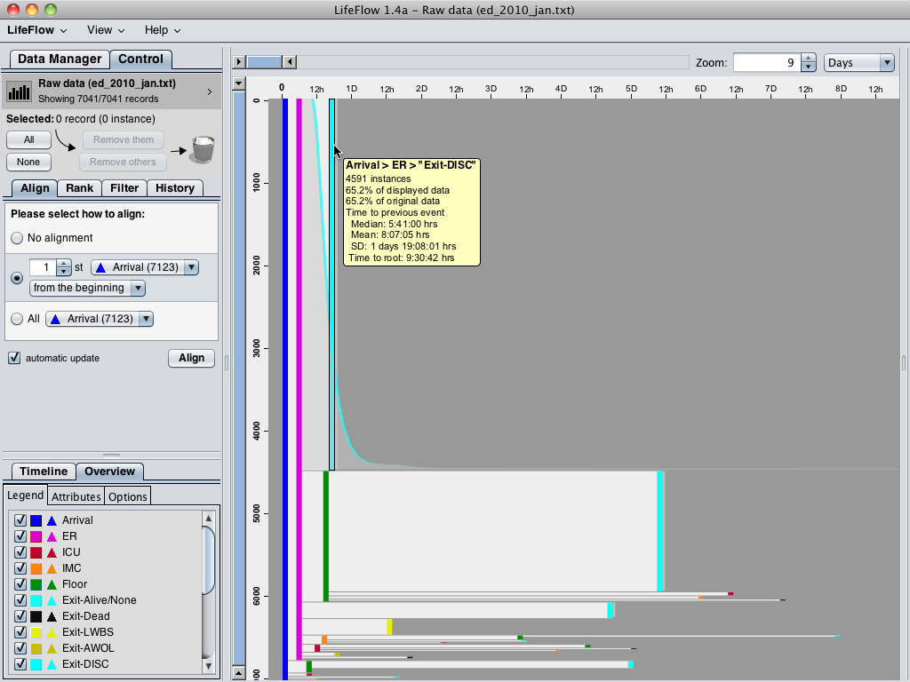
Notes:
Using LifeFlow, 7,041 patients are aggregated into this visualization and LifeFlow immediately reveal the most common pattern, which you could not do easily in SQL.
You could easily notice this huge pattern “Arrival -> ER -> Exit”, meaning patients who visited with minor injuries or simple conditions and left the hospital immediately after receiving their treatment.
When hovering the mouse over, LifeFlow displays a tooltip that gives more information, such as number of patients and other statistics, and also shows the distribution of the patients.
As the horizontal gap represents time, you can see from the distribution that some patients left the hospital very quickly after visiting the emergency room while some of them stayed longer.
*optional
The second most common pattern is “Arrival (Blue) -> ER (Pink) -> Floor (Green) -> Exit (Cyan)”, meaning patients who were admitted to observe the conditions and then everything went well so they left the hospital.
You can also use the horizontal gap to compare these patients with the patients who exit from the emergency room.
Comparing the gap from pink to cyan and pink to green, you can see that the gap from pink to green is smaller than pink to cyan, so the patients were transferred to Floor faster than exit the hospital in average.
You have seen the two most common cases, now I will remove the common patterns so we can analyze the less frequent patterns.

Slide 16
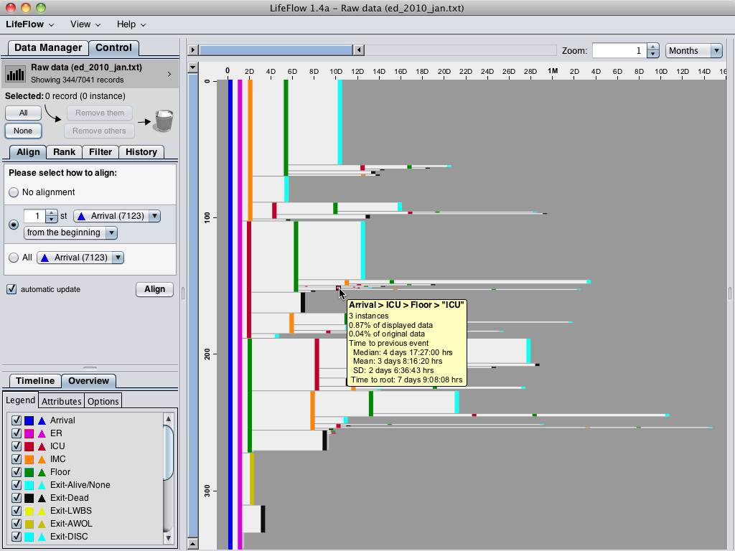
Notes:
After removing all the common cases, we have 344 patients left.
These are mostly the patients who were admitted.
There are many information that I can explain from this visualization here, but I will go straight into the case that our physician partners are mostly interested in.
The mouse is pointing at this sequence, which represents the “bounce backs” patients, meaning patients who were transferred from ICU to Floor because they seemed to get better, however, they were transferred back to the ICU.
So the physician are interested in finding these patients to analyze what made them made the wrong decisions.
*optional
Another case is the step ups, which means the patients whose level of care were escalated to higher level, you can see from the visualization that there were patients who were transferred from ER to Floor (green) to ICU (red) and IMC (orange).
The number of these patients and the average transferred time could be compare to the hospital standards to measure the quality of care.

Slide 17
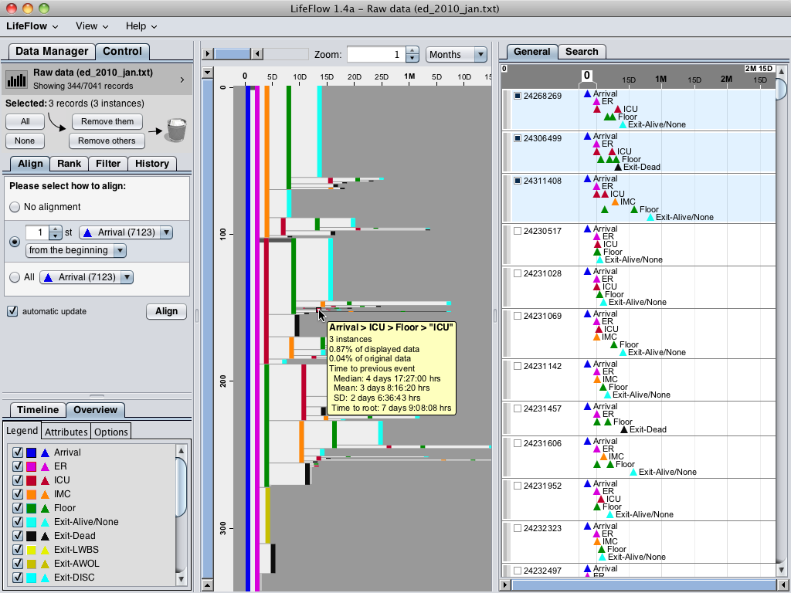
Notes:
Ben: This slide is optional. You can use it to show that when you click on the bounce backs patients, you can get the details of each patient in LifeLines2 view.

Slide 18
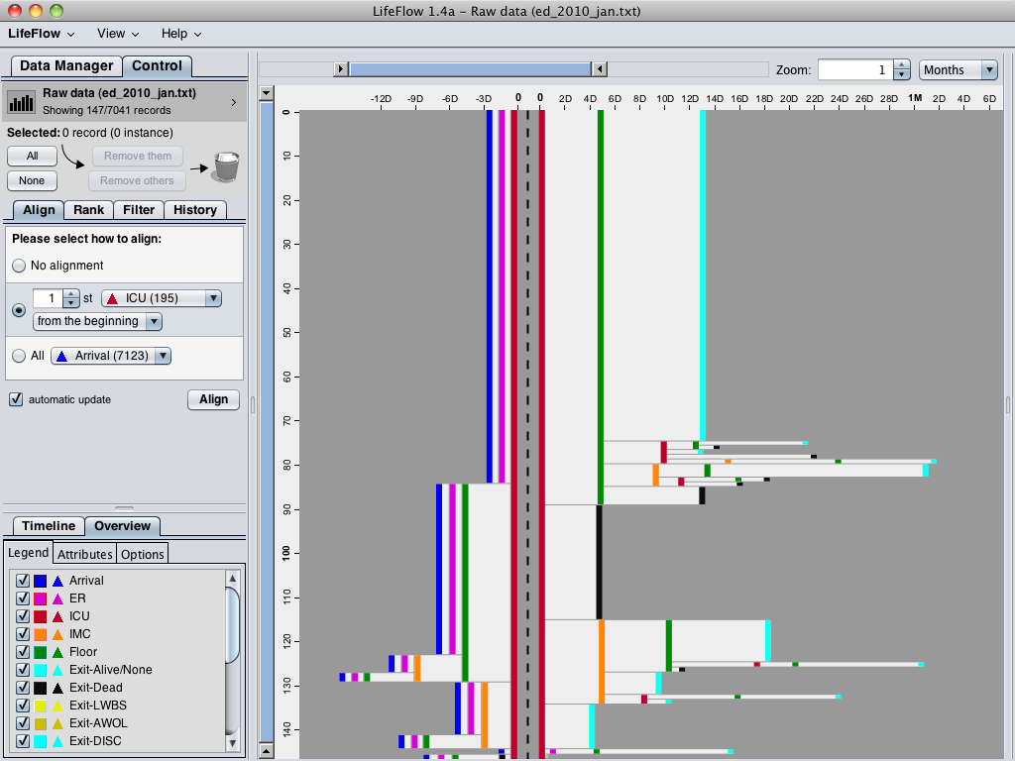
Notes:
Another interesting feature is you can align by a particular event.
For example, if you want to know what happened before and after the patients went to the ICU, you can align by ICU.
The dash line separate between what happened before and what happened after.
You can see that the ICU patients mostly came from the ER (pink), and most of them were transferred to Floor (green) after that.
Unfortunately, some of them died after they were transferred to the ICU (black).
From this visualization, you may notice a small pattern in the bottom.
Let me zoom in.

Slide 19
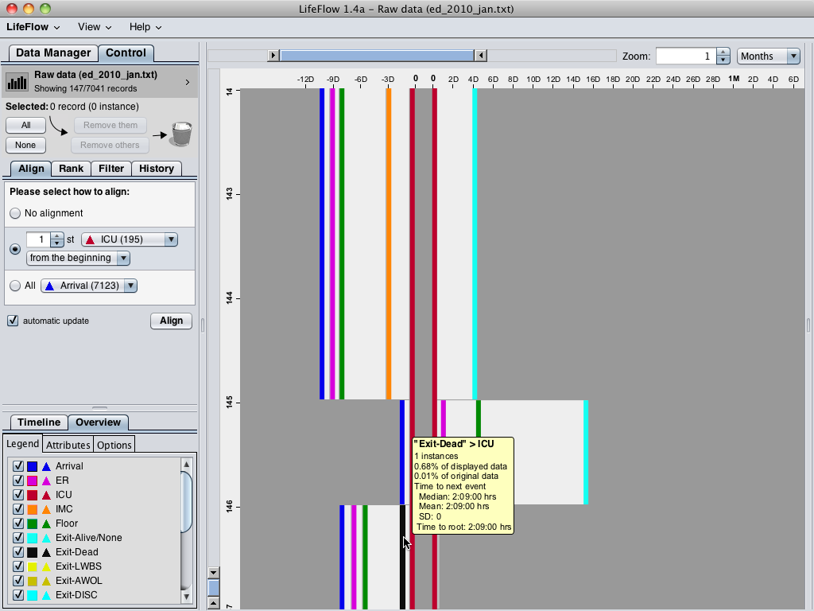
Notes:
So this patient was dead before transferred to the ICU, which is impossible.
Of course, this must be problem with data entry.
But we may never notice it if the data are hidden in the database.
Therefore, you can see that LifeFlow support this kind of analysis by
giving overview, showing common trends,
providing summary of every sequences, you can do SQL and calculate average for every transfer if you like, but in LifeFlow, it is right there, you just need to move your mouse over.
showing every possible transfer pattern and may led you to a discovery of surprising pattern.

Slide 20
Office of National Coordinator: SHARP
Strategic Health IT Advanced Research Projects
- Security of Health Information Technology
- Patient-Centered Cognitive Support
- Healthcare Application and Network Platform Architectures
- Secondary Use of EHR Data
Univ of Maryland HCIL tasks
- Missing Laboratory Reports
- Medication Reconciliation
- Alarms and Alerts Management
www.cs.umd.edu/hcil/sharp

Slide 21
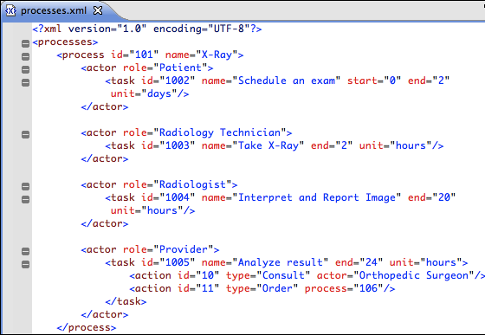
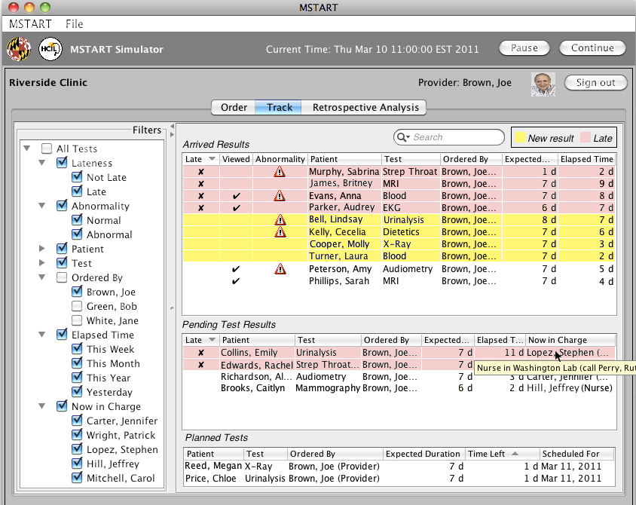
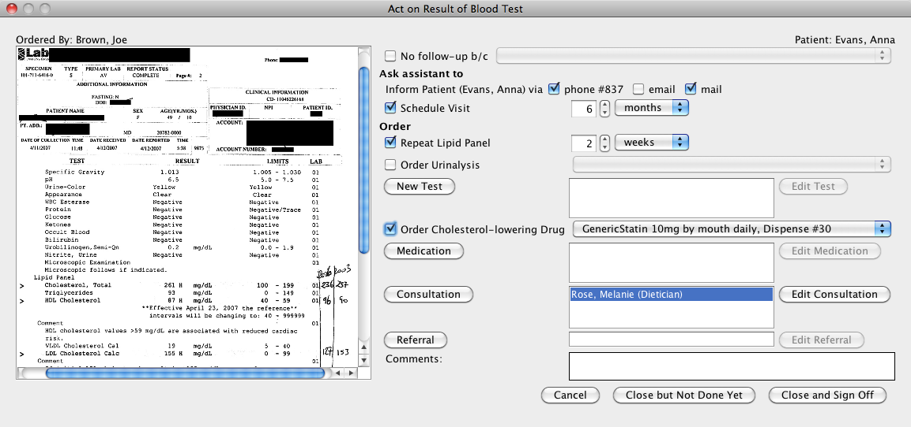
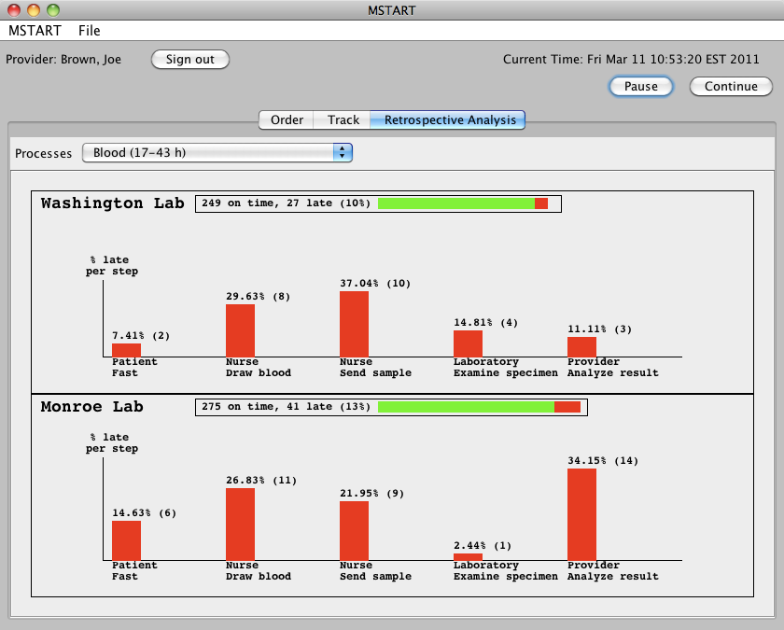
Lab test tracking to ensure completion
Define tracking processes
Assign temporal responsibility
Define possible actions Predict expected duration
Generate User Interface from processes Enhance situation awareness
Integrate follow-up actions with results Simplify rapid operations Provide retrospective analysis
PhD work: Sureyya Tarkan

Slide 22
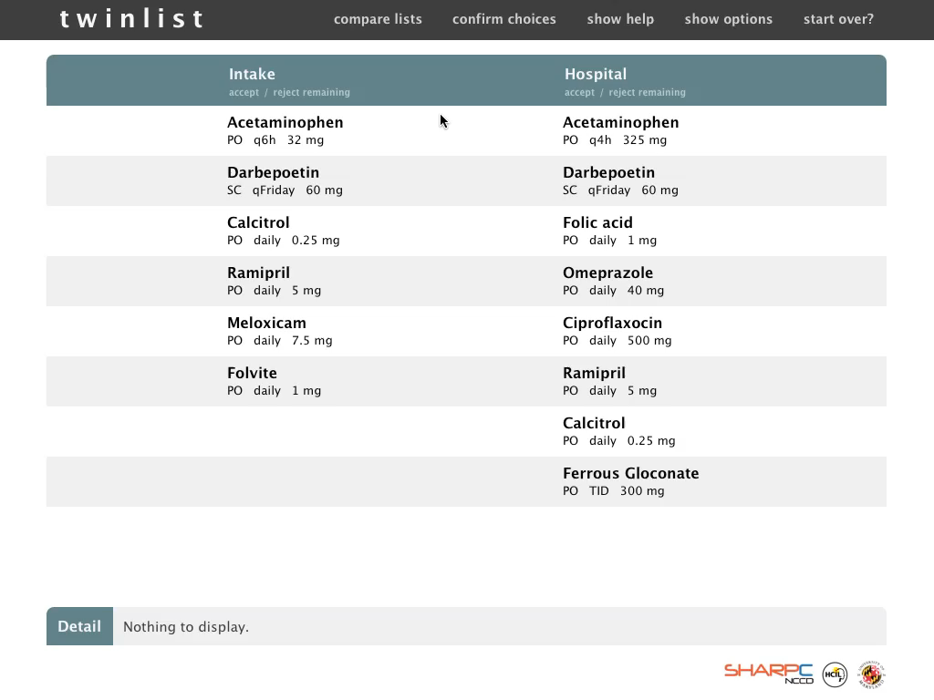

Slide 23
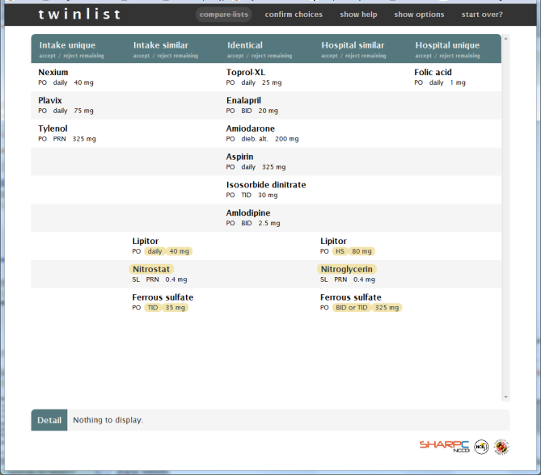
Twinlist: Medication Reconciliation
”Best reconciliation app I have ever seen”
Dr. Shawn Murphy, PartnersHealthcare & Harvard Medical
”Super-cool demo”
Dr. Jonathan Nebeker, Univ of Utah & VA
Tiffany Chao, Catherine Plaisant, Ben Shneideman
Based on class project of : Leo Claudino, Sameh Khamis, Ran Liu, Ben London, Jay Pujara
Students of CMSC734 Information Visualization class

Slide 24
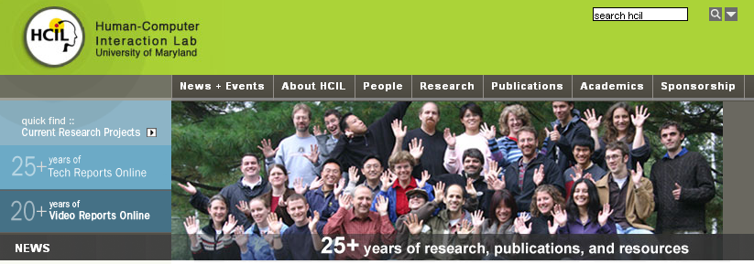
29th Annual Symposium
May 22-23, 2012
www.cs.umd.edu/hcil

