Slide 1

Information Visualization in Medical Informatics
Ben Shneiderman ben@cs.umd.edu @benbendc
Founding Director (1983-2000), Human-Computer Interaction Lab
Professor, Department of Computer Science
Member, Institute for Advanced Computer Studies
University of Maryland
College Park, MD 20742

Slide 2


Interdisciplinary research community
- Computer Science & Info Studies
- Psych, Socio, Poli Sci & MITH
(www.cs.umd.edu/hcil)

Slide 3
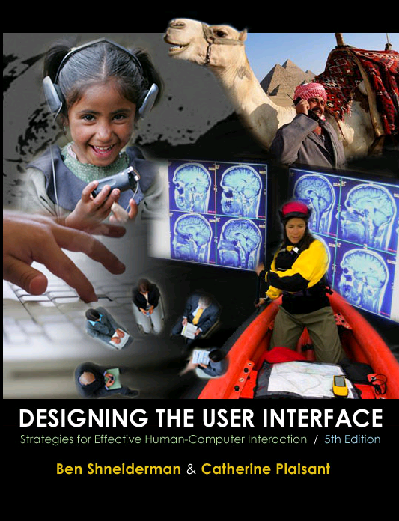
Design Issues
Input devices & strategies
  Keyboards, pointing devices, voice
  Direct manipulation
  Menus, forms, commands
Output devices & formats
  Screens, windows, color, sound
  Text, tables, graphics
  Instructions, messages, help
Collaboration & Social Media
Help, tutorials, training
Search
www.awl.com/DTUI
Fifth Edition: 2010
Visualization

Slide 4

Information Visualization & Visual Analytics
Visual bands
  Human percle
    Trend, clus..
    Color, size,..
Three challe
  Meaningful vi
  Interaction: w
  Process mo
  1999

Slide 5

Information Visualization & Visual Analytics
Visual bandwidth is enormous
  Human perceptual skills are remarkable
    Trend, cluster, gap, outlier...
    Color, size, shape, proximity...
Three challenges
  Meaningful visual displays of massive da
  Interaction: widgets & window coordinati
  Process models for discovery
  1999 2004

Slide 6
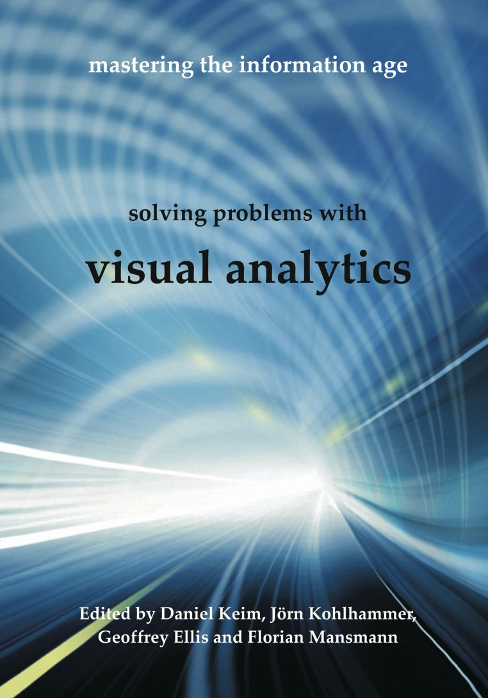
Information Visualization & Visual Analytics
Visual bandwidth is enormous
  Human perceptual skills are remarkable
    Trend, cluster, gap, outlier...
    Color, size, shape, proximity...
Three challenges
  Meaningful visual displays of massive data
  Interaction: widgets & window coordination
  Process models for discovery
  1999 2004 2010

Slide 7
Business takes action
General Dynamics buys MayaViz
Agilent buys GeneSpring
Google buys Gapminder
Oracle buys Hyperion
Microsoft buys Proclarity
InfoBuilders buys Advizor Solutions
SAP buys (Business Objects buys
Xcelsius & Inxight & Crystal Reports )
IBM buys (Cognos buys Celequest) & ILOG
TIBCO buys Spotfire

Slide 8
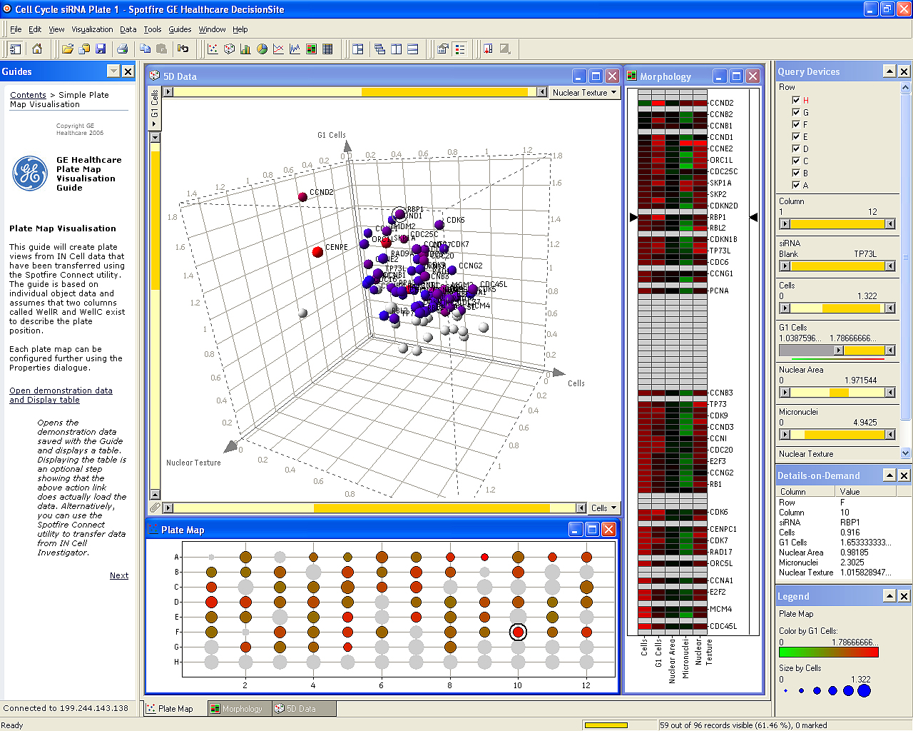
Spotfire: Retinol’s role in embryos & vision
Notes:
"The IN Cell Analyzer automated microscope was used to identify proteins influencing the division of human cells. After the images were analyzed, quantitative results were transferred to Spotfire DecisionSite. This screen revealed the previously unknown involvement of the retinol binding protein RBP1 in cell cycle control.(Stubbs S, & Thomas N. 2006 Methods in Enzymology; 414:1-21.) Retinol a form of Vitamin A plays a crucial role in vision and during embryonic development"

Slide 9
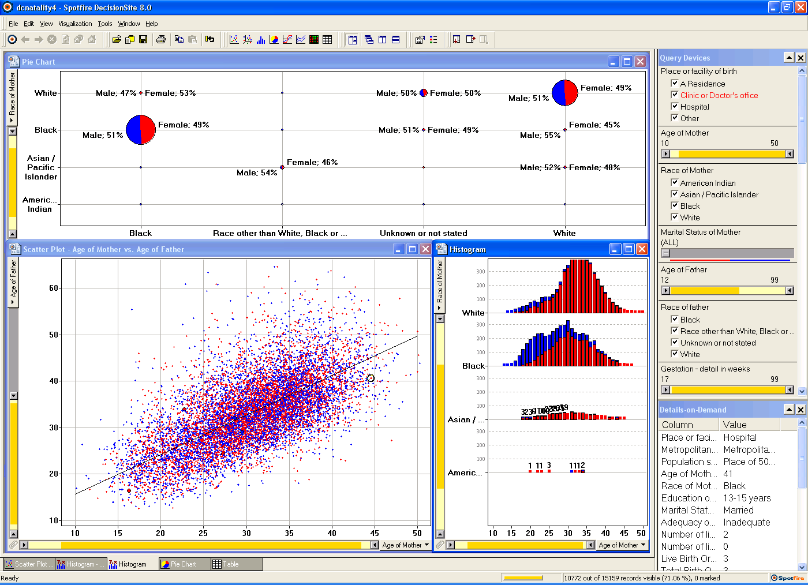
Spotfire: DC natality data

Slide 10

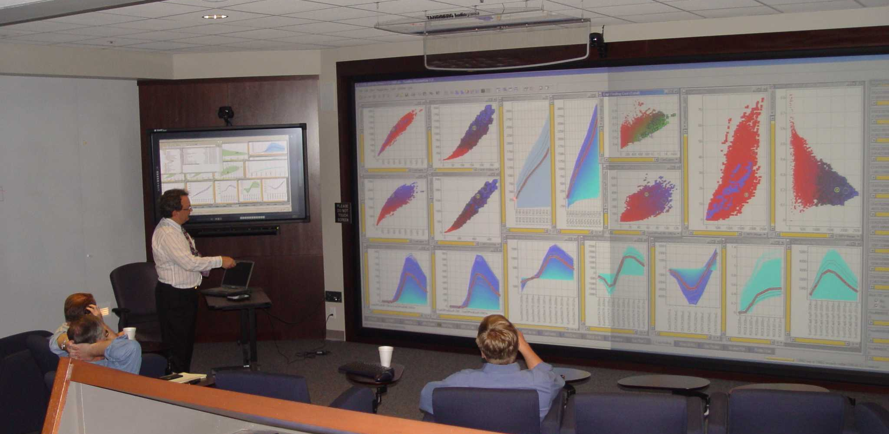

Slide 11
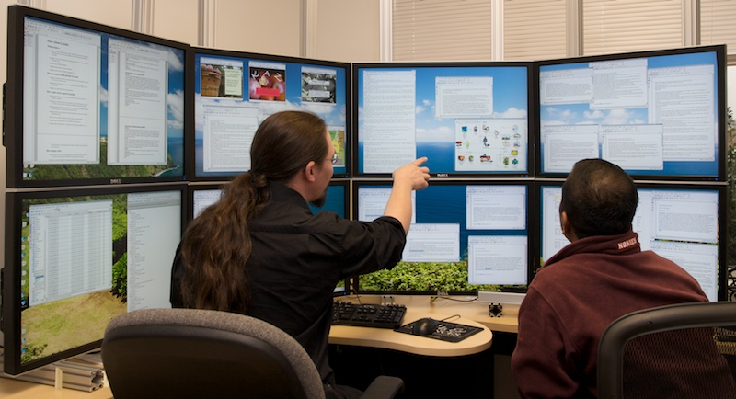

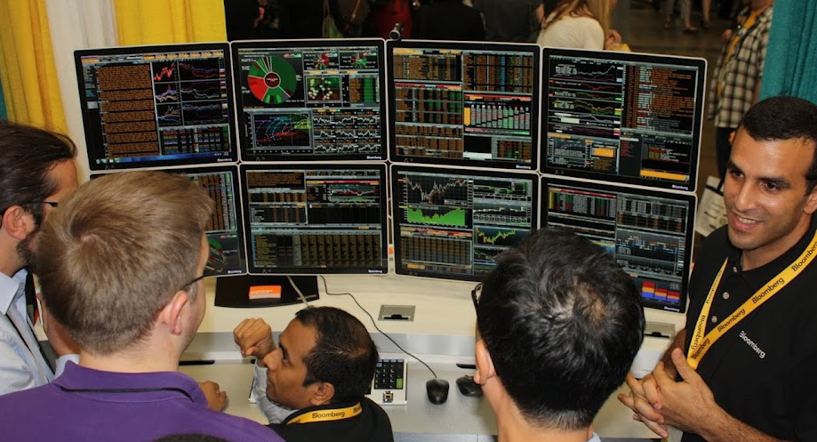
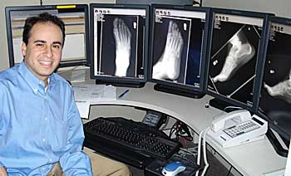
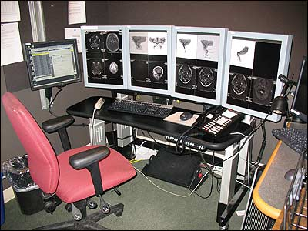
10M - 100M pixels: Large displays

Slide 12
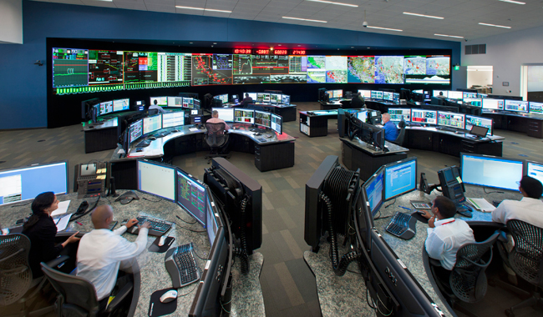
100M-pixels & more

Slide 13
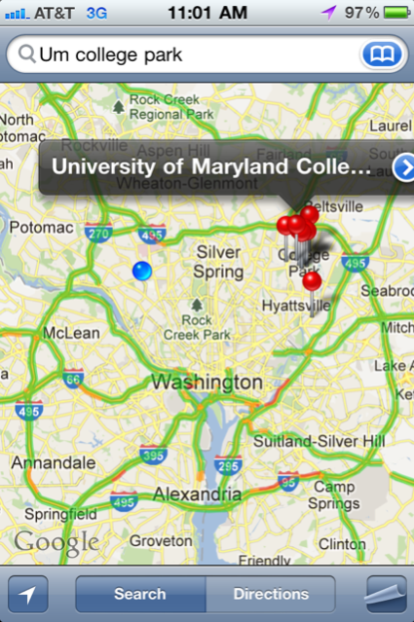
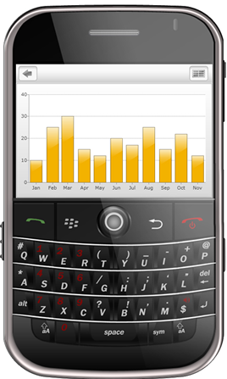
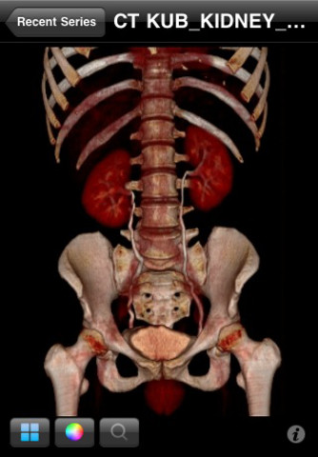
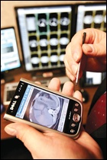
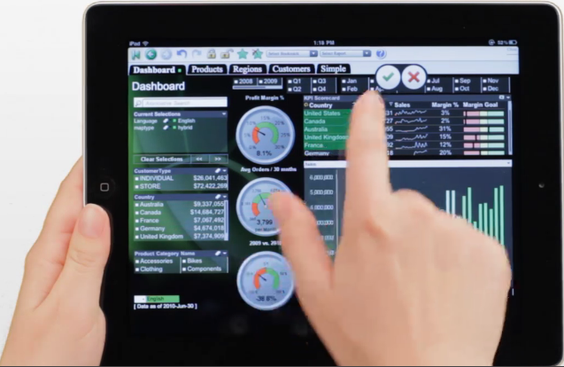
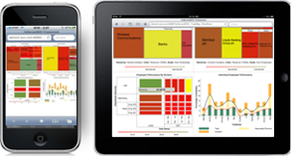
1M-pixels & less
Small mobile devices

Slide 14
Information Visualization: Mantra
Overview, zoom & filter, details-on-demand
Overview, zoom & filter, details-on-demand
Overview, zoom & filter, details-on-demand
Overview, zoom & filter, details-on-demand
Overview, zoom & filter, details-on-demand
Overview, zoom & filter, details-on-demand
Overview, zoom & filter, details-on-demand
Overview, zoom & filter, details-on-demand
Overview, zoom & filter, details-on-demand
Overview, zoom & filter, details-on-demand

Slide 15
Information Visualization: Data Types
InfoViz SciViz .
1-D Linear Document Lens, SeeSoft, Info Mural
2-D Map GIS, ArcView, PageMaker, Medical imagery
3-D World CAD, Medical, Molecules, Architecture
Multi-Var Spotfire, Tableau, Qliktech, Visual Insight
Temporal LifeLines, TimeSearcher, Palantir, DataMontage
Tree Cone/Cam/Hyperbolic, SpaceTree, Treemap
Network Pajek, UCINet, NodeXL, Gephi, Tom Sawyer
infosthetics.com visualcomplexity.com eagereyes.org
flowingdata.com perceptualedge.com datakind.org
visual.ly visualizing.org infovis.org

Slide 16
Anscombe’s Quartet
1 |  | 2 |  | 3 |  | 4
x | y | x | y | x | y | x | y
10.0 | 8.04 | 10.0 | 9.14 | 10.0 | 7.46 | 8.0 | 6.58
8.0 | 6.95 | 8.0 | 8.14 | 8.0 | 6.77 | 8.0 | 5.76
13.0 | 7.58 | 13.0 | 8.74 | 13.0 | 12.74 | 8.0 | 7.71
9.0 | 8.81 | 9.0 | 8.77 | 9.0 | 7.11 | 8.0 | 8.84
11.0 | 8.33 | 11.0 | 9.26 | 11.0 | 7.81 | 8.0 | 8.47
14.0 | 9.96 | 14.0 | 8.10 | 14.0 | 8.84 | 8.0 | 7.04
6.0 | 7.24 | 6.0 | 6.13 | 6.0 | 6.08 | 8.0 | 5.25
4.0 | 4.26 | 4.0 | 3.10 | 4.0 | 5.39 | 19.0 | 12.50
12.0 | 10.84 | 12.0 | 9.13 | 12.0 | 8.15 | 8.0 | 5.56
7.0 | 4.82 | 7.0 | 7.26 | 7.0 | 6.42 | 8.0 | 7.91
5.0 | 5.68 | 5.0 | 4.74 | 5.0 | 5.73 | 8.0 | 6.89

Slide 17
Anscombe’s Quartet
1 |  | 2 |  | 3 |  | 4
x | y | x | y | x | y | x | y
10.0 | 8.04 | 10.0 | 9.14 | 10.0 | 7.46 | 8.0 | 6.58
8.0 | 6.95 | 8.0 | 8.14 | 8.0 | 6.77 | 8.0 | 5.76
13.0 | 7.58 | 13.0 | 8.74 | 13.0 | 12.74 | 8.0 | 7.71
9.0 | 8.81 | 9.0 | 8.77 | 9.0 | 7.11 | 8.0 | 8.84
11.0 | 8.33 | 11.0 | 9.26 | 11.0 | 7.81 | 8.0 | 8.47
14.0 | 9.96 | 14.0 | 8.10 | 14.0 | 8.84 | 8.0 | 7.04
6.0 | 7.24 | 6.0 | 6.13 | 6.0 | 6.08 | 8.0 | 5.25
4.0 | 4.26 | 4.0 | 3.10 | 4.0 | 5.39 | 19.0 | 12.50
12.0 | 10.84 | 12.0 | 9.13 | 12.0 | 8.15 | 8.0 | 5.56
7.0 | 4.82 | 7.0 | 7.26 | 7.0 | 6.42 | 8.0 | 7.91
5.0 | 5.68 | 5.0 | 4.74 | 5.0 | 5.73 | 8.0 | 6.89
Property | Value
Mean of x | 9.0
Variance of x | 11.0
Mean of y | 7.5
Variance of y | 4.12
Correlation | 0.816
Linear regression | y = 3 + 0.5x

Slide 18
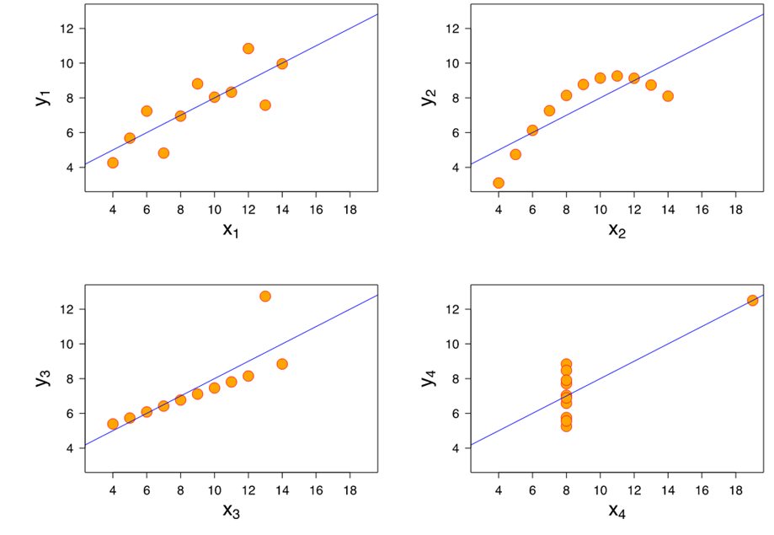
Anscombe’s Quartet

Slide 19
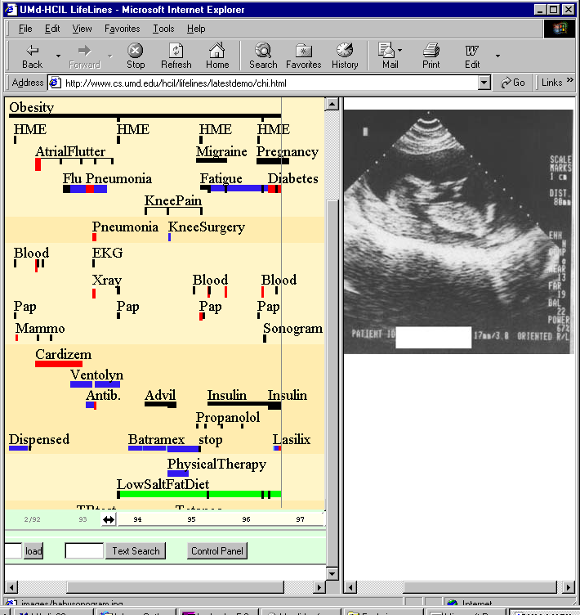
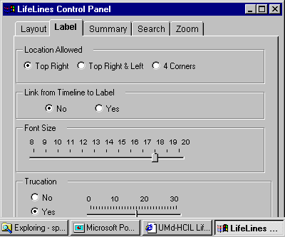
LifeLines: Patient Histories
www.cs.umd.edu/hcil/lifelines

Slide 20
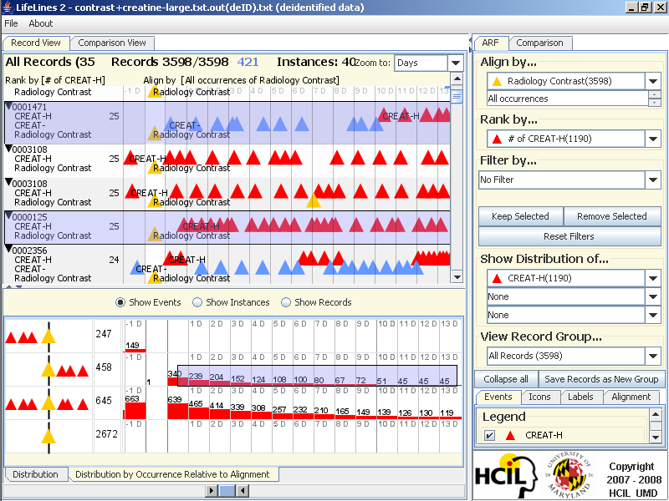
LifeLines2: Align-Rank-Filter & Summarize
www.cs.umd.edu/hcil/lifelines

Slide 21
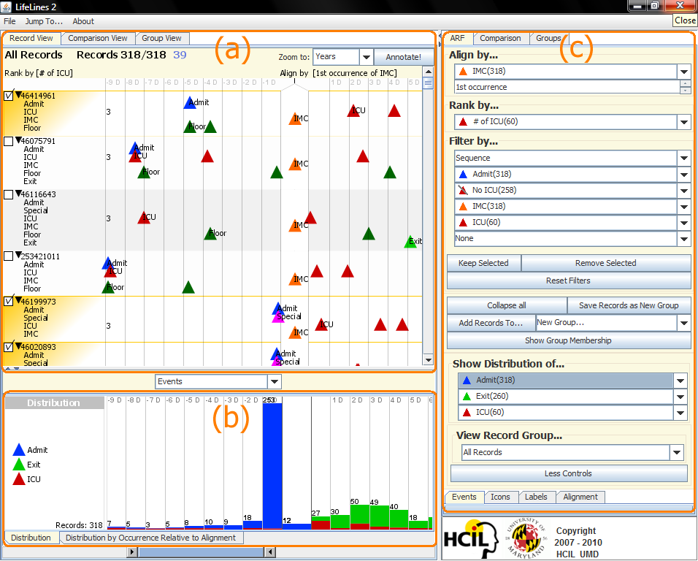
LifeLines2: Align-Rank-Filter & Summarize
www.cs.umd.edu/hcil/lifelines2
Notes:
(a) shows the main visualization of multiple EHRs. (b) is a temporal summary, showing the distribution of the three event types Admit, Exit, and ICU over time. (c) is the control panel for Lifelines2. Each of the 318 patients is aligned by their 1st occurrence of IMC, ranked by the number of ICU events, and filtered by the sequence of events.

Slide 22
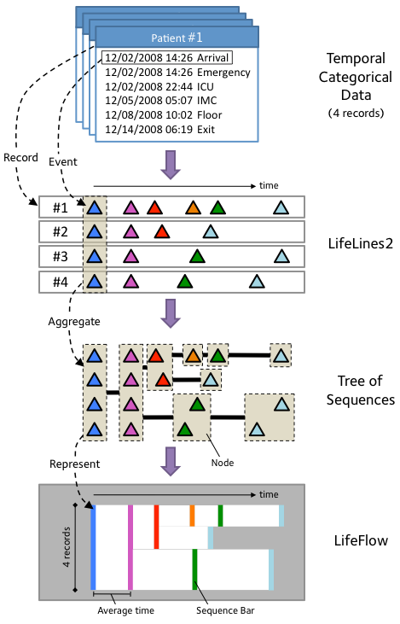
LifeFlow: Aggregation Strategy
Temporal
Categorical Data
(4 records)
LifeLines2 format
Tree of Event
Sequences
LifeFlow Aggregation
www.cs.umd.edu/hcil/lifeflow

Slide 23
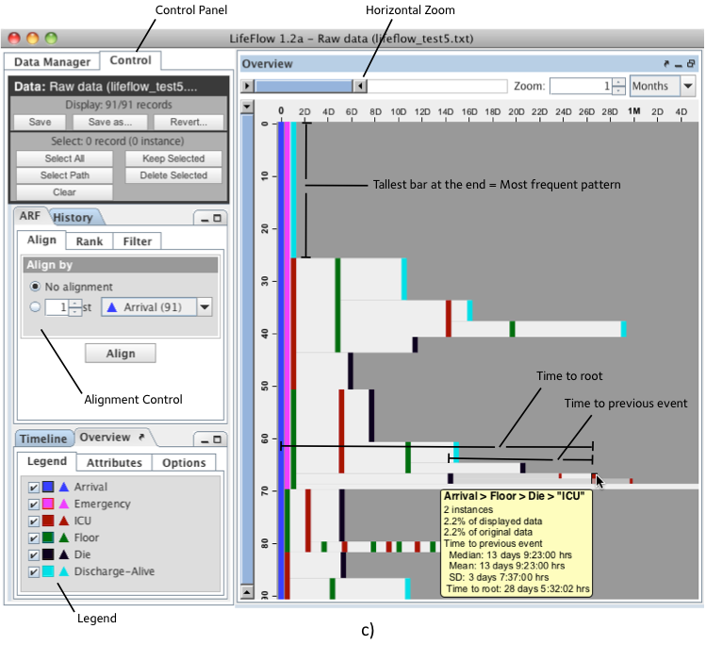
LifeFlow: Interface with User Controls

Slide 24
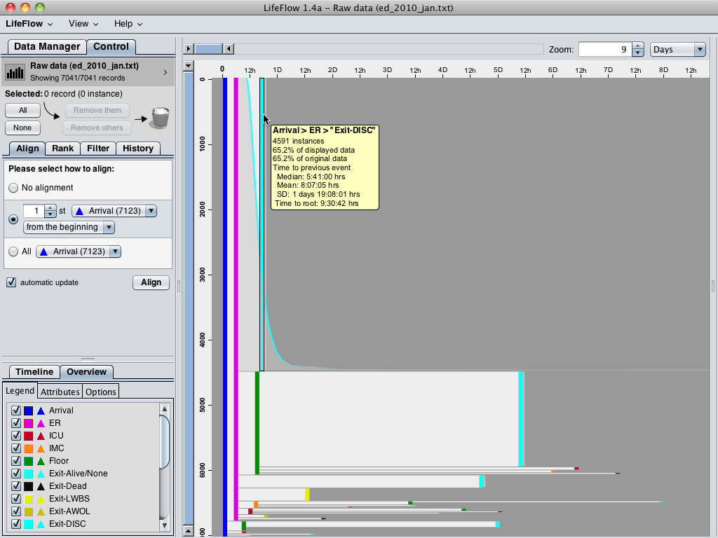
Notes:
Using LifeFlow, 7,041 patients are aggregated into this visualization and LifeFlow immediately reveal the most common pattern, which you could not do easily in SQL.
You could easily notice this huge pattern “Arrival -> ER -> Exit”, meaning patients who visited with minor injuries or simple conditions and left the hospital immediately after receiving their treatment.
When hovering the mouse over, LifeFlow displays a tooltip that gives more information, such as number of patients and other statistics, and also shows the distribution of the patients.
As the horizontal gap represents time, you can see from the distribution that some patients left the hospital very quickly after visiting the emergency room while some of them stayed longer.
*optional
The second most common pattern is “Arrival (Blue) -> ER (Pink) -> Floor (Green) -> Exit (Cyan)”, meaning patients who were admitted to observe the conditions and then everything went well so they left the hospital.
You can also use the horizontal gap to compare these patients with the patients who exit from the emergency room.
Comparing the gap from pink to cyan and pink to green, you can see that the gap from pink to green is smaller than pink to cyan, so the patients were transferred to Floor faster than exit the hospital in average.
You have seen the two most common cases, now I will remove the common patterns so we can analyze the less frequent patterns.

Slide 25
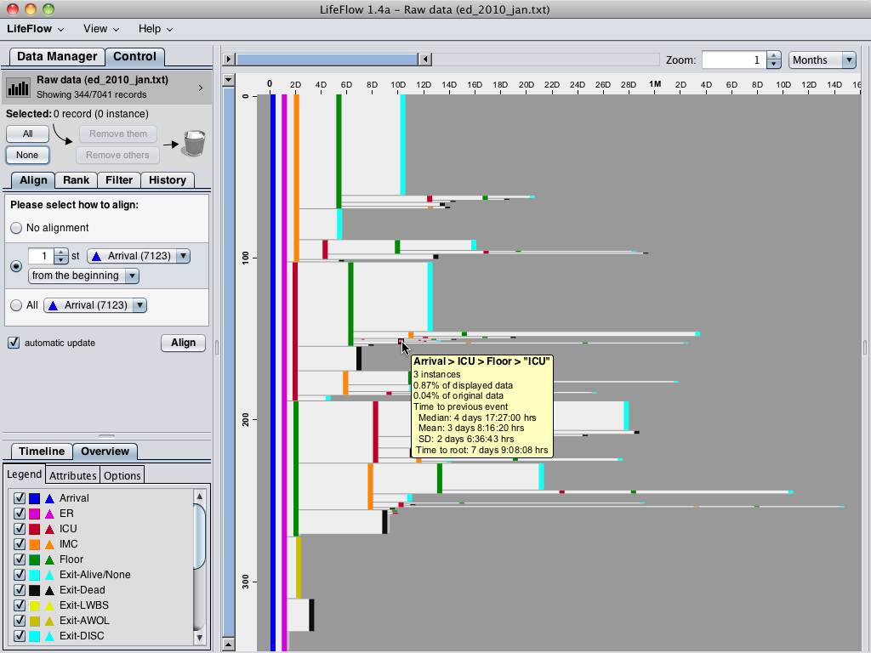
Notes:
After removing all the common cases, we have 344 patients left.
These are mostly the patients who were admitted.
There are many information that I can explain from this visualization here, but I will go straight into the case that our physician partners are mostly interested in.
The mouse is pointing at this sequence, which represents the “bounce backs” patients, meaning patients who were transferred from ICU to Floor because they seemed to get better, however, they were transferred back to the ICU.
So the physician are interested in finding these patients to analyze what made them made the wrong decisions.
*optional
Another case is the step ups, which means the patients whose level of care were escalated to higher level, you can see from the visualization that there were patients who were transferred from ER to Floor (green) to ICU (red) and IMC (orange).
The number of these patients and the average transferred time could be compare to the hospital standards to measure the quality of care.

Slide 26
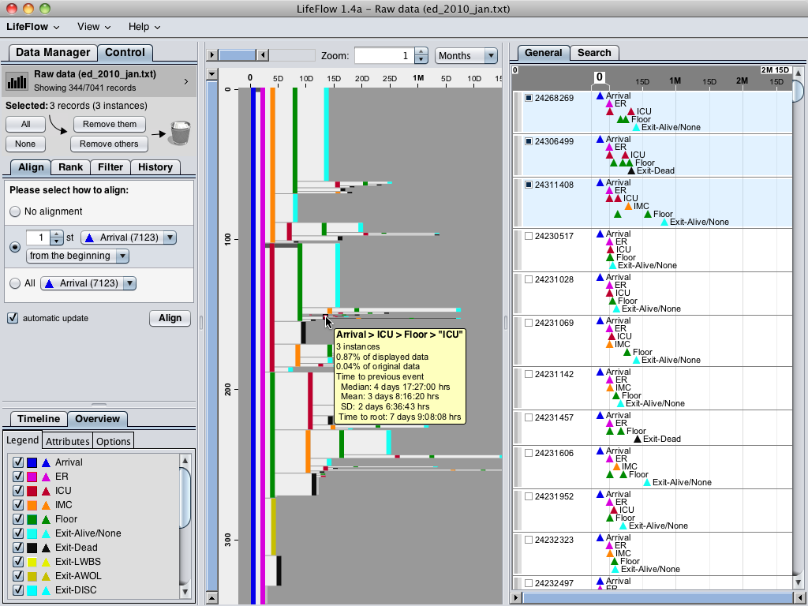
Notes:
Ben: This slide is optional. You can use it to show that when you click on the bounce backs patients, you can get the details of each patient in LifeLines2 view.

Slide 27
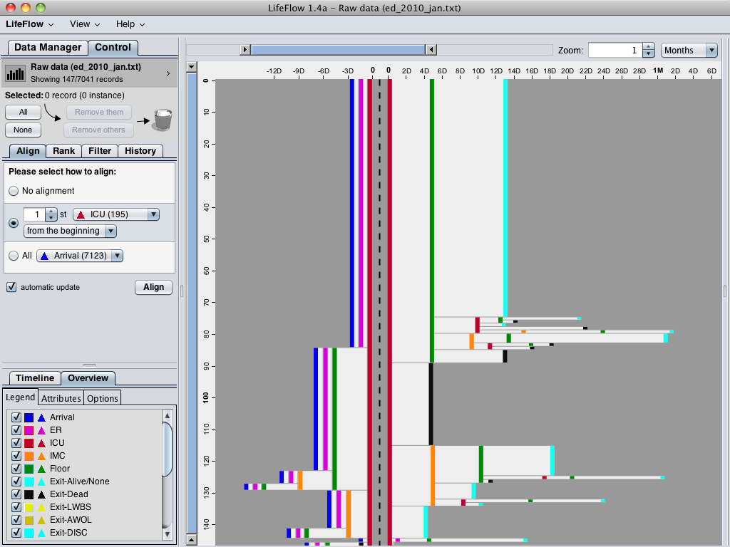
Notes:
Another interesting feature is you can align by a particular event.
For example, if you want to know what happened before and after the patients went to the ICU, you can align by ICU.
The dash line separate between what happened before and what happened after.
You can see that the ICU patients mostly came from the ER (pink), and most of them were transferred to Floor (green) after that.
Unfortunately, some of them died after they were transferred to the ICU (black).
From this visualization, you may notice a small pattern in the bottom.
Let me zoom in.

Slide 28
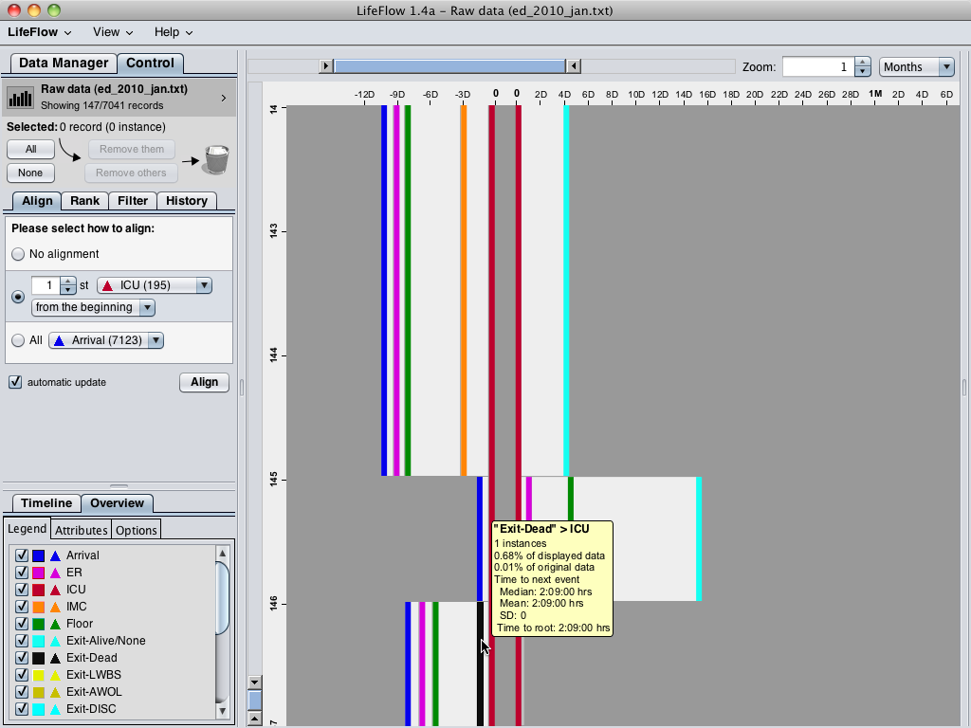
Notes:
So this patient was dead before transferred to the ICU, which is impossible.
Of course, this must be problem with data entry.
But we may never notice it if the data are hidden in the database.
Therefore, you can see that LifeFlow support this kind of analysis by
giving overview, showing common trends,
providing summary of every sequences, you can do SQL and calculate average for every transfer if you like, but in LifeFlow, it is right there, you just need to move your mouse over.
showing every possible transfer pattern and may led you to a discovery of surprising pattern.

Slide 29
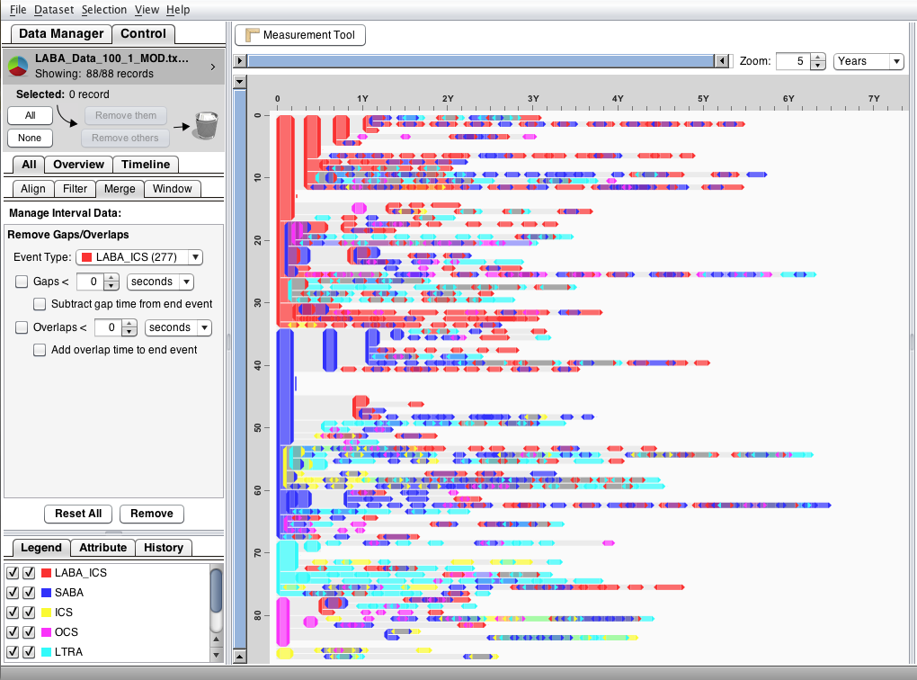
EventFlow: Original Dataset

Slide 30
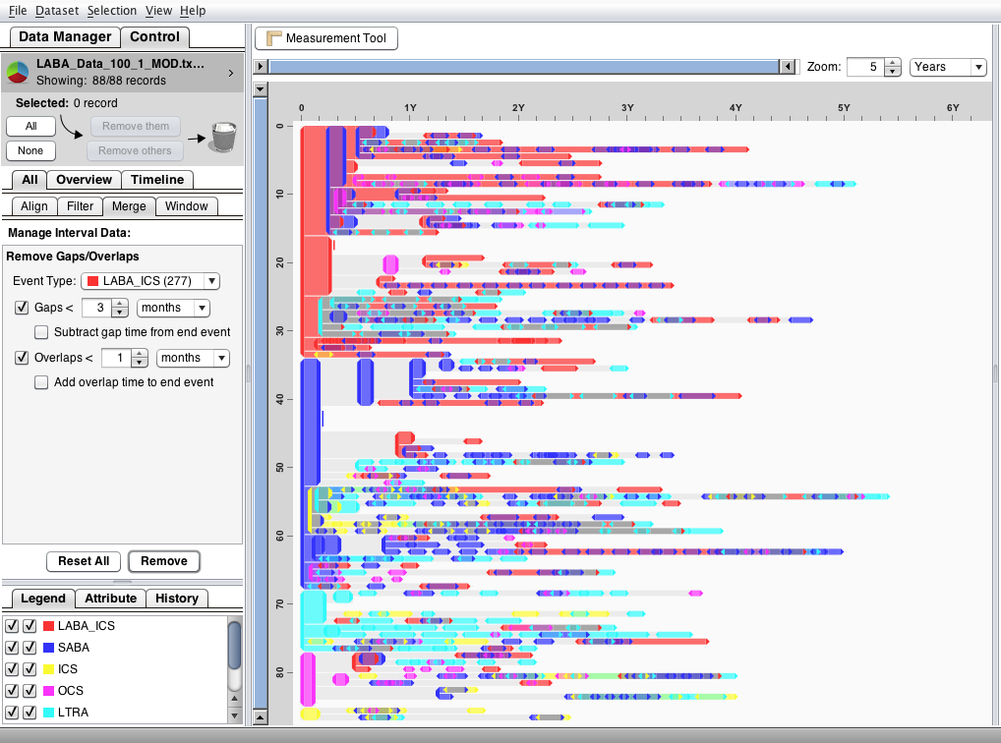
LABA_ICSs Merged

Slide 31
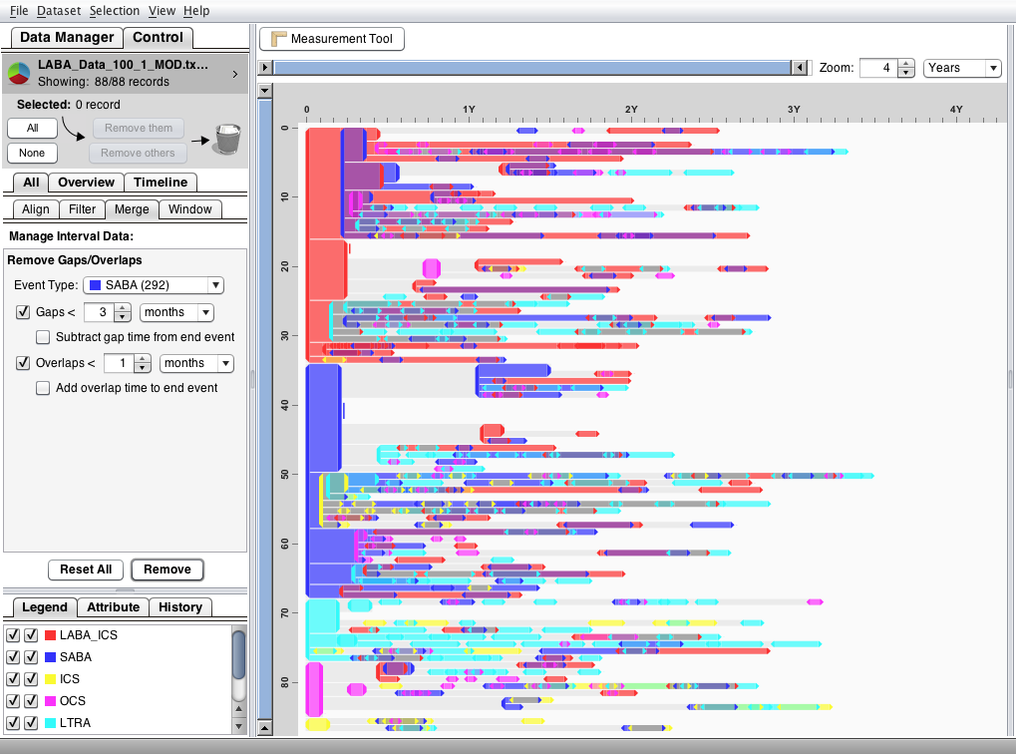
SABAs Merged

Slide 32
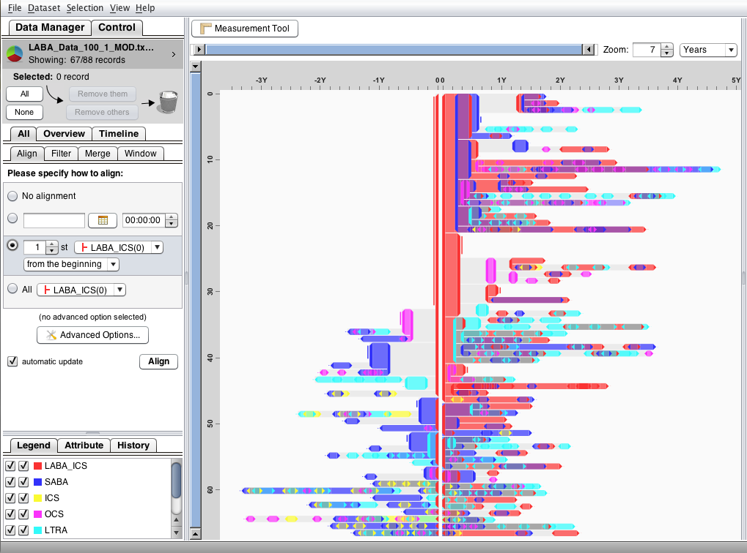
Align by First LABA_ICS

Slide 33
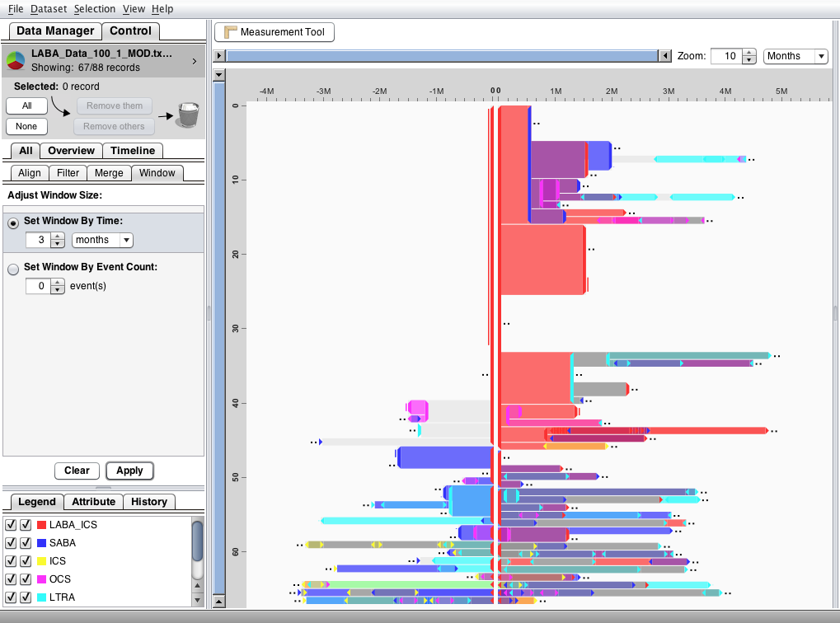
Reduce Window Size

Slide 34
Original Dataset

Slide 35
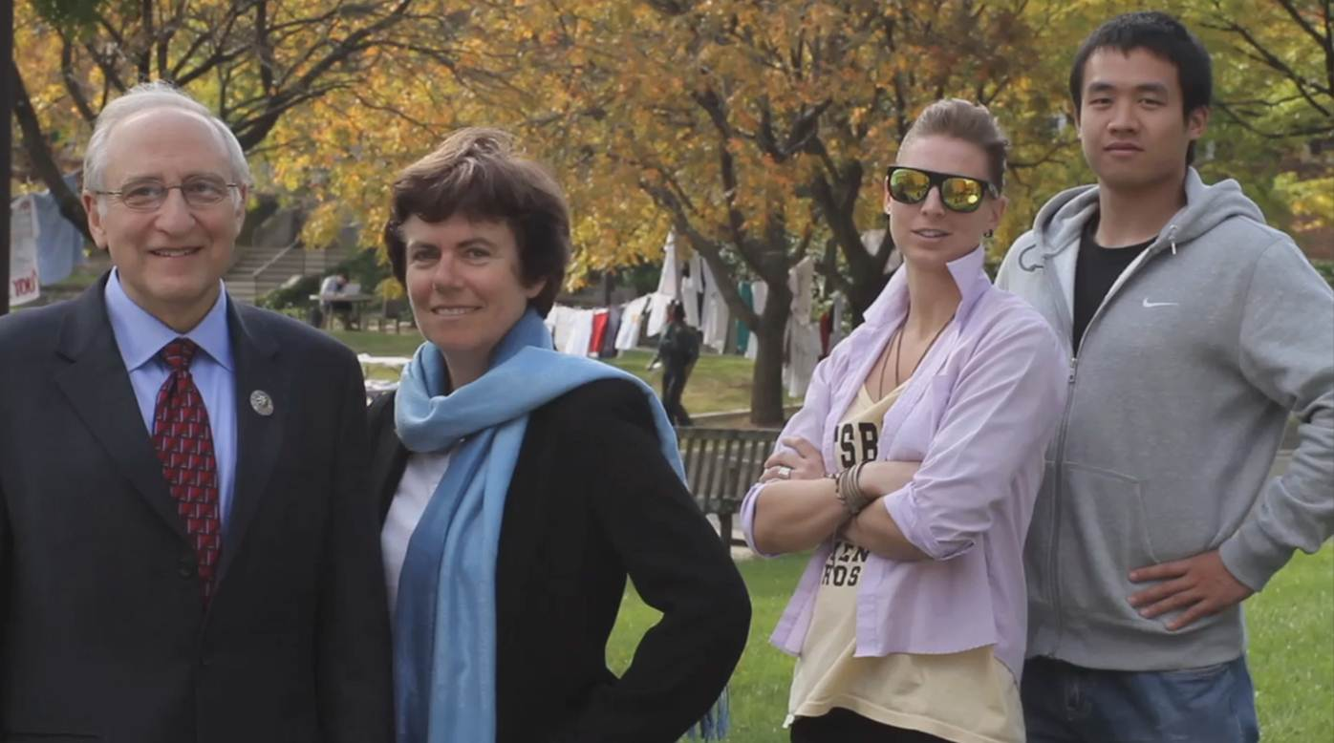
EventFlow Team: Oracle support
www.cs.umd.edu/hcil/eventflow
www.umdrightnow.umd.edu/news/umd-research-team-developing-powerful-data-visualization-tool-support-oracle

Slide 36
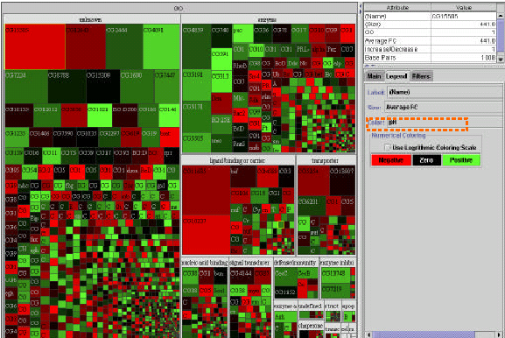
Treemap: Gene Ontology
Space filling
Space limited
Color coding
Size coding
- Requires learning
(Shneiderman, ACM Trans. on Graphics, 1992 & 2003)
www.cs.umd.edu/hcil/treemap/

Slide 37
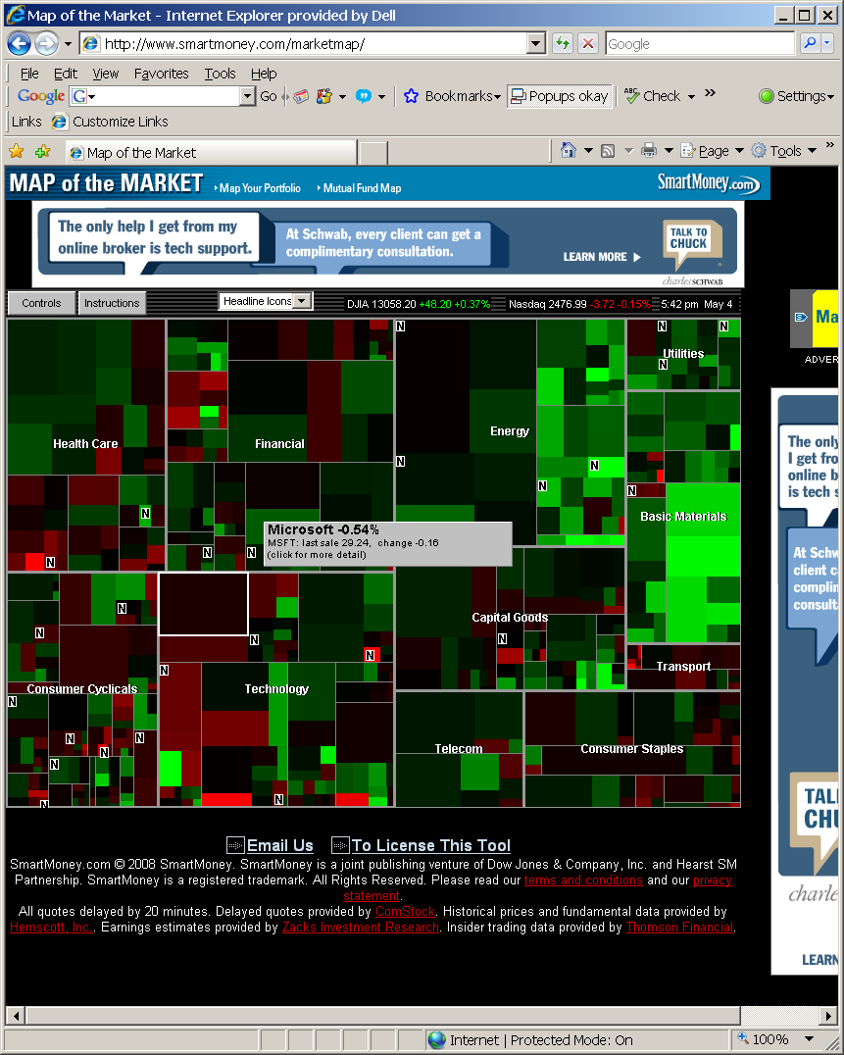
Treemap: Smartmoney MarketMap
www.smartmoney.com/marketmap

Slide 38
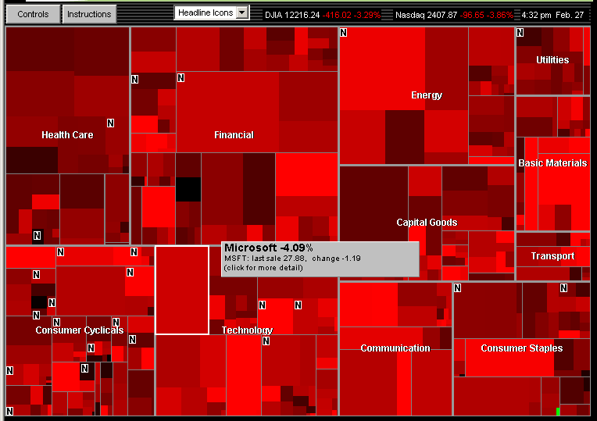
Market falls steeply Feb 27, 2007, with one exception
Notes:
38

Slide 39
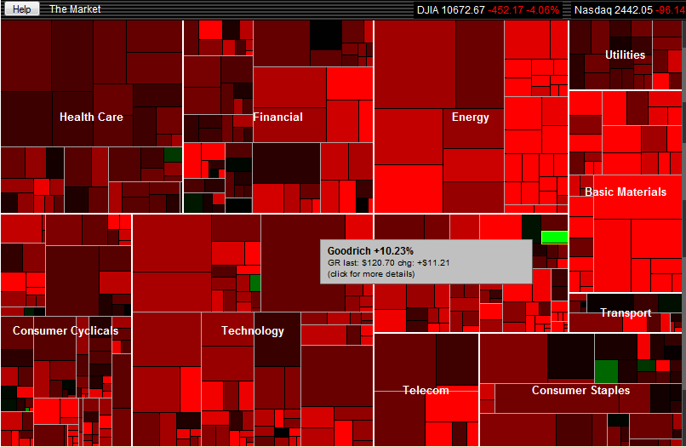
Market falls steeply Sept 22, 2011, some exceptions
Notes:
39

Slide 40
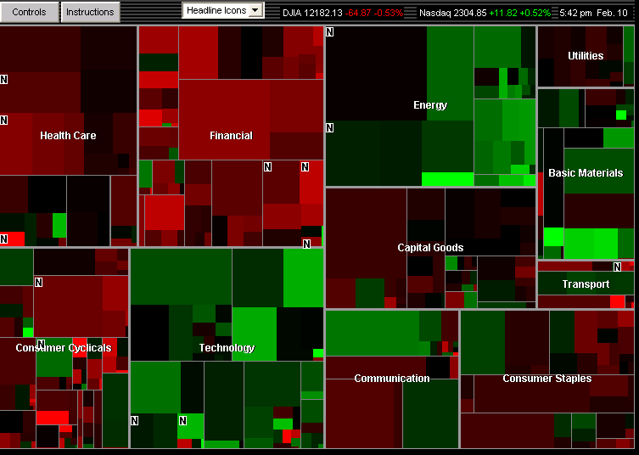
Market mixed, February 8, 2008
Energy & Technology up, Financial & Health Care down
Notes:
40

Slide 41
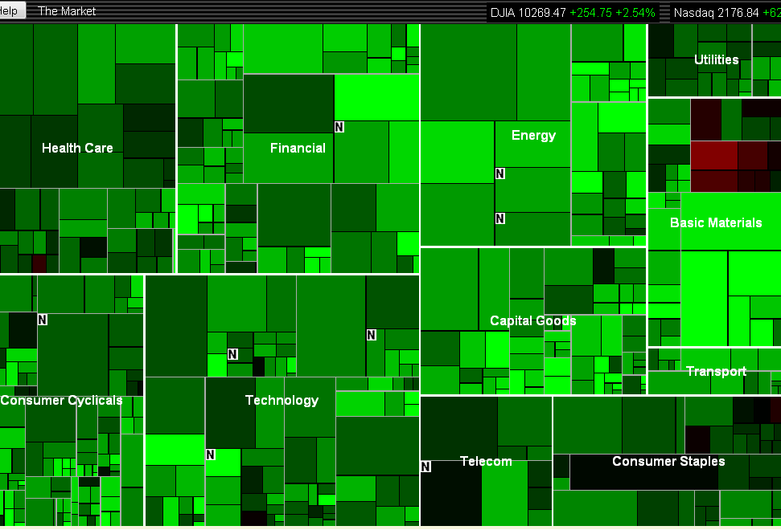
Market rises, September 1, 2010, Gold contrarians
Notes:
41

Slide 42
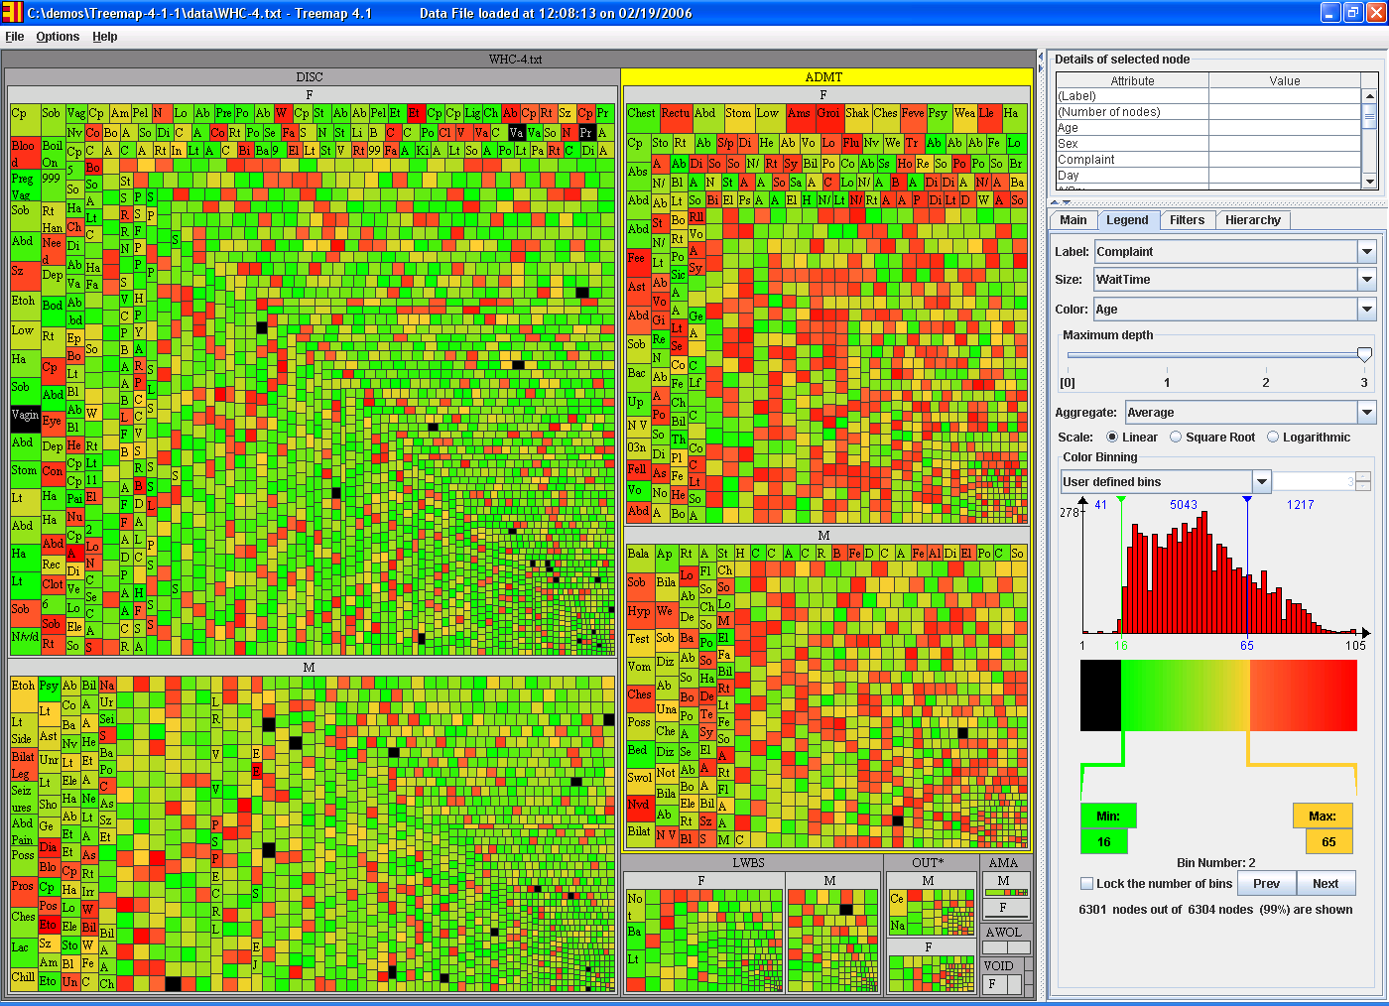
Treemap: WHC Emergency Room
(6304 patients in Jan2006)
Group by Admissions/MF, size by service time, color by age

Slide 43
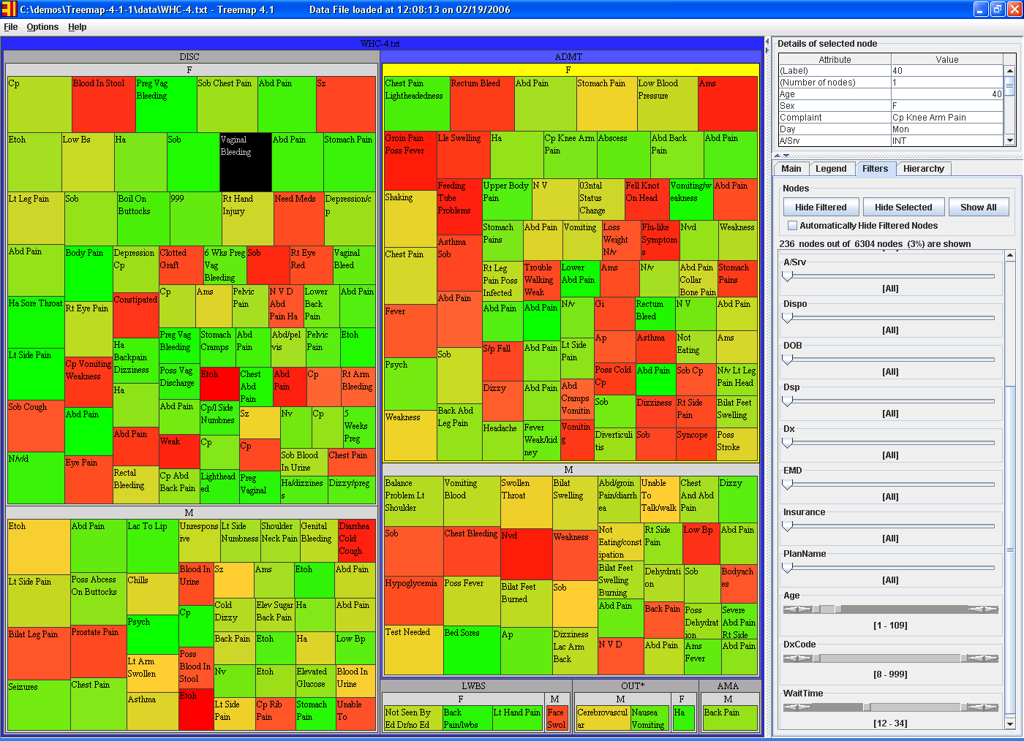
Treemap: WHC Emergency Room
(6304 patients in Jan2006) (only those service time >12 hours)
Group by Admissions/MF, size by service time, color by age

Slide 44
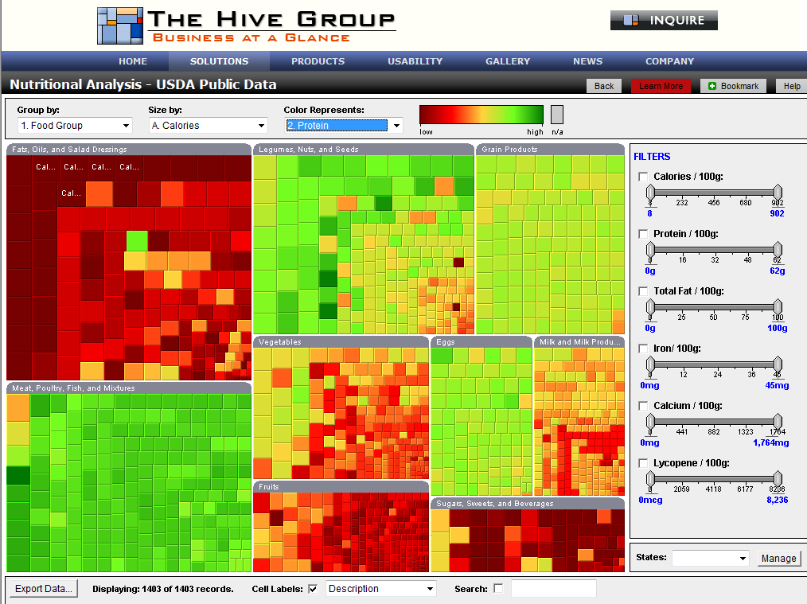
Treemap: Nutritional Analysis
www.hivegroup.com

Slide 45
Office of National Coordinator: SHARP
Strategic Health IT Advanced Research Projects
- Security of Health Information Technology
- Patient-Centered Cognitive Support
- Healthcare Application and Network Platform Architectures
- Secondary Use of EHR Data
Univ of Maryland HCIL tasks
- Missing Laboratory Reports
- Medication Reconciliation
- Wrong Patient Errors
www.cs.umd.edu/hcil/sharp

Slide 46
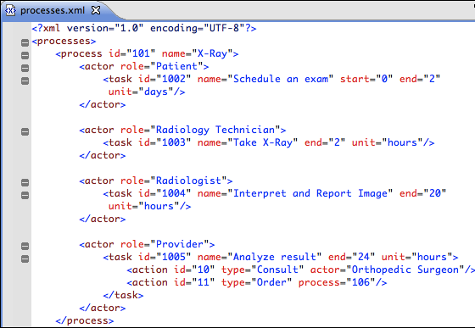
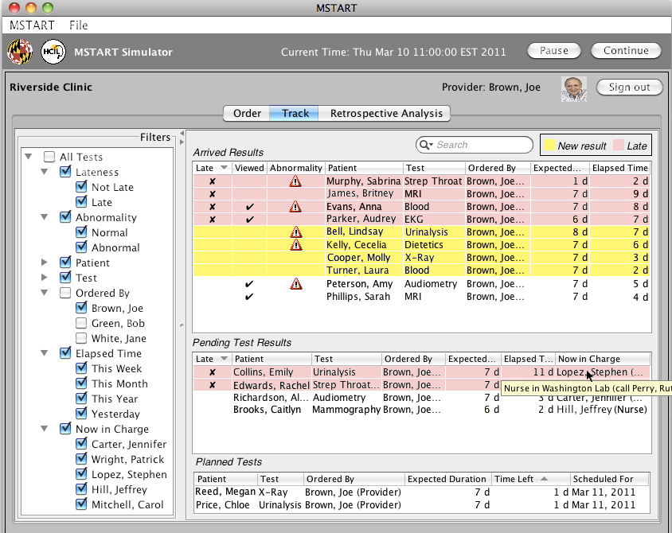
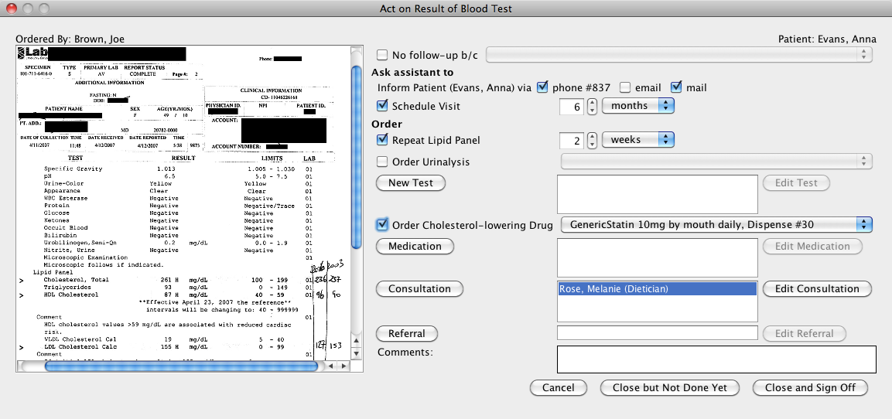
Lab test tracking to ensure completion
Define tracking processes
Assign temporal responsibility
Define possible actions
Predict expected duration
Generate User Interface from processes
Enhance situation awareness
Integrate follow-up actions with results
Simplify rapid operations
Provide retrospective analysis
PhD work: Sureyya Tarkan

Slide 47
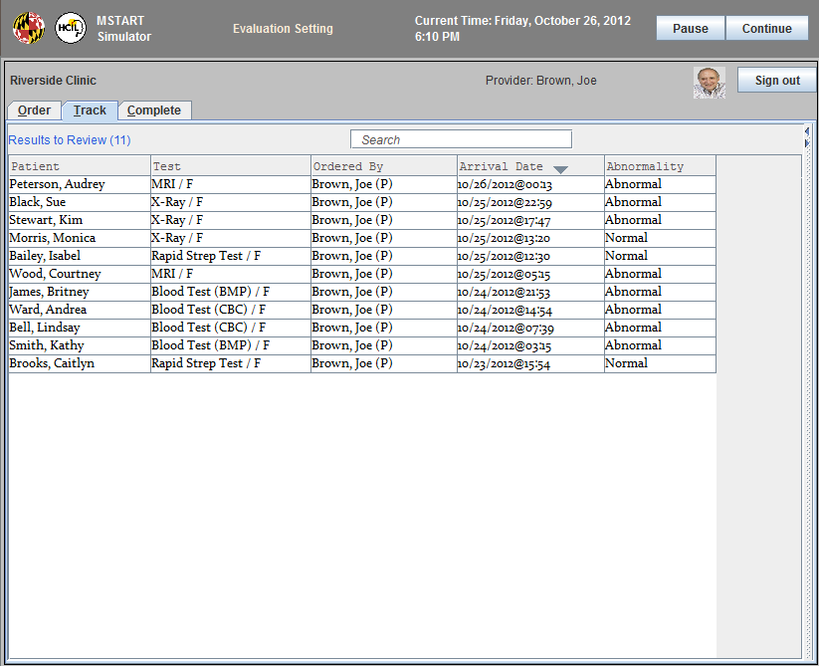
Missing Lab Tests: Results Only

Slide 48
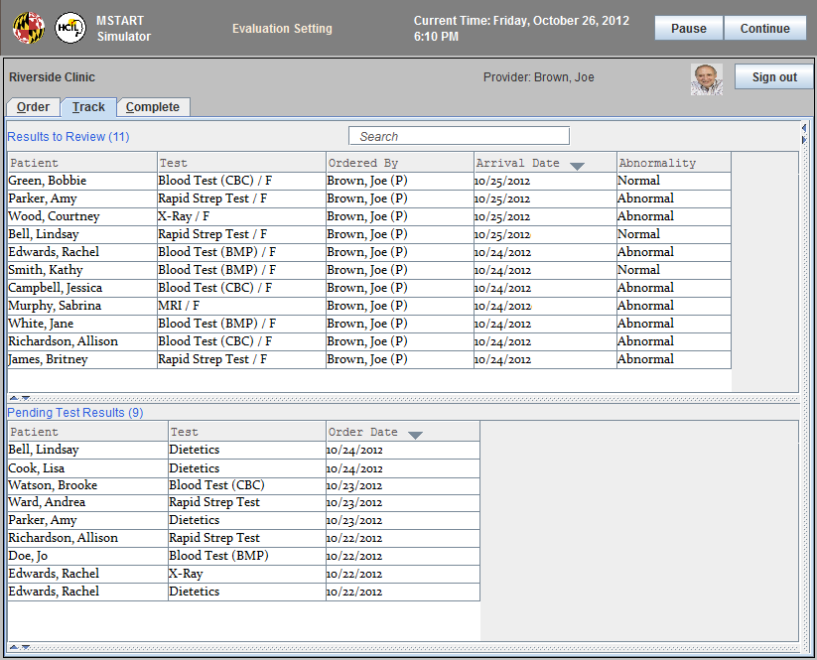
Missing Lab Tests: Results+Pending

Slide 49
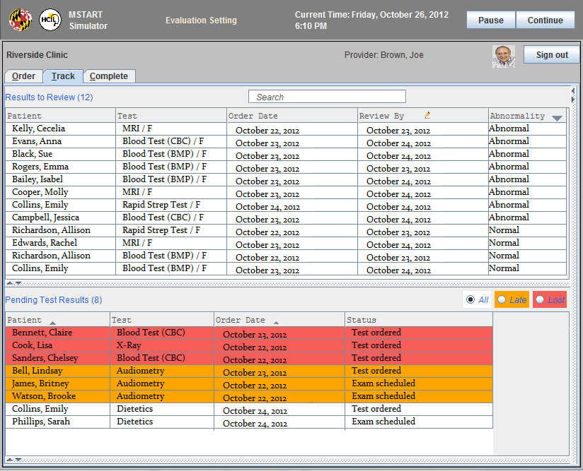
Missing Lab Tests: Prioritized Pending

Slide 50
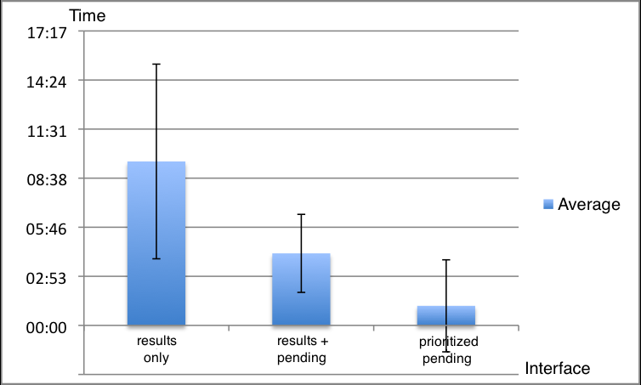
Performance Times: 18 participants

Slide 51

Retrospective Analyses Lab Tests

Slide 52

Medication Reconciliation: Current Form
Univ of Maryland HCIL tasks
- Missing Laboratory Reports
- Medication Reconciliation
- Alarms and Alerts Management
www.cs.umd.edu/hcil/sharp
www.youtube.com/watch?v=ZGf1EiuIIIM

Slide 53

Twinlist: Medication Reconciliation
“Best reconciliation app
I have ever seen”
Dr. Shawn Murphy, PartnersHealthcare & Harvard Medical
“Super-cool demo”
Dr. Jonathan Nebeker, Univ of Utah & VA
“Twinlist concept is brilliant”
Dr. Kevin Hughes, Harvard Medical School
Tiffany Chao, Catherine Plaisant, Ben Shneideman
Based on class project of : Leo Claudino, Sameh Khamis, Ran Liu, Ben London, Jay Pujara
Students of CMSC734 Information Visualization class
www.youtube.com/watch?v=YoSxlKl0pCo

Slide 54

Twinlist: Medications Grouped

Slide 55

Reducing Wrong Patient Errors:
Animated Transitions & Photos

Slide 56

Reducing Wrong Patient Errors:
Animated Transitions & Photos

Slide 57


Reducing Wrong Patient Errors:
Animated Transitions & Photos

Slide 58
Reducing Wrong Patient Errors:
Animated Transitions & Photos
63%
43%
36%
7%
Control
Animation
Photo
Combined
The combination of animation & photo resulted in a significant increase
in error recognition rate relative to the control & animation groups →
Dramatic implications for commercial systems
(Taieb-Maimon, Plaisant & Shneiderman, 2012)

Slide 59

UI Techniques to Reduce Selection Errors
Highlight on Departure + Animation
Re-sort lists, Group by attributes
Show floor plan
Larger fonts + Space between rows

Slide 60

UI Techniques to Reduce Selection Errors

Slide 61

UN Millennium Development Goals
To be achieved by 2015
Eradicate extreme poverty and hunger
Achieve universal primary education
Promote gender equality and empower women
Reduce child mortality
Improve maternal health
Combat HIV/AIDS, malaria and other diseases
Ensure environmental sustainability
Develop a global partnership for development
Notes:
61

Slide 62

30th Annual Symposium
May 22-23, 2013
www.cs.umd.edu/hcil
@benbendc

