Slide 1

The Next 25 Years of HCI Research:
Technology-Mediated Social Participation
Ben Shneiderman ben@cs.umd.edu
Twitter: @benbendc
Founding Director (1983-2000), Human-Computer Interaction Lab
Professor, Department of Computer Science
Member, Institute for Advanced Computer Studies

Slide 2


Interdisciplinary research community
- Computer Science & Info Studies
- Psych, Socio, Poli Sci & MITH
(www.cs.umd.edu/hcil)

Slide 3
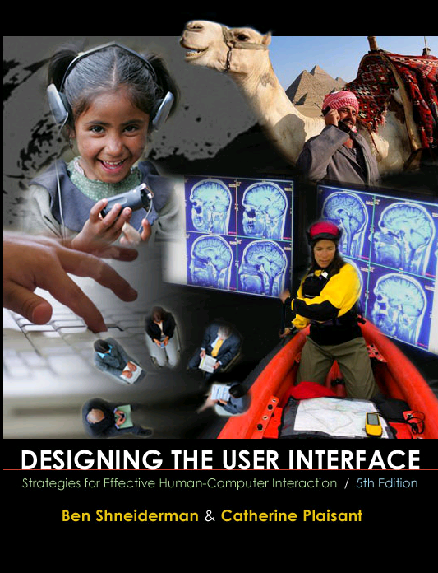
Design Issues
Input devices & strategies
  Keyboards, pointing devices, voice
  Direct manipulation
  Menus, forms, commands
Output devices & formats
  Screens, windows, color, sound
  Text, tables, graphics
  Instructions, messages, help
Collaboration & Social Media
Help, tutorials, training
Search
www.awl.com/DTUI
Fifth Edition: 2010
Visualization

Slide 4
HCI Pride: Serving 5B Users
Mobile, desktop, web, cloud
→ Diverse users: novice/expert, young/old, literate/illiterate,
abled/disabled, cultural, ethnic & linguistic diversity, gender,
personality, skills, motivation, ...
→ Diverse applications: E-commerce, law, health/wellness,
education, creative arts, community relationships, politics,
IT4ID, policy negotiation, mediation, peace studies, ...
→ Diverse interfaces: Ubiquitous, pervasive, embedded, tangible,
invisible, multimodal, immersive/augmented/virtual, ambient,
social, affective, empathic, persuasive, ...

Slide 5
HCI Futures
Micro-HCI → Computing, Psychology & Ergonomics
Single user interfaces, technology-centered, narrow guidelines
Short-term controlled studies & usability tests: speed & errors
Clear requirements, benchmark tasks, self-efficacy,
human performance measures, predictive models

Slide 6
HCI Futures
Micro-HCI → Computing, Psychology & Ergonomics
Single user interfaces, technology-centered, narrow guidelines
Short-term controlled studies & usability tests: speed & errors
Clear requirements, benchmark tasks, self-efficacy,
human performance measures, predictive models
Macro-HCI → Business, Sociology & New Media
Social participation, motivation, trust, empathy, responsibility,
privacy, collaboration, affective experience, morals, ethics
Open tasks, long duration, novel user goals, community efficacy
Voluminous logging data, case studies, ethnography
New measures: giga-hellos, tera-contribs, peta-thankyous

Slide 7
Goal
Apply social media to transform society
Reduce medical errors, obesity & smoking
Promote energy & water conservation
Prevent disasters & terrorism
Increase community safety
Improve education
Facilitate good government
Resolve conflicts

Slide 8
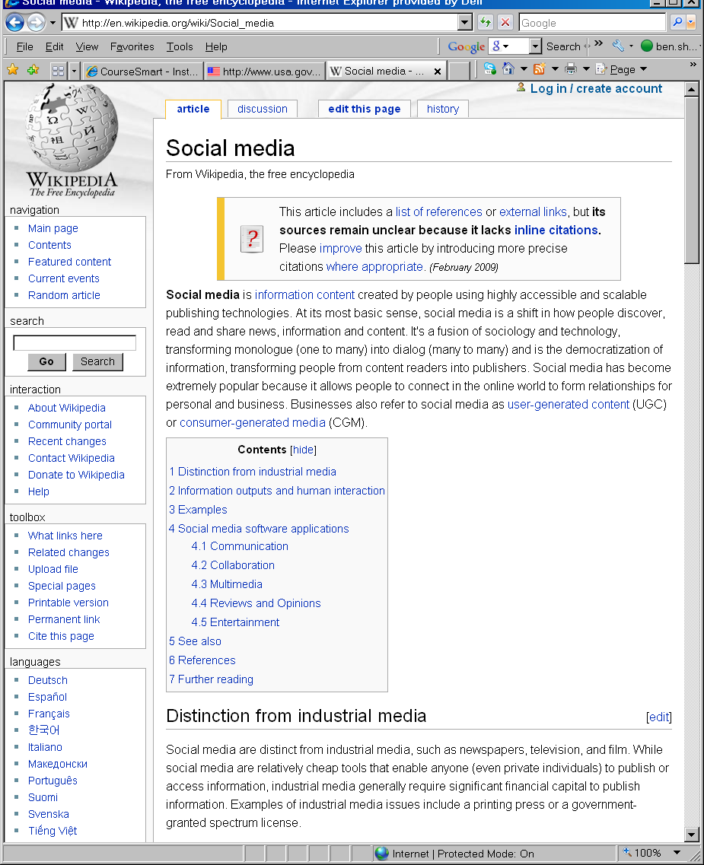
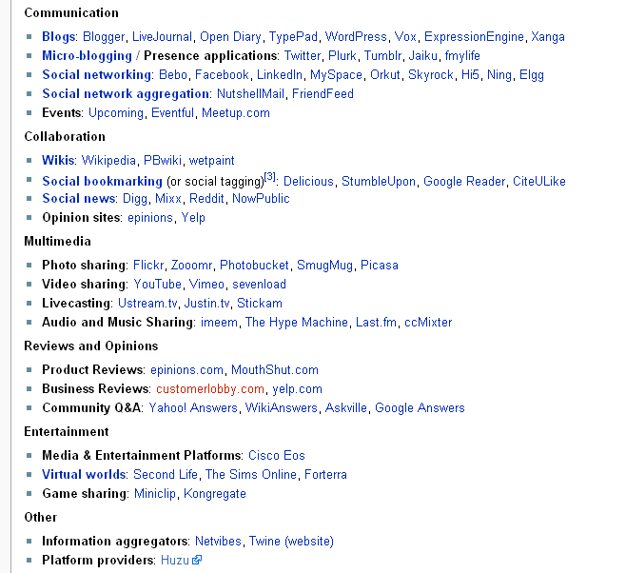
Wikipedia

Slide 9
Challenges
  Malicious attacks
  Privacy violations
  Not trusted
  Fails to be universal
  Unreliable when needed
  Misuse by
    Terrrorists & criminals
    Promoters of racial hatred
    Political oppressers

Slide 10
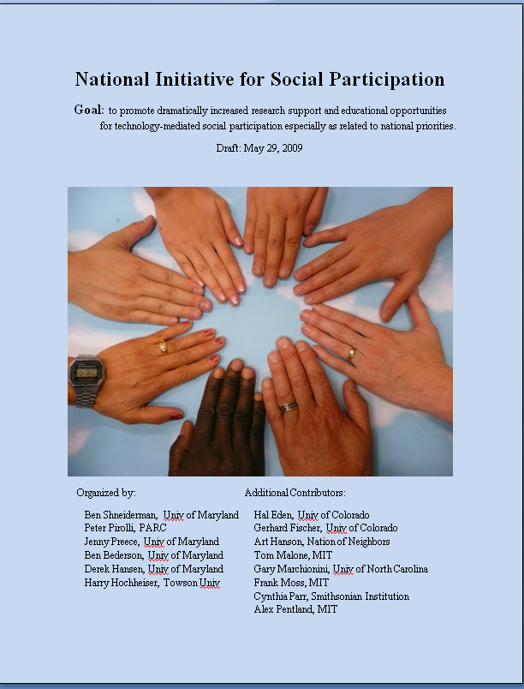
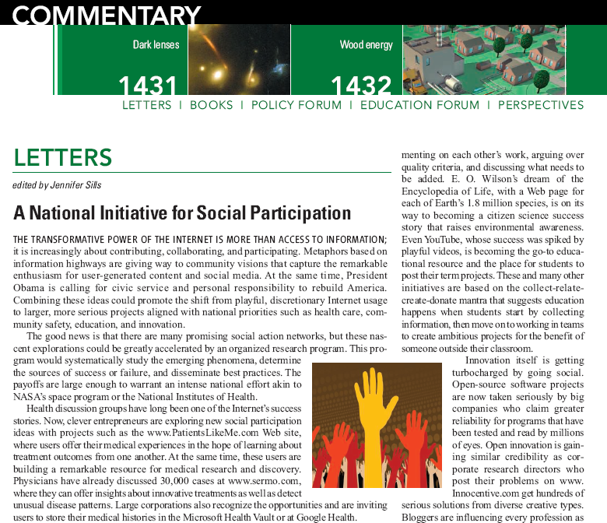
Early Steps
Informal Gathering
College Park, MD, April 2009
Article: Science March 2009
BEN SHNEIDERMAN
http://iparticipate.wikispaces.com
Notes:
Todd Beamer – United 93

Slide 11
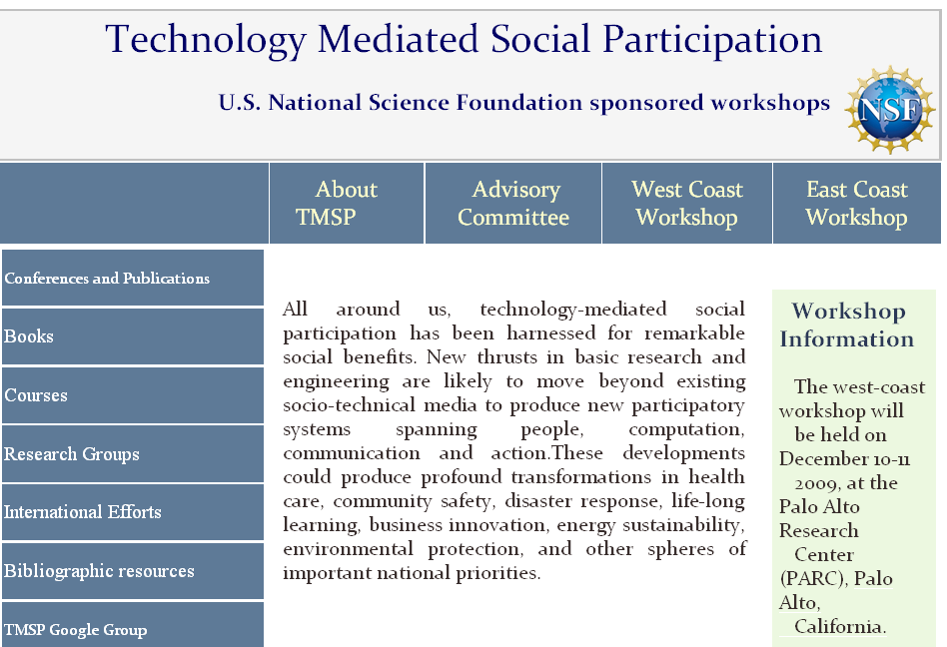
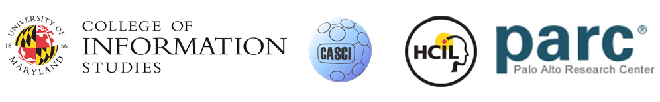
NSF Workshops: Academics, Industry, Gov’t
Jenny Preece (PI), Peter Pirolli & Ben Shneiderman (Co-PIs)
www.tmsp.umd.edu

Slide 12

Cyberinfrastructure for Social Action on National Priorities
- Scientific Foundations
- Advancing Design of
Social Participation Systems
- Visions of What is Possible With Sharable
Socio-­technical Infrastructure
- Participating in Health 2.0
- Educational Priorities for
Technology Mediated Social Participation
- Engaging the Public in Open Government:
Social Media Technology and
Policy for Government Transparency

Slide 13
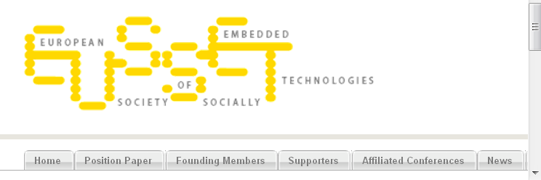
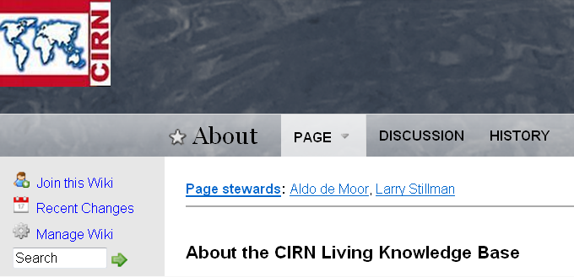
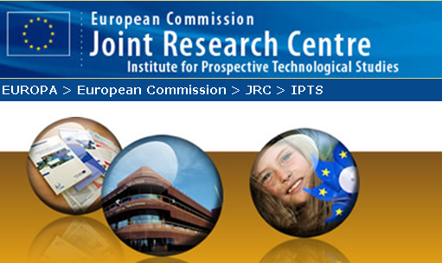
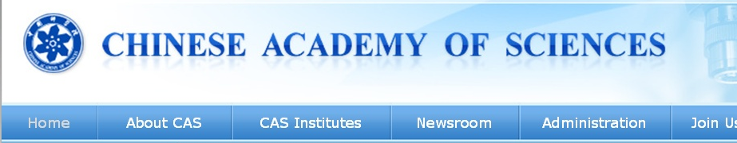
International Efforts
Community Informatics
Research Network
intlsocialparticipation.net

Slide 14
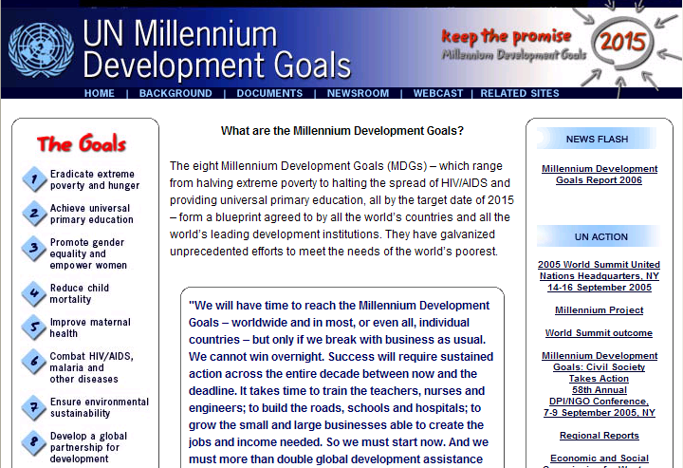
UN Millennium Development Goals
To be achieved by 2015
Eradicate extreme poverty and hunger
Achieve universal primary education
Promote gender equality and empower women
Reduce child mortality
Improve maternal health
Combat HIV/AIDS, malaria and other diseases
Ensure environmental sustainability
Develop a global partnership for development
Notes:
14

Slide 15
Vision: Social Participation
1) Focus on National Priorities & Impact
  Disaster response, community safety
  Health, energy, education, e-government
  Environmental awareness, biodiversity
2) Develop Theories of Social Participation
  How do social media networks evolve?
  How can participation be increased?
3) Provide Technology Infrastructure
  Scalable, reliable, universal, manageable
  Protect privacy, stop attacks, resolve conflicts

Slide 16
Vision: Social Participation
1) Focus on National Priorities & Impact
  Disaster response, community safety
  Health, energy, education, e-government
  Environmental awareness, biodiversity
2) Develop Theories of Social Participation
  How do social media networks evolve?
  How can participation be increased?
3) Provide Technology Infrastructure
  Scalable, reliable, universal, manageable
  Protect privacy, stop attacks, resolve conflicts

Slide 17
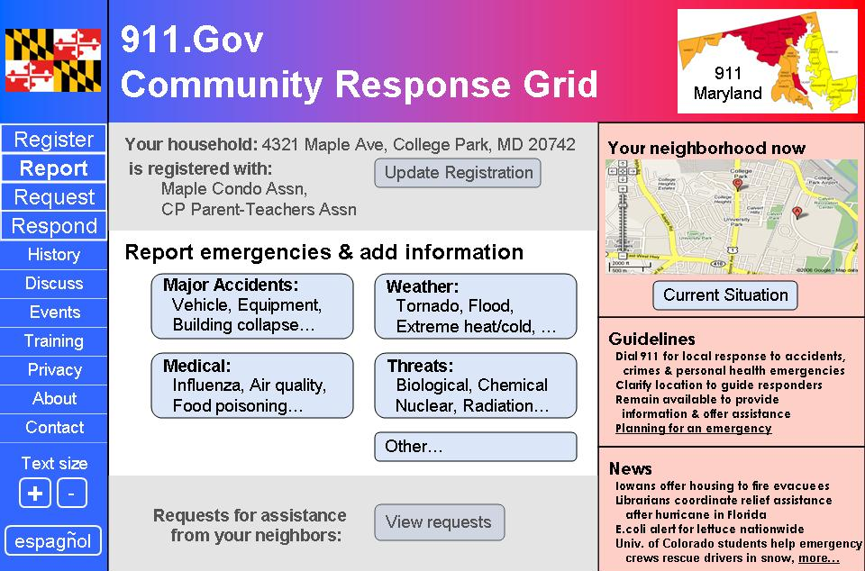
911.gov: Internet & mobile devices
Residents report information
Professionals disseminate instructions
Resident-to-Resident assistance
Professionals in control
while working with
empowered residents
Shneiderman & Preece, Science (Feb. 16, 2007)
www.cs.umd.edu/hcil/911gov

Slide 18
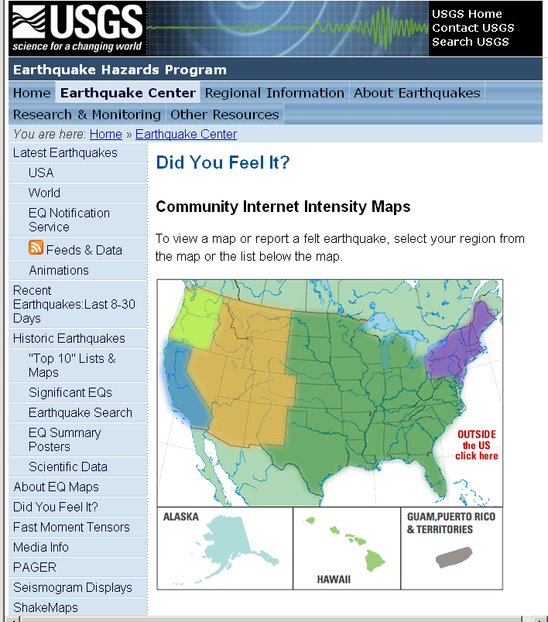
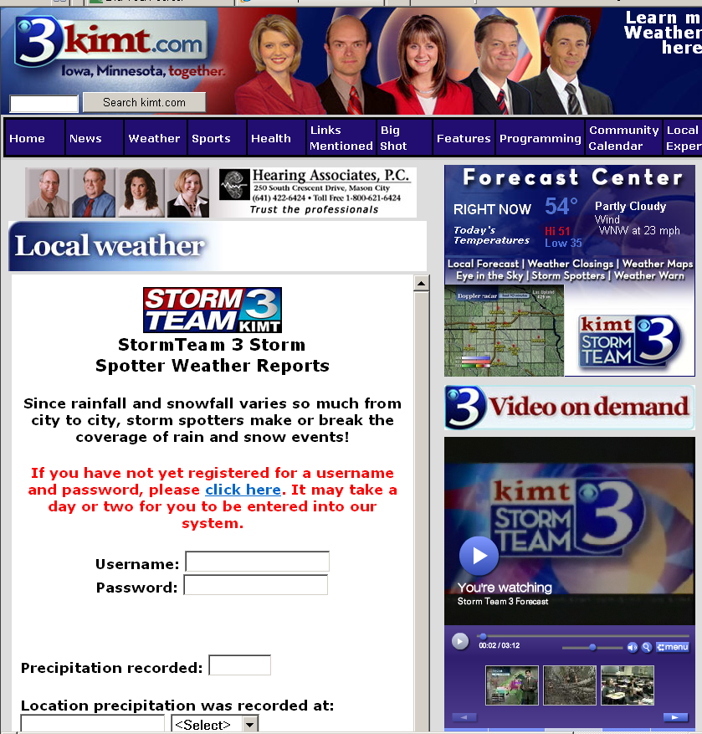
Reporting: Earthquakes & Storms
earthquake.usgs.gov/eqcenter/dyfi
weather.kimt.com

Slide 19
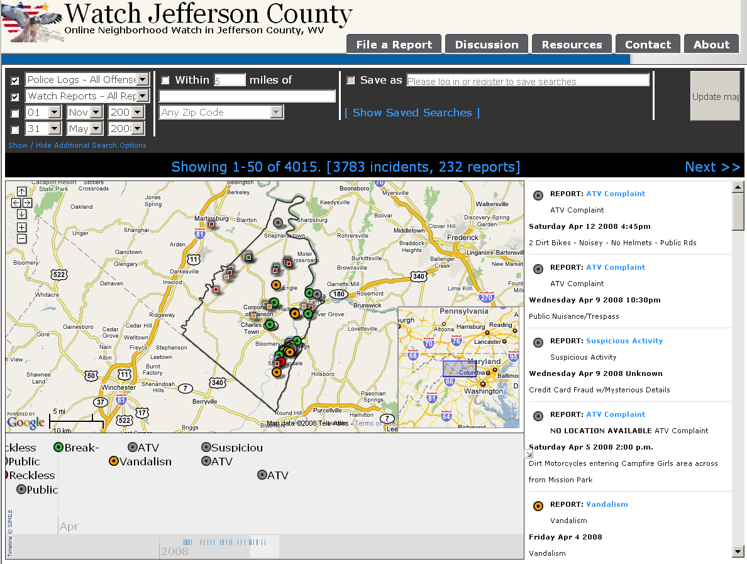
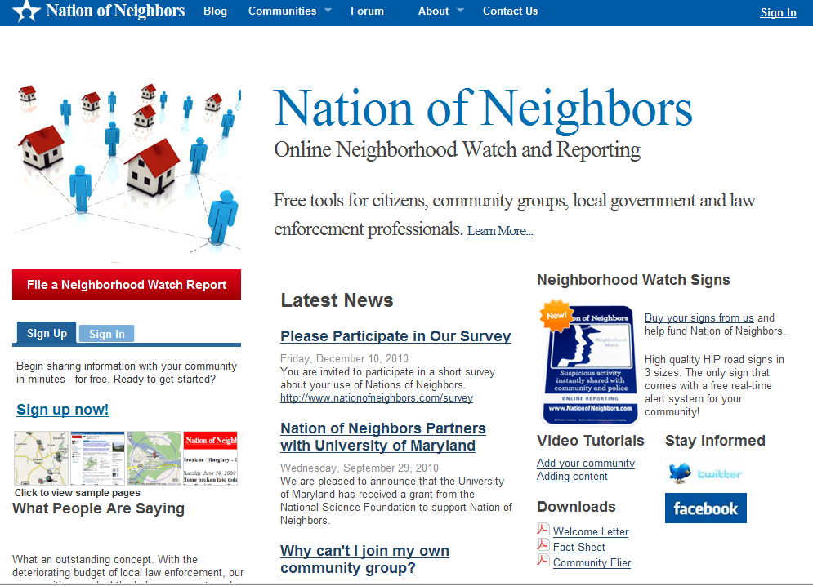
Reporting: Local incidents
watchjeffersoncounty.net
→ nationofneighbors.net

Slide 20
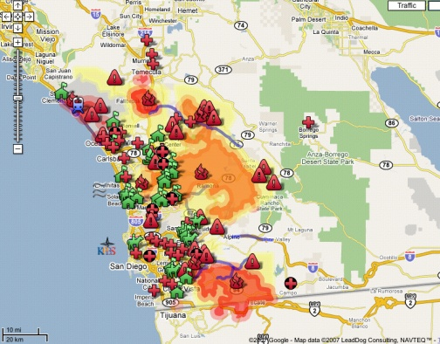
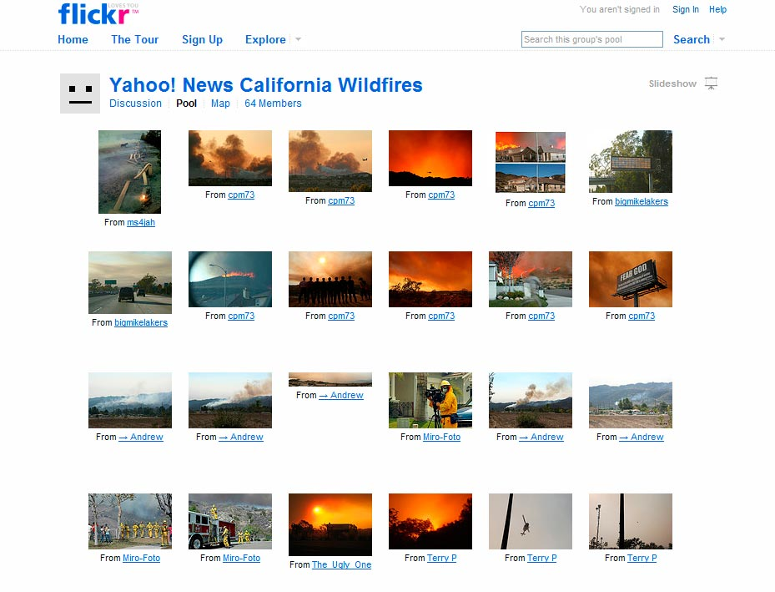
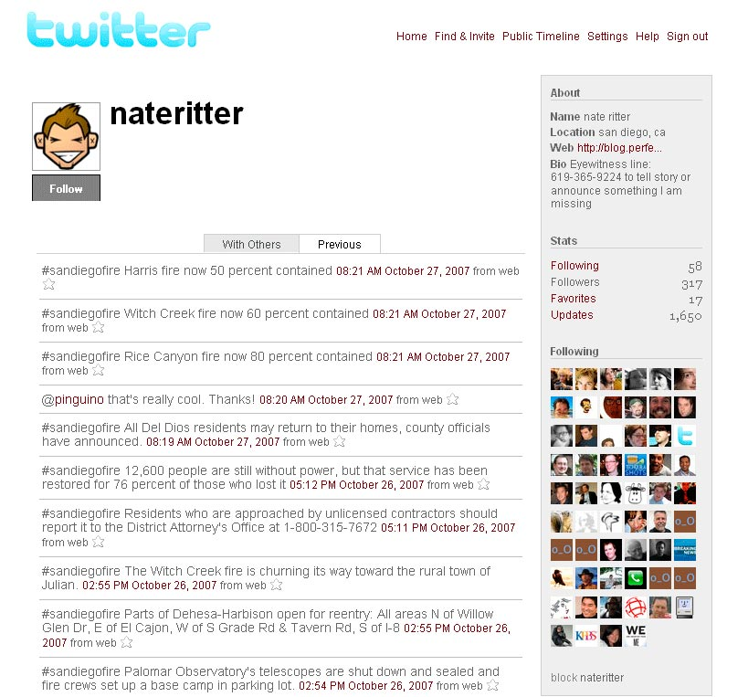
Disaster Response: Wildfires

Slide 21
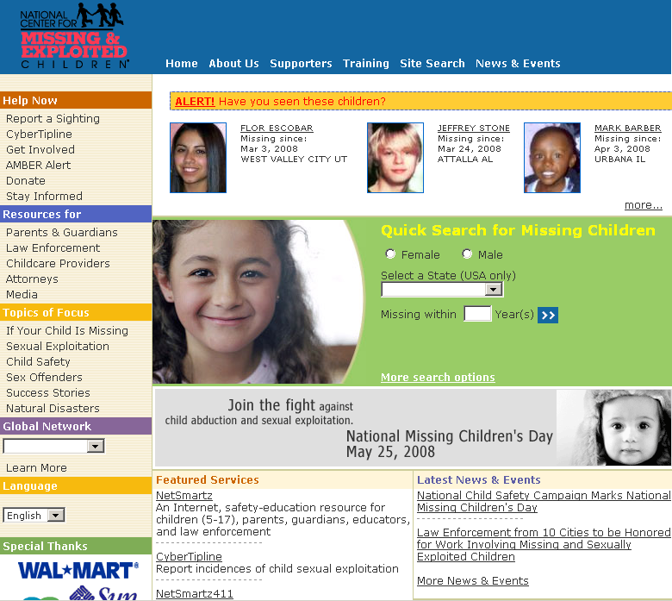
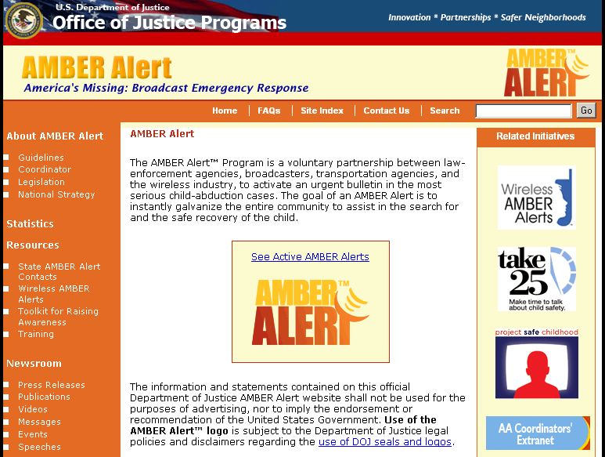
Community Safety: Abducted Children
www.ncmec.org
www.missingkids.com
www.amberalert.gov

Slide 22
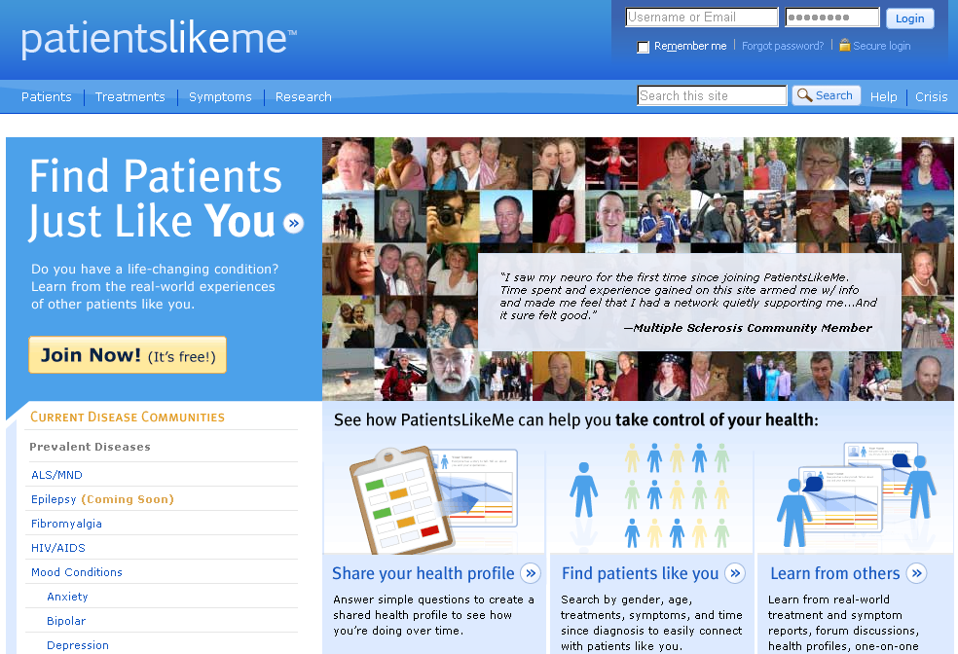
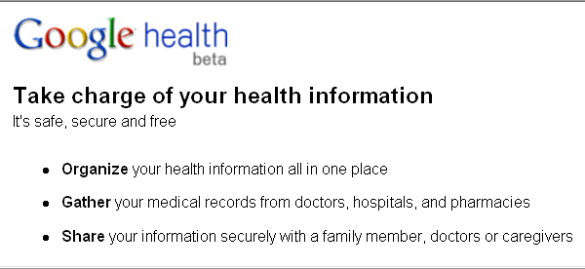
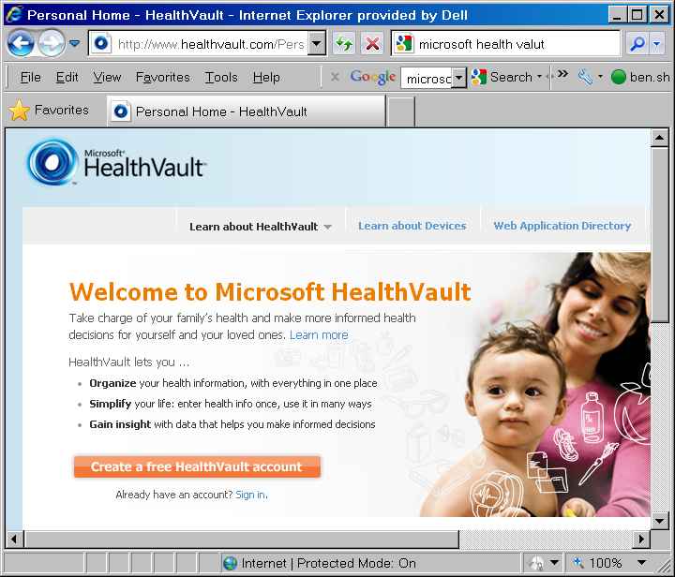
Health & Healthcare

Slide 23
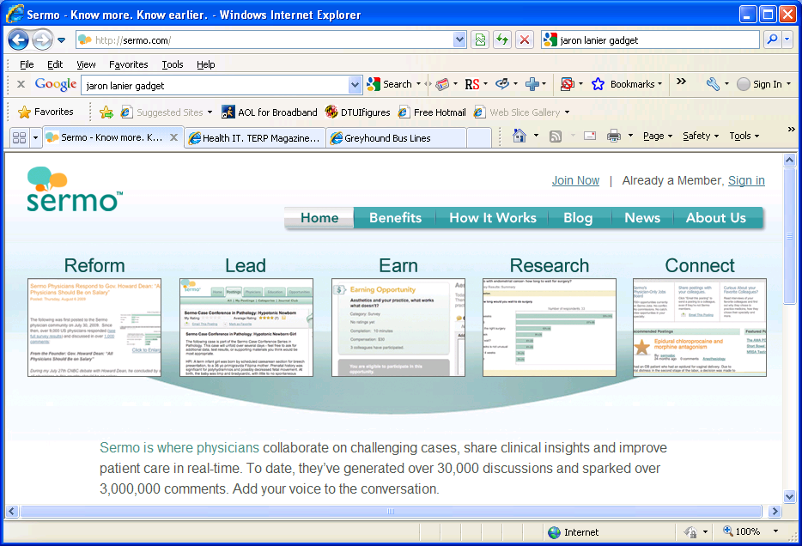
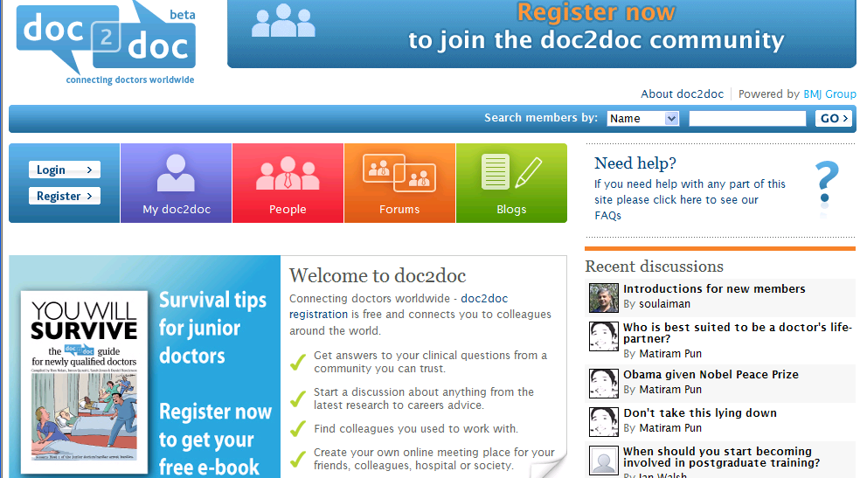
Doctor-to-Doctor Networks

Slide 24
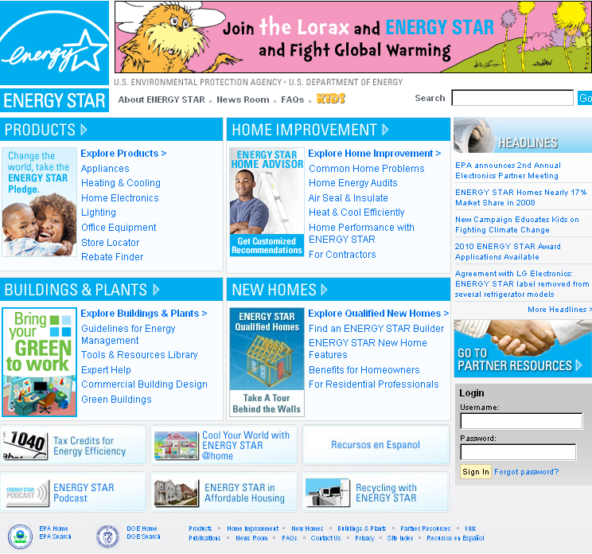
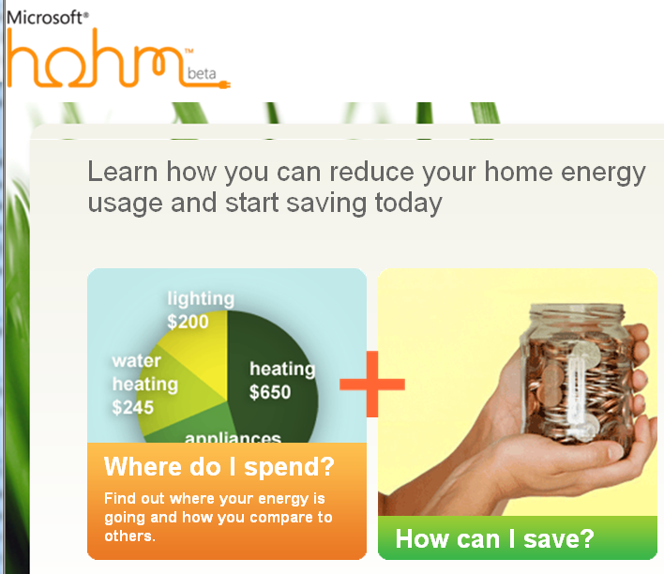
Energy Sustainability
Energystar.gov
microsoft-hohm.com

Slide 25
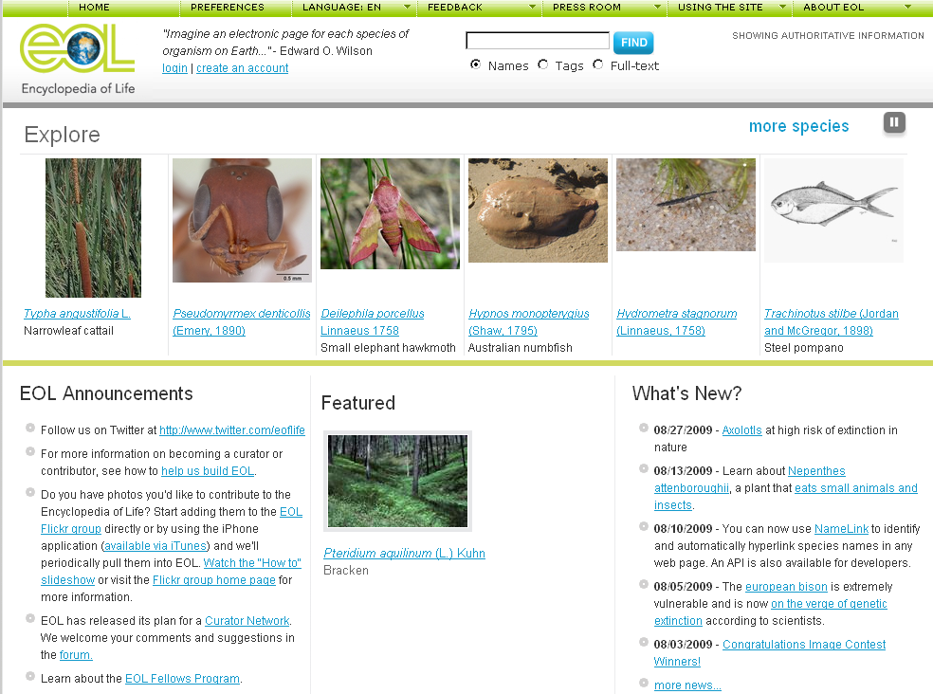
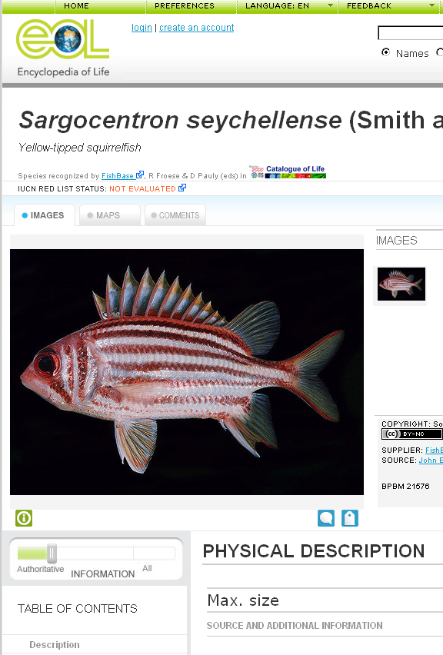
Biodiversity: Encyclopedia of Life
eol.org

Slide 26
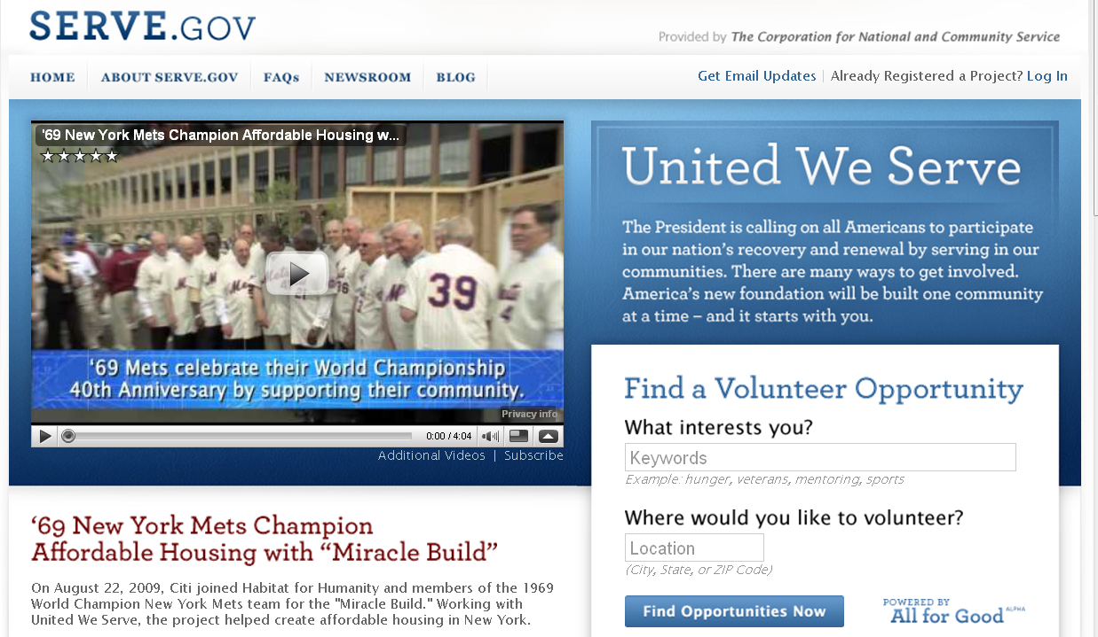
Serve.gov: Voluntary service
Register Your Project & Recruit Volunteers
Find a Volunteer Opportunity
Read Inspiring Stories of Service & Share Your Own Story
Notes:
26

Slide 27
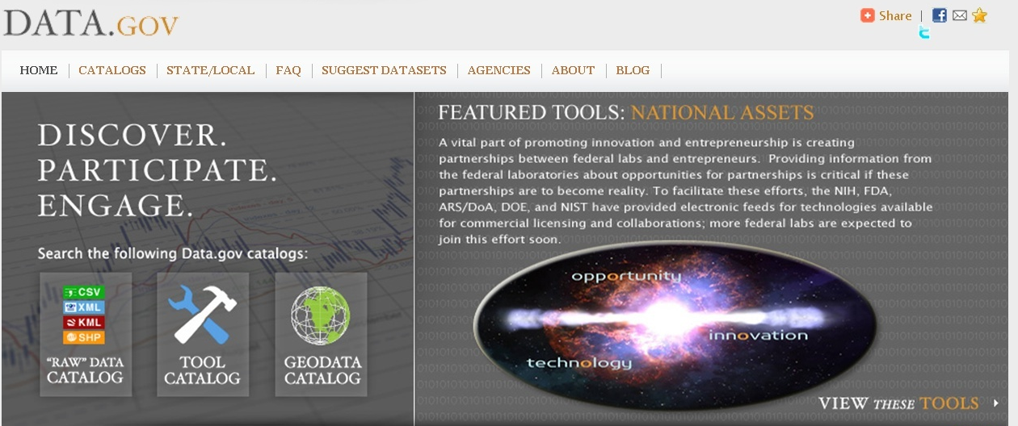
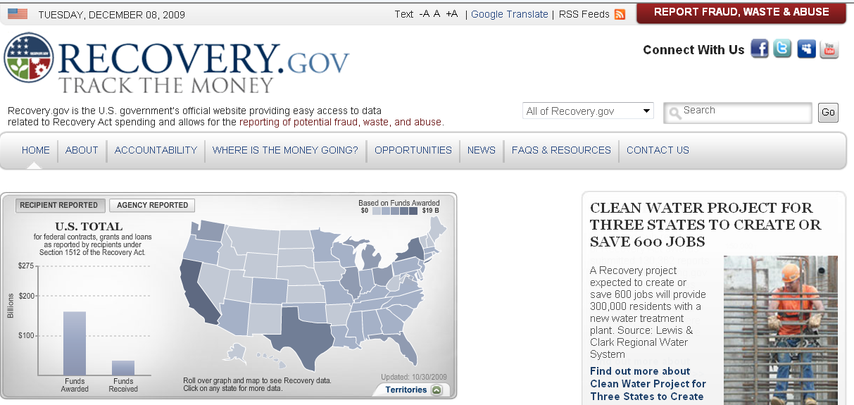
Open Data.gov + Recovery.gov
Notes:
27

Slide 28
Vision: Social Participation
1) Focus on National Priorities & Impact
  Disaster response, community safety
  Health, energy, education, e-government
  Environmental awareness, biodiversity
2) Develop Theories of Social Participation
  How do social media networks evolve?
  How can participation be increased?
3) Provide Technology Infrastructure
  Scalable, reliable, universal, manageable
  Protect privacy, stop attacks, resolve conflicts

Slide 29
    Network Theories: Evolution models
  Random, preferential attachment,…
  Monotonic, bursty,…
  Power law for degree (hubs & indexes)
  Small-world property
  Forest fire, spreading activation,…
  Matures, decays, fragments, …
Watts & Strogatz, Nature 1998; Barabasi, Science 1999, 2009;
Newman, Phys. Rev. Letters 2002
Kumar, Novak & Tomkins, KDD2006
Leskovec, Faloutsos & Kleinberg, TKDD2007

Slide 30
    Network Theories: Social science
  Relationships & roles
  Strong & weak ties
  Motivations: egoism, altruism, collectivism,
  principlism
  Collective intelligence
  Collective action & governance
  Social information foraging
Moreno, 1938; Granovetter, 1971; Burt, 1987; Ostrom, 1992;
Wellman, 1993; Batson, Ahmad & Tseng, 2002;
Malone, Laubaucher & Dellarocas, 2009; Pirolli, 2009

Slide 31
    Network Theories: Stages of participation
Wikipedia, Discussion & Reporting
Reader
First-time Contributor
(Legitimate Peripheral Participation)
Returning Contributor
Frequent Contributor
Preece, Nonnecke & Andrews, CHB2004
Forte & Bruckman, SIGGROUP2005; Hanson, 2008
Porter: Designing for the Social Web, 2008
Vassileva, 2002, 2005; Ling et al., JCMC 2005; Rashid et al., CHI2006
Notes:
five stages of emotional response: (1) denial, (2) bargaining, (3) anger, (4) despair, (5) acceptance. ...

Slide 32
From Reader to Leader:
Motivating Technology-Mediated Social Participation
All
Users
Reader
Contributor
Collaborator
Leader
`
Preece & Shneiderman, AIS Trans. Human-Computer Interaction1 (1), 2009
aisel.aisnet.org/thci/vol1/iss1/5/

Slide 33
    Motivating Readers
Usability | Sociability
Interesting & relevant content presented in attractive, well-organized layouts | Encouragement by friends, family, respected authorities, advertising
Frequently updated content with highlighting to encourage return visits | Repeated visibility in online, print, television, other media
Support for newcomers: tutorials, animated demos, FAQs, help, mentors, contacts | Understandable norms & policies
Clear navigation paths → sense of mastery and control | Sense of belonging: recognition of familiar people & activities
Universal usability: novice/expert, small/large display, slow/fast network, multilingual, support for users with disabilities | Charismatic leaders with visionary goals
Interface design features to support reading, browsing, searching, sharing | Safety & privacy

Slide 34
    Motivating Contributors
Usability | Sociability
Low threshold interfaces to encourage small contributions (no login) | Support for legitimate peripheral participation
High ceiling interfaces that allow large frequent contributions | Chance to build reputation over time while performing satisfying tasks
Visibility for users’ contributions & impact - aggregated over time | Recognition for the highest quality & quantity of contributions
Visibility of ratings & comments | Recognition of a person’s specific expertise
Tools to undo vandalism, limit malicious users, control pornography & libel | Policies & norms for contributions

Slide 35
    Motivating Collaborators
Usability | Sociability
Ways to locate relevant & competent individuals to form collaborations | Atmosphere of empathy & trust that promotes belonging to the community & willingness to work within groups to produce something larger
Tools to collaborate: communicate within groups, schedule projects, assign tasks, share work products, request assistance | Altruism: a desire to support the community, desire to give back, willingness to reciprocate
Visible recognition collaborators, e.g. authorship, citations, links, acknowledgements | Ways to develop a reputation for themselves & their collaborators; develop & maintain status within group
Ways to resolve differences (e.g. voting), mediate disputes & deal with unhelpful collaborators | Respect for status within the community

Slide 36
    Motivating Leaders
Usability | Sociability
Leaders are given higher visibility & their efforts are highlighted, sometimes with historical narratives, special tributes, or rewards | Leadership is valued and given an honored position & expected to meet expectations
Leaders are given special powers, e.g. to promote agendas, expend resources, or limit malicious users | Respect is offered for helping others & dealing with problems
Mentorship efforts are visibly celebrated, e.g. with comments from mentees | Mentors are cultivated & encouraged

Slide 37
Vision: Social Participation
1) Focus on National Priorities & Impact
  Disaster response, community safety
  Health, energy, education, e-government
  Environmental awareness, biodiversity
2) Develop Theories of Social Participation
  How do social media networks evolve?
  How can participation be increased?
3) Provide Technology Infrastructure
  Scalable, reliable, universal, manageable
  Protect privacy, stop attacks, resolve conflicts

Slide 38
Technology Infrastructure
Mobile, Desktop, Web, Cloud
100% uptime, 100% secure
Giga-collabs, Tera-contribs
Universal accessibility & usability
Trust, empathy, responsibility, privacy
Leaders can manage usage
Designers can continuously improve

Slide 39
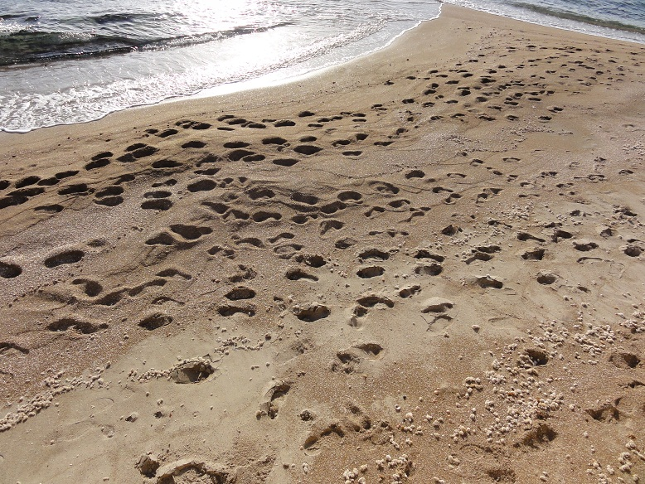
    Footprints of Human Activity
Footprints in sand as Caesarea

Slide 40
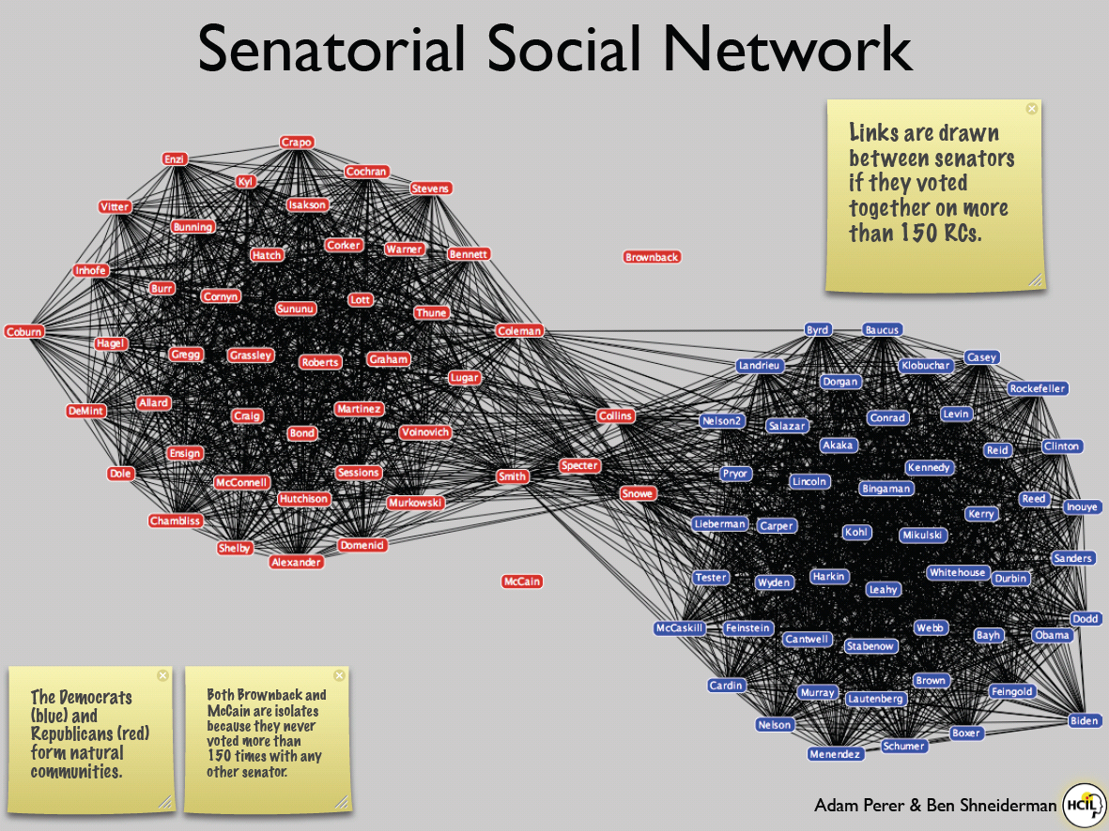
SocialAction
Integrates statistics
& visualization
4 case studies, 4-8 weeks
(journalist, bibliometrician, terrorist analyst,
organizational analyst)
Identified desired features, gave strong positive feedback about benefits of integration
www.cs.umd.edu/hcil/socialaction
Perer & Shneiderman, CHI2008, IEEE CG&A 2009

Slide 41
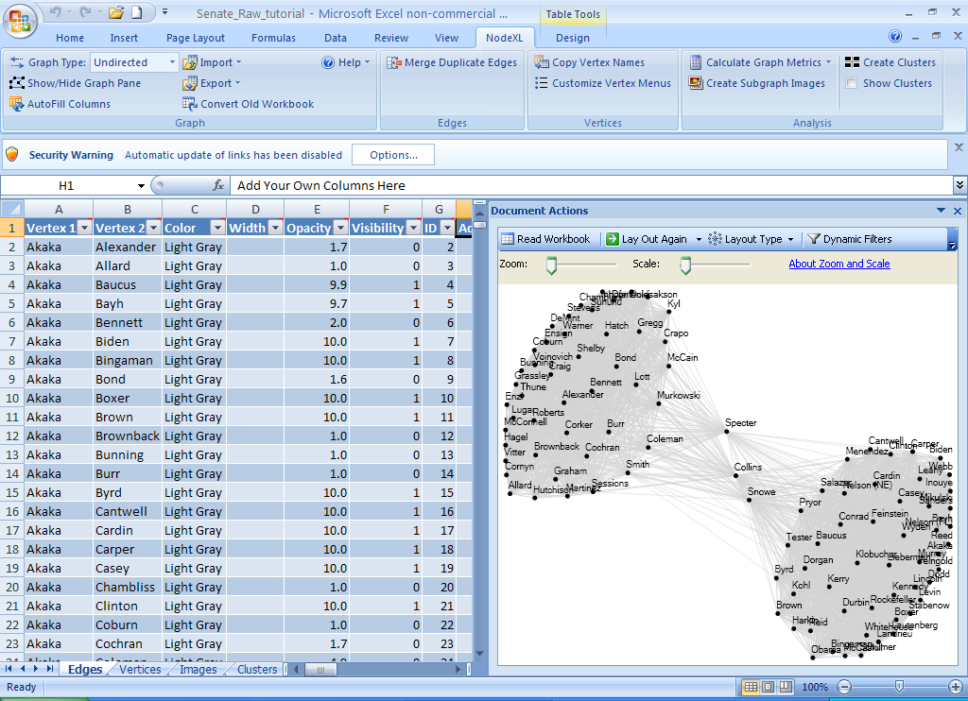
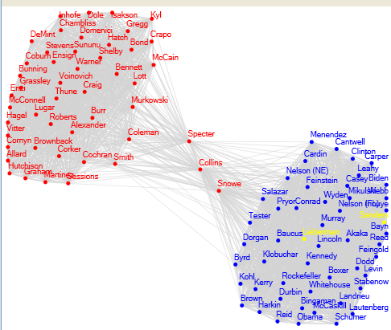
NodeXL:
Network Overview for Discovery & Exploration in Excel
www.codeplex.com/nodexl
casci.umd.edu/NodeXL_Teaching

Slide 42
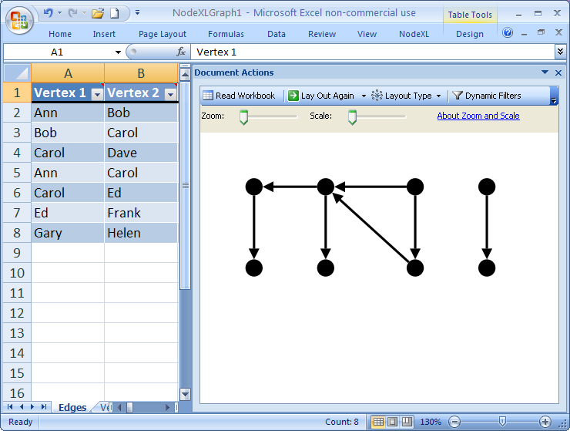
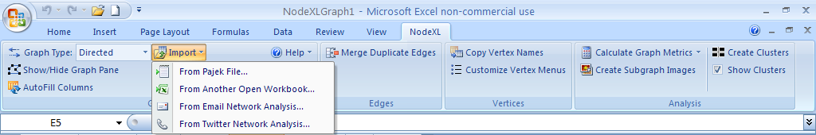
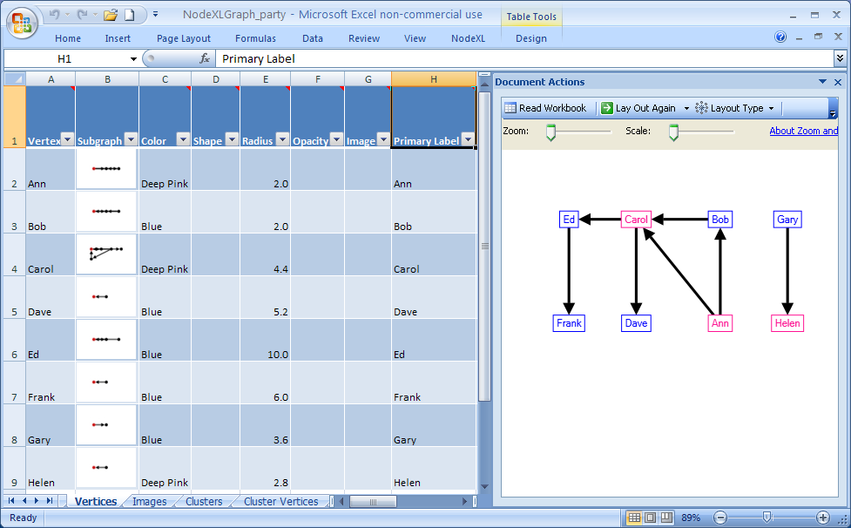
NodeXL:
Network Overview for Discovery & Exploration in Excel
www.codeplex.com/nodexl

Slide 43
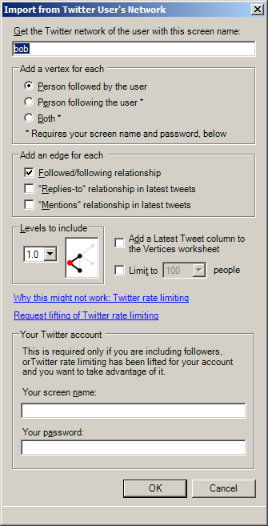
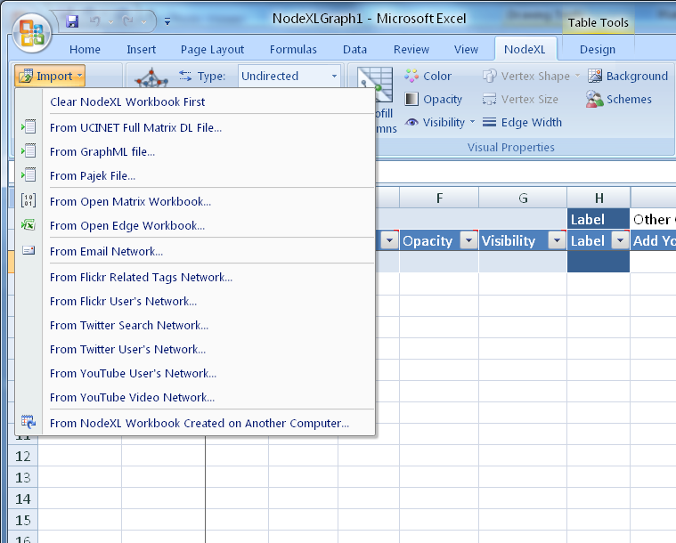
NodeXL: Import Dialogs
www.codeplex.com/nodexl

Slide 44
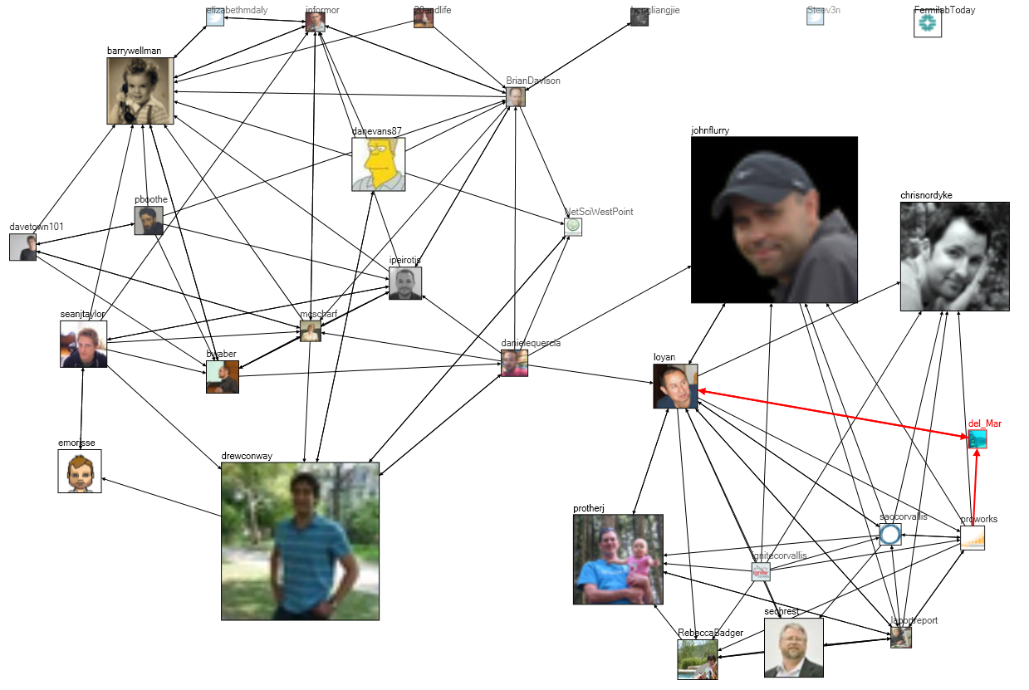
Tweets at #WIN09 Conference: 2 groups
Notes:
Chapter 3, Figure 1 (page 6). A NodeXL social media network diagram of relationships among Twitter users mentioning the hashtag “#WIN09” used by attendees of a conference on Network Science at NYU in September 2009. Each user’s node is sized proportional to the number of tweets they have ever made to that date.

Slide 45
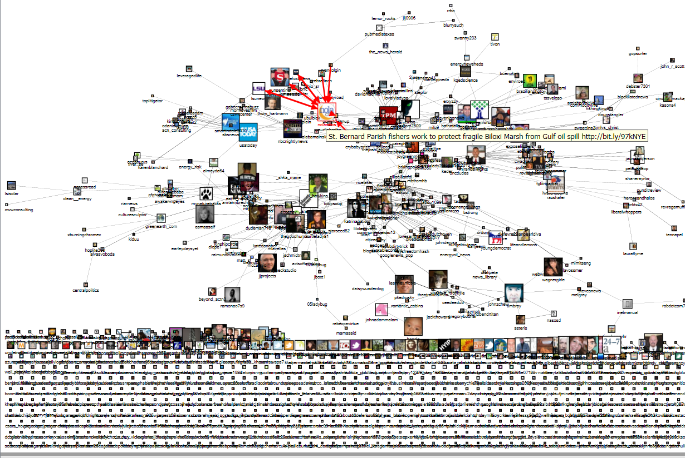
Oil Spill Twitter Community
www.codeplex.com/nodexl/

Slide 46
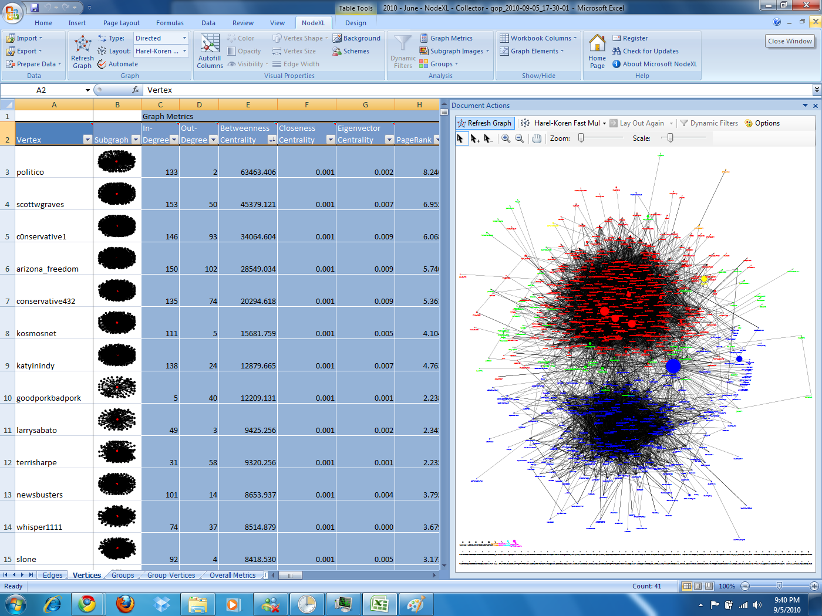
Twitter discussion of #GOP
Red: Republicans, anti-Obama,
mention Fox
Blue: Democrats, pro-Obama,
mention CNN
Green: non-affiliated
Node size is number of followers
Politico is major bridging group
Notes:
Figure 13.24. NodeXL network of Flickr users who comment on Marc_Smith’s photos (network depth 1.5; edge weight≥4).

Slide 47
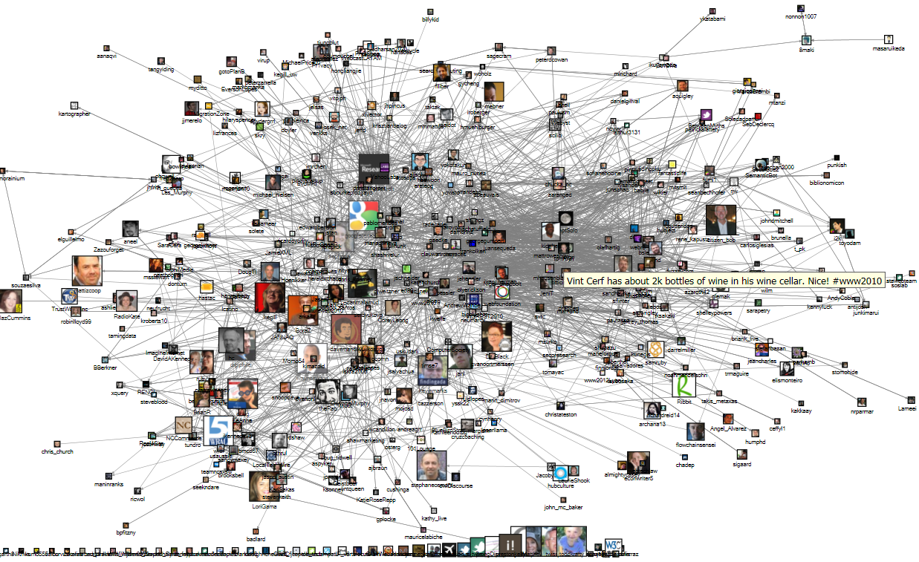
WWW2010 Twitter Community

Slide 48
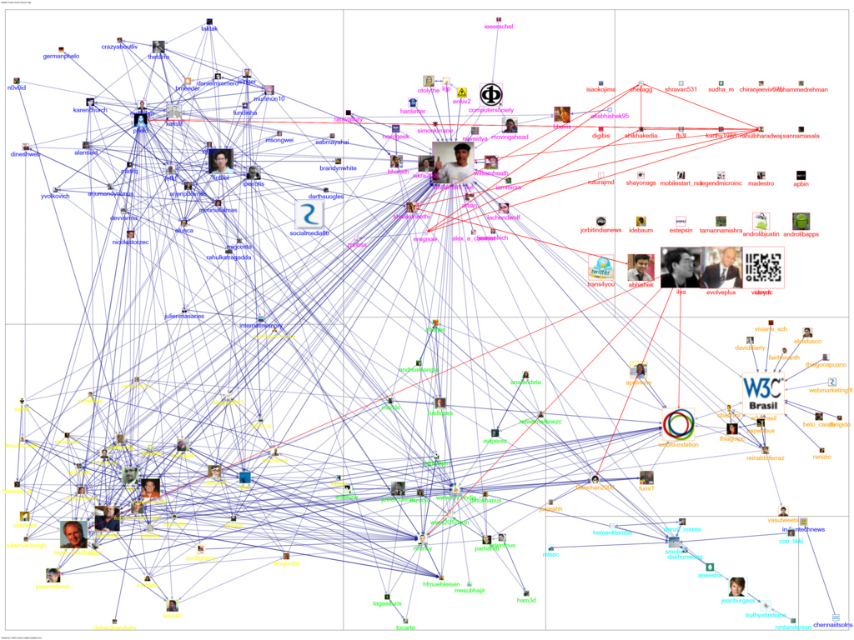
WWW2011 Twitter Community: Grouped

Slide 49
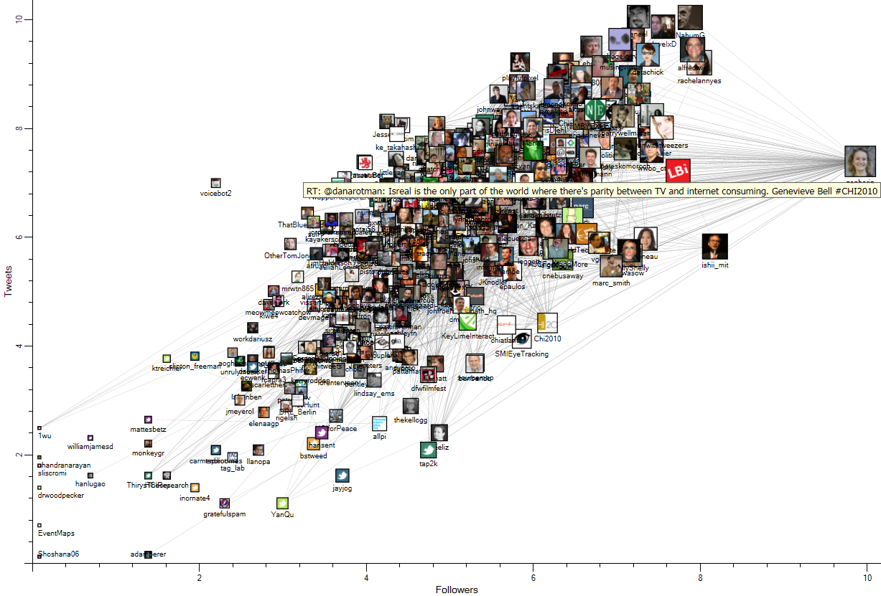
CHI2010 Twitter Community
www.codeplex.com/nodexl/

Slide 50
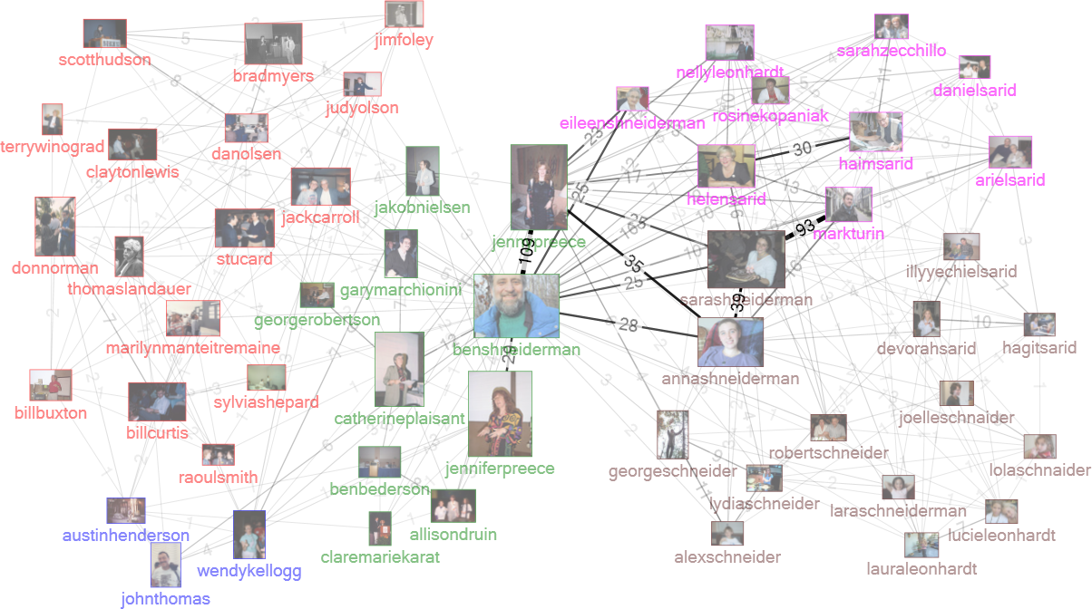
Flickr networks
Notes:
Chapter 3, Figure 1 (page 6). A NodeXL social media network diagram of relationships among Twitter users mentioning the hashtag “#WIN09” used by attendees of a conference on Network Science at NYU in September 2009. Each user’s node is sized proportional to the number of tweets they have ever made to that date.

Slide 51


Flickr clusters for “mouse”
Computer Mickey
Animal
Notes:
Figure 13.20. NodeXL cluster visualization showing three Flickr tag clusters, each representing a different context for “mouse”.
Figure 13.21. NodeXL display of Isolated clusters for three different contexts for the “mouse” tag in Flickr: mouse animal, computer mouse, and Mickey Mouse Disney character.

Slide 52

Flickr commenters on Marc Smith’s pix
Notes:
Figure 13.24. NodeXL network of Flickr users who comment on Marc_Smith’s photos (network depth 1.5; edge weight≥4).

Slide 53

Figure 7.11. : Lobbying Coalition Network connecting organizations (vertices) that have jointly filed comments on US Federal Communications Commission policies (edges). Vertex Size represents number of filings and color represents Eigenvector Centrality (pink = higher). Darker edges connect organizations with many joint filings. Vertices were originally positioned using Fruchterman-Rheingold and hand-positioned to respect clusters identified by NodeXL’s Find Clusters algorithm.

Slide 54

Analyzing Social Media Networks with NodeXL
I. Getting Started with Analyzing Social Media Networks
1. Introduction to Social Media and Social Networks
2. Social media: New Technologies of Collaboration
3. Social Network Analysis
II. NodeXL Tutorial: Learning by Doing
4. Layout, Visual Design & Labeling
5. Calculating & Visualizing Network Metrics
6. Preparing Data & Filtering
7. Clustering &Grouping
III Social Media Network Analysis Case Studies
8. Email
9. Threaded Networks
10. Twitter
11. Facebook
12. WWW
13. Flickr
14. YouTube
15. Wiki Networks
http://www.elsevier.com/wps/find/bookdescription.cws_home/723354/description

Slide 55

Social Media Research Foundation
Social Media Research Foundation
smrfoundation.org
We are a group of researchers who want to create open tools, generate and host open data, and support open scholarship related to social media.
smrfoundation.org

Slide 56
Let’s get to work!
Do great research!!!! → Inspirational
Universities
  Add courses & degree programs
  Help Federal & Local governments
Industry
  Offer researchers access to data
  Develop infrastructure and analysis tools
Government
  National Initiative for Social Participation
  Develop Federal & Local applications

