Slide 1
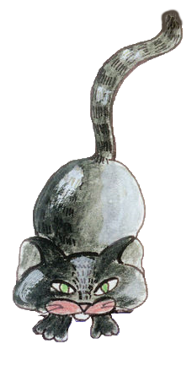
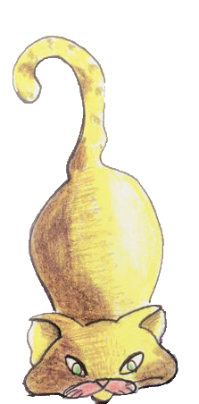

Ben Bederson & Allison Druin Computer Science Dept. & iSchool Human-Computer Interaction Lab University of Maryland
black ears to
blonde cats:
paths for designing change
Notes:
Timing:
(26) ICDL
4: Black ears & ICDL Vision
4: ICDL Demo
4: Mongolia
4: OLPC & Use
5: Readability
5: Four country study
(13) Co-design
5: General
2: NPS
2: UNICEF
2: Giigle
2: KidPad
(2) Ben Bridge
(7) Voting
(6) Mobile
3: iPhone
3: Jerry
(6) Futures & Call to action
As researchers, we both have grown up in the field of Human-Computer
Interaction. Over the past two decades, we learned how to understand,
design, and innovate for diverse users. The challenging
lessons we learned have resulted in technologies that can transform
how the world's children read books, how the American public votes, how
families can visit U.S. National Parks, and much more. As all of us
look to the future, we believe it is time to consider change that goes
beyond innovating technology. We must use our experiences as HCI
researchers to lead, innovate, and transform our field.
Therefore, our talk will focus on a "Call to Action" with five strategic
paths for change. This "Call“ emerged from our own experiences and
will be illustrated by our work. We will present examples, show demos,
and highlight the possibilities for the future.

Slide 2
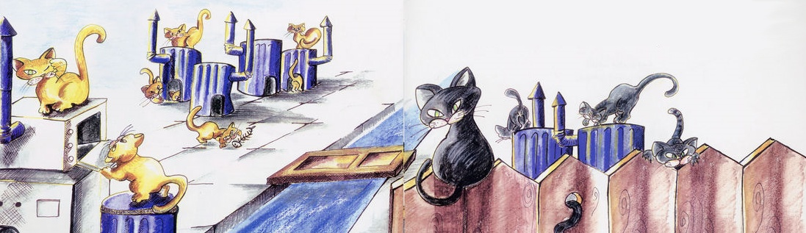
“Once upon a time a huge tribe of cats lived in a remote village. A river divided the village in two. Black cats lived on one bank and blonde cats lived on the other… In summer and autumn, a black cat ruled the village and in spring and winter, a blonde cat ruled the village.”
-Black ears … blonde ears (2002)

Slide 3
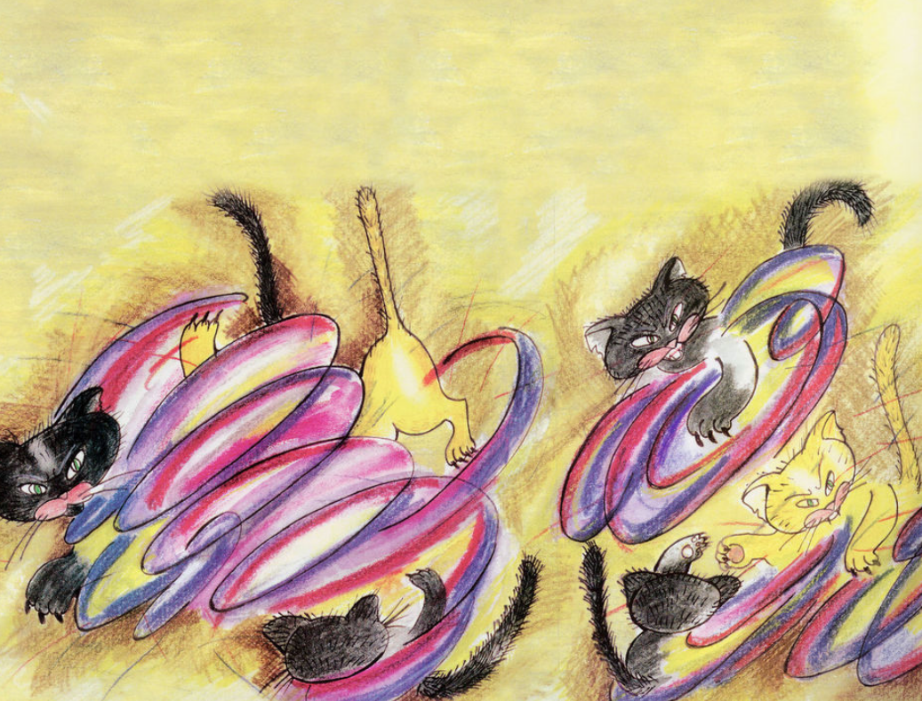

Slide 4
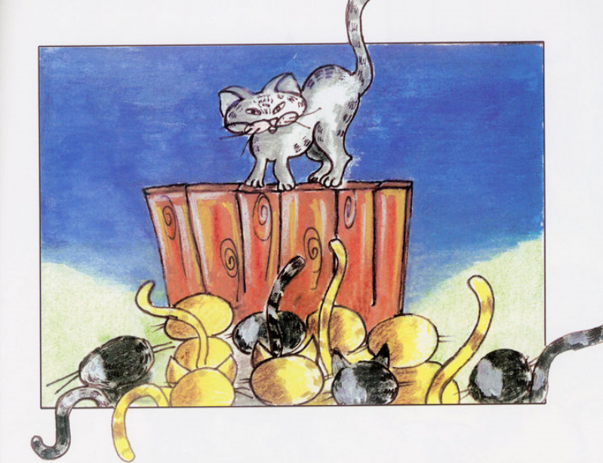

Slide 5
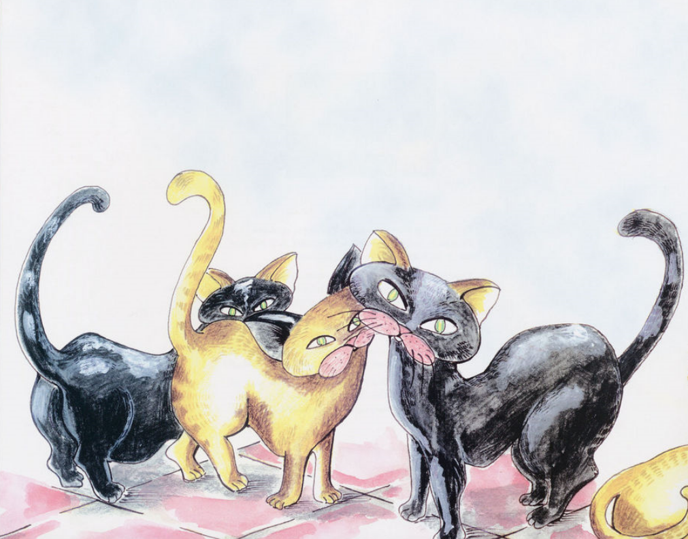
“I think you can hear me now. If you are all willing to listen to each other, we will be able to solve our problems. Only when you can do that will we be happy and able to live in peace.”
-Black ear … blonde ear (2002)
in www.childrenslibrary.org
by Khaled Jumm’a, Illustrated by Foutinie Dedwase
The Tamer Institute for Community Education, Palestine

Slide 6

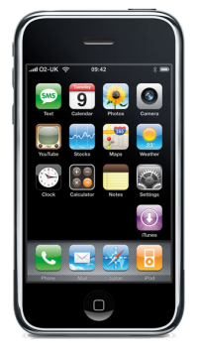

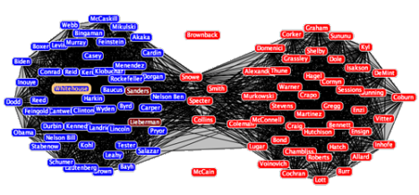
future
of
HCI
mobile
natural language (and vision)
huge
social networks
user
generated content
physical computing
context awareness
privacy awareness
Notes:
Design for the world
ICDL
4 country study
OLPC
Partner for deepest change
Co-design (NPS, UNICEF)
Jerry phone
Support creative expression
KidPad, PETS, StoryRooms
Balance understanding, innovation and real use
ICDL readability => iPhone
Giigle
Lead change with HCI
Voting

Slide 7
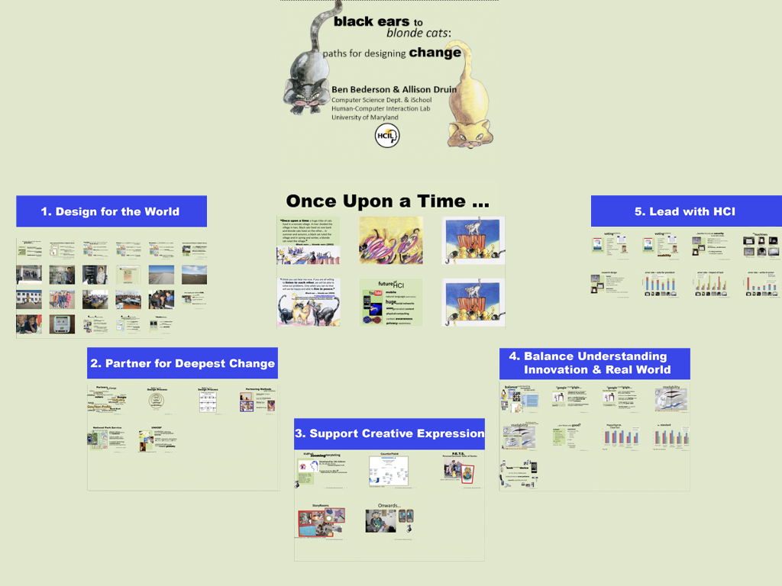
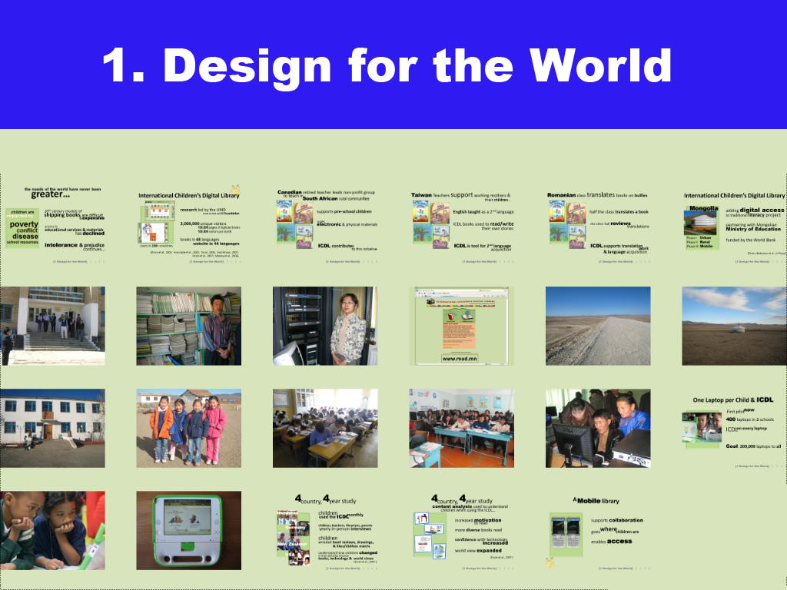
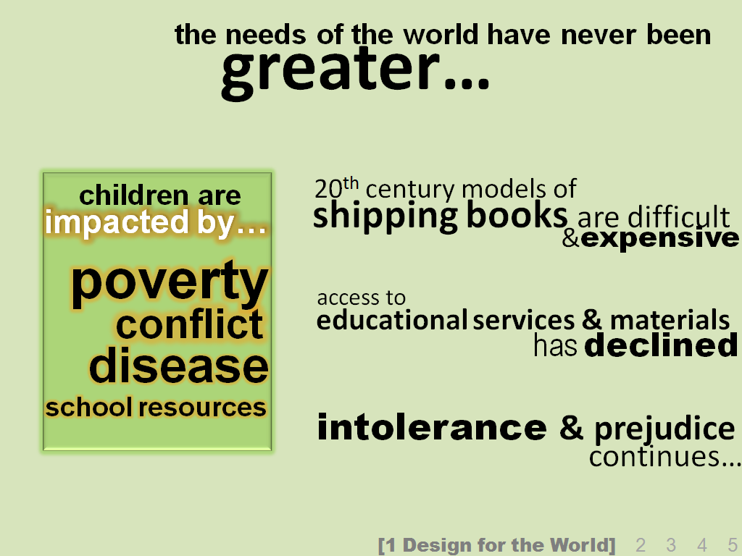

Slide 8
greater…
the needs of the world have never been
children are
20th century models of
shipping books are difficult
impacted by…
&expensive
poverty
access to
conflict
educational services & materials
disease
has declined
school resources
intolerance & prejudice
continues…
[1 Design for the World] 2 3 4 5

Slide 9
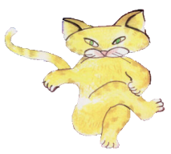
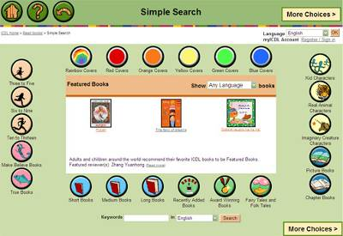
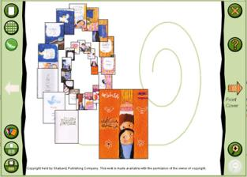
International Children’s Digital Library
research led by the UMD
2,000,000 unique visitors
books in 48 languages
now a non-profit foundation
150,000 pages of digitized books
100,000 visitors per month
website in 16 languages
users in 200+ countries
[Druin et al., 2001; Hourcade et al., 2002; Druin, 2005; Hutchinson, 2007;
Druin et al., 2007; Massey et al., 2006]
[1 Design for the World] 2 3 4 5

Slide 10




Canadian retired teacher leads non-profit group
to teach in
South African rural communities
supports pre-school children
uses
electronic & physical materials
ICDL contributes
to this initiative
[1 Design for the World] 2 3 4 5

Slide 11
Taiwan Teachers support working mothers &
their children…
English taught as a 2nd language
ICDL books used to read/write
their own stories
ICDL is tool for 2nd language
acquisition
[1 Design for the World] 2 3 4 5

Slide 12
Romanian class translates books on bullies
half the class translates a book
the other half reviews
translations
ICDL supports translation
work
& language acquisition
[1 Design for the World] 2 3 4 5

Slide 13
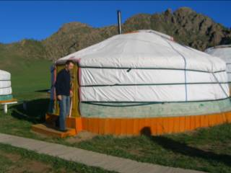
International Children’s Digital Library
Mongolia
adding digital access
to traditional literacy project
partnering with Mongolian
Ministry of Education
Phase I Urban
Phase II Rural
Phase III Mobile
funded by the World Bank
[Druin, Bederson et al., In Press]
[1 Design for the World] 2 3 4 5

Slide 14
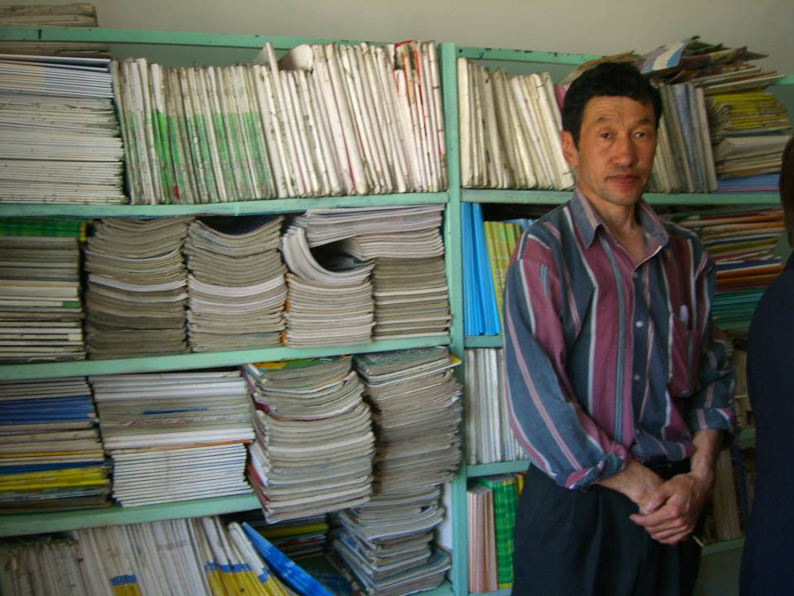

Slide 15
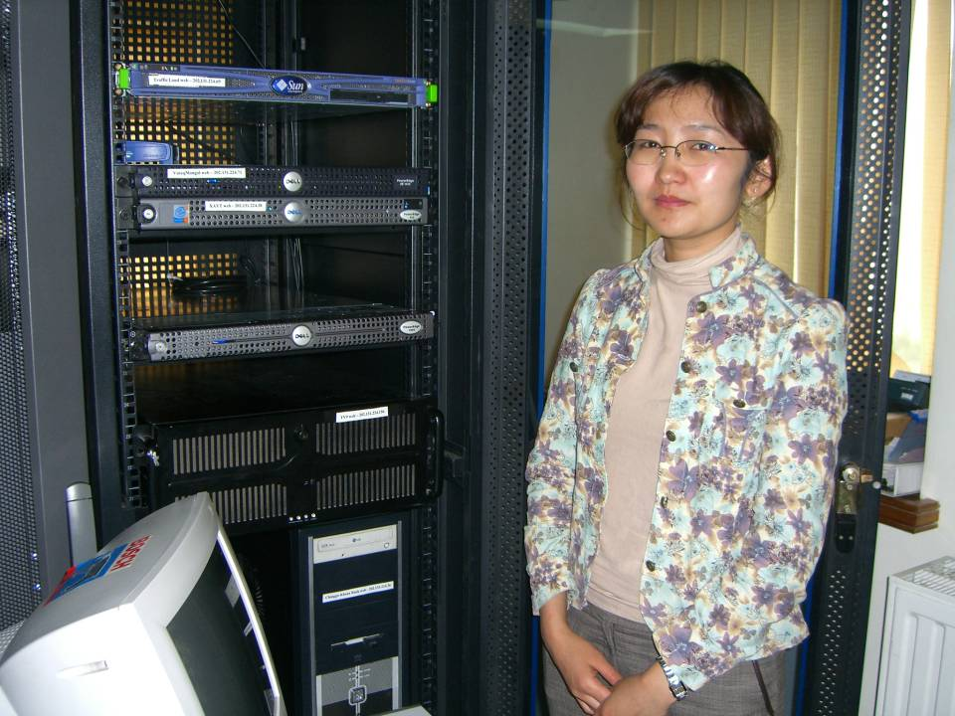

Slide 16
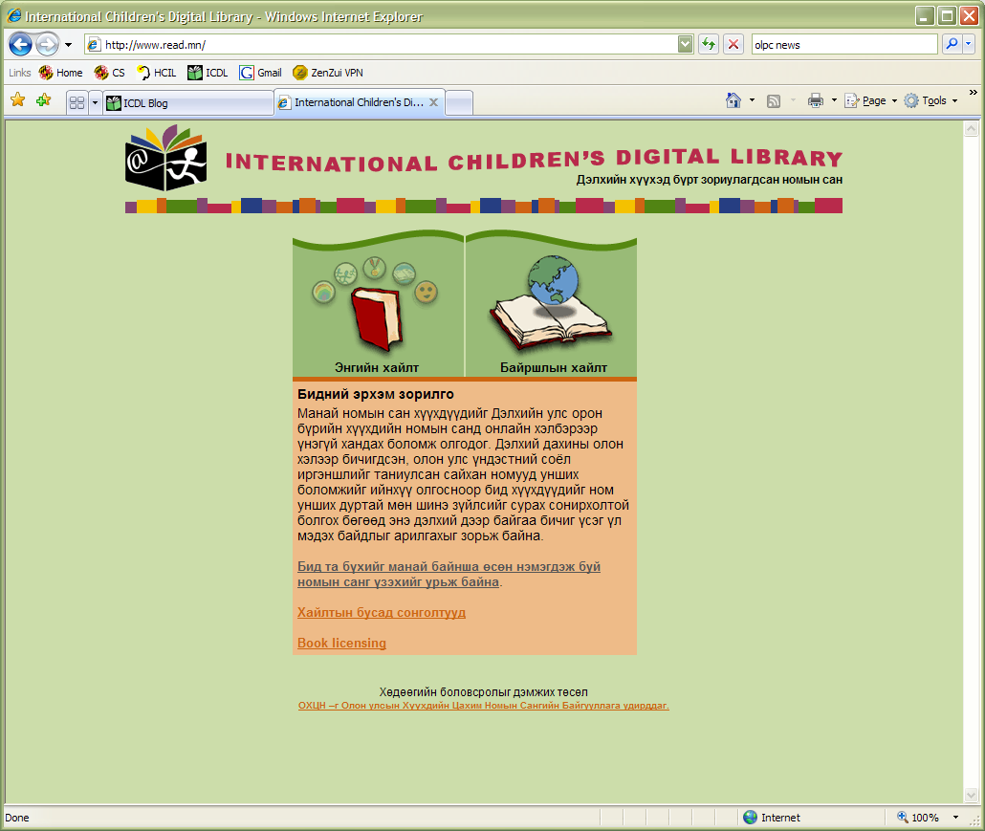
www.read.mn

Slide 17


Slide 18
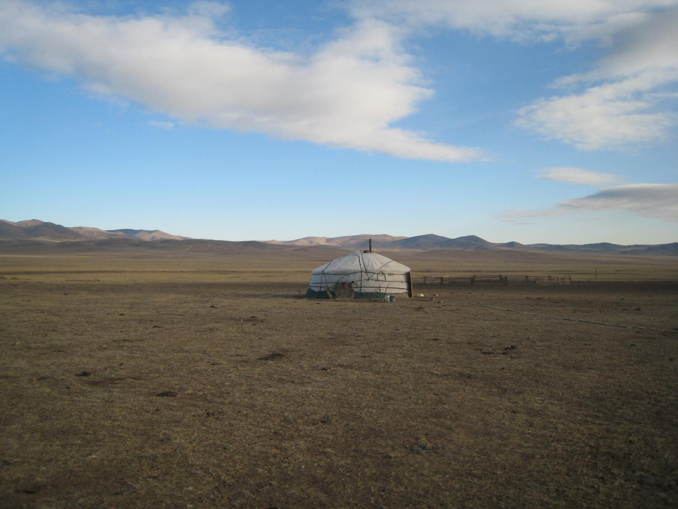

Slide 19
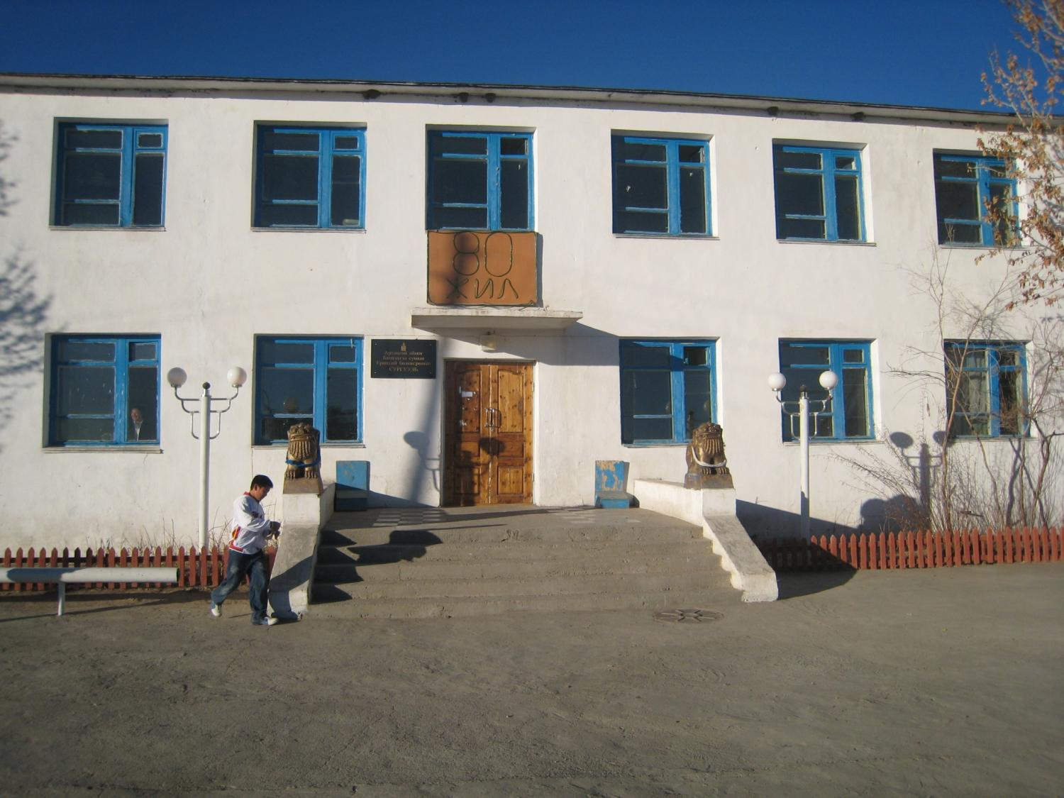

Slide 20
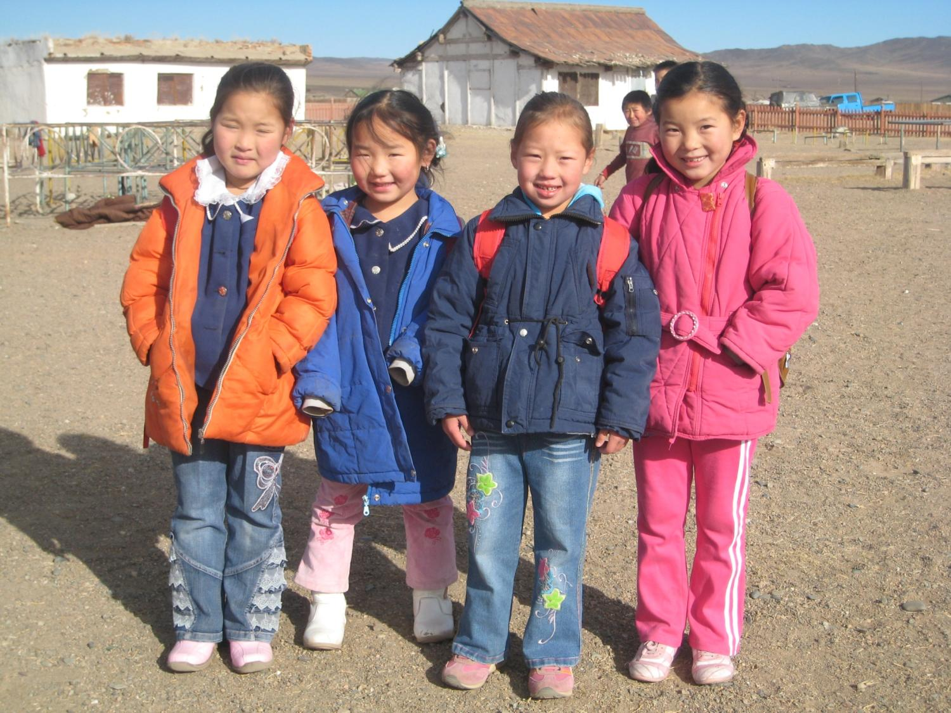

Slide 21
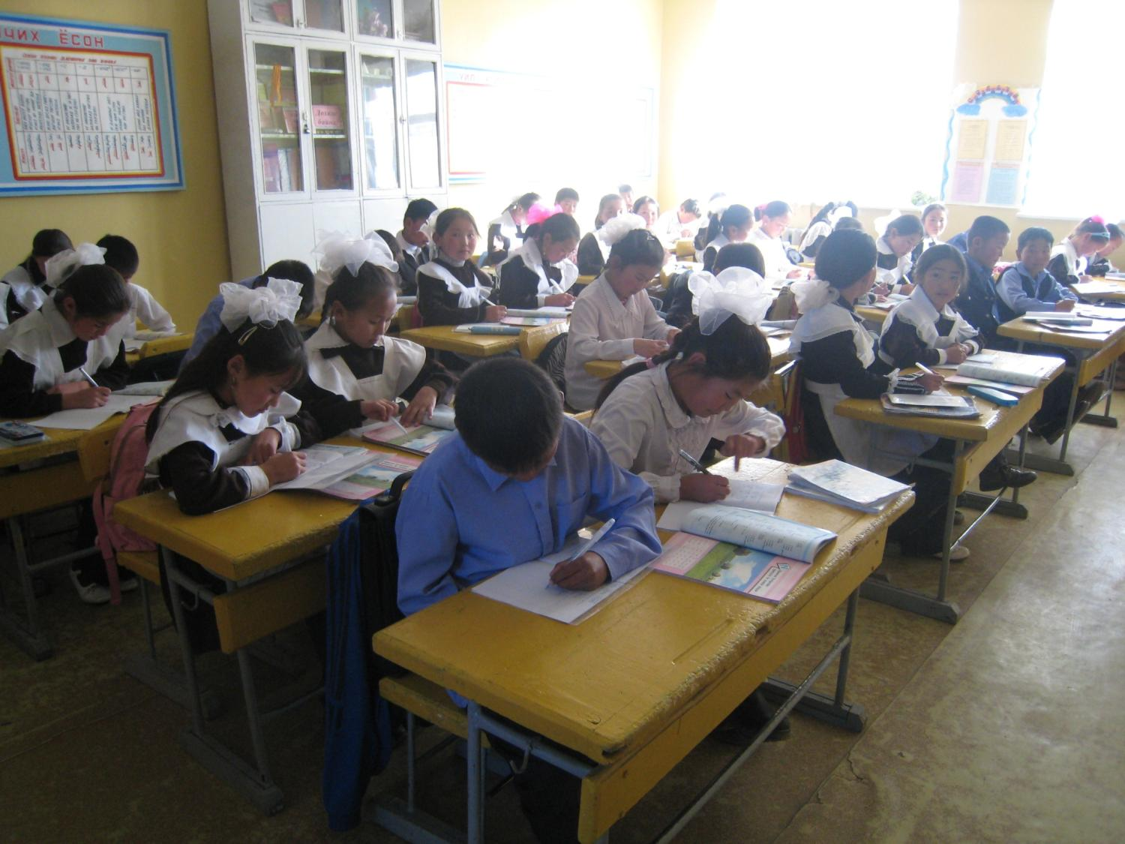

Slide 22
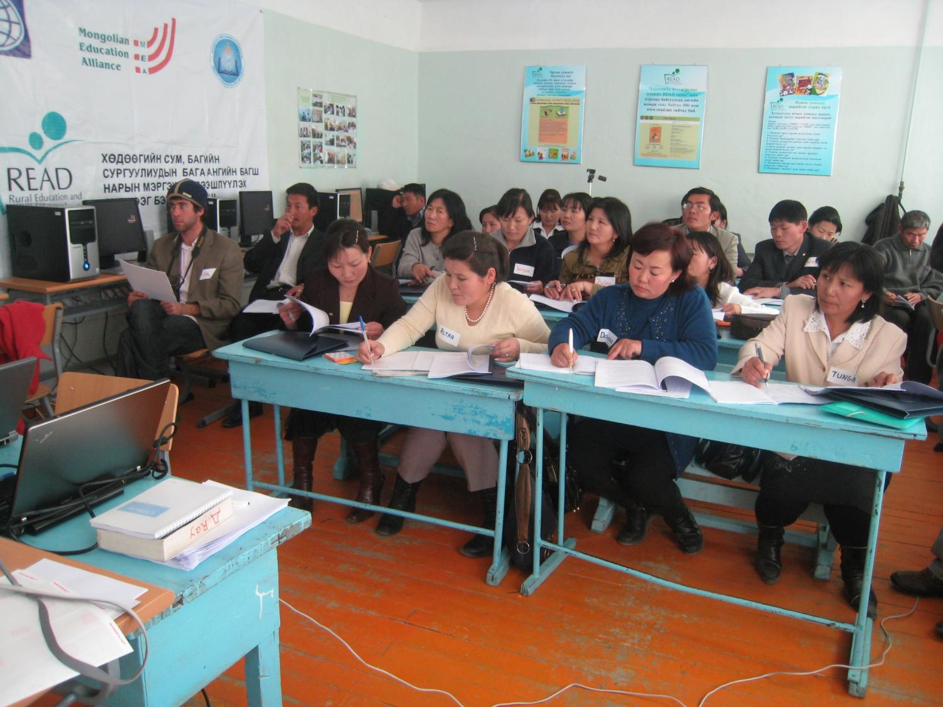

Slide 23
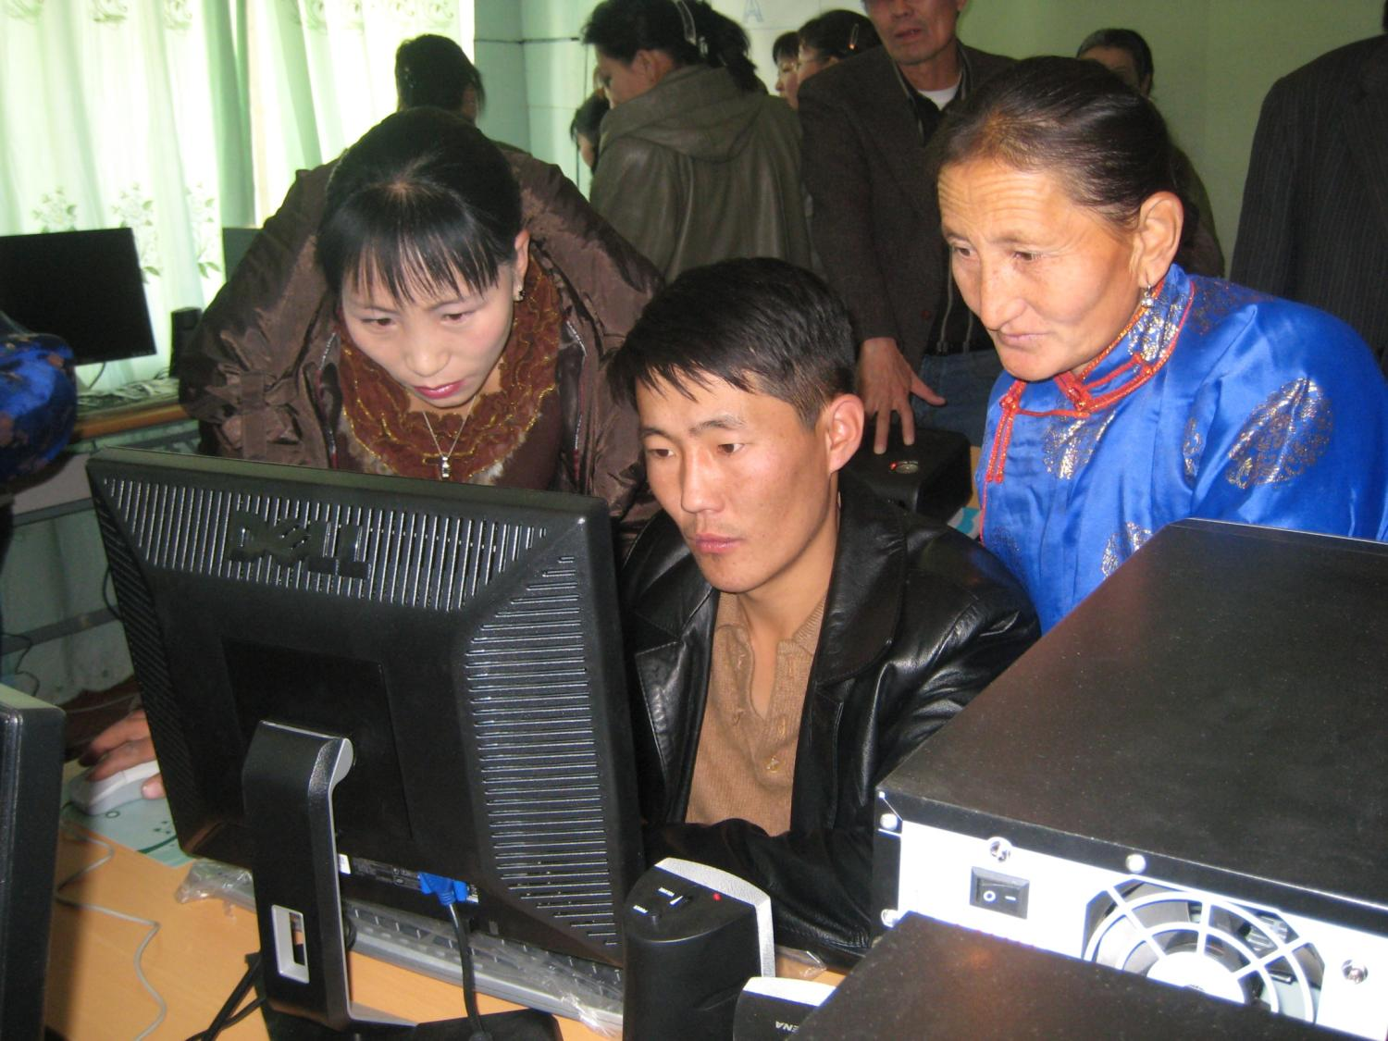

Slide 24
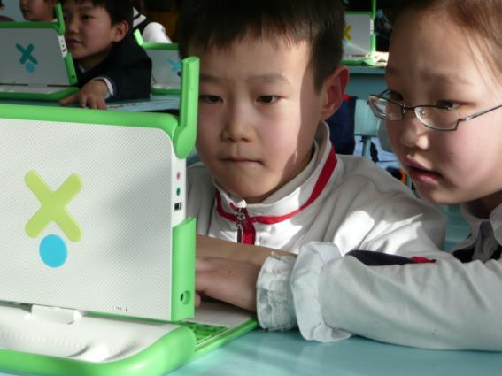
One Laptop per Child & ICDL
now
First pilot
400 laptops in 2 schools
Goal: 200,000 laptops to all
ICDL
on every laptop
[1 Design for the World] 2 3 4 5

Slide 25
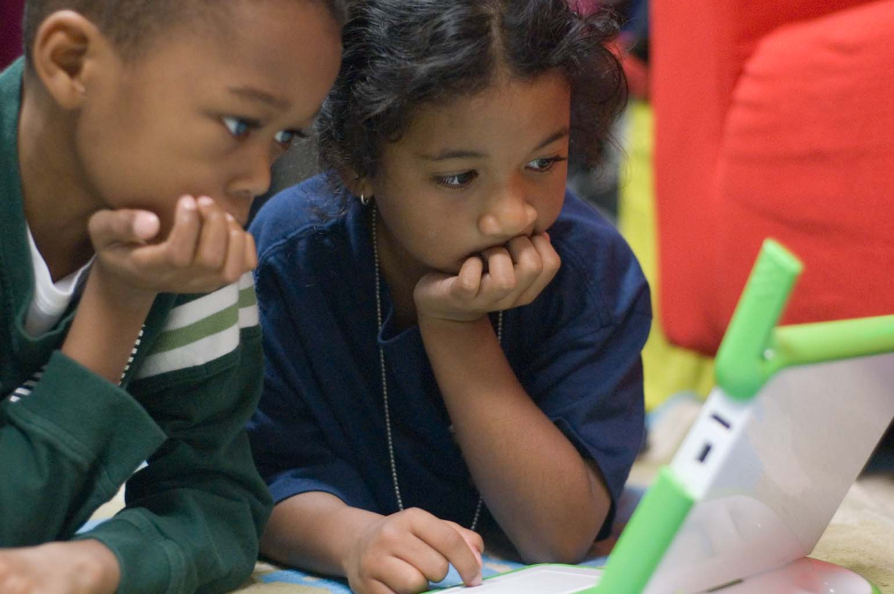

Slide 26
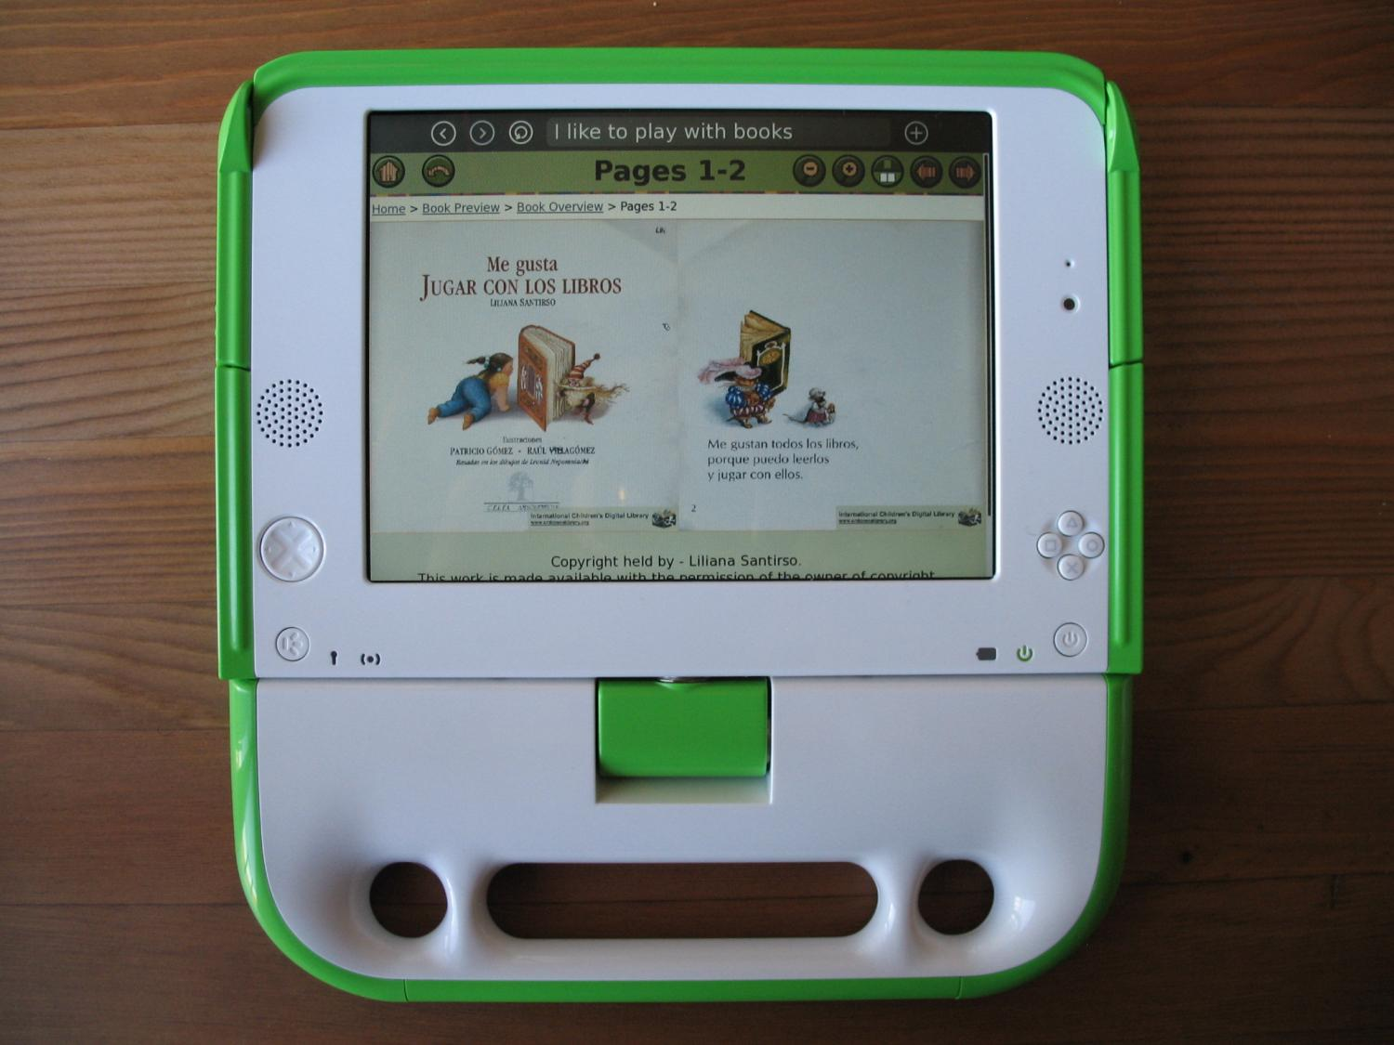

Slide 27
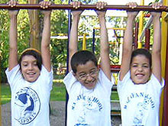
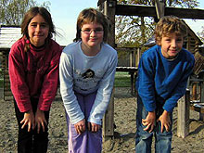
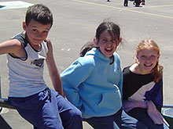
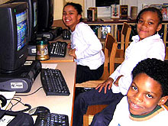
country,
4
4
year study
Honduras
children
monthly
used the ICDL
children, teachers, librarians, parents
Germany
yearly in-person interviews
children
emailed book reviews, drawings,
New Zealand
& likes/dislikes matrix
understand how children changed
USA
in their attitudes towards
books, technology & world views
[Druin et al., 2007 ]
[1 Design for the World] 2 3 4 5

Slide 28


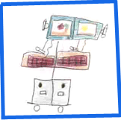

country,
4
4
year study
content analysis used to understand
children when using the ICDL…
increased motivation
to read
more diverse books read
confidence with technology
increased
world view expanded
[Druin et al., 2007 ]
[1 Design for the World] 2 3 4 5

Slide 29
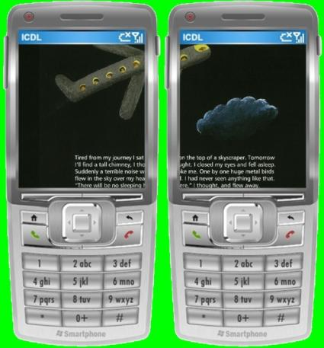
Mobile library
A
supports collaboration
where
goes children are
enables access
[1 Design for the World] 2 3 4 5

Slide 30
Call for Action: Design for the World
HCI Peace Corps
Service projects around the world
Master’s projects, Ph.D. work, sabbatical work
based on HCIL’s annual service project

Slide 31
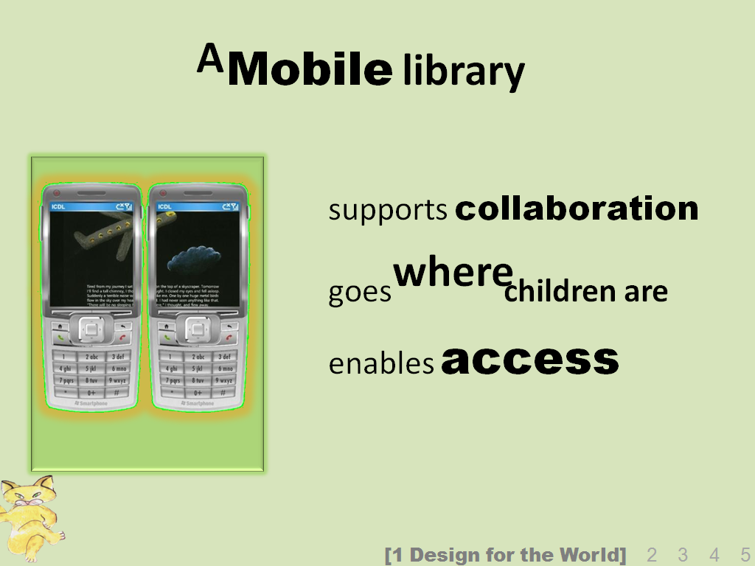
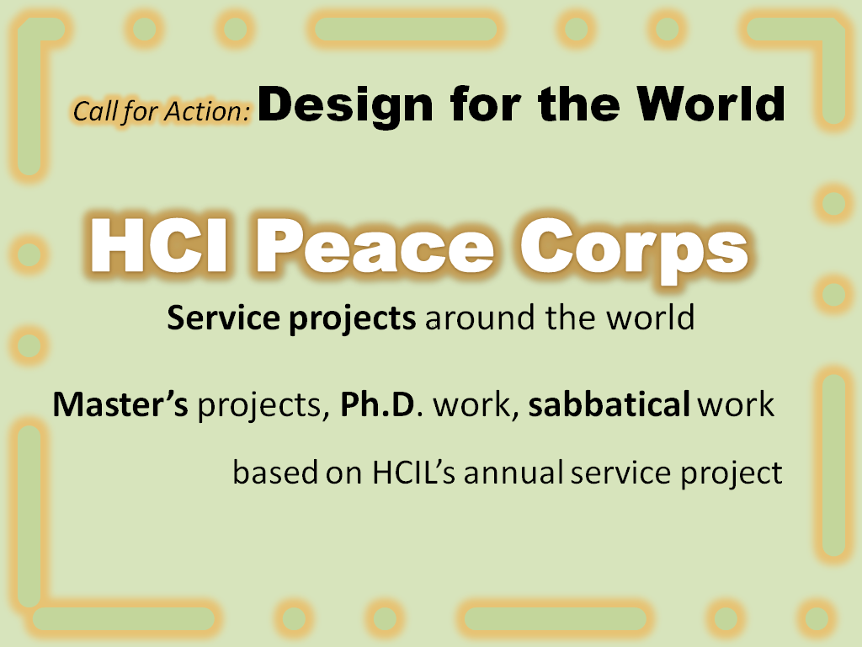
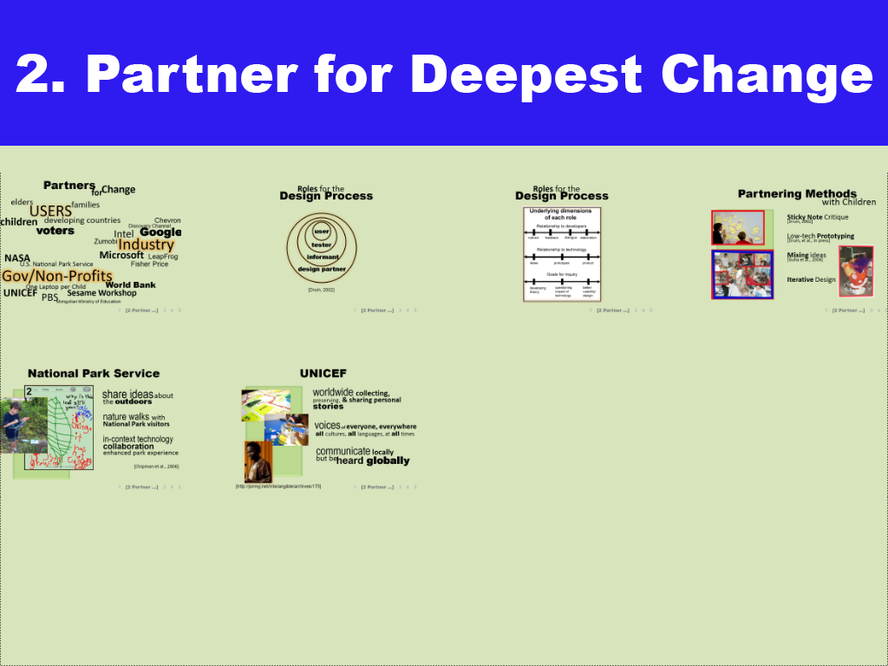
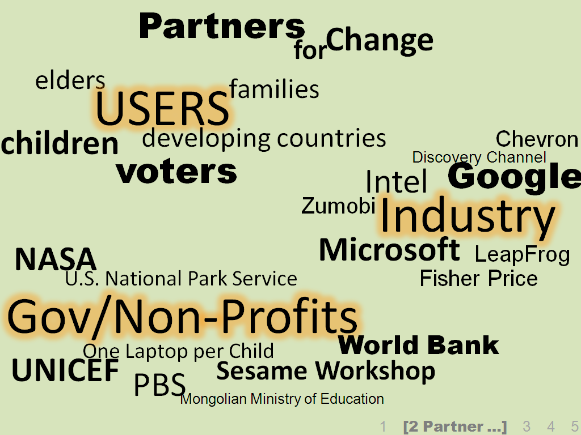

Slide 32
Partners
Change
for
elders
USERS
families
children
developing countries
voters
Chevron
Google
Intel
Discovery Channel
Industry
Zumobi
Microsoft
NASA
U.S. National Park Service
LeapFrog
Fisher Price
Gov/Non-Profits
One Laptop per Child
World Bank
UNICEF
Sesame Workshop
PBS
Mongolian Ministry of Education
1 [2 Partner …] 3 4 5

Slide 33
Design Process
Roles for the
user
tester
informant
design partner
[Druin, 2002]
1 [2 Partner …] 3 4 5

Slide 34
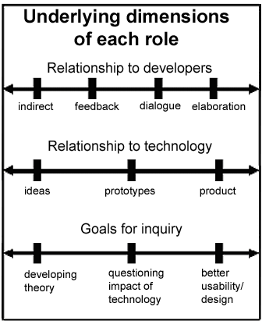
Roles for the
Design Process
1 [2 Partner …] 3 4 5

Slide 35
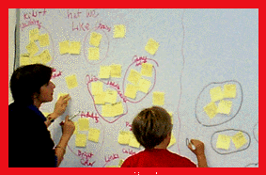
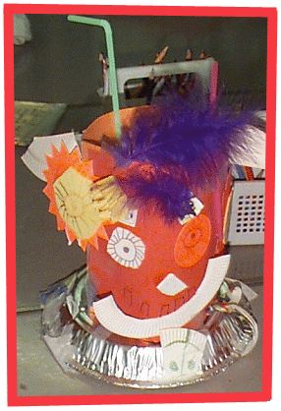
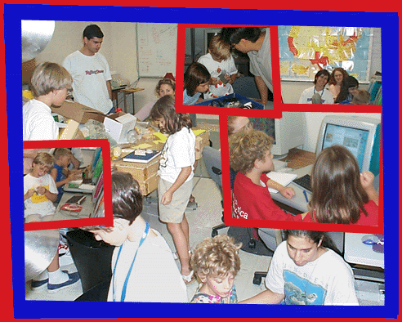
Partnering Methods
with Children
Sticky Note Critique
[Druin, 2002]
Low-tech Prototyping
[Druin, et al., In press]
Mixing ideas
[Guha et al., 2004]
Iterative Design
1 [2 Partner …] 3 4 5

Slide 36
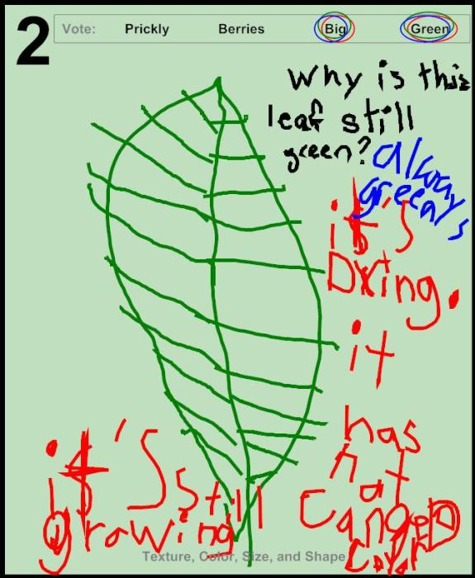
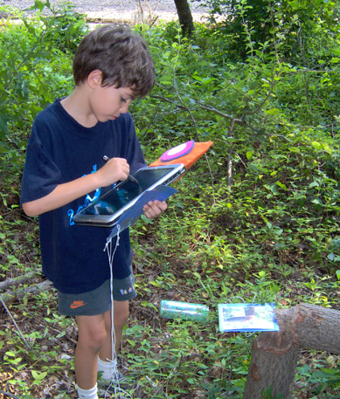
National Park Service
share ideas about
the outdoors
nature walks with
National Park visitors
in-context technology
collaboration
enhanced park experience
[Chipman et al., 2006]
1 [2 Partner …] 3 4 5

Slide 37
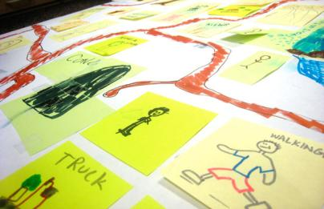
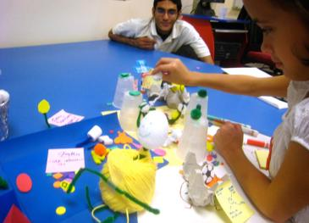

UNICEF
worldwide collecting,
preserving, & sharing personal
stories
voices of everyone, everywhere
all cultures, all languages, at all times
communicate locally
but be
heard globally
[http://jonnyj.net/interangible/archives/175]
1 [2 Partner …] 3 4 5

Slide 38
Call for Action: Partner for Deepest Change
HCI Partnership Award
highlights HCI community’s partnerships
Most unlikely set of partners
CHI award…

Slide 39
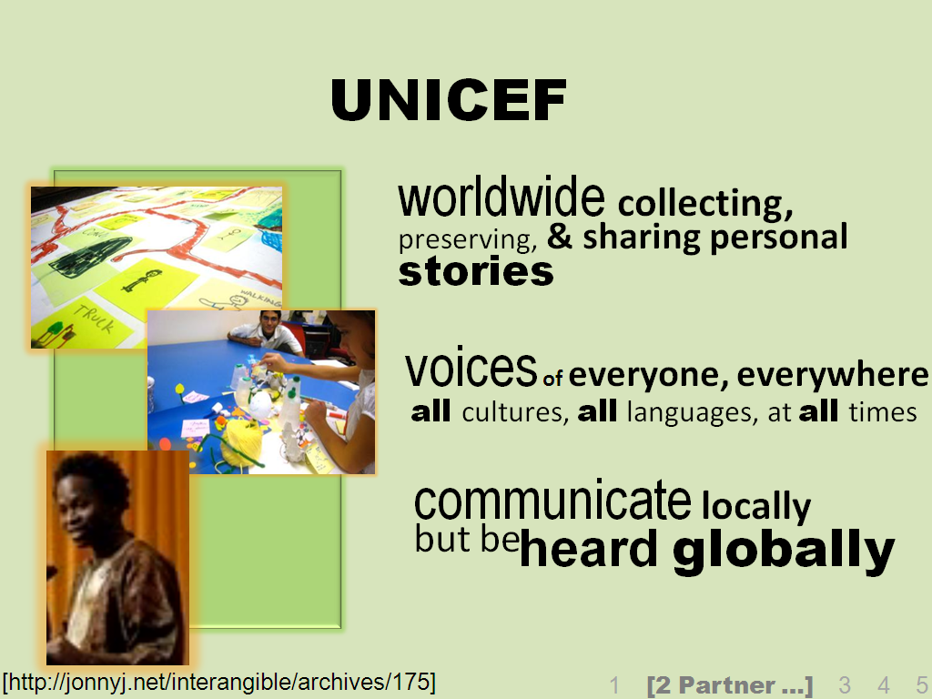
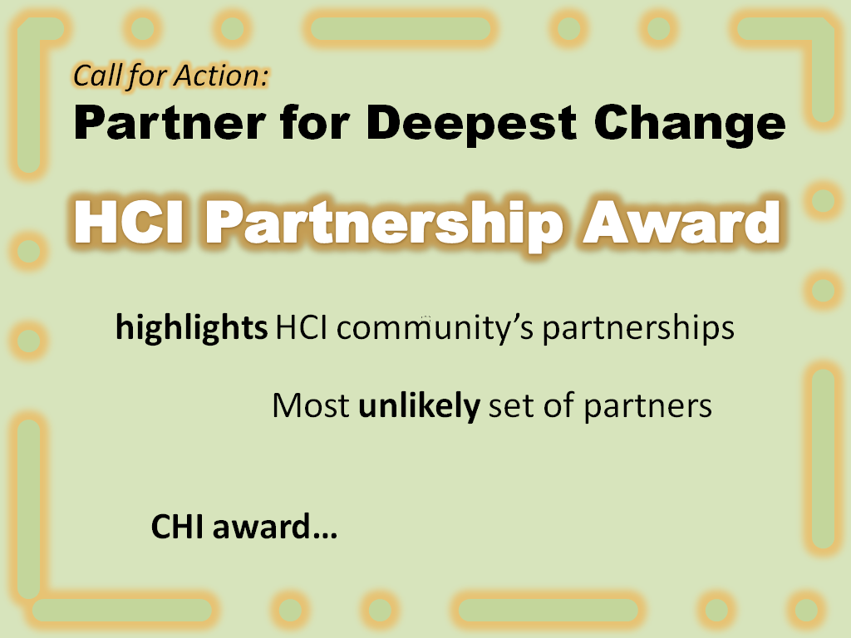
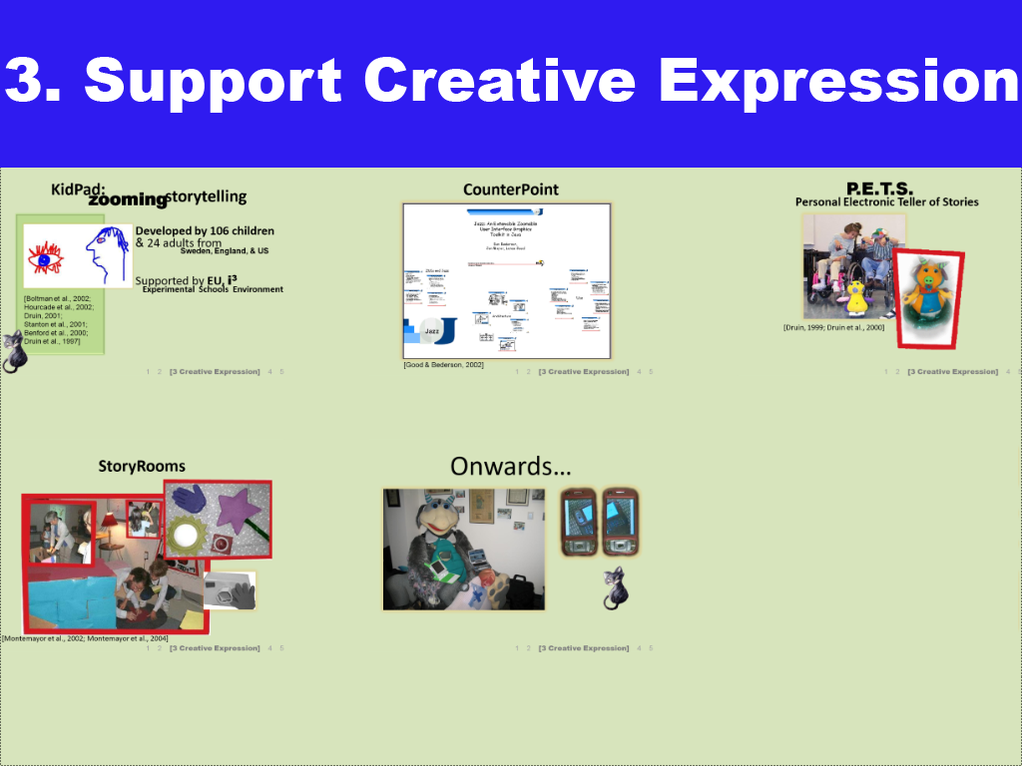
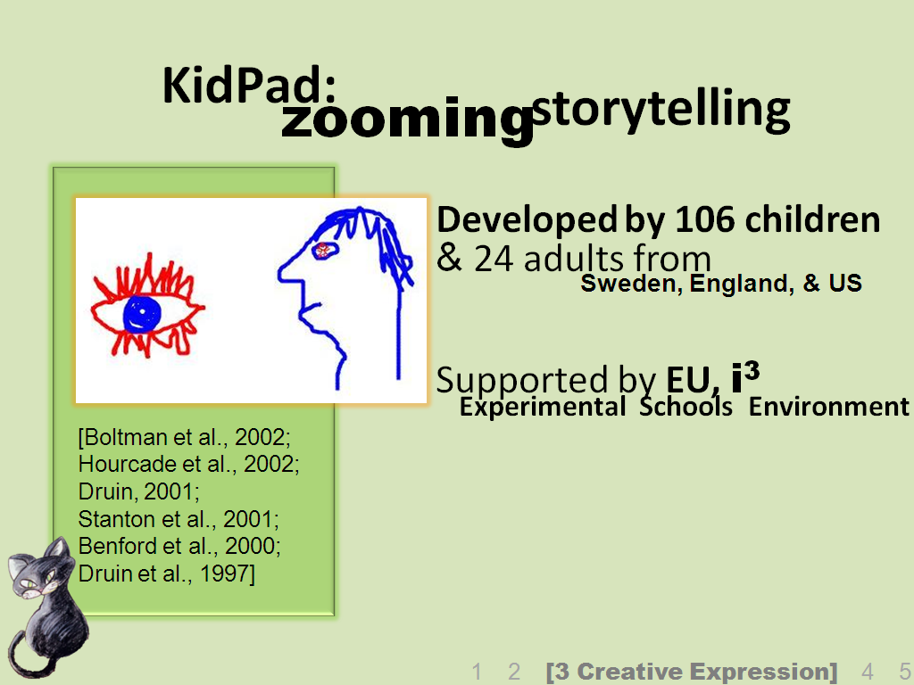

Slide 40
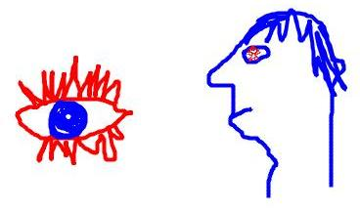

KidPad:
storytelling
zooming
Developed by 106 children
& 24 adults from
Supported by EU, i³
Sweden, England, & US
Experimental Schools Environment
[Boltman et al., 2002; Hourcade et al., 2002; Druin, 2001; Stanton et al., 2001; Benford et al., 2000; Druin et al., 1997]
1 2 [3 Creative Expression] 4 5

Slide 41

CounterPoint
[Good & Bederson, 2002]
1 2 [3 Creative Expression] 4 5

Slide 42


P.E.T.S.
Personal Electronic Teller of Stories
[Druin, 1999; Druin et al., 2000]
1 2 [3 Creative Expression] 4 5

Slide 43



StoryRooms
[Montemayor et al., 2002; Montemayor et al., 2004]
1 2 [3 Creative Expression] 4 5

Slide 44


Onwards…
1 2 [3 Creative Expression] 4 5

Slide 45
Call for Action: Support Creative Expression
HCI Stories
collection of stories on how HCI supports
creative expression
traveling exhibit in museums, art schools, galleries
possible YouTube collection
shows next generation of creativity
[CC 2007]

Slide 46





Slide 47






& real world
balance
understanding
innovation
1 2 3 [4 Balance …] 5

Slide 48



distributed human computation
social
web scale
1 2 3 [4 Balance …] 5

Slide 49

If
google
could
giigle…
interviewed local maryland
children & parents
(12 in pilot study / 120 in the main study)
goal: to understand how
the Google search UI
is used by
children
how children (7, 9, & 11)
use data to develop prototype
search on the open web
to support children’s search
1 2 3 [4 Balance …] 5

Slide 50
If
google
could
giigle…
Pre-CHI-Paper trends…
if the children don’t find it,
it’s not there
confusion over where to type
challenges with typing make
challenges to see screen
2-step queries not done
even by 11-year olds
Currently analyzing results
using qualitative methods
results pages: no need for
more than 4 results
1 2 3 [4 Balance …] 5

Slide 51

readability
1 2 3 [4 Balance …] 5
Notes:
ICDL starts with scanned books. Hold up physical book.
51

Slide 52


55% of ICDL users have screens 1024x768 or smaller
readability
1 2 3 [4 Balance …] 5
Notes:
Displaying on medium size computer screen such as this laptop requires shrinking them dramatically.
52

Slide 53
…are these any good?
evaluate
rate (after each)
easy to see
can read quickly
easy to manipulate
keeps author’s intent
attractive
rank (at end)
same
experiment
read ½ book each with…
physical book
standard
ClearText
PopoutText
27 adults
The Blue Sky
Ciconia Ciconia
[Quinn et al., 2008]
same author
similar style
1 2 3 [4 Balance …] 5
Notes:
Ran experiment. Used adults as a starting point, but want to try again with kids in the future. Participants read half a book with each of the 4 methods: physical book, standard, ClearText, and PopoutText.

Slide 54
PopoutText vs.
ClearText
*
*
*
* Sig. diff.
1 2 3 [4 Balance …] 5
Notes:
Analyzed results, with focus on subjective ratings. First, notice in the first two columns of each group that ClearText was preferred over PopoutText for all but legibility and perceived speed, probably because of less clicking and full display of the illustrations.
Note: Everyone who sees this says I should shorten the x-axis labels. However, I believe the most obvious abbreviations would be misleading, vague, or confusing. Consider “speed”, “ease of use”, and “creative intent”. The first implies that we measured the actual speed, which we did not. The second is a vague term which I never use. I think “manipulate” is more specific than “use” in an important way. “Creative intent” is probably not clear unless you already know what we’re talking about. Furthermore, these labels are much closer to what the participants were actually asked.
54

Slide 55
vs. standard
*
*
*
*
*
*
*
*
* Sig. diff. over standard
1 2 3 [4 Balance …] 5
Notes:
ClearText preferred to Standard on all metrics. PopoutText only on legibility, perceived reading speed, ease of manipulation, probably because of more manipulation and alteration of illustrations.
Note: Everyone who sees this says I should shorten the x-axis labels. However, I believe the most obvious abbreviations would be misleading, vague, or confusing. Consider “speed”, “ease of use”, and “creative intent”. The first implies that we measured the actual speed, which we did not. The second is a vague term which I never use. I think “manipulate” is more specific than “use” in an important way. “Creative intent” is probably not clear unless you already know what we’re talking about. Furthermore, these labels are much closer to what the participants were actually asked.
55

Slide 56














book device
a
on every
let the library follow you
mobile phones are everywhere
capacity is growing very fast
1 2 3 [4 Balance …] 5

Slide 57
Call for Action: Balance …
HCI Incubator
International fund to support the best HCI ideas
early, early
funding for research ideas that can
have real-world impact
expand Y Combinator vision

Slide 58





Slide 59



voting
systems
accessibility
accuracy
complexity
cost
reliability
security
security perception
size
speed
usability
butterfly ballot
[Brookings Press, 2008]
hanging chad
1 2 3 4 [5 Leading with HCI]

Slide 60
voting
systems
accessibility
accuracy
complexity
cost
reliability
security
security perception
size
speed
usability
butterfly ballot
[Brookings Press, 2008]
hanging chad
1 2 3 4 [5 Leading with HCI]

Slide 61



…but the focus is on security
so we did a study…
expert review (10 experts)
field study (1,500 participants in 3 states)
lab study (42 participants)
looked at accuracy…preference
on 6 voting machines
4 verification systems
1 2 3 4 [5 Leading with HCI]

Slide 62






machines
the
Diebold
Avante
ES&S
Model 100
AccuVote-TS
Vote Trakker
Hart
UMD
Nedap
Zoomable Prototype
LibertyVote
InterCivic eSlate
1 2 3 4 [5 Leading with HCI]

Slide 63
research design
tasks:
18 offices & 4 ballot questions
office block & straight party
multi-candidate election
change a vote
cast a write-in vote
process:
pre-mark booklet
write-in matched voter with booklet
1 2 3 4 [5 Leading with HCI]

Slide 64






error rate – vote for president
1 2 3 4 [5 Leading with HCI]

Slide 65
error rate – impact of task
1 2 3 4 [5 Leading with HCI]

Slide 66
error rate – write-in errors
No vote cast
Name didn’t match
Bubble not filled in
1 2 3 4 [5 Leading with HCI]

Slide 67




Slide 68
Call for Action: Lead with HCI
HCI Congress
expansion of US Public Policy Group
representation of all desired HCI groups
in academia, industry, etc.
convenes to vote platforms for policies
to highlight
possibly lobby on the world stage
(United Nations, country governments, etc.)

Slide 69

HCI Peace Corps
HCI Congress
HCI Partner Award
HCI Incubator
HCI Stories

