Slide 1


Reducing Missed Laboratory Results
Sureyya Tarkan, Catherine Plaisant, Ben Shneiderman, A. Zachary Hettinger
UMD Department of Computer Science, HCIL, MedStar Institute for Innovation

Slide 2
‘Missed Results’ Problem
Mishandling of abnormal results & no follow-up (Wahls, 2007)
Most common missing information: test results (Dovey, 2002)
Delay in care, time/financial loss, pain/suffering, adverse clinical consequence (Hickner, 2008)

Slide 3
Test Process Steps
Specimen lost
Patient & Physician
Pre-analytic
  Ordering the test
  Implementing the test
Analytic
  Performing the test
Post-analytic
  Reporting results to the clinician
  Responding to the results
  Notifying the patients of the results
  Following-up to ensure the patient took the appropriate action based on test results
Specimen damaged during transport
Lab technician
Specimen mislabeled in office
Patient doesn’t go
Physician
Results misplaced
No documentation on record
Nurse
Physician on vacation

Slide 4
Related Work
Results Manager by Partners Healthcare (Poon, 2003)
Little-JIL (Christov, 2008)
Clinical guideline modeling languages (Shahar, 1998; Peleg, 2000; Fox, 1996)
Notes:
Organizes by visits rather than orders
Focuses on the formulizing the processes
Medical guidelines that do not necessarily specify the step-by-step workflow

Slide 5
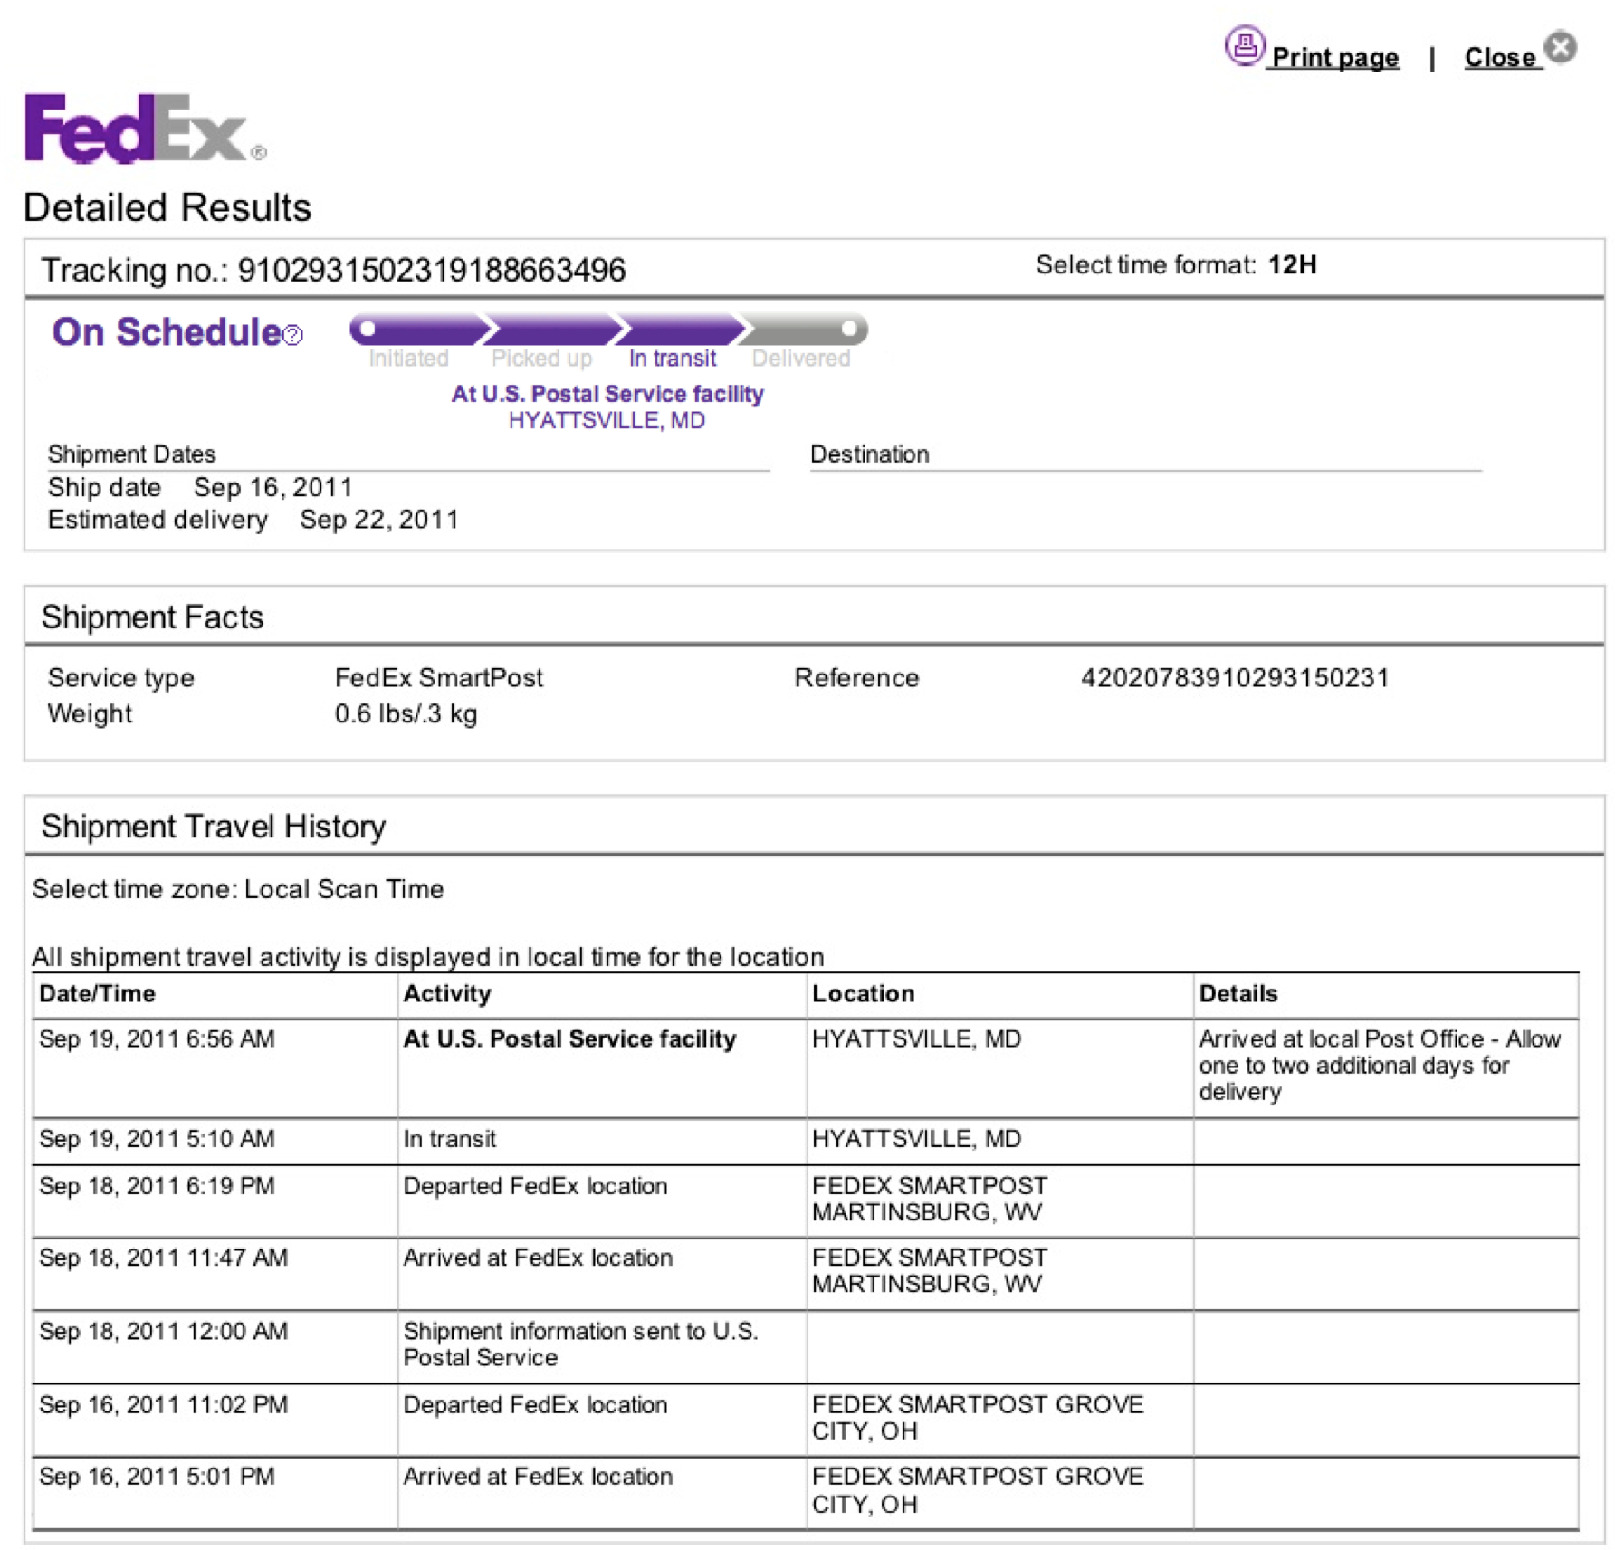
Motivation: Package tracking
Clear expectation
Constant feedback
Explicit responsibility

Slide 6
Approach for Reducing Missed Laboratory Results
Model user actions within workflow specification
  Assign temporal responsibility
Derive an interactive display from the model
  From order time to until all follow-up actions are taken
  Support actor actions as part of tracking
Provide retrospective analyses for clinic manager to identify common problems and compare performance

Slide 7
Laboratory Test Result Management Workflow

Slide 8
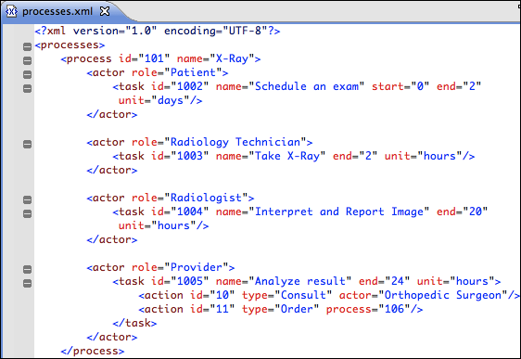
Modeling Workflow & Actions

Slide 9
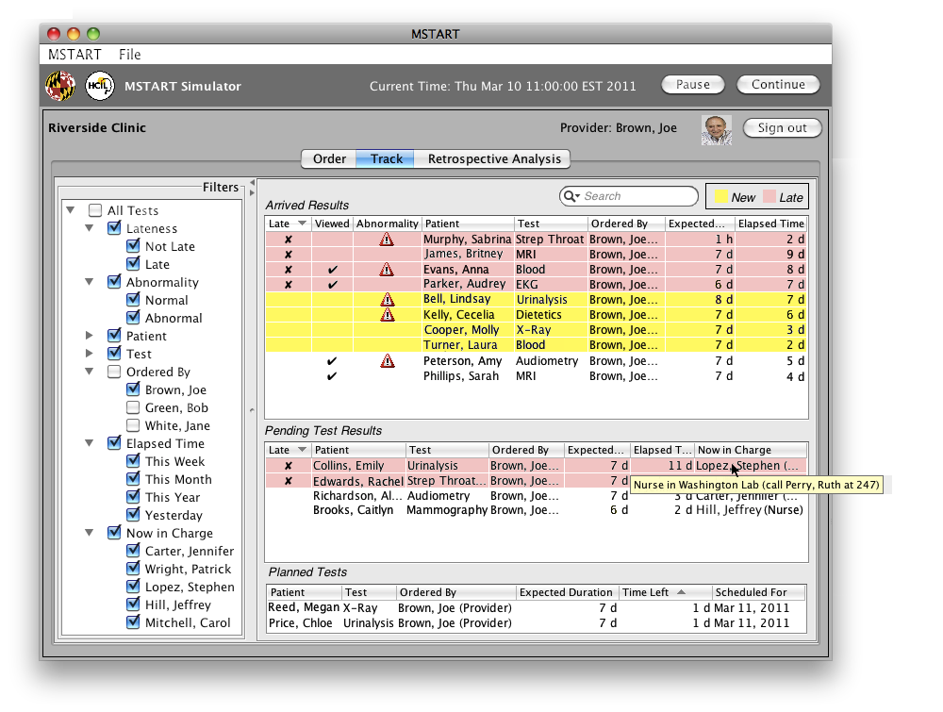
Multi-Step Task Analyzing, Reporting, Tracking (MSTART) Prototype
Notes:
I am building an inspirational prototype in hopes that some of these ideas might be of interest to vendors
Runs in simulation mode: places orders automatically and simulates actor actions

Slide 10
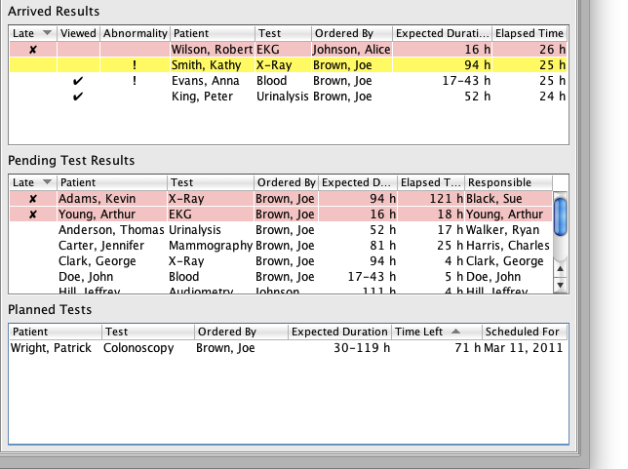
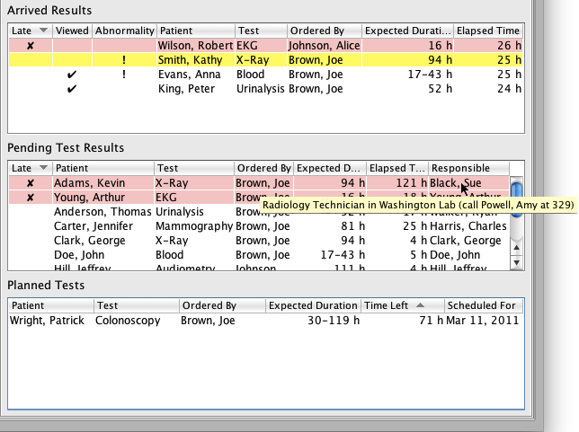
Notes:
What is unique here are:
showing expected duration calculated from model definition,
elapsed time since it started being processed, and
who is in charge of handling the current step.
Like email’s Sent box, has a Pending list

Slide 11
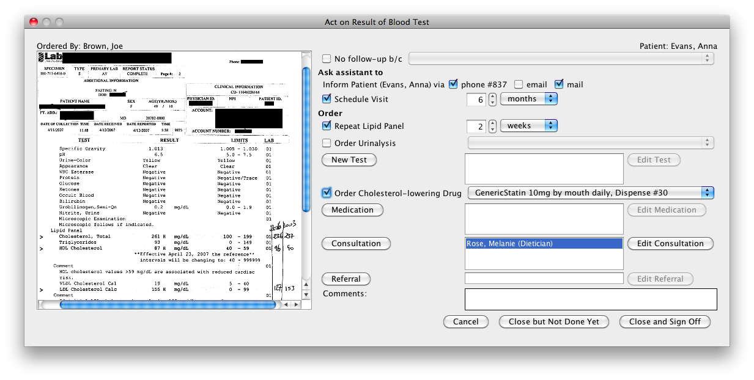
Generating Actor Action Sheets: Result Review
Notes:
combines viewing lab result report (on the left) with possible actions (on the right)
It may seem obvious but it’s not the way it’s typically done: if you start following up and you forget to finish, there’s no way to keep track of it

Slide 12
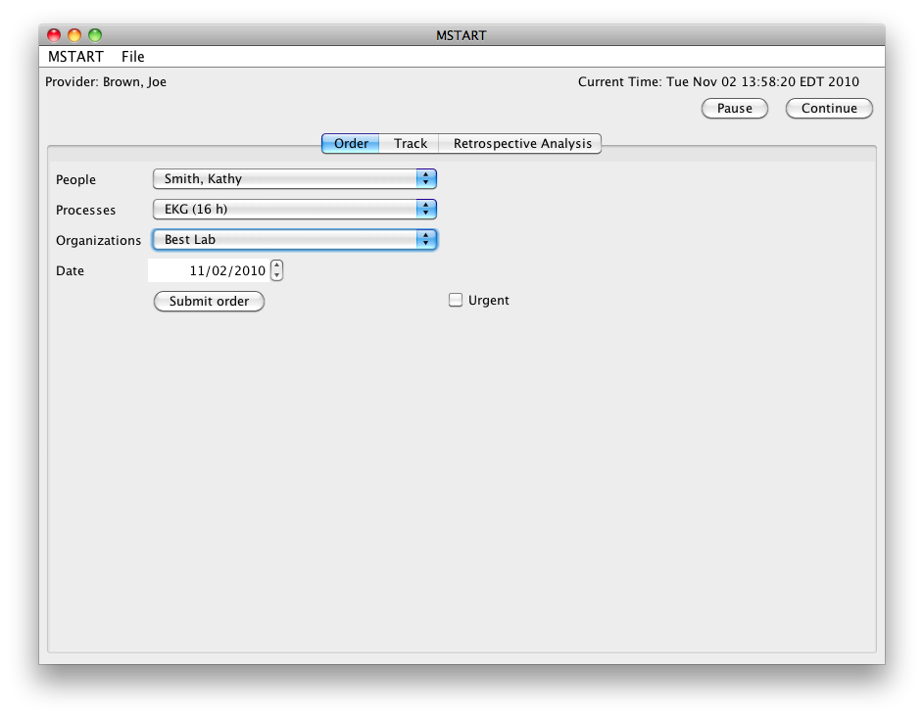
Order
Notes:
not focusing on Computerized Physician Order Entry (CPOE)

Slide 13
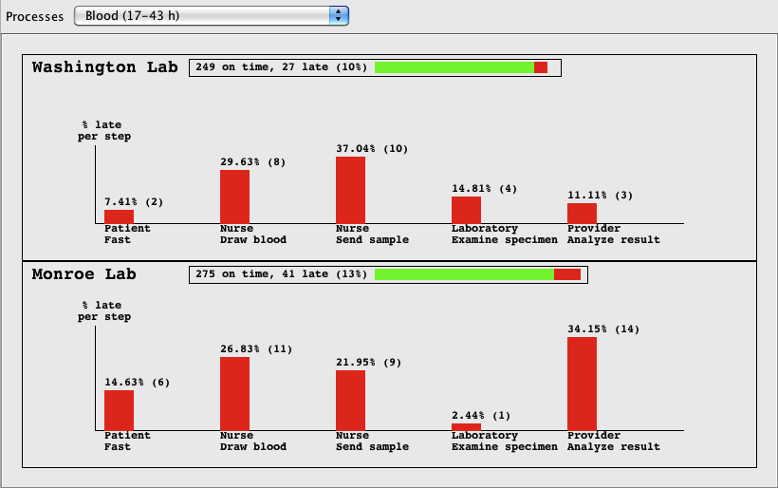
Retrospective Analysis
Notes:
It provides insight to problems in order to give ideas on how to fix them

Slide 14
Initial Evaluation
More than a dozen physicians, estimated total of about eight hours of review
Workflow model
  Repeat testing
  Reflex tests
  Predict estimated time
Interface generation
  Notify manager
  Planned orders table
Retrospective analysis
  Severity of lateness
  Quality attributes to compute metrics

Slide 15

Conclusion: Guidelines
Make temporal responsibility visible
Tracking should show what is pending (and how much time has passed since last action)
Prioritize late and critical (abnormal) entries
Integrate review of results with possible actor actions from within same screen
Retrospective analysis improves accountability
Acknowledgments
Zach Hettinger, Daniel Murphy, Archana Laxmisan, Hardeep Singh, Dean Sittig
Strategic Health-IT Advanced Research Projects (SHARP)
Contact: sureyya@cs.umd.edu
Website: http://www.cs.umd.edu/hcil/sharp/

