Slide 1
Ensuring Timely Management of Medical Orders
Sureyya Tarkan, Kostas Pantazos, Catherine Plaisant, Ben Shneiderman
UMD Dept of Computer Science & HCIL
sureyya@cs.umd.edu
http://www.cs.umd.edu/hcil/sharp/

Slide 2
A Story

Slide 3
Missed Lab Results

Slide 4
VA View Alert Window
Alert arrived results in chronological order

Slide 5
Approach

Slide 6
Solution
Model
Provider, Resident, Assistant
Manager
Table
Visualization
Table
Table

Slide 7
Solution
Model
Provider, Resident, Assistant
Manager
Table
Visualization
Table
Table

Slide 8
Model Laboratory Test Result Management Workflow & Actions

Slide 9
Solution
Model
Provider, Resident, Assistant
Manager
Table
Visualization
Table
Table

Slide 10
Incoming Results
Pending Tests

Slide 11
Live Demo

Slide 12
Solution
Model
Provider, Resident, Assistant
Manager
Table
Visualization
Table
Table

Slide 13
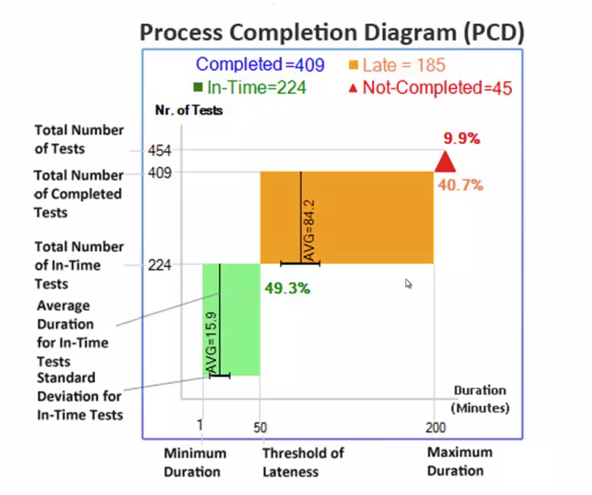

Slide 14
Multi-Step Process Visualization

Slide 15
Multi-Step Process Visualization

Slide 16
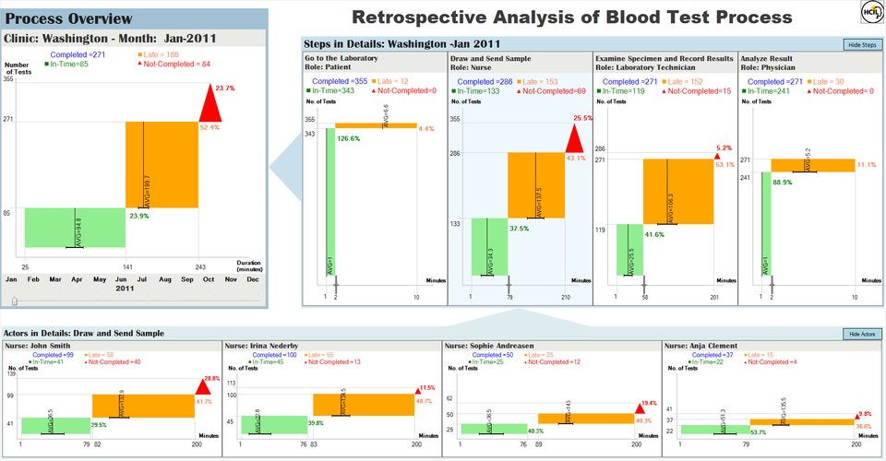
Conclusion
Model
Acknowledgments
Strategic Health-IT Advanced Research Projects (SHARP)
Contact: sureyya@cs.umd.edu
Website: http://www.cs.umd.edu/hcil/sharp/
Provider, Resident, Assistant
Manager
Show pending results
Use icons and color-coding
Rank by lateness
Apply compact layout
Integrate rapid actions within same display

