Slide 1
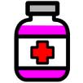





Twinlist: Novel User Interface Designs for Medication Reconciliation
C. Plaisant, T. Chao, J. Wu, B. Shneiderman
University of Maryland, College Park
J. Herskovic, T. Johnson, E. Bernstam, E. Markowitz
University of Texas, Houston
Z. Hettinger
Medstar Institute for Innovation, DC
S. Powsner
Yale University, CT

Slide 2
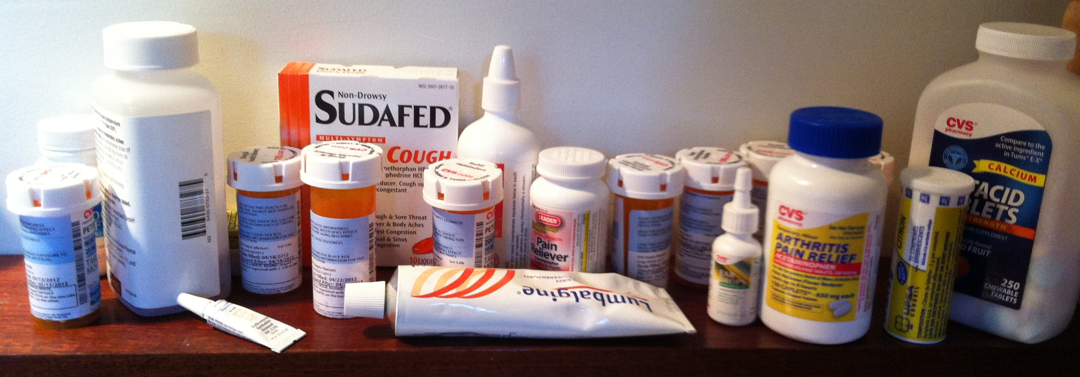
Medication Reconciliation
(illustrated)
My EHR
Notes:
A task doctors are asked to do in many situations: For example Imagine that this is what the patient told me he was taking last month… but today he is telling you he is taking this

Slide 3
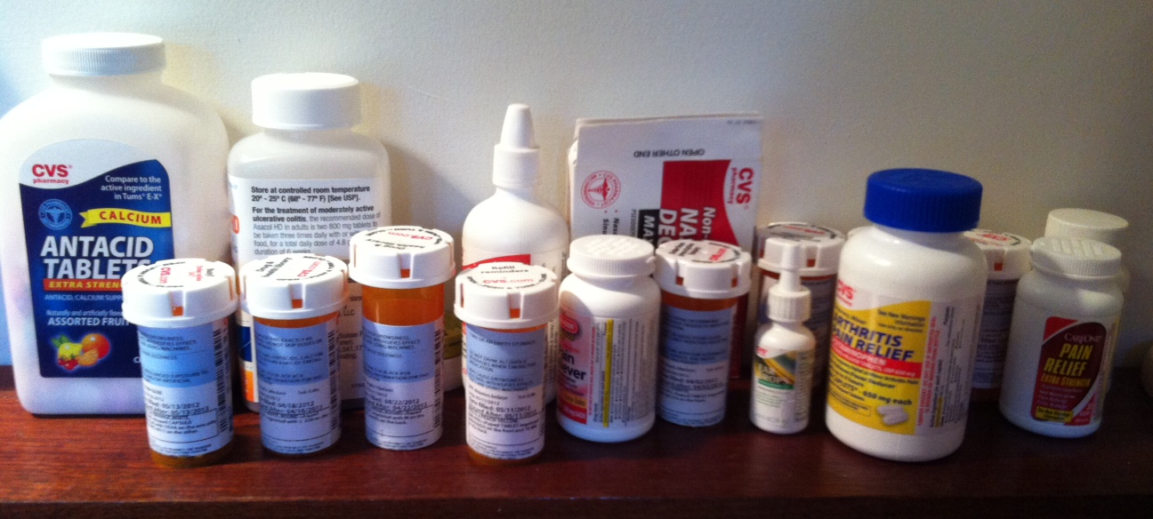
Medication Reconciliation
(illustrated)
Pharmacy
Notes:
What’s the same, what’d different?

Slide 4
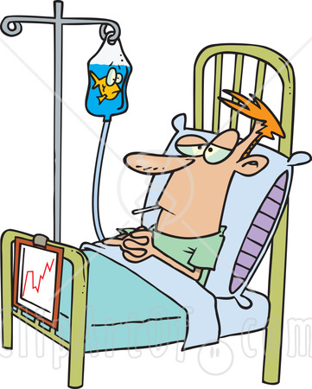

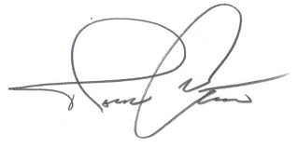

Hospital Discharge Scenario (used in rest of talk)
Home Meds reported during Intake Interview
Meds administered
while at hospital
Compare
Keep or not?
Change?
Reconciled list
Meds to take at home

Slide 5
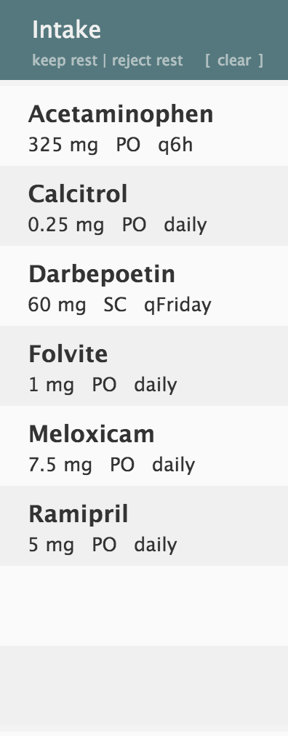
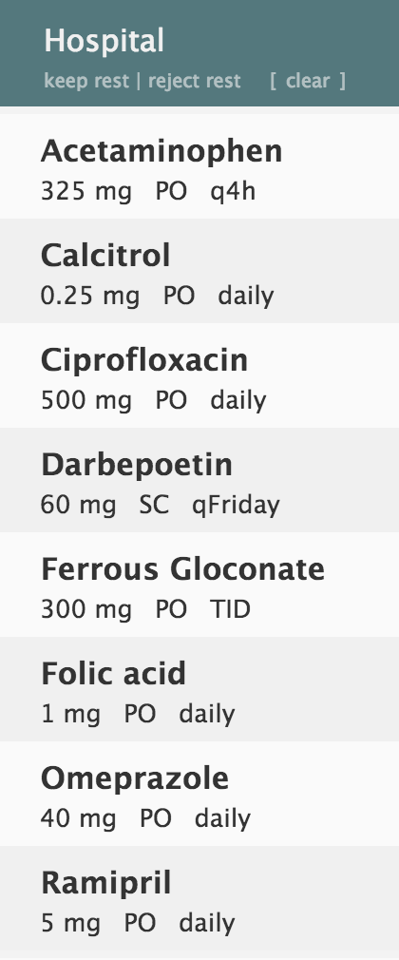

Slide 6
unique
unique
unique
unique

Slide 7
Twinlist spatial layout to reveals similarities and differences multi-step animation to help 1st time users carefully designed interaction to facilitate task of reconciliation
Video: simple example
Evaluation (complex cases)
Alt designs (paper)

Slide 8
Search for “Twinlist demo” on YouTube
OR go to www.cs.umd.edu/hcil/sharp/twinlist
Prototype developed by Tiffany Chao and Johnny Wu
VIDEO

Slide 9
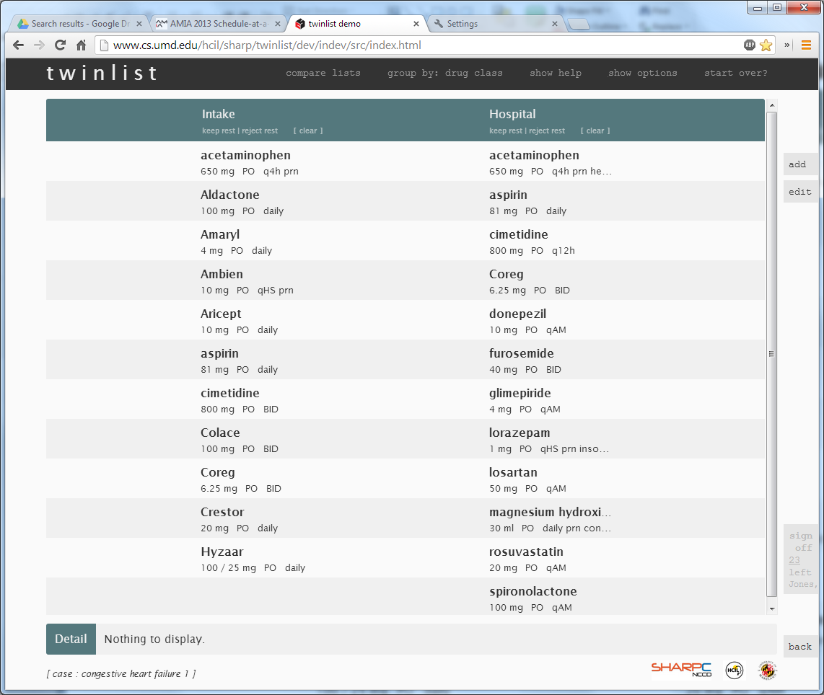
Notes:
Can you see whats the same? Or different? Between the home and hospital meds? Twinlist helps by

Slide 10
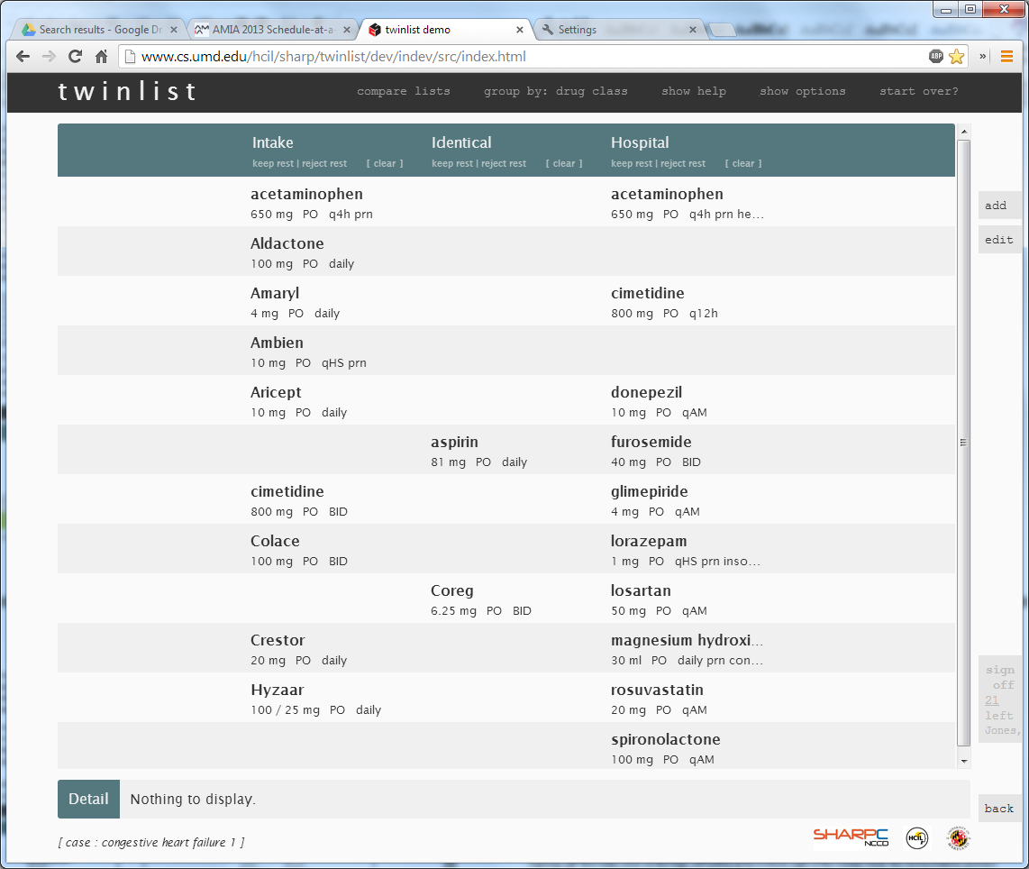
Notes:
We bring to the middle the things that are the identical

Slide 11
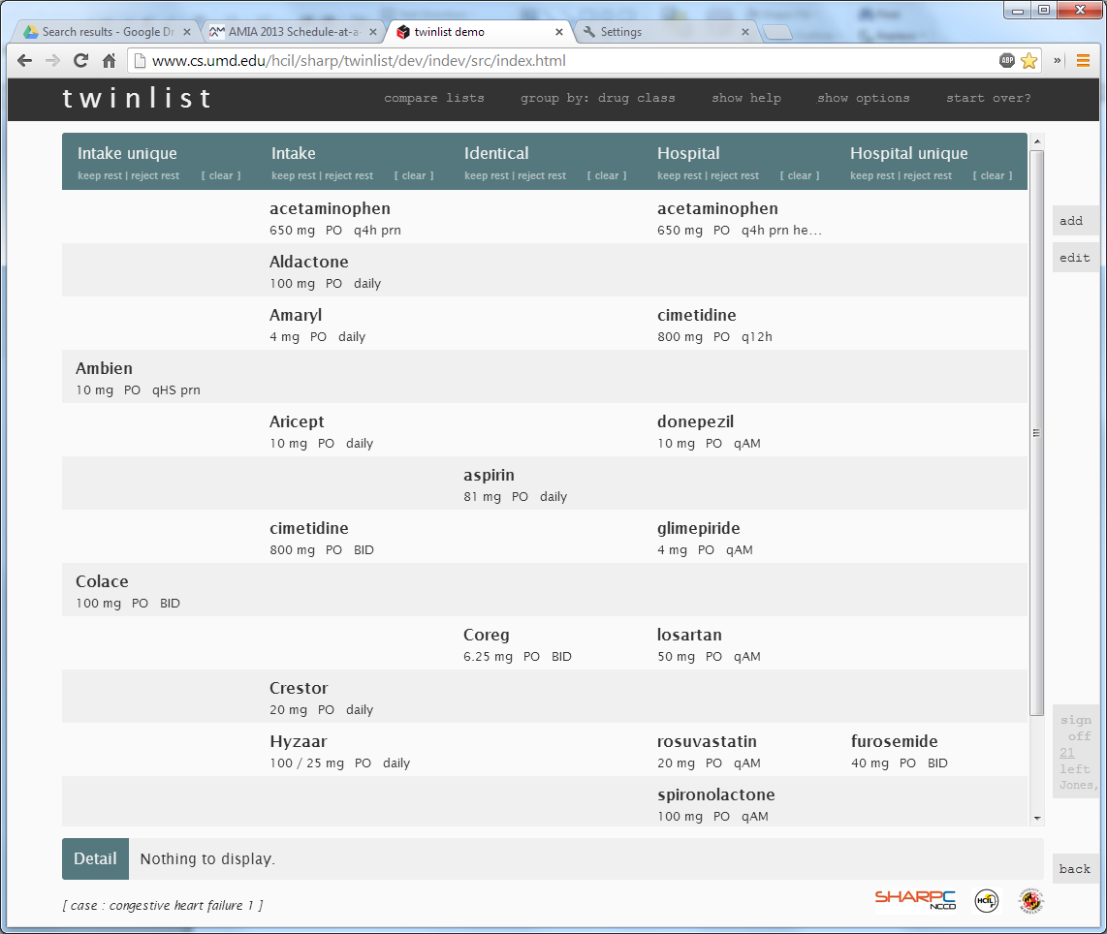
Notes:
Push to the side the drugs that are UNIQUE

Slide 12
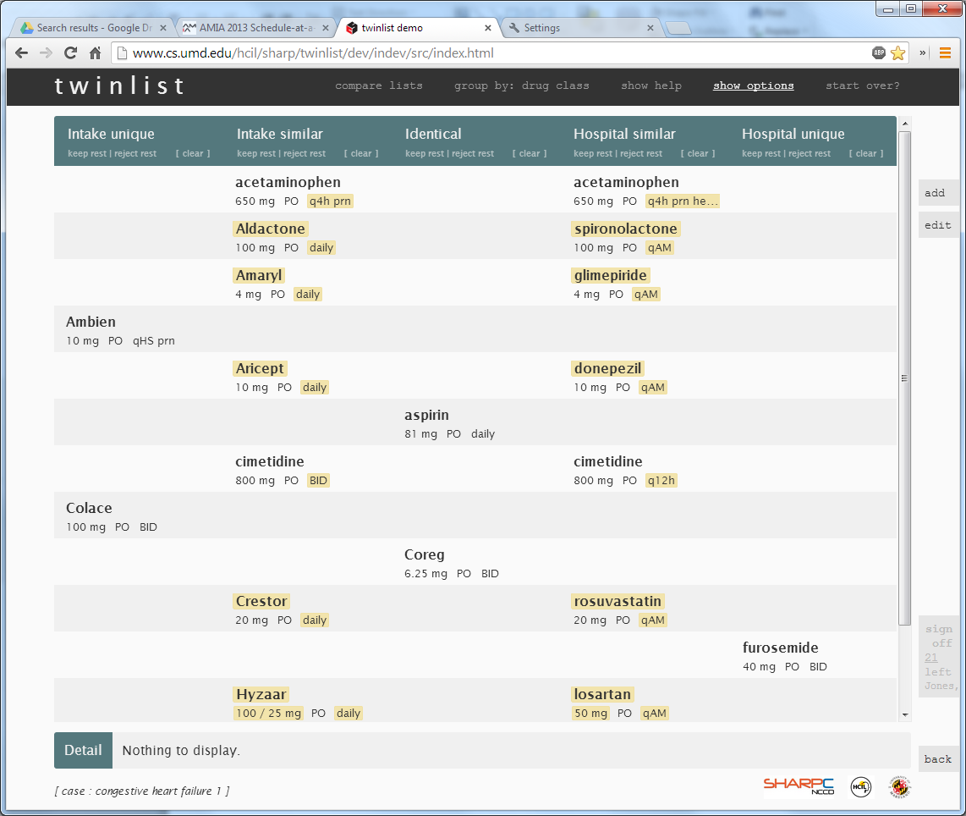
Notes:
Align the similar drugs

Slide 13
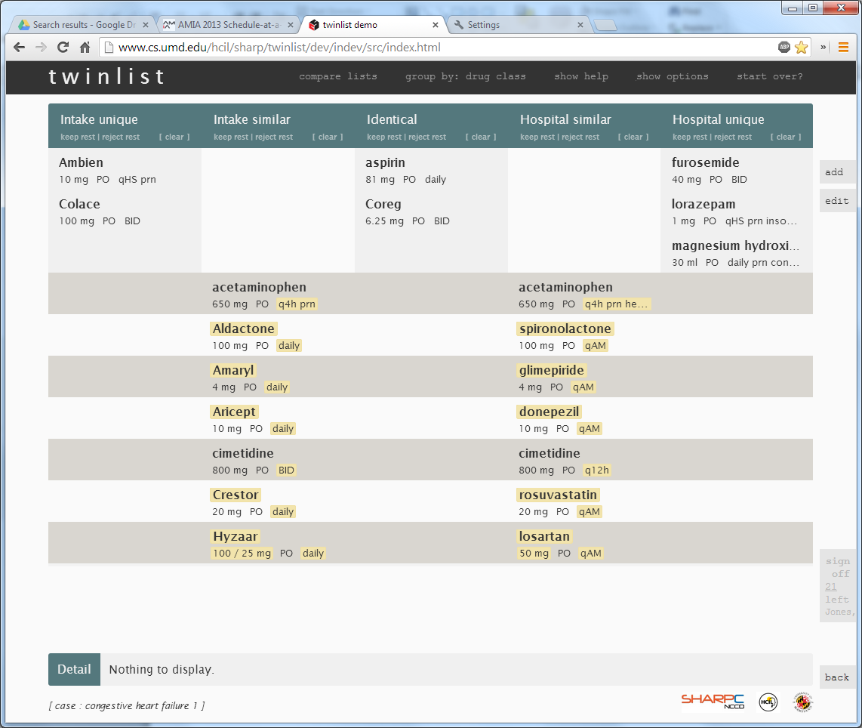
Notes:
Compact the display

Slide 14
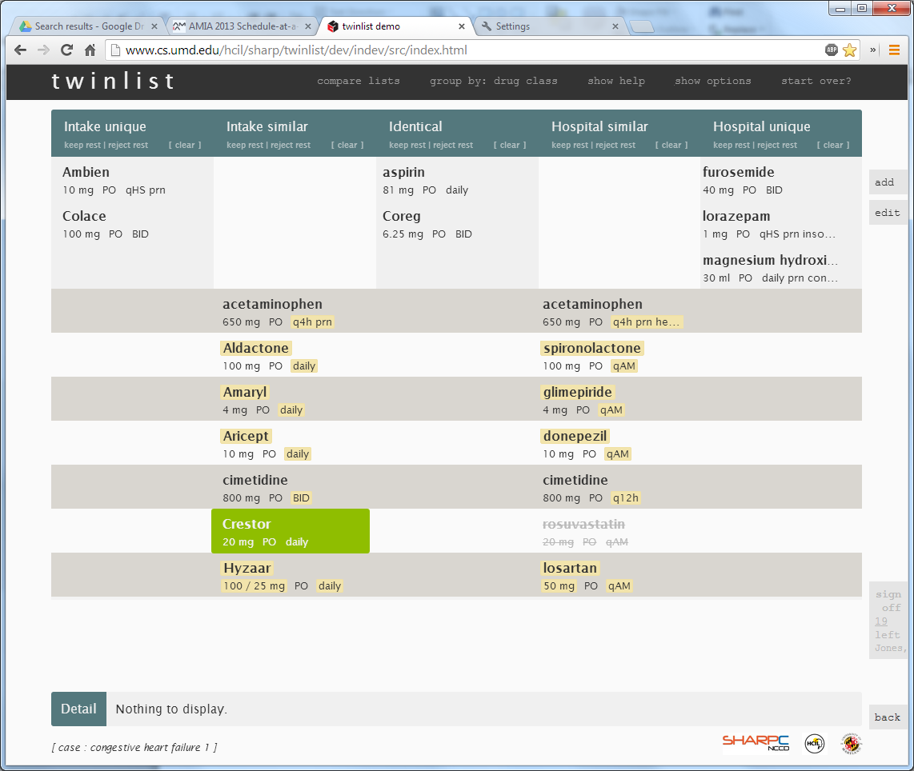
Notes:
And make it easy to select what you want

Slide 15
Evaluation
1- Role of animation
with students
  > Animation helped users learn the layout
    Fewer clarification questions
    Animated version preferred
  > Most said they would eventually turn off animation
2- Performance (just completed)
20 physicians
4 complex cases to reconcile
2 with Baseline
  2 with Twinlist

Slide 16
Participants read narrative about case
e.g.
Jim Jones is a 74 year old, married businessman, now retired.
He's being treated for Coronary Artery Disease (stent placed at age 70) Constipation, chronic Diabetes Mellitus, Type II Elevated Cholesterol GERD Hypertension Mild Dementia
His family internist sent him to the hospital Monday morning after his wife insisted he go to the clinic because he was having trouble breathing, and was rubbing his chest. He had been doing fine until sometime during the night. She said he had seemed quite well Sunday afternoon watching the game-- two of their sons came over to watch the game with him. They made it "a little tailgate party-- hot dogs with saukraut and everything."
On examination his internist found moderate pulmonary congestion, but no EKG changes. Troponin was negative. Because of his past history and strong family history of MI, patient was admitted, treated, and now on Wednesday afternoon, wants to be discharged. His internist is away for a professional meeting. One of the medical house officers is handling the discharge orders, etc.

Slide 17
then use either
Baseline or Twinlist
Contact plaisant@cs.umd.edu for copy of demonstration + code
DEMO

Slide 18
Unpublished so not included in online slides
Results preview
Please contact plaisant@cs.umd.edu

Slide 19
Alternative layouts
Further grouping of drugs (still 5 columns)
  Grouping by class
  Grouping by diagnosis
  Multiple groups per drug
No horizontal spreading
  1 column/list + similarity info on mouse-over
  1 column/list + extra column for groups
Vertical grouping by similarity (U. Texas Prototype)
See PAPER

Slide 20
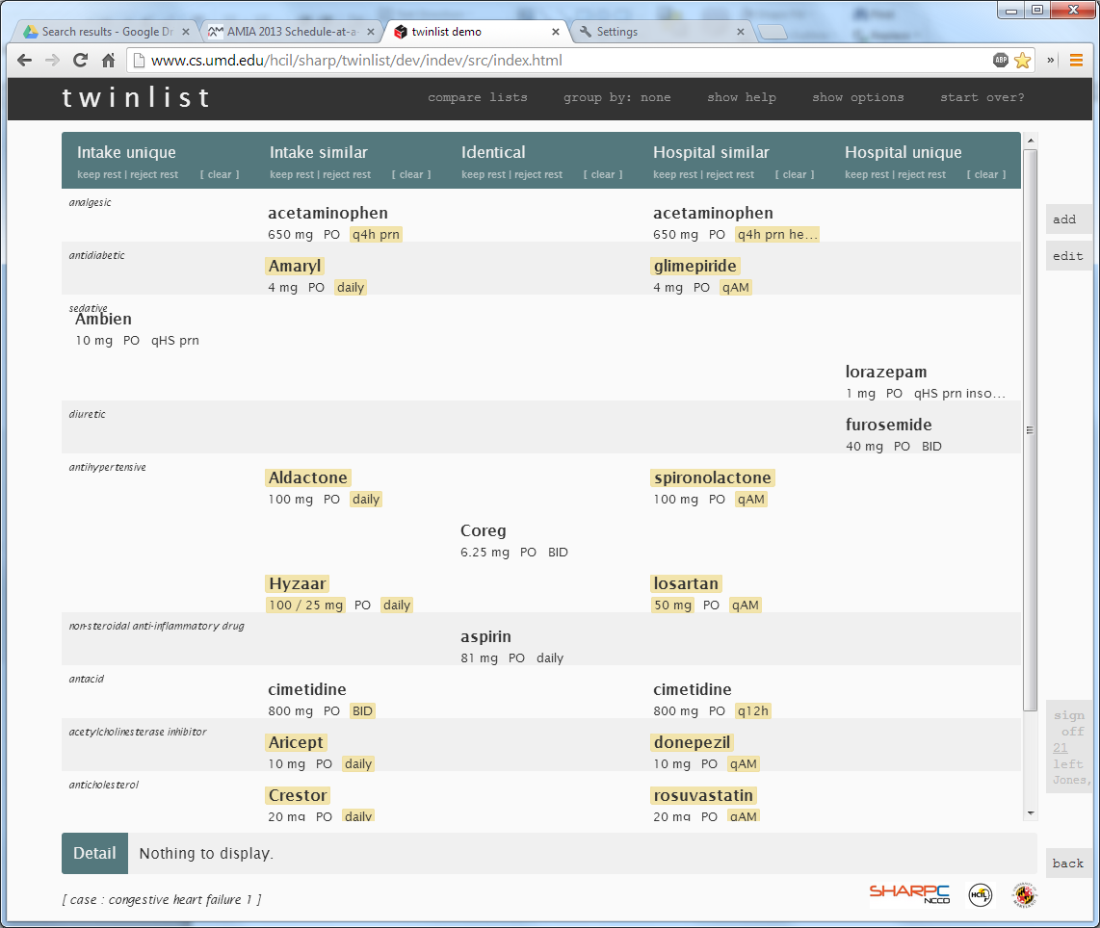
e.g. Group by class, or by diagnosis

Slide 21
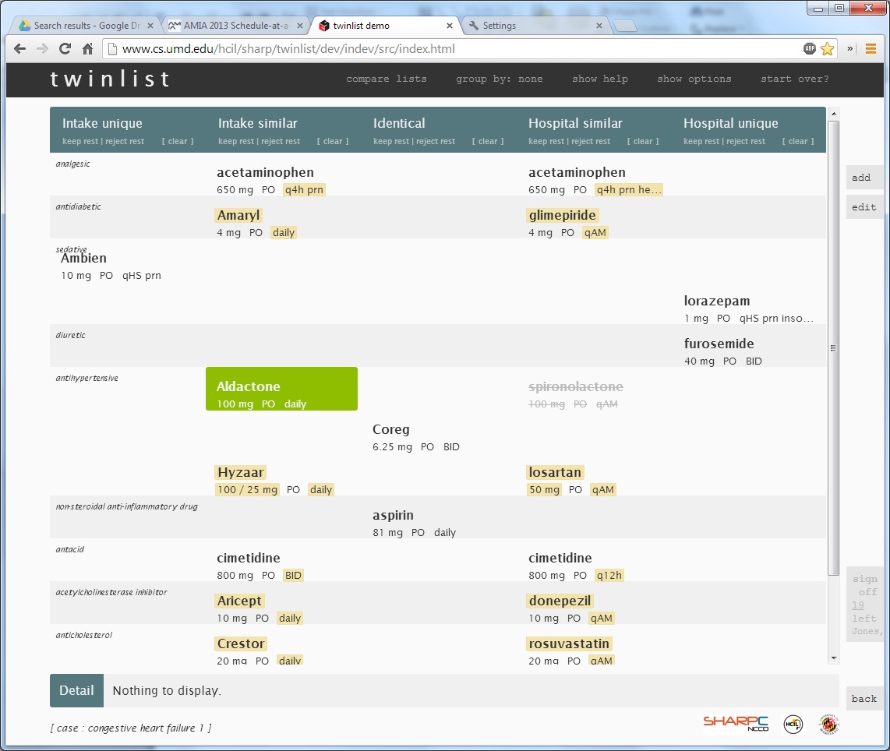

Slide 22
Computing Similarity
Equivalence | Criteria | Example
Form Equivalence | Identical except for brand vs. generic | Advil = Ibuprofen Senormin = Atenolol
Functional Equivalence | Same therapeutic intent | Atenolol and Propanolol both betablockers
Partial Equivalence | Form or functional equivalence, but differ in dosage, frequency, or route | Advil 100 mg Acetaminophen 200mg
No equivalence | Unique in form and function
Available at https:// github.com/jherskovic/MedRec (contact Jorge.R.Herskovic@uth.tmc.edu)
REF: “Automated medication reconciliation and complexity of care transitions” AMIA 2011
See also AMIA 2013 papers re: mining associations between medications & problems (D. Sittig – A.Wright etc.)
SHARPC P3 website points to knowledge bases
See also Pan-SHARP project for a SMART app combining NLP to extract drug names + similarity computation + Twinlist

Slide 23
Other Uses
  Reconciling problems
  Reconciling allergies
  Reconciling immunizations
  etc.
  Several vendors using/adapting design

Slide 24
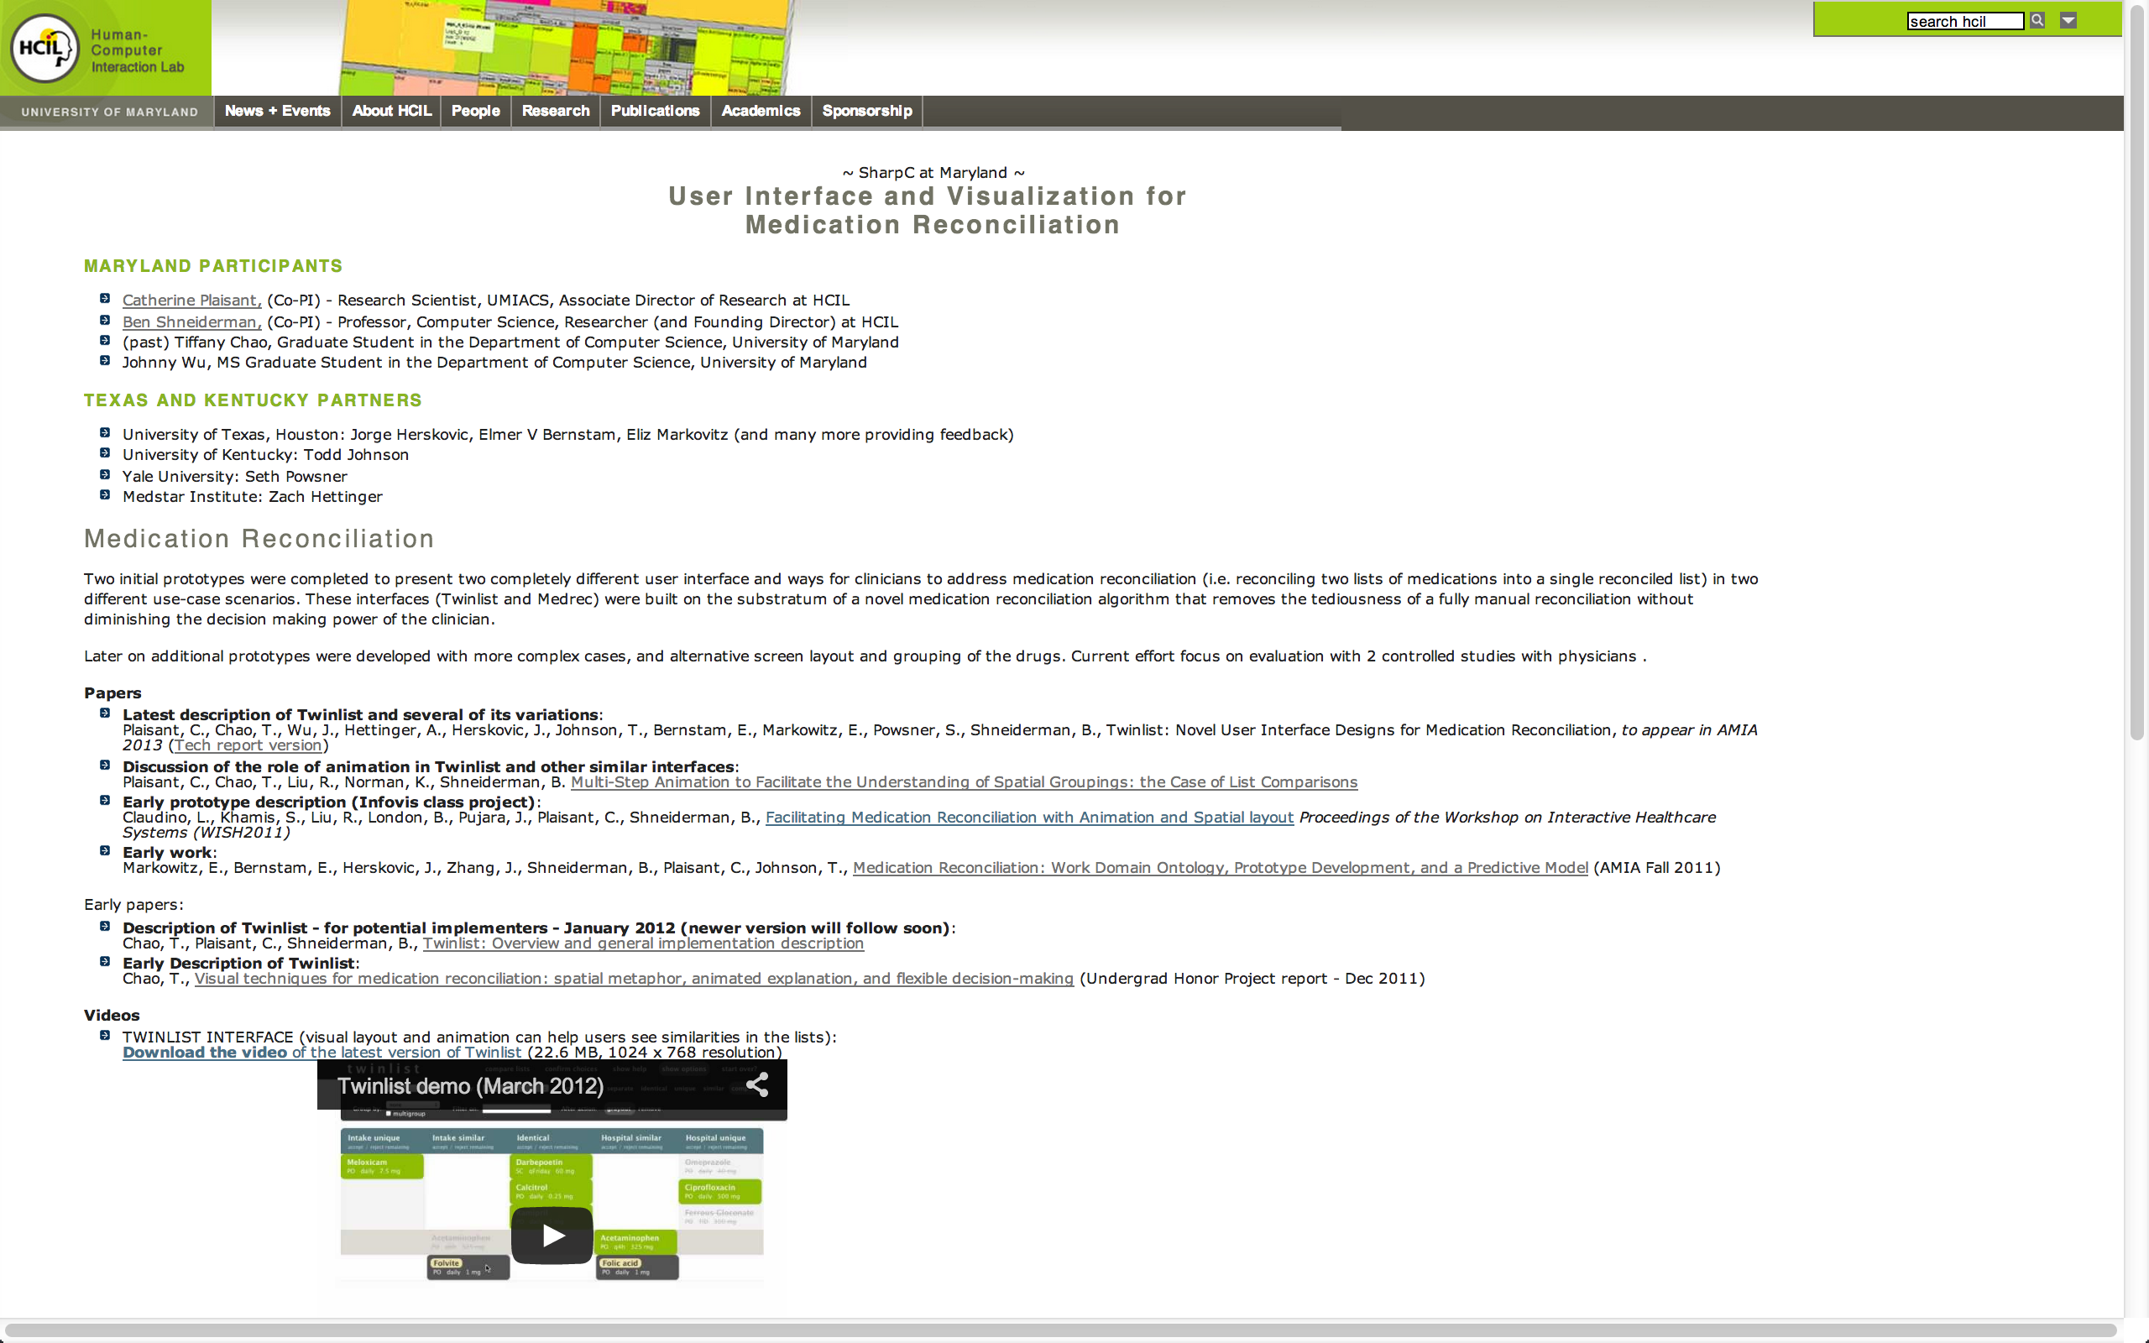
plaisant@cs.umd.edu
www.cs.umd.edu/hcil/sharp/twinlist (papers/videos)
Acknowledgements
Strategic Health IT Advanced Research Projects Program (SHARP)
Office of the National Coordinator for Health Information Technology (Grant Number 10510592)

Slide 25
Thank You
UI design can have strong impact on patient safety
Numerous ways to reveal similarity
Multi-step animations can help 1st time users Consider grouping
Twinlist open source (email me)
plaisant@cs.umd.edu
www.cs.umd.edu/hcil/sharp/twinlist (papers/videos)
Acknowledgements
Strategic Health IT Advanced Research Projects Program (SHARP)
Office of the National Coordinator for Health Information Technology (Grant Number 10510592)

