Slide 1
Privacy Enhancing Technologies
Lecture 2 Attack
Elaine Shi
slides partially borrowed from Narayanan, Golle and Partridge

Slide 2
The uniqueness of high-dimensional data
In this class:
How many male:
How many 1st year:
How many work in PL:
How many satisfy all of the above:

Slide 3
How many bits of information needed to identify an individual?
World population: 7 billion
log₂(7 billion) = 33 bits!

Slide 4
Attack or “privacy != removing PII”
Gender | Year | Area | Sensitive attribute
…
…
…
Male | 1st | PL | (some value)
…
…
Adversary’s auxiliary information

Slide 5





“Straddler attack” on recommender system
People who bought
also bought
Amazon

Slide 6
Where to get “auxiliary information”
Personal knowledge/communication
Your Facebook page!!
Public datasets
  (Online) white pages
  Scraping webpages
Stealthy
  Web trackers, history sniffing
  Phishing attacks or social engineering attacks in general

Slide 7
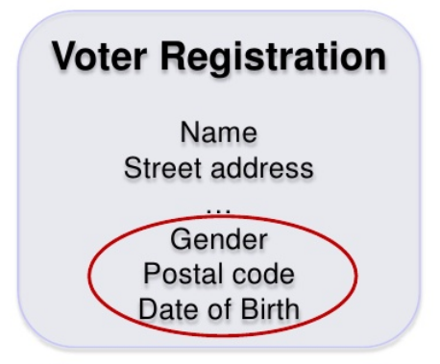
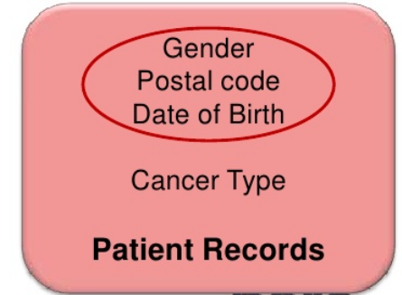
Linkage attack!
[Golle and Partridge 09]
87% of US population have unique date of birth, gender, and postal code!

Slide 8
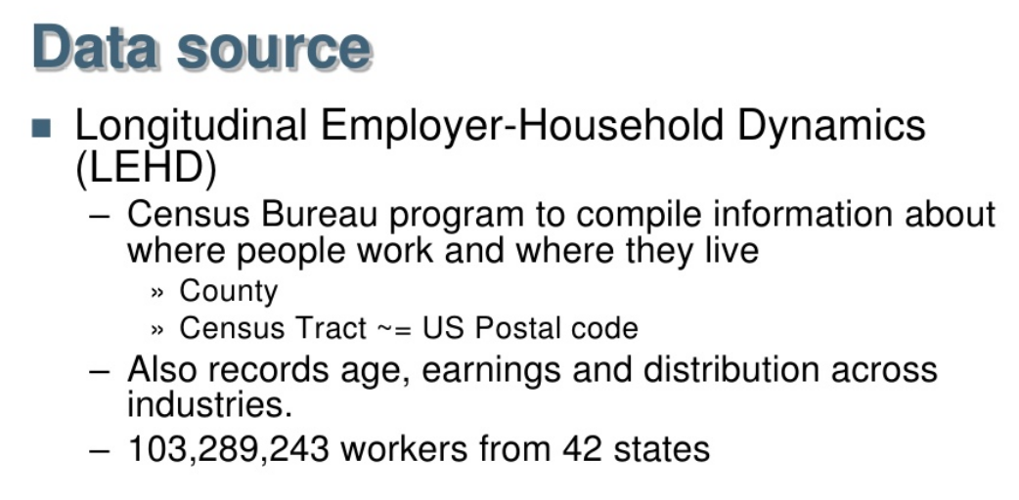
Uniqueness of live/work locations
[Golle and Partridge 09]

Slide 9
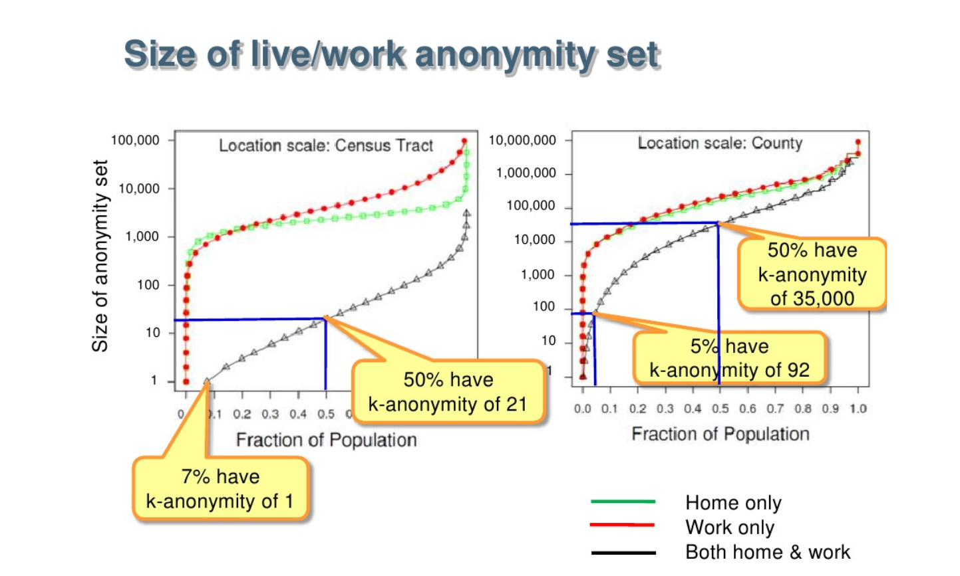
[Golle and Partridge 09]

Slide 10
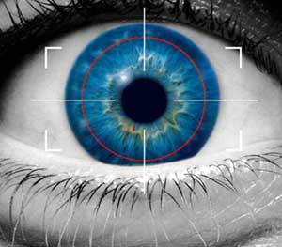
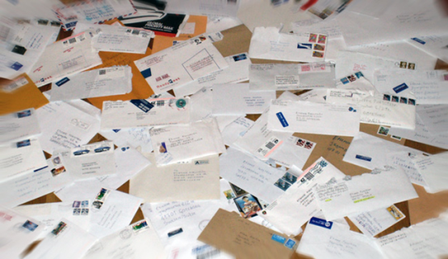

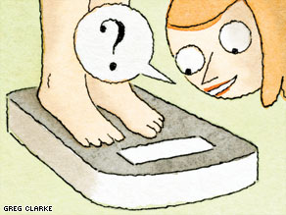
Attackers
Global surveillance
Advertising/marketing
Phishing
Nosy friend
Notes:
Aux is an issue in all of these models

Slide 11
Case Study: Netflix dataset

Slide 12

Linkage attack on the netflix dataset
Netflix: online movie rental service
In October 2006, released real movie ratings of 500,000 subscribers
  10% of all Netflix users as of late 2005
  Names removed, maybe perturbed

Slide 13
The Netflix dataset
17K movies – high dimensional!
Average subscriber has 214 dated ratings
 | Movie 1 | Movie 2 | Movie 3 | … …
Alice | Rating/ timestamp | Rating/ timestamp | Rating/ timestamp | ……
Bob
Charles
David
Evelyn
…
…
500K users

Slide 14
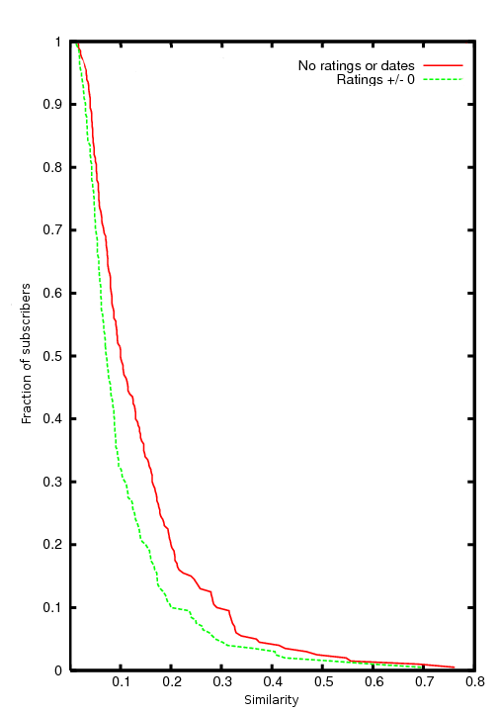
Netflix Dataset: Nearest Neighbor
Curse of dimensionality
Considering just movie names, for 90% of records there isn’t a single other record which is more than 30% similar
similarity

Slide 15
Deanonymizing the Netflix Dataset
How many does the attacker need to know to identify his target’s record in the dataset?
  Two is enough to reduce to 8 candidate records
  Four is enough to identify uniquely (on average)
  Works even better with relatively rare ratings
    “The Astro-Zombies” rather than “Star Wars”
Fat Tail effect helps here:
most people watch obscure crap (really!)

Slide 16
Challenge: Noise
Noise: data omission, data perturbation
Can’t simply do a join between 2 DBs
Lack of ground truth
  No oracle to tell us that deaonymization succeeded!
  Need a metric of confidence?

Slide 17
Scoring and Record Selection
Score(aux,r’) = min_{i∈supp(aux)}Sim(aux_{i},r’_{i})
  Determined by the least similar attribute among those known to the adversary as part of Aux
  Heuristic: Σ_{i∈supp(aux)} Sim(aux_{i},r’_{i}) / log(|supp(i)|)
    Gives higher weight to rare attributes
Selection: pick at random from all records whose scores are above threshold
  Heuristic: pick each matching record r’ with probability ce^{score(aux,r’)/σ}
    Selects statistically unlikely high scores

Slide 18
How Good Is the Match?
It’s important to eliminate false matches
  We have no deanonymization oracle, and thus no “ground truth”
“Self-test” heuristic: difference between best and second-best score has to be large relative to the standard deviation
  (max-max₂) / σ ≥ φ
Eccentricity

Slide 19
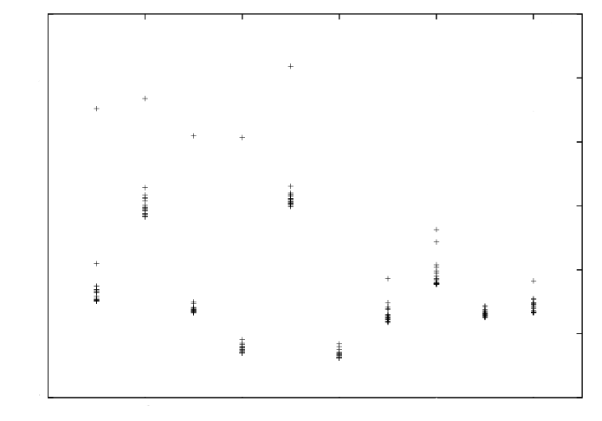
Eccentricity in the Netflix Dataset
Algorithm is given Aux of
a record in the dataset
score
max-max2
… Aux of a record
not in the dataset
aux

Slide 20
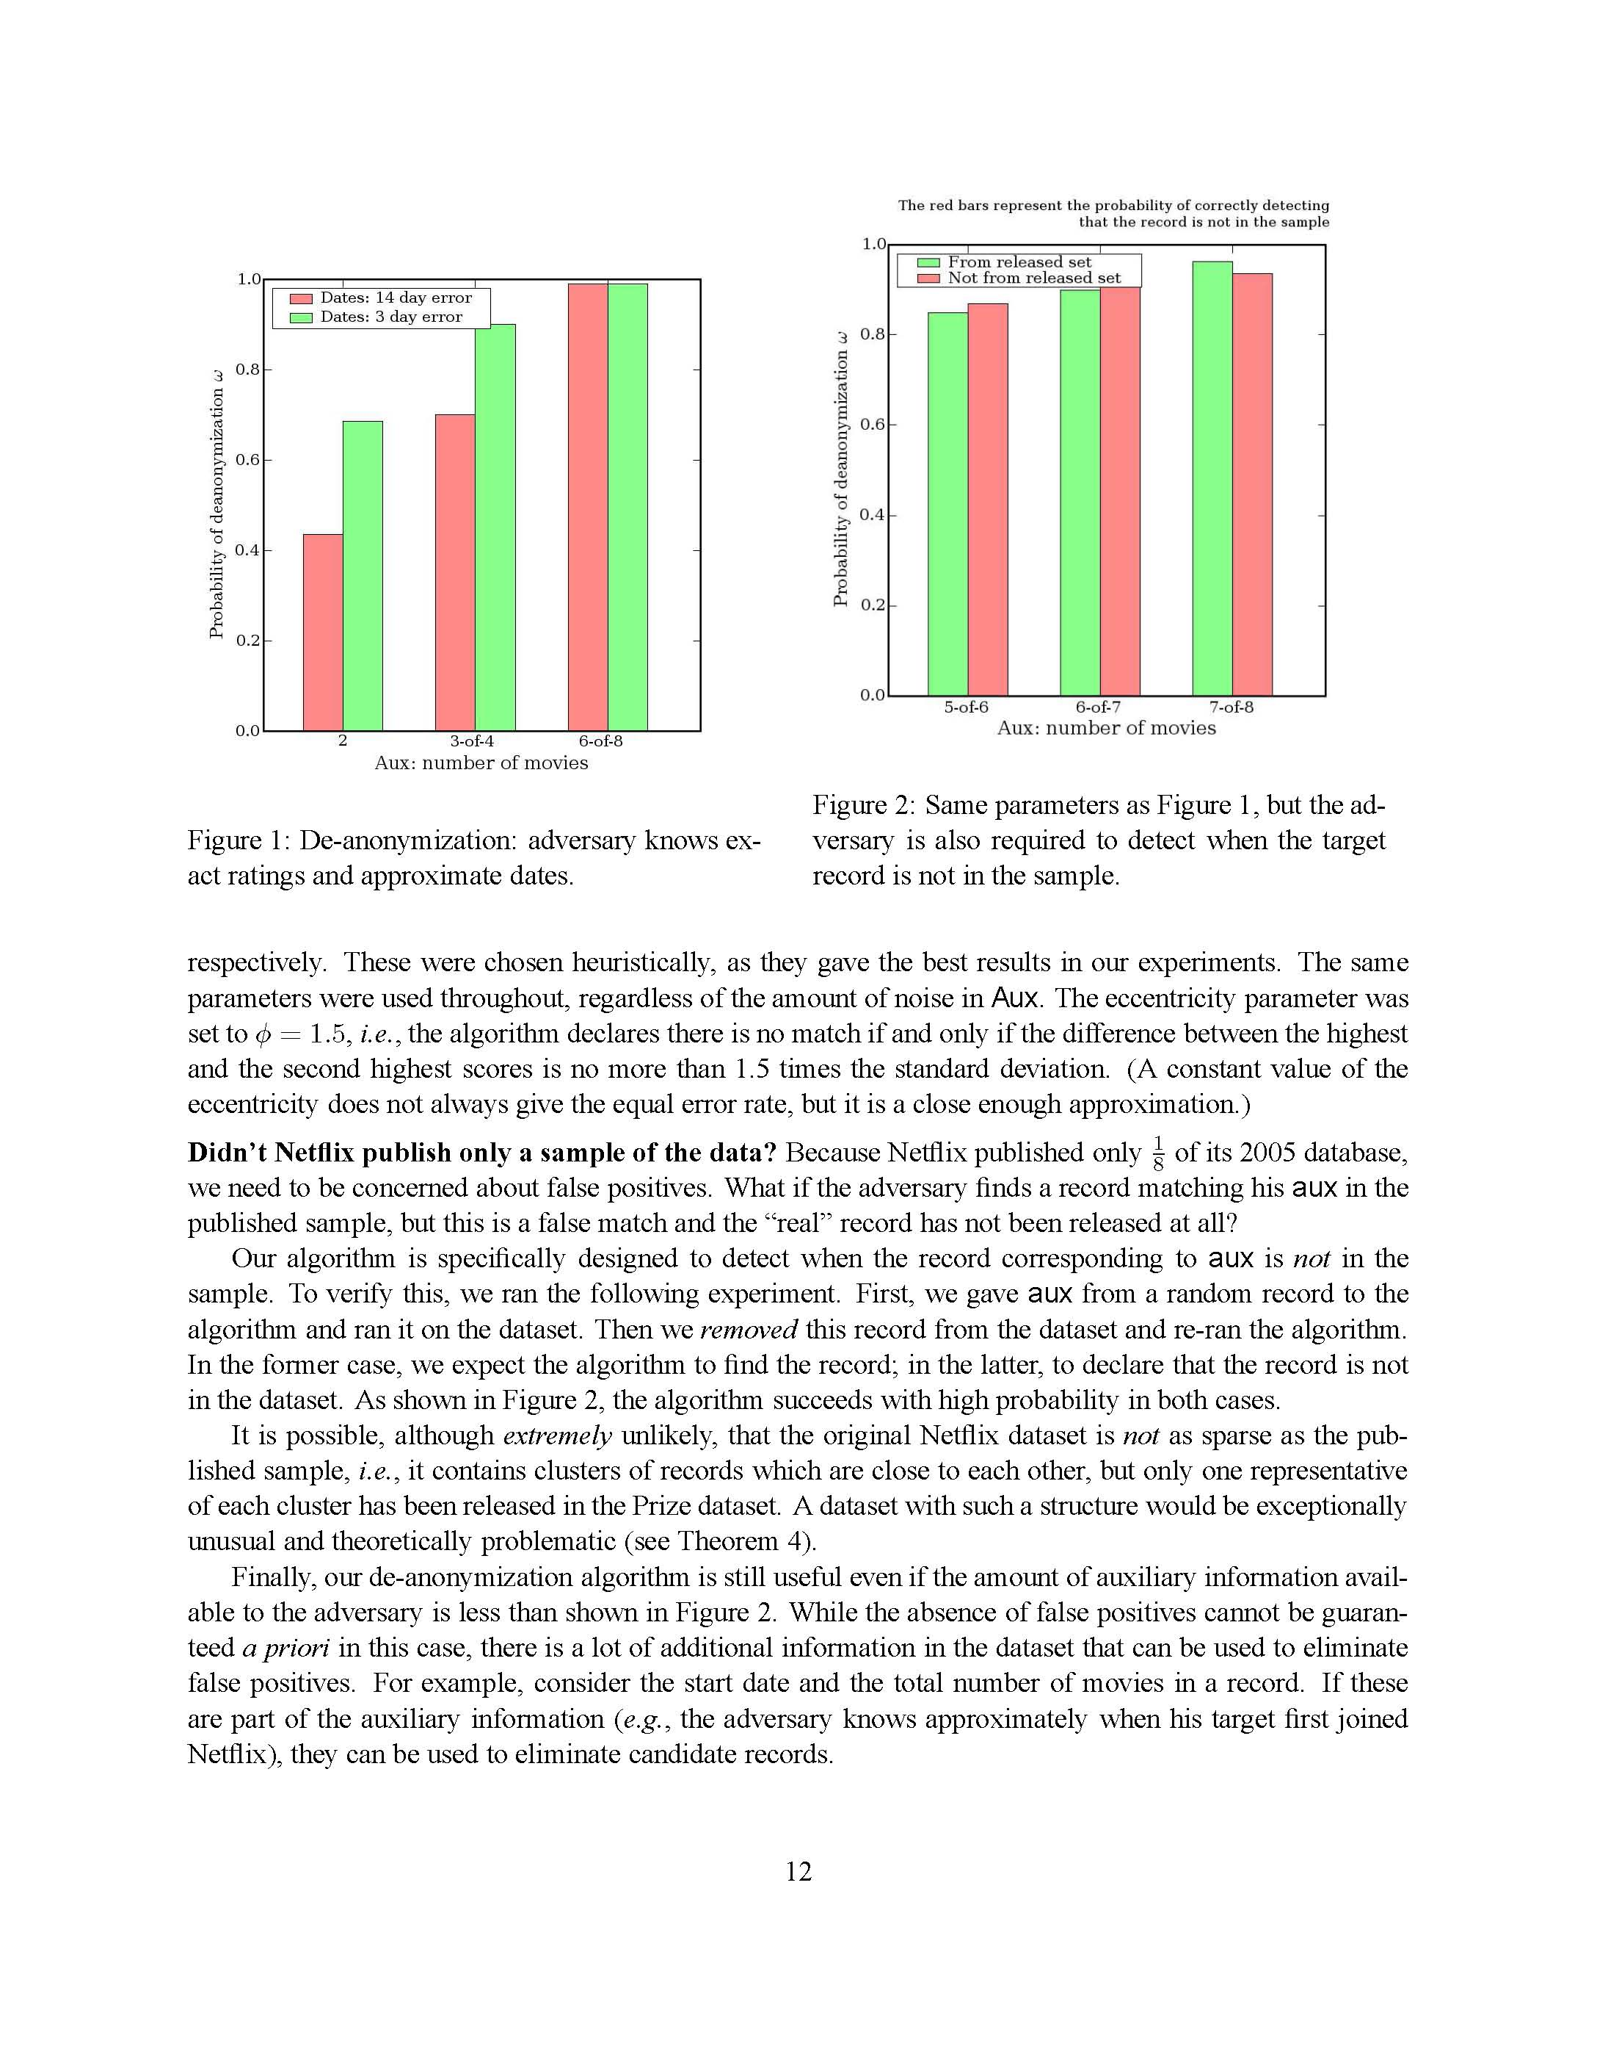
Avoiding False Matches
Experiment: after algorithm finds a match, remove the found record and re-run
With very high probability, the algorithm now declares that there is no match

Slide 21
Case study: Social network deanonymization
Where “high-dimensionality” comes from graph structure and attributes

Slide 22
Motivating scenario:
Overlapping networks
Social networks A and B have overlapping memberships
Owner of A releases anonymized, sanitized graph
  say, to enable targeted advertising
Can owner of B learn sensitive information from released graph A’?

Slide 23
Releasing social net data: What needs protecting?
↙Λ
Node attributes
  SSN
  Sexual orientation
Edge attributes
  Date of creation
  Strength
Edge existence
ð
Ω
Ξ
Ω
ð
∆↙ð
Ξ
Đð
ΛΞά
Ωά

Slide 24


IJCNN/Kaggle Social Network Challenge

Slide 25
IJCNN/Kaggle Social Network Challenge

Slide 26
IJCNN/Kaggle Social Network Challenge
A B
J₁ K₁
J₂ K₂
A
C
C D
B
D
J₃ K₃
E F
E
F
Training Graph
Test Set

Slide 27
Deanonymization: Seed Identification
Anonymized Competition
Graph
Crawled Flickr Graph

Slide 28
Propagation of Mappings
Graph 1
“Seeds”
Graph 2

Slide 29
Challenges: Noise and missing info
Loss of Information
Graph Evolution
Both graphs are subgraphs of Flickr
Not even induced subgraph
Some nodes have very little information
A small constant fraction of nodes/edges have changed

Slide 30
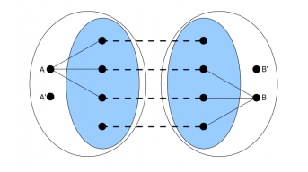
Similarity measure

Slide 31
Combining De-anonymization with Link Prediction

Slide 32
Case study: Amazon attack
Where “high-dimensionality” comes from temporal dimension

Slide 33
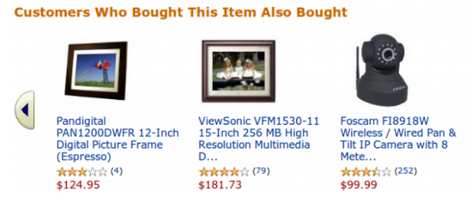
Item-to-item recommendations

Slide 34











Modern Collaborative Filtering
Item-Based and Dynamic
Recommender System
Selecting an item makes it and past choices more similar
Thus, output changes in response to transactions

Slide 35

Inferring Alice’s Transactions
Based on those changes, we infer transactions
We can see the recommendation lists for auxiliary items
Today, Alice watches a new show (we don’t know this)
...and we can see changes in those lists

Slide 36
Summary for today
High dimensional data is likely unique
  easy to perform linkage attacks
What this means for privacy
  Attacker background knowledge is important in formally defining privacy notions
  We will cover formal privacy definitions in later lectures, e.g., differential privacy

Slide 37
Homework
The Netflix attack is a linkage attack by correlating multiple data sources. Can you think of another application or other datasets where such a linkage attack might be exploited to compromise privacy?
The Memento and the web application paper are examples of side-channel attacks. Can you think of other potential side channels that can be exploited to leak information in unintended ways?

Slide 38
Reading list
[Suman and Vitaly 12] Memento: Learning Secrets from Process Footprints
[Arvind and Vitaly 09] De-anonymizing Social Networks
[Arvind and Vitaly 07] How to Break Anonymity of the Netflix Prize Dataset.
[Shuo et.al. 10] Side-Channel Leaks in Web Applications: a Reality Today, a Challenge Tomorrow
[Joseph et.al. 11] “You Might Also Like:” Privacy Risks of Collaborative Filtering
[Tom et. al. 09] Hey, You, Get Off of My Cloud: Exploring Information Leakage in Third-Party Compute Clouds
[Zhenyu et.al. 12] Whispers in the Hyper-space: High-speed Covert Channel Attacks in the Cloud

