Slide 1
Privacy Enhancing Technologies
Lecture 3 Differential Privacy
Elaine Shi
Some slides adapted from Adam Smith’s lecture and other talk slides

Slide 2
Roadmap
Defining Differential Privacy
Techniques for Achieving DP
Output perturbation
Input perturbation
Perturbation of intermediate values
Sample and aggregate

Slide 3
General Setting
Medical data
Query logs
Social network data
…
Data mining
Statistical queries

Slide 4
General Setting
publish
Data mining
Statistical queries

Slide 5
How can you allow meaningful usage of such datasets while preserving individual privacy?

Slide 6
Blatant Non-Privacy

Slide 7
Blatant Non-Privacy
Leak individual records
Can link with public databases to re-identify individuals
Allow adversary to reconstruct database with significant probablity

Slide 8
Attempt 1: Crypto-ish Definitions
I am releasing some useful statistic f(D), and nothing more will be revealed.
What kind of statistics are
safe to publish?

Slide 9
How do you define privacy?

Slide 10
Attempt 2:
I am releasing researching findings showing that people who smoke are very likely to get cancer.
You cannot do that, since it will break my privacy. My insurance company happens to know that I am a smoker…

Slide 11
Attempt 2: Absolute Disclosure Prevention
“If the release of statistics S makes it possible to determine the value [of private information] more accurately than is possible without access to S, a disclosure has taken place.” [Dalenius]

Slide 12
An Impossibility Result
[informal] It is not possible to design any non-trivial mechanism that satisfies such strong notion of privacy.[Dalenius]

Slide 13
Attempt 3: “Blending into Crowd” or k-Anonymity
K people purchased A and B, and all of them also purchased C.

Slide 14
Attempt 3: “Blending into Crowd” or k-Anonymity
K people purchased A and B, and all of them also purchased C.
I know that Elaine bought A and B…

Slide 15
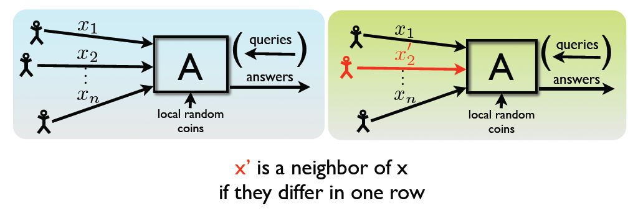
Attempt 4: Differential Privacy
From the released statistics, it is hard to tell which case it is.

Slide 16
Attempt 4: Differential Privacy
For all neighboring databases x and x’
For all subsets of transcripts:
Pr[A(x) є S] ≤ e^{ε} Pr[A(x’) є S]

Slide 17
Attempt 4: Differential Privacy
Please don’t blame me if your insurance company knows that you are a smoker, since I am doing the society a favor.
I am releasing researching findings showing that people who smoke are very likely to get cancer.
1
2
Oh, btw, please feel safe to participate in my survey, since you have nothing more to lose.
Since my mechanism is DP, whether or not you participate, your privacy loss would be roughly the same!
3
4

Slide 18
Notable Properties of DP
Adversary knows arbitrary auxiliary information
No linkage attacks
Oblivious to data distribution
Sanitizer need not know the adversary’s prior distribution on the DB

Slide 19
Notable Properties of DP

Slide 20
DP Techniques

Slide 21
Techniques for Achieving DP
Output perturbation
Input perturbation
Perturbation of intermediate values
Sample and aggregate

Slide 22
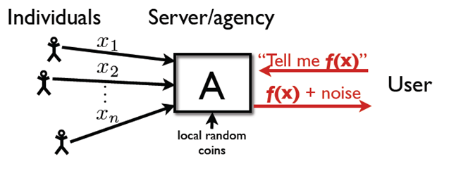
Method1: Output Perturbation
x,x’ neighbors

Slide 23
Method1: Output Perturbation
Theorem:
A(x) = f(x) + Lap() is -DP
Intuition: add more noise when function is sensitive

Slide 24
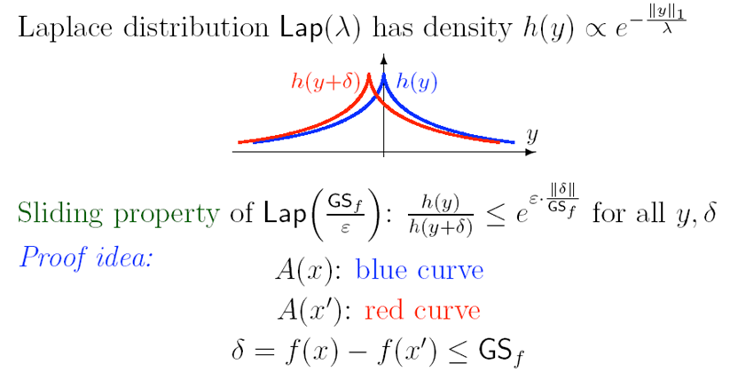
Method1: Output Perturbation
A(x) = f(x) + Lap() is -DP

Slide 25
Examples of Low Global Sensitivity
Average
Histograms and contingency tables
Covariance matrix
[BDMN] Many data-mining algorithms can be implemented through a sequence of low-sensitivity queries
Perceptron, some EM algorithms, SQ learning algorithms

Slide 26
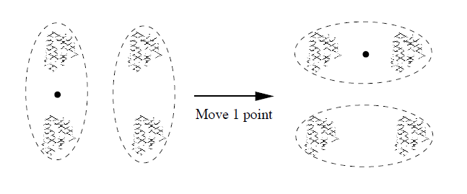
Examples of High Global Sensitivity
Order statistics
Clustering

Slide 27
PINQ

Slide 28
PINQ
Language for writing differentially-private data analyses
Language extension to .NET framework
Provides a SQL-like interface for querying data
Goal: Hopefully, non-privacy experts can perform privacy-preserving data analytics

Slide 29
Scenario
Query through PINQ interface
Trusted curator
Data analyst

Slide 30
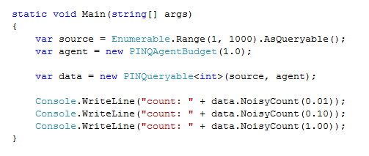
Example 1

Slide 31
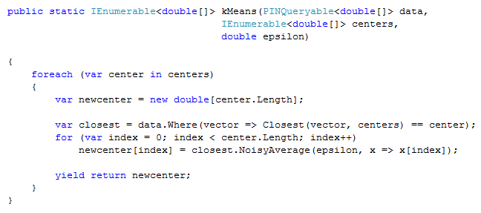
Example 2: K-Means

Slide 32
Example 3: K-Means with Partition Operation

Slide 33
Partition
O1
O2
O_{k}
O1
O2
O_{k}
…
…
P1
P2
P_{k}
P1
P2
P_{k}

Slide 34
Composition and privacy budget
Sequential composition
Parallel composition

Slide 35
K-Means: Privacy Budget Allocation

Slide 36
Privacy Budget Allocation
Allocation between users/computation providers
Auction?
Allocation between tasks
In-task allocation
Between iterations
Between multiple statistics
Optimization problem
No satisfactory solution yet!

Slide 37
When Budget Has Exhausted
?

Slide 38
Transformations
Where
Select
GroupBy
Join

Slide 39
Method 2: Input Perturbation
Randomized response [Warner65]
Please analyze this method in homework

Slide 40
Method 3: Perturb Intermediate Results

Slide 41
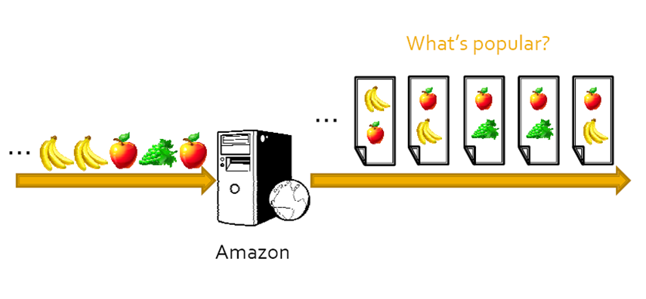
Continual Setting

Slide 42
Perturbation of Outputs, Inputs, and Intermediate Results

Slide 43
Comparison
Method | Error
Output perturbation
Input perturbation
Perturbation of Intermediate results

Slide 44
Binary Tree Technique
[1, 8]
[1, 4]
[5, 8]
[1, 2]
1 2 3 4 5 6 7 8

Slide 45
Binary Tree Technique
[1, 8]
[1, 4]
[5, 8]
[1, 2]
1 2 3 4 5 6 7 8

Slide 46
Key Observation
Each output is the sum of O(log T) partial sums
Each input appears in O(log T) partial sums

Slide 47
Method 4: Sample and Aggregate
Data dependent techniques

Slide 48
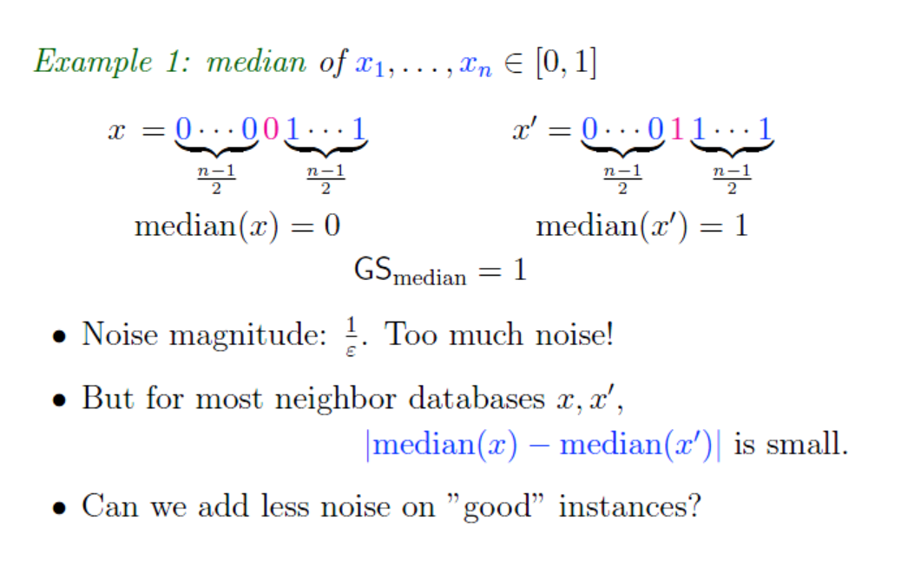
Examples of High Global Sensitivity

Slide 49
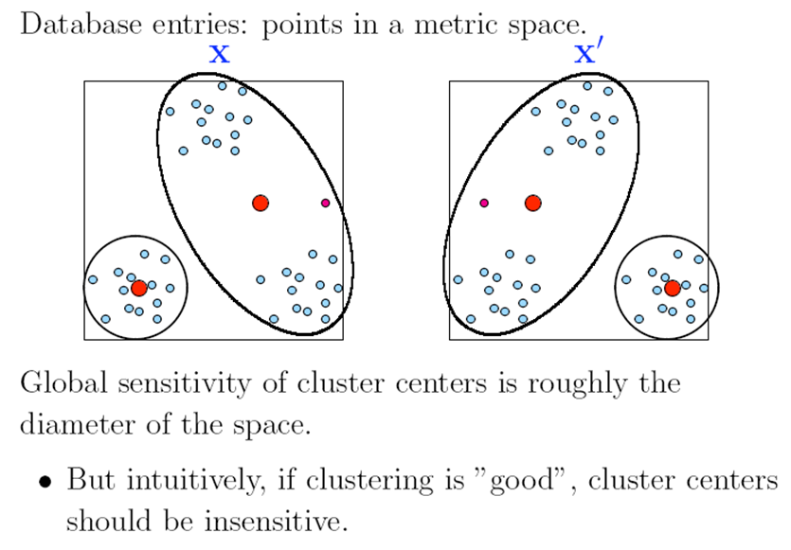
Examples of High Global Sensitivity

Slide 50
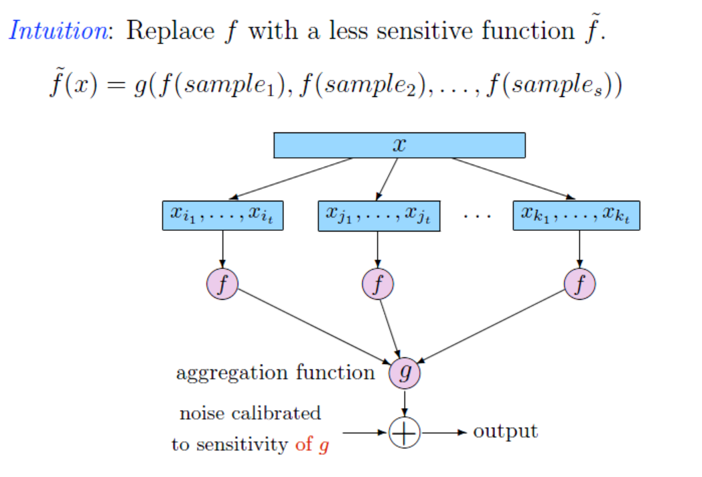
Sample and Aggregate
[NRS07, Smith11]

Slide 51
Sample and Aggregate
Theorem:
The sample and aggregate algorithm preserves -DP, and converges to the “true value” when the statistic f is asymptotically normal on a database consisting of i.i.d. values.

Slide 52
“Asymptotically Normal”
CLT: sum of h(x_{i}) where h(X_{i}) has finite expectation and variance
Common maximum likelihood estimators
Estimators for common regression problems
…

Slide 53
DP Pros, Cons, and Challenges?
Utility v.s. privacy
Privacy budget management and depletion
Allow non-experts to use?
Many non-trivial DP algorithms require really large datasets to be practically useful
What privacy budget is reasonable for a dataset?
Implicit independence assumption? Consider replicating a DB k times

Slide 54
Other Notions
Noiseless privacy
Crowd-blending privacy

Slide 55
Homework
If I randomly sample one record from a large database consisting of many records, and publish that record, would this be differentially private? Prove or disprove this. (If you cannot give a formal proof, say why or why not).
Suppose I have a very large database (e.g., containing ages of all people living in Maryland), and I publish the average age of all people in the database. Intuitively, do you think this preserves users' privacy? Is this differentially private? Prove or disprove this. (If you cannot give a formal proof, say why or why not).
What do you think are the pros and cons of differential privacy?
Anlyze Input Perturbation(Second techniques for achieving DP)

Slide 56
Reading list
Cynthia Dwork's video tutoial on DP
[Cynthia 06] Differential Privacy (Invited talk at ICALP 2006)
[Frank 09] Privacy Integrated Queries
[Mohan et. al. 12] GUPT: Privacy Preserving Data Analysis Made Easy
[Cynthia Dwork 09] The Differential Privacy Frontier

