Slide 1
Privacy Enhancing Technologies
Lecture 1 Landscape
Elaine Shi

Slide 2
Privacy Definitions and Landscape, Attacks against Privacy

Slide 3
What Is Privacy?

Slide 4
Non-Privacy

Slide 5
Non-Privacy
Collecting information unbeknownst to users
Sell/share users’ information to third-parties violating contracts/terms-of-use/expectations
Fail to protect users’ information
  Security breach
  Insider attack

Slide 6


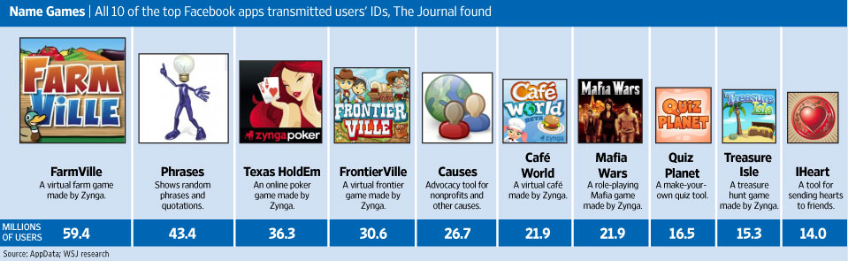

Class-action Law Suits (I)

Slide 7
Class-Action Law Suits (II)
Canadian class action on Facebook and settlement
Class action on Google Buzz, StreetView and settlement
Netflix cancels its contest due to class action lawsuit
On-going class action lawsuits
  Google android
  Apple
  Netflix viewing habits

Slide 8
Non-Privacy
Sharing information unbeknownst to users:
  Facebook employee Jeff Bowen posted on Facebook’s blog: “We are now making a user’s address and mobile phone number accessible as part of the User Graph object.”
  But don’t worry, Bowen wrote, because “these permissions only provide access to a user’s address and mobile phone number, not their friend’s [sic] addresses or mobile phone numbers.”
  Feature has been suspended
  http://www.wired.com/epicenter/2011/01/no-facebook-you-may-not/
Notes:
complete

Slide 9

Non-Privacy
Apr 26, 2011, Sony said it believes an unauthorized person obtained PSN user information, including members' names, addresses, birthdays, and login passwords. The company said there was no evidence that credit card information was stolen, but did not rule out that possibility.
A class action lawsuit was filed against Sony a day after the company publicly admitted that personal information from PlayStation Network was compromised by a security breach.

Slide 10
Non-Privacy
Insider misuse of information
  Google fires engineer who snooped on teenagers’ accounts
Notes:
complete

Slide 11
Making public information more public?
MySpace recently started selling user data in bulk on Infochimps. As MySpace has pointed out, the data is already public, but privacy concerns have nevertheless been raised.
Google Buzz’s auto-connect: it connected your public activity on Google Reader and other services and streamed it to your friends.
Anecdote: When search engines indexed the Usenet's content…
Arvind Narayanan
http://33bits.org

Slide 12
What Is Privacy?
Privacy is “the ability of an individual or group to seclude themselves or information about themselves and thereby reveal themselves selectively”
-- Wikipedia

Slide 13
Individual or Group
Individual
Special-interest groups
Enterprise
Government
Notes:
Quote that Microsoft survey?

Slide 14
Privacy-Sensitive Data
Individual
  Medical info (HIPPA), financial info
Special-interest groups
Enterprise
  Financial information, proprietary information, trade secrets
Government
  Classified information, top secrets
Notes:
Quote that Microsoft survey?

Slide 15
Do People Care About Privacy?

Slide 16
Opinions
"People have really gotten comfortable not only sharing more information and different kinds, but more openly and with more people… that social norm is just something that has evolved over time."
-- Mark Zuckerberg

Slide 17
Opinions
“Users don’t care about their privacy, they willingly post their personal and location information on Facebook and Foursquare…”
“Technological advances will put an end to privacy.”
  Think about social networks, smart grids…
Users give away their personal information for small rewards

Slide 18
However…
People tend to claim that they are very concerned about their privacy in surveys [Harris Interactive 2001]

Slide 19
Privacy Harm
Employer
Insurance companies
Stalking or cyber-stalking
  Women care about location privacy more than men
  In a recent survey, about 50% of women indicated that they have been stalked…
Teenagers: parents
More reasons?

Slide 20
Privacy Harm
[Calo 2010]
Subjective:
“Unwanted perception of observation”
  Anxiety, embarrassment, fear
  E.g., landlord listening on tenant, government surveillance
Objective:
“Unanticipated or coerced use of information concerning a person against that person”
  E.g., identity theft, leaking of classified information that reveals an undercover agent

Slide 21
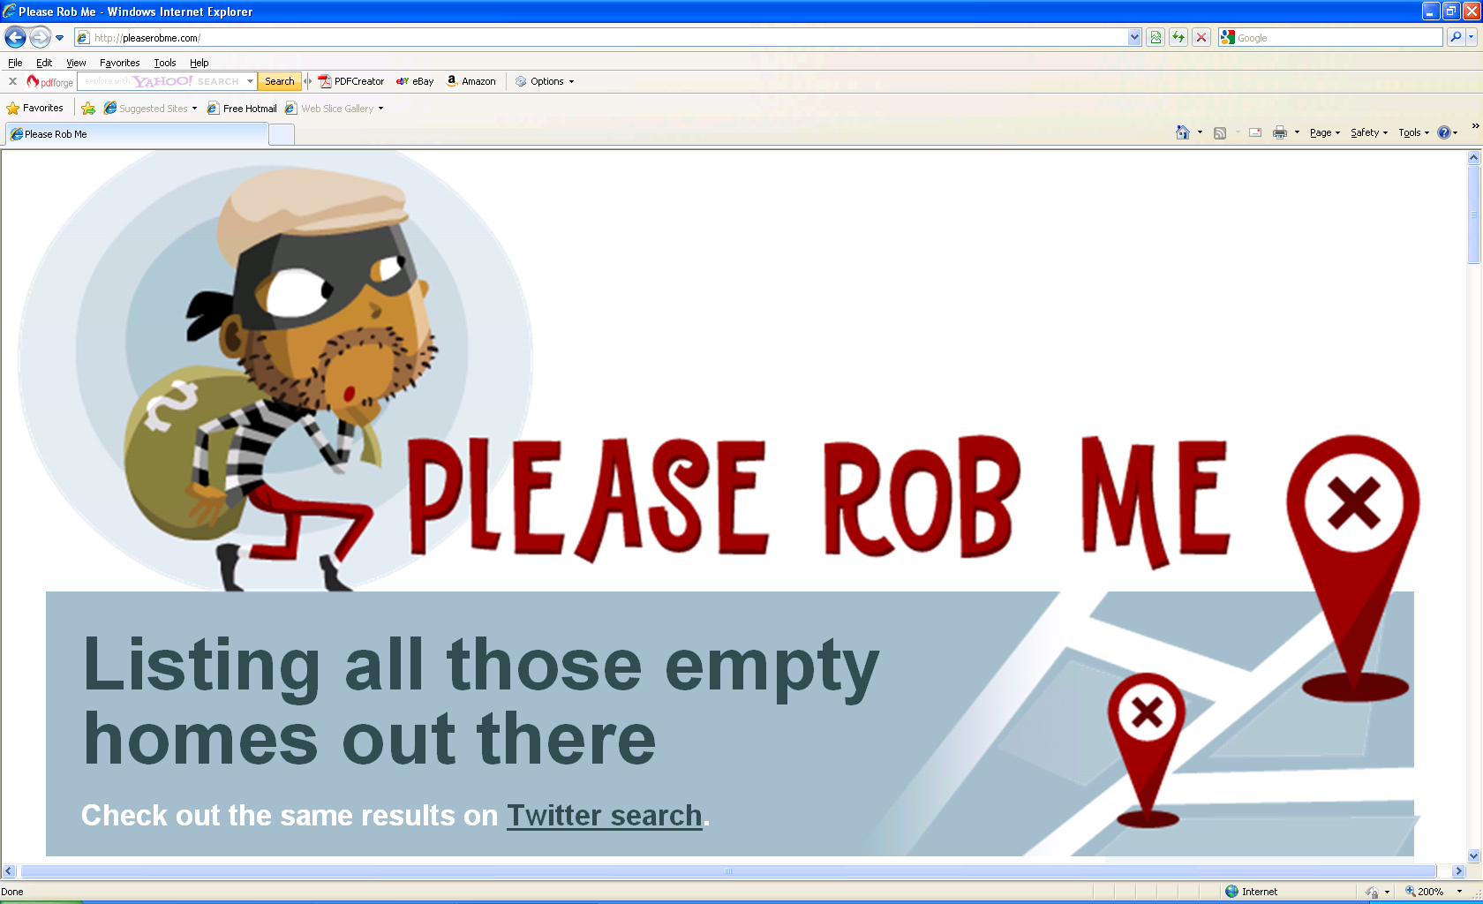
Please rob me!
Notes:
Continuing on Jessica’s questions ---
We share – is it a curse or blessing

Slide 22
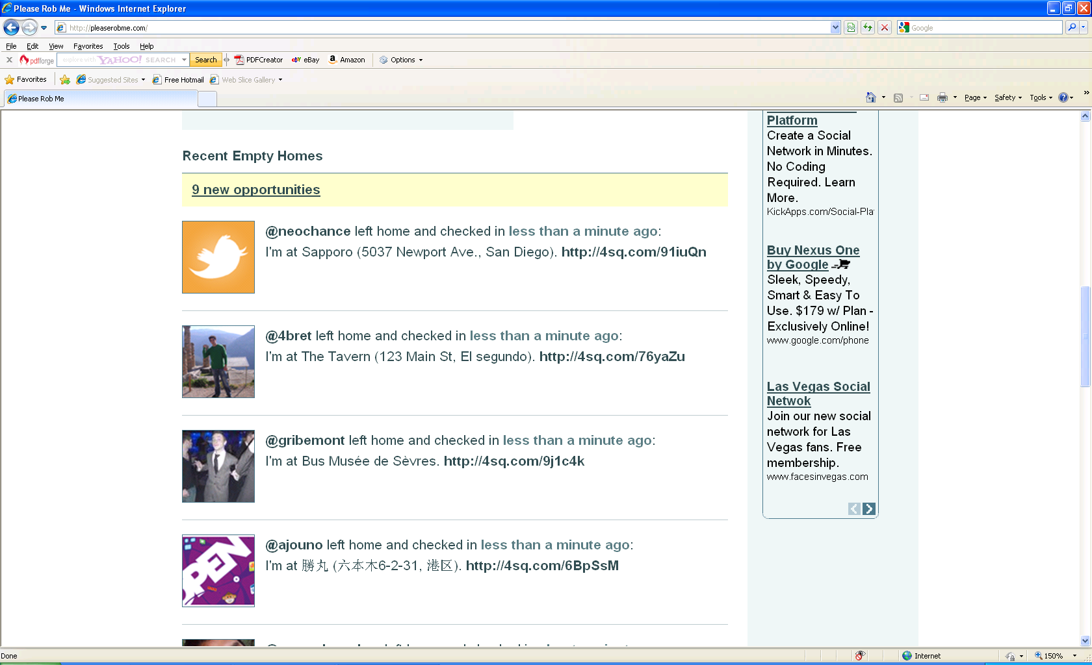
Who to rob?

Slide 23
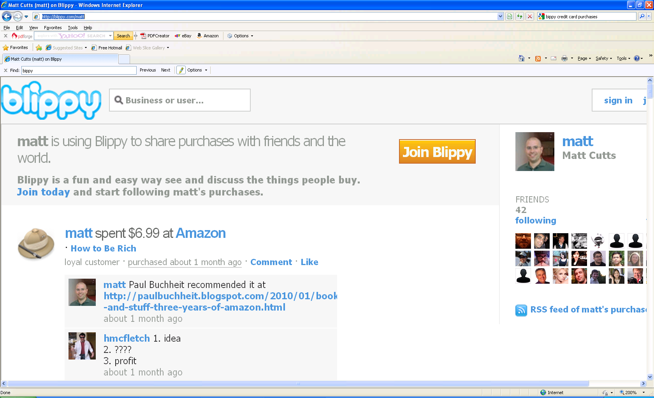
What to rob?

Slide 24
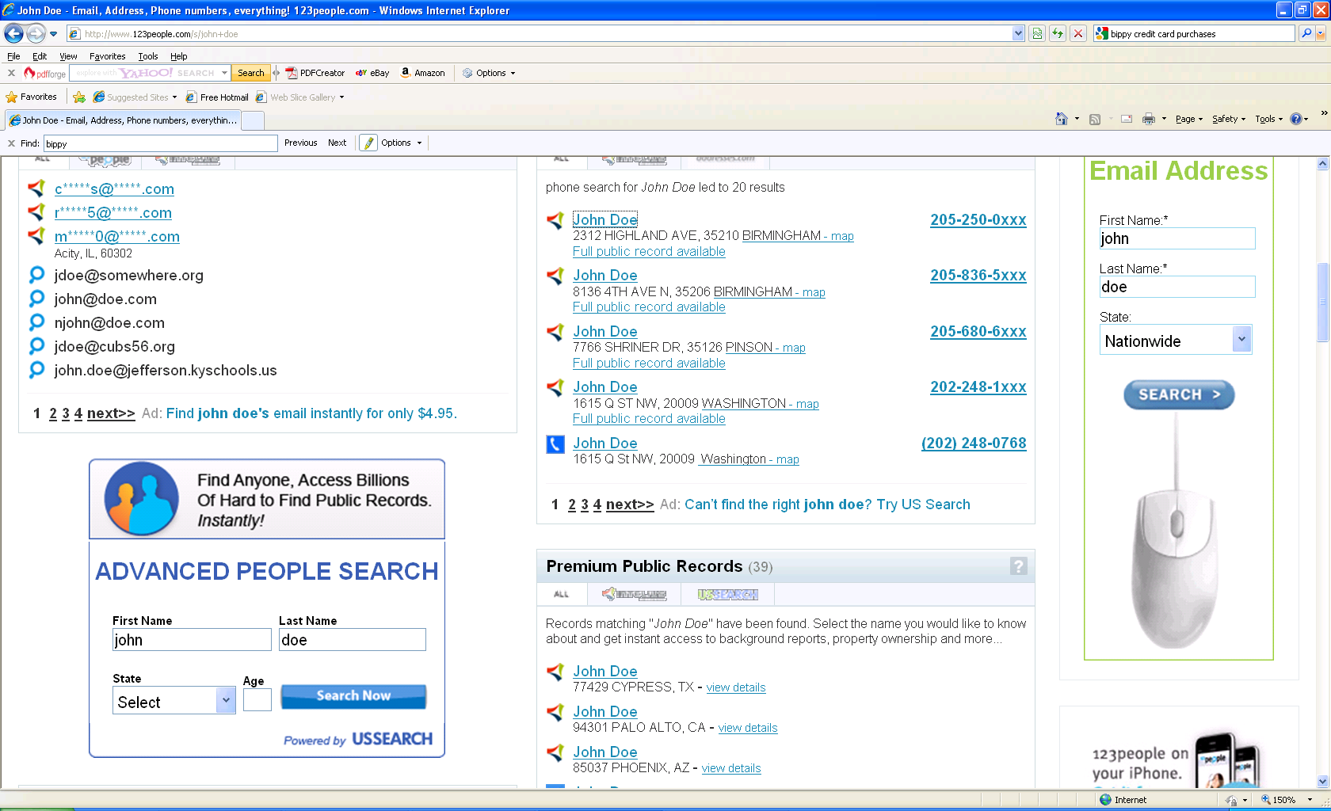
Where to rob?

Slide 25

Experiment: Which would you choose?
$10 anonymous
$12 identified

Slide 26
What is privacy worth?
[Acquisti et. al. 2009]
Difficult to evaluate:
Inconsistent decisions:
  Willingness to pay for privacy
  Willingness to give up privacy for small rewards
Psychological factors:
  Endowment effect
  Order effect

Slide 27
Do Companies Care About Privacy?

Slide 28
(Non-) Incentives
Increased operational, maintenance cost?
Decreased utility?
  Can a medical site offer value-added services if records are encrypted?
  Data anonymization, sanitization, perturbation hurt the accuracy and resolution of data sets.
New Facebook features: default setting skewed towards sharing information rather than restricting it
Notes:
Can a medical site offer meaningful services

Slide 29
Privacy Is an Interdisciplinary Field
Privacy and Law
  US: 4th Amendment: unreasonable search & seizure
  EU: fundamental right, includes “right to be forgotten”
Privacy and Economics
  Markets and regulation
  Fundamentalists and pragmatists
Philosophy of Privacy
  What are privacy norms and where do they come from?
  Why do certain patterns of information flow provoke public outcry in the name of privacy, and not others?
Privacy and Sociology
  To what extent is privacy a cultural construct?
  Are norms generational and experiential?

Slide 30
The concept of privacy is most often associated with Western culture, English and North American in particular. According to some researchers, the concept of privacy sets Anglo-American culture apart even from other Western European cultures such as French or Italian. The concept is not universal and remained virtually unknown in some cultures until recent times. The word "privacy" is sometimes regarded as untranslatable by linguists. Many languages lack a specific word for "privacy".
Wikipedia

Slide 31

Privacy-related Research in CS
Privacy-enhancing Cryptography
  E.g., Zero-knowledge proof, anonymous credential, anonymous cash
Anonymous communications
  E.g., MIX Nets, TOR
Data protection
Data privacy, inferential privacy breaches

Slide 32
Theoretic Formulations of Privacy
Confidentiality:
  Encryption: Indistinguishability under Chosen-Ciphertext-Attack
  Secure Multi-party Computation
Pseudonymity
  = Anonymity + Linking
Anonymity
  unidentified, unlinkable
  E.g., group signatures, anonymous credentials
K-anonymity
Differential privacy

Slide 33
Why is Privacy Hard?

Slide 34
Non-technical factors
Economics and deployment incentives
  Users:
  What is privacy worth?
  How much are people willing to pay for privacy?
  Service providers:
  How much does it cost to provide privacy?
Psychology
Legislation
Notes:
Mention Privacy v.s. utility somewhere…

Slide 35
Attacks: Inferential Privacy Breaches
Re-identification is matching a user in two datasets by using some linking information (e.g., name and address, or movie mentions)
Unintended information leaks
Difficult to balance utility and privacy
Examples
  AOL
  Netflix
  Social network de-anonymization
  Side-channel attacks in web applications
Notes:
Imagine if your search queries were released and identified, would you feel embarassed about any queries that you made?
How about the side channel attack, by measuring packet length of auto suggestion, guess search query

Slide 36
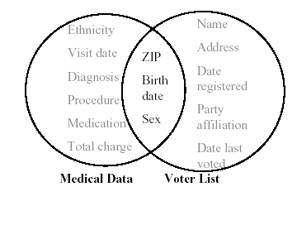
Linkage: Quasi Identifiers
Latanya Sweeney

Slide 37
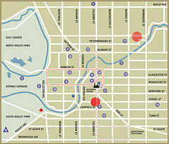
Home/Work location pairs
Location pair (block level) is uniquely identifying for majority
Even at tract level (roughly ZIP codes): 5% are unique

Slide 38
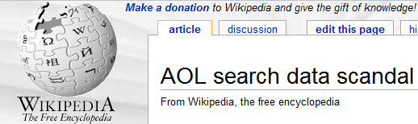
Linkage: Fuzzy Attributes
Frankowski et al.: “Privacy Risks of Public Mentions”
  “MovieLens” database
AOL “Anonymized” search logs
  twenty million search keywords, 650,000 users, 3-month period
  People searching for their own name, diseases, “how to kill your wife”, etc.
  Easily de-anonymized
  Class action lawsuit
  CTO resignation

Slide 39
Other Examples
Netflix data set: curse of high-dimensionality
Linkage: graph structure
  Narayanan & Shmatikov 09: De-anonymizing social networks
  Using only topology info, de-anonymize twitter & flickr graphs
  1/3 users on both twitter & flickr can be re-identified on twitter with 12% error rate
Genetic studies
  Homer et al., Wang et al.
  Identify individuals from aggregate information
Recommender systems
  Calandrino et al.: “You Might Also Like:” Privacy Risks of Collaborative Filtering
  Inferring individual users’ transactions from the aggregate outputs of collaborative filtering

Slide 40
Traffic Analysis
Language identification of encrypted VoIP traffic
  Uncovering spoken phrases in encrypted VoIP
Keyboard Acoustic Emanations
Timing analysis of keystrokes and timing attacks on SSH
Statistical identification of encrypted web browsing traffic
  Inferring the source of encrypted HTTP connections
Discovering search queries in encrypted HTTP traffic

Slide 41
What Can We Do?
i.e., what should privacy technology offer?

Slide 42
Satisfy the interests of all parties
Users:
Usability, functionality
Service providers:
Efficiency
Low maintenance and operational cost
Utility of data, value-added services
Compatibility with legacy applications, and ease of deployment
Developers:
Make it easy to develop privacy-preserving applications

Slide 43
Homework
Give an example where privacy requirement and efficiency/utility conflict.
Give some more real life examples of attacks against privacy.

Slide 44
Reading list
[Acquisti et. al. 2009] What is privacy worth?
[Rui et. al. 09] Learning Your Identity and Disease from Research Papers: Information Leaks in Genome Wide Association Study

