Slide 1
Privacy Enhancing Technologies
Lecture 4 Principles of System Security
Elaine Shi
slides partially borrowed from Jonathan Katz

Slide 2
Roadmap
Privacy and System Security
Principle of least privilege
Principle of Privilege Separation

Slide 3
Why System Security?
System security is necessary for privacy.
e.g. If OS is cpmpromised, data can be breached.

Slide 4
System security
Several meanings of “system security” here:
Security of the entirety of what is being protected
Operating-system security
Host security

Slide 5
Principle of least privilege
A subject should be given only the privileges it needs to accomplish its task
E.g., only allow access to information it needs
E.g., only allow necessary communication
The function of a subject (not its identity) should determine this
I.e., if a subject needs some privileges to complete a specific task, it should relinquish those privileges upon completion
If reduced privileges are sufficient for a given task, the subject should request only those privileges

Slide 6
Principle of least privilege
Every program and every privileged user of the system should operate using the least amount of privilege necessary to complete the job.[Jerome Saltzer 74]

Slide 7
Example
User account management: normal user does not have administrator's privilege.
A CEO share his office key only with his assistant, but not anyone else.

Slide 8
More example
A web server should not run with root privilege if root privilege is not needed.

Slide 9
Privilege Separation
Divided system into parts which are limited to the specific privileges they require in order to perform a specific task.
E.g.,
OS ensures isolation between apps
Hypervisor ensures isolation between OS

Slide 10
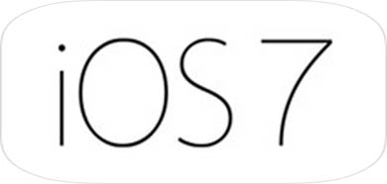
OS ensures isolation between apps
App
App
App
App
OS
If one of the application is buggy and thus is compromised or crashed, it will not affect the behavior of other applications

Slide 11
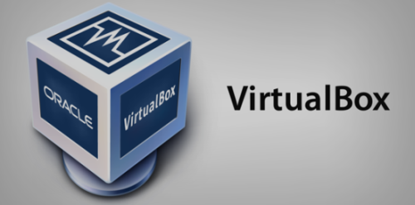
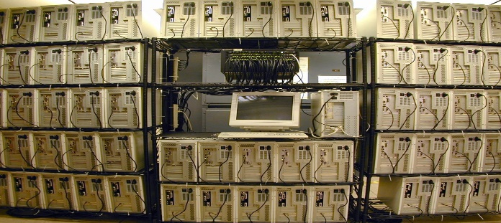
Hypervisor ensures isolation between OS
OS
OS
OS
Hypervisor
Hardware
Notes:
VMM or Hypervisor
Question: What causes these drawbacks?
Observation: Cause is Persistence, i.e., VMM is present even when not performing security-sensitive operations!
Insight: Avoid w/ security on-demand.

Slide 12
Homework
Can you give some more examples in real life that indicate principle of least privilege and privilege separation?

Slide 13
Reading list
[Saltzer and Schroeder 1975] The Protection of Information in Computer Systems

