Slide 1
Privacy Enhancing Technologies
Lecture 5 Trusted Computing
Elaine Shi

Slide 2
Roadmap
Background on Trusted Computing
Whole-system, load-time attestation
Fine-grained, run-time attestation
  or verifiable program execution

Slide 3
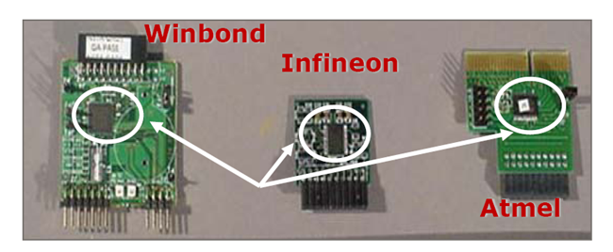
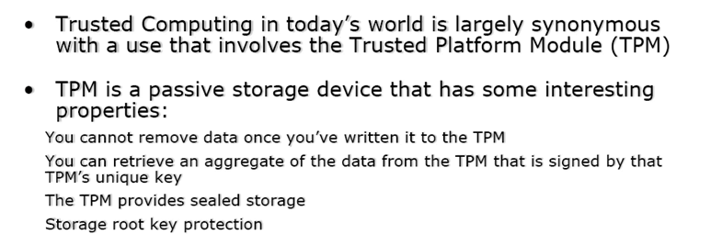
Trusted Computing & TPM

Slide 4
Trusted Computing Group
Founded in 1999, evolved since then
Core members
  AMD, HP, IBM, Intel, Microsoft, Sun
Who’s Who of product vendors
  ARM, Dell, Phoenix, VeriSign, RSA, Texas Instruments, Maxtor, Seagate, National Semi, Toshiba, France Telecom, Fujitsu, Adaptec, Philips, Ricoh, Nvidia
http://www.trustedcomputinggroup.org
Adapted from V. Shmatikov

Slide 5
What code is running on a remote system?
How do you verifiably execute a program on a remote host?
Why do we want to do this?
Applications?

Slide 6
What code is running on a remote system?
How do you verifiably execute a program on a remote host?
To establish trust in a remote system
To establish a TCB on a remote system

Slide 7
What code is running on a remote system?
How do you verifiably execute a program on a remote host?
SETI@HOME
Enterprise network management
Platform for private data
Secure BGP routing
Secure cryptographic setup

Slide 8
Whole-system, Load-time attestation
IMA [Sailer et. al.]

Slide 9
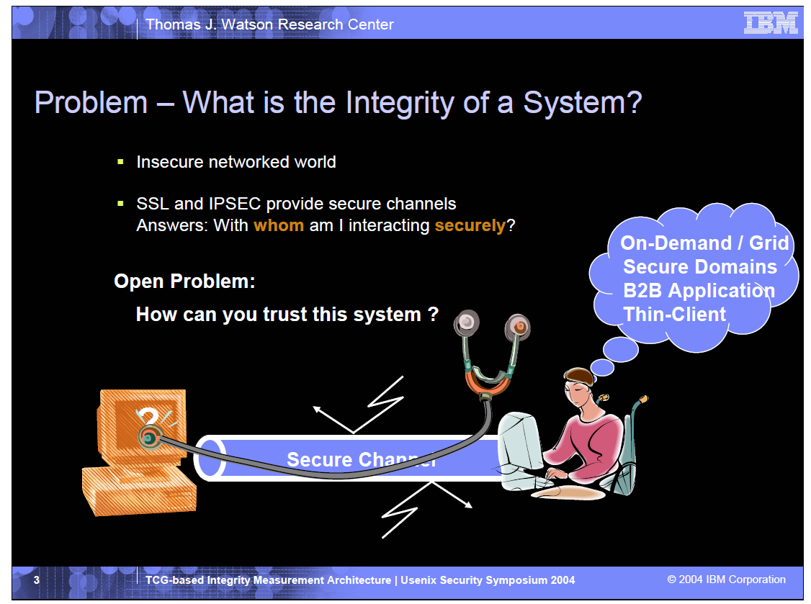

Slide 10
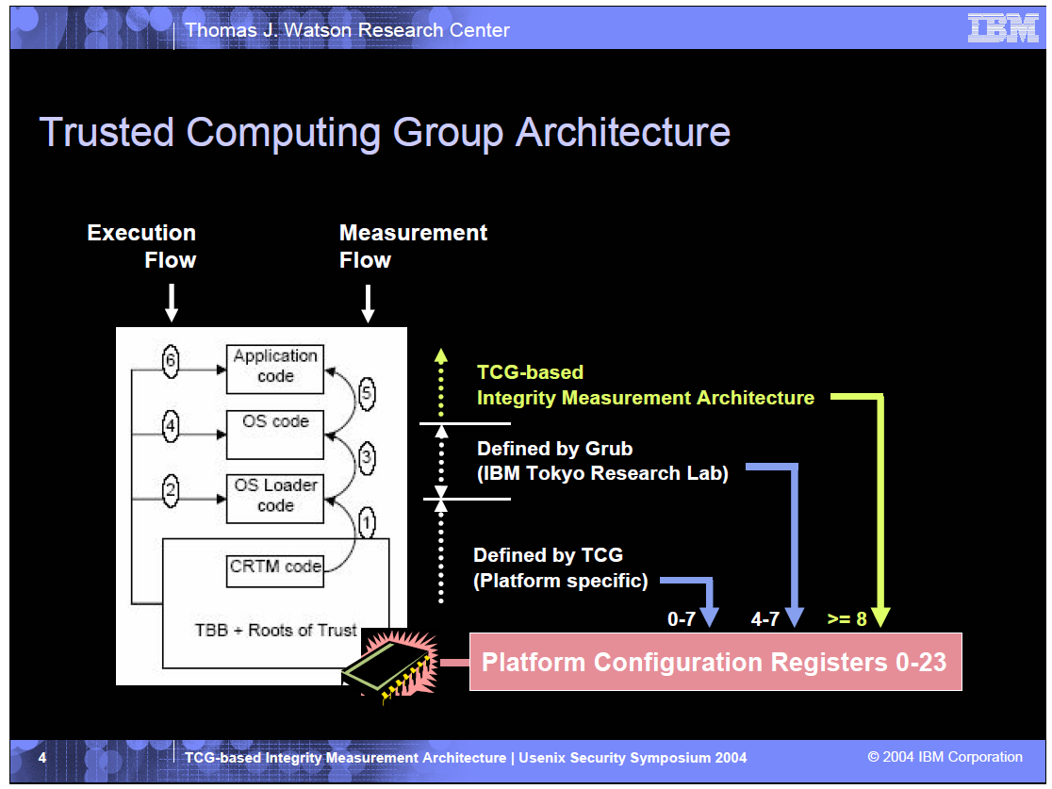

Slide 11
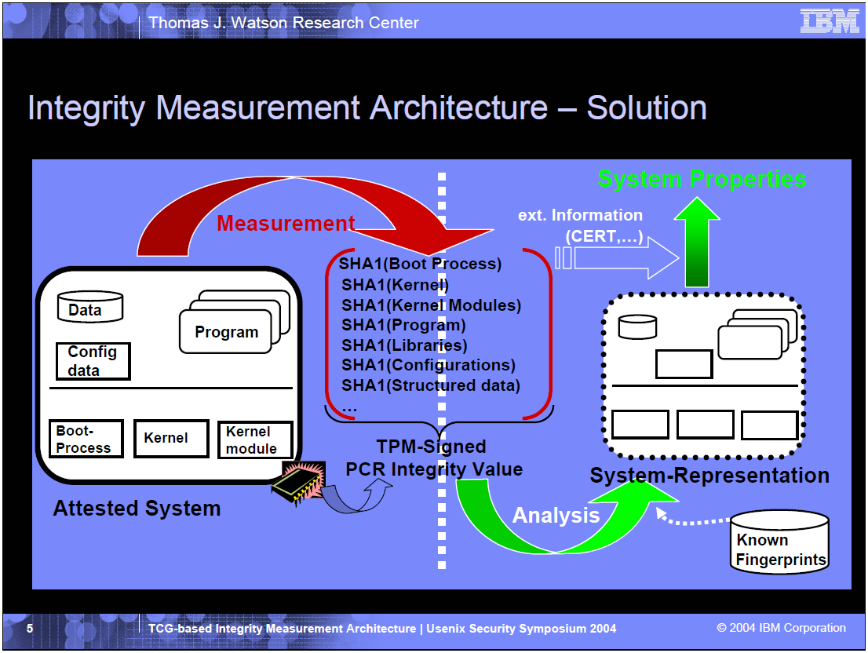

Slide 12
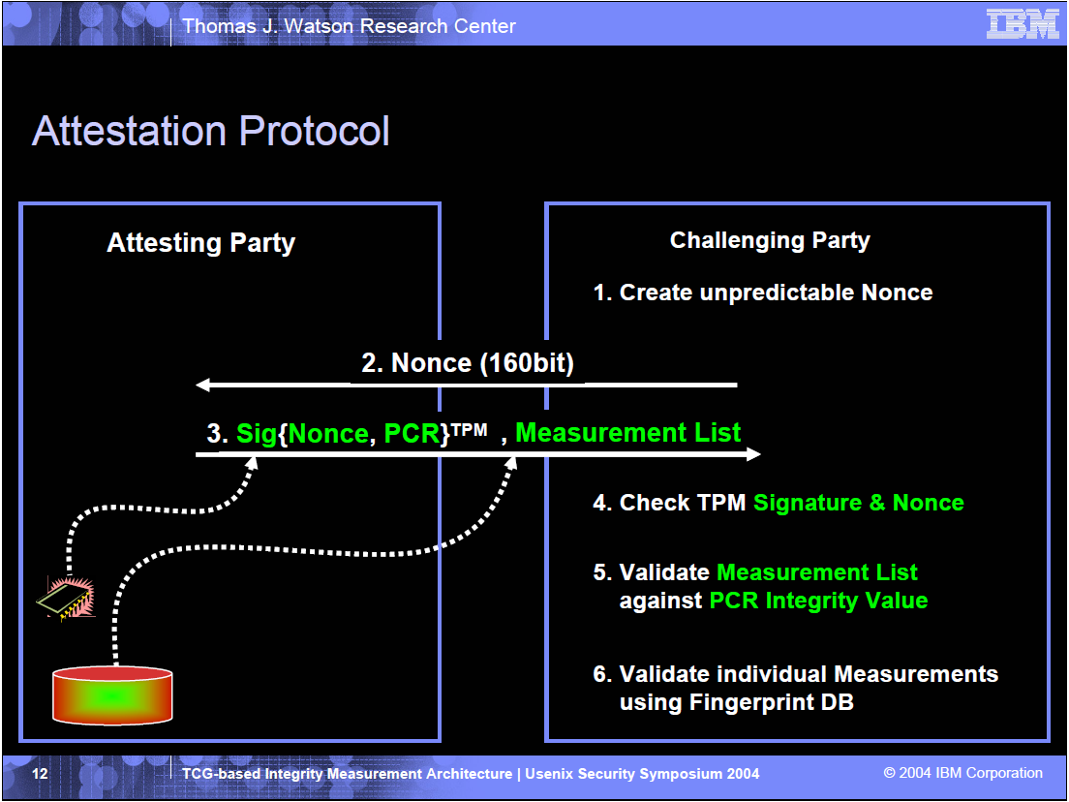

Slide 13
Pros and Cons
Hash may be difficult to verify
  Heterogeneous software versions and configs
  Proprietary software
- System may be compromised at run-time
+ Load-time attestation can be used to verifiably load a small TCB
  whose security can be formally verified

Slide 14
Fine-Grained, Run-time Attestation (a.k.a. verified execution)
Flicker [McCune et. al.]
TrustVisor [McCune et. al.]

Slide 15

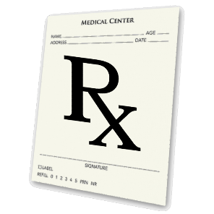
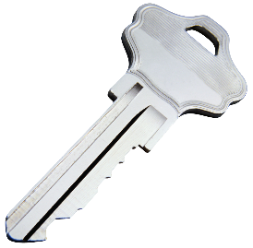
Problem Overview
S
App
App
…
S
OS
DMA Devices
(Ex: Network, Disk, USB)
CPU, RAM,
Chipset
Notes:
Emphasize that this is an overview!

Slide 16
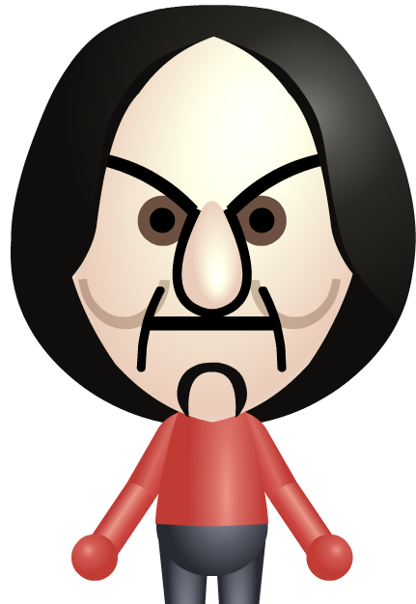
Problem Overview
Adversary Capabilities
App
App
…
Run arbitrary code with maximum privileges
Subvert devices
Perform limited hardware attacks
  E.g., Power cycle the machine
  Excludes physically monitoring CPU-to-RAM communication
S
OS
DMA Devices
(Ex: Network, Disk, USB)
CPU, RAM,
Chipset
Notes:
Emphasize that this models a remote/software attacker, which is most common by far.

Slide 17
Previous Work: Persistent Security Layers
  [Gold et al. ‘84], [Shockley et al. ‘88], [Karger et al. ‘91], [England et al. ‘03], [Garfinkel et al. ‘03], …
App
…
App
S
S
OS
Security Kernel
Virtual Machine Monitor
Hardware
Hardware
Notes:
Once VMM takes over, it never gives up control
KVM/370 in Retrospect – Gold, Linde, Cudney
An Overview of the GEMSOS class A1 technology and application experience – Shockley, Tao, Thompson
A Retrospective on the VAX VMM Security Kernel – Karger, Zurko, Bonin, Mason, Kahn
Terra: A virtual machine-based platform for trusted computing – Garﬁnkel, Pfaff, Chow, Rosenblum, and Boneh.
Reducing TCB complexity for security-sensitive applications: Three case studies – Singaravelu, Pu, Haertig, and Helmuth.
A trusted open platform - England, B. Lampson, J. Manferdelli, M. Peinado, and B. Willman.

Slide 18
Previous Work: Persistent Security Layers
App
…
App
  [Gold et al. ‘84], [Shockley et al. ‘88], [Karger et al. ‘91], [England et al. ‘03], [Garfinkel et al. ‘03], …
Drawbacks:
OS
Performance reduction
Increased attack exposure
Additional complexity
S
Virtual Machine Monitor
DMA Devices
(Ex: Network, Disk, USB)
CPU, RAM,
Chipset
Notes:
VMM or Hypervisor
Question: What causes these drawbacks?
Observation: Cause is Persistance, i.e., VMM is present even when not performing security-sensitive operations!
Insight: Avoid w/ security on-demand.

Slide 19
Flicker Overview: On-Demand Security
[IEEE S&P ‘07], [EuroSys ‘08], [ASPLOS ‘08]
App
App
App
App
…
…
S
OS
OS
Flicker
Hardware
Hardware

Slide 20
Flicker: An On-Demand Secure Environment
[IEEE S&P ‘07], [EuroSys ‘08], [ASPLOS ‘08]
Full secrecy
Full isolation
Minimal trust
Minimal complexity
App
1
App
App
App
…
…
Full HW access
Full performance
OS
OS
Insecure
Secure
S
Flicker
Hardware
Hardware
Notes:
Of course, by design, the Flicker environment is quite spartan. This means you can include exactly the code you need for your app and nothing else. Applications this work well for include computational tasks (e.g., crypto), those that require minimal UI, e.g., password entry, etc.

Slide 21
Secure Context Switching
Steps:
App
App
App
App
App
…
Request Flicker
Late Launch
Application Code Execution
Resume OS
…
OS
Allow?
OS
✓
S
S
Outputs
Inputs
S
S
Late
Module
Module
Module
Module
Launch
Flicker
Flicker
Late
S
RAM
Launch
RAM
CPU
CPU
CPU
Flicker
Notes:
Module makes the decision, which prevents a malicious module from being run. Of course, the tradeoff is availability. A malicious OS may choose not to run Flicker. Fortunately, as I describe later, the user can detect this.

Slide 22
App
App
…
OS
Module
Module
RAM
CPU

Slide 23
Must be unforgeable
Late
Launch
Flicker
S
How can we convey the log to Alice?
Must be tamper-proof
Inputs
Outputs
Prevents
Additions
Notes:
Mention that this log is what prevents (via later detection) the adversary from providing bad input

Slide 24
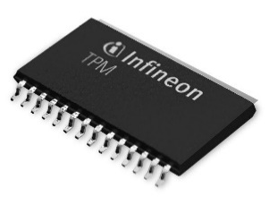

Hardware-Supported Logging
Trusted Platform Module (TPM)
John
Provides integrity for append-only logs
Can digitally sign logs
Equipped with a certificate of authenticity
Can authenticate that a Late Launch took place
Hancock
✓
✓
Late
Late
Launch
Launch
Notes:
Mention that logs don’t persist through reboot

Slide 25
Late
Launch
Flicker
S
Inputs
Outputs

Slide 26

Attestation
Guarantees freshness
random #
random #
Trustworthy!
✓
Guarantees real TPM
John
Guarantees actual TPM logs
Hancock
John
Hancock
Notes:
Alice trusts her phone. Attestation is a protocol that allows Alice to extend the trust she has in her phone to allow her to trust the software on her computer.
Random # is “given” to the TPM
Allows Alice to conclude that the log is accurate, and hence she can trust that the code described did indeed execute in a secure environment.

Slide 27
Comparison With “Traditional” Attestation
  [Gasser et al. ‘89], [Arbaugh et al. ‘97], [Sailer et al. ‘04], [Marchesini et al. ‘04]
Traditional
Flicker
Key Insight:
Late Launch + Fine-Grained Attestations
BIOS
Late
Launch
Bootloader
OS
Flicker
Fine-Grained Attestations Simplify Verification
S
Input
Fine-Grained Attestations Improve Privacy
Output
Drivers 1…N
App 1…N
Notes:
Digital Distributed System Security Architecture – Gasser, Goldstein, Kaufman, Lampson
A Reliable Bootstrap Architecture- Arbaugh, Farber, Smith
Design and Implementation of a TCG-based Integrity Measurement Architecture - Sailer, Zhang, Jaeger, van Doorn
Open-Source Applications of TCPA hardware - Marchesini, Smith, Wild, Stabiner, Barsamian

Slide 28
Application: Verifiable Malware Scanning
John
Hancock
Late
Launch
App
1
…
App
N
Run Detector
Flicker
OS
D
John
✓
Hancock
D
App
1
…
App
N
Inputs
Flicker
OS
Hardware
Outputs
Hardware

Slide 29



Additional Applications
Improved SSH password handling
Distributed computing
Protected CA keys

Slide 30
Pros and Cons?
Current systems only support one Flicker session at a time
  TrustVisor addresses this
- Flicker environment is spartan (by design!)
  No system calls, no interrupts
- Flicker does not guarantee availability
Flicker is vulnerable to sophisticated HW attacks
Not scalable for frequent requests

Slide 31
Additional reading: TrustVisor
μTPM or “software virtual TPM”
  Reduce number of calls to hardware TPM
  Multiple applications/VMs share the same hardware TPM
  Also in [vTPM] work
Balance between TCB reduction and scalability

Slide 32
Summary
After 8 years the commercial impact of TCG technology has been negligible
  Need killer applications (applications in the cloud?)
  Fortunately, there is a vibrant and growing TC research community

Slide 33
Challenges
Scalability
  New hardware features to reduce virtualization-related overhead
  TCB on top of a distributed infrastructure, e.g., Hadoop or MapReduce?
Broader goal
  A security/privacy platform allowing programmers to easily develop security/privacy applications?

Slide 34
Limitations
Physical attacks
  Physical attacks are more difficult to launch, and do not scale
Vulnerabilities in TCB
Side-channel attacks

Slide 35
Discussion
Other applications?
Alternative approaches?

Slide 36
Homework
What do you think are the major challenges of deploying Trusted Computing/code attestation in the cloud?
What is the pros and cons of persistent trusted layer? (e.g. OS, hypervisor)
What is the pros and cons of on-demand secure environment?

Slide 37
Reading list
[McCune et. al. ] Flicker: Minimal TCB Code Execution
[Jonathan et. al. ] TrustVisor: Efficient TCB Reduction and Attestation.
[Nuno Santos et. al. ] Policy-Sealed Data: A New Abstraction for Building Trusted Cloud Services
[Parno et. al. ] Memoir: Practical State Continuity for Protected Modules
[Elaine Shi et. al. ] BIND: A Fine-grained Attestation Service for Secure Distributed Systems.
[Stefan Berger et.al. ] vTPM: Virtualizing the Trusted Platform Module.
[Schiffman et. al. ] Seeding Clouds with Trust Anchors

