Slide 1
Chapter 5
Deliberation with Nondeterministic Domain Models
Dana S. Nau
University of Maryland

Slide 2
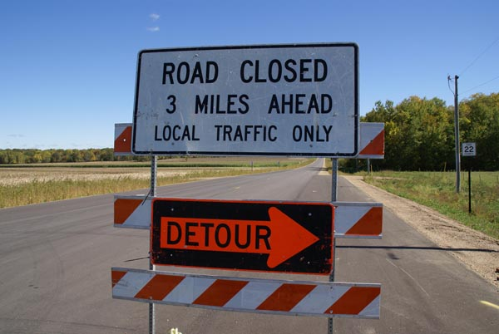
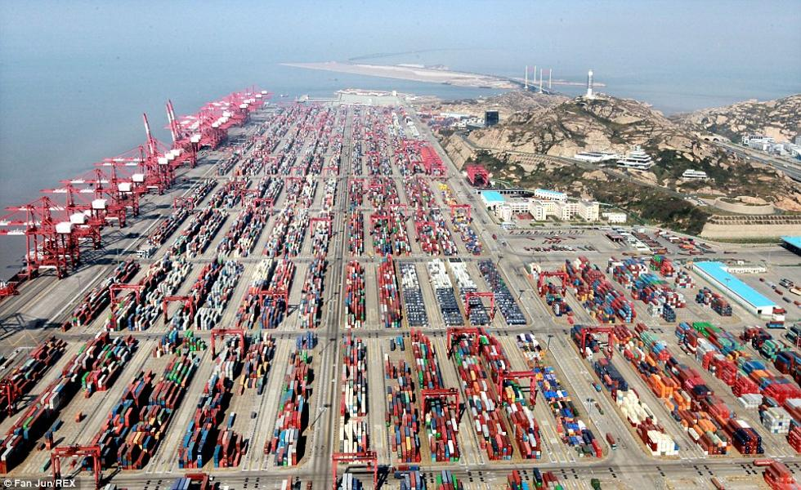

Motivation
c
We’ve assumed action a in state s
has just one possible outcome
  γ(s,a)
Often more than one possible outcome
  Unintended outcomes
  Exogenous events
  Inherent uncertainty
a
b
grasp(c)
c
a
b
a
b
c

Slide 3
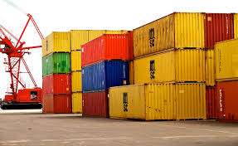

Example
Very simple harbor management domain
  Unload a single item from a ship
  Move it around a harbor
One state variable: pos(item)
  Simplified names for states
  For {pos(item)=on_ship}, just write on_ship

Slide 4
Nondeterministic Planning Domains
3-tuple (S, A, γ)
  S and A – finite sets of states and actions
  γ: S × A → 2^{S}
γ(s,a) = {all possible “next states” after
applying action a in state s}
  a is applicable in state s iff γ(s,a) ≠ ∅
Applicable(s) = {all actions applicable in s}
= {a ∈ A | γ(s,a) ≠ ∅}
Example:
  Applicable(at_harbor) = {park}
  park has three possible outcomes
    put item in parking1 or parking2 if one of them has space
    or in transit1 if there’s no parking space
  γ(at_harbor, park) = {parking1, parking2, transit1}

Slide 5
Nondeterministic Planning Domains
One possible action representation:
  like classical, but with n mutually exclusive “effects” lists
e.g., park:
pre: pos(item) = at_harbor
eff₁: pos(item) ← parking1
eff₂: pos(item) ← parking2
eff₃: pos(item) ← transit1
Problem:
  number of effects lists may be combinatorially large
  Suppose a can cause any possible
  combination of effects e₁, e₂, …, e_{k}
  Need eff₁ , eff₂ , …, eff₂k
    One for for each combination
  Section 5.4: a way to alleviate this
For now, ignore most of that, just look at the underlying semantics
  states, actions ⇔ nodes, edges in a graph

Slide 6
Nondeterministic Planning Domains
For deterministic planning problems, search space was a graph
Now it’s an AND/OR graph
  OR branch:
    several applicable actions,
    which one to choose?
  AND branch:
    multiple possible outcomes,
    must handle all of them
Analogy to PSP in Chapter 2
  OR branch ⇔ action selection
  AND branch ⇔ flaw selection

Slide 7
Plans Policies
Need something more general than a sequence of actions ⟨unload, park, deliver⟩
  After park, what do we do next?
    multiple possible outcomes, must handle all of them
Policy: a partial function π : S ⇸ A
      i.e., Dom(π) ⊆ S
  For every s ∈ Dom(π),
  require π(s) ∈ Applicable(s)
Meaning: perform π(s)
whenever we’re in state s
Two equivalent notations:
That’s just the notation
  implementation could be quite different
π₁(on_ship) = unload,
π₁ (at_harbor) = park,
π₁ (parking1) = deliver
π₁ = {(on_ship, unload),
(at_harbor, park),
(parking1, deliver)}

Slide 8
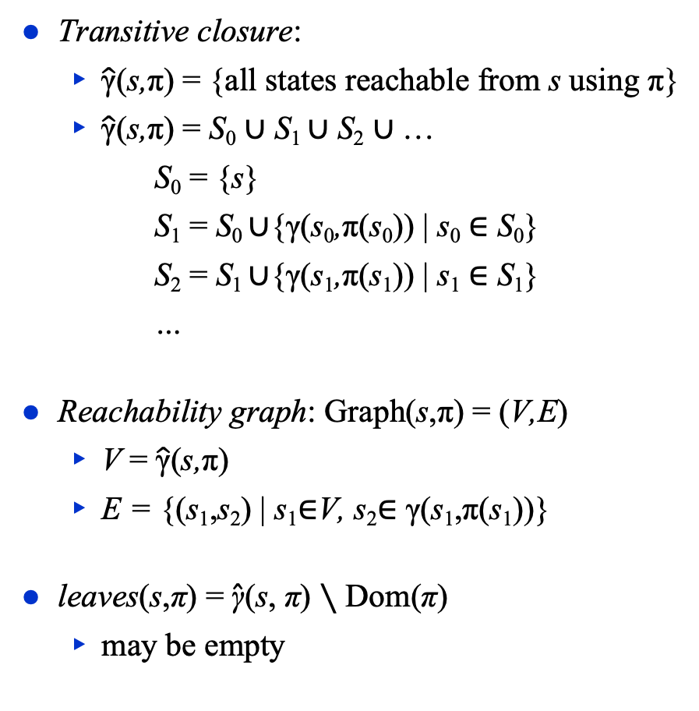
Definitions Over Policies
Transitive closure:
  $\hat{\text{γ}}$(s,π) = {all states reachable from s using π}
  $\hat{\text{γ}}$(s,π) = S₀ ∪ S₁ ∪ S₂ ∪ …
      S₀ = {s}
      S₁ = S₀ ∪{γ(s₀,π(s₀)) | s₀ ∈ S₀}
      S₂ = S₁ ∪{γ(s₁,π(s₁)) | s₁ ∈ S₁}
      …
Reachability graph: Graph(s,π) = (V,E)
  V = $\hat{\text{γ}}$(s,π)
  E = {(s₁,s₂) | s₁∈V, s₂∈ γ(s₁,π(s₁))}
leaves(s,π) = $\hat{\text{γ}}$(s, π) ∖ Dom(π)
  may be empty
π₁ = {(on_ship, unload),
(at_harbor, park),
(parking1, deliver)}

Slide 9
Performing a Policy
PerformPolicy(π)
s ← observe current state
while s ∈ Dom(π) do
perform action π(s)
s ← observe current state
π₁ = {(on_ship, unload),
(at_harbor, park),
(parking1, deliver)}

Slide 10
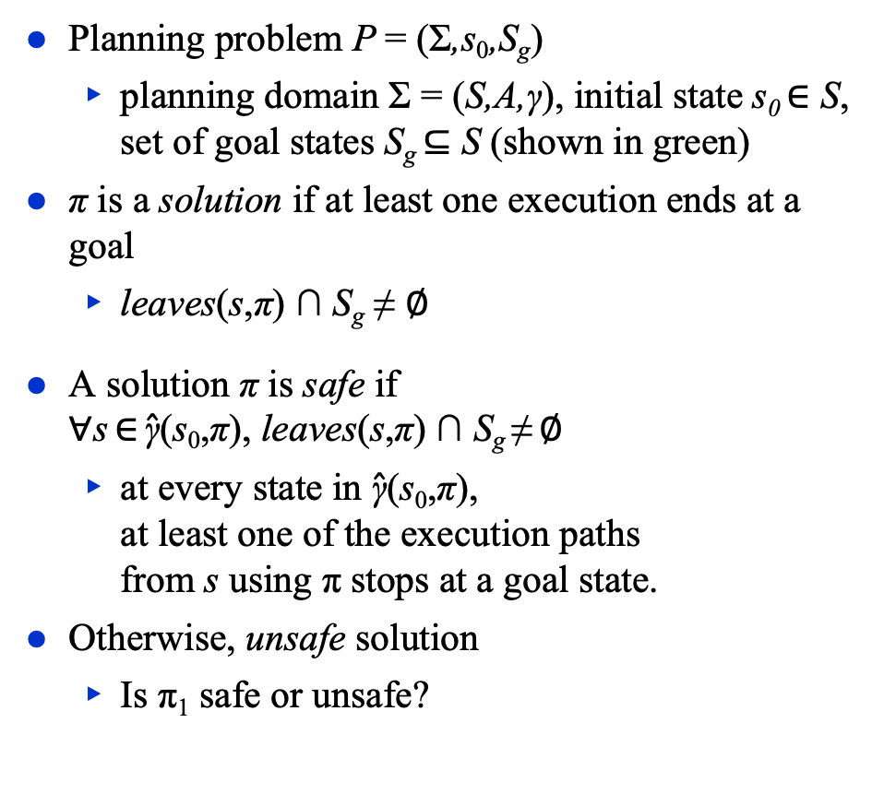
Planning Problems and Solutions
Planning problem P = (Σ,s₀,S_{g})
  planning domain Σ = (S,A,γ), initial state s₀ ∈ S,
  set of goal states S_{g} ⊆ S (shown in green)
π is a solution if at least one execution ends at a goal
  leaves(s,π) ∩ S_{g} ≠ ∅
A solution π is safe if
∀s ∈ $\hat{\text{γ}}$(s₀,π), leaves(s,π) ∩ S_{g} ≠ ∅
  at every state in $\hat{\text{γ}}$(s₀,π),
  at least one of the execution paths
  from s using π stops at a goal state.
Otherwise, unsafe solution
  Is π₁ safe or unsafe?
S_{g}
s₀
π₁ = {(on_ship, unload),
(at_harbor, park),
(parking1, deliver)}

Slide 11
Safe Solutions
PerformPolicy(π)
s ← observe current state
while s ∈ Dom(π) do
perform action π(s)
s ← observe current state
Acyclic safe solution
  Graph(s₀,π) is acyclic, and leaves(s,π) ⊆ S_{g}
If we run PerformPolicy(π) starting at s₀,
we’re guaranteed to stop at a goal
  π₂ = {(on_ship, unload), (at_harbor, park),
  (parking1, deliver), (parking2, deliver),
  (transit1, move), (transit2, move),
  (transit3, move)}

Slide 12

Safe Solutions
PerformPolicy(π)
s ← observe current state
while s ∈ Dom(π) do
perform action π(s)
s ← observe current state
Cyclic safe solution
  Graph(s₀, π) is cyclic, and leaves(s,π) ⊆ S_{g} ,
  and ∀s ∈ $\hat{\text{γ}}$(s₀,π), leaves(s,π) ∩ S_{g} ≠ ∅
    At every state s in $\hat{\text{γ}}$(s₀,π),
    at least one of the execution
    paths from s using π
    ends at a goal state
  Will never get caught in
  a dead end
Poll: Let π be a cyclic safe solution. Suppose we run PerformPolicy(π) starting at s₀.
Are there situations where we can be sure π will reach a goal?
Are there situations where we can’t be sure π will reach a goal?
back
  π₃ = {(on_ship, unload), (at_harbor, park),
  (parking1, deliver), (parking2, back),
  (transit1, move), (transit2, move),
  (gate1, back)}
move
move

Slide 13

Safe Solutions
PerformPolicy(π)
s ← observe current state
while s ∈ Dom(π) do
perform action π(s)
s ← observe current state
Cyclic safe solution
  Graph(s₀, π) is cyclic, and leaves(s,π) ⊆ S_{g},
  and ∀s ∈ $\hat{\text{γ}}$(s₀,π), leaves(s,π) ∩ S_{g} ≠ ∅
    At every state s in $\hat{\text{γ}}$(s₀,π),
    at least one of the execution
    paths from s using π
    ends at a goal state
  Will never get caught in
  a dead end
  Every “fair”
  execution will
  reach a goal
Poll:
Can you think of a real-world situation in which all executions are “fair”?
Can you think of a real-world situation in which there are “unfair” executions?
back
  π₃ = {(on_ship, unload), (at_harbor, park),
  (parking1, deliver), (parking2, back),
  (transit1, move), (transit2, move),
  (gate1, back)}
move
move

Slide 14
Kinds of Solutions
Goal
  acyclic
  solutions
  a
  safe solutions
  cyclic solutions
  c
  solutions
  unsafe solutions
  b

Slide 15
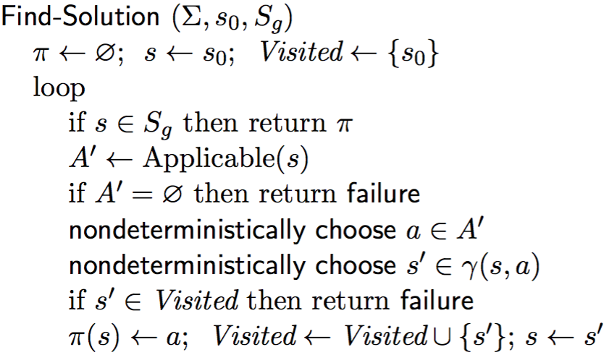
Finding (Unsafe) Solutions
For comparison:
Forward-search (Σ, s₀, g)
  s ← s₀; π ← ⟨⟩
  loop
    if s satisfies g then return π
    A′ ←{a ∈ A | a is applicable in s}
    if A′ = ∅ then return failure
    nondeterministically choose a ∈ A′
    s ← γ(s,a); π ← π.a
(*)
Decide which state to plan for
Cycle-checking
Poll: which should (*) be?
A. nondeterministically choose
B. arbitrarily choose

Slide 16
Example
s = on_ship
S_{g}
s
π = {}
Visited = {on_ship}

Slide 17
Example
s = on_ship
a = unload
γ(s,a) = {at_harbor}
s ← s′ = at_harbor
S_{g}
a
s
s′
π = {(on_ship, unload)}
Visited = {on_ship, at_harbor}

Slide 18
Example
s = at_harbor
a = park
γ(s,a) = {parking1,
parking2,
transit1}
s ← s′ = parking1
S_{g}
a
s
π = {(on_ship, unload),
(at_harbor, park)}
s′
Visited = {on_ship, at_harbor, parking1}

Slide 19
Example
s = parking1
a = deliver
γ(s,a) = {gate1,
gate2,
transit2}
s ← s′ = gate1
S_{g}
s′
a
π = {(on_ship, unload),
(at_harbor, park),
(parking1, deliver)}
s
Visited = {on_ship, at_harbor, parking1, gate1}

Slide 20
Example
s = gate1
S_{g}
s
gate1 is a goal,
so return π
π = {(on_ship, unload),
(at_harbor, park),
(parking1, deliver)}
Visited = {on_ship, at_harbor, parking1, gate1}

Slide 21
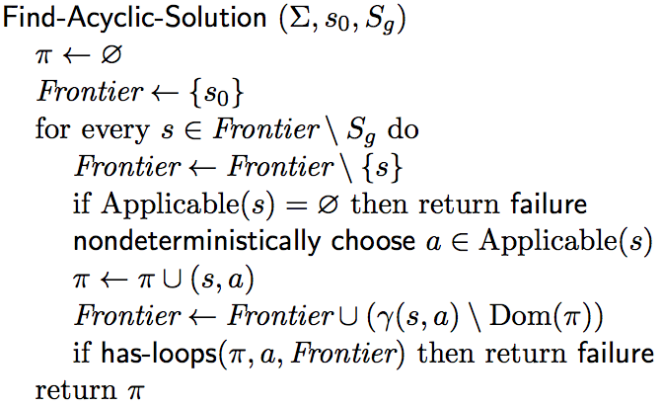
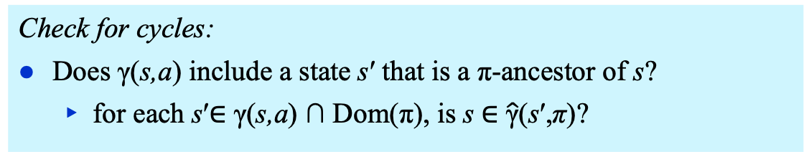
Find-Acyclic-Solution
Keep track of unexpanded states, as in A*
Add all states s such that
π(s) isn’t already defined
Check for cycles:
Does γ(s,a) include a state s′ that is a π-ancestor of s?
  for each s′∈ γ(s,a) ∩ Dom(π), is s ∈ $\hat{\text{γ}}$(s′,π)?

Slide 22
Example
S_{g}
Frontier = {on_ship}
π = {}

Slide 23
Example
S_{g}
Frontier = {at_harbor}
π = {(on_ship, unload)}

Slide 24
Example
S_{g}
Frontier = {parking1, parking2, transit1}
π = {(on_ship, unload),
(at_harbor, park)}

Slide 25
Example
S_{g}
Frontier = {parking2, transit1, transit2,
gate1, gate2}
π = {(on_ship, unload),
(at_harbor, park),
(parking1, deliver)}

Slide 26
Example
nondeterministically choose back or deliver
back ⇒ cycle, so return failure
deliver ⇒ no cycle, so continue
S_{g}
Frontier = {transit1, transit2, transit3 ,
gate1, gate2}
π = {(on_ship, unload),
(at_harbor, park),
(parking1, deliver),
(parking2, deliver)}

Slide 27
Example
S_{g}
Frontier = {transit2, transit3,
gate1, gate2}
π = {(on_ship, unload),
(at_harbor, park),
(parking1, deliver),
(parking2, deliver),
(transit1, move)}

Slide 28
Example
S_{g}
Frontier = {transit3,
gate1, gate2}
π = {(on_ship, unload),
(at_harbor, park),
(parking1, deliver),
(parking2, deliver),
(transit1, move),
(transit2, move)}

Slide 29
Example
S_{g}
Frontier = {gate1, gate2} ⊆ S_{g}
Found a solution
π = {(on_ship, unload),
(at_harbor, park),
(parking1, deliver),
(parking2, deliver),
(transit1, move),
(transit2, move),
(transit3, move)}

Slide 30
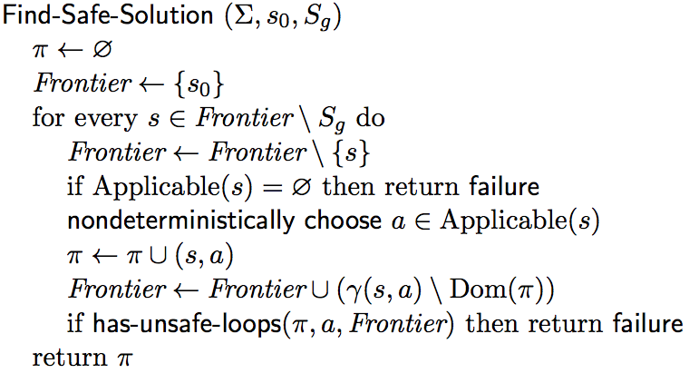
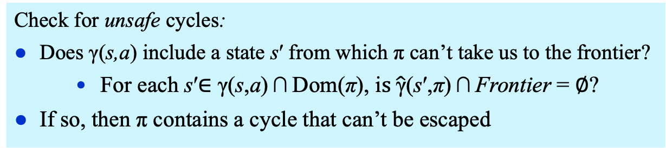
Find-Safe-Solution
Like
Find-Acyclic-Solution
except here:
Check for unsafe cycles:
Does γ(s,a) include a state s′ from which π can’t take us to the frontier?
    For each s′∈ γ(s,a) ∩ Dom(π), i$s \hat{\text{γ}}$(s′,π) ∩ Frontier = ∅?
If so, then π contains a cycle that can’t be escaped

Slide 31
Example
S_{g}
Frontier = {on_ship}
π = {}

Slide 32
Example
S_{g}
Frontier = {at_harbor}
π = {(on_ship, unload)}

Slide 33
Example
S_{g}
Frontier = {parking1, parking2, transit1}
π = {(on_ship, unload),
(at_harbor, park)}

Slide 34
Example
S_{g}
Frontier = {parking2, transit1, transit2,
gate1, gate2}
π = {(on_ship, unload),
(at_harbor, park),
(parking1, deliver)}

Slide 35
Example
Nondeterministically choose either back or deliver
back is OK because cycle is escapable
S_{g}
Frontier = {parking2, transit1, transit2,
gate1, gate2}
π = {(on_ship, unload),
(at_harbor, park),
(parking1, deliver)}

Slide 36
Example
S_{g}
Frontier = {transit1, transit2,
gate1, gate2}
π = {(on_ship, unload),
(at_harbor, park),
(parking1, deliver),
(parking2, back)}

Slide 37
Example
S_{g}
Frontier = {transit2,
gate1, gate2}
π = {(on_ship, unload),
(at_harbor, park),
(parking1, deliver),
(parking2, back),
(transit1, move)}

Slide 38
Example
S_{g}
Frontier = {gate1, gate2} ⊆ S_{g}
π = {(on_ship, unload),
(at_harbor, park),
(parking1, deliver),
(parking2, back),
(transit1, move),
(transit2, move)}

Slide 39
Guided-Find-Safe-Solution
Motivation: much easier to find solutions if they don’t have to be safe
  Find-Safe-Solution needs plans for all possible outcomes of actions
  Find-Solution only needs a plan for one of them
Idea:
  loop
    Find a (possibly unsafe) solution π
    For each each leaf node of π
      If the leaf node isn’t a goal,
        find a (possibly unsafe) solution
        and incorporate it into π

Slide 40
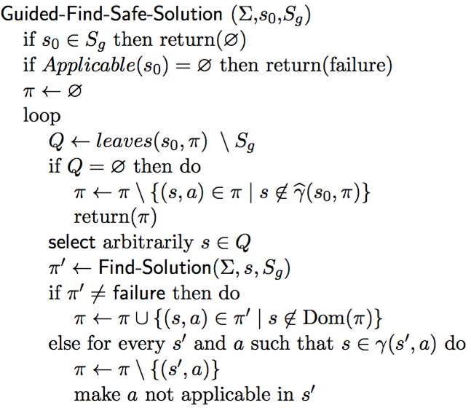
Guided-Find-Safe-Solution
π is a solution. Return the part that’s reachable from s₀.
Choose any leaf s that isn’t a goal.
Find a (possibly unsafe) solution π′ for s.
For each (s,a) in π′, add to π
unless π already has an action at s
s is unsolvable. For each (s′,a) that can produce s, modify π and Σ so we’ll never use a at s′

Slide 41
Example
tr5
tr4
S_{g}

Slide 42
Example
tr5
tr4
S_{g}
π = {(on_ship, unload),
(at_harbor, park),
(parking1, deliver)}
Q = {parking2, transit1,
transit2}

Slide 43
Example
tr5
tr4
S_{g}
π = {(on_ship, unload),
(at_harbor, park),
(parking1, deliver),
(parking2, deliver)}
Q = {transit1, transit2,
transit3}

Slide 44
Example
tr5
tr4
S_{g}
π = {(on_ship, unload),
(at_harbor, park),
(parking1, deliver),
(parking2, deliver),
(transit3, move),
(tr4, move)}
Q = {transit1, transit2, tr5}

Slide 45
Example
fail
tr5
tr4
S_{g}
π = {(on_ship, unload),
(at_harbor, park),
(parking1, deliver),
(parking2, deliver),
(transit3, move),
(tr4, move)}
Q = {transit1, transit2, tr5}

Slide 46
Example
Modify Σ_{d} to make move inapplicable at transit3
tr5
tr4
S_{g}
π = {(on_ship, unload),
(at_harbor, park),
(parking1, deliver),
(parking2, deliver),
(tr4, move)}
Q = {transit1, transit2,
transit3}

Slide 47
Example
fail
tr5
tr4
S_{g}
π = {(on_ship, unload),
(at_harbor, park),
(parking1, deliver),
(parking2, deliver),
(tr4, move)}
Q = {transit1, transit2,
transit3}

Slide 48
Example
Modify Σ_{d} to make deliver inapplicable at parking2
tr5
tr4
S_{g}
π = {(on_ship, unload),
(at_harbor, park),
(parking1, deliver),
(tr4, move)}
Q = {transit1, transit2,
parking2}

Slide 49
Example
tr5
tr4
S_{g}
π = {(on_ship, unload),
(at_harbor, park),
(parking1, deliver),
(tr4, move),
(parking2, back)}
Q = {transit1, transit2}

Slide 50
Example
tr5
tr4
S_{g}
π = {(on_ship, unload),
(at_harbor, park),
(parking1, deliver),
(tr4, move),
(parking2, back),
(transit1, move)}
Q = {transit2}

Slide 51
Example
tr5
tr4
S_{g}
π = {(on_ship, unload),
(at_harbor, park),
(parking1, deliver),
(tr4, move),
(parking2, back),
(transit1, move),
(transit2, move)}
Q = ∅

Slide 52
Example
Remove (tr4,move) from π because π can’t ever reach tr4
tr5
tr4
S_{g}
π = {(on_ship, unload),
(at_harbor, park),
(parking1, deliver),
(tr4, move),
(parking2, back),
(transit1, move),
(transit2, move)}
Q = ∅

Slide 53
Discussion
How to implement it?
  Need implementation of Find-Solution
  Need it to be very efficient
    We’ll call it many times
Idea: instead of Find-Solution,
use a classical planner
  Any of the algorithms from Chapter 2
  Efficient algorithms, search heuristics
Need to convert the actions into something the classical planner can use …

Slide 54
Determinization
Let a_{i} be a nondeterministic action with n possible outcomes
Determinization of a_{i} =
  {n deterministic actions, one for each outcome of a_{i} }
at_harbor
park
parking1
transit1
parking2
at_harbor
park1
park3
park2
parking1
transit1
parking2

Slide 55
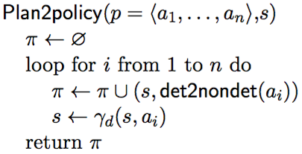
Determinization
Suppose a classical planner returns an acyclic plan p = ⟨a₁, a₂, …, a_{n}⟩
Actions and states: ⟨s₀, a₁, s₁, a₂, s₂, a₃, …, a_{n}, s_{n}⟩
Convert p to a policy ⟨(s₀,a₁), (s₁,a₂), …, (s_{n–1},a_{n})⟩
  a₁ = the nondeterministic action whose determinization includes a_{i}

Slide 56
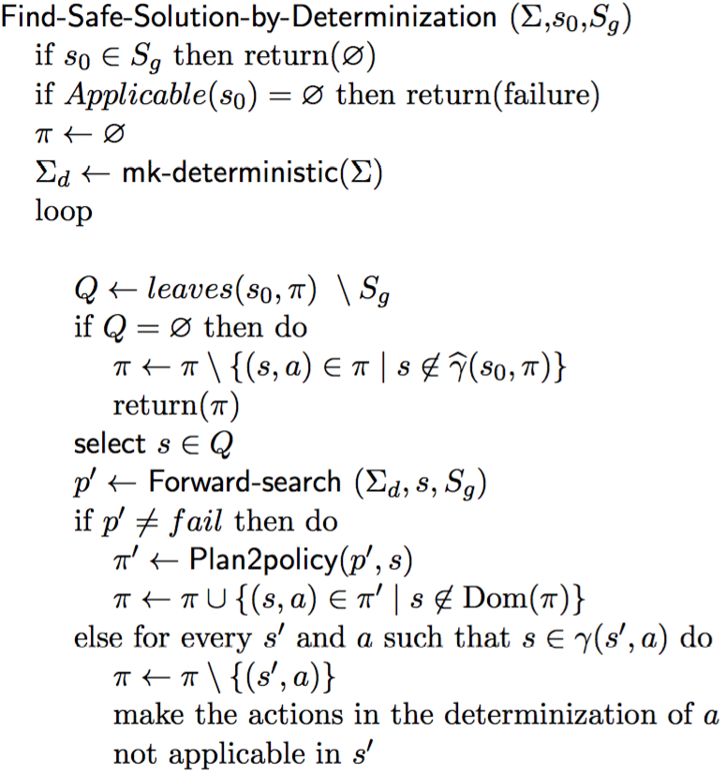
Find-Safe-Solution-by-Determinization
Any classical planner that doesn’t return cyclic plans

Slide 57
Example
tr5
tr4
S_{g}

Slide 58
Example
tr5
tr4
S_{g}

Slide 59
Example
tr5
tr4
S_{g}

Slide 60
Example
tr5
tr4
S_{g}

Slide 61
Example
tr5
tr4
S_{g}

Slide 62
Example
tr5
tr4
S_{g}

Slide 63
Example
fail
tr5
tr4
S_{g}

Slide 64
Example
Modify Σ_{d} to make move inapplicable at transit3
tr5
tr4
S_{g}

Slide 65
Example
fail
tr5
tr4
S_{g}

Slide 66
Example
Modify Σ_{d} to make deliver inapplicable at parking2
tr5
tr4
S_{g}

Slide 67
Example
tr5
tr4
S_{g}

Slide 68
Example
tr5
tr4
S_{g}

Slide 69
Example
tr5
tr4
S_{g}

Slide 70
Example
tr5
tr4
S_{g}

Slide 71
Example
tr5
tr4
S_{g}

Slide 72
Example
Remove (tr4,move) from π because π can’t ever reach tr4
tr5
tr4
S_{g}

Slide 73
Making Actions Inapplicable
Modify Σ_{d} to make a inapplicable at s
  worst-case exponential time
Better: hash table of bad state-action pairs
  For every (s′,a) such that s ∈ γ(s′,a),
  Bad[s′] ← Bad[s′] ∪ determinization(a)
  Modify classical planner to take the table as an argument
    if s is current state, only choose
    actions in Applicable(s) \ Bad[s]

Slide 74
Skip Ahead
Several topics I’ll skip for now
    will come back later if there’s time
  Other kinds of search algorithms
    min-max search
  Symbolic model checking techniques
    Backward search
    BDD representation
      Reduce search-space size by planning over sets of states

Slide 75
5.6 Online Approaches
Motivation
  Planning models are approximate – execution seldom works out as planned
  Large problems may require too much planning time
2nd motivation even more stronger in nondeterministic domains
  Nondeterminism makes planning exponentially harder
    Exponentially more time, exponentially larger policies
Offline vs Runtime
Search Spaces

Slide 76
Online Approaches
Need to identify good actions without exploring entire search space
  Can be done using heuristic estimates
Some domains are safely explorable
  Safe to create partial plans, because goal states are always reachable
In domains with dead-ends, partial planning won’t guarantee success
  Can get trapped in dead ends that we would have detected if we had planned fully
    No applicable actions
      robot’s battery goes dead
    Applicable actions, but caught in a loop
      robot goes into a collection of rooms from which there’s no exit
  But partial planning can still make success more likely

Slide 77
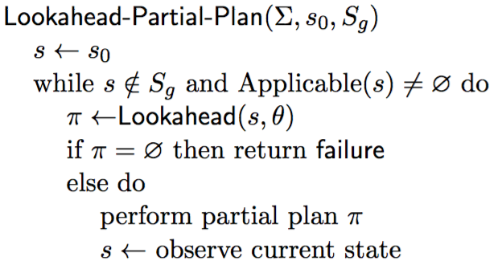
Lookahead-Partial-Plan
Adaptation of Run-Lazy-Lookahead (Chapter 2)
Lookahead is any planning
algorithm that returns a policy π
  π may be partial or unsafe solution
Execute π as far as it will go, then call Lookahead again
tr5
tr4
S_{g}

Slide 78
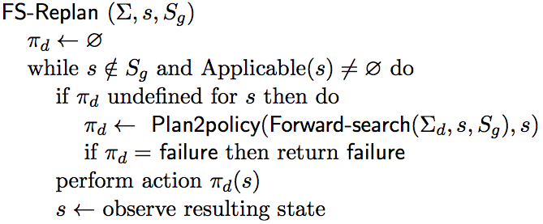
FS-Replan
tr5
tr4
S_{g}
Adaptation of Lookahead-Partial-Plan
  Calls classical planner on determinized domain
  Gets plan, converts converts to policy
    Unsafe solution
  Executes policy as far as it will go, then calls classical planner again

Slide 79
More Possibilities for Lookahead
What if Lookahead doesn’t
have time to run to completion?
  Can use the same techniques
  we discussed in Chapter 3
    Receding horizon
    Sampling
    Subgoaling
    Iterative deepening
  A few others …
Planning
Acting

Slide 80
More Possibilities for Lookahead
Full horizon, limited breadth:
  look for solution that works for some of the outcomes
  E.g., modify Find-Acyclic-Solution to examine i outcomes of each action
Iterative broadening:
  for i = 1 by 1 until time runs out
    look for a solution that handles i outcomes per action
S_{g}
T ← i elements of γ(s,a) \ Dom(π)
Frontier ← Frontier ∪ T

Slide 81
Safely Explorable Domains
Safely explorable domain
  for every state s, at least one goal state is reachable from s
For Lookahead, suppose we use Lookahead-Partial-Plan or FS-Replan
  Then Lookahead never returns failure
Every “fair” execution will eventually reach a goal
Poll: Suppose we just choose a random action each time. Is every “fair” execution guaranteed to reach a goal?

Slide 82
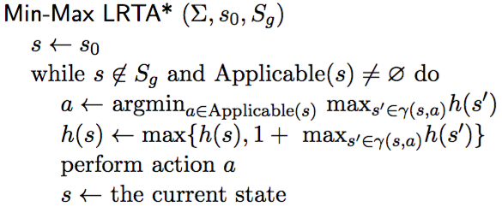
Min-Max LRTA*
If some actions have cost ≠ 1,
then use cost(s,a) here
loop
  choose an action a that (according to h) has optimal worst-case cost
    Update h(s) to use a’s worst-case cost
    Perform a
In safely explorable domains with no “unfair” executions, guaranteed to reach a goal

Slide 83
Example
S_{g}
Suppose that initially,
h(s) = 0 for every state s
h = 0

Slide 84
Example
S_{g}
Suppose that initially,
h(s) = 0 for every state s
a = unload
h = 1
h = 0

Slide 85
Example
h = 0
S_{g}
a = unload
h = 1
h = 0
a = park
h = 1+max(0,0,0)
= 1
h = 0

Slide 86
Example
h = 0
a = deliver
h = 1
1+ 1 = 2
h = 0
1+ max(0,0) = 1
S_{g}
a = unload
h = 1
a = park
h = 1+max(0,0,0)
= 1

Slide 87
5.7 Refinement Methods
Differences to refinement methods in Chapter 3:
  Tasks refine into automata
  Need to combine the automata
Important work, but the concepts are complicated
  We won’t have time to cover them

Slide 88
Summary
Actions, plans, policies, planning problems
types of solutions: unsafe, safe (acyclic, cyclic)
  Find-solution, Find-acyclic-solution, Find-safe-solution
Guided-find-safe-solution
  call find-solution to get an unsafe solution
  call find-solution again on the leaves
  if dead-ends are encountered, modify actions that lead to them
Find-safe-solution-by-determinization
  Like Guided-find-safe-solution, but
  call classical planner on determinized domain, convert plan into policy
Online approaches
  Lookahead-partial-plan
    adaptation of Run-Lazy-Lookahead
  FS-replan
    adaptation of Run-Lookahead
Ways to do the lookahead
  full breadth with limited depth,
    iterative deepening
  full depth with limited breadth
    iterative broadening
  convergence in safely explorable domains

