Slide 1
A Verified DSL for MPC in
Aseem Rastogi
Microsoft Research India
(Computer Aided Security Proofs, Aarhus, Denmark)

Slide 2
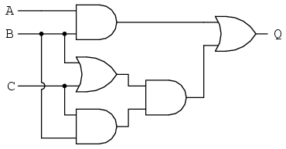
Secure Multi-party Computation (MPC)
General n-party cryptographic protocols
Compute f(x₁, x₂, x₃)
Without revealing inputs
Input: x₂
Encrypted msgs
Circuit representation of f
Input: x₁
Input: x₃

Slide 3
Secure Multi-party Computation (MPC)
General n-party cryptographic protocols
Compute f(x₁, x₂, x₃)
Without revealing inputs
Input: x₂
f(x₁, x₂, x₃)
Circuit representation of f
Input: x₁
Input: x₃

Slide 4
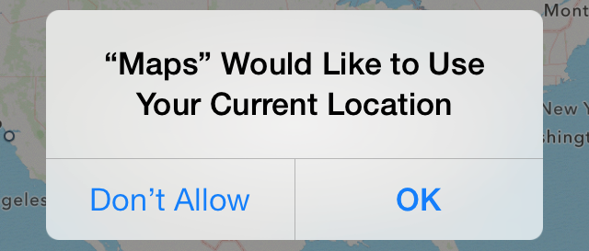
Wide ranging applications of MPC
Auctions
Online ads
Statistical computations over joint data
Location privacy, and many more

Slide 5
How should we program MPC
What programming interface (API) to use
Requirements:
Should be high-level
Should simplify reasoning about the programs
*We consider only honest-but-curious threat model

Slide 6
MPC frameworks
Circuit libraries
Circuit compilers
let g1 = Gate (AND, w1, w2) in
let g2 = Gate (XOR, w2, w3) in
…
Too low-level
let r = x + y + z in
…
Only monolithic circuit code
What about normal computations around it ?

Slide 7
Unoptimized vs optimized median
Joint median computation
(x1, x2) (y1, y2) Assume: x1 < x2 y1 < y2 Distinct (x1, x2, y1, y2)
let b = compare x1 y1 in
let x3 = b ? x2 : x1 in
let y3 = b ? y1 : y2 in
smaller x3 y3
let b = do_sec (compare, x1) in
let x3 = b ? x2 : x1 in
do_sec (smaller, x3)
let b = do_sec (compare, y1) in
let y3 = b ? y1 : y2 in
do_sec (smaller, y3)
Notes:
Instead of median, do PSI ? Do median, then say ad placement is PSI, and this is how PSI looks like. Non trivial about Poker.

Slide 8
Writing one program for each party
Joint median computation
(x1, x2) (y1, y2) Assume: x1 < x2 y1 < y2 Distinct (x1, x2, y1, y2)
let b = do_sec (compare, x1) in
let x3 = b ? x2 : x1 in
do_sec (smaller, x3)
let b = do_sec (compare, y1) in
let y3 = b ? y1 : y2 in
do_sec (smaller, y3)
Not scalable
Chances of errors, no tool support to catch them
Reasoning about some program property as a whole is hard

Slide 9
Key Idea
MPC Specific computation pattern
Parties compute their programs, and
Synchronize at secure computations
We use this insight to design a better MPC language

Slide 10
Wysteria: DSL for Programming MPC
A new high-level MPC language
Supports n-party generic applications
Wysteria programs are:
written like regular single-threaded programs, and
executed in a distributed, multi-party setting
Notes:
SIMD analogy, mention it … Third bullet -> implemented as a DSL embedded in F* > Mechanically verified toolchain, and enables formal verification of MPC programs

Slide 11
Key Idea of Wysteria
We could write it in a single program
let b = do_sec (compare, x1) in
let x3 = a ? x2 : x1 in
do_sec (smaller, x3)
let b = do_sec (compare, y1) in
let y3 = a ? y1 : y2 in
do_sec (smaller, y3)
let b = as_sec {A, B} (compare x1 y1) in
let x3 = as_par {A} (b ? x2 : x1) in
let y3 = as_par {B} (b ? y1 : y2) in
as_sec {A, B} (smaller x3 y3)
as_par and as_sec are two of the API functions exported by Wysteria
{A}, {B}, {A, B} are party sets

Slide 12
Wysteria computational model
let b = as_sec {A, B} (compare x1 y1) in
let x3 = as_par {A} (b ? x2 : x1) in
let y3 = as_par {B} (b ? y1 : y2) in
as_sec {A, B} (smaller x3 y3)
let b = as_sec {A, B} (compare x1 y1) in
let x3 = as_par {A} (b ? x2 : x1) in
let y3 = as_par {B} (b ? y1 : y2) in
as_sec {A, B} (smaller x3 y3)
let b = as_sec {A, B} (compare x1 y1) in
let x3 = as_par {A} (b ? x2 : x1) in
let y3 = as_par {B} (b ? y1 : y2) in
as_sec {A, B} (smaller x3 y3)
let b = as_sec {A, B} (compare x1 y1) in
let x3 = as_par {A} (b ? x2 : x1) in
let y3 = as_par {B} (b ? y1 : y2) in
as_sec {A, B} (smaller x3 y3)
Every party runs the same program
as_par ps e – parties in ps perform e “locally, in-parallel”
as_sec ps e – parties in ps perform e “jointly, using MPC”

Slide 13
Wysteria computational model
let b = as_sec {A, B} (compare x1 y1) in
let x3 = as_par {A} (b ? x2 : x1) in
let y3 = as_par {B} (b ? y1 : y2) in
as_sec {A, B} (smaller x3 y3)
■
let b = as_sec {A, B} (compare x1 y1) in
let x3 = as_par {A} (b ? x2 : x1) in
let y3 = as_par {B} (b ? y1 : y2) in
as_sec {A, B} (smaller x3 y3)
Every party runs the same program
as_par ps e – parties in ps perform e “locally, in-parallel”
as_sec ps e – parties in ps perform e “jointly, using MPC”

Slide 14
Wysteria computational model
let b = as_sec {A, B} (compare x1 y1) in
let x3 = as_par {A} (b ? x2 : x1) in
let y3 = as_par {B} (b ? y1 : y2) in
as_sec {A, B} (smaller x3 y3)
let b = as_sec {A, B} (compare x1 y1) in
let x3 = as_par {A} (b ? x2 : x1) in
let y3 = as_par {B} (b ? y1 : y2) in
as_sec {A, B} (smaller x3 y3)
■
Every party runs the same program
as_par ps e – parties in ps perform e “locally, in-parallel”
as_sec ps e – parties in ps perform e “jointly, using MPC”

Slide 15
Wysteria computational model
let b = as_sec {A, B} (compare x1 y1) in
let x3 = as_par {A} (b ? x2 : x1) in
let y3 = as_par {B} (b ? y1 : y2) in
as_sec {A, B} (smaller x3 y3)
let b = as_sec {A, B} (compare x1 y1) in
let x3 = as_par {A} (b ? x2 : x1) in
let y3 = as_par {B} (b ? y1 : y2) in
as_sec {A, B} (smaller x3 y3)
■
Every party runs the same program
as_par ps e – parties in ps perform e “locally, in-parallel”
as_sec ps e – parties in ps perform e “jointly, using MPC”

Slide 16
Wysteria computational model
let b = as_sec {A, B} (compare x1 y1) in
let x3 = as_par {A} (b ? x2 : x1) in
let y3 = as_par {B} (b ? y1 : y2) in
as_sec {A, B} (smaller x3 y3)
let b = as_sec {A, B} (compare x1 y1) in
let x3 = as_par {A} (b ? x2 : x1) in
let y3 = as_par {B} (b ? y1 : y2) in
as_sec {A, B} (smaller x3 y3)
■
Every party runs the same program
as_par ps e – parties in ps perform e “locally, in-parallel”
as_sec ps e – parties in ps perform e “jointly, using MPC”

Slide 17
Wysteria advantages over previous work
let b = as_sec {A, B} (compare x1 y1) in
let x3 = as_par {A} (b ? x2 : x1) in
let y3 = as_par {B} (b ? y1 : y2) in
as_sec {A, B} (smaller x3 y3)
One, single-threaded program, scalable
Design precludes a whole class of errors
Higher assurance (Formal verification?)
Notes:
Do examples here. PSI. Poker. It’s written in F*, and it’s all verified. With each example, say what you proved about it.

Slide 18
Unoptimized vs optimized median
as_sec {A, B}
let b = compare x1 y1 in
let x3 = b ? x2 : x1 in
let y3 = b ? y1 : y2 in
smaller x3 y3
Unoptimized median
let b = as_sec {A, B} (compare x1 y1) in
let x3 = as_par {A} (b ? x2 : x1) in
let y3 = as_par {B} (b ? y1 : y2) in
as_sec {A, B} (smaller x3 y3)
Optimized median
(runs faster)
Optimized version reveals more, by design
Is it secure ? Does it leak more than the unoptimized one ?
Notes:
Instead of median, do PSI ? Do median, then say ad placement is PSI, and this is how PSI looks like. Non trivial about Poker.

Slide 19
Formal verification of Wysteria programs
Wysteria is implemented as a DSL in F*
Wysteria programs are simply F* programs
Programmers can use F* facilities to verify MPC programs

Slide 20
Sample Code for Median
(In emacs)

Slide 21
Formally verifying the median properties
as_sec {A, B}
let b = compare x1 y1 in
let x3 = b ? x2 : x1 in
let y3 = b ? y1 : y2 in
smaller x3 y3
Unoptimized median
let b = as_sec {A, B} (compare x1 y1) in
let x3 = as_par {A} (b ? x2 : x1) in
let y3 = as_par {B} (b ? y1 : y2) in
as_sec {A, B} (smaller x3 y3)
Optimized median
(runs faster)
Both versions compute the correct median
Optimized one does not leak more than the unoptimized one
(Security verified in the idealized crypto model)
Notes:
Instead of median, do PSI ? Do median, then say ad placement is PSI, and this is how PSI looks like. Non trivial about Poker.

Slide 22
Wysteria metatheory
Formalize two semantics
Single-threaded semantics (Wysteria semantics in F*)
Distributed semantics (for running the programs)
Soundness theorem
Define a slice relation that relates
a single-threaded configuration
to
its multi-party protocol
single-threaded termination
C
*
C’
slices to
*
π
π’
protocol termination

Slide 23
Wysteria metatheory
Formalize two semantics
Single-threaded semantics (Wysteria semantics in F*)
Distributed semantics (for running the programs)
Soundness theorem
Define a slice relation that relates
a single-threaded configuration
to
its multi-party protocol
Properties verified in the source carry over when the programs are run in the distributed semantics
Theorem mechanically verified in F*

Slide 24
Sample Code for Metatheory
(In emacs)

Slide 25
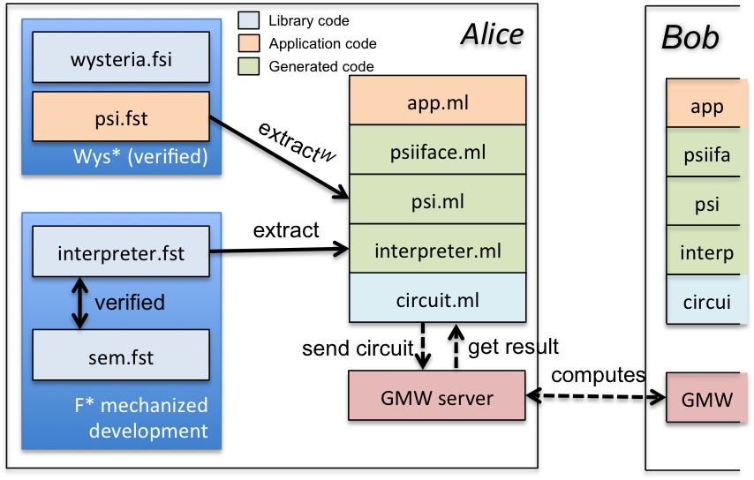
Wysteria toolchain
GMW is an MPC crypto protocol
We use GMW implementation
from Choi et. al.
Interpreter converts as_sec code to boolean circuits dynamically

