Slide 1
JFC-GUI-Ripper

Slide 2


Slide 3
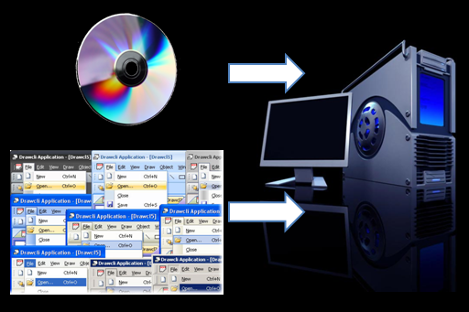

Slide 4
JFC Ripper is a subsystem of the GUITAR suite.
The goal of the JFCGUIRipper is to produce an XML file based on the GUI structure.

Slide 5
Scenarios
I want to detect software crashes only, by creating test cases automatically for a Java application and running them automatically.
Obtaining and viewing a hierarchical view of the GUI of my application.
Inspecting the properties of the GUI widgets in my application.
Capturing a test session and running it automatically for regression testing.
Capturing a test session and creating JFCUnit test cases from it automatically.

