Slide 1
Online Filtering, Smoothing & Probabilistic Modeling of Streaming Data In short, Applying probabilistic models to Streams
Bhargav Kanagal & Amol Deshpande
University of Maryland

Slide 2
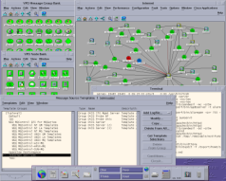
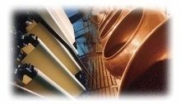
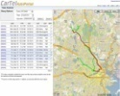
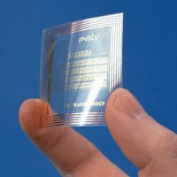
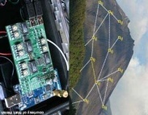
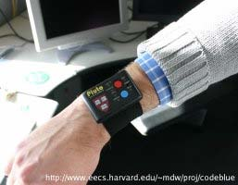
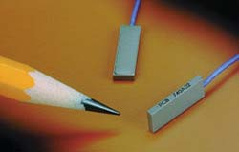
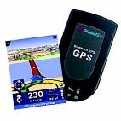
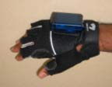
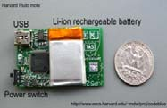
Motivation
Enormous amounts of Streaming data generated by Sensor Networks and other Measurement Infrastructure.
Large Number of Data Stream processing systems
Focus on efficient query processing
Do not support many essential stream processing tasks.
Hidden Variables
Working status of a wireless sensor
GPS: Infer transportation mode based on observations of position
Inferring hidden variables
Eliminating measurement noise
Probabilistically modeling high level events from low level sensor reading.
Noise
Noise is common in all measurement devices
mass-produced, low cost
High level events
Was there was a “shoplifting” ?
“She went for a meeting”
NETWORK
MONITORING
INDUSTRIAL
MONITORING
GPS
RFID DEVICES
SENSOR NETWORKS

Slide 3
Essential Stream Processing Tasks
Cannot be expressed as SQL queries
Majority of the processing will be done outside the database
All the above tasks can be seen as Filtering & Smoothing operations on dynamic probabilistic models (DPMs)
We show how to extend a DBMS to support the application of DPMs

Slide 4
Dynamic Probabilistic Models
SMOOTHING
FILTERING
 | W | F
W | 0.9 | 0.1
F | 0.1 | 0.9
P(S2|S1)
TIME | STATUS (INFERRED) | TEMP (INFERRED)
23 | Working:0.8 Failed:0.2
24 | Working:0.9 Failed:0.1
25 | Working:0.4 Failed:0.6
P(S1=‘W’ )= 0.8, P(S1=‘F’) = 0.2
Working.
Status
S1
S2
S3
COMPUTE NEW PROBABILITY DISTRIBUTION
p(S3, T3)
(BAYESIAN INFERENCE)
UPDATE OLD PROBABILITY DISTRIBUTIONS
p(S1,T1)
p(S2,T2)
(BAYESIAN INFERENCE)
P(T1)
P(T2|T1)
Real
Temp
T1
T2
T3
S1=‘W’ O1=T1 + sensor noise
P(O1|S1,T1)
S1=‘F’ O1 = some random value
P(O2|S2,T2)
Obs.
Temp
O1
O2
O3
OUTPUT
DPM BASED VIEW
TIME = 1
TIME = 2
TIME = 3
A generative model that describes how observations would have been generated.
Specified using probability distributions.
O_{t} = T_{t}+ small noise or O_{t} is random based on Status
Used to infer values of unobserved variable

Slide 5
DPM-Based Views & Particle based Representation
Intra-tuple
DPM-Based View
Probabilistic View
Key Attribute -> time
Correlations
TIME | STATUS (INFERRED) | TEMP (INFERRED)
23 | Working: 0.8 Failed: 0.2
24 | Working : 0.9 Failed : 0.1
Advantages of Particle Filtering
Accuracy proportional to 1/N (independent of attributes)
Efficient query processing without altering query processing machinery
They neatly fit in database tables
Inter-tuple
DPM BASED VIEW
Particle-based Representation
Probability distribution stored as a set of samples with weights attached.
Particle Filtering + Particle Smoothing - algorithms directly on particles
id | TIME | STATUS | TEMP | weight
... | ... | … | … | …
1 | 23 | W | 45 | 0.1
2 | 23 | W | 46 | 0.3
3 | 23 | W | 47 | 0.4
4 | 23 | F | 49 | 0.15
5 | 23 | F | 56 | 0.05
… | … | … | … | …
PARTICLE TABLE

Slide 6
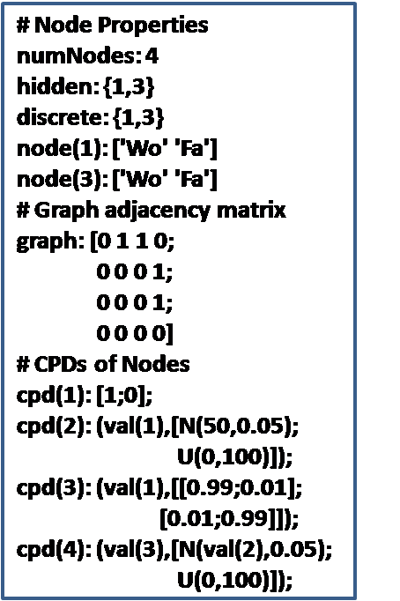
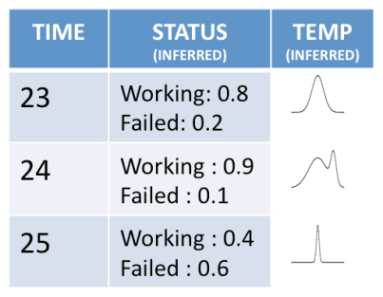
System Architecture
USER
CREATE VIEW dpmview
DPM hmm.dpm
STREAM sensors
QUERY
TRANSFORMER
VIEW
MANAGER
DPM based View
UPDATE
MANAGER
sensors
id | … | … | … | w
1 | … | … | . | .
.2 | .. | .. | . | .
PARTICLE TABLE
1 | 3 | 25

Slide 7
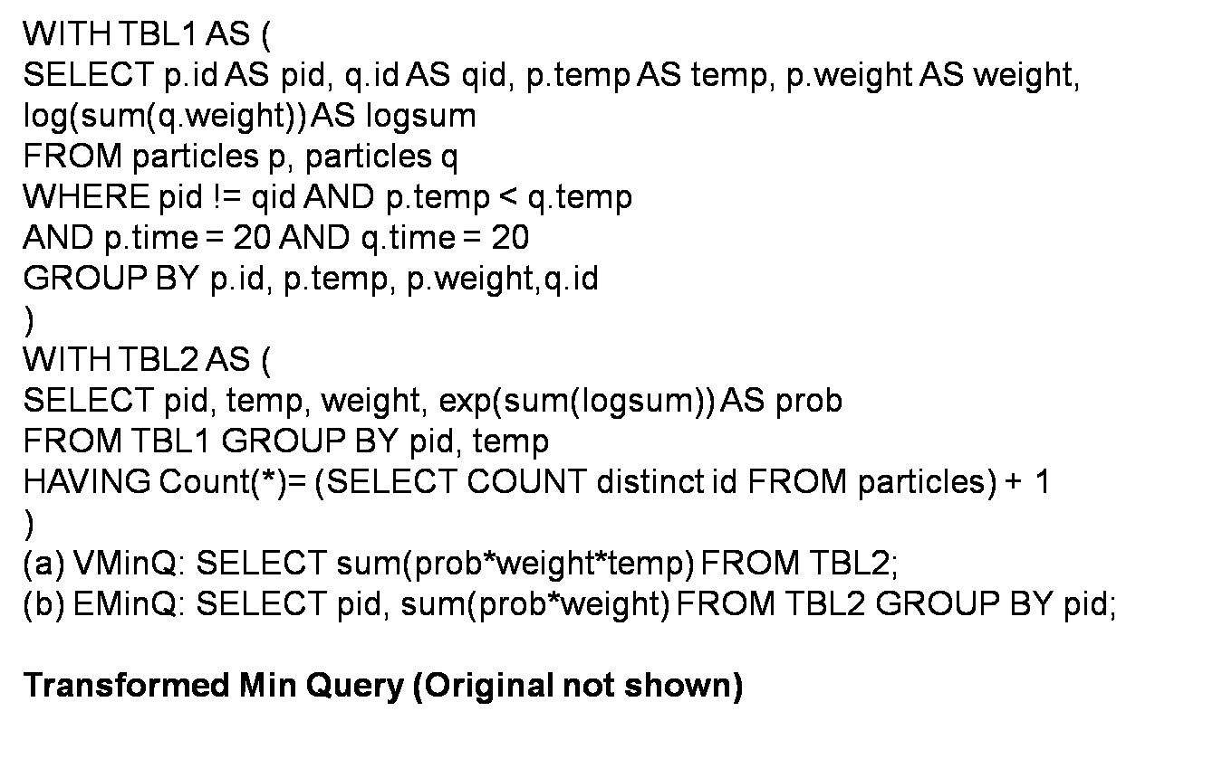
Query Processing
We currently support single-table Select, Project & Aggregate queries
SELECT temp, time
FROM dpmview
WHERE status = “W”
WITH CONFIDENCE 0.95
USER
SELECT time, SUM(temp*weight)
FROM particles p1
GROUP BY time
HAVING
0.95 <
QUERY
TRANSFORMER
VIEW
MANAGER
SELECT SUM(weight) FROM particles p2
WHERE p1.time = p2.time AND status = ‘W’
DPM based View
UPDATE
MANAGER
PARTICLE TABLE
.

Slide 8
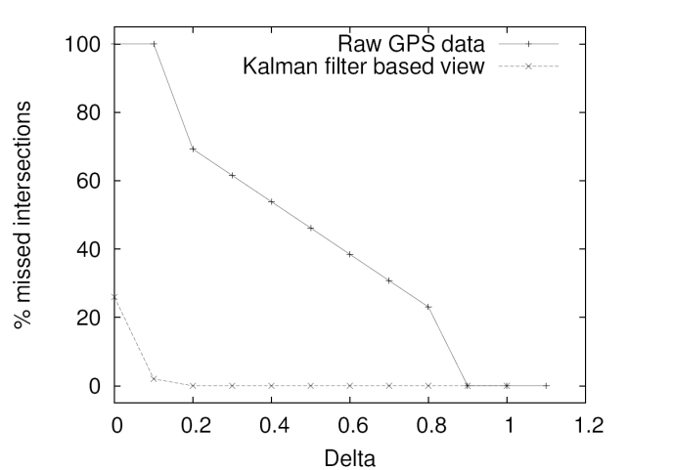
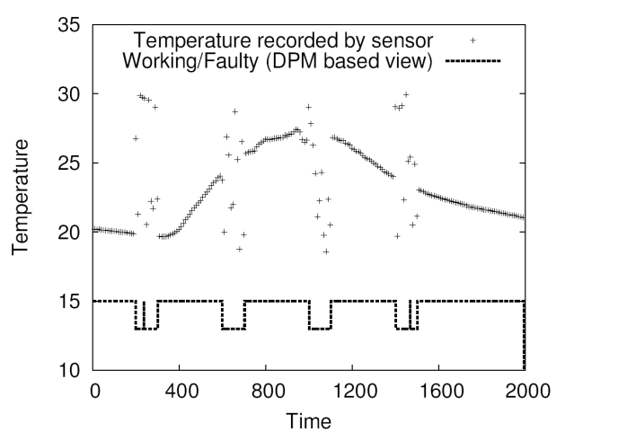
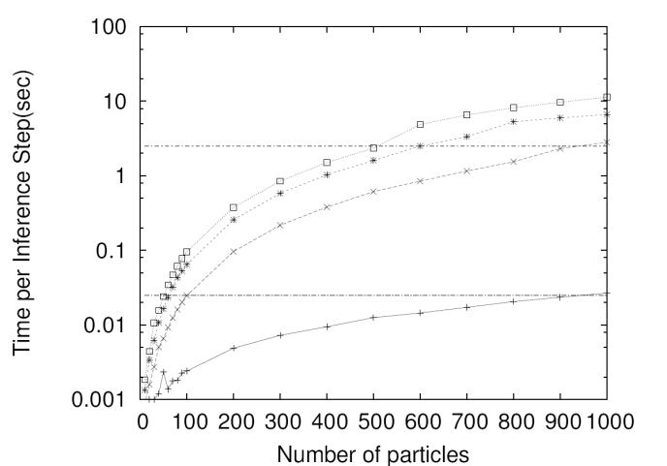
Implementation & Exp Results
Implemented in Java using Apache Derby
Data Sets
Intel Lab Sensor Dataset
Simulated GPS Moving Objects Dataset
Applying DPMs to data is critical
Inference using our system is accurate (< 2% error, N = 10) and efficient (20ms/tuple, N = 20)

Slide 9
Conclusions & Future Work
Conclusions
We extend a database system that can apply DPMs to data in real time
We have developed algorithms to execute SQL-style queries on DPMs
Ongoing Work
Representing inter-tuple correlations using Markov chains
Query processing algorithms that are aware of such correlations

Slide 10
Related Work / References
Probabilistic Databases
Nilesh N. Dalvi and Dan Suciu. Efficient query evaluation on probabilistic databases. In VLDB, 2004.
R. Cheng, D. V. Kalashnikov, and S. Prabhakar. Evaluating probabilistic queries over imprecise data. In SIGMOD, 2003.
Data Stream Processing
D. Carney et al. Monitoring streams - a new class of data management applications. In VLDB, 2002.
Sirish Chandrasekaran et al. TelegraphCQ: Continuous dataflow processing for an uncertain world. In CIDR, 2003.
Bayesian Networks & Inference Algorithms
Judea Pearl. Probabilistic Reasoning in Intelligent Systems: Networks of Plausible Inference. Morgan Kaufmann, 1988.
Arnaud Doucet, Nando de Freitas, and Neil Gordon. Sequential Monte Carlo methods in practice. Springer, 2005.
Kevin Murphy. Dynamic Bayesian Networks: Representation, Inference and Learning. PhD thesis, UC Berkeley, 2002.

