Slide 1

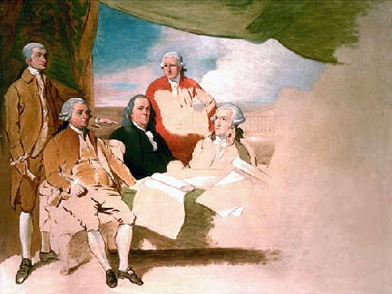
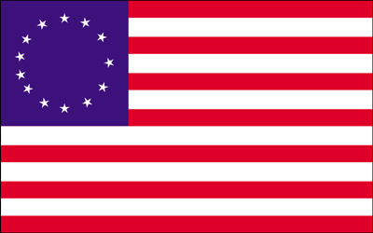
Treaty of Paris (1783)
Kevin Hogan

Slide 2
Building up to Revolution
Prior to 1776, Thirteen Colonies controlled by British
Series of legislation after French and Indian War
Variety of taxes and regulations
Colonists play bigger role in protecting Colonies
No input of elected officials from Colonies

Slide 3
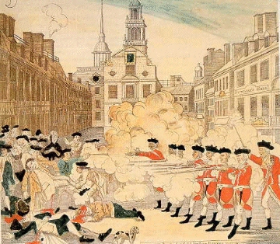
Building up to Revolution
Colonists are none too happy about the situation
Boston Massacre in 1770
Boston Tea Party in 1773 responds to Tea Act
First Continental Congress meets in 1774

Slide 4
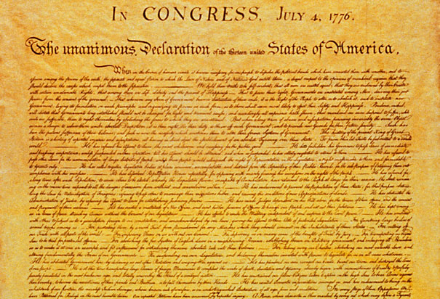
The Revolutionary War
Shot heard ‘round the world (1775)
First military action of the war
Start of Battles of Lexington and Concord
The Colonies win!... for now
British forced to evacuate Boston in 1776
Americans control the colonies
Declaration of Independence in July 1776

Slide 5
The Revolutionary War
British return to fight
Win Battle of Brooklyn in August 1776
Take New York City and New Jersey
They also fought through the south
But the Colonies get allies in 1778
French and Spanish support the effort
In 1781, the British surrendered their army at Yorktown, VA

Slide 6
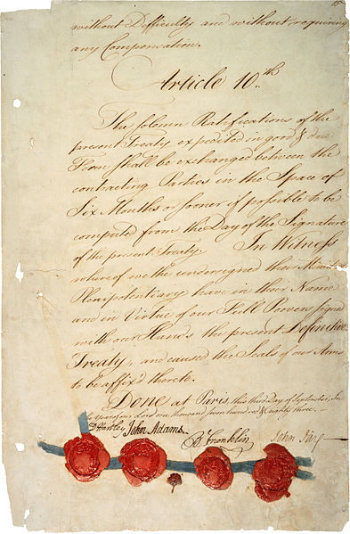
The Treaty
Peace negotiations begin in 1782
Representatives from Colonies and Britain officially sign document in 1783

Slide 7
Item 1: Colonial Independence
This was the whole reason that the Americans went to war, so it’s really important to them
British like Colonies as an economic asset, but the people didn’t support the conflict
Americans: 40 points, British: 25 points

Slide 8
Item 2: Territory Boundaries
Americans wanted as much as they could get
Suggested taking present-day Canada
British see tactical advantage in giving some land to Americans
Don’t want French or Spanish to get it
Americans: 25 points, British: 30 points

Slide 9
Item 3: Fishing Rights
The main point of contention was the Grand Banks of Newfoundland
Lots of cod and swordfish
Americans and British want this about the same, since fish is good for trading
Americans: 10 points, British: 5 points

Slide 10
Item 4: Treatment of Loyalists
Colonists bitter with peers that took side of enemy
British told Benny Franklin they wouldn’t acknowledge independence without return of confiscated property
Americans: 15 points, British: 35 points

Slide 11
Item 5: Access to Miss. River
River is of strategic importance to both parties
Provides sea access to much of North America
Both like it about the same
Americans: 10 points, British: 15 points

Slide 12
Summary of Assigned Points
Points of Contention | British Point Values | American Point Values
1. Independence of Colonies | 25 | 40
2. Boundaries | 30 | 25
3. Fishing Rights | 5 | 10
4. Loyalist Property | 35 | 15
5. Access to Miss. River | 15 | 10
TOTAL | 100 | 100

Slide 13
Applying Adjusted Winner
Points of Contention | British Point Values | American Point Values
1. Independence of Colonies | 25 | 40
2. Boundaries | 30 | 25
3. Fishing Rights | 5 | 10
4. Loyalist Property | 35 | 15
5. Access to Miss. River | 15 | 10
TOTAL | 80 | 50

Slide 14

Applying Adjusted Winner
Land area ratio is smallest.
Splitting land area:
$$80−30x=50+25 x$$
$$x=\frac{6}{11}=0.5454$$
Americans get 6/11 of land, British get 5/11

Slide 15
Applying Adjusted Winner
Points of Contention | British Point Values | American Point Values
1. Independence of Colonies | 25 | 40
2. Boundaries | 30*(5/11) | 25*(6/11)
3. Fishing Rights | 5 | 10
4. Loyalist Property | 35 | 15
5. Access to Miss. River | 15 | 10
TOTAL | 63 and 7/11 | 63 and 7/11

Slide 16
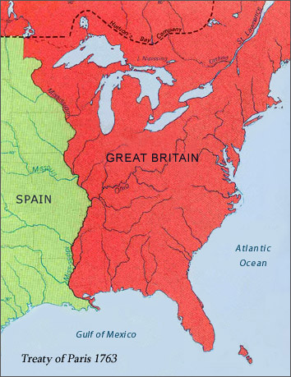
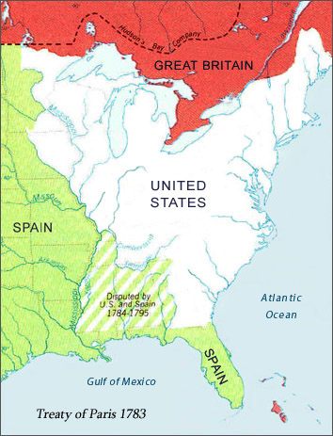
Discussion
Hard to represent desire for independence in AW
This was sort of a deal-breaker for Colonists
AW is very close on boundaries

Slide 17
Discussion
AW shows Americans get fishing rights
Reality: both share the territory
AW shows all property returned to Loyalists
Reality: a “strong suggestion” that colonists sometimes ignored
AW gives full Miss. River access to Brits
Reality: shared between both parites

