Slide 1
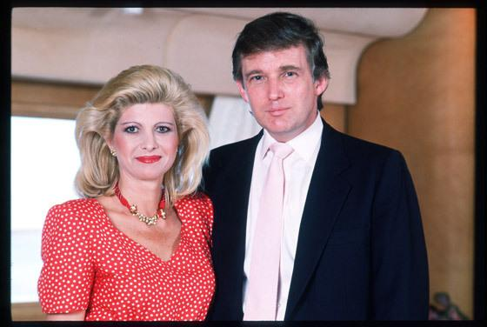
Donald & Ivana Trump Divorce Case
Brenda Shah
Hannah Klein
HONR209M

Slide 2
History of Donald Trump
Full name: Donald John Trump
Birth date: June 14, 1946 in Queens, New York
Education: New York Military Academy, Fordham University, Wharton School of Finance
Best known for: real estate mogul and billionaire. Owner of Trump Plaza and hosts The Celebrity Apprentice, owns the the Miss Universe Organization

Slide 3
History of Ivana Trump
Maiden name: Ivana Marie Zelnícková
Birth date: Feb 20, 1949 in Gottwaldov (now Zlín), Czech Republic
Occupation: Czech skier turned model, television personality
What is she doing now? Writing novels and self help books

Slide 4
History of the Marriage
Met in 1976 and got married 9 months after they met
Married 1977, married for 13 years
Had a prenuptial and postnuptial agreement
They had 3 children together: Donald Jr. (36), Ivanka (32), and Eric (29)

Slide 5
Background for Divorce
Discussions lasted for 1 year
He was rumored to have been cheating on her with his future ex-wife Marla Maples and other women
30th most expensive divorce of all time
#5 on TIME’s Top 10 Donald Trump Failures

Slide 6
Points of Dispute
Old Mercedes
Greenwich, CT Mansion
Manhattan Apartment (Trump Tower)
Florida Vacation home (Mar-A-Lago)
Child Support
Children (Donald Jr., Ivanka, and Eric)
Jewelry
$14 million cash settlement

Slide 7
Old Mercedes
After Ivana filed for divorce, Donald reposed her Mercedes
It was important to Ivana to get back the Mercedes because she claimed Donald had given it to her as a gift
Donald is reported as saying that Ivana was “nickle and diming” him for the car
Points assigned: Ivana: 20, Donald: 10

Slide 8
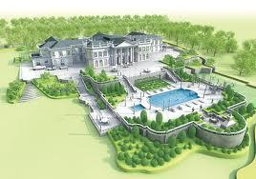
Greenwich, CT Mansion
Where the family went for long weekends and vacations
Ivana wanted the Greenwich home for the kids and as a place to vacation that was still close
Donald knew that he worked alot and does not have much time to vacation
Point values: Ivana: 25, Donald: 5

Slide 9
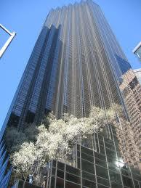
Manhattan Apartment (Trump Tower)
This is Trump’s most famous property and his pride and joy, he wanted Ivana out at all costs
The Trump clan had lots of homes in the New York area, and even though Ivan helped to build the Trump Tower, she was not as connected to it
Points assigned: Ivana: 5, Donald: 35

Slide 10
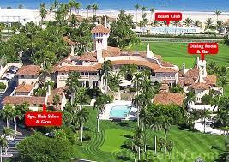
Florida Vacation Home (Mar-A-Lago)
The family home in Palm Beach which also serves as a private club for the Palm Beach elite.
Ivana wanted the home to take the children to vacation farther from home
Trump loved the Florida estate and it was his favorite place to vacation, he also wanted to opportunity to vacation there with his children
Points: Ivana:5, Donald: 15

Slide 11
$300,000 Child Support
They were very civil when working with their children, Donald knew that Ivana would have the children for the majority of the time so we was content with paying child support, but he did not want to pay as much as Ivana wanted to child support
Ivana and her children were used to a lavish lifestyle, it was very important to her that they always have enough money to maintain that lifestyle
Points assigned: Ivana: 10, Donald: 5

Slide 12
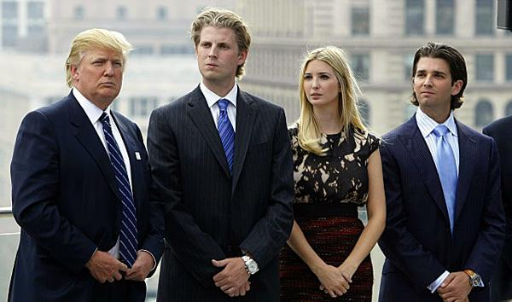
Children (Donald Jr., Ivanka, Eric)
Both were interested in what would be best for the children
Donald was devoted to his work and Ivana had more time to care for the children
They both want Ivana and Donald to have joint custody over their children and allow both parents to be strong influences in their children’s lives
Points assigned: Ivana: 15, Donald: 10

Slide 13
Jewelry
Ivana wanted to keep all of the jewelry that Donald bought her, it was very important for her to maintain her local celebrity status and to accessorize accordingly
Donald was more than happy to give Ivana most of the jewelry, however he was in debt and realized he could sell some of the more expensive pieces
Points: Ivana: 20, Donald: 5

Slide 14
$14 million cash settlement
Ivana helped Trump establish his company and build Trump Towers all across the United States, she felt she deserved some payment for her work
Trump worked hard to build his company and wanted to reap to rewards from all his hard work and time spent on his company
Points assigned: Ivana: 10, Donald: 15

Slide 15
Point Values Assigned
 | Donald | Ivana
Old Mercedes | 10 | 20
Greenwich, CT Mansion | 5 | 15
Manhattan Apartment (Trump Tower) | 35 | 5
Florida Vacation Home (Mar-A-Lago) | 15 | 5
Child Support | 5 | 10
Children (Donald Jr., Ivanka, Eric) | 10 | 15
Jewelry | 5 | 20
$14 million cash settlement | 15 | 10
Total | 65 | 80

Slide 16
Adjusted Winner Method
 | Donald | Ivana | Winner/Loser Ratio (Fluid Items Only)
Old Mercedes | 10 | 20 | 2
Greenwich, CT Mansion | 5 | 15 | 3
Manhattan Apartment (Trump Tower) | 35 | 5 | 7
Florida Vacation Home (Mar-A-Lago) | 15 | 5 | 3
Child Support | 5 | 10
Children (Donald Jr., Ivanka, Eric) | 10 | 15 | 1.5
Jewelry | 5 | 20 | 4
$14 million cash settlement | 15 | 10
Total | 65 | 80

Slide 17
Adjusted Winner Con’t
x = amount being split
Donald = 65 + 10x
Ivana = 80 - 15x
65 + 10x = 80 - 15x
25x = 15
x = 3/5
Donald = 65 + 10(3/5) = 65 + 6 = 71
Ivana = 80 - 15(3/5) = 80 - 9 = 71

Slide 18
Discussion of Results
Originally, Ivana was the winner with 8- points and Donald was the loser with 65 points.
We split the custody of the children because it was the fluid item that Ivana, the winner, won and had the lowest winner/loser ratio.
Splitting of the children allowed both of their totals to equal out at 71, where Donald gained 6 points and Ivana lost 9 points, but both are still happy.

Slide 19
Actual Divorce Settlement
Ivana received $20 million, the $14 million family estate in Connecticut, a $5 million housing allowance, retained split custody of the kids, $350,000 annual alimony, the Old Mercedes, all of her jewelry and 49% of Mar-A-Lago.
Donald received Trump Tower, retained split custody of the kids, 51% of the Mar-A-Lago, and pays child support.

Slide 20
Why our prediction was close to actual settlement
The children were the fluid item, which makes sense because both parents want the best for their children and split custody is a real thing, so both end up “winning” and getting more points.
The rest of the items were either not fluid or Donald and Ivana had very separate interests.

Slide 21
What are they up to now
After their divorce, Donald married Marla Maples and they had one daughter together, they divorced and in 2004 he married Melania Knauss who gave birth to Trump’s fifth child, Barron William Trump
Ivana married four more times, all of her marriages failed. She started a clothing company and is rumored to be currently dating one of her ex- husbands

Slide 22
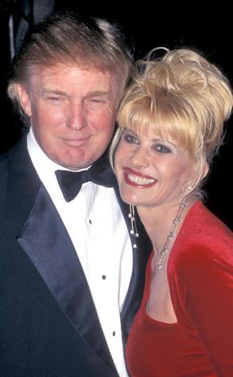

Slide 23
References
http://www.biography.com/people/donald-trump-9511238
http://www.biography.com/people/ivana-trump-9542158
http://www.people.com/people/archive/article/0,,20116915,00.html
http://www.thebiographychannel.co.uk/biographies/ivana-trump.html
http://en.wikipedia.org/wiki/Donald_Trump
http://articles.baltimoresun.com/1991-03-25/features/1991084035_1_ivana-trump-donald-and-ivana-divorce-settlement

