Slide 1
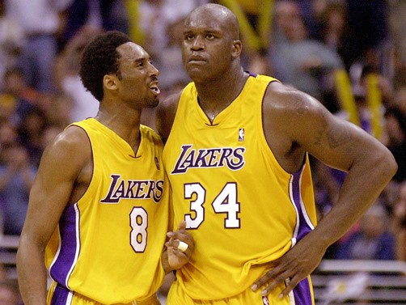
The Kobe Bryant and Shaquille O’Neal Conflict
By Joshua Bass

Slide 2
Shaq
Shaq was one of the best players in the NBA at the time and at 7’1 325 pounds, the most physically imposing player as well
Left Orlando Magic due to tensions with coach Brian Hill and because he wanted to be in a bigger media market to promote his brand
Signed with Lakers in summer of 1996 on a 7 year, $121 million contract

Slide 3
Kobe
Drafted straight out of high school in the 1996 NBA draft by the Charlotte Hornets
Traded to the Lakers on draft night
Was the youngest player to ever play in the NBA at the time of his first game
Had a steep learning curve in his first few seasons

Slide 4
Background of Tension
Shaq said “I’m not gonna be babysitting” during 1996 training camp because Kobe had a reputation of being immature and selfish
Bryant did nothing to ingratiate himself to the team, didn’t go to Shaq’s wedding and did not invite any teammates to his own wedding
Shaq carried the team to the playoffs while Bryant was a supporting player for the duo’s first 3 seasons, but they couldn’t win a championship
This angered Bryant who was obsessed with winning

Slide 5
New Coach and Success
Lakers hired Phil Jackson as coach who built teams offense around Shaq with his triangle offense
Won three straight titles from 2000-2002
O’Neal won the 2000 MVP trophy and Bryant received honors as well
Shaq still thought Kobe was playing selfishly and called him out in meetings

Slide 6
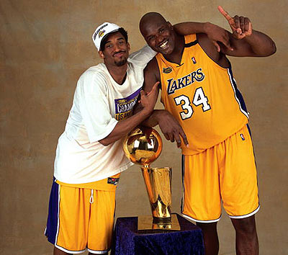

Slide 7
Relationship Deteriorates
Kobe criticized Shaq for being out of shape at the start of the 2003 season
Upset when Shaq didn’t call to give support for Bryant’s upcoming sexual assault case
Shaq thought he wasn’t getting the ball enough
This time, success could not mask problems as Lakers were upset by Detroit in the finals.

Slide 8
Relationship Deteriorates cont.
Shaq had demanded a new contract or else he wanted to be traded
Bryant felt that Shaq was letting this get in the way of the team’s success
Shaq was traded during the summer of 2004 to the Miami Heat
Kobe signed a 7 year, $136 million contract the next day

Slide 9
Points of Contention
Fame and Marketing
Playing Style
Leadership/ Camaraderie
Money
Coaching

Slide 10
Fame and Marketing
Shaq wanted to be the face of the franchise because he was concerned with his image and post-NBA entertainment career (included a rapping and acting career)
Felt as though he led them to the championships
Bryant mainly cared about winning, but didn’t want Shaq to take all the credit for the championships and wanted them to be equal
Points: Shaq 30 Kobe 15

Slide 11
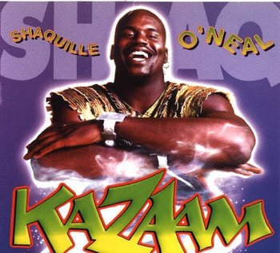

Slide 12
Playing Style
Shaq wanted to play slow and have the offense centered on him playing inside, which it did under Jackson
Kobe wanted to play up-tempo and showcase his skills which he felt weren't being used properly
Kobe wanted to get his stats up to gain recognition and step out of Shaq’s shadow
Wanted to be known as the best player in the league
Points: Shaq 15 Kobe 35

Slide 13
Leadership/Camaraderie
Shaq wanted Kobe to take on more of a leadership role because he got all of the blame when the team lost
Kobe was a loner who never went out to dinner with the team or to any other social gatherings
Kobe thought that as long as they were winning, why should he need to be a leader
Points: Shaq 15 Kobe 10

Slide 14
Money
Shaq felt the Lakers owed him a large contract because he led them to 3 championships and had been their best player for almost a decade
Yelled to Lakers owner Jerry Buss “Pay Me” after dunking in a preseason game
Money was secondary to Kobe who was focused on building his rep around the league and winning
Points: Shaq 25 Kobe 10

Slide 15
Coaching
Kobe thought that the coaches coddled Shaq and that his teammates always took Shaq’s side
Kobe felt that the coaches were too tough on him
Shaq felt that he deserved this good treatment as a veteran
Shaq had fought with coaches in the past so he needed someone who he would get along with to control his volatile personality
Points: Shaq 15 Kobe 30

Slide 16
Before Adjusted Winner
 | Kobe | Shaq
Fame and Marketing | 15 | 30
Playing Style | 35 | 15
Leadership/Camaraderie | 10 | 15
Money | 10 | 25
Coaching | 30 | 15
Total Points | 65 | 70

Slide 17
Adjusted Winner
Divide the money because it is the most fluid item
70-25x= 65+10x
5=35x
x=1/7
They each end up with 66.42 points

Slide 18
Aftermath
Shaq got a new contract and won a championship with the Heat in his 1st season with them but battled injuries and declining skill for the rest of his career
Currently works as an NBA analyst for TNT
Kobe’s teams struggled in the immediate post-Shaq years
Traded for Pau Gasol in 2008 and the duo won 2 championships together in 2009 and 2010

Slide 19
Would it have worked?
Kobe and Shaq’s personalities clashed so much that the relationship was never sustainable
Even 3 straight championships couldn’t stop the tension
The two had conflicting agendas and Bryant had contempt for Shaq’s lack of conditioning and work ethic
The difference in age made it difficult as Shaq was already in his prime and Kobe was a very young player looking to prove his value

Slide 20
Works Cited
Jackson, Phil, and Michael Arkush. The Last Season: A Team in Search of Its Soul. New York: Penguin, 2004. Print.
Plaschke, Bill. "If Only Shaq, Kobe Said It in Public." Editorial. LA Times n.d.: n. pag. Los Angeles Times. Los Angeles Times, 02 Apr. 2013. Web. 7 Nov. 2013. <http://articles.latimes.com/2013/apr/02/sports/la-sp-plaschke-shaq-20130403>.
Tribune News Service. "Shaq Details Feud with Bryant." Chicago Tribune. N.p., 31 Oct. 2011. Web. 1 Nov. 2013. <http://articles.chicagotribune.com/2011-10-31/sports/chi-shaquille-oneal-writes-about-kobe-bryant-feud-20111031_1_kobe-bryant-sexual-assault-shaquille-o-neal>.

