Slide 1
Russian-Georgian Conflict
Dariush Kafashzadeh

Slide 2
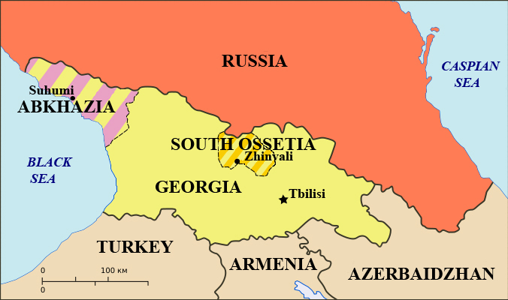
Background to Russian-Georgia Conflict
Conflict was over areas of South Ossetia and Abkhazia
These are regions that are technically part of Georgia, but have gained some independence over the years
Their de Facto independence included an internationally unrecognized government that was largely support by Russia

Slide 3
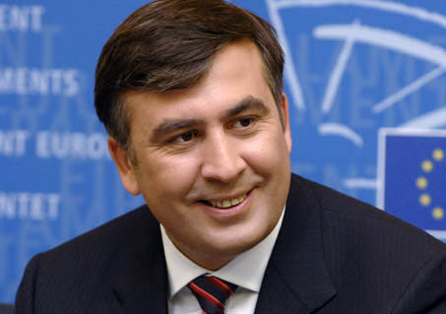
Background to Russian-Georgia Conflict
President Mikheil Saakashvili came to power in Georgia in 2003, and was re-elected in 2008 (Source D)
Was a big advocate of regaining full control over South Ossetia and Abkhazia

Slide 4
Money Talks
A brief war occurred between Georgia and South Ossetia in 2004 over the placement of Georgian troops
Russia, who supplied 2/3 of South Ossetia’s funds, become alarmed at this conflict, and began stepping up support of South Ossetia and Abkhazia under the premise of trying to maintain stability in the region (Source A)

Slide 5
Tensions Rising
Georgia disapproved of what they called Russian interference in domestic affairs
After Saakashvili’s re-election in 2008, he stepped efforts to fully integrate South Ossetia and Abkhazia into Georgia
Russia responded by officially recognizing South Ossetia and Abkhazia as independent countries, further enraging Georgia
(Source B)

Slide 6
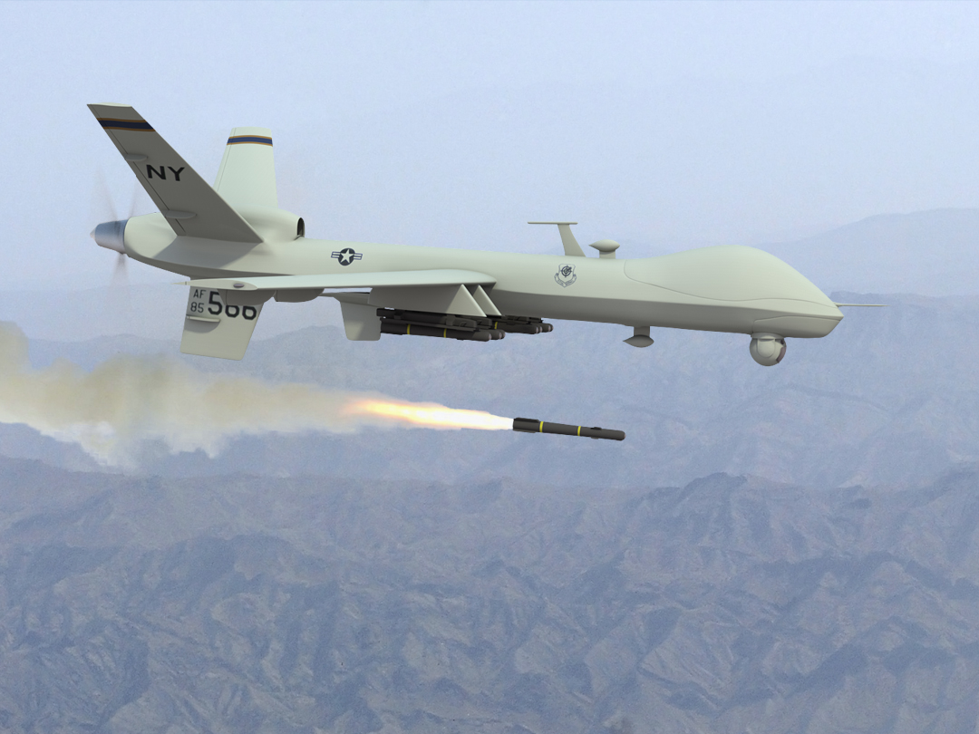
Further Escalation
Both Russia and Georgia began military built up, placing troops near the borders of South Ossetia and Abkhazia
Russians shot down a Georgian reconnaissance drone that was flying over Abkhazia
On June 14, 2008, first fighting occurred between Georgia and South Ossetia

Slide 7
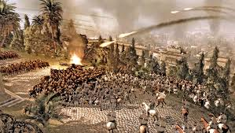
Russian Response
Soon after, Russian troops entered South Ossetia and Abkhazia, noting that since their peacekeepers had been killed in the conflict, they had a stake as well
Full fledge war broke out
between Georgia v. Russia,
South Ossetia, and Abkhazia
on August 7, 2008

Slide 8
Short but deadly
The war lasted a total of 5 days
Predictably, Georgia was badly beaten, forced out of South Ossetia and Abkhazia, and back into their own territory despite the international community’s condemnation of Russia’s over aggressive actions (Source C)
Georgia’s homeland was badly damaged in the war
Treaty negotiation began on August 12 with Russia having more leverage

Slide 9
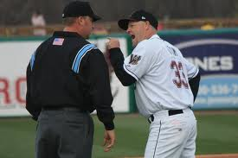
POINTS OF CONTENTION

Slide 10
Complete withdrawal of Georgian troops outside contended borders
Georgia: Although they wanted to keep troops in South Ossetia and Abkhazia, they were much more concerned with recovering and getting Russian troops out of Georgia and the contended regions. Points: 5
Russia: Were strongly opposed to Georgian troops in the region, part of their reason for entering conflict in the first place Points: 20

Slide 11
End to hostilities and removal of 9000 Russian troops in Georgia and regions of conflict
Georgia: Having suffered heavy casualties and defeats, this was the key point for the Georgians as they tried to recover. Points: 45
Russia: Were willing and able to continue the conflict, but felt they had made their point and were facing international pressure to withdraw Points: 20

Slide 12
Russian peacekeepers will take additions measures to ensure attacks from their side stop
Georgia: Georgians wanted some extra assurance that the attacks would stop so they could recover Points: 15
Russia: Saw this as a nuisance, but were planning on stopping attacks anyway Points: 8

Slide 13
Free access to humanitarian aid in Georgia
Georgia: Georgia needed and wanted all the help they could get as they recovered Points: 20
Russia: Russia had no interest in whether or not Georgia got aid, only used this a negotiating ploy Points: 2

Slide 14
A U.N. led debate of the future statuses of South Ossetia and Abkhazia
Georgia: Supported this idea, but again, their biggest concern was their own well-being Points: 15
Russia: Was vehemently opposed to a U.N. led debate, knowing they would support Georgia’s position, and they had a great interest on the statuses of South Ossetia and Abkhazia Points: 50

Slide 15
Tally
Issue | Russia | Georgia
Withdrawal of Georgian troops outside contended borders | 20 | 5
End to hostilities and removal of 9000 Russian troops in Georgia and regions of conflict | 20 | 45
Russian peacekeepers will take additions measures to ensure attacks from their side stop | 8 | 15
Free access to humanitarian aid in Georgia | 2 | 20
A U.N. led debate of the future statuses of South Ossetia and Abkhazia | 50 | 15
Total | 70 | 80

Slide 16
Adjusted Winner
The only fluid item that Georgia won would be the removal of 9000 Russian troops from Georgia and regions of conflict
70+20x=80-45x
65x=10
x=10/65 → x= 2/13

Slide 17
AW Results
Russian can keep 2/13 of their troops (or 1385 troops) in Georgia and contended regions
Withdrawal of Georgian troops outside contended borders
Free access to humanitarian aid in Georgia
Russian peacekeepers will take additions measures to ensure attacks from their side stop
NO U.N. led debate of the future statuses of South Ossetia and Abkhazia

Slide 18
What actually happened
Somewhat close to the AW results
Withdrawal of Georgian troops outside contended borders
Free access to humanitarian aid in Georgia
Russian peacekeepers will take additions measures to ensure attacks from their side stop (no way to prove this)
NO U.N. led debate of the future status of South Ossetia and Abkhazia. Status quo disagreements between Russia and Western World/Georgia remained
Russian still has around 3700 troops in/near the South Ossetian and Abkhazia border (although much of this placement violates parts of the treaty signed)

Slide 19
Conclusion
The main difference between the AW results and reality was the extra Russian troops in the contended regions
Georgia was inevitably going to get a weak deal because of their heavy losses
Georgia put most of its emphasis on healing its own country
Got an overall “fair” deal thanks to heavy international support
Russia was happy with the results

Slide 20
Sources
Russian-Georgian War: Wikipedia (Source A)
http://en.wikipedia.org/wiki/Russia–Georgia_war
August 2008 Russian-Georgian War: Timeline: Institute for War and Peace Reporting (Source B)
http://iwpr.net/report-news/august-2008-russian-georgian-war-timeline
U.S. official: Russia's attack on Georgia is 'disproportionate'(Source C)
http://www.cnn.com/2008/WORLD/europe/08/09/georgia.reax/ - Russia and Georgia Clash Over Separatist Region: New York Times (Source D) http://www.nytimes.com/2008/08/09/world/europe/09georgia.html?pagewanted=all&_r=0

