Slide 1
The Crimean War
Thomas McHale
Sri Kankanahalli

Slide 2
State of Europe: 1800s-1850s

Slide 3
State of Europe: 1800s-1850s
Britain and France expanded
Russia fell behind
Russia tried to establish ports and a navy in the Black Sea
Britain and France grew wary of Russia’s expansionism

Slide 4
State of Europe: 1800s-1850s
Also, the Ottoman Empire was collapsing
Religious conflicts between Muslims and Orthodox Christians
Russia saw an opportunity to secure valuable land

Slide 5
The Crimean War
July 1853: Under pretense of protecting Orthodox Christians, Russia invades Moldavia and Wallachia, and sieges Ottoman forts lining the Danube River
October 1853: Ottoman Empire declares war on Russia
March 1854: France and England declare war on Russia

Slide 6
The Crimean War
June 1854: The Austrian Empire enters the war on the side of the Ottomans
This would have ended the war, if not for warmongering stirred up by British public opinion and newspapers

Slide 7
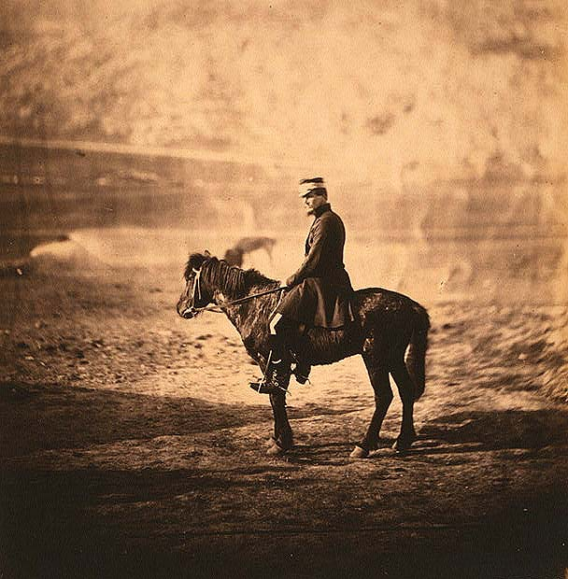
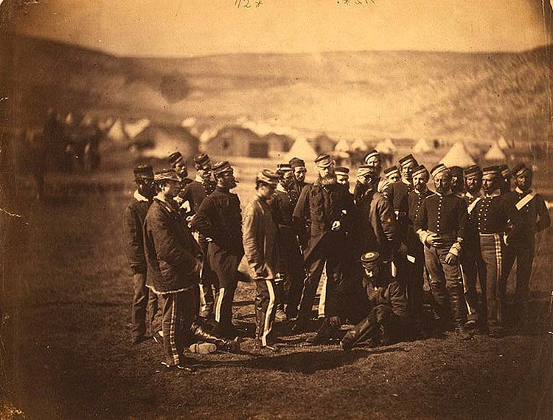
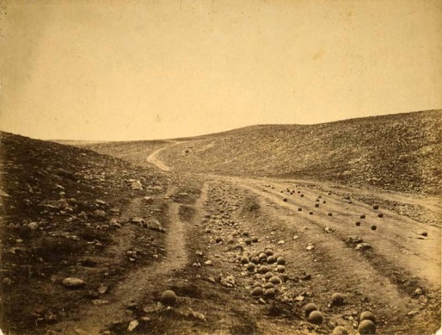
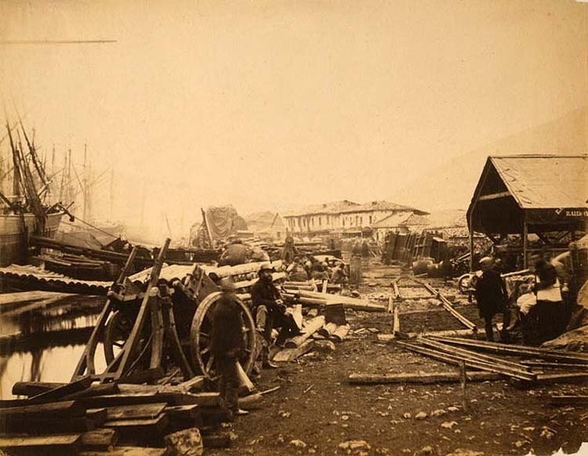
Meanwhile in Britain…
A fantastical new creation known as the “photograph” had just been invented

Slide 8
Meanwhile in Britain…
The Crimean War was the first “media war”, where the public was kept up to date daily through newspapers and photographs
This led to warmongering in newspapers, because the leaders wanted to demonstrate Britain’s military might
A large part of why the war went on so long

Slide 9
End of the War
October 1854: British and French arrive at Sevastopol, the capital of the Crimean peninsula, and begin a siege
February 1855: Tsar Nicholas catches influenza and dies
September 1855: British and French capture Sevastopol, ending Russian and French will to continue the war

Slide 10
Items on the Table
Whether there would be peace at all
Division of territory gained and lost during the war
Religious protection of Christians in the Ottoman Empire
Who could use the Danube for trade
Treatment of Circassian tribes
Who would control Russian trade routes in the Aland Islands
Russia’s right to maintain a navy in the Black Sea
Russia’s right to build forts on the coast

Slide 11
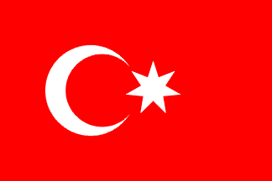
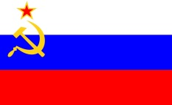
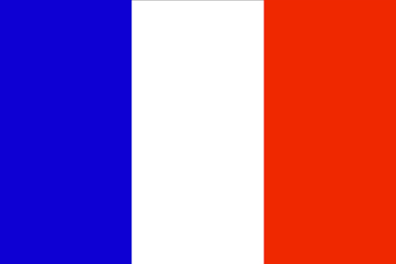
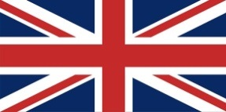
Peace or Not?
Russia and France were war-weary, and ready to make an agreement
Britain wanted the war to continue, to showcase Britain’s might
The Ottoman Empire would do whatever Britain and France did
guys can we stop fighting
i’m down if you are
GLORY TO BRITAIN
BFO: 10
Russia: 15

Slide 12
Dividing Territory
BFO were concerned about Russia’s expansion and didn’t want them to keep the territory they gained
Russia didn’t want to give up anything they had gained
TERRITORY
ok so i’m cutting
no i am
Cut-and-choose is envy-free.
BFO: 15
Russia: 20
who are you and how did you get in my house

Slide 13
Protecting Orthodox Christians
Russia kind of cared about the Orthodox Christians, but mainly used it as an excuse to invade the Ottomans
BFO didn’t really care or have a cohesive view
do you really care about these guys?
nah not really lol
yeah me neither
BFO: 2
Russia: 5

Slide 14
Control of the Danube
BFO and Russia both considered the Danube a major trading resource
BFO wanted to control it, so it could control access to the Black Sea
Russia valued it, but valued the actual Black Sea more
BFO: 15
Russia: 12

Slide 15
The Circassian Tribes
Tribes which Britain had convinced to rebel against Russia
Britain wanted to make sure they weren’t harmed, but didn’t care THAT much
Russia wanted to do whatever it wanted to them, but it wasn’t really a major issue
you really want to hurt these incredibly nice people?
yes.
kk go for it
BFO: 3
Russia: 5

Slide 16
Control of the Aland Islands
Islands which Russia had sea routes along
BFO wanted Russia to lose control, in order to limit its trade/naval power
Russia wanted to keep them, but recognized its navy was not a match for Britain’s or France’s
BFO: 15
Russia: 10

Slide 17
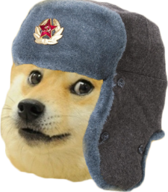
Russia’s Navy in the Black Sea
BFO’s main focus was limiting Russian expansion into the Black Sea
BFO was most concerned about Russia’s navy
Russia cared a lot about its navy, but cared more about their right to build forts along the sea
much economic potential. wow.
why are you a dog
BFO: 25
Russia: 13

Slide 18
Russia’s Forts in the Black Sea
Britain wanted to use this point to force Russia out of the peace settlement, and the others didn’t want Russia to build forts either
Russia cared a lot about its right to build forts
BFO: 15
Russia: 20

Slide 19
Final Breakdown
Issue | BFO | Russia
End of the war | 10 | 15
Territory | 15 | 20
Religious protection | 2 | 5
Control of the Danube | 15 | 12
Circassian tribes | 3 | 5
Aland Islands | 15 | 10
Black Sea: Navy | 25 | 13
Black Sea: Forts | 15 | 20
Total | 55 | 65

Slide 20
Adjusted Winner
Selected territory as the item to split
55 + 15x = 65 - 20x
x = 0.285
What this means in context:
Russia returns the city of Kars, which it had captured during the war (its only major victory)
Russia keeps the region of Bessarabia, which it had seized from the Ottomans in the early 1800s

Slide 21
Adjusted Winner Results
The war ends
Russia keeps Bessarabia and returns Kars
Orthodox Christians are protected by Russia
BFO gets control of the Danube
Russia can do what it wants with the Circassians
Russia cannot build forts on the Aland Islands
Russia cannot build a navy in the Black Sea
Russia can build forts along the coasts of the Black Sea

Slide 22
Treaty of Paris
The war ends
Russia loses a third of Bessarabia and all of the territory surrounding Kars
Orthodox Christians are protected, but by the French, not Russia
The Danube was neutralized, preventing anyone from building forts along it
Russia can do what it wants with the Circassians

Slide 23
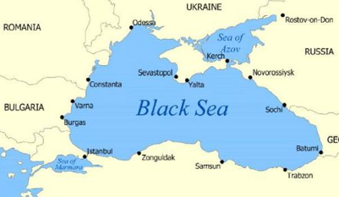
Treaty of Paris
The Aland Islands were neutralized, preventing Russia from building forts along it
Russia wasn’t allowed to build a navy in the Black Sea, but could maintain ports
Russia was not allowed to keep forts along the Black Sea, but can keep some along the Azov Sea, north of the Black Sea

Slide 24
Conclusion
Fairly accurate, but in the actual Treaty of Paris, many more items were split
The majority of discrepancies can be attributed to two things
The AW method is designed to split one item, not several
Russia was more willing to compromise because public opinion of the war had fallen rapidly, creating internal pressure
In the end, the Crimean War majorly altered the balance of power in Europe

Slide 25
References
Curtiss, J.S. (1979). Russia’s Crimean War. Durham, North Carolina: Duke University
Cook, B. W. (Ed.). (1973). The Crimean War: Pro and Con. New York, New York: Garland.
Ffrench Blake, R.L.V. (1972). The Crimean War. Hamden, Connecticut: Archon Books.
Lambert, A. (1994). The War Correspondents: The Crimean War. Phoenix Mill. United Kingdom: Alan Sutton Publishing
Roddy, Zach Alexander. (2013). “Doge with Russian hat.” Oakland Hall, College Park: Adobe Photoshop. 21 November 2013. FDA approved. No animals harmed.

Slide 26
References
http://www.allworldwars.com/Crimean-War-Photographs-by-Roger-Fenton-1855.html
http://www.cglearn.it/mysite/wp-content/uploads/2012/08/afternoon-tea-high-tea.jpg
http://www.clas.ufl.edu/users/oren/Ottoman%20Empire,%20decline.gif
http://www.cs.umd.edu/~gasarch/PICTURES/billvdw.jpg
http://deltas.usgs.gov/images/danube.jpg
http://media.web.britannica.com/eb-media/74/92674-004-3F09657D.jpg
http://upload.wikimedia.org/wikipedia/commons/2/2e/Panorama_dentro.JPG
http://www.orthodoxinfo.com/images/decani/brotherhood.jpg
http://www.prints-4-u.com/store/image2/P1251854/P1251854333.jpg
http://www.russianwarrior.com/STMMain.htm?1854_crimeanhist.htm&1
http://www.worldatlas.com/webimage/countrys/europe/fialand.gif

