Slide 1
The Russo-Japanese War
Liz Demetrides

Slide 2
Background
Russia and Japan were both interested in developing spheres of influence in the Far East.
Japan gained dominance in Korea from the Sino-Japanese war.
Russia gained dominance in Manchuria from the Boxer Rebellion.
Both Japan and Russia wanted their power in these countries recognized.

Slide 3
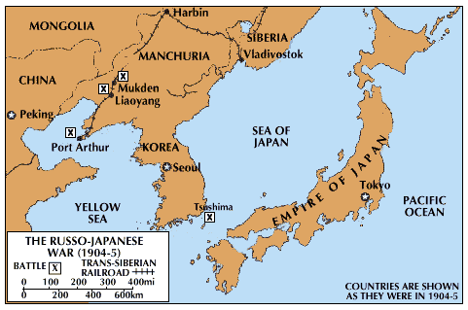

Slide 4
Pre-War negotiations
Japan offered to recognize Russian dominance in Manchuria in exchange for Russia to recognize Japan’s dominance in Korea.
Russia refused Japan’s offers knowing that Japan’s military was much weaker.
But Japan had signed the Anglo-Japanese alliance with Britain in 1902.

Slide 5
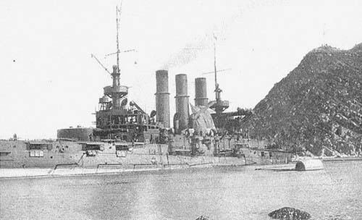
Start of the War
By 1904 negotiations were failing.
When Russia failed to respond to one of Japan’s propositions, Japan was ready to declare war
On February 8, 1904, the Japanese Imperial Navy attacked at Port Arthur.

Slide 6
The War
The war took place primarily in Southern Manchuria and the Sea of Japan and the Yellow Sea.
The Japanese were the clear underdogs.
The success of Japanese campaigns was unexpected by everyone

Slide 7
Contested Items
The war began over the issues of Russian control of Manchuria and Japanese control of Korea, but by the end there were several additional issues that needed to be negotiated.
Manchuria
Korea
Sakhalin Island
War Costs
Pacific Fleet

Slide 8
Russian Dominance in Manchuria
Russia had been fighting for influence in Manchuria, but by the end of the war, Russia was more concerned about other issues. Japan felt more strongly since they had defeated Russia over this issue.
Russia: 10
Japan: 25

Slide 9
Japanese Dominance in Korea
Again, this is what Japan had been fighting for, so they strongly believed they deserved their power in Korea.
Russia: 10
Japan: 30

Slide 10
Sakhalin Island
Japanese had occupied Sakhalin Island in the Battle of Tsushima in order to force Russia into suing for peace, so control of the island was in question. Both countries felt the island was rightfully theirs.
Russia: 20
Japan: 20

Slide 11
War Costs
As the victor, Japan wanted Russia to pay war costs. Russia was itself left financially crippled by the war and insisted on this point.
Russia: 20
Japan: 40

Slide 12
Pacific Fleet
The war had also decimated two of Russia’s three fleets, and Russia wanted to be able to maintain its remaining Pacific fleet.
Russia: 5
Japan: 20

Slide 13
First Pass
ITEMS | JAPAN | RUSSIA
Manchuria | 25 | 10
Korea | 30 | 10
Sakhalin Island | 20 | 20
War Costs | 20 | 40
Pacific Fleet | 5 | 20
TOTAL | 75 | 60

Slide 14
Some fluid Item must be divided.
As the valuations of Sakhalin Island are in ratio 1:1, it is optimal to divide this if possible.
75 - 20x = 60 + 20x
=> x = 3/8

Slide 15
Final Assignments
ITEMS | JAPAN | RUSSIA
Manchuria | 25 | 10
Korea | 30 | 10
Sakhalin Island | 12.5 | 7.5
War Costs | 20 | 40
Pacific Fleet | 5 | 20
TOTAL | 67.5 | 67.5

Slide 16
Actual Results
Treaty of Portsmouth
Differences:
  Japan was given control of Manchuria
  Japan retained only the southern half of Sakhalin Island
Overall, adjusted winner closely matched reality

Slide 17
Bibliography
http://en.wikipedia.org/wiki/Russo-Japanese_War#Campaign_of_1905
Text in Correspondence Regarding Negotiations... (1903–1904) pp. 7-9 and 23-24.
http://www.russojapanesewar.com
http://history.state.gov/milestones/1899-1913/portsmouth-treaty

