Slide 1
Design

Slide 2
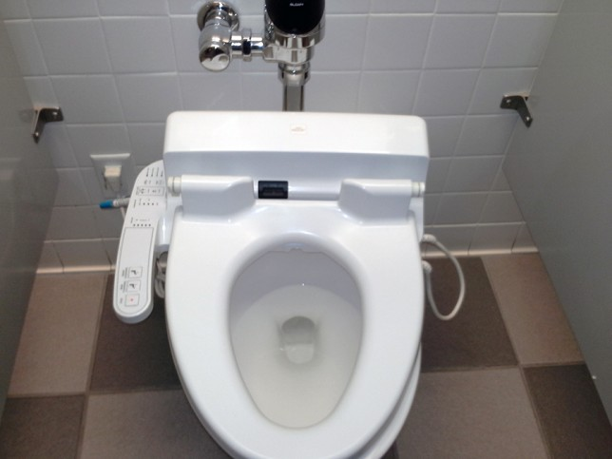

Slide 3
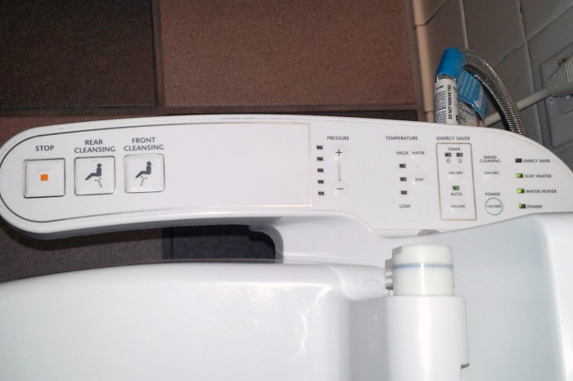

Slide 4
Design Process
Where do ideas come from?
Many processes:
  Waterfall model
  Iterative Model
  System centered design
  User centered design
  Participatory design
  Designer centered design

Slide 5
Ahead of Time
What are the tasks?
  Potentially, what are the actions for each task
What are the user preferences?
What are other requirements?
Consider all aspects of usability when designing

Slide 6
Traditional Development Models
Requirements
Design
Development
Testing
Requirements
Design
Development
Testing
Linear
(“waterfall”)
Iterative
Notes:
Waterfall – 100% complete before moving to the next stage. Emphasis on documentation.

Slide 7
System Centered Design
What can be built easily on this platform?
What can I create from the available tools?
What do I as a programmer find interesting to work on?

Slide 8
User Centered Design
Design is based upon a user’s
  Abilities and real needs
  Context
  Work
  Tasks
  Preferences
Golden rule of interface design:
“Know The User”

Slide 9
User Centered Design
... is based on understanding the domain of work or play in which people are engaged and in which they interact with computers, and programming computers to facilitate human action. ...
Three assumptions:
  The result of a good design is a satisfied customer
  The process of design is a collaboration between designers and customers. The design evolves and adapts to their changing concerns, and the process produces a specification as an important byproduct
  The customer and designer are in constant communication during the entire process
Denning and Dargan

Slide 10
Participatory Design
Problem
  intuitions wrong
  interviews etc. not precise
  designer cannot know the user sufficiently well to answer all issues that come up during the design
Solution
  designers should have access to pool of
  representative users. That is, END users,
  not their managers or representatives

Slide 11
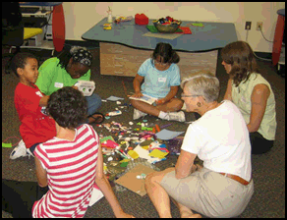
Participatory Design
Users become first class members in the design process
    active collaborators vs passive participants
Users considered subject matter experts
    know all about the work context
Iterative process
    all design stages subject to revision

Slide 12
Brainstorming
Seed the brainstorm
  Topic statement
Get physical
Follow the rules (IDEO)
  Stay focused
  One conversation at a time
  Encourage wild ideas
  Defer judgment
  Build upon idea from others
Number your ideas
Target:
  100 ideas per hour
Notes:
Sitation by Linus Pauling
The most problematic object in your life.
What shall we not do?

Slide 13
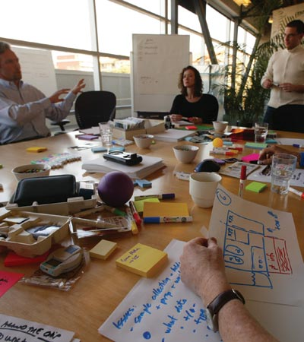
The IDEO Design Process
Understand
Observe
Implementation
Design Process
Evaluate and Refine
Visualize and Predict
(Ideate)
IDEO shopping cart
Notes:
Play video from TED site, not youtube

Slide 14
Designer Centered Design
“It isn’t the consumers’ job to know what they want.”
-- Steve Jobs

