Slide 1
Design and Qualitative Analysis

Slide 2
Why is Usability Important?
We are not the users
Even design experts don’t think the same way as all other humans
Users are always right
If a user can’t do what they want, the application is broken
Decreases development costs (i.e., fewer revisions)
Increases revenue higher customer satisfaction => better reviews and more referrals, etc.

Slide 3
What Does Usability Measure?
Many things, but these are easiest to measure (in decreasing order of commonality):
Error frequency and severity (accuracy)
Efficiency of use (speed)
Learnability
Memorability
User preference

Slide 4
Usability Methods
No Users:
Cognitive Walkthrough
Task oriented
Examined by experts
Heuristic evaluation
Interface oriented
Examined by experts
With Users:
Focus group
General discussion
Usability test
Task & interface oriented

Slide 5
Cognitive Walkthrough
Requirements:
Description or prototype of interface
Task description
List of actions to complete task
User background
What you look for:
Will users know to perform the action?
Will users see the control?
Will users know the control does what they want?
Will uses understand the feedback?

Slide 7
Heuristic Analysis
“Rules of thumb” that describe features of usable systems
Can be used as design principles
Can be used to evaluate a design
Pros and cons
Easy and inexpensive
Performed by expert
No users required
Catches many design flaws
More difficult than it seems
Not a simple checklist
Cannot assess how well the interface will address user goals

Slide 8
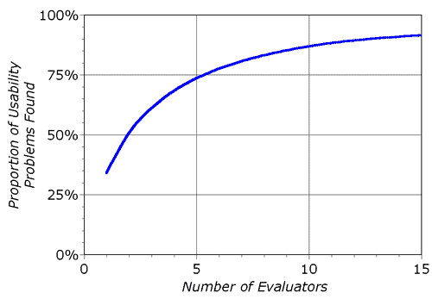
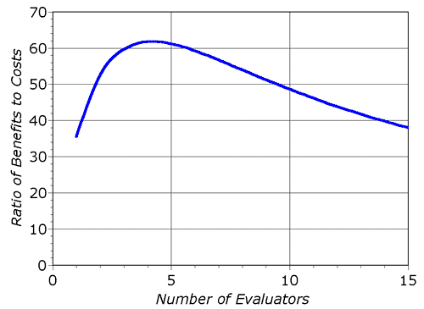
Heuristic Analysis – “Usability Engineering”
Introduced by Nielsen (1994)
Can be performed on working UI or sketches
Requires a small set of evaluators to examine the UI
Check compliance with usability principles
Each evaluator works independently
Go through the interface several times with different perspectives
All reviews are aggregated in one final usability report

Slide 9
Nielsen's evaluation phases (1-2)
Pre-evaluation training
Provide the evaluator with domain knowledge if needed
Evaluation
First step: get a feel for flow and scope
Second step: focus on specific elements
Multiple passes is better
Create a list of all problems
Rate severity of problem
Notes:
4 steps: Pre evaluation, Evaluation, Rating, debriefing.

Slide 10
Nielsen's evaluation phases (3)
Severity rating
Performed by individuals, then aggregated
Establishes a ranking between problem
Reflects frequency, impact and persistence
Cosmetic, minor, major and catastrophic
Notes:
So as described here this heuristic can be used in many different way: It was first intended to be used during the evaluation phase of the project, but I think this rules are also very useful during the idea selection phase an will be more useful for you at this point in the course. Furthermore I believe that this rules are very useful to illustrate how the theories we study before are related to design.

Slide 11
Nielsen's evaluation phases (4)
Debriefing
Discuss outcome with design team
Suggest potential solutions
Assess how hard things are to fix

Slide 12
Nielsen’s heuristics
Simple and natural dialog
Speak the users’ language
Minimize user memory load
Consistency
Feedback
Clearly marked exits
Shortcuts
Prevent errors
Good error messages
Provide help and documentation
Notes:
So what I would like to do during the next two lecture is to go through each of these rules in turn and see how what we learn before relate to these rules.

Slide 13
Example Analysis
Analyze http://www.runwashington.com/ and specifically the race calendar features
Browse race calendar, search for races of a specific length, etc.
As a group, have each person analyze independently, then aggregate scores with severity ratings.
Report back as class

Slide 14
Usability Study – Qualitative
Gather user’s perception of the interaction
Concerned more about ability to use system than how much they like it
Methods
Direct observation
Simple observation
Thinking aloud
Constructive interaction (co-discovery)
Indirect
Interviews
Questionnaires / Surveys
Notes:
The qualitative approach goal is to gather information about the perceoved quality of the interaction. Its methods often involve a human judgement
Interviews questionnaires ans surveys (as explain in the reading how many of you have use the a survey or a questionnair for the first phase of the design?)
Introspection (Walkthroughs), direct observation where the designer or its representativue observe users manipulating the interface, thinking aloud when the user is ask to introspectively comments about their action as they are using the interface or constructive interaction when a small team of user is ask to collaborate toward accomplishing a task using the interface. And I will go in more detail on each of these next lecture.

Slide 15
Direct observation
Observing (and recording) users interacting with the system
In field (preferred) or lab
For a set of pre-determined tasks or through normal duties
Be prepared!
Excellent at identifying gross design/interface problems
Three general approaches:
simple observation
think-aloud
constructive interaction

Slide 16
Be prepared!
Select the correct population
Set objectives and tasks
Realistic
Informative
Hardware
Computer, video equipment…
Software
Up and running, properly debugged…
Facilitator
Using a checklist might be useful
Practice!

Slide 17
Creating tasks
Describe in terms of end goals
Specific and realistic
Doable
Not too long (< 5-10 minutes each), or shorter

Slide 18
Recording observations
Need a record
Further analysis
Proof during discussion
Techniques
Paper and pencil
Simple to set up
Free form
Coding scheme
Might be biased
Audio/Video recording
More accurate
Time consuming to analyze
Encoding is a time consuming process
From “Observing the user experience” (Kuniavsky)
Notes:
The first thing that is important is to be sure to record your observations because it is very easy to forget detail, but also it might be very useful later on to have the data either for future analysis or simply to show to developpers or your management that yes users are really doing what you are saying they do.
Paper and pencil: I like this method because it is strait forward, easy to go by and it works very well but because I am the person taking niote it is of course biases. A very important point is that people and company are more tolerant to that that any other method of recording (In fact for the very reason that they are not an accurate representation of reality)
But if you can it is always best to have a Video recording. I think that video is a great tool because it allow you to see things you cannot se otherwise. Obviously that come at a cost of a long time to encode

Slide 19
Simple observation method
Evaluator observes users interacting
Sometime behind a half-silvered mirror
Drawback
No insight into the user decision process or attitude

Slide 20
The think aloud method
Subjects are asked to say what they are thinking/doing
What they believe is happening
What they are trying to do
Why they took an action
Widely used in industry
Drawbacks
Awkward/uncomfortable for subject (thinking aloud is not normal!)
“Thinking” about it may alter the way people perform their task
Hard to talk when they are concentrating on problem
Notes:
OK The think aloud method. Subjects are asked to say what they are doing and thinking. So this method is widely use in the industry but it has drawback because it is often odd to speak and do the something at the sametime. And as I said before it is hard to talk and solve a problem at the same time.
Lets try one example.

Slide 21
Facilitator’s Roles
Support participant
Support designers/developers
Accurately collect data

Slide 22
The Constructive Interaction Method
Two people work together on a task
Normal conversation between the two users is monitored
removes awkwardness of think-aloud
Variant: Co-discovery learning
Use semi-knowledgeable “coach” and naive subject together
Make naive subject use the interface
Drawback
Need a good team
Notes:
Constructive methods
In that case 2 people are working together and you monitor the conversation between them. The underlying idea is that the conversation is a by product of what is going on behind the schene and will help you undersatn that while introducing less distortion.
Of course you need a good team.

Slide 23
Debriefing
Post-observation interviews
Questions from your notes
Questions from users diary
Questions from a video footage
Pros and Cons
Avoids erroneous reconstruction
Provide many constructive suggestions
Time consuming
But extremely valuable

Slide 24
Quick Study Option 1
Break up into groups of 3-4
Have participant that doesn’t know http://www.usatf.org/routes/map/ visit
Use think aloud protocol to do these tasks:
Find a running route that’s between 3 and 6 miles that starts on campus in college park
Create your own running route that starts at Hornbake. It should be at least 3 miles and run on roads/paths
Then we’ll get back together and briefly report

Slide 26
Quick Study Option 2
Choose a website
Develop 3 important tasks
We will then have members of groups switch. Preferably get someone who does not know your site well.
Using the think aloud protocol, have your subjects do the tasks.
Report back

Slide 27
Interviews
Method
Pick the right population
Individual or group discussion
Be prepared
Plan a set of central questions
Probe more deeply on interesting issues as they arise
Focus on goals not technology
Find the root of the problem
Pros and cons
Very good at directing next design phase
Provide many constructive suggestions
Subjective
Do not ask leading questions
Time consuming

Slide 28
Leading questions
“Is the daily update an important feature to you?”
vs.
“What are your thoughts about the daily update”
“Should we add support for auto-completion?”
vs.
“What would you like in a tool?”
Good questions:
Are open-ended
Avoid binary answers
Allow silence

Slide 29
Questionnaires and surveys I
Method
Pick the population
Demographics and sample size
Between 50 and 1,000 subjects
Establish the purpose of the questionnaire
What information is sought?
How would you analyze the results?
Establish the means of delivery/collection
On-line
Direct interaction with users
Walking in the street
Post-user testing
Surface mail
including a pre-addressed reply envelope gives far better response
Notes:
Running a questionnaire is like running an experiement: you have to know what you want to demonstrate before running the experiment!

Slide 30
Open ended questions
The user answers in his/her own words
Can you suggest any improvements to the interfaces?
Good for general information
Difficult to analyze
Need for a coder
Can complement closed questions

Slide 31
Caveats…
Observing people is often helpful. But this does not mean:
That if you observe people, your idea is by definition good.
If you come up with an idea without observing people, your idea is by definition bad.

Slide 32
Questionnaires and surveys
Pros and cons
Preparation is expensive
Need to design and debug the questionnaire
Can reach a large population
But often a low return rate
Sample not necessarily representative
As good as the questions asked
Data collection can be tedious
Use automatic forms for large volume
Open ended questions hard to analyze

Slide 33
Questionnaires and surveys II
Method
Design the questionnaire
Don’t forget to debug it!
Deliver
Collect and analyze the data
Establish the main findings

Slide 34
Closed questions
Supply possible answers
Easy to analyze
Limits expressiveness

Slide 35
Style of closed question: Scalar
Likert Scale
Characters on the computer screen are:
hard to read easy to read
1 2 3 4 5
Be sure to pick odd numbers of choice
Often 5 or 7

Slide 36
Style of closed question: Multi-choice
Which types of software have you used? (tick all that apply)
[ ] word processor
[ ] data base
[ ] spreadsheet
[ ] compiler
Can be exclusive or inclusive
Be specific:
Do you use computers at work:
[ ] often [ ] sometimes [ ] rarely
Vs …
Do you use computers at work:
[ ] more than 4 hrs [ ] between 1 and 4 hrs [ ] less that 1 hrs

Slide 37
Style of closed question: Ranked choice
Rank the usefulness of these methods of issuing a command
(1 most useful, 2 next most useful..., blank if not used)
__2__ command line
__1__ menu selection
__3__ control key accelerator
Helpful to understand users preference
Rating vs. Ranking?

