Slide 1
Qualitative vs. Quantitative
Slides taken from Ben Bederson
Qualitative: Develop understanding of human experience
Quantitative: Objectively measure human performance
Less about more vs. more about less
When are each appropriate?
Notes:
The act of getting a phd is to know absolutely everything about nothing

Slide 2
Quantitative Evaluation
Gather (performance) measurements
Methods
User interaction collection (i.e., logging)
Mouse clicks, keys pressed,…
Data collected during system use
Google, Amazon
Controlled experiments
Set forth a testable hypothesis
Manipulate one or more independent variable
Observe effect on one or more dependent variable
Can be reproduced by others
Notes:
Goal of controlled experiments is to know that results aren’t due to chance
Example: Does caffeine intake affect the ability of people to recall a list of words?
independent variable: caffeine intake
dependent variable: ability to recall the words

Slide 3
Controlled experiment
State a lucid, testable hypothesis
Identify independent and dependent variables
Design the experimental protocol
Choose the user population
Apply for human subjects protocol review (IRB)
Run some pilot participants
Fix the experimental protocol
Run the experiment
Perform statistical analysis
Draw conclusions
Communicate results

Slide 4
Experiment Design
Is it reliable (repeatable)?
Will you get the same result if someone else repeats the experiment?
Confounding variables?
Does the experiment take into account variations between subjects?
Is it valid?
Does the experiment reflect target use?
Were users typical?
Were tasks typical?
Was the setting realistic?
Was the experience biased?
Notes:
Non-reliable:
* Time of day biased results (confounding variable)
Invalid:
* Undergrads not representative of actual market
* Clicking rapidly between items disregarded time to think about how to use calculator

Slide 5
Are results significant?
Statistical significance
Is observed result is due to chance?
Type I errors are the most disruptive
Design significance?
3.00s versus 3.05s?
Researcher’s Decision | Actual Situation
 | NO effect | Effect
NO effect | Correct decision | Type II error
Effect | Type I error | Correct decision

Slide 6
Are results significant?
Statistical significance
Comparing to the null hypothesis: “There is no effect”
Type I errors are the most disruptive
Design significance?
3.00s versus 3.05s?
Researcher’s Decision | Actual Situation: Null Hypothesis is
 | True | False
Fail to reject the null hypothesis | Correct decision | Type II error
Reject the null hypothesis | Type I error | Correct decision

Slide 7
Example
Examine value of animation during scrolling [Klein & Bederson 2005] http://portal.acm.org/citation.cfm?doid=1056808.1057068
Various reading tasks
For various document types
While scrolling with varying kinds of animated transitions

Slide 8
State a lucid, testable hypothesis
“Animated scrolling will speed up reading and decrease errors, especially for plain documents.”

Slide 9
Choose the variables
Manipulate one or more independent variable (the thing you change)
Document type
Animation speed
Observe effect on one or more dependent variable (the thing you measure)
Time to completion
Accuracy (i.e., error rate)

Slide 10
Design the experimental protocol
Between or within subjects?
Between subjects: each subject runs one condition
- Need more subjects
Difference between subjects might introduce a bias
+ No learning effects across conditions
Within subjects: each subject runs several conditions
+ Need fewer subjects
+ No bias across participants
Possible learning effect across conditions
Which tasks?
Must reflect the hypothesis
Must avoid bias
Instructions, ordering…
In doubt, always favor the null hypothesis
Notes:
How might you handle learning effects?

Slide 11
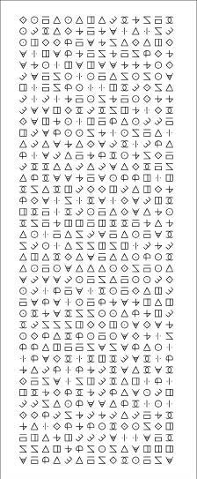
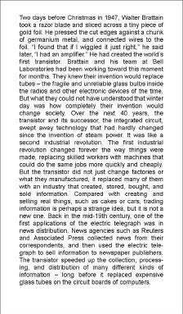
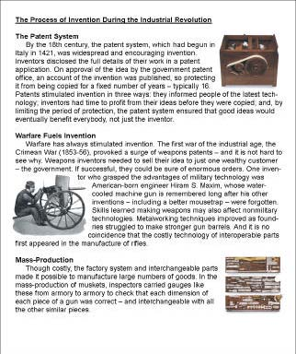
Design the experimental protocol
Running Example:
Reading while scrolling
Notes:
Hypothesis: landmarks will help, and thus decrease the benefit of animation
2 reading tasks, 1 counting task

Slide 12
Chose the user population
Pick a well balanced sample
Novices, experts, average
Age group
Gender…
Population group may be one of the independent variables
Running example
Varied population, did not control

Slide 13
Run the experiment
Always run pilots first!
There are always unexpected problem!
When the experiment has started you cannot pick and choose
Use a check-list so that all subjects follow the same steps
IRB - Don’t forget the consent form!
Don’t forget to debrief each subject
Notes:
People not confortable with aparatus
People tricking the logging mechanism

Slide 14
Run statistical analysis
Properties of our result data
Mean, variance…
How different data sets relate to each other
Are we sampling from similar of different distributions?
Probability that our claims are correct
Statistical significance:
“The hypothesis that technique X is faster is accepted (p < .05)”
means that there is a higher than 95% chance the hypothesis is true
Typical levels are .05 and .01 level
These levels are socially determined

Slide 15
Statistical tools I - Descriptive
Mean
Average
Median
Central value
Standard Deviation
Measure of variation

Slide 16
Statistical tools I - Descriptive
Correlation
Measure the extent to which 2 concepts are related
Caveats
Correlation does not imply cause and effect (hidden variable)
Ice cream consumption and drowning
Third variable problem
Directionality problem
Need a large enough group
r = 0 (no correlation)
r = 1 (positively correlated)
r = -1 (negatively correlated)

Slide 17
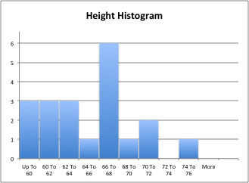
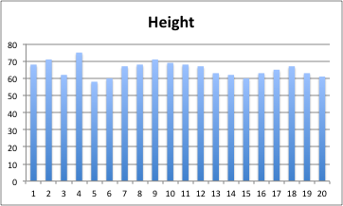
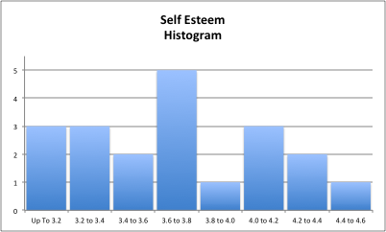
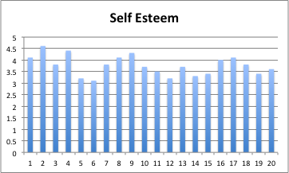
Example (random data)
Height Self Esteem
68 4.1
71 4.6
62 3.8
75 4.4
58 3.2
60 3.1
67 3.8
68 4.1
71 4.3
69 3.7
68 3.5
67 3.2
63 3.7
62 3.3
60 3.4
63 4.0
65 4.1
67 3.8
63 3.4
61 3.6
Mean 65.4 3.8
Median 66.0 3.8
SD 4.4 0.4

Slide 18
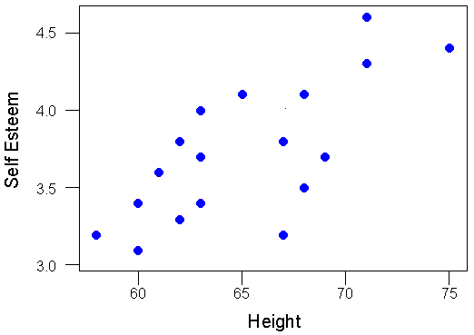
Example (continued)
Correlation: r = 0.73

Slide 19
Statistical tools II - Analytical
T-test
Compare the mean of 2 populations
Null hypothesis: no difference between means
Can only examine a single independent variable
Assumptions
Samples are normally distributed
Very robust in practice
Population variances are equal
Reasonably robust for differing variances
Individual observations in samples are independent
Very important

Slide 20
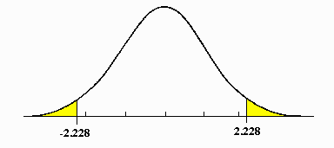
T-Tests
Increase statistical power by:
Increasing number of participants
Decreasing variance
Running 1-tail instead of 2-tail test
Notes:
Two-tail: Effect found if the value of the statistic is either sufficiently large or small.

Slide 21
Statistical tool II - Analytical
ANOVA
Single factor analysis of variance
Compare three or more means
Analysis of variance
Compare relationship between many factors
Beginners type at the same speed on all keyboards,
Touch-typist type fastest on the qwerty
Your protocol influences the kind of test you can use
If in doubt, consult with a statistician before starting the experiment!

Slide 22
Reporting Results
T-TEST
“There was a significant difference in the scores for sugar (M=4.2, SD=1.3) and no sugar (M=2.2, SD=0.84) conditions; p = 0.020.”
ANOVA
“As one would expect, movement times increased as either W decreased or D increased (i.e., as the task got more difficult: for W, F(2,25)=801, p<0.001; and for D, F(3,54)=1429, p<0.001).”

Slide 23
Running example data
Error bars show +/- one standard deviation

Slide 24
Running Example Analysis
Measured speed and error
Significant results for
reading time
reading error
counting time
Animated scrolling
reduces reading errors by up to 54%
task time by up to 3%
task time by up to 24% for counting tasks
300ms seems to be best overall animation time for reading.
Formatted documents had a higher base rate perf, and lower improvement – thus visual landmarks appear to be a good idea

