Slide 1
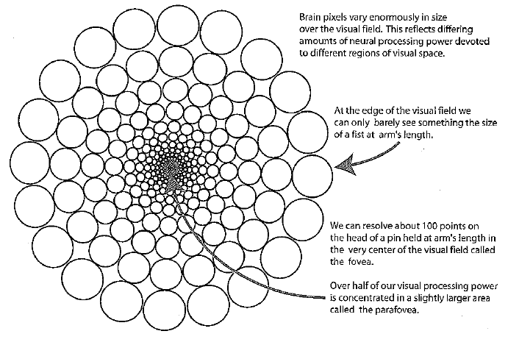

The Eye’s Fovea

Slide 2
Visual Perception
How many 3’s?
1281736875613897654698450698560498286762
9809858453822450985645894509845098096585
9091030209905959595772564675050678904567
8845789809821677654872664908560912949686
1281736875613897654698450698560498286762
9809858453822450985645894509845098096585
9091030209905959595772564675050678904567
8845789809821677654872664908560912949686

Slide 3
Notes:
Discovered by Professor Emile Javal, U. Of Paris. ~1880.
“Perception of reading material only occurs during these pauses since saccadic interfixation moves are so rapid that no clear vision is possible. On the average, pauses take 92 to 94 percent of the reading time and movements take 6 to 8 percent.” -- Tinker

Slide 4
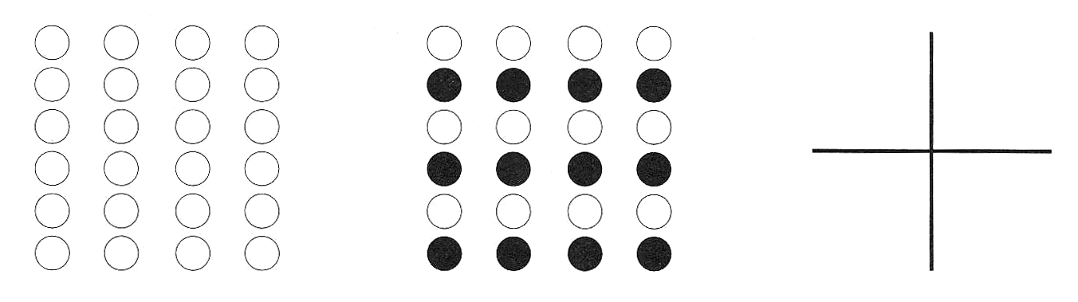

Gestalt Principles
Grouping
  proximity, similarity, continuity
Form perception
  closure, area, symmetry
Notes:
So how to make this design principles work for you? One of the key aspects to rely on is Gestalt principles which describe how people percieve structure in their surrounding. The most inportant for this lecture are principles reenforcing gouping and I illustrate them here:
Another important part os how we perceive forms:
Figure ground reversal.

Slide 5
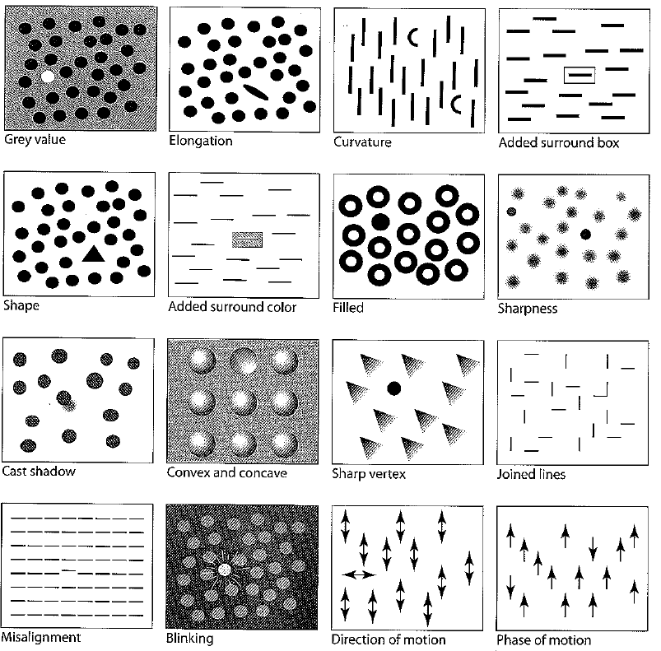
Gestalt Principles
Pop out

Slide 6

Gestalt Principles
Motion, especially when coming into view

Slide 7
Gestalt Principles
More difference gets recognized faster
But simultaneous features can overload system
Gestalt recognition proportional to resolution – i.e., works better in the center (except for motion)
Remember:
Periphery faster
More light sensitive

Slide 8
Color Orders (Edward Tufte)
Notes:
While it is certainly true that hues have a physical order via their wavelength, and that every kindergardner knows the rainbow ordering, our visual system has a very difficult time treating hue in an ordered way. As we see in this image, it is clear that each area is *different*, but none of the areas have an intuitive relationship between each other. Where is above ground? Where is below? What’s the highest point? These questions are hard to answer. (Saturation as a cue is nearly impossible to handle.) This is how most computer scientist would design a map.
This is supposed to convey height above sea level.

Slide 9
Notes:
Color sets that vary primarily by luminance are much easier for us to order. This image uses two color sets: browns for above ground, blues for below. The questions I mentioned before are now much easier to answer. The much more muted colors also much easier to read the information.
Cartographers have been doing this for 2000 years.
The key is to know: under water or not under water? Then, how far for each case? I perception system can’t use hue for how much! But, we can use intensity. As I go deeper, the color gets darker. Intensity is a great axis for presenting quantitative information.

Slide 10
Typography
Notes:
Simple place to start is the difference between Sans Serif and Serif typefaces.

Slide 11
The Competing Hypothesis: Familiarity
“Legibility, in practice, amounts simply to what one is accustomed to” -- Eric Gill, 1931
=> No Robust Evidence for Serif Hypothesis

Slide 12
Put it all together

Slide 13
http://nymag.com/nymetro/health/features/11700/index1.html

Slide 14
January 28, 1986
Notes:
Challenger explosion

Slide 15
Chart given from Morton Thiokol to NASA
E. Tufte, pp. 46-47, Visual Explanations
Notes:
Problems:
chartjunk
Order the o-ring problems by temperature
Show both problems and non-problems
Extend the scale to make the point that the launch was much colder than all the previous launches

Slide 16
Redrawn (Tufte)
Notes:
Problems:
chartjunk
Order the o-ring problems by temperature
Show both problems and non-problems
Extend the scale to make the point that the launch was much colder than all the previous launches

Slide 17
Implications for UI Design
Need to think about human capabilities
Need to design for tasks
Notes:
Representation supports *task* -based on stops, not actual path

Slide 18
Information Visualization
Show lots of data visually to help with analysis
What is interesting in the data?
Identify
  Trends
  Clusters
  Patterns
  Outliers
Communication and exploration/discovery

Slide 19
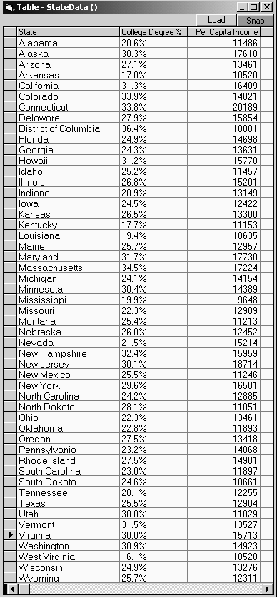
Which state has highest Income?
Relationship between Income and Education?
Outliers?

Slide 20
How Vis Amplifies Cognition
Increasing memory and processing resources available
Reducing search for information
Enhancing the recognition of patterns
Enabling perceptual inference operations
Using perceptual attention mechznisms for monitoring
Encoding info in a manipulable medium

Slide 21
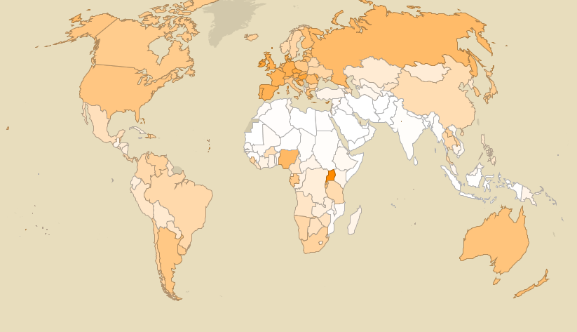
Alcohol Consumption
Notes:
1 encoding – color

Slide 22
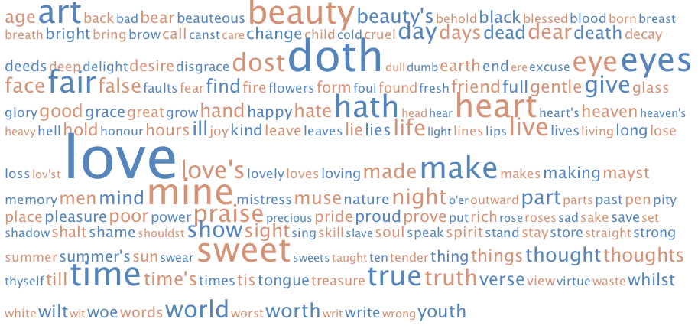
Shakespeare’s Favorite Words
Notes:
One encoding – size

Slide 23
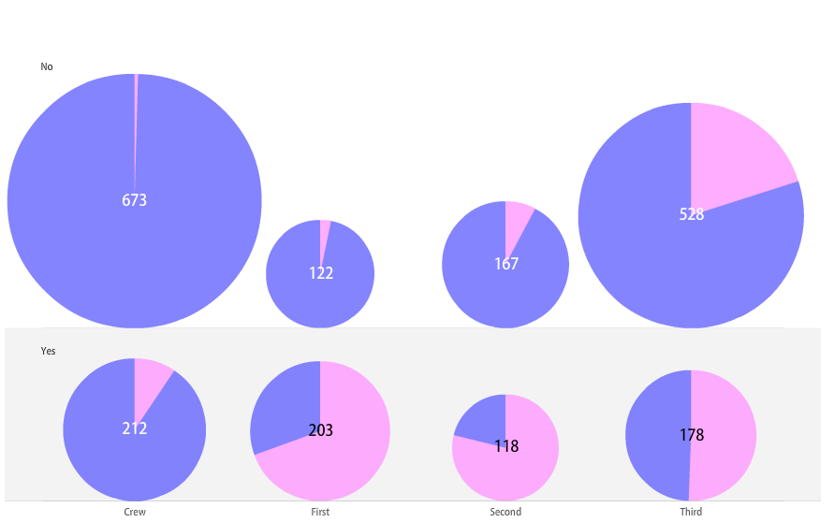
Survival on the Titanic
Crew First Second Third
Notes:
2 encodings – color (gender) and size

Slide 24
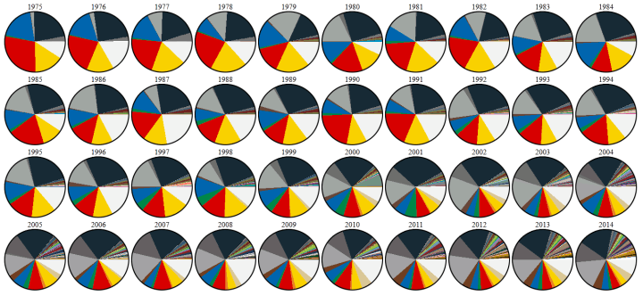
Lego Color Palette

Slide 25
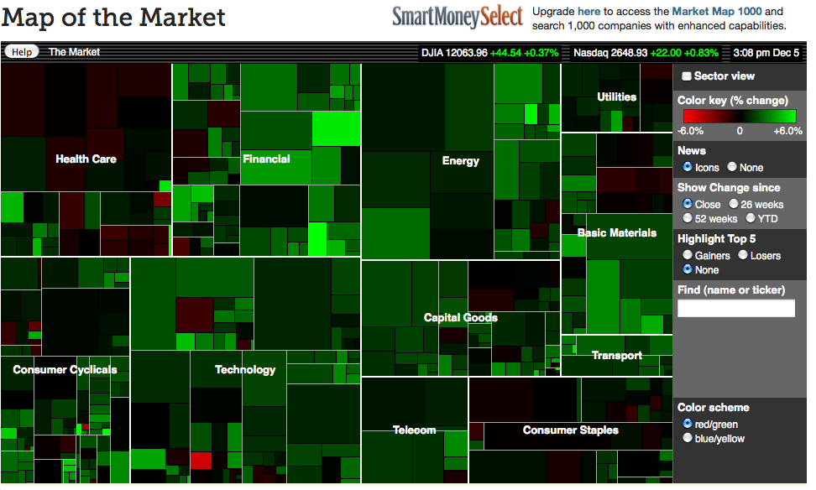
A Good Use of TreeMaps and Interactivity
www.smartmoney.com/marketmap
Notes:
How many encodings?
Color, size, hierarchical position

Slide 26
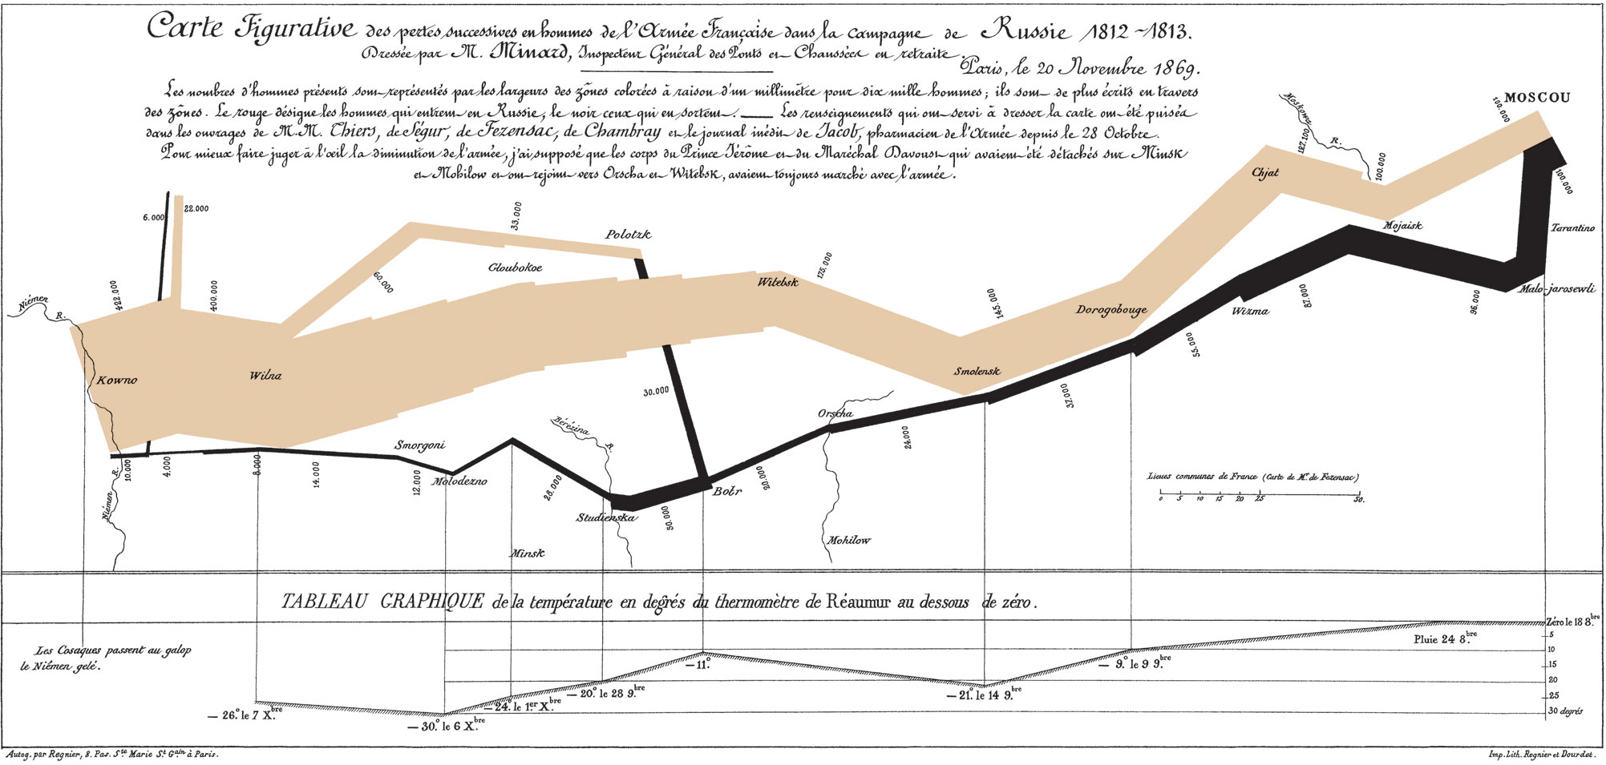
Napoleon’s March
Notes:
3 encodings
Color (attack or retreat)
Position (where in march)
Size (width indicating army size)
Battle of Berezina

Slide 27
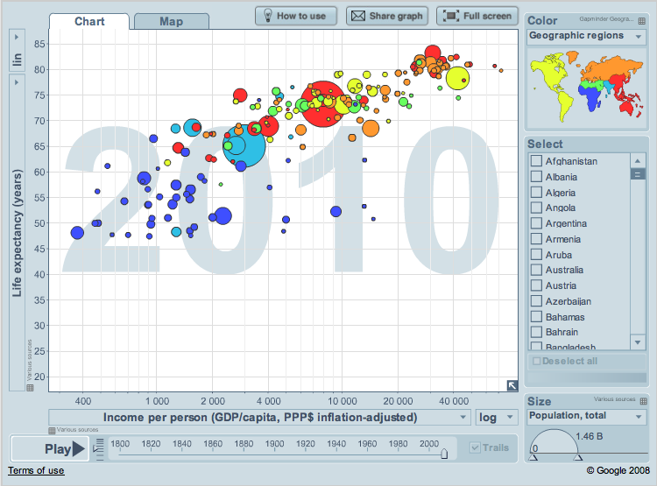
Wealth and Health of the World
Notes:
Color, size, xy position

