Slide 1
Offline Optimal Ads Allocation in SNS Advertising
Hui Miao, Peixin Gao

Slide 2
Social Network Advertising & Ads Allocation Problem

Slide 3
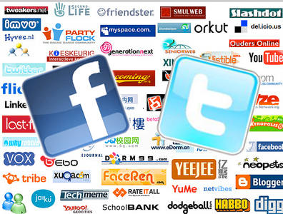
Popularity of SNS
Figure created by Rowan Casey: https://plus.google.com/110172400710124550294
Notes:
Figure created by Rowan Casey: https://plus.google.com/110172400710124550294

Slide 4
Popularity of SNS
U.S. Users Spend More time on Facebook than any other web brands
Source: Nielsen Social Media Report 2011, http://cn.nielsen.com/documents/Nielsen-Social-Media-Report_FINAL_090911.pdf
Notes:
Source: Nielsen Social Media Report 2011, http://cn.nielsen.com/documents/Nielsen-Social-Media-Report_FINAL_090911.pdf

Slide 5
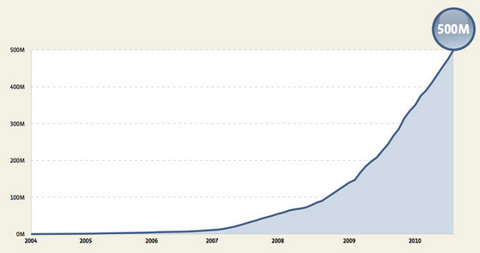
Popularity of SNS
Facebook usages
500 million active users
100 billion hits per day
50 billion photos
2 trillion objects cached, with hundreds of millions of requests per second
130TB of logs every day
Source: Scaling Facebook to 500 Million Users and Beyond, https://www.facebook.com/note.php?note_id=409881258919
Notes:
Scaling Facebook to 500 Million Users and Beyond, https://www.facebook.com/note.php?note_id=409881258919
Now over 1 billion

Slide 6
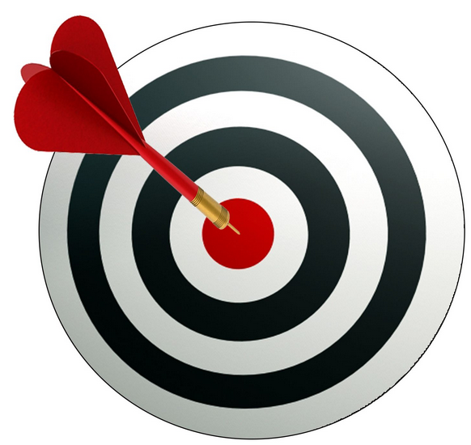
Monetizing Social Networks
Maintaining the operating expenses is definitely not easy.
Facebook introduced Ads in the end of 2007, Twitter in the mid of 2010
Real people profile & activity, Social graph diffusions, Viral marketing .. make it a new way than search engine Ads
Now Ads are the major source of income of SNS sites:
Facebook 14’ 1Q Financial Report:
Revenue: 2.50 billion (2.27 billion from Ads, 90.8%)
Twitter 14’ 1Q Financial Report:
Revenue: 250 million (226 million from Ads, 90.4%)
Notes:
Facebook Ads Declaration: http://www.businessweek.com/the_thread/techbeat/archives/2007/11/facebook_declar.html

Slide 7
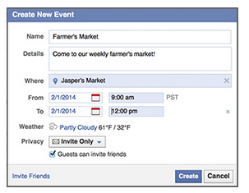
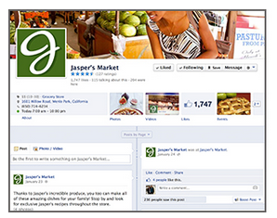
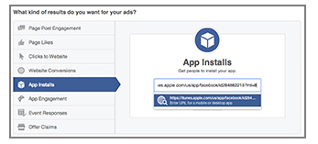
Facebook Social AdsTM 101
Event
Identify Ad Objective
Page in FB
Promote an App
Landing an external website
Figures, Source: https://www.facebook.com/help

Slide 8
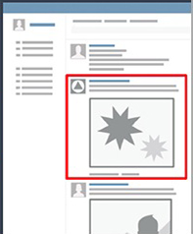
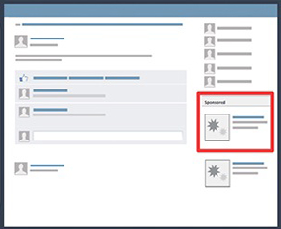
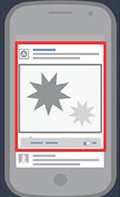
Facebook Social AdsTM 101
Facebook provides these types of Ads placement
Figures, Source: https://www.facebook.com/help
Notes:
Facebook: http://investor.fb.com/releasedetail.cfm?ReleaseID=842071
Twitter: https://investor.twitterinc.com/releasedetail.cfm?ReleaseID=843245

Slide 9
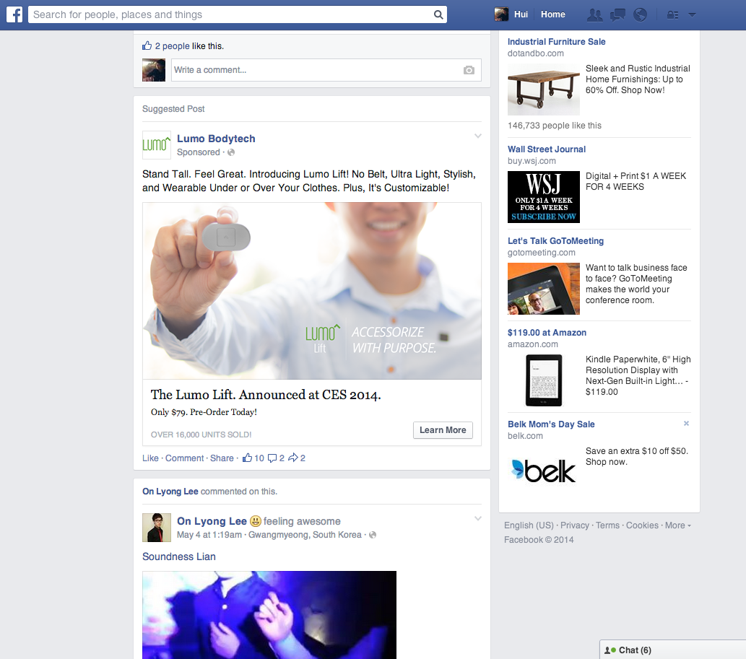
It looks like this in current Facebook
Diffusion by Engagement
A new user impression (hit, refresh) pops different ads
Notes:
From the user’s perspective: https://www.facebook.com/about/ads/#types
Relevant Ads,
Sponsored Stories

Slide 10
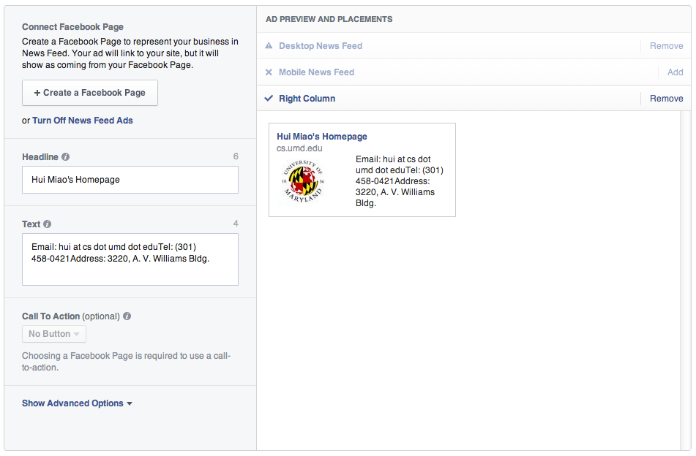
Facebook Social AdsTM 101
Setup an Ad on Facebook
Objective

Slide 11
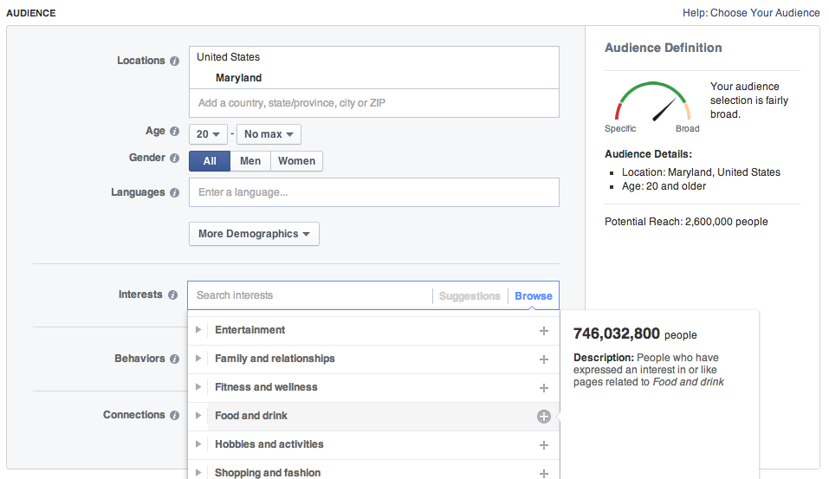
Facebook Social AdsTM 101
Setup an Ad on Facebook
Audience
Note: pay for the diffusion ones
it makes it different from influential maximization problem
Notes:
Decide who you want to see your ad. Use controls to limit who sees your ad by their age, gender, location, etc. The audience size shown roughly indicates the number of people on Facebook who might see your ad. Ads with higher budgets will reach more people of the potential audience.
Target people who are more likely to respond to your ad by using interests to narrow your potential audience. Although your ad will only show to people who fit into the target group that you choose, narrowing down your audience will ensure your ad is shown to the most relevant people.
Ad targeting best practices:
Ads perform better when they’re targeted to at least a few thousand people. Consider removing some of your targeting restrictions if your audience is too small.
If you’re only targeting a few interests, think about adding more related interests. For example, targeting similar words such as puppy, dogs, and dog lovers will increase your potential reach, while still targeting a relevant audience.

Slide 12
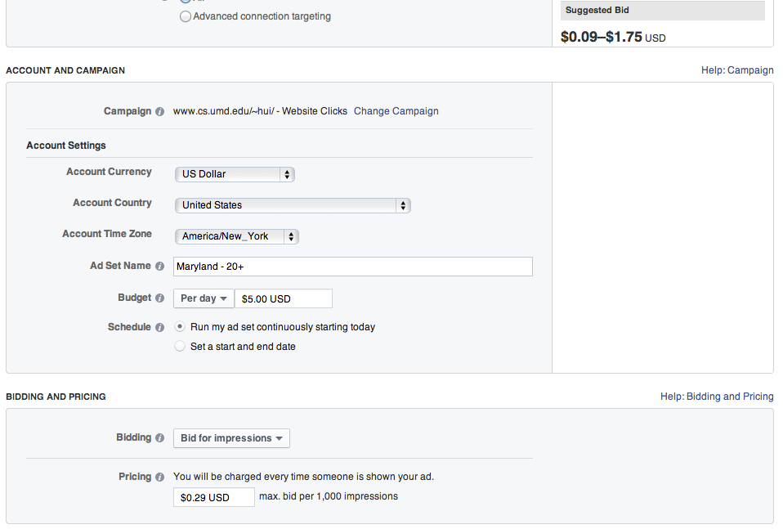
Facebook Social AdsTM 101
Setup an Ad on Facebook
Campaign
CPM makes more sense within Facebook and is the default one when one promotes Page, App or Event
max bid one would like to pay
Notes:
The cost of advertising on Facebook depends on the size of your audience and your budget.
daily budget controls how much you'll spend on a specific ad set each day. Each ad set will have a separate budget, so keep this in mind if you have more than one active ad set in your account. Your ads will automatically stop showing once your daily budget for the ad set has been met for that day.
The minimum daily budget for any ad set is $1.00 USD and must be at least 2 times your cost per click (CPC) bid. For example, if you have a $1.00 CPC, your daily budget must be at least $2.00.
If you’re advertising a Page, app or event and you select See Advanced Options, or if you’re advertising an external website, you’ll be able to pay for clicks (CPC) in the pricing section. The suggested bid range is there to help you pick a maximum bid so your ad will be successful. It’s based on how many other advertisers are competing to show their ad to the same audience as you are.
You don’t have to choose a bid in this range, but you should use it to help you pick a bid that will result in a good amount of impressions and clicks. You will never pay more for an impression or click than necessary, so entering your true maximum is the best way to make sure you don’t miss out on impressions and clicks you could have received.
You may notice that the suggested bid range changes over time. This is normal, since it depends on how many other people are competing for your target audience.
If you notice the suggested bid range increasing for your ad, it may be because its performance history isn't strong due to targeting parameters or the ad creative. Make sure your ad is targeted to the most relevant audience, uses clear language in the ad text, has a strong call to action, and has an eye-catching image.

Slide 13
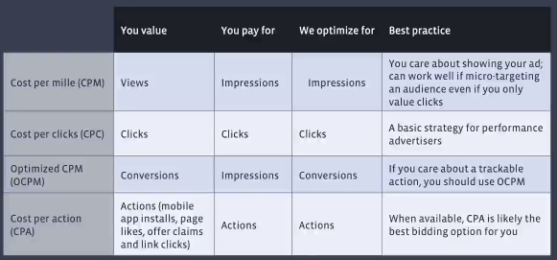
Facebook Social AdsTM 101
Source: https://www.facebook.com/help/www/318171828273417/
Notes:
https://www.facebook.com/help/www/318171828273417/

Slide 14
Summary & the Allocation Problem
A user’s impression is allocated to a set of Ads
Relevant Ads, or Sponsored stories, Friends’ engagement
Right column refreshes, News feeds column has lasting effect
Advertiser
Bid on a target user group by using categorical filters (compare with bid a kwd in Adwords), each user has social influence
Pay for the actions due to diffusion. (in CPM, pays for all impressions), i.e. paid social influence.
Agent
Allocate Ads to their target user groups’ daily impressions
Respect the budget
We study the Maximum Revenue Allocation Problem in SNS Ads

Slide 15
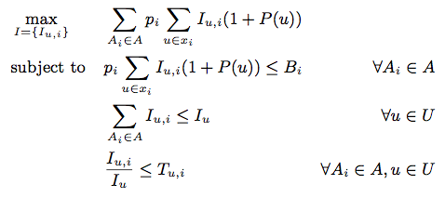
Formulation
Let A be the set of advertisers, and U be the set of users. Each user has daily impression I_{u} and social influence function P(u). Each advertiser A_{i} has a budget B_{i} and bidding price p_{i} , and all advertiser’s targeting preference is a (0,1) matrix T
To maximize the revenue is to find the optimal allocation I:
budget
impression
targeting
And the influence function

Slide 16
Hyperbolic Embedding for Complex Networks

Slide 17
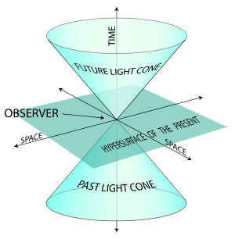
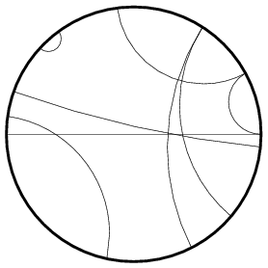
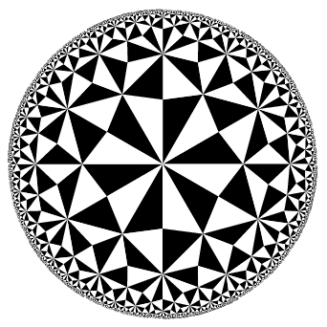
Hyperbolic Geometry
A Non-Euclidean geometry
Often used in understanding physical time and space.
E.g. the light cone
Has its own distance metric
We use the Poincaré hyperbolic disc:
Commonly used hyperbolic two-space model
Hyperbolic Distance: d(x,y)
Interesting things to know, e.g.
having no Parallel Postulate
For any infinite straight line L and any point P not on it, there are many other infinitely extending straight lines that pass through P and which do not intersect L.
the sum of angles of a triangle is less than 180
lines
triangles
Figure source: http://en.wikipedia.org/wiki/Light_cone, http://mathworld.wolfram.com/PoincareHyperbolicDisk.html
Notes:
Henri Poincaré (1854 - 1912).

Slide 18
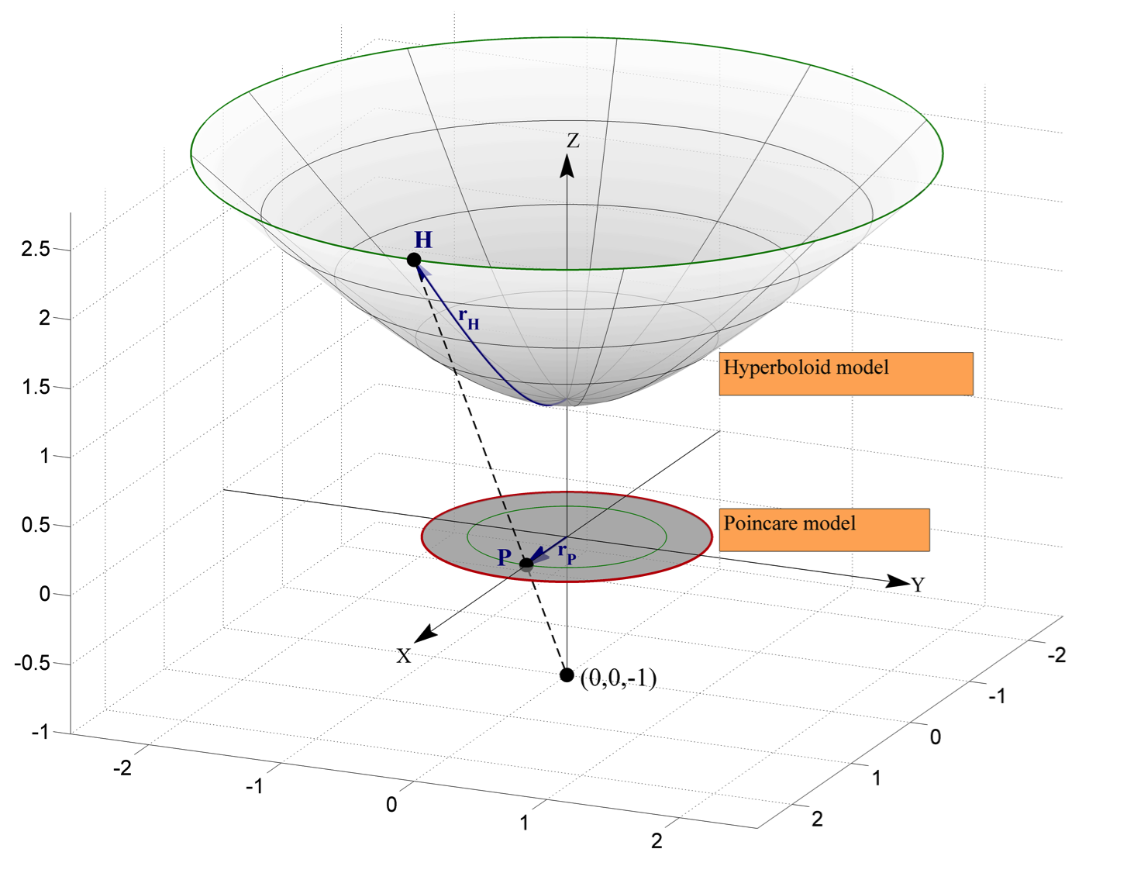
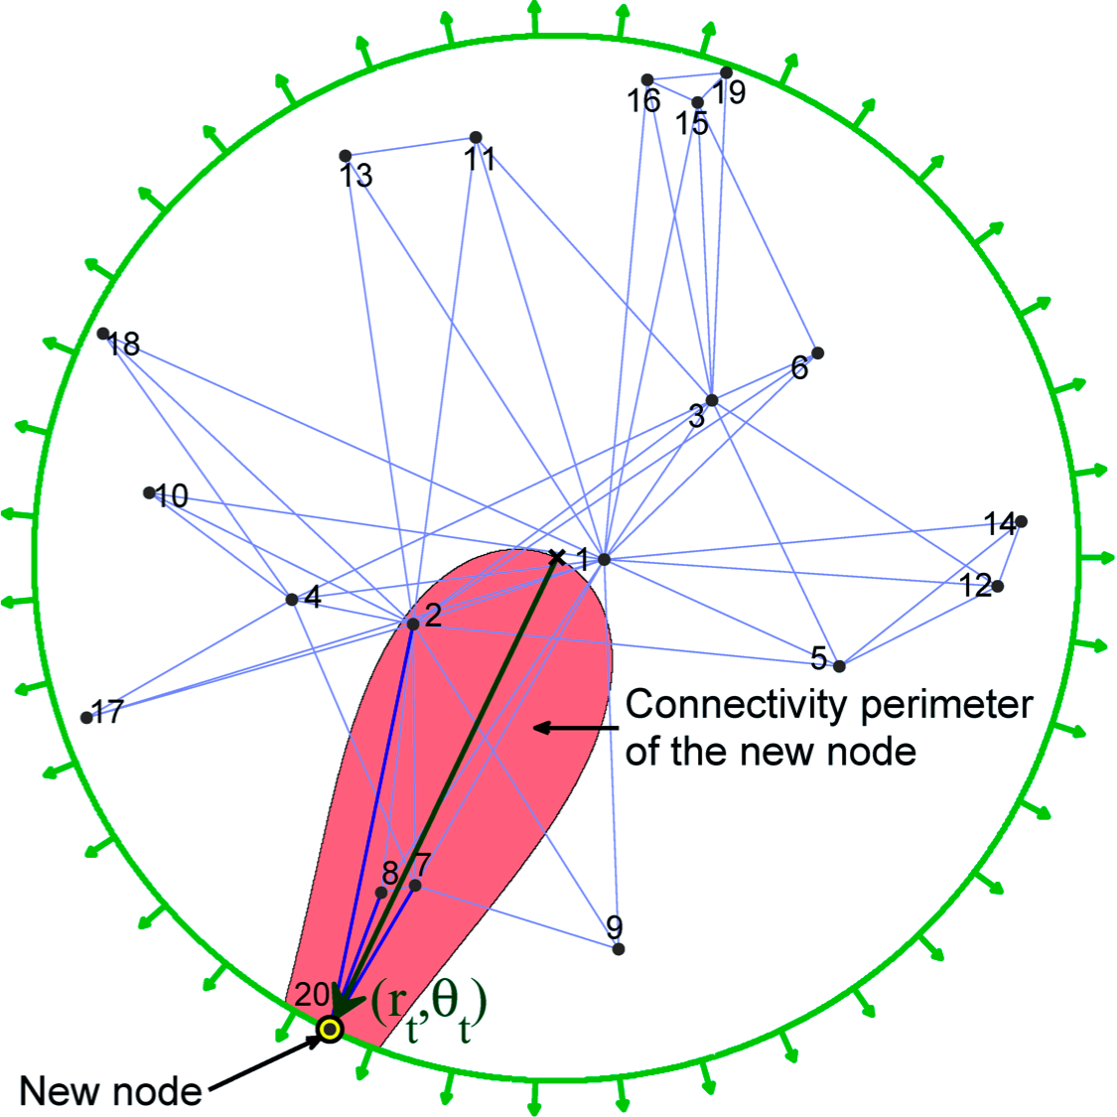
Hyperbolic Embedding
Krioukov et. al proposed a random graph generation method based on hyperbolic geometry.
It shows popularity (heterogeneous degree distributions) as well as strong clustering can described by negative curvature and distance metric of hyperbolic geometry.
Krioukov, D., Papadopoulos, F., Kitsak, M., Vahdat, A., & Boguñá, M. Hyperbolic geometry of complex networks. Physical Review E, 82(3), (2010).
Method
Start from empty network
At time T_{i}, add a new node i at (r_{i}, t_{i}), r_{i} = 2ln(i)/k, assign t_{i} randomly from 0 to 2Pi, (k is related to curvature coefficient)
Shifting all j < i, r_{j} = b r_{i} + (1-b) r_{i ,} (b is related to powerlaw skewness).
Creation of edges for i, by examine the probability of connection (i,j). The probability is related to their hyperbolic distance.
Select a random disconnected pair (m,n) and connect with the hyperbolic distance based probability p(x_mn)
Figure source: Dmitri Krioukov: http://www.isr.umd.edu/events/index.php?mode=4&id=6403
Notes:
We develop a geometric framework to study the structure and function of complex networks. We assume that hyperbolic geometry underlies these networks, and we show that with this assumption, heterogeneous degree distributions and strong clustering in complex networks emerge naturally as simple reflections of the negative curvature and metric property of the underlying hyperbolic geometry.
One can also see the simple mapping method to tell their relationships.
P(x_ij) is decreasing function of x_ij. Meaning, the more far away in hyperbolic space, the less probability that they will have a connection.
Also the inner nodes have higher degree than the outer nodes.

Slide 19
Hyperbolic Embedding
Later they show an embedding algorithm to map real world complex network to the hyperbolic space.
Key idea is they want to get such a hyperbolic embedding that is most likely be produced by the synthetic graph generation algorithm.
Embedding Algorithm:
Papadopoulos, F.; Psomas, C.; Krioukov, D., "Network Mapping by Replaying Hyperbolic Growth,", IEEE/ACM Transactions on Networking , vol.PP, no.99, 2013
Based on the random graph model, they use the real network to estimate the parameters (expected degree of each node) of the joint probability of all nodes by solving a MLE problem.
Sort nodes by degree, mapping nodes to (r,t) according to the descending order. r_{i} = 2ln(i)/k. And fix pervious node to , r_{j} = b r_{i} + (1-b) r_{i}
Use the probability distribution to assign the angular coordinate.

