Slide 1

Online Ad Allocation
Hossein Esfandiari & Mohammad Reza Khani
Game Theory 2014

Slide 2
Outline of the presentation
Introduction to online ad allocation
  [already covered in the course]
Introduction to mechanism design for online ad allocation
  [will be covered by me]
Overview of our results
  [will be covered by Hossein]

Slide 3
Design Goals for Auctions
Incentive Compatibility (IC)
  Transparent mechanisms
  Remove computational load from bidders
High Social welfare
  Sum of profits of participants
  The larger it is the happier is the society (a proxy for long term revenue)
Good Revenue

Slide 4
A relevant design requirement
Revenue Monotonicity (RM):
It is not studied well theoretically.
The revenue does not decrease if we add a bidder or a bidder increases her bid.

Slide 5
Why is it important?
Intuitive: more bidders → more revenue
  Existence of large sale groups in companies to attract more bidders.
Lack of RM leads to confusion in the strategic planning of companies.
No unified benchmark for revenue for general settings.

Slide 6

Auction Example 1
Image-Text Auction
  Selling k identical items
  Text-bidder (demands one)
  Image-bidder (demands all)

Slide 7
VCG Mechanism
Selects a set of winners to maximize the sum of valuations of winners.
VCG is not revenue monotone.
Participants | Valuation | Payment
Image-Participant 1 | 1$ | -
Text-Participant 1 | 1$ | 1$
Adding one more participant
Participants | Valuation | Payment
Image-Participant 1 | 1$ | -
Text-Participant 1 | 1$ | 0$
Text-Participant 2 | 1$ | 0$

Slide 8
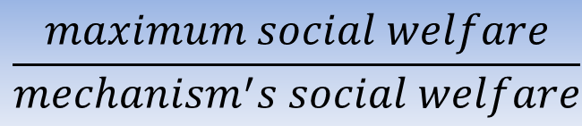
Price of RM
Efficiency and RM not possible together [AM02].
RM is an across-instance constraint.
Price of Revenue Monotonicity (PoRM):
Question: how much social welfare does ensuring RM cost?
$$\frac{maximum social welfare}{mechanism^{′}s social welfare}$$

Slide 9
Goal
Design RM mechanisms with small PoRM

Slide 10


Known Results
Adding a few common-sense constraints:
There is a mechanism for Image-text auction with IC and RM with PoRM of $\ln{k}$.
There is no mechanism for Image-text auction with PoRM better than $\ln{k}$.

Slide 11
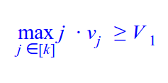
Mechanism
valuations of the text-participants
v₁ ≥ v₂ ≥ … ≥ v_{n}
valuations of the image-participants
V₁ ≥ V₂ ≥ … ≥ V_{m}
The text-participants win if

Slide 12


Allocation Function
If Image-participants win, the first image-participant gets all the items. The critical value of the winner is
If text-participants win, the first j* text-participants win where j* is the maximum j ∈ [k] such that j . v_{j} is greater than V₁. The critical value of the winners is

Slide 13
Price of Revenue Monotonicity (PoRM)
The PoRM of our mechanism is ln k.
Proof by example:
Image-participant: 1
Text-Participants: 1 - ϵ, ½ - ϵ, ⅓ - ϵ, …, 1/ k - ϵ
The image-participant wins with social welfare 1.
The maximum welfare is (1 + ½ + ⅓ + … + 1/k) - k . ϵ.

Slide 14

The lower-bound for PoRM
Let M* be a mechanism with the best PoRM.
M* in type profile ((k, 1), (k, 1 + ϵ)) gives all items to the second participant and make 1 dollar revenue.
M* in type profile ((k, 1), (k, 1 + ϵ), (1, 1 − ϵ), (1, ½ − ϵ), . . . , (1, 1/k − ϵ)), gives the items to image-participants.
There is no mechanism for Image-text auction with PoRM better than $\ln{k}$.

Slide 15
Proof by picture
1-ϵ ½-ϵ ⅓-ϵ 1/k-ϵ

Slide 16
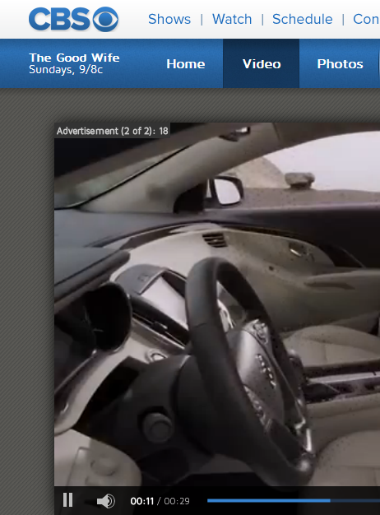
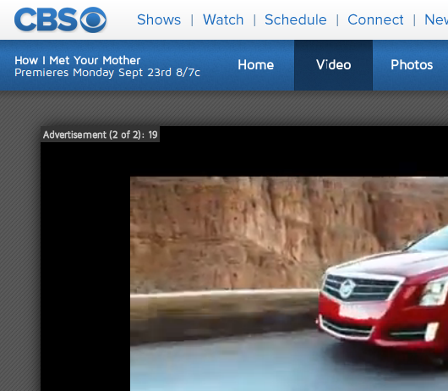
Auction Example 2
Video-pod auction
  Selling k identical items
  Each bidder demands d
  (1 ≤ d ≤ k)
  Generalizes Image-text
  auction.

Slide 17

Known results
There is a mechanism for video-pod auction with IC and RM with PoRM of $\ln^{2}{k}$.

Slide 18
Video pod Auctions
Problem:
  K identical items
  each participant i demands d_{i} and has valuation v_{i}
Group the participants with demands in [2^{i-1}, 2^{i}) in G_{i}
Let v₁ ≥ v₂ ≥ … ≥ v_{n} be valuations of participants in G_{i}
Maximum Possible Revenue of Group i is MPRG_{i} = Max_{j ∈ [k/2^i]} j . v_{j}
The group with maximum MPRG wins
We find the maximum j* such that j* . v_{j*} is greater than the second MPRG
The critical value of the winners is max(v_{k/2^i* + 1}, MPRG_{i’}/j*)

