Slide 1
Online Stochastic Matching
Barna Saha
Vahid Liaghat

Slide 2















Matching?
Adword Types: $y_{1}$, $y_{2}$, $y_{3}$ , $y_{4}$
$$y_{1}$$
$$y_{2}$$
$$y_{3}$$
$$y_{1}$$
$$y_{4}$$
$$y_{3}$$
$$y_{4}$$
$$y_{2}$$
$$y_{2}$$
Adwords
Bidders
$$z_{1}$$
$$z_{2}$$
$$z_{3}$$
$$z_{4}$$
$$z_{5}$$

Slide 3




Matching?
$$n\left(y_{1}\right)=2$$
$$n\left(y_{2}\right)=3$$
$$n\left(y_{3}\right)=2$$
$$n\left(y_{4}\right)=2$$
Adword Types
Bidders
$$z_{1}$$
$$z_{2}$$
$$z_{3}$$
$$z_{4}$$
$$z_{5}$$

Slide 4
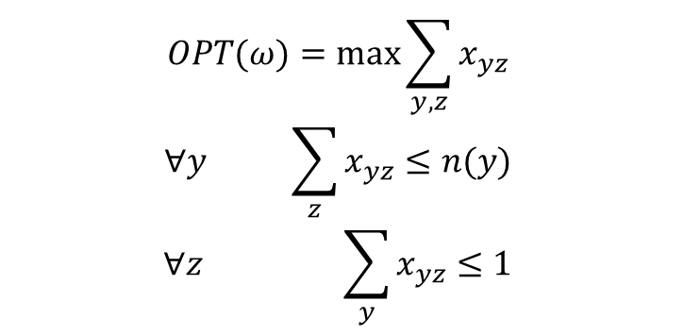
Offline LP Relaxation
$$OPT(ω)=\max{\sum_{y,z}{x_{yz}}}$$
$$∀y \sum_{z}{x_{yz}}≤n(y)$$
$$∀z \sum_{y}{x_{yz}≤1}$$

Slide 5














Online Matching
$$y_{1}$$
$$y_{2}$$
$$y_{3}$$
$$y_{1}$$
$$y_{4}$$
$$y_{3}$$
$$y_{4}$$
$$y_{2}$$
$$y_{2}$$
Adversarial, Unknown Graph
Vazirani et al.[1] 1-1/e
can’t do better
Random Arrival, Unknown Graph
Goel & Mehta[2] 1-1/e
can’t do better than 0.83
i.i.d Model: Known Graph and Arrival Ratios
  Integral: Bahmani et al.[3] 0.699 Can’t do better than 0.902
  General: Saberi et al.[4] 0.702 Can’t do better than 0.823
$$z_{1}$$
$$z_{2}$$
$$z_{3}$$
$$z_{4}$$
$$z_{5}$$

Slide 6

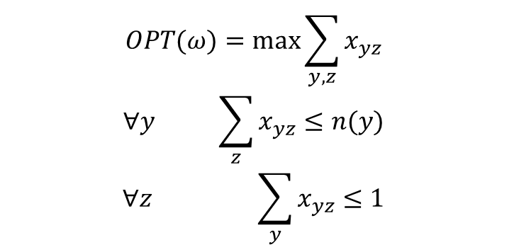
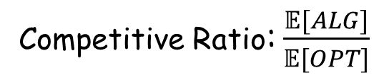
i.i.d. Model
$$OPT(ω)=\max{\sum_{y,z}{x_{yz}}}$$
$$∀y \sum_{z}{x_{yz}}≤n(y)$$
$$∀z \sum_{y}{x_{yz}≤1}$$
$$𝔼\left[n\left(y\right)\right]=r_{y}≤1$$
Competitive Ratio: $\frac{𝔼[ALG]}{𝔼[OPT]}$

Slide 7

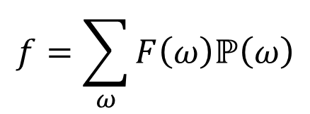
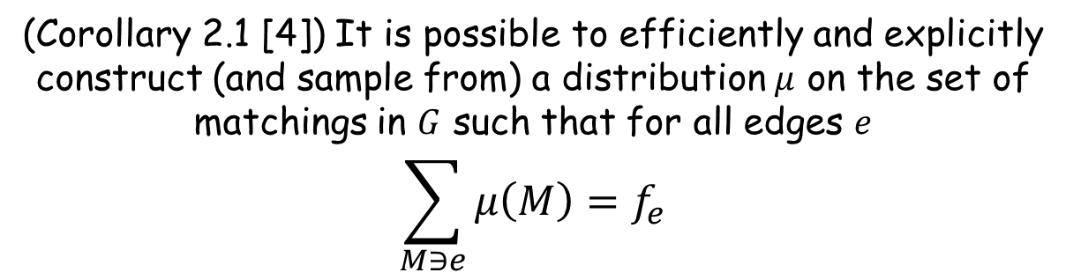
Fractional Matching
$$f=\sum_{ω}{F\left(ω\right)ℙ\left(ω\right)}$$
Fractional Degree: $f_{v}=\sum_{e\sim v}{f_{e}} ∀v∈Y∪Z$
(Corollary 2.1 [4]) It is possible to efficiently and explicitly
construct (and sample from) a distribution $μ$ on the set of
matchings in $G$ such that for all edges $e$
$$\sum_{M∋e}{μ\left(M\right)=f_{e}}$$

Slide 8
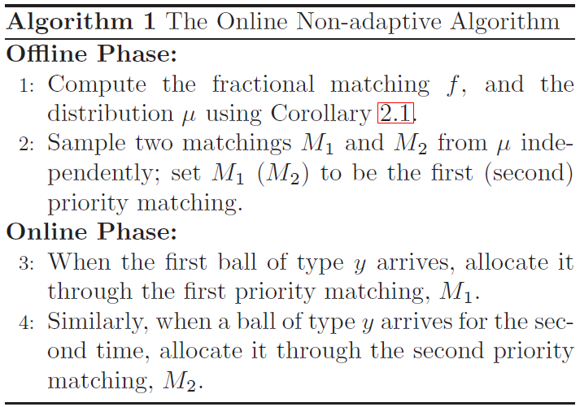
Non-Adaptive Algorithm

Slide 9

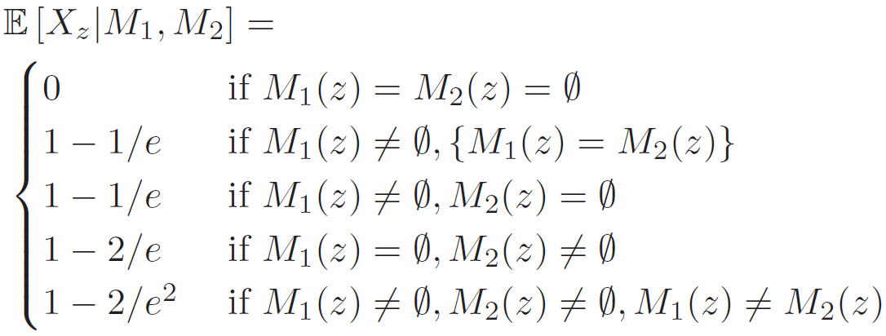

Algorithm 1 - Analysis
$$≥0.684$$

Slide 10
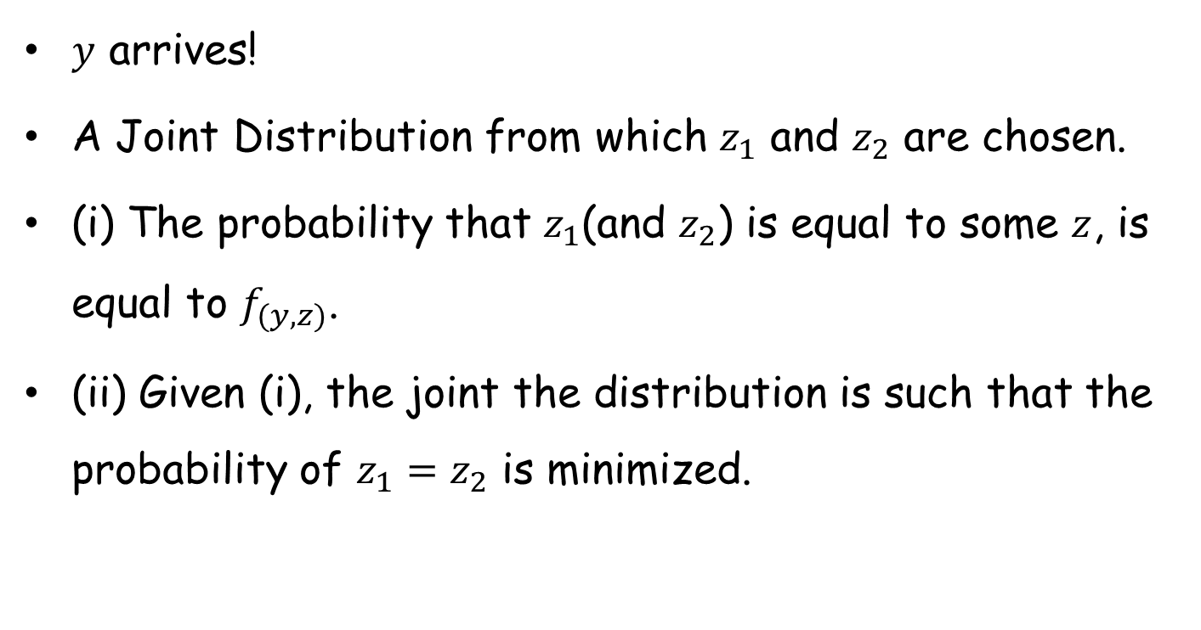
Adaptive Algorithm - idea
$y$ arrives!
A Joint Distribution from which $z_{1}$ and $z_{2}$ are chosen.
(i) The probability that $z_{1}$(and $z_{2}$) is equal to some $z$, is equal to $f_{(y,z)}$.
(ii) Given (i), the joint the distribution is such that the probability of $z_{1}=z_{2}$ is minimized.

Slide 11
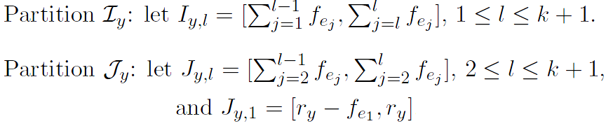
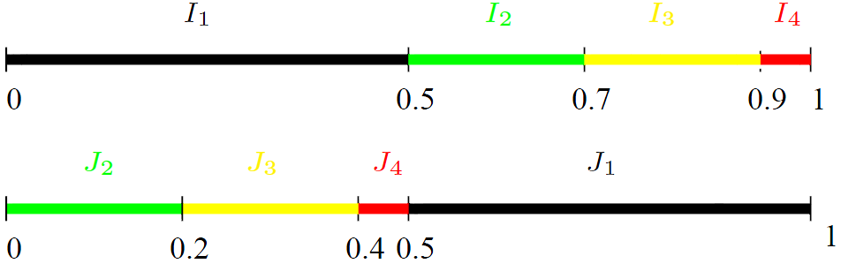

Adaptive Algorithm - partitions
$$f_{e_{1}}≥f_{e_{2}}≥…≥f_{e_{k}}≥f_{e_{k+1}}$$

Slide 12
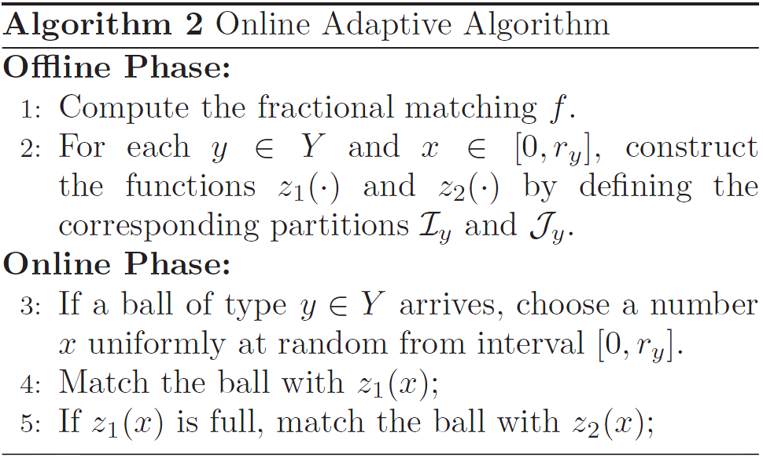
Adaptive Algorithm

Slide 13
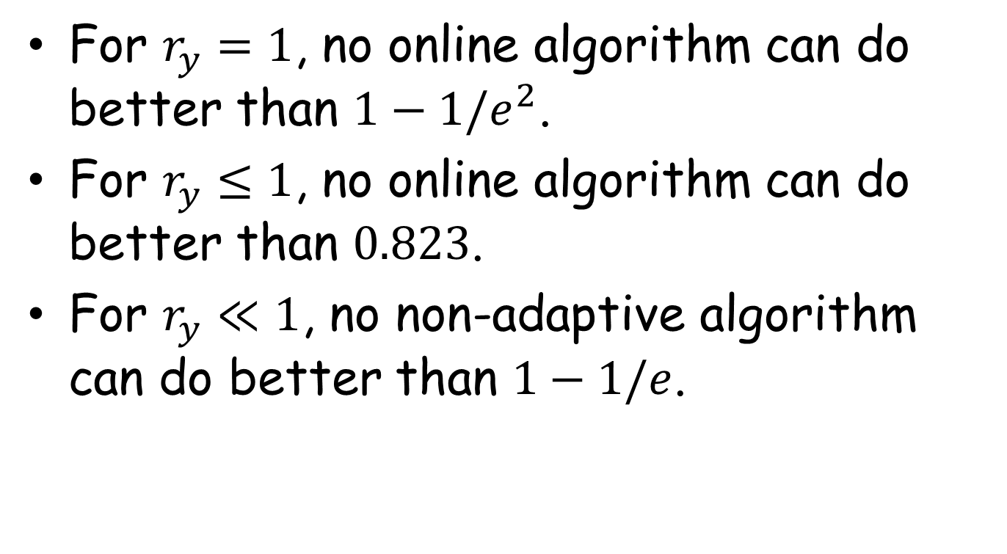
Upper Bounds
For $r_{y}=1$, no online algorithm can do better than $1−1/e^{2}$.
For $r_{y}≤1$, no online algorithm can do better than $0.823$.
For $r_{y}≪1$, no non-adaptive algorithm can do better than $1−1/e$.

Slide 14
Questions?

Slide 15
References
[1] R. M. Karp, U. V. Vazirani, and V. V. Vazirani. An optimal algorithm for online bipartite matching. In STOC, pages 352–358. ACM, 1990.
[2] G. Goel and A. Mehta. Online budgeted matching in random input models with applications to adwords. In SODA, pages 982–991, 2008.
[3] B. Bahmani and M. Kapralov. Improved bounds for online stochastic matching. In ESA, pages 170–181, 2010.
[4] V. H. Manshadi, S. Oveis Gharan, A. Saberi. Online Stochastic Matching: Online Actions Based on Offline Statistics. In SODA, 2011.

