Slide 1
Graph Balancing

Slide 2
Scheduling on Unrelated Machines
M1
M2
M3
J1
J2
J3
J4
J5

Slide 3
Scheduling on Unrelated Machines
M1
M2
M3
J1
J1
J2
J2
J3
J3
J4
J4
J5
J5

Slide 4
Scheduling on Unrelated Machines
M1
J2
J3
M2
J4
M3
J1
J5
Makespan

Slide 5
Restricted Assignment
M1
M2
M3
J1
J2
J3
J4
J5

Slide 6
Graph Balancing
Special case of Restricted Assignment
Each job can be scheduled on at most 2 machines
Machines ⬄vertices
Jobs ⬄ edges
Assign dedicated loads to vertices
Problem is to orient the edges

Slide 7
Graph Balancing
6
2
2
2
5
6
2
1
4
5
3
2
5
5
1
1
2

Slide 8
Graph Balancing Summary
Given: weighted multigraph (V, E, p, q)
V : Vertices ⬄ Machines
E : Edges ⬄ Jobs
∀e∈E, p_{e} = processing time of job e
∀v∈V, q_{v} = dedicated load on vertex v
Output: Orientation of edges λ:E →V
such that λ(e) ∈ e
Load_{v} = q_{v} + Σ_{e:v = λ(e)} p_{e}
Objective: Minimize maximum load

Slide 9
Optimization ⬄ Decision Problem
ρ-relaxed decision procedure
Is there any orientation with maximum load at most d ?
  Answer:
    “NO”
    Orientation with maximum load at most ρd.
Binary search for d and scale everything appropriately

Slide 10
2-approximation LP
Find values x_{ev} ≥ 0, for each e and v∈e, such that
  For each e ∈ E, u,v∈e:
  x_{eu} + x_{ev} = 1
  For each v ∈ V:
  q_{v} + Σ_{e:v∈e} x_{ev} p_{e} ≤ 1

Slide 11
2-Relaxed Decision Procedure
Solve LP in polynomial time.
If not feasible, return “NO”
If feasible, round solution using rotation and tree assignment
After rounding, the maximum load is at most 2
For rounding, decompose the graph as
  Cycles
  Trees

Slide 12
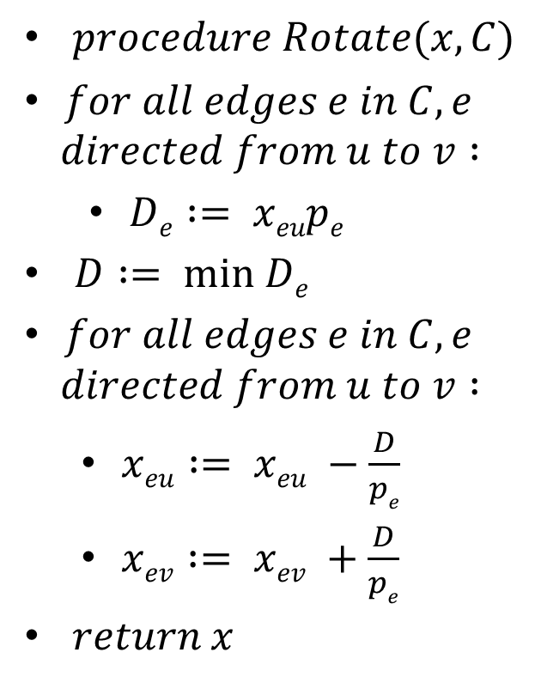
Rotation
$procedure Rotate(x,C)$
$for all edges e in C, e$
$$directed from u to v :$$
  $De := xeupe$
$D := min De$
$for all edges e in C, e$
$$directed from u to v :$$
  $xeu := xeu −\frac{D}{pe}$
  $xev := xev +\frac{D}{pe}$
$return x$
.125
.15
.5
1/4
.5
.3
.6
1/4
1/2
.1
.7
.4
.5
.4
.25
1/2
.5
.6
1/3
.6
.4
.2
.3
1/2

Slide 13
Rotation
$procedure Rotate(x,C)$
$for all edges e in C, e$
$$directed from u to v :$$
  $De := xeupe$
$D := min De$
$for all edges e in C, e$
$$directed from u to v :$$
  $xeu := xeu −\frac{D}{pe}$
  $xev := xev +\frac{D}{pe}$
$return x$
.9
1/4
.1
.1
1
1/4
1/2
.9
0
.3
.7
1/2
.7
.3
1/3
.4
.6
1/2

Slide 14
Rotation
Increases the number of integral solutions.
Breaks the fractional cycles.
Unchanged after rotation
  (x_{eu} + x_{ev}) for all edges e
  (Σ_{e:v ∈e} x_{ev} p_{e}) for all vertices v
Maximum load after rotation is ≤ 1.
After all fractional cycles are broken, only fractional trees remain

Slide 15
Tree Assignment
≤ 1
≤ 1
≤ 1
≤ 1
≤ 1
≤ 1
≤ 1
≤ 1
≤ 1
≤ 1
≤ 1
≤ 1
≤ 1

Slide 16
Tree Assignment
≤ 2
≤ 1
≤ 2
≤ 1
≤ 1
≤ 2
≤ 1
≤ 1
≤ 1
≤ 2
≤ 1
≤ 2
≤ 2

Slide 17






Integrality Gap
v`
1$− ϵ$
1$− ϵ$
1$− ϵ$
1$− ϵ$
1$− ϵ$
1$− ϵ$
1
1

Slide 18








Big edges ${(p}_{e}>1/2$)
$>$1/2
$>$1/2
$>$1/2
$>$1/2
$>$1/2
$>$1/2
$>$1/2

Slide 19
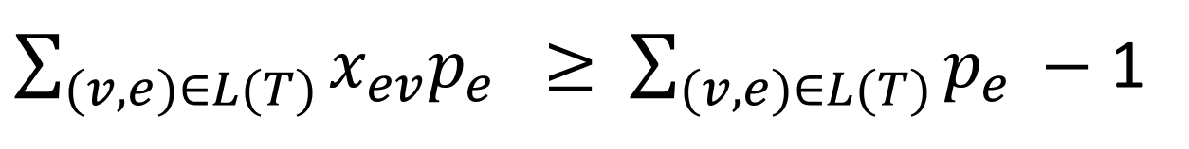
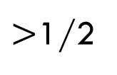
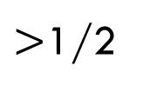
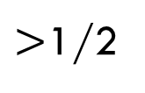
Big trees constraint
$>$1/2
>1/2
>1/2
>1/2
$>$1/2
$>$1/2
$\sum_{(v,e)∈L(T)}{x_{ev}p_{e } ≥ }$ $\sum_{(v,e)∈L(T)}{p_{e }−}$ 1

Slide 20
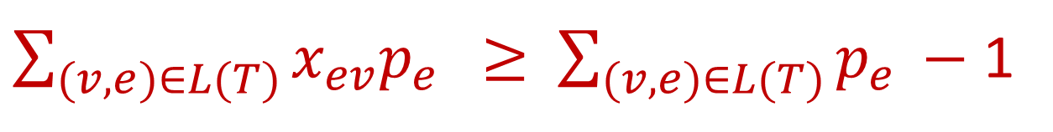
1.75-approximation
Find values x_{ev} ≥ 0, for each e and v∈e, such that
  For each e ∈ E, u,v ∈e:
  x_{eu} + x_{ev} = 1
  For each v ∈ V:
  q_{v} + Σ_{e:v ∈e} x_{ev} p_{e} ≤ 1
  For each T ∈ G^{B} (graph induced on big edges)
$\sum_{(v,e)∈L(T)}{x_{ev}p_{e } ≥ }$ $\sum_{(v,e)∈L(T)}{p_{e }−}$ 1

Slide 21
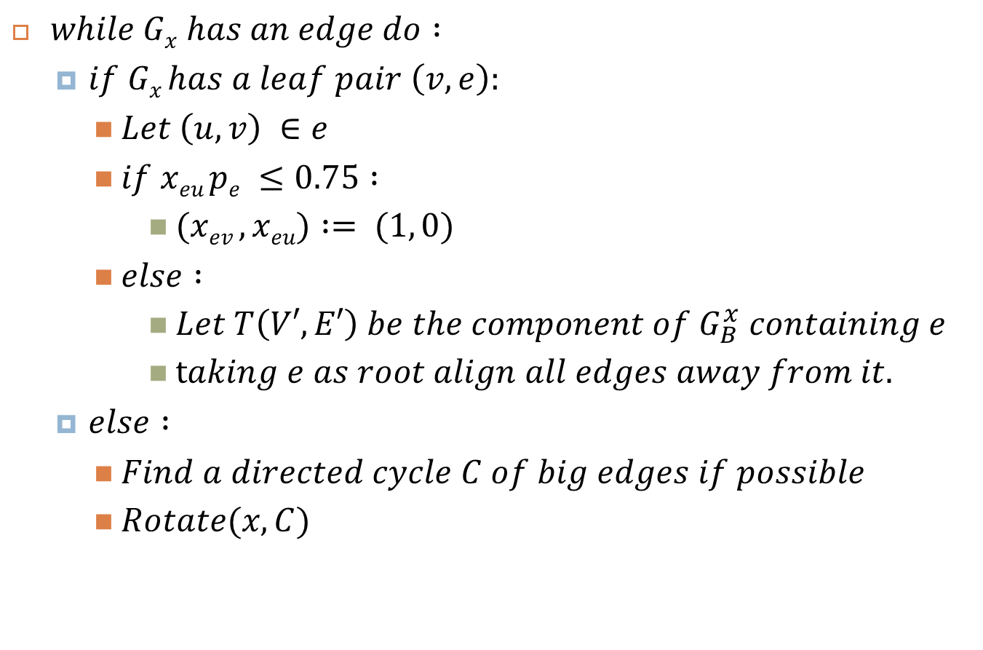


Algorithm
$while Gx has an edge do :$
  $if Gx has a leaf pair \left(v, e\right):$
    $Let \left(u,v\right) ∈e$
    $if xeu pe ≤0.75 :$
      $(xev ,xeu) := (1, 0)$
    $else :$
      $Let T\left(V′,E′\right) be the component of G_{B}^{x} containing e$
      $taking e as root align all edges away from it.$
  $else :$
    $Find a directed cycle C of big edges if possible$
    $Rotate(x,C)$
$>$1/2
.9
.1
.1
>1/2
1
>1/2
.9
0
v
>1/2
.3
$>$1/2
.7
.7
$>$1/2
v
.3
.4
.6

Slide 22
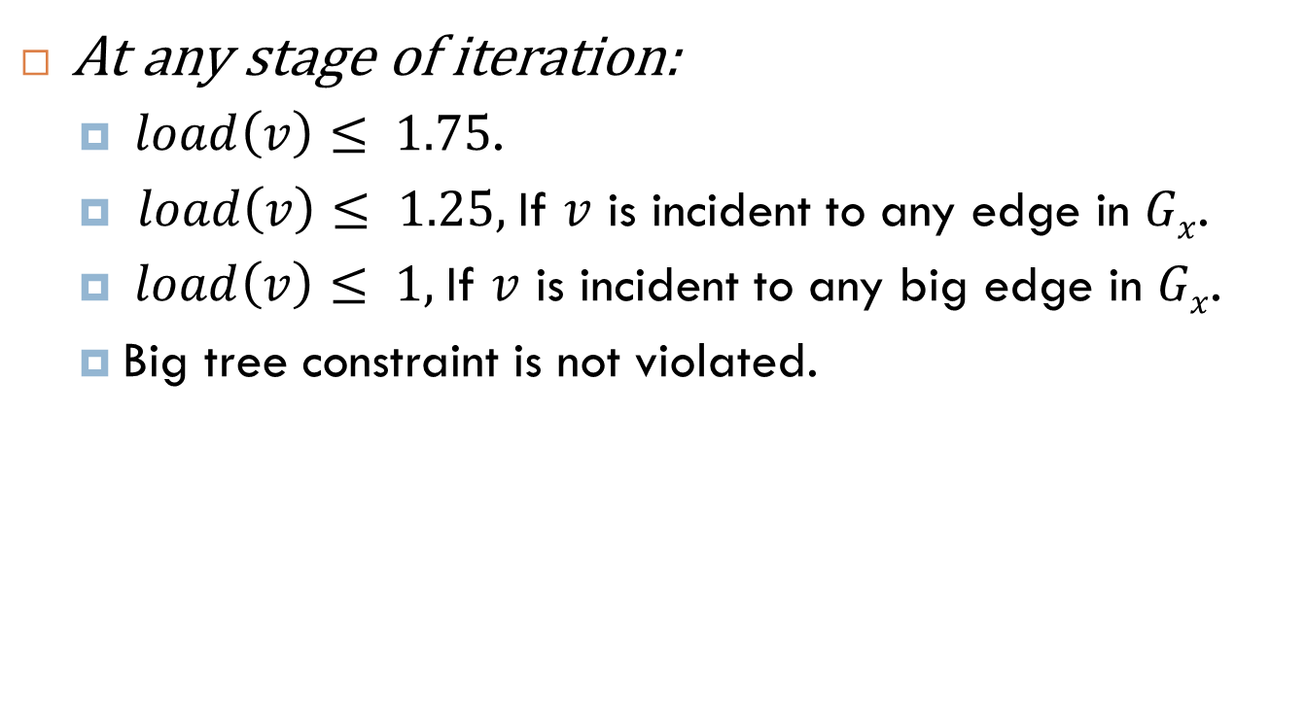
Invariants
At any stage of iteration:
  $load\left(v\right)≤ 1.75$.
  $load\left(v\right)≤ 1.25,$If $v$ is incident to any edge in $Gx$.
  $load\left(v\right)≤ 1,$If $v$ is incident to any big edge in $Gx$.
  Big tree constraint is not violated.

Slide 23

Algorithm
$while Gx has an edge do :$
  $if Gx has a leaf pair \left(v, e\right):$
    $Let \left(u,v\right) ∈e$
    $if xeu pe ≤0.75 :$
      $(xev ,xeu) := (1, 0)$
    $else :$
      $Let T\left(V′,E′\right) be the component of G_{B}^{x} containing e$
      $taking r as root align all edges away from it.$
  $else :$
    $Find a directed cycle C of big edges if possible$
    $Rotate(x,C)$
Case 1: e is a big edge (p_{e} >= 0.5)
Increase in load = p_{e} – x_{ev}p_{e} = x_{eu}p_{e} <= 0.75
Case 2: e is not a big edge (p_{e} < 0.5)
Increase in load = p_{e} – x_{ev}p_{e} < p_{e} < 0.5
Since x_{eu}p_{e} > 0.75, e is definitely a big edge
For any vertex u’ in the tree T, the path joining u’ to v is also a subtree of G_{B}
By the tree constraint,
x_{ev}p_{e} + x_{e’u’}p_{e’} >= p_{e} + p_{e’} -1
p_{e’} – x_{e’u’}p_{e’} <= 1 – (p_{e} - x_{ev}p_{e})
Increase in load <= 0.25

Slide 24






Integrality gap
.25
.25
v`
.25
.25
$$.5− ϵ$$
1
1
1
$$.5− ϵ$$
1
.25
.25
.25
.25
v`
.25
.25
$$.5− ϵ$$
1
1
$$.5− ϵ$$
1
1
.25
.25
.25
.25
1
.25
.25
v`
.25
.25
1
$$.5− ϵ$$
1
1
$$.5− ϵ$$
.25
.25

Slide 25
Thanks!

