Slide 1
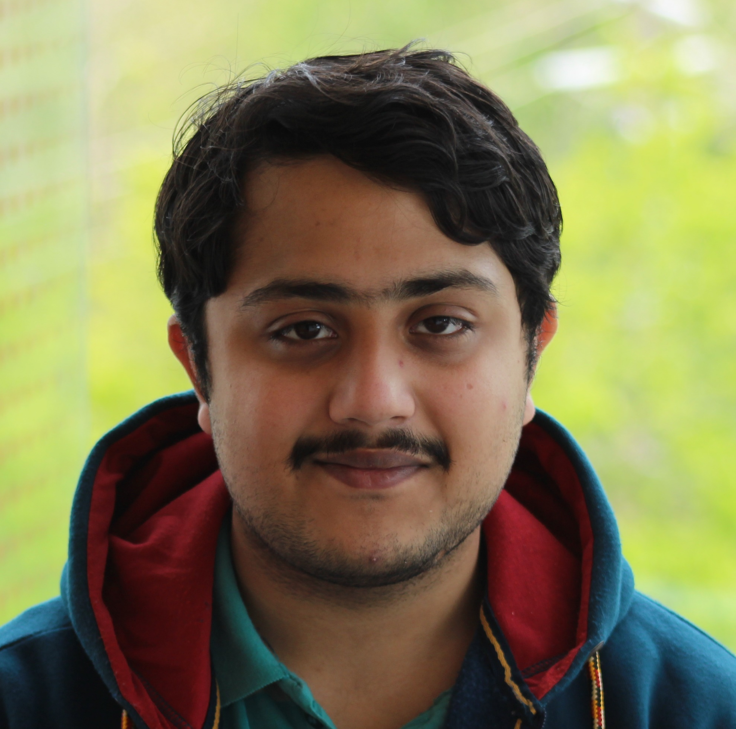

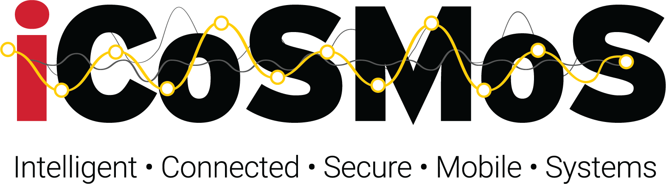
“Is this my president speaking?” Tamper-proofing Speech in Live Recordings
Irtaza Shahid
Nirupam Roy
irtaza@umd.edu
niruroy@umd.edu
Notes:
Hello everyone, I'm Irtaza and today I'll be presenting a tamper-proofing system for speech in live recordings.

Slide 2
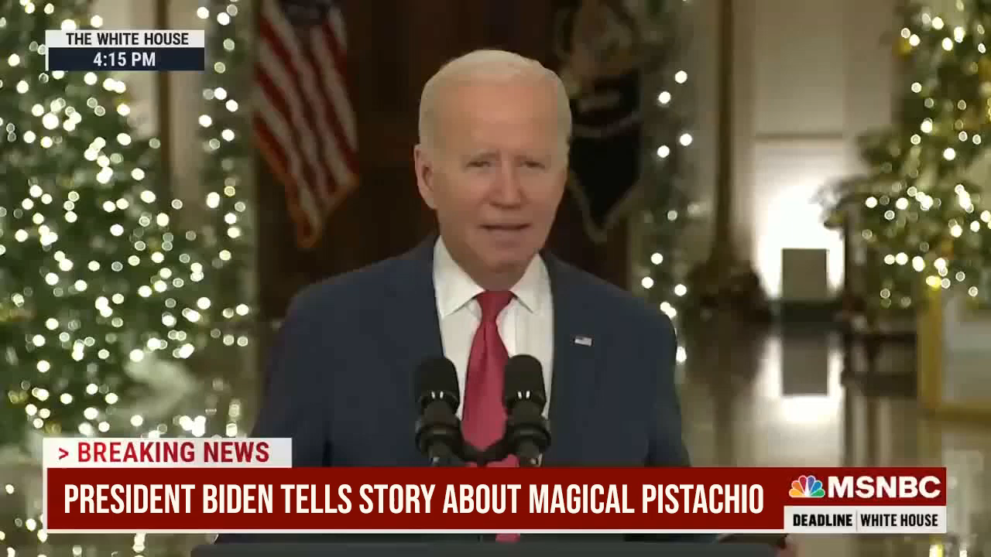

Slide 3
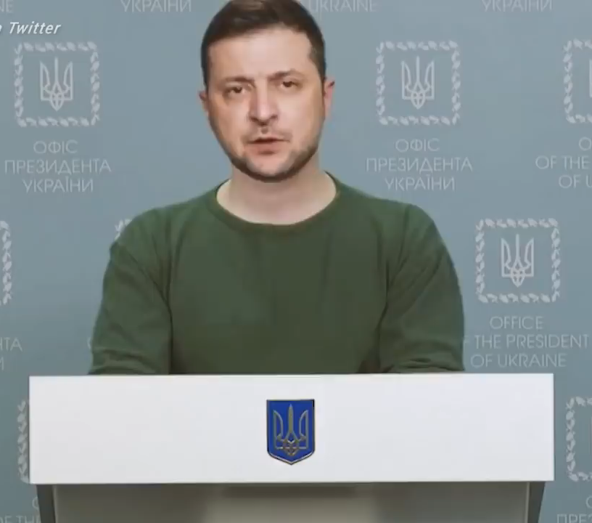
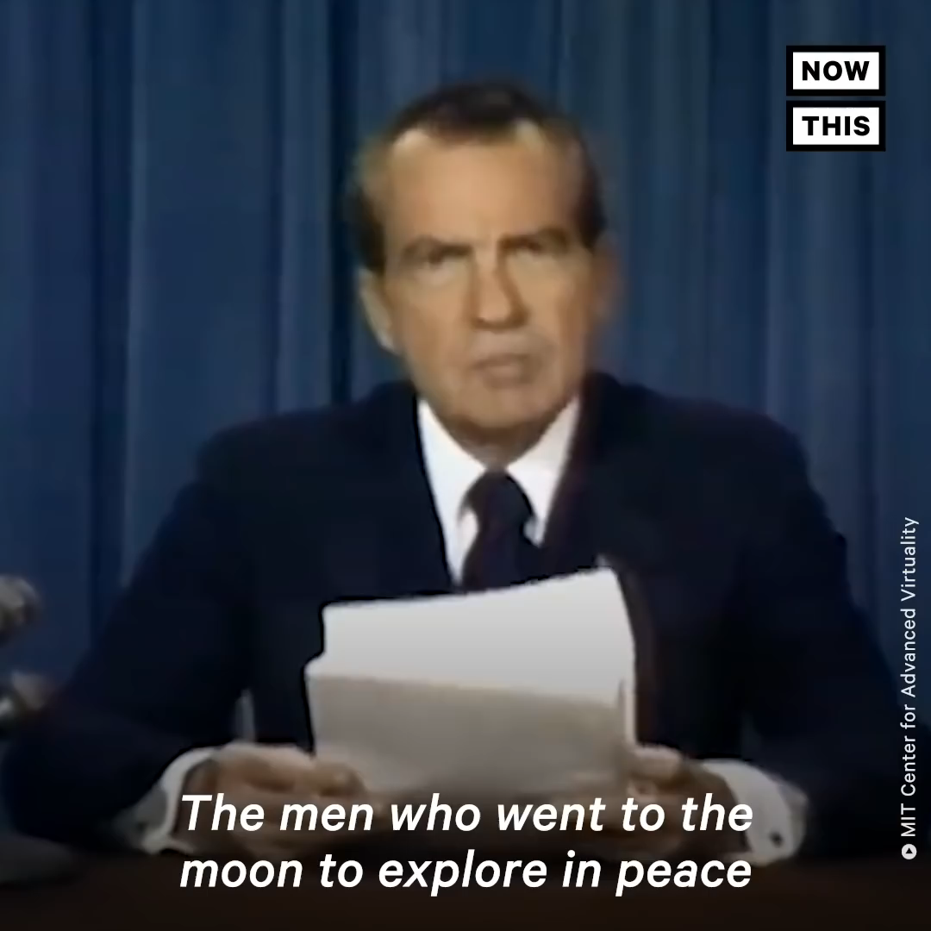
Deep Fake
Deep Fake
Ukrainian President Volodymyr calling on his soldiers to lay down weapons
Nixon discussing about the disaster of moon-landing

Slide 4
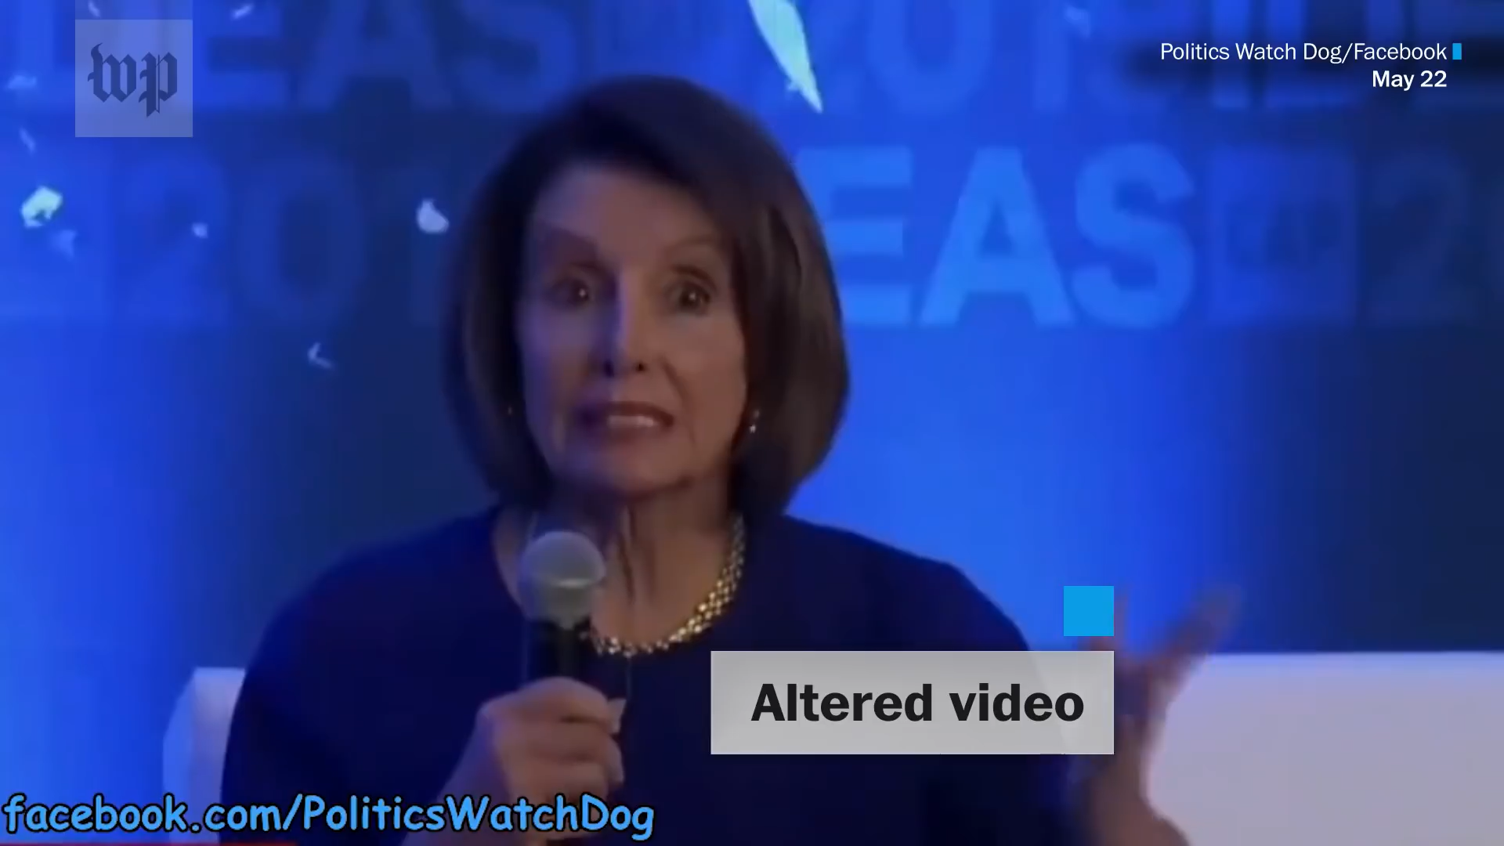
Shallow Fake
Fake video of Nancy Pelosy make her to be intoxicated drunk

Slide 5
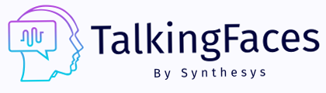
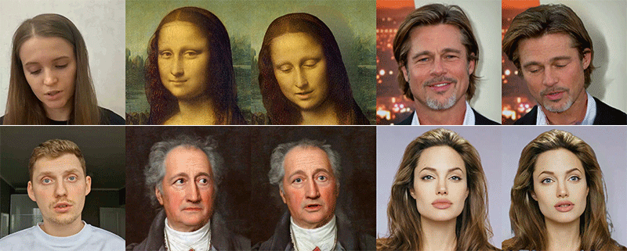

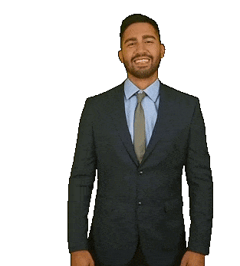

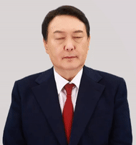
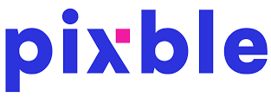






MegaPortraits: High-Res Deepfakes

Slide 6
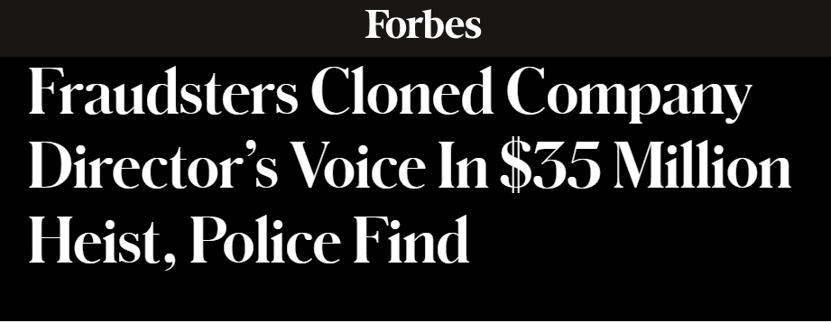

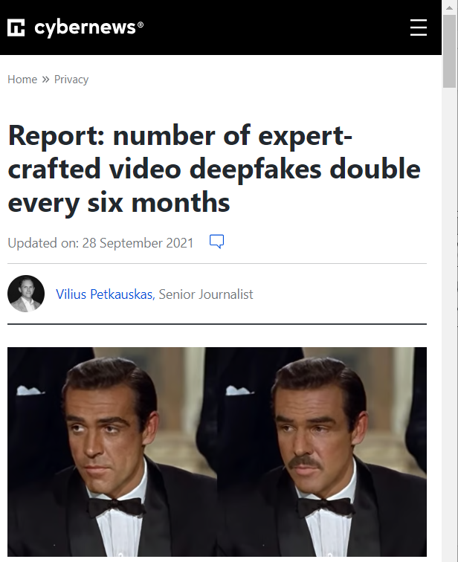
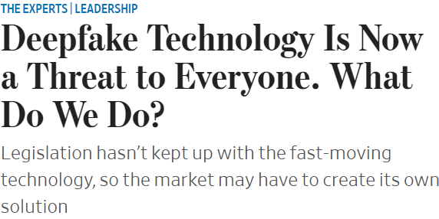
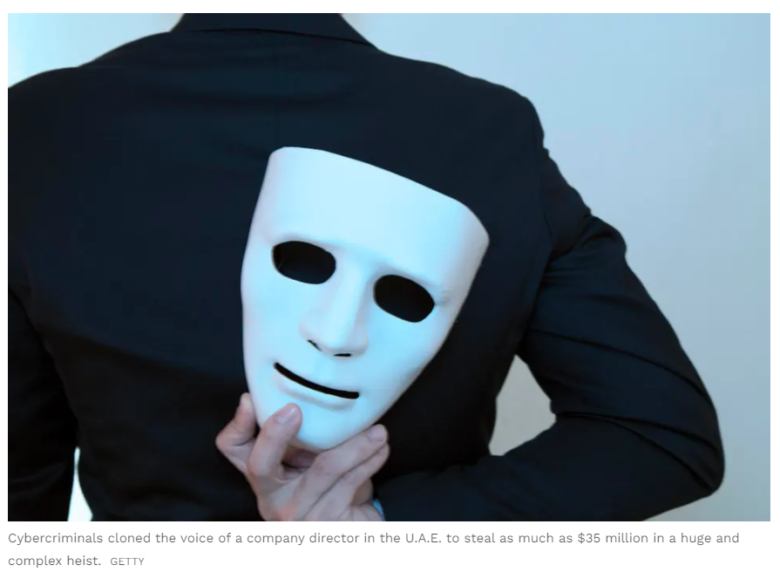


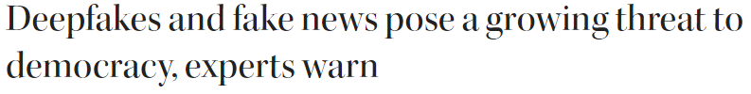
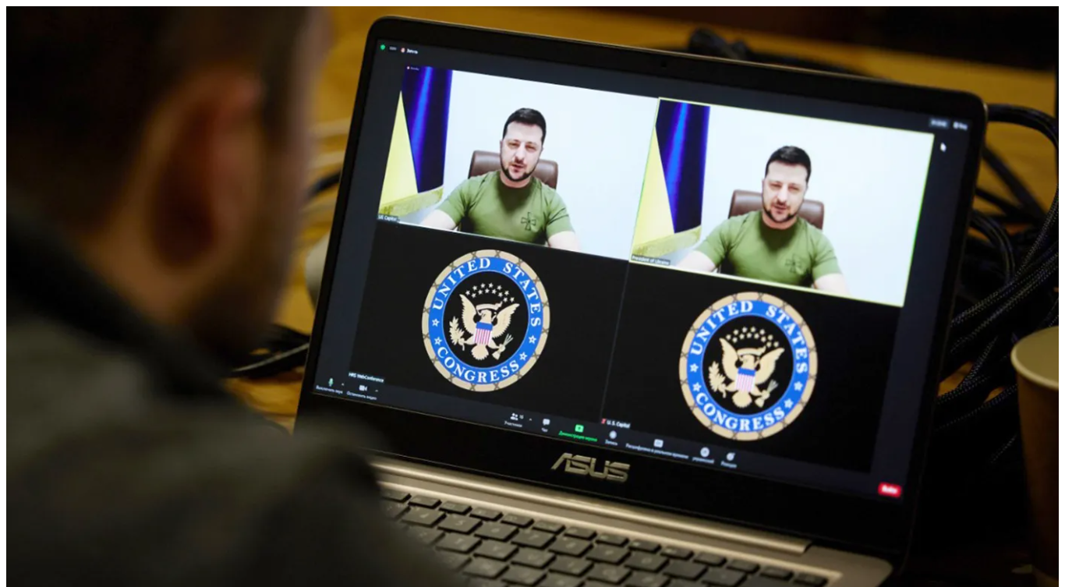
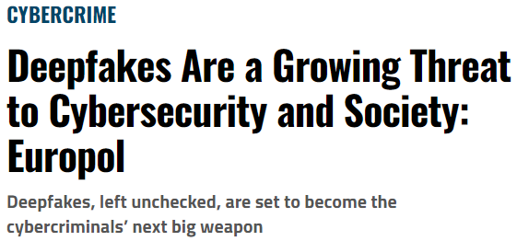
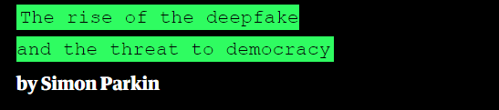
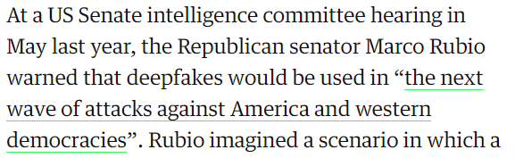

Slide 7
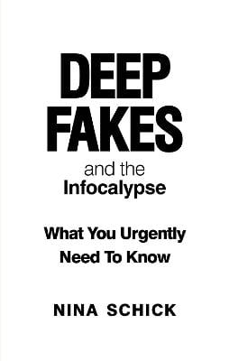
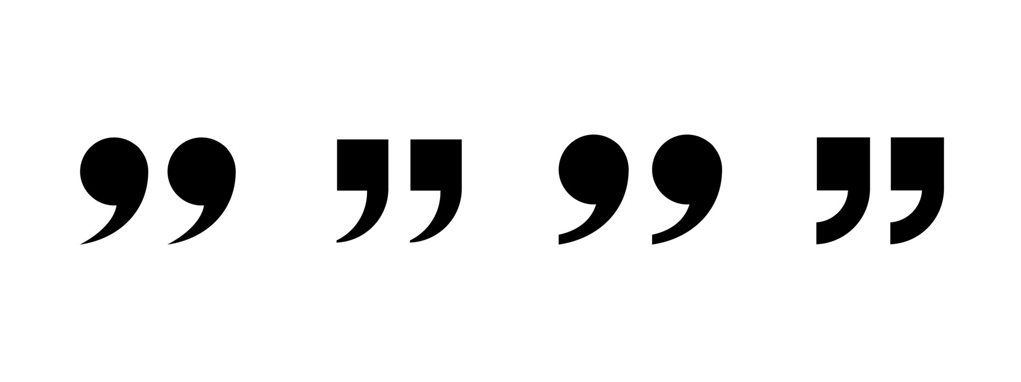
Deep Fakes can be misused to shift public opinion, swing presidential elections, blackmail, and silence individuals.

Slide 8
Deep Fakes can be misused to shift public opinion, swing presidential elections, blackmail, and silence individuals.
Can we prevent deepfake/shallowfake?

Slide 9
Existing Solutions
Digital Watermarking
Provenance Information

Slide 10




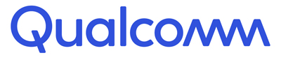




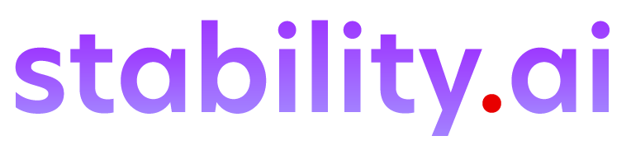
Existing Solutions

Slide 11
Existing Solutions
Rely on embedding meta-information

Slide 12

Limitation
1. Requires source control

Slide 13
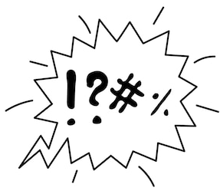

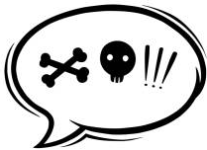
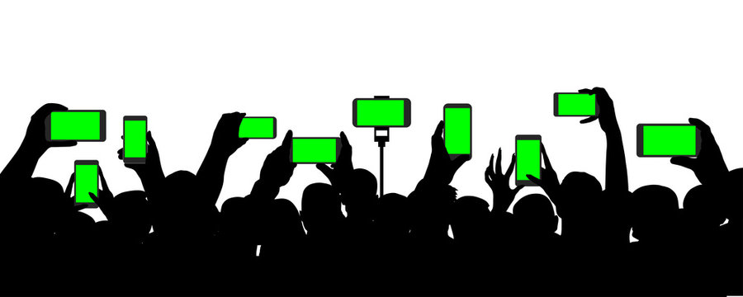
Limitation
1. Requires source control
2. Restrict audience to use specific software

Slide 14
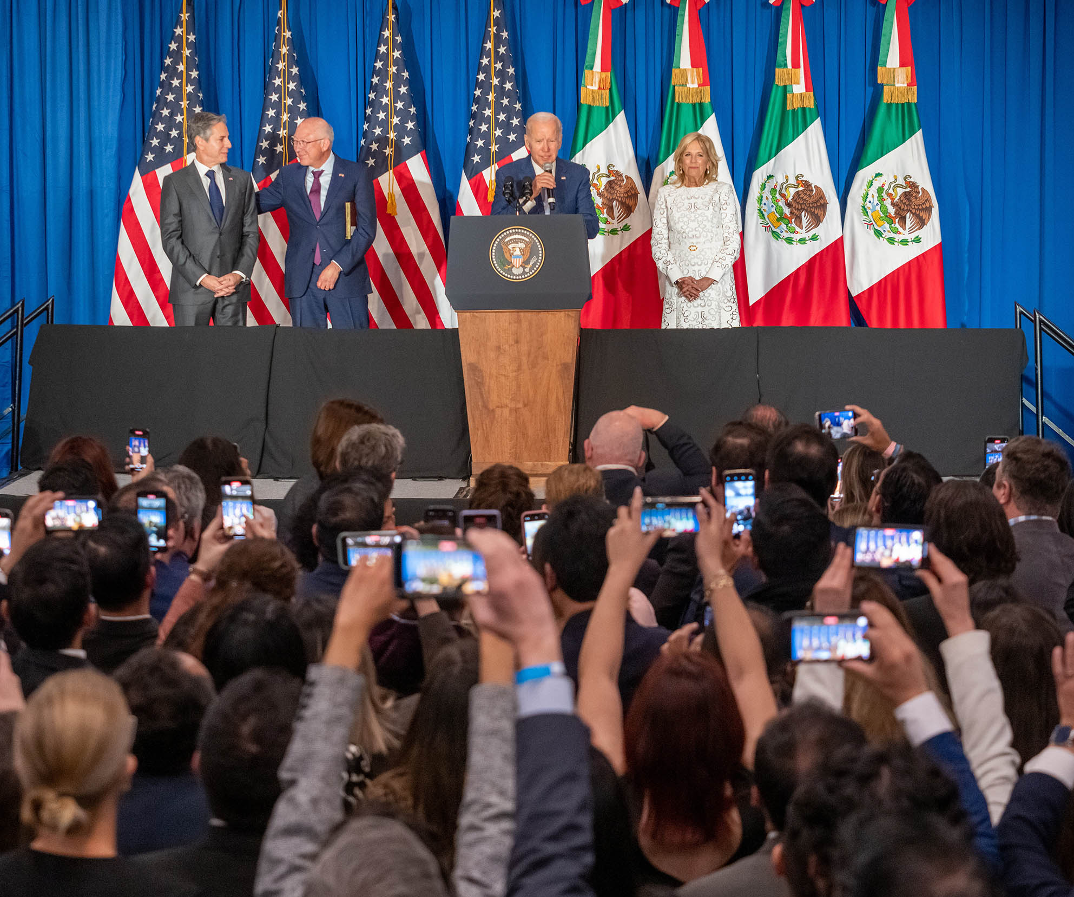

Slide 15
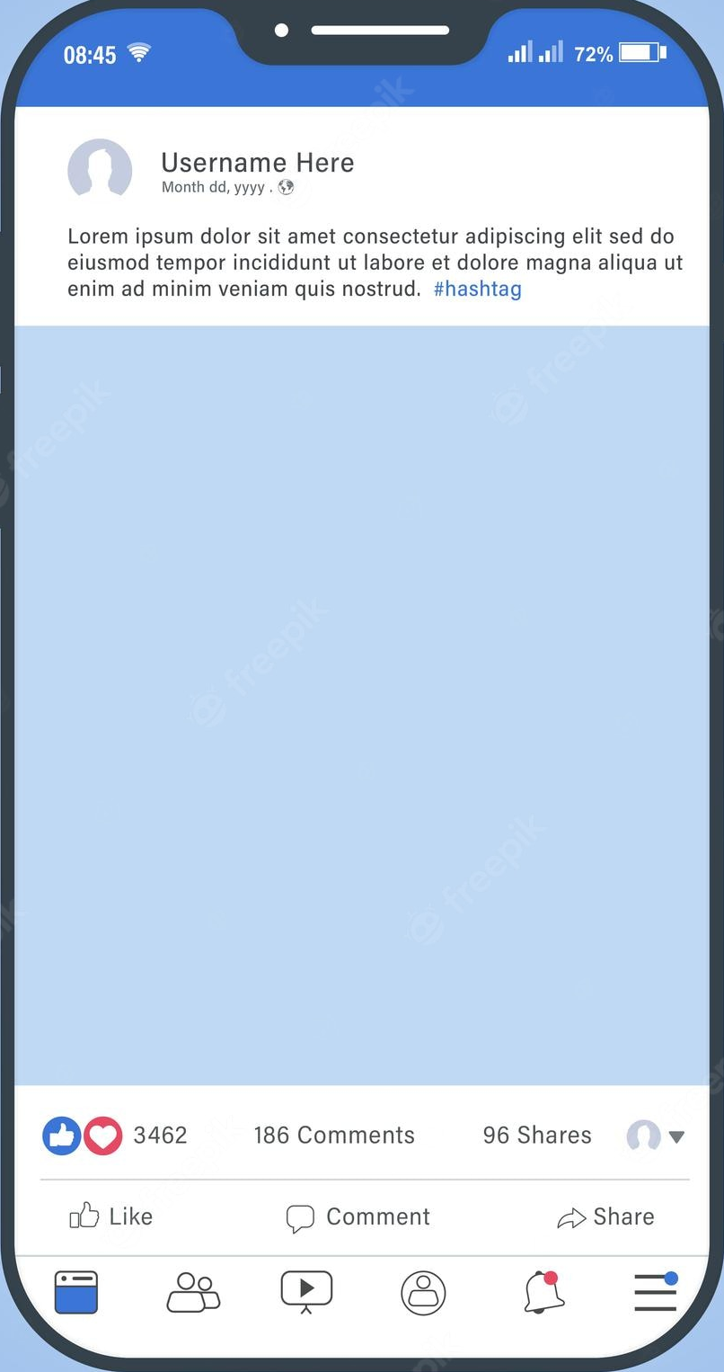
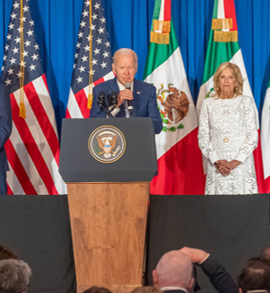

Slide 16
Is it possible to verify live speech when anyone from the audience can record and publish it?

Slide 17

TalkLock
Fake?

Slide 18

Adversary Model

Slide 19

Adversary Model
Directly Record

Slide 20
Adversary Model
Directly Record
Malicious
Modification
Imperceptible
Free from artifacts

Slide 21

Adversary Model
Directly Record
Malicious
Modification
Distribute
Publicly
Imperceptible
Free from artifacts

Slide 22
Adversary Model
Directly Record
Malicious
Modification
Distribute
Publicly
Imperceptible
Free from artifacts

Slide 23
Adversary Model
Information known:
✓ System design
✓ Feature extraction
✓ Verification process
✗ Weights of Neural Network
Directly Record
Malicious
Modification
Distribute
Publicly
Imperceptible
Free from artifacts

Slide 24


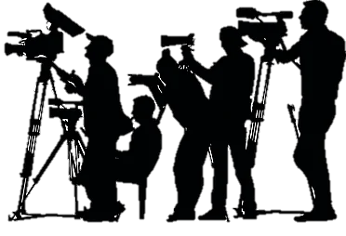

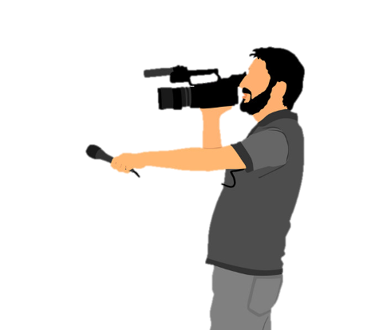
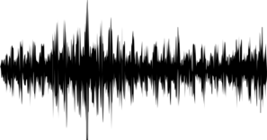
TalkLock
Audiovisual
recording
Live speaker
Notes:
Let’s delve and see how TalkLock able to achieve this…

Slide 25
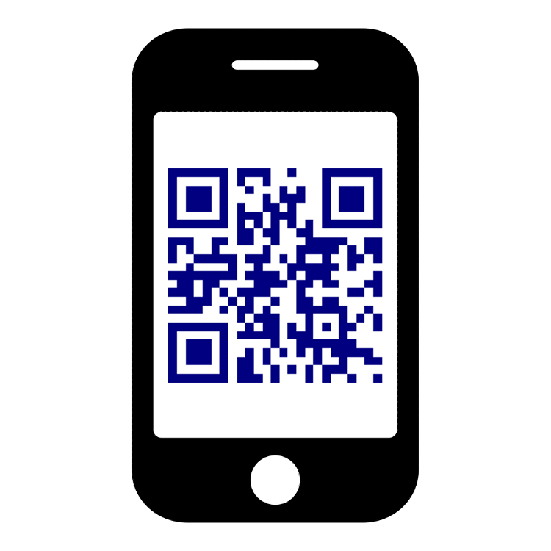
TalkLock
Audiovisual
recording
Live speaker
1. Live Speech Signature Embedding Module
Notes:
To deliver a verifiable speech, the speaker simply needs to place a "signature embedding module" while delivering the speech.

Slide 26
TalkLock
Audiovisual
recording
Live speaker
Speech
1. Live Speech Signature Embedding Module
Notes:
This module captures the speech signal, and …

Slide 27
TalkLock
Audiovisual
recording
Live speaker
QR Code
1. Live Speech Signature Embedding Module
Notes:
generates a cryptographically secure QR code containing immutable meta-information about the speech audio.

Slide 28
TalkLock
Audiovisual
recording
Live speaker
1. Live Speech Signature Embedding Module
QR Code
Notes:
This meta-information is automatically embedded into the recording without any additional requirements or steps from the audience.

Slide 29
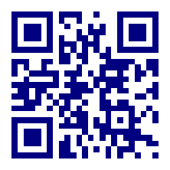
TalkLock
Audiovisual
recording
Live speaker
QR code
1. Live Speech Signature Embedding Module
Notes:
For verification purposes, the system extracts the secure meta-information embedded in the QR code

Slide 30
TalkLock
Audiovisual
recording
Live speaker
QR code
1. Live Speech Signature Embedding Module
Speech signal
Notes:
along with the speech audio from the recording.

Slide 31
TalkLock
Audiovisual
recording
Live speaker
QR code
1. Live Speech Signature Embedding Module
2. Speech Integrity Verification Module
Speech signal
Notes:
A verification module then compare these information to verify the authenticity of the content.
In this way, TalkLock enables “anyone” in the audience to record a verifiable video.

Slide 32
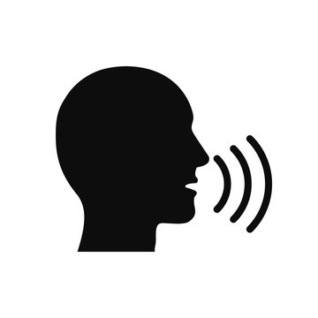
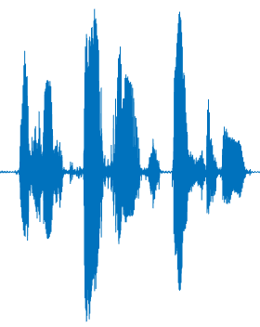

Challenges
Channel Distortion
Ch₁
Ch₂
≠
≠
Notes:
There are three key challenges in realizing TalkLock

Slide 33
Channel Distortion
Speech
d

Slide 34
Channel Distortion
Speech
Ch₁
d
Y₁ = channel₁ * S

Slide 35
Channel Distortion
Speech
Ch₁
Ch₂
d
Y₁ = channel₁ * S
Y₂ = channel₂ * S

Slide 36
Channel Distortion
Speech
Ch₁
Ch₂
d
≠
Y₁ = channel₁ * S
Y₂ = channel₂ * S

Slide 37

Challenges
Channel Distortion
Adversary Attack
Ch₁
Ch₂
Modify
≠
Notes:
There are three key challenges in realizing TalkLock

Slide 38
Adversary Attack
Speech Video
Speech Integrity Verification
Speech Audio

Slide 39
Adversary Attack
TalkLock
Speech Video
Attacker
Speech Integrity Verification
Speech Audio

Slide 40
Adversary Attack
TalkLock
Speech Video
Modify
Attacker
Speech Integrity Verification
Speech Audio

Slide 41
Challenges
Channel Distortion
Adversary Attack
Limited Data Rate
X
Ch₁
Ch₂
Modify
≠
Notes:
There are three key challenges in realizing TalkLock

Slide 42
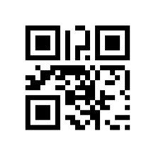
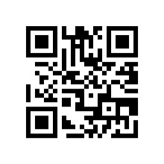
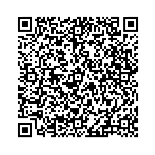

Limited Data Rate
…
……….
1
2
10
40
QR Code Version

Slide 43


Limited Data Rate
…
……….
1
2
10
40
QR Code Version
DAC
Minimum
Sampling Rate
8KHz
32KB

Slide 44
Limited Data Rate
…
……….
1
2
10
40
QR Code Version
Max
3KB
DAC
Data
8KHz
32KB
Version 40
Minimum
Sampling Rate

Slide 45
TalkLock
Live speaker
1
Live Speech-Signature Embedding
Channel
Normalization
Feature
extraction
Secure QR
code
Notes:
There are three key components in TalkLock

Slide 46
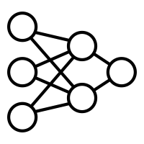
TalkLock
Live speaker
1
Live Speech-Signature Embedding
Channel
Normalization
Feature
extraction
Secure QR
code
Speech Recording
2
Speech Integrity Verification
QR Code decoding &
feature recovery
Siamese net
Fake/Real
+
Channel normalization &
feature extraction
Notes:
There are three key components in TalkLock

Slide 47
TalkLock
Live speaker
1
Live Speech-Signature Embedding
Channel
Normalization
Feature
extraction
Secure QR
code
Speech Recording
2
Speech Integrity Verification
QR Code decoding &
feature recovery
Siamese net
Fake/Real
+
Channel normalization &
feature extraction
Notes:
There are three key components in TalkLock

Slide 48
Channel Normalization
Speech
Z₁ | Z₂ | Z₃ | … | Z_{T}
Y₁ | Y₂ | Y₃ | … | Y_{T}
X₁ | X₂ | X₃ | … | X_{T}
frequency
time

Slide 49
Channel Normalization
Channel Effect: Frequency Selective Fading
Speech
Z₁ | Z₂ | Z₃ | … | Z_{T}
Y₁ | Y₂ | Y₃ | … | Y_{T}
X₁ | X₂ | X₃ | … | X_{T}
a
b
c
frequency
time

Slide 50
Channel Normalization
Channel Effect: Frequency Selective Fading
Speech
Received Signal
Z₁ | Z₂ | Z₃ | … | Z_{T}
Y₁ | Y₂ | Y₃ | … | Y_{T}
X₁ | X₂ | X₃ | … | X_{T}
a
b
c
aZ₁ | aZ₂ | aZ₃ | … | aZ_{T}
bY₁ | bY₂ | bY₃ | … | bY_{T}
cX₁ | cX₂ | cX₃ | … | cX_{T}
Channel
frequency
frequency
time
time

Slide 51
Channel Normalization
Normalize each frequency by dividing it with the highest element in that frequency
Received Signal
Normalized Signal
aZ₁ | aZ₂ | aZ₃ | … | aZ_{T}
bY₁ | bY₂ | bY₃ | … | bY_{T}
cX₁ | cX₂ | cX₃ | … | cX_{T}
Z₁/Z_{M} | Z₂/Z_{M} | Z₃/Z_{M} | … | Z_{T}/Z_{M}
Y₁/Y_{M} | Y₂/Y_{M} | Y₃/Y_{M} | … | Y_{T}/Y_{M}
X₁/X_{M} | X₂/X_{M} | X₃/X_{M} | … | X_{T}/X_{M}
Normalization
frequency
frequency
time
time

Slide 52
TalkLock
Live speaker
1
Live Speech-Signature Embedding
Channel
Normalization
Feature
extraction
Secure QR
code
Speech Recording
2
Speech Integrity Verification
QR Code decoding &
feature recovery
Siamese net
Fake/Real
+
Channel normalization &
feature extraction
Notes:
There are three key components in TalkLock

Slide 53
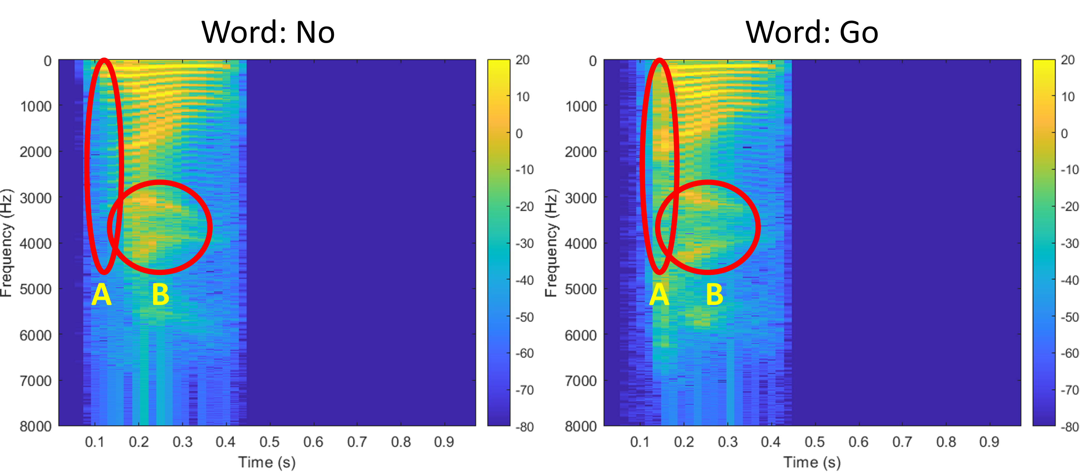
Feature Extraction
Time-Energy Modulation:
Captures the distribution of energy across time.
Time-Frequency Convolutional:
Captures the distribution of energy across harmonics.
Notes:
We have designed two types of features that can capture even minute subtleties in spoken words.
First one is Time Energy modulation which captures how energy is distributed across time
And Second is Time-Frequency Convolutional features which captures how energy is distributed across different harmonics and formants.
You can see from the spectrograms of two closely sounding words that energy uniquely distributed across time and frequency.

Slide 54
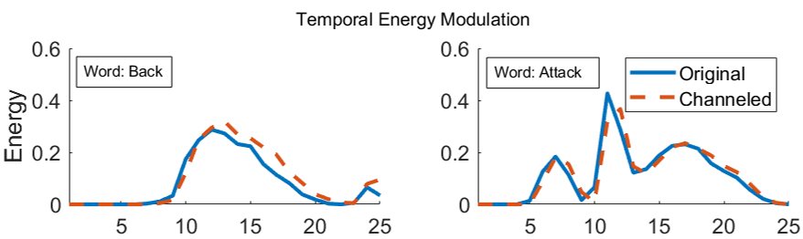
Feature Extraction
Notes:
We have designed two types of features that can capture even minute subtleties in spoken words.
First one is Time Energy modulation which captures how energy is distributed across time
And Second is Time-Frequency Convolutional features which captures how energy is distributed across different harmonics and formants.
You can see from the spectrograms of two closely sounding words that energy uniquely distributed across time and frequency.

Slide 55
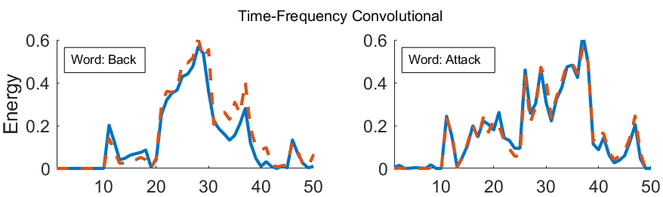
Feature Extraction
Notes:
We have designed two types of features that can capture even minute subtleties in spoken words.
First one is Time Energy modulation which captures how energy is distributed across time
And Second is Time-Frequency Convolutional features which captures how energy is distributed across different harmonics and formants.
You can see from the spectrograms of two closely sounding words that energy uniquely distributed across time and frequency.

Slide 56
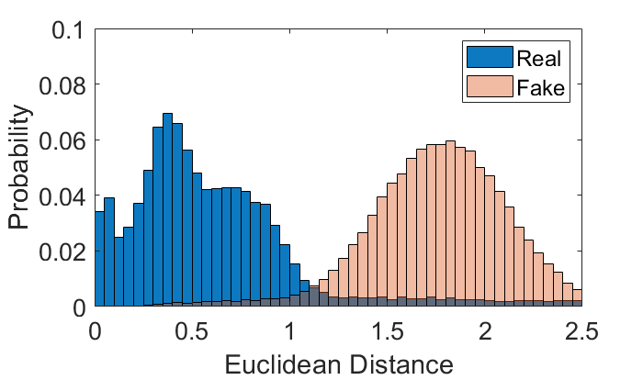
Feature Extraction
Notes:
We have designed two types of features that can capture even minute subtleties in spoken words.
First one is Time Energy modulation which captures how energy is distributed across time
And Second is Time-Frequency Convolutional features which captures how energy is distributed across different harmonics and formants.
You can see from the spectrograms of two closely sounding words that energy uniquely distributed across time and frequency.

Slide 57
TalkLock
Live speaker
1
Live Speech-Signature Embedding
Channel
Normalization
Feature
extraction
Secure QR
code
Speech Recording
2
Speech Integrity Verification
QR Code decoding &
feature recovery
Siamese net
Fake/Real
+
Channel normalization &
feature extraction
Notes:
There are three key components in TalkLock

Slide 58
Secure Meta-information
Element counts
100
200
1
32
Byte# 2
Temporal Energy
Modulation Features
Time-Frequency
Convolutional Features
Packet
Index
Digital
Signature
Byte# 1
Elliptic Curve
key encryption
Notes:
Now that we have generated features, we digitally signed features using speaker’s private key before embedding into the QR code.
The part is critical because it ensures that no adversary can modify content and corresponding meta-information to pass our verification system.

Slide 59
TalkLock
Live speaker
1
Live Speech-Signature Embedding
Channel
Normalization
Feature
extraction
Secure QR
code
Speech Recording
2
Speech Integrity Verification
QR Code decoding &
feature recovery
Siamese net
Fake/Real
+
Channel normalization &
feature extraction
Notes:
There are three key components in TalkLock

Slide 60
TalkLock
Live speaker
1
Live Speech-Signature Embedding
Channel
Normalization
Feature
extraction
Secure QR
code
Speech Recording
2
Speech Integrity Verification
QR Code decoding &
feature recovery
Siamese net
Fake/Real
+
Channel normalization &
feature extraction
Notes:
There are three key components in TalkLock

Slide 61
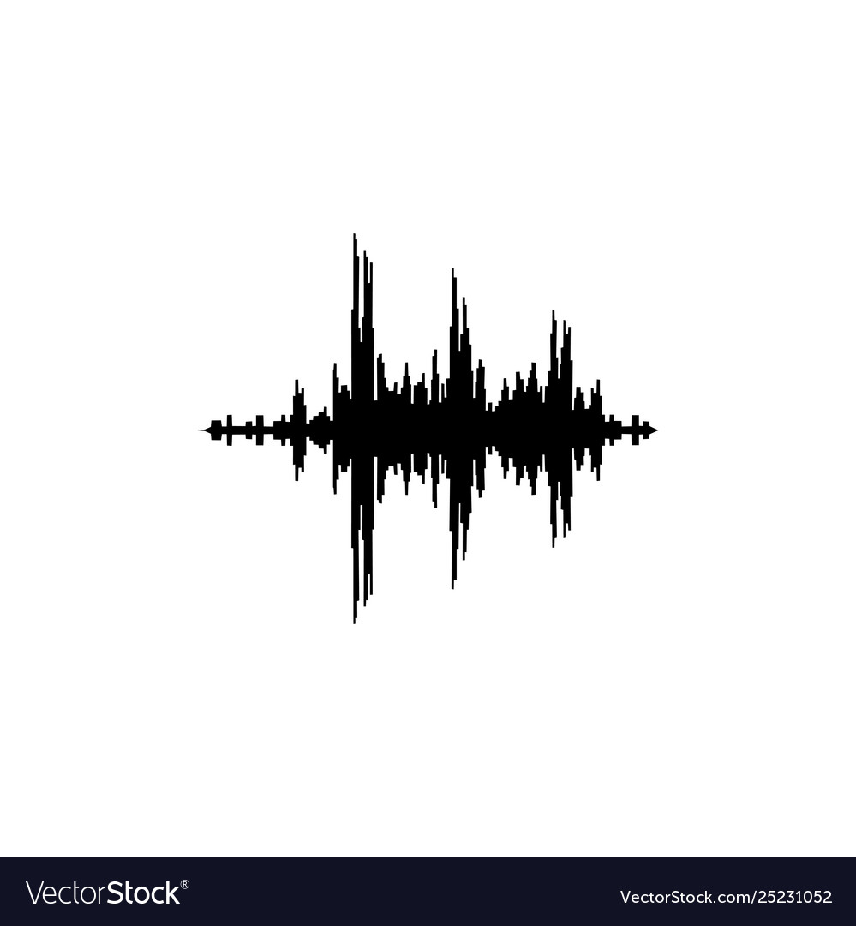

Speech Integrity Verification
(150x1)
Convolution layers
Features
Speech
(64x4)
(32x8)
(16x16)
(16x16)
(8x16)
Fake/Real
QR code
Classification Network
Features
(64x4)
(32x8)
(16x16)
(16x16)
(8x16)
(150x1)
Convolution layers
Siamese Network
Notes:
For final verification, TalkLock extract features from the recorded audio and extract meta-information from the QRcode and then we have trained Siamese Network which take these two pieces of information for integrity classification.

Slide 62
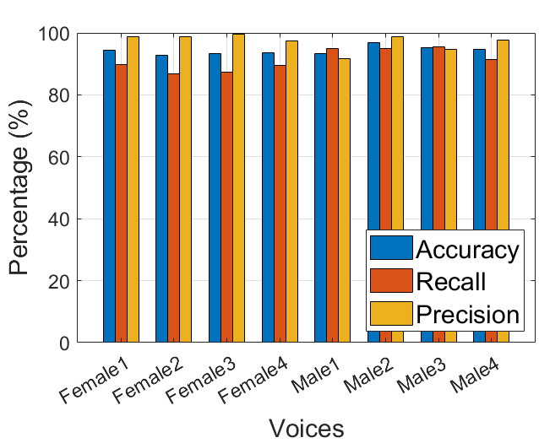
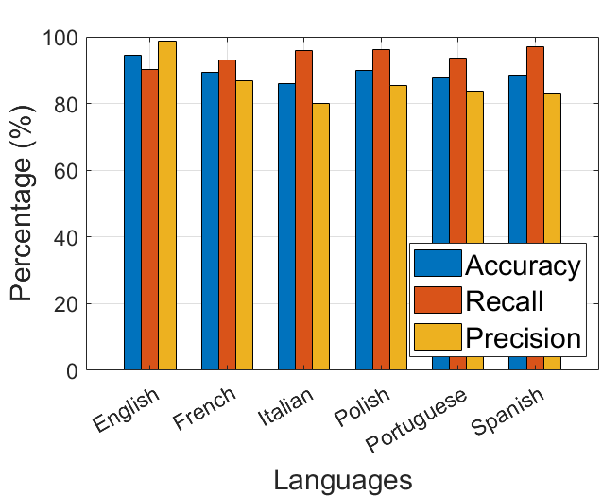
Voices and Languages
Notes:
Now that we have generated features, we digitally signed features using speaker’s private key before embedding into the QR code.
The part is critical because it ensures that no adversary can modify content and corresponding meta-information to pass our verification system.

Slide 63
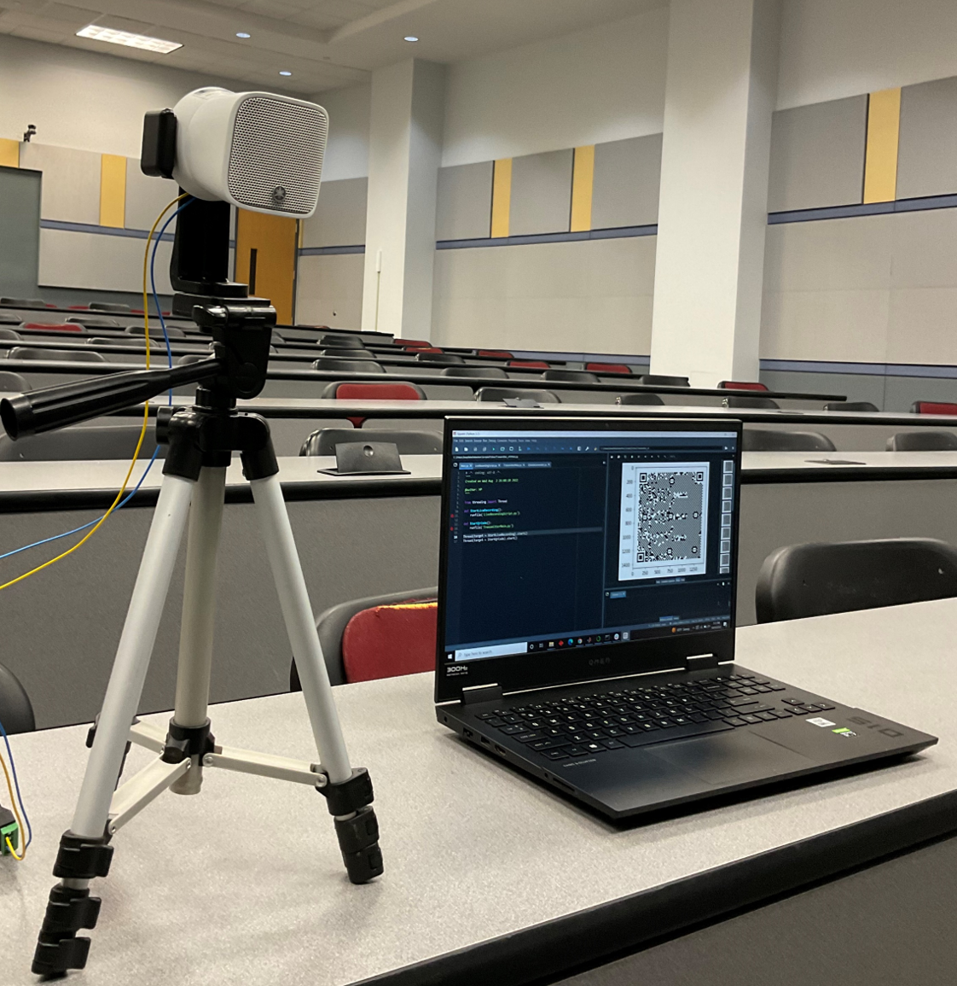
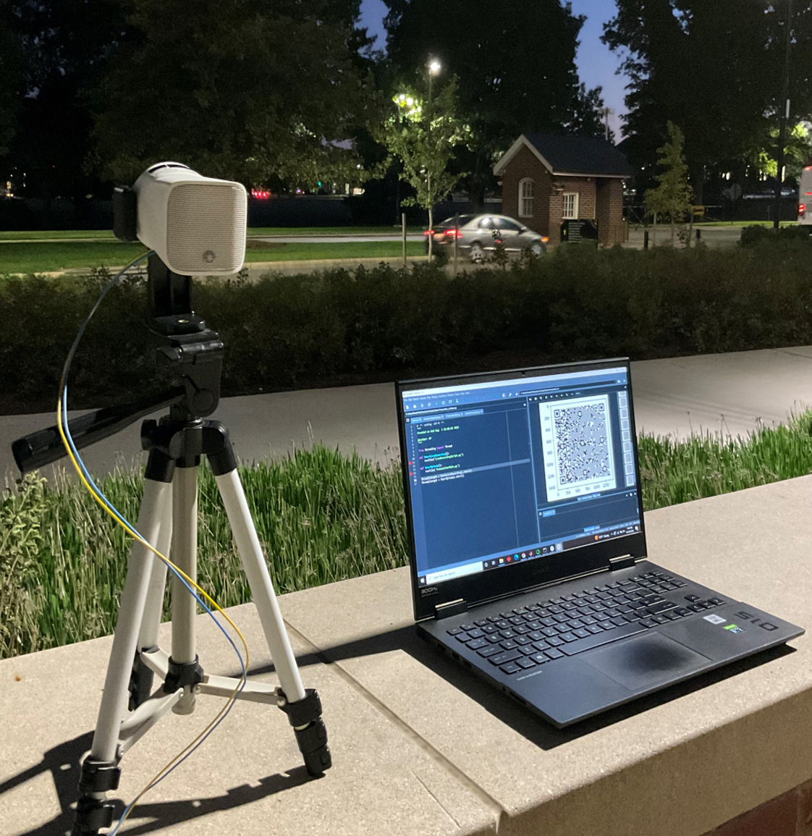



Diverse Environments
Notes:
Now that we have generated features, we digitally signed features using speaker’s private key before embedding into the QR code.
The part is critical because it ensures that no adversary can modify content and corresponding meta-information to pass our verification system.

Slide 64


User Study
Notes:
Now that we have generated features, we digitally signed features using speaker’s private key before embedding into the QR code.
The part is critical because it ensures that no adversary can modify content and corresponding meta-information to pass our verification system.

Slide 65


Various Codecs
Notes:
Now that we have generated features, we digitally signed features using speaker’s private key before embedding into the QR code.
The part is critical because it ensures that no adversary can modify content and corresponding meta-information to pass our verification system.

Slide 66

TalkLock
Enable “anyone” to record a verifiable video
Applicable to any speaker and language
Robust in real-world environments
Compatible across platforms
Notes:
To learn more about the challenges and crucial details involved in implementing this system, I invite you all to attend our talk at MobiSys and read our paper.

Slide 67
TalkLock: Tamper-proofing Speech in Live Recordings
Irtaza Shahid
irtaza@umd.edu
Notes:
Thank you!

