Slide 1






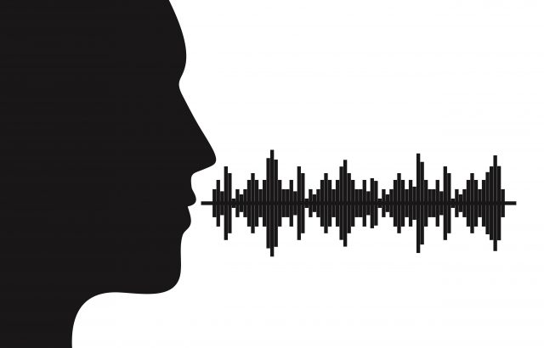


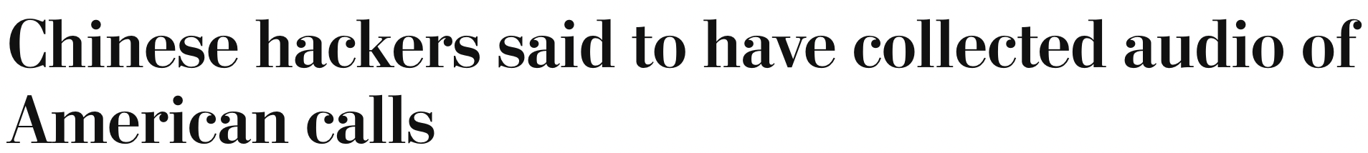

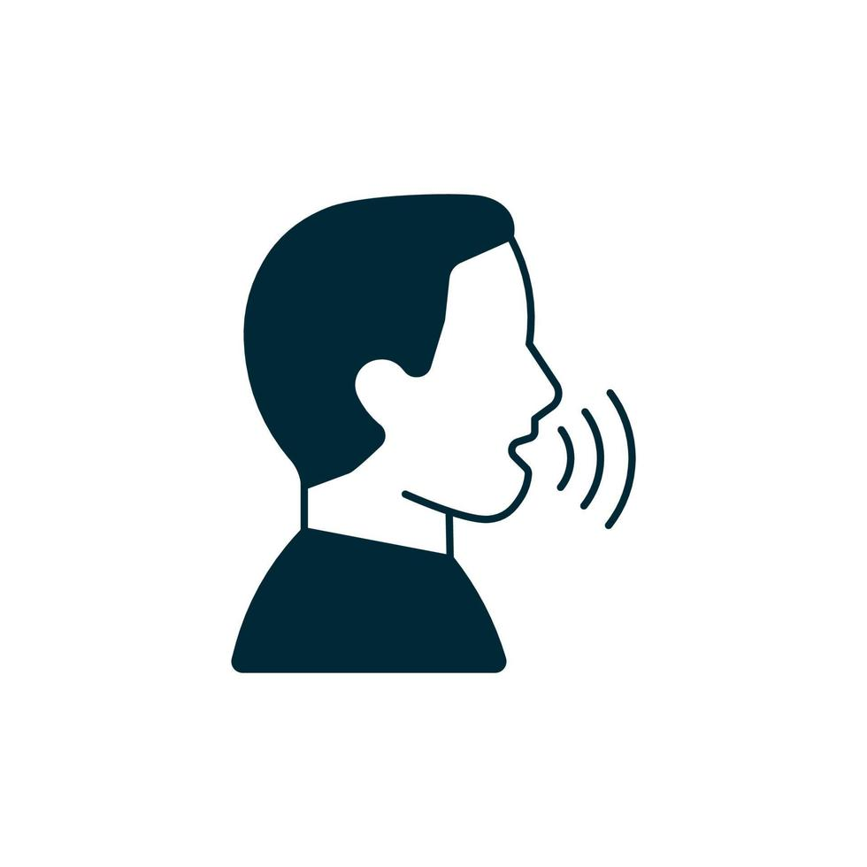
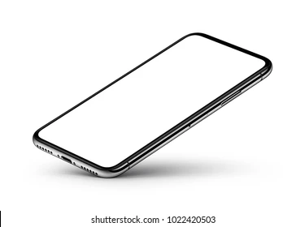









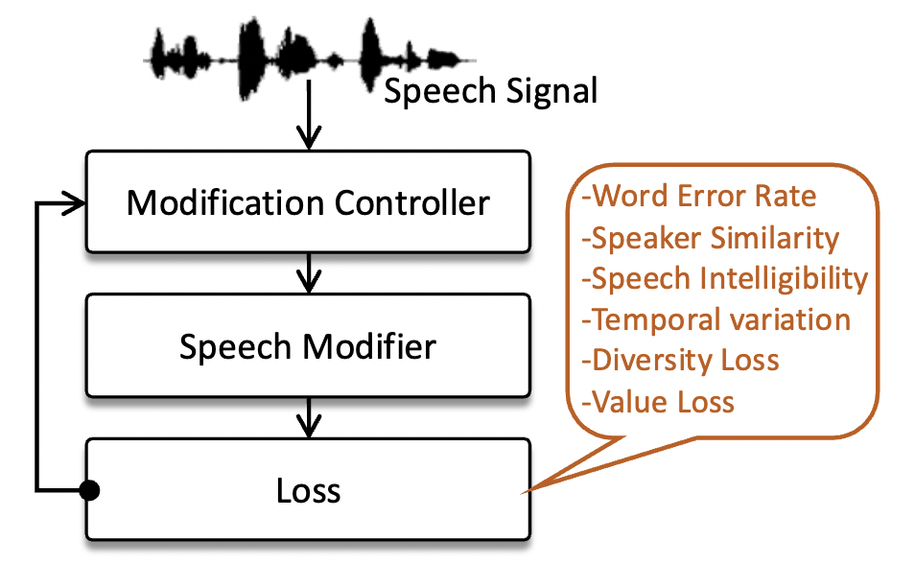
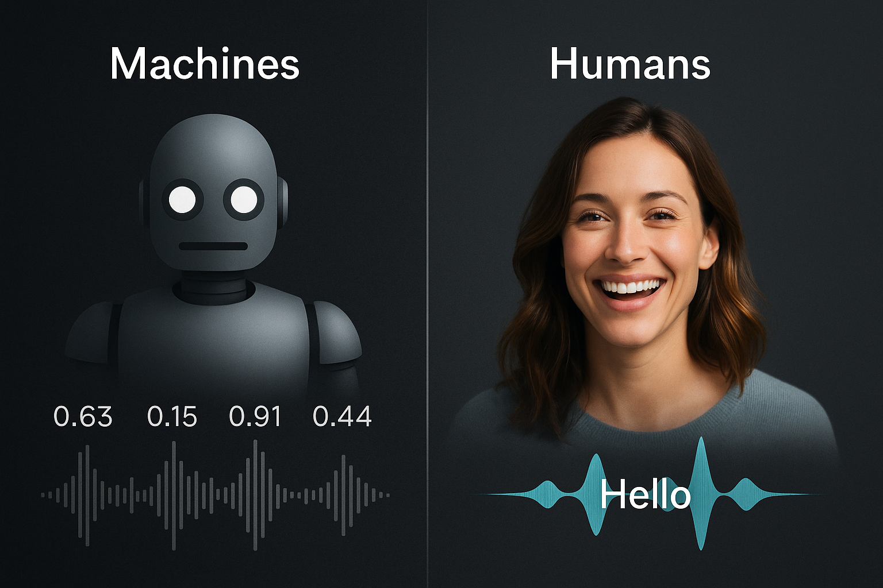
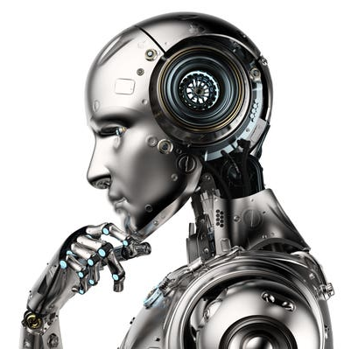
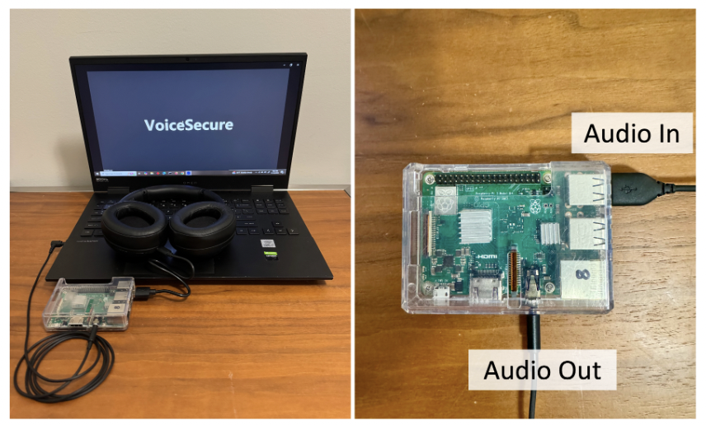
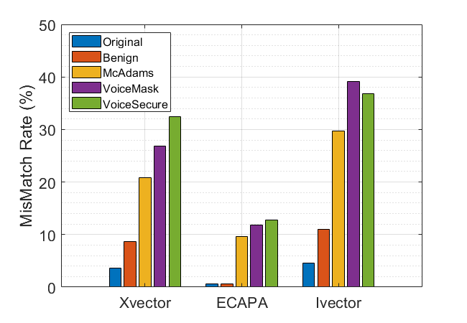
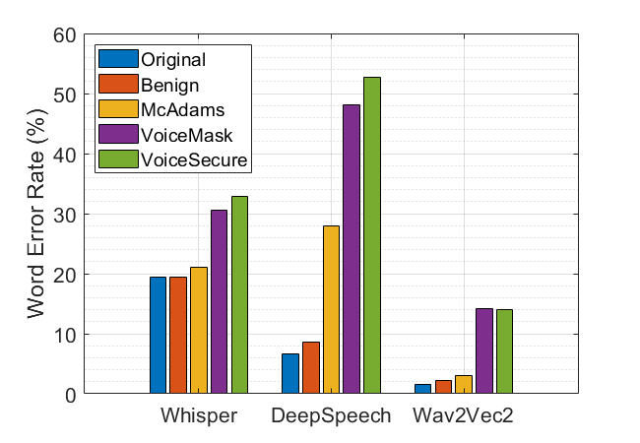
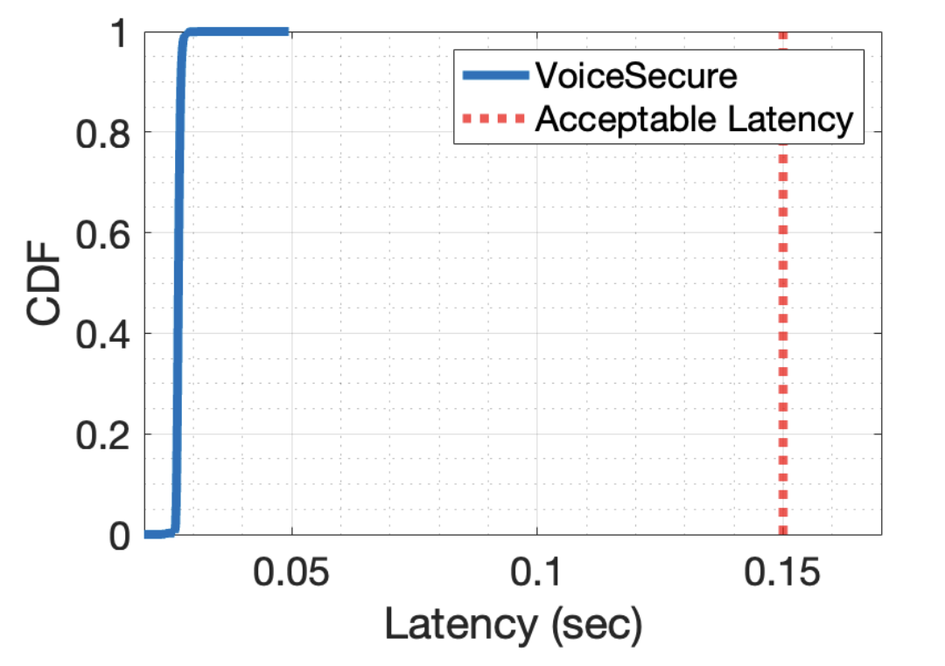



For Human Ears Only: Preventing Automated Monitoring on Voice Data
Irtaza Shahid, Nirupam Roy
University of Maryland, College Park
Over 95% data is transferred digitally
Huge Privacy Concern
Speech Content
Speaker Identity
Gender
Geography
Age
Emotional cues
Health signatures
Adversary Model
Compromised
User Devices
(Malware)
Untrusted
Network
(Eavesdropping)
Compromised Server
(Data Breach)
Untrusted
Network
(Eavesdropping)
Compromised
User Devices
(Malware)
System design
Untrusted voice communication infrastructure
VoiceSecure
(Cellular network, application server, end devices)
(Trusted offline module)
Malicious voice
monitoring
Speech recognition
Intelligibility
Speaker profiling
Perceptual quality
Perceived Perception (Psychoacoustics)
Adaptive tuner
(AI agent)
VS
Prototype
Evaluation Results
Reach out to us
Code and artifacts available online

