Slide 1
Algorithms
Lecture 19

Slide 2
Additional NP-complete problems
There are thousands of problems that have been shown to be NP-complete
Several of these are “classical” (including circuit SAT and 3-SAT)
We will explore a few others
We show that a problem L ∈ NP is NP-complete by showing that an NP-complete problem is reducible to L
Sometimes, requires some cleverness
Other times, just involves choosing the right NP-complete problem

Slide 3
Independent set
An independent set in a graph G is a set of vertices where no two vertices have an edges between them
Ind-Set = {(G, k) | G has an ind. set of size ≥ k}
Note Ind-Set ∈ NP
This problem has nothing to do with logic or circuits!

Slide 4
Ind-Set is NP-complete
Given a 3-SAT formula ϕ with k clauses; convert it to a graph G s.t. there is an independent set of a size k iff ϕ is satisfiable
Idea:
Each clause corresponds to a triangle in G
Independent set can include at most one of those vertices; let it correspond to one that is true
Add edges for conflicts between terms
Cannot both be true
G has an independent set of size k ⇔ ϕ is satisfiable

Slide 5
Ind-Set is NP-complete
If ϕ is satisfiable, pick one true term per clause
This is an independent set, since true terms cannot conflict
If G has an independent set S of size k, then:
S contains one vertex per clause, none of which conflict with each other
Set variables to make corresponding terms true
Each clause in ϕ will be satisfied

Slide 6
Vertex cover
An vertex cover in a graph G is a set of vertices such that every edge is incident on at least one vertex in the set
V-Cover = {(G, k) | G has a vertex cover of size ≤ k}
Note V-Cover ∈ NP
This problem has nothing to do with logic or circuits!

Slide 7
Vertex cover is NP-complete
Claim: S is an independent set iff V\S is a vertex cover
Proof: S is an independent set ⇔ no edge has both ends in S ⇔ every edge has at least one end in V/S ⇔ V/S is a vertex cover

Slide 8
Hamiltonian cycle
Given a directed graph G, a Hamiltonian cycle is a cycle that visits each vertex exactly once
L_{HAM} = {G | G has a Hamiltonian cycle}
Note L_{HAM} ∈ NP

Slide 9
Hamiltonian cycle is NP-complete
Reduction from 3-SAT

Slide 10
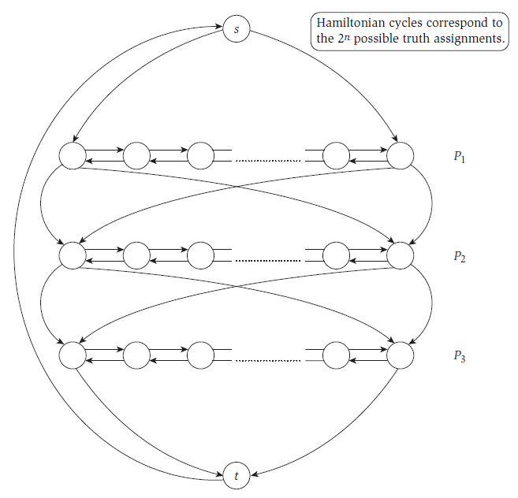
Image taken from Kleinberg & Tardos, “Algorithm Design,” Addison Wesley, 2006

Slide 11
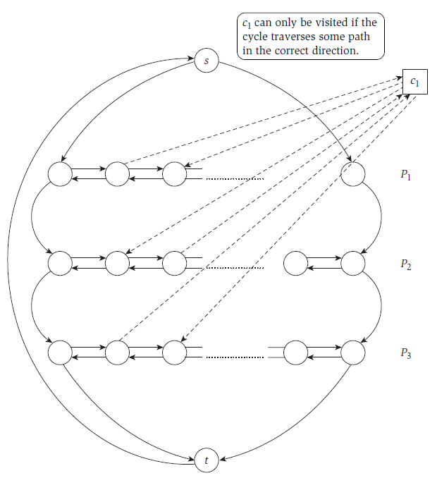
Image taken from Kleinberg & Tardos, “Algorithm Design,” Addison Wesley, 2006

Slide 12
Hamiltonian cycle is NP-complete
Claim: there is a Hamiltonian cycle in this graph iff the original formula ϕ is satisfiable
Proof:
ϕ is satisfiable ⇒ construct Hamiltonian cycle
Hamiltonian cycle ⇒ if cycle enters a clause-vertex using an edge, it must exit with the corresponding edge ⇒ use this to define values for the variables that satisfy ϕ

Slide 13
Traveling salesperson problem (TSP)
Given a set of vertices with pairwise directed edges between all pairs of vertices, and a weight for each edge, a tour is a cycle that visits each vertex exactly once and returns to the starting point
L_{TSP} = {(TSP, k) | TSP has a tour of weight ≤ k}
Note L_{TSP} ∈ NP

Slide 14
TSP is NP-complete
Reduction from Hamiltonian cycle
Given directed graph G, define TSP as follows:
Each node in G is a city
(v, w) have distance 1 iff there is an edge in G from v to w; otherwise, distance 2
TSP has a tour of weight n ⇔ there is a Hamiltonian cycle in G

