Slide 1
Algorithms
Lecture 20

Slide 2
Review: NP
Recall the definition of NP:
  L ∈ NP if there exists an efficient verification algorithm V such that
    If x ∈ L there is a witness/proof w such that V(x, w) = 1
    If x ∉ L then for all proofs w we have V(x, w) = 0
  I.e., possible to efficiently prove/verify that x ∈ L

Slide 3
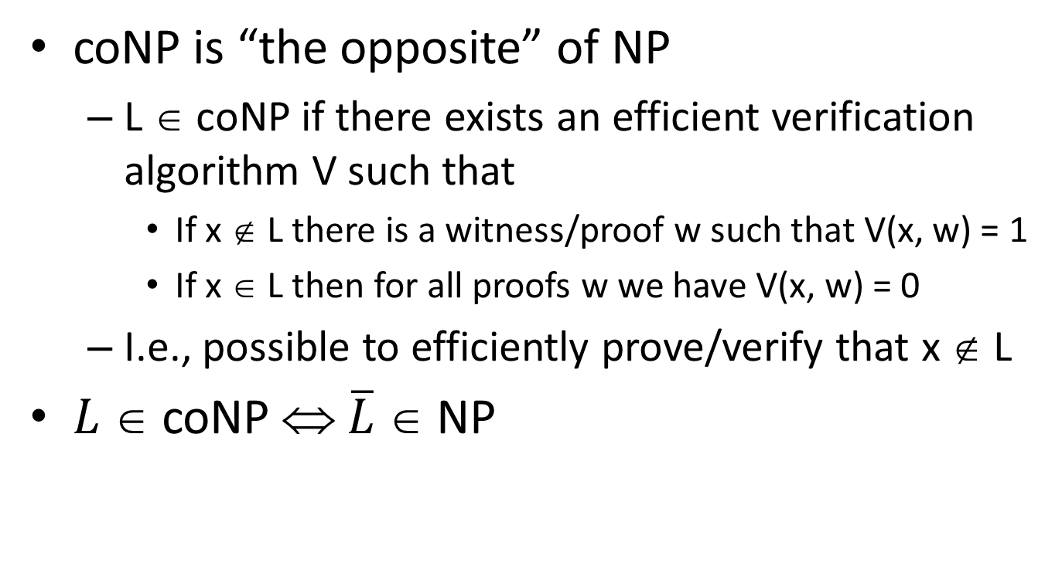
coNP
coNP is “the opposite” of NP
  L ∈ coNP if there exists an efficient verification algorithm V such that
    If x ∉ L there is a witness/proof w such that V(x, w) = 1
    If x ∈ L then for all proofs w we have V(x, w) = 0
  I.e., possible to efficiently prove/verify that x ∉ L
$L$ ∈ coNP ⇔ $\overline{L}$ ∈ NP

Slide 4
Example: independent set
An independent set in a graph G is a set of vertices where no two vertices have an edge between them
Let ind(G) = the size of the largest ind. set in G
Ind-Set = {(G, k) | ind(G) ≥ k}
Why is this in NP?
What is a witness that (G, k) ∈ Ind-Set?
How would you prove that (G, k) ∉ Ind-Set

Slide 5
Example: co-independent set
co-Ind-Set = {(G, k) | ind(G) < k}
Why is this in coNP?
What is a witness that (G, k) ∉ co-Ind-Set?
How would you prove that (G, k)∈co-Ind-Set?

Slide 6
Example: vertex cover
A vertex cover in a graph G is a set of vertices such that every edge is incident with at least one vertex in the set
Let vc(G) = the size of the smallest vertex cover in G
VC = {(G, k) | vc(G) ≤ k}
Why is this in NP?
What is a witness that (G, k) ∈ VC?
How would you prove that (G, k) ∉ VC

Slide 7
Example: co-vertex cover
co-VC = {(G, k) | vc(G) > k}
Why is this in coNP?
What is a witness that (G, k) ∉ co-VC?
How would you prove that (G, k)∈co-VC?

Slide 8
Example: max-flow
Given a flow graph G, let flow(G) denote the value of the maximum flow in G
Max-flow ={(G, k) | flow(G) ≥ k}
Why is this in NP?
What is a witness that (G, k) ∈ Max-flow?
Why is this in coNP?(!)
What is a witness that (G, k) ∉ Max-flow?
(Note: since Max-flow ∈ P, we already knew it was in NP ∩ coNP…)

Slide 9
P, NP, and coNP
Note: P ∈ coNP, so P ∈ NP ∩ coNP
  Open question: is P = NP ∩ coNP?
Is NP = coNP?
For every problem where we can efficiently prove existence of a solution, can we also efficiently prove non-existence of a solution?
Seems unlikely
  Not only intuitively (in general), but also for concrete problems like independent set
Note: NP ≠ coNP ⇒ P ≠ NP

Slide 10
Dealing with NP-completeness

Slide 11
Where things stand
When faced with a new problem, we can try to do one of two things
  Find an efficient algorithm
  Prove that the problem is NP-hard
If the problem is NP-hard, this indicates that no polynomial-time algorithm exists
What to do next?

Slide 12
Dealing with NP-hardness
Some possibilities
  Try to solve the problem as efficiently as possible (even if not in polynomial time)
  Try to solve special cases of the problem, or a relaxed version of the problem, in polynomial time
  Find approximate solutions in polynomial time

Slide 13
Example: vertex cover
An vertex cover in a graph G is a set of vertices such that every edge is incident with at least one vertex in the set
Finding the smallest vertex cover in a graph is NP-hard
VC = {(G, k) | G has a vertex cover of size ≤ k}
  VC is NP-complete

Slide 14
A quick lemma
Lemma: If a graph G with n vertices has a vertex cover of size k, then it has < kn edges
Proof: Each vertex in the vertex cover can be connected to at most n-1 vertices, and those are the only edges in the graph
When deciding if (G, k) ∈ VC, we will assume G has < kn edges

Slide 15
Algorithms for vertex cover
There are two parameters here: n and k ≤ n
Complexity parameterized in terms of both

Slide 16
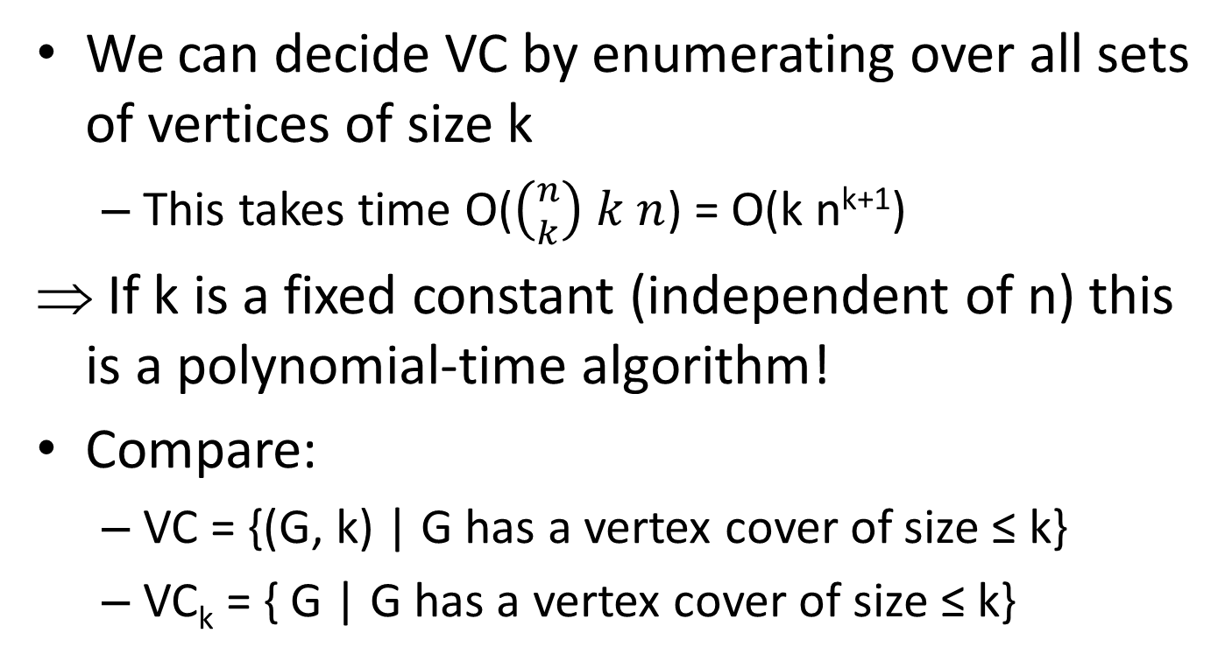
Algorithm for vertex cover
We can decide VC by enumerating over all sets of vertices of size k
  This takes time O($\left({n \atop k}\right) k n$) = O(k n^{k+1})
If k is a fixed constant (independent of n) this is a polynomial-time algorithm!
Compare:
  VC = {(G, k) | G has a vertex cover of size ≤ k}
  VC_{k} = { G | G has a vertex cover of size ≤ k}

Slide 17
Algorithms for vertex cover
We have shown an algorithm that runs in
time O(k n^{k+1})
  In practice, this is infeasible for n=1000, k=10
  Can we do better?

Slide 18
Another quick lemma
Fix G and an arbitrary edge (u, v). Then G has a vertex cover of size k iff either G-{u} or G-{v} has a vertex cover of size k-1
  Say G has vertex cover C of size k. C must include either u or v (or both); say u ∈ C. Then C-{u} is a vertex cover of G-{u}.
  ⇐ Say G-{u} has a vertex cover C’ of size k-1. Then C’∪{u} is a vertex cover of G of size k.

Slide 19
Algorithm for vertex cover
Use divide-and-conquer!
VCover(G, k)
if G has ≤ k vertices, return 1
if G has > kn edges, return 0
let (u, v) be an edge in G
return VCover(G-{u}, k-1) ∨ VCover(G-{v}, k-1)
Running time T(n, k) ≤ 2T(n-1,k-1) + ckn
  T(k, n) = O(2^{k} kn)
  Exponential, but much better than O(k n^{k+1})!

Slide 20
Summarizing…
If we only care about small k, the problem can be solved in polynomial time
Even if we care about general k, there is a better algorithm than the trivial one

Slide 21
Vertex cover on trees
The general vertex cover problem is NP-hard
But the problem is solvable in polynomial-time in some special cases
E.g., if we restrict attention to trees

Slide 22
A quick lemma
If T is a tree and v is a leaf, there is a minimum-size vertex cover that does not contain v
Proof
  Fix some minimum-size vertex cover C, and consider the edge (u, v)
    Either u or v is in C
  If v ∈ C, remove it and add u to C instead

Slide 23
Algorithm for vertex cover
To find a vertex cover for a forest F:
Initialize C to empty
While F has an edge
Let (u, v) be an edge where v is a leaf
Add u to C
Delete from F all edges incident to u

Slide 24
Independent set
Recall that if C is a vertex cover, then V\C is an independent set
So the previous algorithm allows us to solve the independent set problem on trees as well

Slide 25
A quick lemma
If T is a tree and v is a leaf, there is a max-size independent set that contains v

Slide 26
Algorithm for independent set
To find an independent set for a forest F:
Initialize S to empty
While F has an edge
Let (u, v) be an edge where v is a leaf
Add v to S
Delete u, v, and edges incident to u from F
Add any isolated vertices to S

Slide 27
Maximum-weight independent set
We next look at the harder problem of finding a maximum-weight independent set (where each vertex has a corresponding weight)
Idea: use dynamic programming!
Fix a root of the tree, and orient the tree accordingly
Let OPT(u) = the maximum weight of the independent set in the tree rooted at u

Slide 28
Maximum-weight independent set
The maximum-weight independent set rooted at u either includes u or not
  If not, then OPT(u) = Σ_{v} OPT(v) , where the sum is over the children of u
  If so, then OPT(u) = w_{u} + Σ_{v} OPT(v), where the sum is over the grandchildren of u
This can be turned into an algorithm that works in linear time

