Slide 1
Algorithms
Lecture 23

Slide 2
Beyond NP: PSPACE

Slide 3
Planning

Slide 4
Planning problems
Versions of planning problems come up often in AI/robotics
Problem defined by:
  n Boolean conditions modeling the (current) state of the world; represented by an n-bit string
  k operators that can change the current state; each operator O_{i} specifies:
    What conditions need to hold to apply the operator
    Which conditions become true/false after applying O_{i}
  Initial conditions and goal conditions
Is it possible to reach the goal from the initial state?

Slide 5
Planning in PSPACE
View as a graph problem
  Vertices = 2^{n} possible states
  Directed edge from s₁ to s₂ iff there is an allowed operator that changes state from s₁ to s₂
The graph has exponential size, so can only be maintained implicitly in poly-space
  E.g., for any vertex, can determine in time poly(n, k) all the other vertices to which it is connected

Slide 6
Planning in PSPACE
Problem is equivalent to deciding if there is a path from the initial state to the goal state
  But the graph has exponential size!
  Even the solution might be exponential!
    However, it has length at most 2^{n}
  Even if we work with the implicit graph, we need a memory-efficient algorithm
Use divide-and-conquer!

Slide 7
Planning in PSPACE
Path(s, t, L) determines if there is a path from s to t of length at most L
Path(s, t, L)
if L=1, solve directly
else for each vertex v
if Path(s, v, L/2) and Path(v, t, L/2) return 1
return 0

Slide 8
Planning in PSPACE
What is the recurrence here?
S(n, k, L) = S(n, k, L/2) + poly(n, k, log L)
  Space can be re-used!
S(n, k, L) = poly(n, k, log L) ⋅ log L
  S(n, k, 2^{n}) = poly(n, k)

Slide 9
Final note
In dynamic programming we use space to save time (by storing intermediate results)
Here we use time to save space (by throwing away our work, and recomputing results when we need them)
Can be interesting also to study time/space tradeoffs, as well as algorithms that are efficient in both time and space

Slide 10
Randomized algorithms

Slide 11
Randomized algorithms
Randomization can help in many settings
  Simpler algorithms
  More efficient algorithms
  Sometimes the only poly-time algorithms we know use randomization
  In some cases, solving the problem is only possible using randomization
However, it still not does (seem to) allow us to solve NP-complete problems in poly-time

Slide 12
Randomization
(At least) two ways to study randomization in the context of algorithms
  Analyze the performance of an algorithm on randomly generated input
    I.e., average-case (vs. worst-case) analysis
    Drawback: in many cases we don’t know the distribution inputs will come from
  Analyze the performance of a randomized algorithm for all inputs

Slide 13
Randomization
Two ways to analyze the performance of a randomized algorithm
  Algorithm might only output a correct answer with some probability
    Interested in lower bounding the probability of getting the correct answer
    Sometimes you don’t know when you got the right answer!
  Algorithm may always get the right answer, but have variable running time
    Interested in understanding the expected running time
    Interested in understanding the probability that the algorithm exceeds some running time

Slide 14
Randomization
Should you be concerned about an algorithm with a small probability of error?
Randomized algorithms are now standard

Slide 15
Are randomized algorithms possible?
Computers are inherently deterministic
Nevertheless, we can imagine algorithms that execute a fixed set of instructions while having the ability to “toss coins” (i.e., read a sequence of uniform bits)
  Note: random ≠ uniform, however very often these are used interchangeably

Slide 16
Random-number generation
Two steps:
  Continually collect a “pool” of high-entropy (i.e., “unpredictable”) data
  When random bits are requested, process the high-entropy data to generate a sequence of uniform, independent bits

Slide 17
Step 1
Collect a “pool” of high-entropy data
Must ultimately come from some physical process (since computation is deterministic)
  External inputs
    Keystroke/mouse movements
    Delays between network events
    Hard-disk access times
    Other external sources
  Hardware random-number generation (e.g., Intel)
  Quantum effects

Slide 18
Step 2: Smoothing
Need to eliminate both bias and dependencies
Ex: von Neumann approach for eliminating bias:
  Collect two bits per output bit
    01 -> 0
    10 -> 1
    00, 11 -> skip
  Note that this assumes independence (as well as constant bias)

Slide 19
Pseudorandomness
A small number of uniform bits can be used to generate a huge number of bits that are indistinguishable from uniform
  Take CMSC 456 to learn more!

Slide 20
Random-number generation
We will just assume algorithms have access to as many uniform, independent bits as needed

Slide 21
Probabilistic analysis
Part of the goal is for you to understand basic techniques of probabilistic analysis
  Will do proofs in detail
  Sometimes the proofs are more interesting than the application
You are responsible for understanding how to use these techniques
  I will try to highlight them as we encounter them
  I assume you have seen most of them before

Slide 22
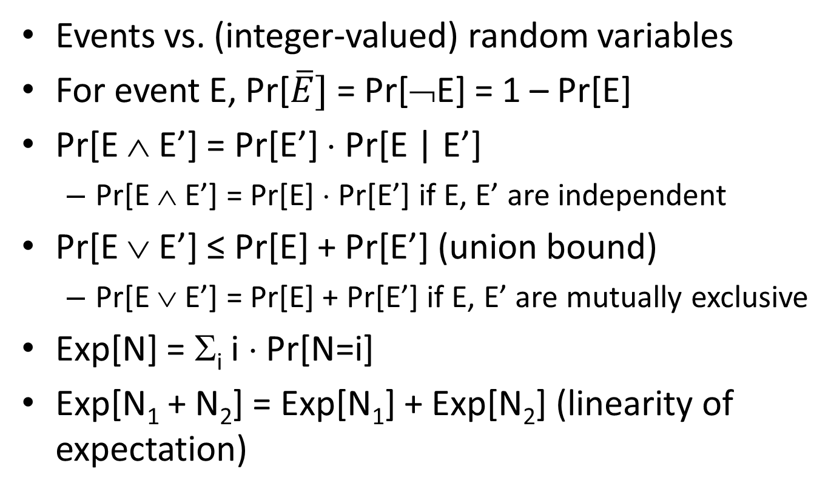
Probability facts
Events vs. (integer-valued) random variables
For event E, Pr[$\overline{E}]$ = Pr[¬E] = 1 – Pr[E]
Pr[E ∧ E’] = Pr[E’] ⋅ Pr[E | E’]
  Pr[E ∧ E’] = Pr[E] ⋅ Pr[E’] if E, E’ are independent
Pr[E ∨ E’] ≤ Pr[E] + Pr[E’] (union bound)
  Pr[E ∨ E’] = Pr[E] + Pr[E’] if E, E’ are mutually exclusive
Exp[N] = Σ_{i} i ⋅ Pr[N=i]
Exp[N₁ + N₂] = Exp[N₁] + Exp[N₂] (linearity of expectation)

Slide 23
Contention resolution

Slide 24
Contention resolution
Imagine n identical machines trying to access some resource
  In each time step (round), each machine can attempt to access the resource or not
  A machine succeeds in some round iff it is the only one to attempt access in that round
Goal is for all machines to eventually access the resource
No deterministic algorithm is possible here!

Slide 25
Contention resolution
Say in each round, each machine tries to access the resource with probability p
Let A_{i,j} be the event that machine i tries to access the resource in round j
  So Pr[A_{i,j}] = p for all i, j
  Pr[¬A_{i,j}] = 1 – p

Slide 26
Contention resolution
Let Unique_{i,j} be the event that only machine i attempts to access the resource in round j
What is the probability that machine i succeeds in round j?
  Pr[Unique_{i,j}] = Pr[A_{i,j} ∧ (∧_{i’≠i} ¬A_{i’,j})]
  = Pr[A_{i,j}] ⋅ Π_{i’≠i} Pr[¬A_{i’,j}]
  = p ⋅ (1-p)^{n-1}
  (using independence)

Slide 27
Contention resolution
For fixed n, we can take the derivative of this expression with respect to p to find the optimal value of p
p = 1/n
Pr[Unique_{i,j}] = 1/n ⋅ (1 – 1/n)^{n-1} ≈ 1/ne
Note: 1/2e ≤ (1 – 1/n)^{n} ≤ 1/e for n ≥ 2

Slide 28
Contention resolution
What is the probability that some machine succeeds in round j?
  Pr[∨_{i} Unique_{i,j}] = Σ_{i} Pr[Unique_{i,j}]
  = n ⋅ p ⋅ (1 – p)^{n-1} ≈ 1/e
  (since mutually exclusive)

Slide 29
Contention resolution
What is the probability that machine i succeeds by round T?
  Pr[Succ_{i,T}] = Pr[∨^{T}_{j=1} Unique_{i,j}]
  = 1 – Pr[∧ ¬Unique_{i,j}]
  = 1 – Π Pr[¬Unique_{i,j}]
  = 1 – Π (1 – Pr[Unique_{i,j}])
  = 1 – (1 – Pr[Unique_{i,j}])^{T}
  ({Unique_{i,j}} are independent, not mutually exclusive!)

Slide 30
Contention resolution
What is the probability that machine i does not succeed by round T?
  Pr[Fail_{i,T}] = (1 – Pr[Unique_{i,j}])^{T} ≤ (1 – 1/en)^{T}
Taking T = enρ, we get
(1 – 1/en)^{T} = ((1 – 1/en)^{en})^{ρ} ≤ 1/e^{ρ}

