Slide 1
Algorithms
Lecture 24

Slide 2
Contention resolution

Slide 3
Contention resolution
Imagine n identical machines trying to access some resource
In each time step (round), each machine can attempt to access the resource or not
A machine succeeds in some round iff it is the only one to attempt access in that round
No deterministic algorithm is possible here!

Slide 4
Contention resolution
Say in each round, each machine tries to access the resource with probability p
Let A_{i,j} be the event that machine i attempts to access the resource in round j
So Pr[A_{i,j}] = p for all i, j
Pr[¬A_{i,j}] = 1 – p
All {A_{i,j}} are independent

Slide 5
Contention resolution
Let Unique_{i,j} be the event that only machine i attempts to access the resource in round j
What is the probability that machine i succeeds in round j?
Pr[Unique_{i,j}] = Pr[A_{i,j} ∧ (∧_{i’≠i} ¬A_{i’,j})] = Pr[A_{i,j}] ⋅ Π_{i’≠i} Pr[¬A_{i’,j}] = p ⋅ (1-p)^{n-1} (using independence)

Slide 6
Contention resolution
For fixed n, we can take the derivative of this expression with respect to p to find the optimal value of p
p = 1/n
Pr[Unique_{i,j}] = 1/n ⋅ (1 – 1/n)^{n-1} ≈ 1/ne
Note: 1/2e ≤ (1 – 1/n)^{n} ≤ 1/e for n ≥ 2

Slide 7
Contention resolution
What is the expected number of machines N that attempt to access the resource in a given round?
Let N_{i} be the indicator random variable that is 1 iff machine i attempts to access the resource in that round
Note N = Σ_{i} N_{i}, and Exp[N_{i}] = p
Exp[N] = Exp[Σ_{i} N_{i}] = Σ_{i} Exp[N_{i}] = Σ_{i} p = np (linearity of expectation)
When p = 1/n, then Exp[N] = 1

Slide 8
Contention resolution
What is the probability that some machine succeeds in round j?
Pr[∨_{i} Unique_{i,j}] = Σ_{i} Pr[Unique_{i,j}] = n ⋅ p ⋅ (1 – p)^{n-1} ≈ 1/e (since mutually exclusive)

Slide 9
Contention resolution
What is the probability that machine i succeeds by round T?
Pr[Succ_{i,T}] = Pr[∨^{T}_{j=1} Unique_{i,j}] = 1 – Pr[∧ ¬Unique_{i,j}] = 1 – Π Pr[¬Unique_{i,j}] = 1 – Π (1 – Pr[Unique_{i,j}]) = 1 – (1 – Pr[Unique_{i,j}])^{T} ({Unique_{i,j}} independent, but not mutually exclusive!)

Slide 10
Contention resolution
What is the probability that machine i does not succeed by round T?
Pr[Fail_{i,T}] = (1 – Pr[Unique_{i,j}])^{T} ≤ (1 – 1/en)^{T}
Taking T = enρ, we get (1 – 1/en)^{T} = ((1 – 1/en)^{en})^{ρ} ≤ 1/e^{ρ}

Slide 11
Contention resolution
What is the probability that there is some machine that does not succeed by round T = enρ?
Pr[∨_{i} Fail_{i,T}] ≤ Σ_{i} Pr[Fail_{i,T}] = n ⋅ Pr[Fail_{i,T}] ≤ n/e^{ρ}
(union bound)
I.e., except with probability n/e^{ρ}, all machines succeed by round T

Slide 12
Contention resolution
What is the expected number of rounds N until a given machine succeeds?
Let q denote the probability that the machine succeeds in any particular round
Exp[N] = Σ_{i} i ⋅ Pr[N = i] = Σ_{i} i ⋅ (1 – q)^{i-1} ⋅ q
Exp[N] – (1 – q) ⋅ Exp[N] = Σ_{i} (1 – q)^{i-1} ⋅ q = 1 ⇒ Exp[N] = 1/q

Slide 13
A real-world application: COVID testing

Slide 14
COVID testing
Assume we have N students, each probability p of being positive
Want to find all positive cases
Clearly, we can do it using N tests
Can we do better?

Slide 15
Remark
This is a well-studied problem in theory under the name “combinatorial group testing”
Real-life constraints sometimes mean that theoretical solutions don’t apply
A recent paper (April, 2020) gave a simple improvement to a widely used technique

Slide 16
Pooling
Introduced in 1943
Randomly assign students to groups of size s
Assume for simplicity that s divides N
[Round 1:] For each group, combine samples of all students and administer one test
If negative, everyone in the group is negative
[Round 2:] If positive, test everyone in the group

Slide 17
Pooling
What is the expected number of tests?
N/s tests administered in round 1
Let T_{i} be the indicator random variable that is 1 iff student i is tested in round 2
Two cases:
If student i is positive, they are definitely tested
Exp[T_{i}] = 1
If student i is negative, they are tested iff they are put in a group with someone who is positive
Exp[T_{i}] = 1 – (1 – p)^{s-1}

Slide 18
Pooling
Overall, Exp[T_{i}] = p ⋅ 1 + (1 – p) ⋅ (1 – (1 – p)^{s-1})
So the expected number of tests is N/s + N ⋅ {p + (1 – p) ⋅ (1 – (1 – p)^{s-1})}
If we know p, we can use calculus to solve for the optimal s

Slide 19
Double pooling (2020)
Randomly partition students into groups of size s, twice
[Round 1:] For each group, combine samples of all students and administer one test
[Round 2:] Test any student if both of the groups he/she were in tested positive

Slide 20
Double pooling
What is the expected number of tests?
2N/s tests administered in round 1
Let T_{i} be an indicator random variable that is 1 iff student i is tested in round 2
Two cases:
If student i is positive, they are definitely tested
Exp[T_{i}] = 1
If student i is negative, they are tested iff they are put twice in a group with someone who is positive
Exp[T_{i}] = (1 – (1 – p)^{s-1})²

Slide 21
Double pooling
Overall, Exp[T_{i}] = p ⋅ 1 + (1 – p) ⋅ (1 – (1 – p)^{s-1})²
So the expected number of tests (normalized by the number of students) is 2N/s + N ⋅ {p + (1 – p) ⋅ (1 – (1 – p)^{s-1})²}
If we know p, we can use calculus to solve for the optimal s

Slide 22
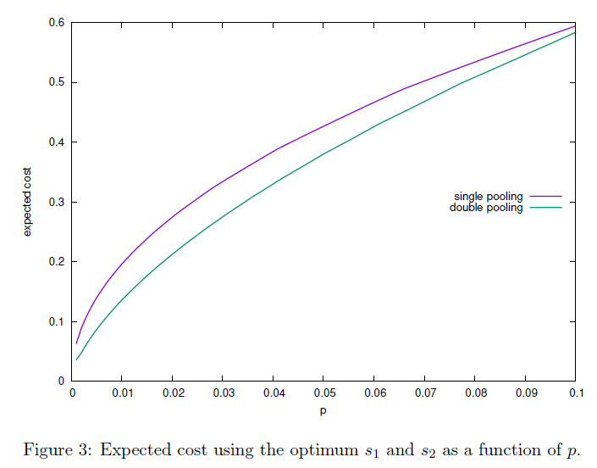
From: Broder and Kumar, “A Note on Double Pooling Tests”

Slide 23
Vaccine effectiveness

Slide 24
Using Bayes’s law
The latest vaccine studies showed that Pr[no vaccine administered | sick] = 0.9
What we care about is Pr[sick | vaccine administered]
We can use Bayes’s law to compute this!
Pr[sick | vaccine] = Pr[vaccine | sick] Pr[sick]/Pr[vaccine] = 0.1 Pr[sick] / 0.5 = Pr[sick]/5
I.e., taking the vaccine reduces the probability of getting sick by a factor of 5

Slide 25
Minimum cut

Slide 26
Minimum cut
Recall that a cut in a graph is a partition of its vertices into two non-empty subsets A, B
The size of a cut is the number of edges from vertices in A to vertices in B
I.e., the number of edges crossing the cut
Min-cut problem: Given a graph G, find a minimum cut
Note: previously we looked at finding a minimum s-t cut

Slide 27
Minimum cut
Possible to find the (global) min-cut by finding the minimum s-t cut for some s and all t
…but randomized algorithms are simpler; can be more efficient
The algorithm we show can be optimized

Slide 28
Bounding the min-cut size
Fix a connected graph G
Consider putting each vertex uniformly in either A or B
What is the expected size S of the resulting cut?
Let I_{e} be an indicator random variable that is 1 if edge e is in the cut, and 0 otherwise
Exp[S] = Exp[Σ_{e} I_{e}] = Σ_{e} Exp[I_{e}] = Σ_{e} ½ = |E|/2
In particular, there must be a cut of size ≥|E|/2
Exp[S] = Σ_{s} s ⋅ Pr[S=s] ≥ Σ_{s} s_{min} Pr[S > 0] = s_{min} (1 – 2^{-|V|+1})
There must be a cut of size at most (roughly) |E|/2

Slide 29
Finding a min-cut
Continually pick a uniform edge in the (multi)graph and contract it, until there are two vertices left; return the resulting edges in the original graph as the cut
Theorem: this returns a min-cut with probability at least 1/$\left({n \atop 2}\right)$, where n is the number of vertices

Slide 30
Finding a min-cut
Fix some min-cut C of size k; we show that C is returned with at least the claimed probability
C will be returned unless some edge in C is contracted
What is the probability that no edge in C is ever contracted?
Let Bad_{i} be the event that an edge of C is contracted in step i
Let Good_{i} be the complement of Bad_{i}

Slide 31
Finding a min-cut
Consider the first step
G has at least k n/2 edges
Each vertex has degree at least k, or else C would not be a min-cut
Pr[Bad₁] ≤ k/(kn/2) = 2/n
Pr[Good₁] ≥ 1 – 2/n

Slide 32
Finding a min-cut
Consider the second step, assuming Bad₁ did not occur
As before, each vertex has degree at least k; now there are n-1 vertices
Pr[Bad₂ | Good₁] ≤ k/(k(n-1)/2) = 2/(n-1)
Pr[Good₂ | Good₁] ≥ 1 – 2/(n-1)
Pr[Good₂ ∧ Good₁] = Pr[Good₁] ⋅ Pr[Good₂ | Good₁] ≥ (1 – 2/n) ⋅ (1 – 2/(n-1))

Slide 33
Finding a min-cut
Continuing in this way, we get Pr[∧_{i} Good_{i}] ≥ (1 – 2/n)(1 – 2/(n-1)) … (1 – 2/3) = $\frac{n−2}{n}\frac{n−3}{n−1}$ $\frac{n−4}{n−2}$… $\frac{1}{3}$ = $\frac{2}{n(n−1)}$ = 1/$\left({n \atop 2}\right)$

