Slide 1
Algorithms
Lecture 25

Slide 2
Minimum cut

Slide 3
Minimum cut
Recall that a cut in a graph is a partition of its vertices into two non-empty subsets A, B
The size of a cut is the number of edges from vertices in A to vertices in B
  I.e., the number of edges crossing the cut
Min-cut problem: Given a graph G, find a minimum cut
  Note: previously we looked at finding a minimum s-t cut

Slide 4
Minimum cut
Possible to find the (global) min-cut by finding the minimum s-t cut for some s and all t
  …but randomized algorithms are simpler; can be more efficient
  The algorithm we show can be optimized

Slide 5
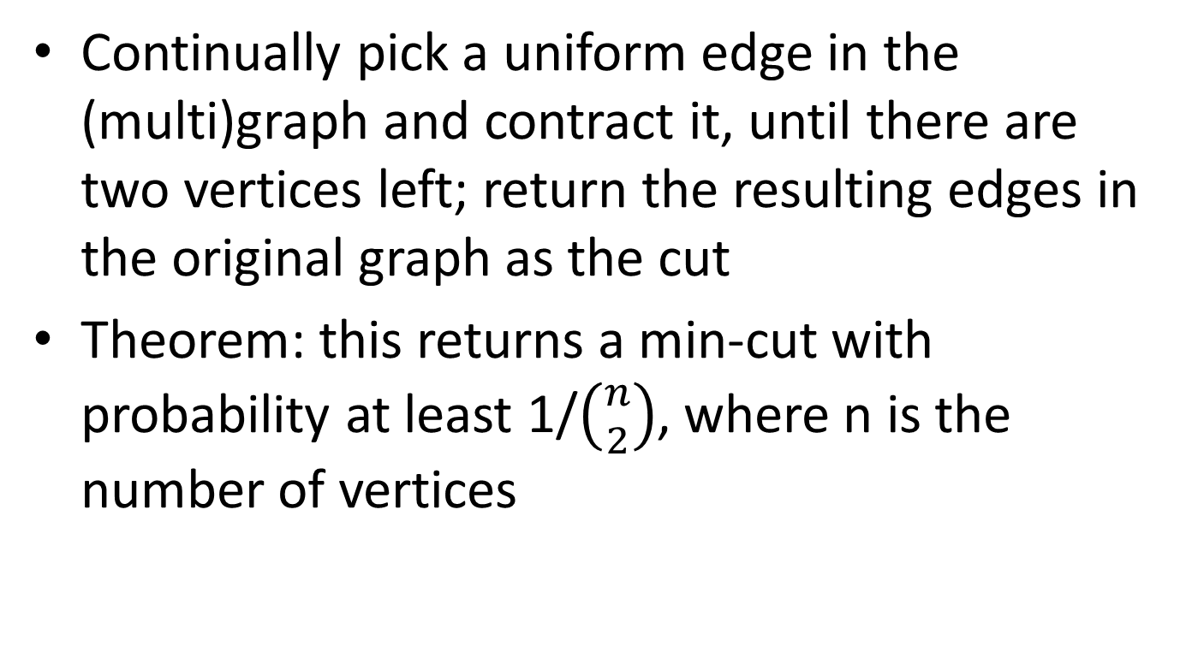
Finding a min-cut
Continually pick a uniform edge in the (multi)graph and contract it, until there are two vertices left; return the resulting edges in the original graph as the cut
Theorem: this returns a min-cut with probability at least 1/$\left({n \atop 2}\right)$, where n is the number of vertices

Slide 6
Finding a min-cut
Fix some min-cut C of size k; we show that C is returned with at least the claimed probability
C will be returned unless some edge in C is contracted
  What is the probability that no edge in C is ever contracted?
Let Bad_{i} be the event that an edge of C is contracted in step i
  Let Good_{i} be the complement of Bad_{i}

Slide 7
Finding a min-cut
Consider the first step
G has at least k n/2 edges
  Each vertex has degree at least k, or else C would not be a min-cut
Pr[Bad₁] ≤ k/(kn/2) = 2/n
Pr[Good₁] ≥ 1 – 2/n

Slide 8
Finding a min-cut
Consider the second step, assuming Bad₁ did not occur
As before, each vertex has degree at least k; now there are n-1 vertices
Pr[Bad₂ | Good₁] ≤ k/(k(n-1)/2) = 2/(n-1)
  Pr[Good₂ | Good₁] ≥ 1 – 2/(n-1)
Pr[Good₂ ∧ Good₁] = Pr[Good₁] ⋅ Pr[Good₂ | Good₁]
≥ (1 – 2/n) ⋅ (1 – 2/(n-1))

Slide 9
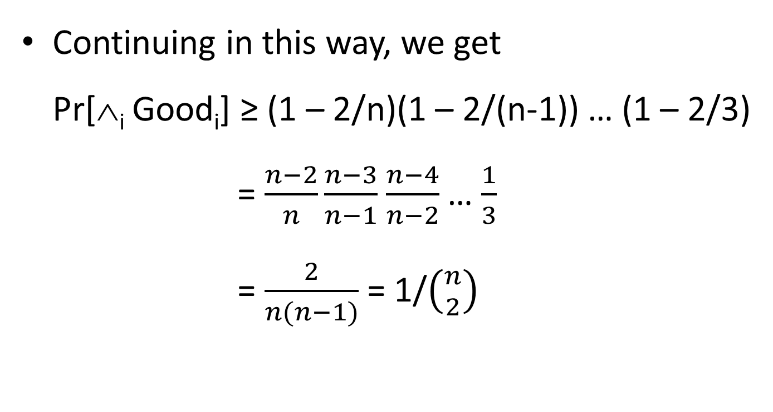
Finding a min-cut
Continuing in this way, we get
Pr[∧_{i} Good_{i}] ≥ (1 – 2/n)(1 – 2/(n-1)) … (1 – 2/3)
= $\frac{n−2}{n}\frac{n−3}{n−1}$ $\frac{n−4}{n−2}$… $\frac{1}{3}$
= $\frac{2}{n(n−1)}$ = 1/$\left({n \atop 2}\right)$

Slide 10
Finding a min-cut
The probability that the algorithm finds a min-cut is inverse polynomial, but not very large
Run the algorithm T times, and take the smallest cut returned!
  What is the probability that this finds a min-cut?

Slide 11
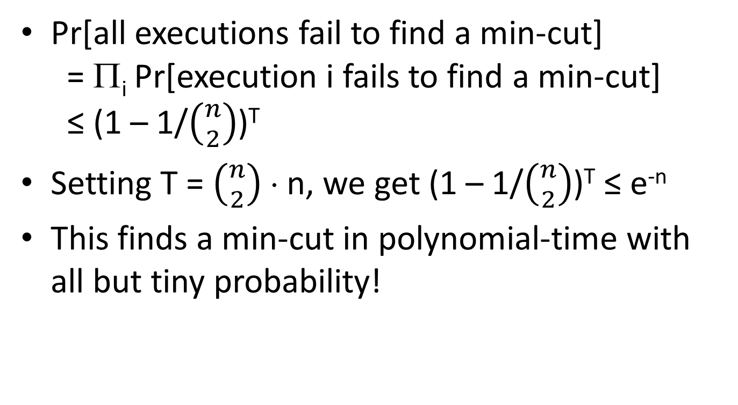
Finding a min-cut
Pr[all executions fail to find a min-cut]
= Π_{i} Pr[execution i fails to find a min-cut]
≤ (1 – 1/$\left({n \atop 2}\right)$)^{T}
Setting T = $\left({n \atop 2}\right)$ ⋅ n, we get (1 – 1/$\left({n \atop 2}\right)$)^{T} ≤ e^{-n}
This finds a min-cut in polynomial-time with all but tiny probability!

Slide 12
Max-SAT

Slide 13
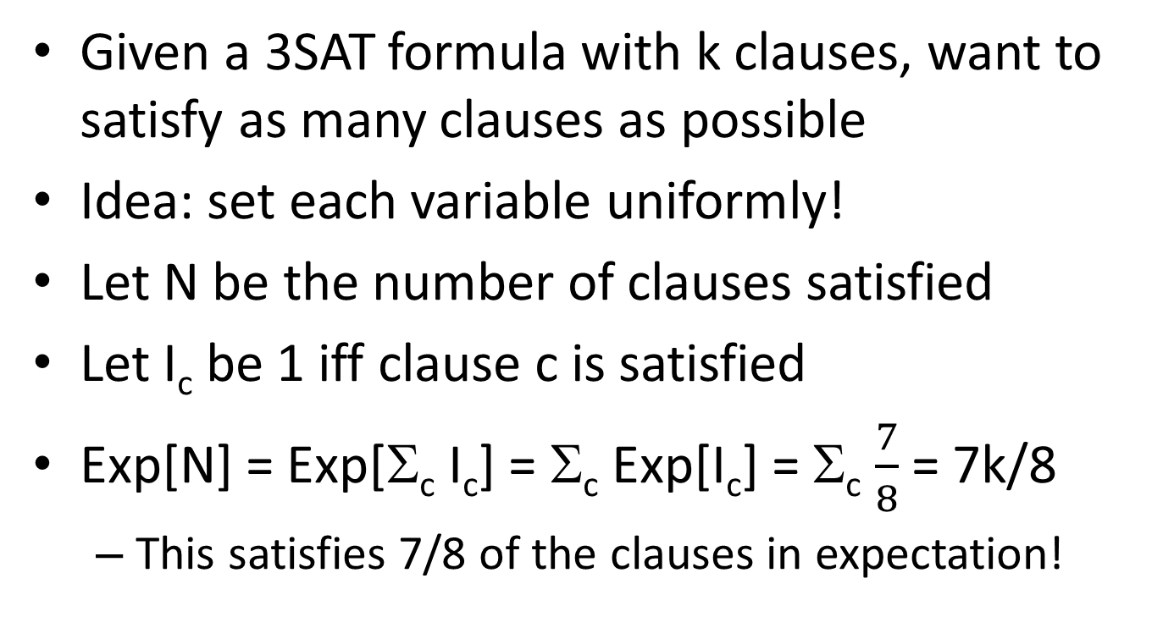
Max-SAT
Given a 3SAT formula with k clauses, want to satisfy as many clauses as possible
Idea: set each variable uniformly!
Let N be the number of clauses satisfied
Let I_{c} be 1 iff clause c is satisfied
Exp[N] = Exp[Σ_{c} I_{c}] = Σ_{c} Exp[I_{c}] = Σ_{c} $\frac{7}{8}$ = 7k/8
  This satisfies 7/8 of the clauses in expectation!

Slide 14
Max-SAT
What if we want to satisfy at least 7/8 of the clauses (with high probability)?
  (Note: our analysis here is different from what is in the book)
Markov’s inequality: If X is a nonnegative r.v. and t > 0, then Pr[X ≥ t] ≤ Exp[X]/t
  Proof: Exp[X] = Σ_{i<t} i ⋅ Pr[X = i] + Σ_{i≥t} i ⋅ Pr[X = i]
  ≥ t ⋅ Σ_{i≥t} Pr[X = i]
  = t ⋅ Pr[X ≥ t]

Slide 15
Max-SAT
Apply Markov’s inequality to the number N’ of clauses that are not satisfied
Exp[N’ + N] = Exp[k] = k
  Exp[N’] = k/8
Pr[N’ > k/8] = Pr[N’ ≥ (k+1)/8] ≤ k/(k+1)
Pr[N ≥ 7k/8] ≥ 1 – Pr[N’ > k/8] ≥ 1/(k+1)
Can now compute the expected number of iterations of the algorithm needed, or how many times it is necessary to run the algorithm so it succeeds except with arbitrarily small probability

Slide 16
Coupon-collector problem

Slide 17
Problem setup
There are n types of items
Items arrive one-by-one; the items’ types are uniformly distributed and independent
How many items N do you expect to see before getting one of each type of item?

Slide 18
Analysis
Let N_{i} be the number of items you see after having i-1 types, until you get an item of the ith type
Exp[N_{i}] = ?
  The probability that the next item will be a new type is (n-i+1)/n
  So the expected number of items needed until getting a new type is n/(n-i+1)
Exp[N] = Exp[Σ_{i} N_{i}] = Σ_{i} Exp[N_{i}] = n ⋅ Σ_{i} 1/(n-i+1)
= O(n log n)

Slide 19
Application
Recall the contention resolution problem…
In any round, the probability that some machine succeeds is ≈ 1/e
  Conditioned on the event that some machine succeeds, it is equally likely to be any machine
How many successes do we need in expectation before every machine succeeds?
  This is just the coupon-collector problem!
How many rounds do we need in expectation before every machine succeeds?

