Slide 1
Algorithms
Lecture 27

Slide 2
Advanced topics

Slide 3
Advanced topics
Meant to give you a taste for the breadth of the field; research directions to pursue
Will only scratch the surface – you can take entire courses on these topics!
You are responsible for the material on parallel/distributed algorithms
The material on linear programming is optional – will not be on the final

Slide 4
Parallel/distributed algorithms

Slide 5
Parallel/distributed algorithms
Until now, our mental model of a computer has involved a single processor
Inherently sequential
Many reasons to consider using multiple processors working in parallel
End of Moore’s law?
Faster end-to-end time
Multiprocessor architectures widely available
Large data centers/cloud computing more common
Better scalability (buy more machines)

Slide 6
Parallel/distributed computing
Parallel and distributed computing share many features, and some algorithms can be used in both settings
For our purposes:
Parallel computing: many processors with access to shared memory (think: many cores, single chip)
Distributed computing: multiple machines that can communicate with each other
Often want to minimize communication
Often need to deal with asynchrony
Often concerned with fault tolerance

Slide 7
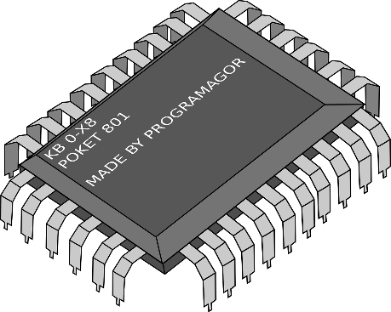
Parallel computing

Slide 8
Shared memory
Need to resolve potential memory conflicts
Exclusive read, exclusive write (EREW): only one processor is allowed to access a given position in memory at each step
Concurrent read, exclusive write (CREW): multiple processors may read a given position in memory at each step
Concurrent read, concurrent write (CRCW): at each step, reads precede all writes; lowest-indexed write to a location succeeds

Slide 9
Complexity measures
Interested in two measures:
Total work W (across all processors)
Time T (“depth”)
W = O(T * number of processors)
When determining complexity, we allow poly-many processors (i.e., the number of processors grows with the problem size)
Understand “inherent parallelism” of problem
Can buy more machines if needed
Can scale results for fixed # of processors

Slide 10
Complexity measures
Theorem: An algorithm using work W and time T with infinitely many processors can be implemented with p processors using O(W) work and O(T + W/p) time

Slide 11
Complexity classes
NC = problems that can be solved using poly-many processors in polylog time
Can also characterize in terms of Boolean circuits with polylog depth
NC ⊆ P, inclusion believed to be strict
Can define notion of P-completeness; such problems are “the hardest problems in P to parallelize”

Slide 12
Summation and prefix-sum

Slide 13
Summation
Goal: compute the sum of n numbers
Recursive algorithm: Sum(A[1…n]) if n=1, return A[1] else in parallel do: s₁ = Sum(A[1…n/2]) s₂ = Sum(S[n/2+1…n]) return s₁ + s₂

Slide 14
Summation complexity
W(n) = 2⋅W(n/2) + O(1) ⇒ W(n) = O(n)
T(n) = T(n/2) + O(1) ⇒ T(n) = O(log n)

Slide 15
Summation
Another view: maintain a binary tree in memory, where each node holds the sum of the values in the leaves of its subtree
Algorithm: fill in values at all nodes, working from leaves up to the root
All nodes at the same level can be handled in parallel!

Slide 16
Prefix-sum
Given a₁, …, a_{n}, let S_{i} = Σ_{j≤i} a_{j}
Goal: compute S₁, S₂, …, S_{n}
Idea 1: apply summation algorithm n times in parallel
W(n) = n ⋅ W’(n) = O(n²)
T(n) = T’(n) = O(log n)
Idea 2: sequentially compute S₁, …, S_{n}
W(n) = O(n)
T(n) = O(n)

Slide 17
Prefix-sum
Use binary tree as before
Apply summation algorithm so each node v holds the sum B[v] of the values in its subtree
Then fill in values so each node v holds C[v]=S_{i}, where i is the right-most leaf in its subtree
Do this from the root to the leaves
C[right child of v] = C[v]
C[left child of v] = C[v] – B[right child of v]
Process all nodes at each level in parallel
W(n) = O(n), T(n) = O(log n)

Slide 18
Prefix-sum
Recursive formulation (assume n=2^{r}):
prefix-sum(a₁, …, a_{n}) for i=1, …, n/2 in parallel do: a’_{i} = a_{2i-1} + a_{2i} (S’₁, …, S’_{n/2}) = prefix-sum(a’₁, …, a’_{n/2}) S’₀ = 0 for i=1, …, n/2 in parallel do: S_{2i-1} = S’_{i-1} + a_{2i-1} S_{2i} = S’_{i}

Slide 19
Prefix-sum
Prefix-sum has many applications
Note it generalizes to any associative operation
Nice example: compaction
Compact(A[1…n], P) = array with elements of A that satisfy predicate P

Slide 20
Compaction
A[1]
A[2]
A[3]
A[4]
A[n]
1
0
1
0
0
0
1
1
0
0
0
0
1
1
2
2
2
2
3
4
4
4
4
4
A[1]
A[3]
A[7]
A[8]
1. Check whether each element of A satisfies the predicate: Time = O(1), Work = O(n)
2. Prefix-sum: Time = O(log n), Work = O(n)
3. Place items satisfying the predicate into the right spot: Time = O(1), Work = O(n)

