Slide 1
Algorithms
Lecture 9

Slide 2
Divide-and-conquer:
Computational arithmetic

Slide 3
Fast exponentiation
Cryptography deals with huge numbers
Frequent operation: compute a^{n} mod b
Naïve algorithm: O(n)
  n ≈ 2²⁰⁰⁰ is typical (!)
  Linear-in-n time is horrible here…
  We want an algorithm that is polynomial in the length of n, i.e., an O(polylog n)-time algorithm

Slide 4
Divide-and-conquer algorithm
Exp(a, n, b)
  If n=1 return a mod b
  Else
    Tmp₁ = Exp(a, ⎣n/2⎦ , b)
    Tmp₂ = Exp(a, ⎡n/2⎤ , b)
    Return Tmp₁ * Tmp₂ mod b
T(n) ≤ 2 T(n/2) + c
T(n) = O(n)
  No better than the naïve algorithm…

Slide 5
Divide-and-conquer algorithm
Exp(a, n, b)
  If n=1 return a mod b
  Else if n even
    Tmp = Exp(a, n/2 , b)
    Return Tmp * Tmp mod b
  Else if n odd
    Tmp = Exp(a, (n-1)/2, b)
    Return a * Tmp * Tmp mod b
T(n) ≤ T(n/2) + c
T(n) = O(log n)
  Huge improvement!

Slide 6
Big-integer arithmetic
What is the complexity of basic arithmetic?
Motivations
  Numbers in crypto can be huge, e.g., 1000⁺ bits
  Fundamental problem…
How long does it take to add two k-bit (positive) integers?
Is this optimal?

Slide 7
Multiplication
How long does it take to multiply two k-bit integers?
“Grade-school algorithm” takes time O(k²)
Is this optimal?

Slide 8
Karatsuba’s algorithm
Idea: note that
x y = (x₁ 2^{k/2} + x₀)(y₁ 2^{k/2} + y₀)
= x₁y₁ 2^{k} + (x₁y₀ + x₀y₁) 2^{k/2} + x₀y₀
  Note that bit-shifts are easy…
If we use 4 multiplications of k/2-bit integers we haven’t gained anything…
Instead, compute x₁y₁, x₀y₀, and (x₀+x₁)(y₀+y₁)
  Then x₁y₀ + x₀y₁ = (x₀+x₁)(y₀+y₁) – x₁y₁ – x₀y₀ (!)
  Only 3 multiplications needed!
T(k) = 3T(k/2) + ck ⇒ T(k) = O(k^{log2 3}) = O(k^{1.59})

Slide 9
Integer multiplication
Is this optimal?
Breakthrough [2019]:
O(k log k)-time algorithm!

Slide 10
Matrix multiplication
Let A, B be n × n matrices
What is the complexity of computing AB?
  Measure in terms of number of multiplications
Straightforward algorithm uses O(n³) time

Slide 11
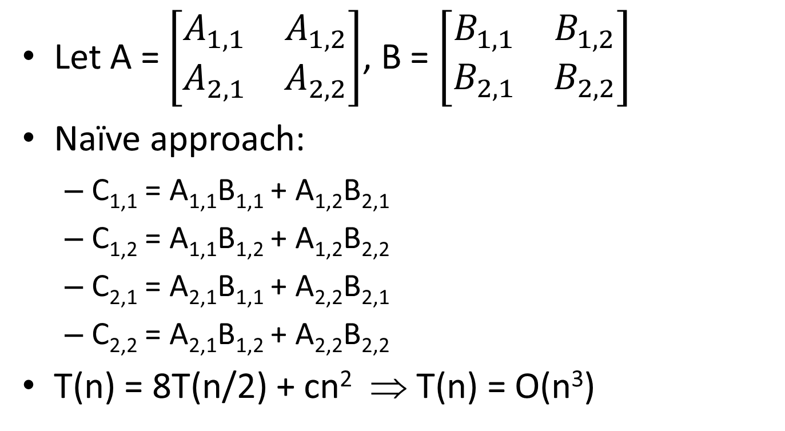
Matrix multiplication
Let A = $\left[\begin{matrix}A_{1,1} & A_{1,2} \\ A_{2,1} & A_{2,2}\end{matrix}\right]$, B = $\left[\begin{matrix}B_{1,1} & B_{1,2} \\ B_{2,1} & B_{2,2}\end{matrix}\right]$
Naïve approach:
  C_{1,1} = A_{1,1}B_{1,1} + A_{1,2}B_{2,1}
  C_{1,2} = A_{1,1}B_{1,2} + A_{1,2}B_{2,2}
  C_{2,1} = A_{2,1}B_{1,1} + A_{2,2}B_{2,1}
  C_{2,2} = A_{2,1}B_{1,2} + A_{2,2}B_{2,2}
T(n) = 8T(n/2) + cn² ⇒ T(n) = O(n³)

Slide 12
Strassen’s algorithm
Compute
  M₁ = (A_{1,1} + A_{2,2})(B_{1,1} + B_{2,2})
  M₂ = (A_{2,1} + A_{2,2})B_{1,1}
  M₃ = A_{1,1}(B_{1,2} – B_{2,2})
  M₄ = A_{2,2}(B_{2,1} – B_{1,1})
  M₅ = (A_{1,1} + A_{1,2})B_{2,2}
  M₆ = (A_{2,1} – A_{1,1})(B_{1,1} + B_{1,2})
  M₇ = (A_{1,2} – A_{2,2})(B_{2,1} + B_{2,2})
(7 recursive calls…)

Slide 13
Strassen’s algorithm
Then compute
  C_{1,1} = M₁ + M₄ – M₅ + M₇
  C_{1,2} = M₃ + M₅
  C_{2,1} = M₂ + M₄
  C_{2,2} = M₁ – M₂ + M₃ + M₆
T(n) = 7 T(n/2) + c n²
⇒ T(n) = O(n^{log2 7}) = O(n^{2.808})

Slide 14
Matrix multiplication
Is this optimal?
Current best: O(n^{2.3729})
Lower bound: Ω(n²)

Slide 15
Fast Fourier Transform (FFT)

Slide 16
Convolutions
Problem: given (a₀, …, a_{n-1}) and (b₀, …, b_{n-1}), compute (c₀, …, c_{2n-2}), where
c_{k} = Σ_{i+j=k} a_{i}b_{j}
What is the complexity for computing this?
  Measure in terms of number of multiplications
Naïve algorithm runs in O(n²) time
  Each c_{k} can be computed in O(n) time
  Output vector c has O(n) coordinates

Slide 17
Convolutions
Why would we want to do this?
  It is exactly polynomial multiplication
  Also used in signal processing, cryptography, statistics, …
From now on, we treat a, b, c as polynomials
  E.g., a(X) = a₀ + a₁X + a₂X² + … + a_{n-1}X^{n-1}
  a, b are degree-(n-1) polynomials, and c is a degree-(2n-2) polynomial

Slide 18
FFT idea 0
Recall that a degree-(n-1) polynomial p(X) is defined by its value at n points
  I.e., for any distinct w₀, w₁, …, w_{n-1}, the values p(w₀), p(w₁), …, p(w_{n-1}) uniquely define a degree-(n-1) polynomial p(X)
If we fix some distinct {w_{i}}, we have two ways to represent a degree-(n-1) polynomial:
(p₀, p₁, …, p_{n-1}) or (p(w₀), p(w₁), …, p(w_{n-1}))
  “Coefficient” and “evaluation” representations

Slide 19
FFT idea 1
Given the eval. representations of a, b (as degree-(2n-2) polynomials), we can compute the evaluation representation of c in O(n) time
Simply compute c(w₀) = a(w₀) ⋅ b(w₀),
…,
c(w_{2n-2}) = a(w_{2n-2}) ⋅ b(w_{2n-2})

Slide 20
FFT idea 1
The overall structure of the algorithm will be:
  Convert a, b to their eval representations
  Compute eval representation of c
  Convert c to its coefficient representation
We have seen how to do step #2 in O(n) time

Slide 21
FFT idea 2
Converting a(X) to its eval representation requires evaluating a(X) at O(n) points
  Evaluating a(X) at a point takes O(n) time
Observation: we can simultaneously evaluate a(X) at O(n) points in O(n log n) time if we pick the points cleverly
  In particular, use complex numbers
  (Nothing so far assumed real numbers)

Slide 22
FFT idea 2
Consider the equation X^{2n} – 1 = 0
  This has 2n distinct complex roots
  The roots are
  1, e^{2πi/2n}, (e^{2πi/2n})², …, (e^{2πi/2n})^{2n-1}
  (i.e., the (2n)^{th} roots of unity), which are equally spaced on the unit circle in the complex plane
  Let w_{k, j} = (e^{2πi/k})^{j} // this is different from the book(!)
    Square of a (2n)^{th} root of unity is an n^{th} root of unity
  We will evaluate on w_{2n, 0}, w_{2n, 1}, …, w_{2n,2n-1} using divide-and-conquer

Slide 23
FFT idea 2
Eval(a) // evaluate a degree-(2n-1) polynomial on the (2n)^{th} roots of unity; assume n is a power of 2
  Let a_{even}(X) = a₀ + a₂ X + a₄ X² + … + a_{2n-2} X^{n-1}
  a_{odd}(X) = a₁ + a₃ X + a₅ X² + … + a_{2n-1} X^{n-1}
  // Note that a(X) = a_{even}(X²) + X ⋅ a_{odd}(X²)
  Call Eval(a_{even}) and Eval(a_{odd})
    We get a_{even} and a_{odd} evaluated on the n^{th} roots of unity
  a(w_{2n, i}) = a_{even}(w²_{2n, i}) + w_{2n, i} ⋅ a_{odd}(w²_{2n, i})
  = a_{even}(w_{n, i}) + w_{2n, i} ⋅ a_{odd}(w_{n, i})
T(n) = 2T(n/2) + c n ⇒ T(n) = O(n log n)

Slide 24
FFT idea 3
We now have the eval. representation of c
  c(w_{2n,0}), …, c(w_{2n,2n-1})
  Define d_{i} = c(w_{2n,i})
Want to convert to coefficient representation c(X) = c₀ + c₁ + … + c_{2n-1} X^{2n-1}
  This is just polynomial interpolation
  But we want to do it in O(n log n) time
Idea: view the {d_{i}} as coefficients of a polynomial d(X) and evaluate it at the (2n)^{th} roots of unity(!!)

Slide 25

Lemma
Lemma: For any (2n)^{th} root of unity w≠1, we have $\sum_{s=0}^{2n−1}{w^{s}}$ = 0
Proof: w is a root of X^{2n}-1 = (X-1) ⋅ $\sum_{s=0}^{2n−1}{X^{s}}$

Slide 26
FFT idea 3
Let d(X) = d₀ + d₁ X + … + d_{2n-1} X^{2n-1}, where d_{i} = c(w_{2n,i}) for some c(X) = c₀ + c₁ X + … + c_{2n-1} X^{2n-1}
Claim: for j=1, …, 2n, d(w_{2n,j}) = 2n ⋅ c_{2n-j}
Proof: d(w_{2n,j}) = Σ_{s} d_{s} w^{s}_{2n,j}
= Σ_{s} Σ_{t} c_{t} w^{t}_{2n,s} w^{s}_{2n,j}
= Σ_{t} c_{t} (Σ_{s} w^{s}_{2n,t+j})
// term in parentheses is 0 unless w_{2n,t+j} = 1 (i.e., unless t=2n-j), in which case it equals 2n
= 2n c_{2n-j}

Slide 27
(Small) example
a(X)=3+2X, b(X) = -1 + 3X
4th roots of unity are {1, i, -1, -i} (in that order)
a(1) = 5; a(i) = 3+2i; a(-1) = 1; a(-i) = 3-2i
b(1) = 2; b(i) = -1+3i; b(-1) = -4; b(-i)=-1-3i
So c(1) = 10; c(i) = -9+7i; c(-1) = -4; c(-i) = -9-7i
Set d(X) = 10 + (-9+7i)X – 4X² – (9+7i)X³
d(i)/4 = 0 = c₃ ; d(-1)/4 = 6 = c₂; d(-i)/4 = 7 = c₁; d(1)/4 = -3 = c₀
Check: -3 + 7X + 6X² = a(X) ⋅ b(X)

