Slide 1
Algorithms
Lecture 14

Slide 2
Divide-and-conquer: Computational arithmetic

Slide 3
Fast exponentiation
Cryptography deals with huge numbers
Frequent operation: compute a^{n} mod b
Polynomial-in-n time is horrible here…
n ≈ 2²⁰⁰⁰ is typical (!)
We want an algorithm that is polynomial in the length of n, i.e., an O(polylog n)-time algorithm

Slide 4
Naïve divide-and-conquer algorithm
Exp(a, n, b)
If n=1 return a mod b
Else
Tmp = Exp(a, n-1 , b)
Return a * Tmp mod b
T(n) ≤ T(n-1) + c
T(n) = O(n)

Slide 5
Divide-and-conquer algorithm
Exp(a, n, b)
If n=1 return a mod b
Else
Tmp₁ = Exp(a, ⎣n/2⎦ , b)
Tmp₂ = Exp(a, ⎡n/2⎤ , b)
Return Tmp₁ * Tmp₂ mod b
T(n) ≤ 2 T(n/2) + c
T(n) = O(n)
No better than the naïve algorithm…

Slide 6
Divide-and-conquer algorithm
Exp(a, n, b)
If n=1 return a mod b
Else if n even
Tmp = Exp(a, n/2 , b)
Return Tmp * Tmp mod b
Else if n odd
Tmp = Exp(a, (n-1)/2, b)
Return a * Tmp * Tmp mod b
T(n) ≤ T(n/2) + c
T(n) = O(log n)
Huge improvement!

Slide 7
Big-integer arithmetic
What is the complexity of basic arithmetic?
Motivations
Numbers in crypto can be huge, e.g., 1000⁺ bits
Fundamental problem…
How long does it take to add two k-bit (positive) integers?
Is this optimal?

Slide 8
Multiplication
How long does it take to multiply two k-bit integers?
“Grade-school algorithm” takes time O(k²)
Is this optimal?

Slide 9
Karatsuba’s algorithm
Idea: note that x y = (x₁ 2^{k/2} + x₀)(y₁ 2^{k/2} + y₀) = x₁y₁ 2^{k} + (x₁y₀ + x₀y₁) 2^{k/2} + x₀y₀
Bit-shifts are easy…
If we use 4 multiplications of k/2-bit integers we haven’t gained anything…
Instead, compute x₁y₁, x₀y₀, and (x₁-x₀)(y₁-y₀)
Then x₁y₀ + x₀y₁ = x₁y₁ + x₀y₀ – (x₁-x₀)(y₁-y₀) (!)
Only 3 multiplications needed!
T(k) = 3T(k/2) + ck ⇒ T(k) = O(k^{log2 3}) = O(k^{1.59})

Slide 10
Integer multiplication
Is this optimal?
Breakthrough [2019]: O(k log k)-time algorithm!

Slide 11
Matrix multiplication
Let A, B be n × n matrices
What is the complexity of computing AB?
Measure in terms of number of multiplications
Straightforward algorithm uses O(n³) time

Slide 12
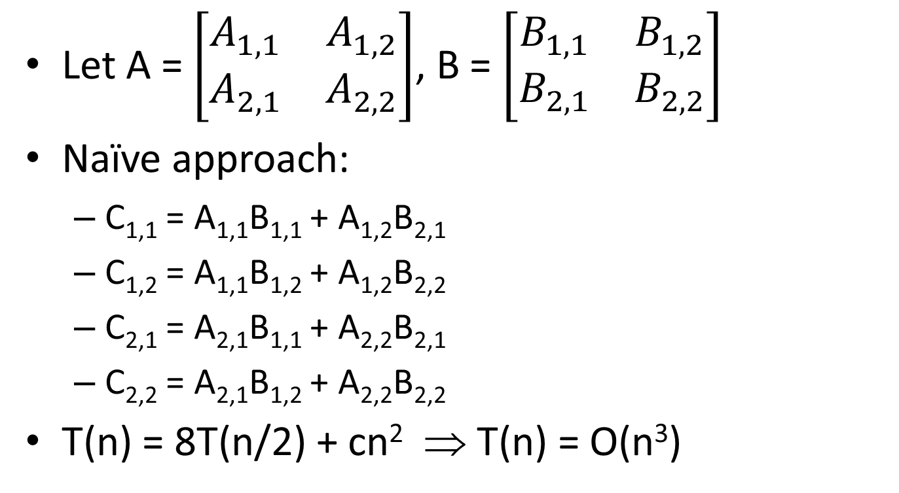
Matrix multiplication
Let A = $\left[\begin{matrix}A_{1,1} & A_{1,2} \\ A_{2,1} & A_{2,2}\end{matrix}\right]$, B = $\left[\begin{matrix}B_{1,1} & B_{1,2} \\ B_{2,1} & B_{2,2}\end{matrix}\right]$
Naïve approach:
C_{1,1} = A_{1,1}B_{1,1} + A_{1,2}B_{2,1}
C_{1,2} = A_{1,1}B_{1,2} + A_{1,2}B_{2,2}
C_{2,1} = A_{2,1}B_{1,1} + A_{2,2}B_{2,1}
C_{2,2} = A_{2,1}B_{1,2} + A_{2,2}B_{2,2}
T(n) = 8T(n/2) + cn² ⇒ T(n) = O(n³)

Slide 13
Strassen’s algorithm
Compute
M₁ = (A_{1,1} + A_{2,2})(B_{1,1} + B_{2,2})
M₂ = (A_{2,1} + A_{2,2})B_{1,1}
M₃ = A_{1,1}(B_{1,2} – B_{2,2})
M₄ = A_{2,2}(B_{2,1} – B_{1,1})
M₅ = (A_{1,1} + A_{1,2})B_{2,2}
M₆ = (A_{2,1} – A_{1,1})(B_{1,1} + B_{1,2})
M₇ = (A_{1,2} – A_{2,2})(B_{2,1} + B_{2,2})
(7 recursive calls…)

Slide 14
Strassen’s algorithm
Then compute
C_{1,1} = M₁ + M₄ – M₅ + M₇
C_{1,2} = M₃ + M₅
C_{2,1} = M₂ + M₄
C_{2,2} = M₁ – M₂ + M₃ + M₆
T(n) = 7 T(n/2) + c n² ⇒ T(n) = O(n^{log2 7}) = O(n^{2.808})

Slide 15
Matrix multiplication
Is this optimal?
Current best [2020]: O(n^{2.37286})
Lower bound: Ω(n²)

Slide 16
Dynamic programming

Slide 17
Recap
So far we have seen two approaches to designing algorithms
Greedy algorithms
For some problems there is no greedy solution
Divide-and-conquer
Typically (but not always!) this only improves the run-time by a polynomial factor compared to a naïve solution

Slide 18
Dynamic programming
Basic idea: break problem into smaller problems (like divide-and-conquer), but store intermediate results and use them to solve larger and larger problems

Slide 19
Simple example, I
Fibonacci numbers
1, 1, 2, 3, 5, 8, …
Consider computing the ith Fibonacci number:
Fib(i) if i=1, 2 return 1 else tmp₁ = Fib(i-1) tmp₂ = Fib(i-2) return tmp₁ + tmp₂

Slide 20
Simple example, II
What is the complexity of this algorithm?
T(i) = T(i-1) + T(i-2) + c ⇒ T(i) = 2^{Θ(i)}
Why is it so expensive?
Look at computation tree of Fib(5)
Nodes appear multiple times!
We are repeating the same computation again and again…
Store intermediate results (“memoization”)
Work “bottom up” rather than “top down”
⇒ O(i) running time(!)

