Slide 1
Algorithms
Lecture 28

Slide 2
NP-completeness, rephrased
Can show that L ∈ NP is NP-complete by showing that for some NP-complete L’ there is a poly-time algorithm f such that
x ∈ L’ ⇔ f(x) ∈ L

Slide 3
Independent set
An independent set in a graph G is a set of vertices such that no two vertices have an edge between them
Ind-Set = {(G, k) | G has an ind. set of size ≥ k}
  Note Ind-Set ∈ NP
This problem has nothing to do with logic or circuits!
  It is a problem that naturally arises when trying to maximize something subject to constraints

Slide 4
Ind-Set is NP-complete
Reduce from 3-SAT
Given a 3-SAT formula ϕ with k clauses; convert it to a graph G s.t. there is an independent set of size k iff ϕ is satisfiable
Idea:
  Each clause corresponds to a triangle in G
    Independent set can include at most one of those vertices; let it correspond to one that is true
  Add edges for conflicts between terms
    I.e., where both cannot be true
G has an independent set of size k ⇔ ϕ is satisfiable

Slide 5
Ind-Set is NP-complete
If ϕ is satisfiable, pick one true term per clause
  This is an independent set, since true terms cannot conflict
If G has an independent set S of size k, then:
  S contains one vertex per clause, none of which conflict with each other
  Set variables to make corresponding terms true
  Each clause in ϕ will be satisfied

Slide 6
Vertex cover
A vertex cover in a graph G is a set C of vertices such that every edge in G is incident on at least one vertex in C
V-Cover
= {(G, k) | G has a vertex cover of size ≤ k}
  Note V-Cover ∈ NP
This problem has nothing to do with logic or circuits!
  It is a problem that naturally arises when trying to satisfy constraints using a minimum number of items

Slide 7
V-Cover is NP-complete
Claim: I is an independent set iff V \ I is a vertex cover
Proof: I is an independent set ⇔ no edge has both ends in I ⇔ every edge has at least one end in V / I ⇔ V / I is a vertex cover
This implies a reduction from Ind-Set to V-Cover

Slide 8
Hamiltonian cycle
Given a directed graph G, a Hamiltonian cycle is a cycle that visits each vertex exactly once
HAM = {G | G has a Hamiltonian cycle}
  Note HAM ∈ NP
We show HAM is NP-complete by reduction from 3-SAT

Slide 9
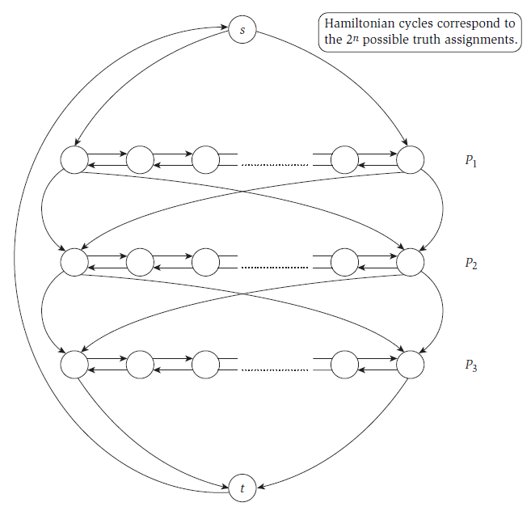
P_{i} corresponds to the variable x_{i}
Image taken from Kleinberg & Tardos, “Algorithm Design,” Addison Wesley, 2006

Slide 10
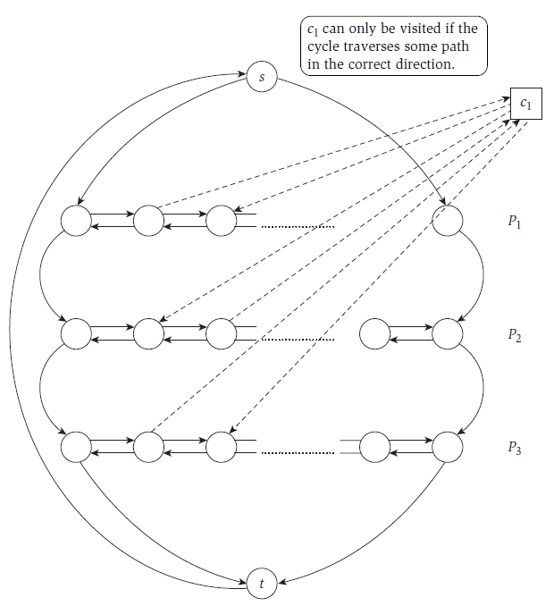
c₁ = x₁ ∨ ¬x₂ ∨ x₃
Image taken from Kleinberg & Tardos, “Algorithm Design,” Addison Wesley, 2006

Slide 11
HAM is NP-complete
Claim: there is a Hamiltonian cycle in this graph iff the original formula ϕ is satisfiable
Proof:
  ϕ is satisfiable ⇒ construct Hamiltonian cycle
  Hamiltonian cycle ⇒ if cycle enters a clause-vertex using an edge, it must exit with the corresponding edge ⇒ use this to define values for the variables that will satisfy ϕ

