Slide 1
Algorithms
Lecture 30

Slide 2
Dealing with
NP-completeness

Slide 3
Where things stand
When faced with a new problem, we can try:
  Finding an polynomial-time algorithm
  Proving that the problem is NP-hard
If the problem is NP-hard, this indicates that (likely) no polynomial-time algorithm exists
What to do next?

Slide 4
Dealing with NP-hardness
Some possibilities:
  Solve the problem as efficiently as possible (even if not in polynomial time)
    Hope that instances arising in practice are “easy”
    Hope that instances arising in practice are “small”
  Solve special cases of the problem in polynomial time
    Maybe all instances arising in practice are special cases
  Find a relaxed version of the problem that can be solved in polynomial time
    Find approximate solutions in polynomial time

Slide 5
Example: vertex cover
A vertex cover in a graph G is a set of vertices such that every edge is incident with at least one vertex in the set
Finding the smallest vertex cover in a graph is NP-hard
VC = {(G, k) | G has a vertex cover of size ≤ k}
  VC is NP-complete

Slide 6
A quick lemma
Lemma: If a graph G with n vertices has a vertex cover of size k, then G has < kn edges
Proof: Each vertex in the vertex cover can be connected to at most n-1 vertices, and those are the only edges in the graph
When deciding if (G, k) ∈ VC, we will assume G has < kn edges

Slide 7
Algorithms for vertex cover
There are two parameters here: n and k ≤ n
Complexity parameterized in terms of both

Slide 8
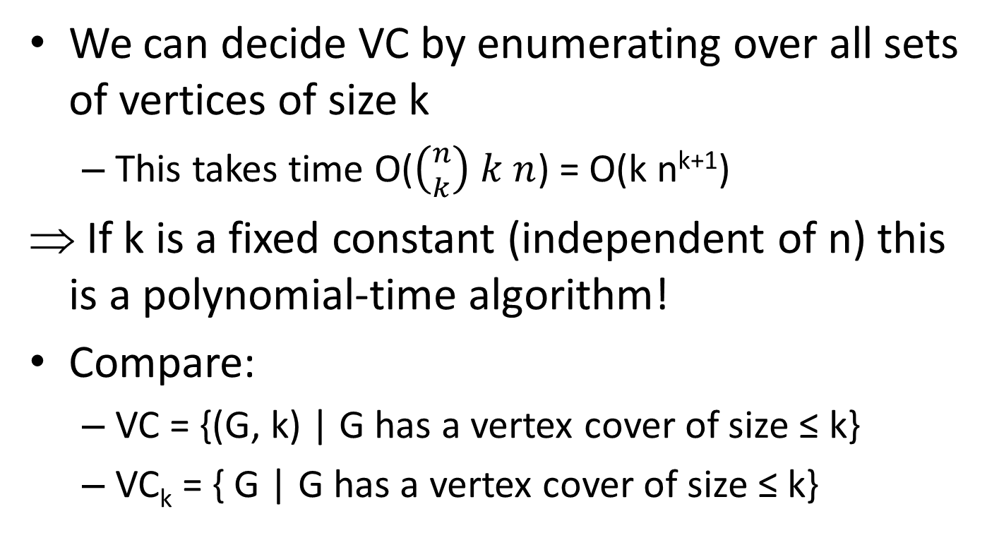
Algorithm for vertex cover
We can decide VC by enumerating over all sets of vertices of size k
  This takes time O($\left({n \atop k}\right) k n$) = O(k n^{k+1})
If k is a fixed constant (independent of n) this is a polynomial-time algorithm!
Compare:
  VC = {(G, k) | G has a vertex cover of size ≤ k}
  VC_{k} = { G | G has a vertex cover of size ≤ k}

Slide 9
Algorithms for vertex cover
We have shown an algorithm that runs in
time O(k n^{k+1})
  In practice, this is infeasible for n=100, k=10
  Can we do better?

Slide 10
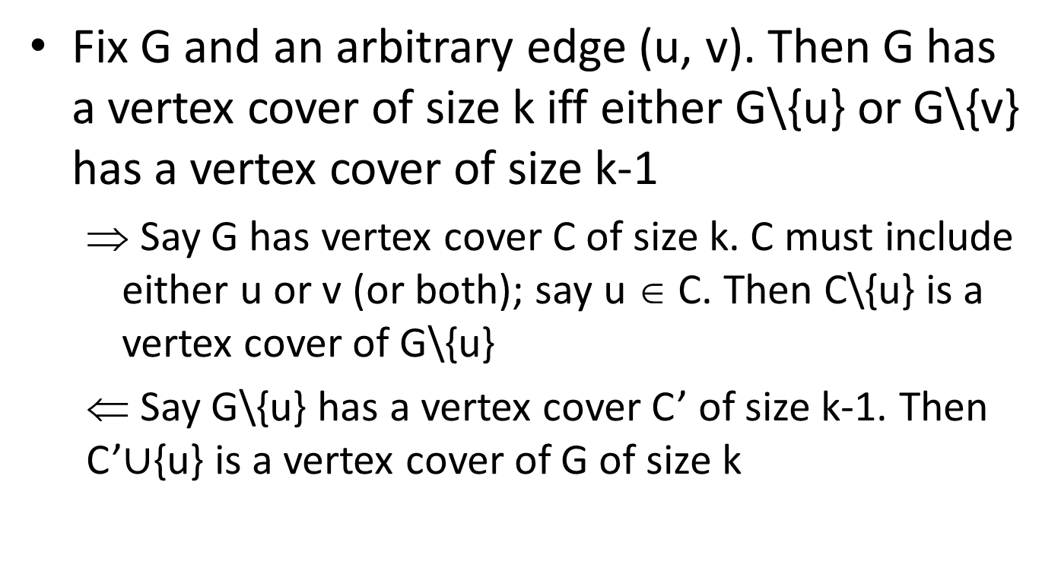
Another quick lemma
Fix G and an arbitrary edge (u, v). Then G has a vertex cover of size k iff either G\{u} or G\{v} has a vertex cover of size k-1
  Say G has vertex cover C of size k. C must include either u or v (or both); say u ∈ C. Then C\{u} is a vertex cover of G\{u}
  ⇐ Say G\{u} has a vertex cover C’ of size k-1. Then C’$∪${u} is a vertex cover of G of size k

Slide 11
Algorithm for vertex cover
Use divide-and-conquer!
VCover(G, k)
if G has ≤ k vertices, return 1
if G has ≥ kn edges, return 0
let (u, v) be an edge in G
return VCover(G\{u}, k-1)∨VCover(G\{v}, k-1)
Running time T(n, k) ≤ 2T(n-1, k-1) + ckn
  T(k, n) = O(2^{k} kn)
  Exponential, but much better than O(k n^{k+1})!

Slide 12
Summarizing…
If we only care about small k, the problem can be solved in polynomial time
Even if we care about general k, there is a better algorithm than the trivial one

Slide 13
NP-hardness
NP-hardness only means that there is unlikely to be a polynomial-time algorithm that solves every instance of the problem
Random instances, or instances that arise “in practice,” may be easy
Special cases of the problem may be easy

Slide 14
SAT solvers
(Efficient) SAT solvers exist, and are widely used!
  There is even a SAT (solving) competition…
Can be heuristic or provable
While these may work “most of the time”, one of the following is true:
  On some instances, the SAT solver runs for exponential time
  On some instances, the SAT solver fails to return an answer

Slide 15
Vertex cover on trees
The general vertex-cover problem is NP-hard
But the problem is solvable in polynomial-time in some special cases
E.g., if we restrict attention to trees (or, more generally, forests)

Slide 16
A quick lemma
If T is a tree and v is a leaf, there is an optimal vertex cover that does not contain v
Proof
  Fix some optimal vertex cover C, and consider the edge (u, v)
    Either u or v is in C (but not both!)
  If v ∈ C, remove it and add u to C instead
More generally, if v has 0 or 1 edges there is an optimal vertex cover that does not contain v

Slide 17
Algorithm for vertex cover
To find a vertex cover in a forest F:
Initialize C to empty
While F has an edge
Let (u, v) be an edge where v is a leaf
Add u to C
Delete from F all edges incident to u

Slide 18
Independent set
Recall that if C is a vertex cover, then V\C is an independent set
So the previous algorithm allows us to solve the independent-set problem on trees as well

Slide 19
A quick lemma
If T is a tree and v is a leaf, there is an optimal independent set that contains v
More generally, if a vertex v has 0 or 1 edges then there is an optimal independent set that contains v

Slide 20
Algorithm for independent set
To find an independent set in a forest F:
Initialize S to empty
While F has a vertex
Let v be a vertex with 0 or 1 edges
Add v to S
If v had 0 edges, delete v from F
If v had 1 edge to a vertex u, delete v, u, and edges incident to u from F

Slide 21
Maximum-weight independent set
Consider the harder problem of finding a maximum-weight independent set (where vertex v has weight w_{v}) in a tree
Idea: use dynamic programming!
Fix a root of the tree, and orient edges accordingly
Let OPT(u) = the maximum weight of the independent set in the tree rooted at u

Slide 22
Maximum-weight independent set
Base case: for a leaf v, OPT(v) = w_{v}
The maximum-weight independent set rooted at u either includes u or not
  If not, then OPT(u) = Σ_{v} OPT(v) , where the sum is over the children of u
  If so, then OPT(u) = w_{u} + Σ_{v} OPT(v), where the sum is over the grandchildren of u
This can be turned into an algorithm that works in linear time

